Slide 1
Orientation
CSC215
Lecture
This slides set is your reference about teaching/studying the course in this semester. It will be updated throughout the semester to cope with all necessary changes. Consult it frequently for any information related to the lectures, labs, exams, homework, and office hours.

Slide 2
Course Information Objectives
Student can compare and contrast Procedural and Object-oriented programming
Student understands the function call mechanism in procedural programming
Student can define types in the C programming language
Student understands the memory management in procedural programming
Student can manipulate pointers to achieve different tasks
Student can write and debug procedural programs

Slide 3
Course Information Topics and Calendar
W 1 | Orientation and Introduction | MT Time TBD | FE 16-12-2024 8:00 - 11:00
W 2 | Types, Operators, and Expressions
W 3 | Control Flow
W 4 | Functions and Program Structure
W 5 | Pointers, Arrays, Memory Management
W 6 | User Defined Data Types
W 7 | Input and Output
W 8 | Standard Library
W 9 | Advanced Pointers
W10 | Linked Lists and Data Structures

Slide 4
Course Information Assessment
Name | Procedural Programming
Code | CSC215
Credits | 3 hours
Style (weekly) | 2H Lecture 2H Lab
Grade | 100
Quizes (5) on Weeks 5,7,9,11,13 | 10
Midterm | 25
Lab | 25
Final Exam | 40

Slide 5
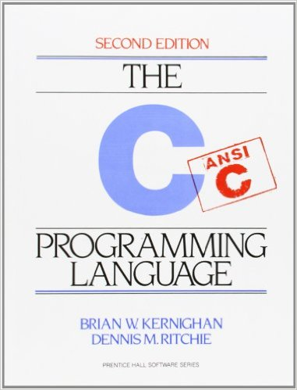
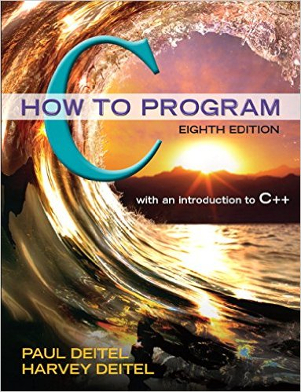
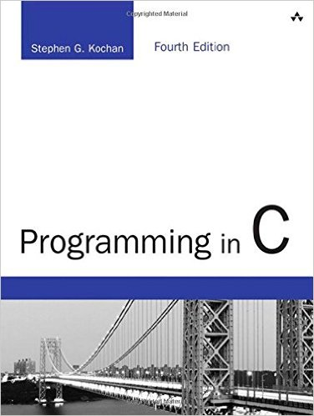
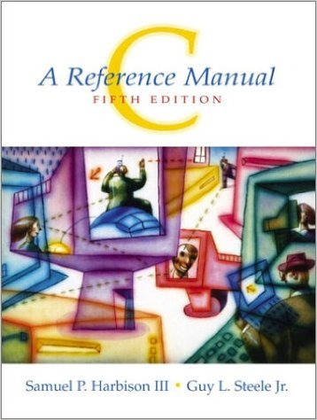
Course Information Textbook
Textbooks, any of the following books:
The C Programming Language
Brian W. Kernighan & Dennis M. Ritchie
2nd edition, Prentice Hall
C How to Program
Paul Deitel & Harvey Deitel
8th edition, Pearson
Programming in C
Stephen G. Kochan
4th edition, Addison-Wesley Professional
C: A Reference Manual
Samuel P. Harbison & Guy L. Steele Jr.
5th edition, Pearson

Slide 6
Course Information References
Free books and references:
The C Book
an online version of the popular introduction and reference on the ANSI Standard C programming language
GBDirect Publications
http://publications.gbdirect.co.uk/c_book/
Frequently Asked Questions
comp.lang.c
http://c-faq.com/
The C Book
FAQs comp.lang.c
C Programming
WikiBook
http://en.wikibooks.org/wiki/C_Programming
C Programming

Slide 7
Course Information Tools
In lab:
Command line interface
Text editor
GCC
On your machine:
Windows: CMD, notepad (or any other editor) and GCC through MinGW or Cygwin
You can also install WSL or use a virtual machine with linux guest system
Linux and OSX: same as in the lab: terminal, emacs (or any other editor) and GCC
Online:
www.codechef.com/ide: quick, single file
www.tutorialspoint.com/compile_c_online.php
www.onlinegdb.com

Slide 8
Instructor's Information
Lectures & Lab
Schedule
Name | Mohammed Faroun
Email | faroun@ksu.edu.sa
Office | Bulding. 31 Room G005
Office Tel. | +966 11 4676137
Office hours | Th 08:00 AM -03:00 PM

Slide 9
How To Study CSC215
Review CSC111. You are expected to be mastering all of its topics.
Attend lectures and labs
Attend
Pay attention, ask questions and take notes.
Study what you have learned on the same day
Read slides, notes and optionally the textbook
Redo the examples by yourself
Apply on a computer
Use my office hours.
Do all of your homework assignments
Spend enough time thinking
Implement and run your solutions
Submit in a timely manner
Look for examples, exercises, problems to solve and previous exams.
Discuss with your colleagues, but never ask for ready solutions, and submit your own work.

Slide 10
CSC215 Attendance Policy
Attendance will be taken at the end of every lecture and lab session
Attendance will be recorded through LMS. It is the students’ duty to keep an eye on their absence rates.
Each student must attend in his designated section, No Exceptions.
Absence with excuse will be recorded as absence.
I do not handle absence excuses. If you have one and you miss a quiz or exam, follow the formal procedures with the office of the vice dean of academic affairs.
Lectures will be given even if only one student attends.

