Slide 1
CNS stimulant drugs
Lab# 1

Slide 2
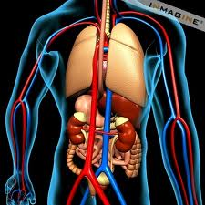
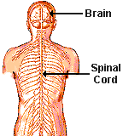
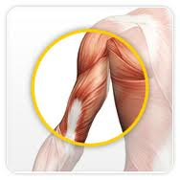
Consists :
A- nerves
B- ganglia
smooth muscle, cardiac muscle, and glands
The Nervous System
CNS
PNS
Sensory division (afferent)
Motor division (efferent)
Brain
Spinal cord
Somatic nervous system (voluntary)
Autonomic nervous system (involuntary)
Sympathetic
Parasympathetic
The main function is to connect CNS to the limbs and organs.
Outside of the CNS
From CNS to PNS
From PNS to CNS
Skeletal muscle

Slide 3
Neuron
They are the basic functional units of the nervous system.
- They contain three major parts
1- Cell Body | 2- Dendrites | 3- Axons
has many of organelles such as mitochondria, cytoplasm and a nucleus | Bring information to the cell body | Take information away from the cell body
1
3
Axon terminal
Effector
2
Synapse
Is the site where the axon of a neuron communicates with effectors or other neurons.

Slide 4
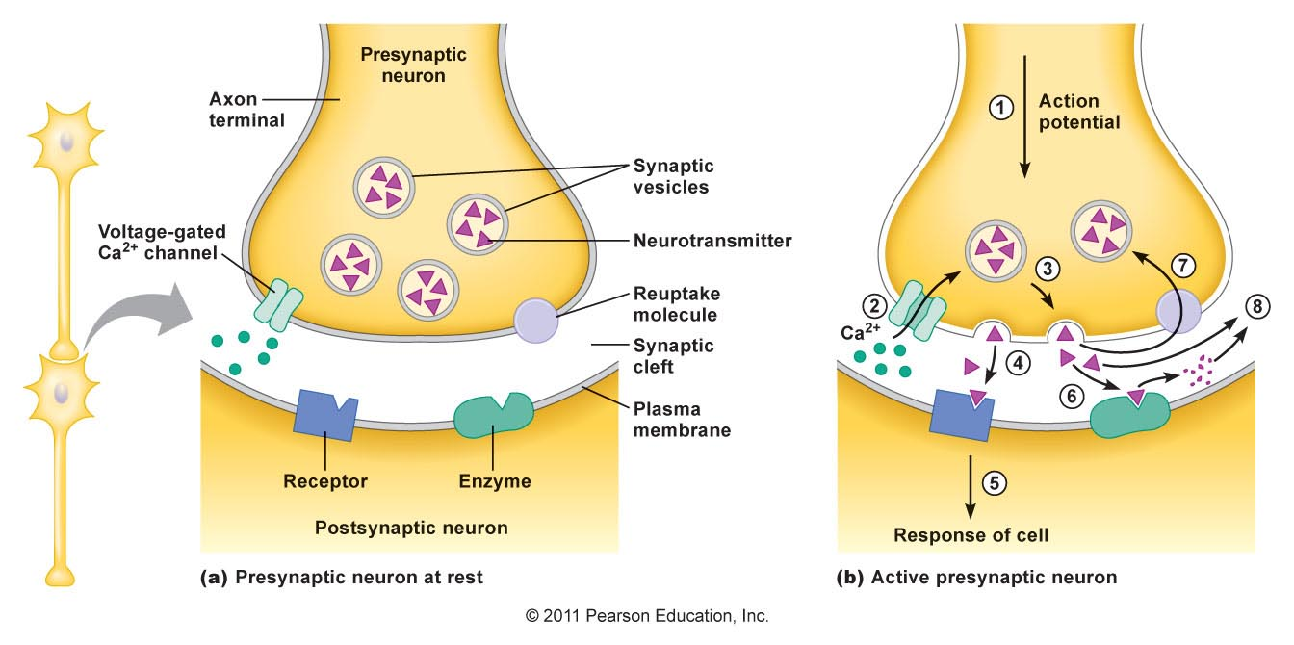
reuptake
Enzyme to Destruction
Notes:
http://nortonbooks.com/college/biology/animations/ch25a01.swf

Slide 5
Neurotransmitter
A chemical messenger released from the synaptic terminal of a neuron at a chemical synapse that diffuses across the synaptic cleft and bind to the postsynaptic cell.
Transmitter | Category | Located | Excitatory | inhibitory
Ach | Choline derivative | PNS/CNS
NE | Catecholamine | PNS/CNS
Dopamine |  | CNS
5-HT | amines
Aspartic acid | Amino acid
Glutamic acid
GABA
Glycine
Notes:
Definition
noun, plural: chemical synapses
A specialized cell-to-cell junction where nerve impulse is transmitted in one direction, from one neuron to another or from a neuron to a non-neuronal cell.

Slide 6
CNS stimulants
Definition:
“Stimulants are substances which tend to increase behavioral activity when administered”
Signs and symptoms:
1- Elevate Mood.
2- Increase Motor Activity.
3- Increase Alertness.
4- Decrease need for Sleep.
N.B: Overdose lead to convulsion and death.

Slide 7
MOA of CNS stimulants
Imbalance between inhibitory and excitatory processes as in the brain. This hyper excitability of neurons results from:
1- Blocking the neurotransmitters’ reuptake:
Most reuptake inhibitors affect either NE or 5HT(Serotonin).
Ex. Amphetamine and cocaine.
2- Promoting the release of neurotransmitters:
Ex. Amphetamine
3- Block the metabolism of neurotransmitters:
(Monoamine Oxidase Inhibitors).
Ex. Phenelzine
4- Antagonizing the effect of the inhibitory neurotransmitters:
(GABA and glycine antagonist)
Ex. Picrotoxin & Strychnine
inhibitory
excitatory

Slide 8
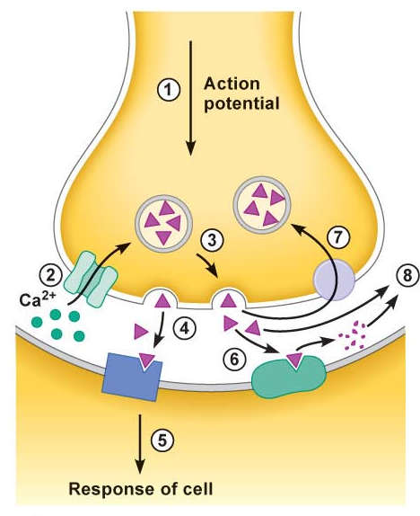
X
reuptake
X
X
Enzyme to Destruction
LIKE MO

Slide 9
Lab Work
Objectives:
1- To demonstrate effects of some CNS stimulants on mice.
2- After the lab, you should able to handle and inject the mice correctly.
3- You should be able to differentiate between Amphetamine, Picrotoxin and Strychinine regarding the symptoms that induced by each of them.

Slide 10
1- Amphetamine
MOA:
Block the reuptake of Norepinephrine and Dopamine into the presynaptic neuron and increase the release of these Monoamines into the extraneuronal space.
Clinical use:
1. Narcolepsy.
2. Attention-deficit hyperactivity disorder (ADHD)
3. Simple obesity
Adverse effects:
- Cardiovascular: Hypertension.
- Endocrine metabolic: Weight loss.
- Gastrointestinal: Loss of appetite, Xerostomia
- Neurologic: Headache, Insomnia
- Psychiatric: Feeling nervous

Slide 11
Signs and Symptoms:
After injecting the mice with Amphetamine, you well notice:
1- Hair erection.
2- Licking, gnawing.
3- Stereotype.
4- Sniffing.

Slide 12
2- Picrotoxin
MOA:
Non-competitive antagonist of GABA receptors.
After injecting the mice with Picrotoxin, you well notice:
Clonic Convulsion characterized by :
1. Asymmetric
2. Intermittent
3. Spontaneous
4. Coordinated

Slide 13
3- Strychnine
MOA:
Competitive antagonist of the Glycine receptors.
After injecting the mice with Strychnine, you well notice:
Tonic convulsion characterized by :
1. Symmetric
2. Reflex in origin
3. Continuous
4. Uncoordinated.

Slide 14
Drug | MOA | Site of action | Signs and symptoms
Amphetamine | Blocking the neurotransmitters’ reuptake and Promoting the release of neurotransmitters | Cerebral Stimulants | 1- Hair erection. 2- Licking, gnawing. 3- Stereotype. 4- Sniffing.
Picrotoxin | antagonist of GABA receptors | Medullary Stimulants | Clonic Convulsion characterized by 1. Asymmetric 2. Intermittent 3. Spontaneous 4. Coordinated
Strychnine | Competitive antagonist of the Glycine receptors | Spinal Stimulants | Tonic convulsion characterized by : 1. Symmetric 2. Reflex in origin 3. Continuous 4. Uncoordinated

Slide 15
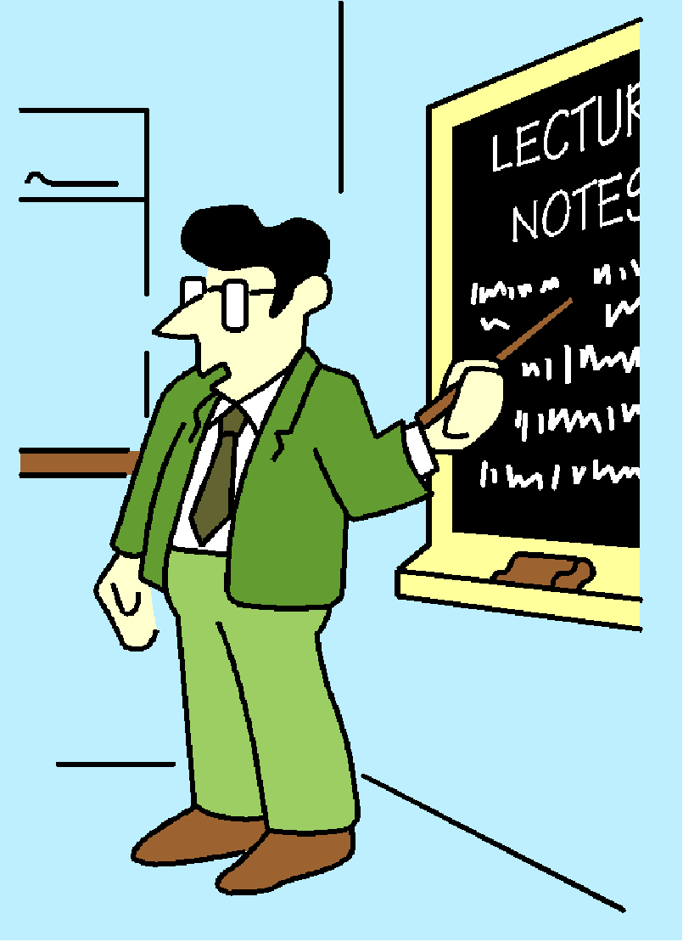
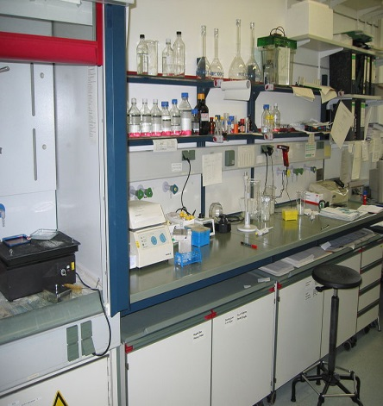
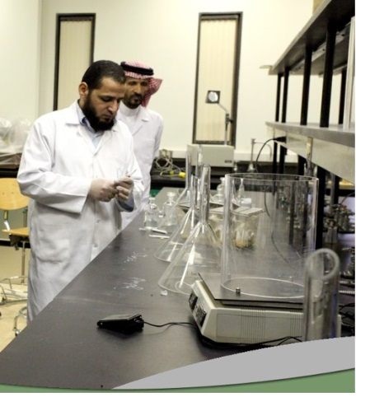
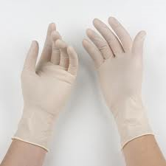
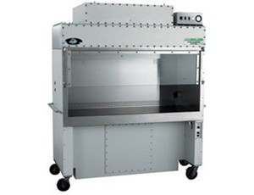
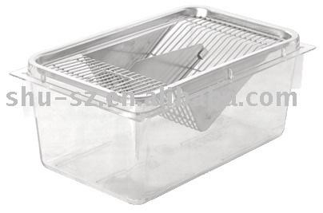
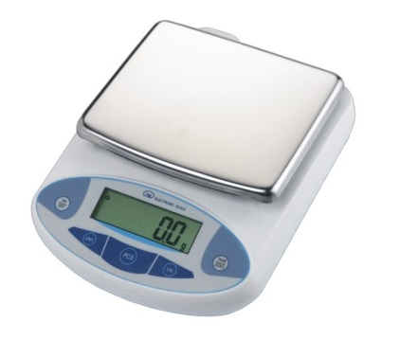
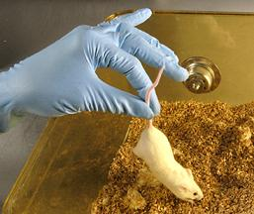
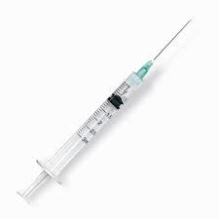
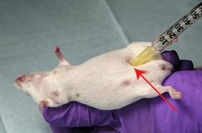
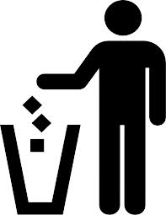
Injection volume= $\frac{dose\left(\frac{mg}{kg}\right)×body weight in gm }{Conc. g\%×10000}$ = ……..ml

