Slide 1
LAB 2
CNS depressants
CNS depressants

Slide 2
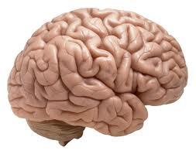
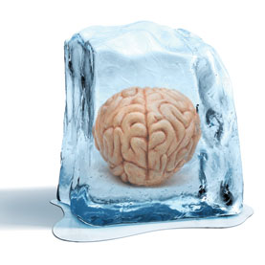
Some Drugs That Effect CNS

Slide 3
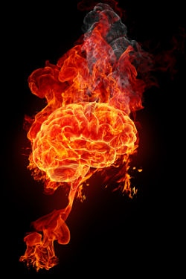
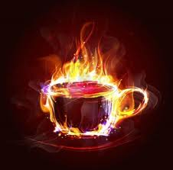
Stimulants
Depressants

Slide 4
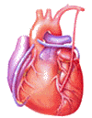
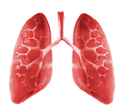
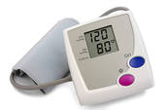
A stimulant is a drug that speeds up activities of the CNS
A depressant is a drug that slows brain and body reactions
Stimulants increase
Depressants decrease
HR
Increase Motor Activity.
Increase Alertness.
Decrease need for Sleep
Relax muscle tension
Lower alertness
Cause drowsiness
RR
BP

Slide 5
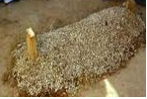
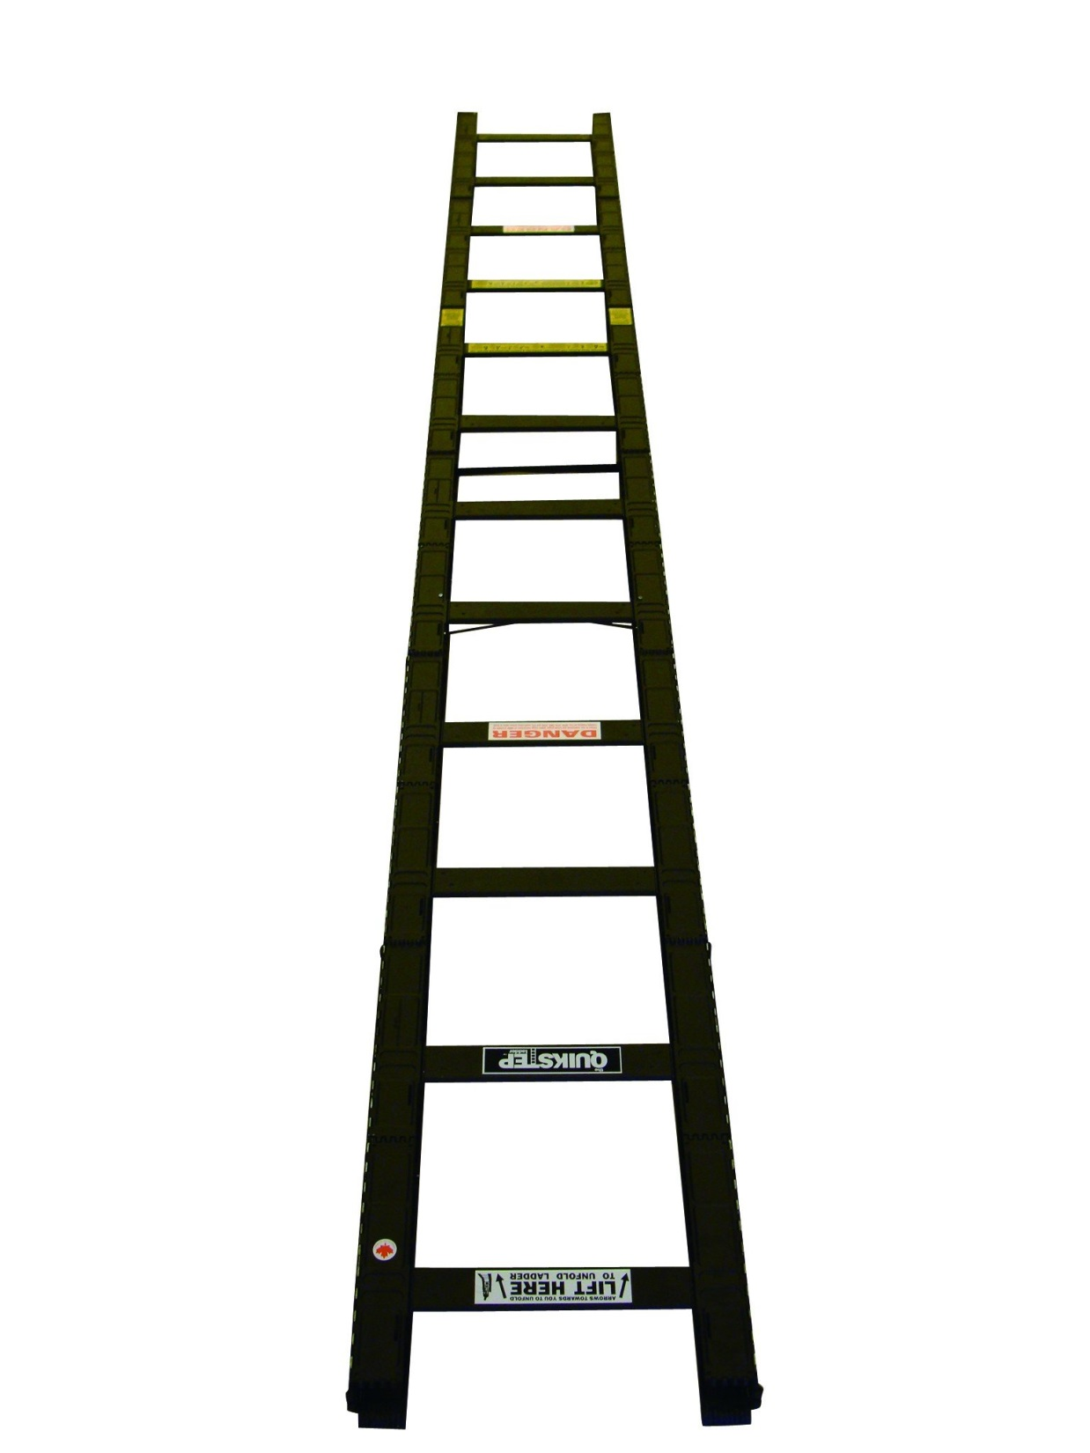
Cardiac dysrhythmias
Seizures,
Confusion,
Over dose
Respiratory failure
Coma, loss of reflexes,
Unconsciousness
Severe
CNS
Higher dose
Insomnia
Nervousness,
Excessive talking,
Hyperactivity,
Decreased perception of heat or cold
Sleep
Drowsiness
Moderate
CNS
increase dose
Decreased fatigue
Mental alertness,
Wakefulness,
Inability to focus
Decreased interest in surroundings,
Mild CNS
Stimulants
Depressants
Low dose
Notes:
The clinical value of CNS depressants is dose dependent
Low dose (sedatives, relieve anxiety and promote relaxation)
Higher doses (hypnotics, can cause drowsiness and promote sleep)
At even higher doses (anesthetics, can cause anesthesia and are used for patient management during surgery)

Slide 6
Classification on CNS depressant (pharmacological action)
General Anesthetics
Tranquilizer
Sedative-Hypnotic Drugs
Skeletal muscle relaxants
Antiseizure
Some types of Antihistamine
Opioid and Alcohol
Miscellaneous

Slide 7
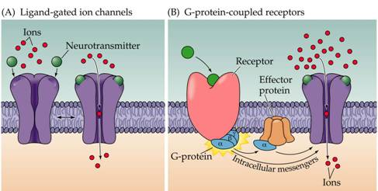
GABA
Is inhibitory neurotransmitter.
Is present throughout the CNS, including the spinal cord.
GABA Receptors
GABA A
GABA B
Ligand-gated ion channel
(ionotropic receptors)
Metabotropic receptors
Notes:
Which are typically released from local interneurons.

Slide 8
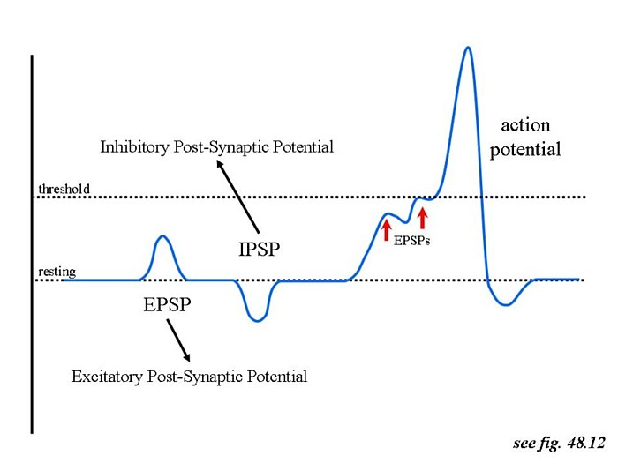
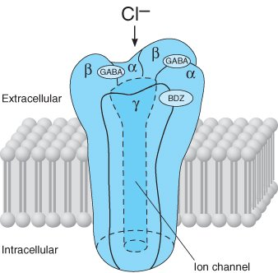
GABA A ( Chloride ion channel)
Ci -
Ci -
Ci -
Prevent action potential
Ci -
Ci -
Ci -
Ci -
Ci -
↑ Cl- conductance
Hyperpolarization of membrane

Slide 9
General Anesthesia
Is characterized by five primary effects :
Unconsciousness
Amnesia
Analgesia
Inhibition of autonomic reflexes
Skeletal muscle relaxation.
None of the currently available anesthetic agents when used alone can achieve all five of these desired effects
The modern practice of anesthesiology relies on the use of combinations of IV and inhaled drugs (balanced anesthesia techniques)
To take advantage of the favorable properties of each agent while minimizing their adverse effects
Notes:
Stages Of Anesthesia
Stage of analgesia: decrease feeling of pain but the patient is still conscious.
Stage of excitement: delirium , respiration is irregular and the consciousness is lost but the feeling of severe pain is present.
Stage of surgical anesthesia: regular respiration, relaxation of the skeletal muscles and the feeling of surgery is lost.
Stage of Medullary depression: severe depression in vasomotor center in the medulla and respiratory center. Without full circulatory and respiratory support the result is death.

Slide 10
General anesthetics
Inhaled
IV
Gas
(nitrous oxide)
Volatile liquids
(halothane)
Barbiturates
(thiopental)
Benzodiazepines
(midazolam)
Opioids
(fentanyl)
Dissociative
(ketamine)
Miscellaneous
(etomidate, propofol)
MOA of Inhaled anesthetics, barbiturates, benzodiazepines, etomidate, and propofol are facilitate GABA-mediated inhibition at GABAA receptors.
Its antagonism of the action of glutamic acid on the NMDA receptor

Slide 11
Sedative-Hypnotic Drugs
Sedation : reduction of anxiety
Hypnosis : induction of sleep
Sedative = anxiolytic = antianxiety = minor tranquilizer : a drug that reduce anxiety
Increase dose of sedative that will lead to hypnosis
Clinical use of Sedative-Hypnotic Drugs
Anxiety
Sleep disorder
Antiseizure
Anesthesia protocol

Slide 12
Sedative-hypnotics
Benzodiazepine
Barbiturates
Miscellaneous agent
Short action
Intermediate action
Long action
Ultra-short action
Short action
Long action
Chloral hydrate
….etc.
Intermediate action
Notes:
Ultrashort acting: ( 15 minutes) e.g. Thiopental.
Short acting: ( 2-4 hours) e.g. Pentobarbital .
Intermediate acting: (4-6 hours) e.g. Amobarbital.
Long acting: ( 6-8 hours): e.g. Phenobarbital.
Diazepam (Valium) and clorazepate (Tranxene) have fast onsets of action,
oxazepam (Serax) has a slow onset, and
lorazepam (Ativan), alprazolam (Xanax), and clonazepam (Klonopin) have intermediate onsets of action

Slide 13
Coma
(Barbiturates)
Medullary depression
Anesthesia
(Benzodiazepines)
CNS effects
Hypnosis
Sedation
Possible selective anticonvulsant and muscle-relaxing activity
Increase Sedative-hypnotic Dose
Relationship between dose of benzodiazepines and barbiturates and their CNS effect

Slide 14
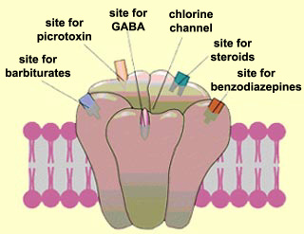

Slide 15
Tranquilizer
They are drugs which used to relieve mental anxiety and stress without affecting the consciousness
Major tranquilizer = Antipsychotic
Example
Chlorpromazine (CPZ)
MOA : Work by blocking dopamine (D 2 )receptor.

Slide 16
Work lab
To demonstrate the effect of different types of CNS depressants as :
- Hypnotics. Phenobarbital
- Sedatives. Chloral hydrate (at sedative dose)
- Tranquilizers. CPZ
To learn how to distinguish between their signs if they are given as unknown drugs.

Slide 17
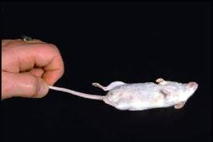
Righting reflex
righting reflex the ability of the mice to assume an optimal position when there has been a departure from it.
Is widely used to screen compounds with sedative properties
If it isn’t lost Righting reflex ------- +ve
If it’s lost Righting reflex ------- - ve
Notes:
Righting Reflex is a simple assay to assess motor coordination
onset of action = the start of loss in righting reflex
duration of drug effect = from the start of loss till the return of righting reflex

Slide 18
1- Phenobarbital
Hypnotic drug
Long acting: ( 6-8 hours):
After injection of Phenobarbital we can observe :
Loss of righting reflex ( -ve)
2- chloral hydrate
Sedative drug
When the dose increased they will induce sleep.
Trichloroethanol is the active metabolite of chloral hydrate .
Trichloroacetic acid is the toxic metabolite .
After injection of chloral hydrate we can observe :
NO loss righting reflex (+ve)

Slide 19
CPZ
After injection of CPZ we can observe signs such as:
No loss of righting reflex (+ ve)
Ataxic gait: loss of muscle coordination .
Catalepsy : rigid body
Creeping gait
Grasping test (CPZ):
When you trying to put the mice on the cord, the mice will fall down
Notes:
State of catalepsy → onset time
Symptoms of Catalepsy Symptoms of catalepsy include:
Extremely rigid body posture
Decreased sensitivity to pain
Limbs that stay in the same position when they are moved
Slower bodily functions, particularly breathing
Decreased muscle control, or complete loss of muscle control

Slide 20
Calculate the dose
Type | Example | Conc (g%) | Dose (mg/kg)
Hypnotic | Phenobarbital | 2% | 200
Sedative | Chloral Hydrate | 3% | 150
Tranquilizer | Chlorpromazine | 0.2% | 40
Dose (mg/Kg) x Body weight in Grams
Injection volume =
= xxxxx ml
Conc. g% x 10000

Slide 21
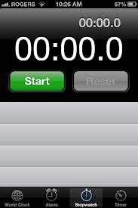
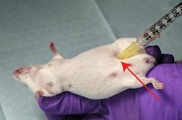
Test and sign
Righting test + ve
Righting test - ve
Righting test - ve Ataxic gait Catalepsy Creeping gait Grasping test
Phenobarbital
Chloral hydrate
CPZ

