Slide 1
CLS 331 ‘’Identification of free amino acids by TLC using silica gel plates’’
Amino acids: are the building blocks of peptides and proteins.
They possess two functional groups—the carboxylic acid group gives the acidic character, and the amino group provides the basic character.

Slide 2
General structure of an amino acid:
H
I
R-C-COOH
I
NH2
R denotes the functional group of the amino acids.
The acidic COOH and basic NH₂ groups react with one another to form an internal salt called a zwitterion.

Slide 3
There are 20 amino acids derived from proteins. Of the 20 amino acids, 11 can be synthesized in the body. That leaves nine amino acids that you need to get directly from your diet. Those nine amino acids are called "essential amino acids."

Slide 4
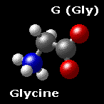
Some amino acids are polar(hydrophilic) e.g. Serine, tyrosine.
And some are nonpolar (hydrophobic) e.g. Glycine, alanine.

Slide 5
The different side chains, and the solubilities provided by these side chains, affect their rate of migration in thin-layer chromatography (TLC).
Chromatography: is the collective term for a set of laboratory techniques for the separation of mixtures of substances into their components.

Slide 6
Types:
Column chromatography; in a tube.
Planar chromatography
Paper chromatography
Thin layer chromatography
They all have a stationary phase ( solid, or a liquid supported on a solid) and a mobile phase ( a liquid or a gas).

Slide 7
Thin layer chromatography:
Is done using a thin, uniform layer of silica gel or alumina coated onto a piece of glass, metal or rigid plastic.
the silica gel is the stationary phase, and it also often contains a substance which fluoresces in UV light...

Slide 8
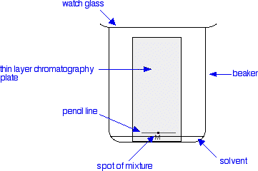
Thin layer chromatography

Slide 9
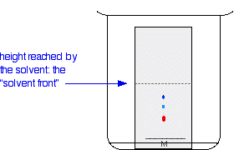
The reason for covering the beaker is to make sure that the atmosphere in the beaker is saturated with solvent vapour.
As the solvent slowly travels up the plate, the different components of the dye mixture travel at different rates and the mixture is separated into different coloured spots.

Slide 10
Method:
Preparation of the silica gel plates.
A pencil line is drawn near the bottom of the plate and a small drop of a solution of the mixture is placed on it.
When the spot of mixture is dry, the plate is stood in a shallow layer of solvent in a covered beaker.

Slide 11
4. When the solvent front is about 15 cm, remove the plate and dry it.
5. locate the a.a by spraying with the ninhydrin solution.
6. place the plate in a drying oven at 110⁰c,10 minutes.
Calculation:
Rf value= distance travelled by component
distance travelled by solvent

