Slide 1
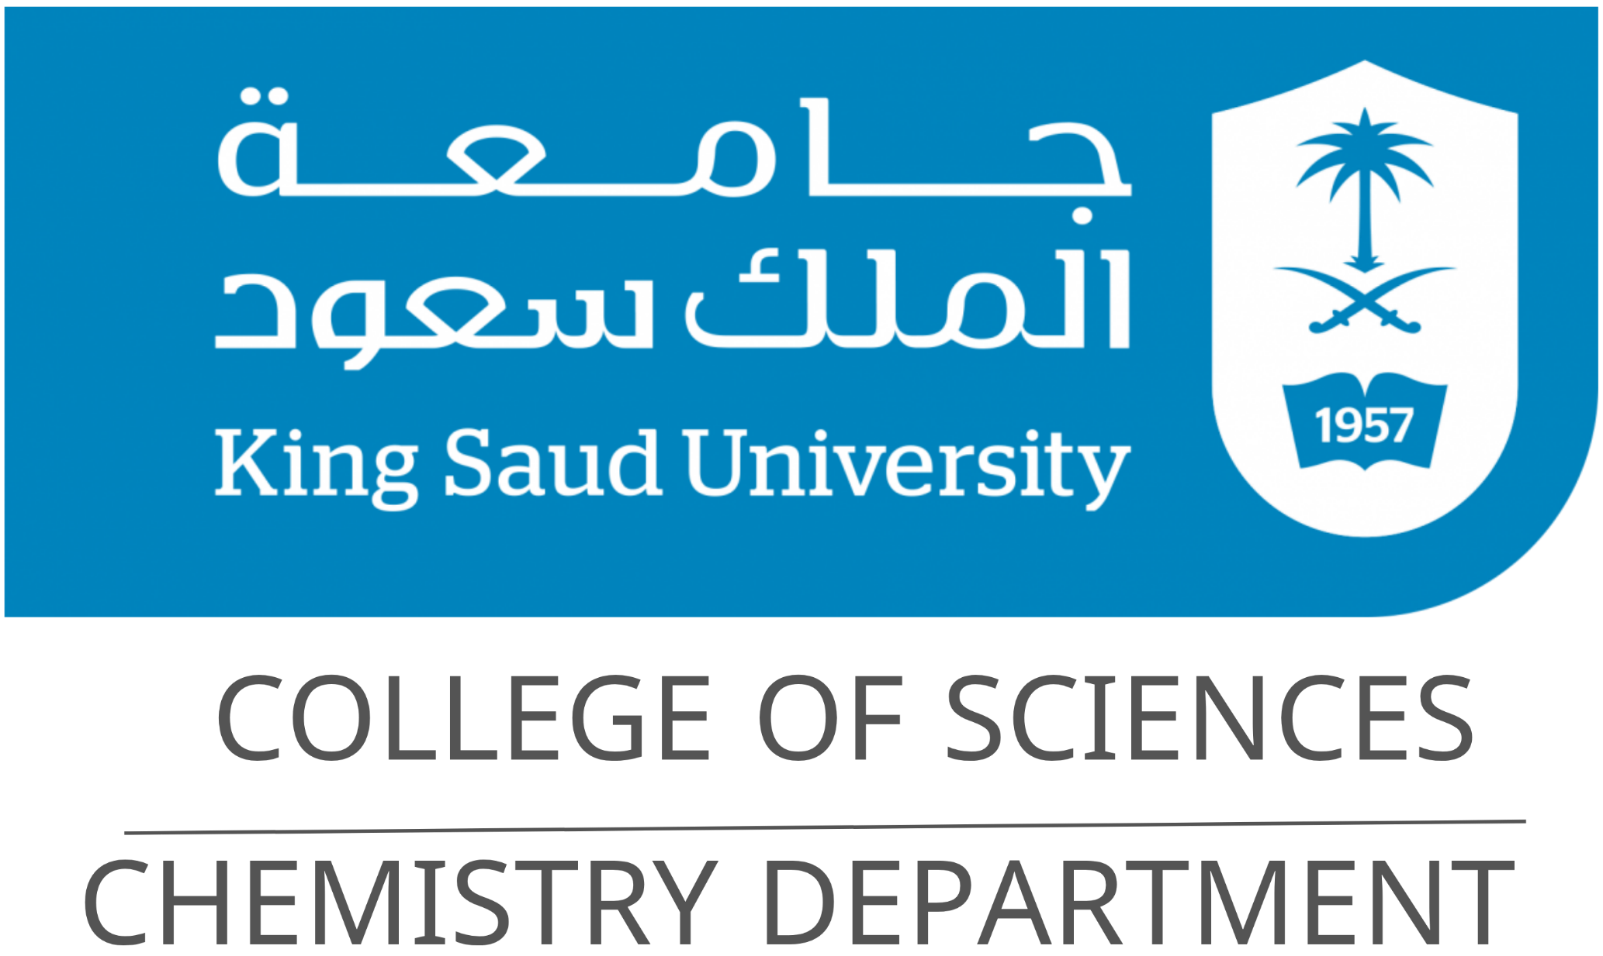
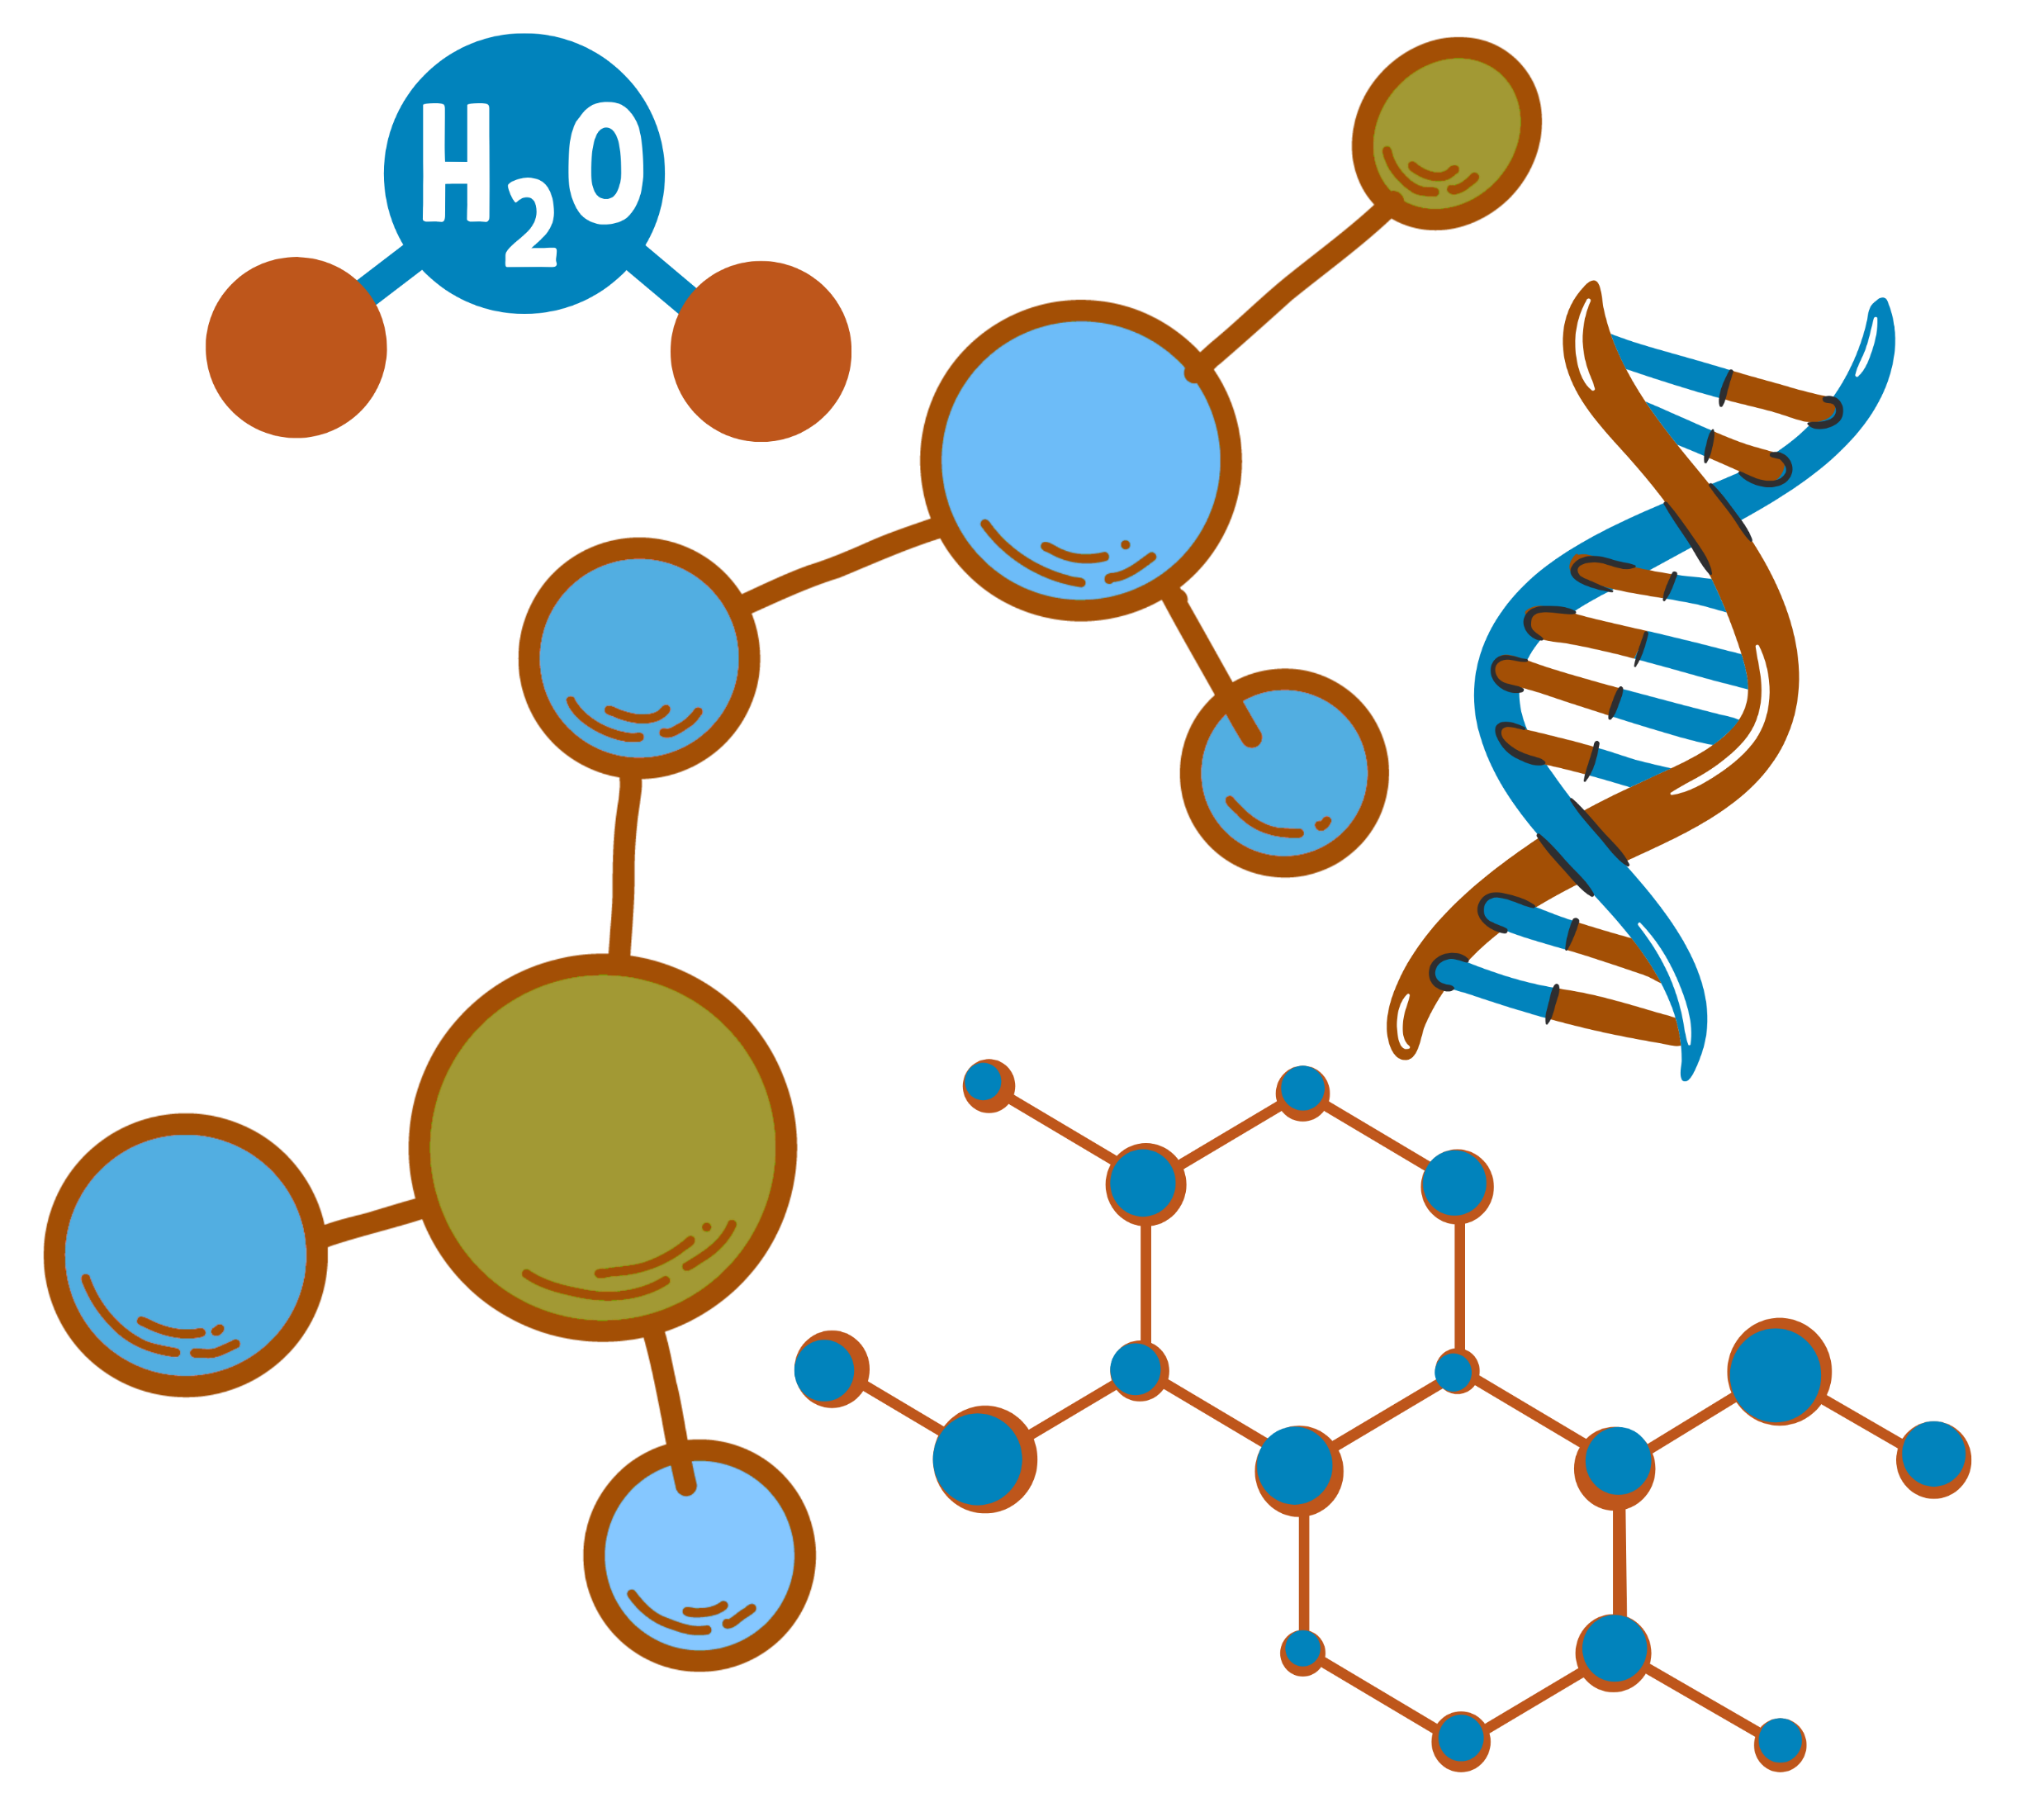
Heterocyclic Organic Chemistry
CHEM 341
Chapter 0:
Syllabus

Slide 2


Chapter 0: Syllabus
Course Title and General Information
Course Code | Course Title | Program
CHEM 341 | Heterocyclic Organic Chemistry | Chemistry – College of Science
Credit Hours | Department | College
2 (2 Lectures + 0 Practical) | Chemistry Department | Science

Slide 3
Chapter 0: Syllabus
Course Content Overview and Reference
Chapter 1 | Introduction and Nomenclature
Definition of heterocyclic chemistry and aromaticity Nomenclature of heterocyclic compounds (Common, IUPAC and replacement names
Chapter 2 | Five-Membered Rings
Properties, preparation, reactions and cycloaddition reactions
Chapter 3 | Six-Membered Rings
Properties, preparation, and reactions
Chapter 4 | Fused Rings
Properties, preparation, and reactions

Slide 4
Chapter 0: Syllabus
Course Content Overview and Reference
Chapter 5 | Carbohydrates
Classifications, projection formulae, and configuration of simple sugars Cyclic hemiacetals, anomerism, and mutarotation Reactions of monosaccharides: acetals/ketals, esterification, redox, hydrazone and osazone formation, chain extension/shortening Stereochemistry of monosaccharides and molecular weight of oligo- and polysaccharides
Chapter 6 | Amino Acids, Peptides and Proteins
Definitions, Protein amino acids, Physicochemical properties of amino acids and peptides acid–base properties. Preparation for amino acids and peptides
Chapter 7 | Lipids
Definitions of lipids Classification of lipids Fatty Acids Chemical Properties

Slide 5
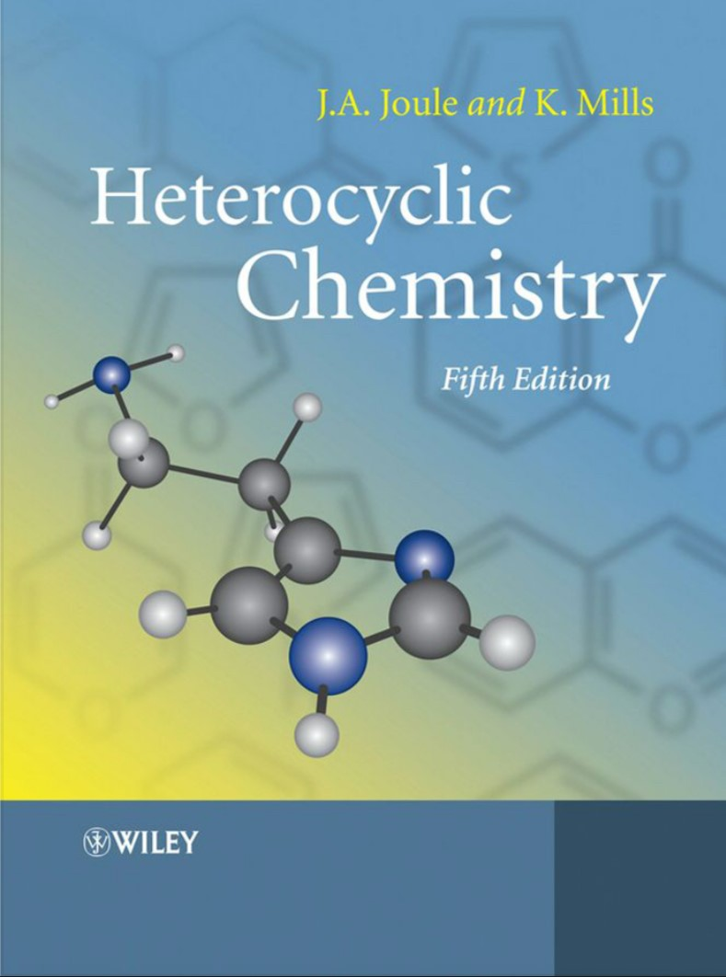
Chapter 0: Syllabus
Reference
Reference
Heterocyclic chemistry, J.A. Joule and K. Mills, and G. F. Smith.4th ed., Blackwell Publishing 2000.

Slide 6
Chapter 0: Syllabus
Course Objectives
Name heterocyclic, carbohydrates, amino acids, peptides, protein and lipids of organic compounds using IUPAC and COMMON naming system, their occurrence in nature, physical properties. | Identify, classify and understand physical and chemical properties of the major functional groups. | Understanding the reaction of functional groups and families of these organic compounds. | The practical uses of these organic compounds as drugs, food additives, pesticides, plastics, and other products, as well as their occurrence in nature.

Slide 7
Chapter 0: Syllabus
Course Learning Outcomes
Knowledge | Skills | Values
Recognition and classification of diverse structures Nomenclature and identification principles Aromatic nature, reactivity, and stability Synthetic methods: classical and modern | Integrate and assess chemical information and data to acquire a cohesive comprehension of heterocyclic organic compounds. Develop analytical skills in the identification, analysis, and separation of heterocyclic compounds. Cultivate applications of heterocyclic organic compounds in diverse areas of science, technology, and industry. | Communicate proficiently in oral and written formats, articulating scientific chemical issues tailored to diverse audiences. Foster critical thinking skills and the ability to apply acquired knowledge to solve problems related to heterocyclic compounds.

Slide 8
Chapter 0: Syllabus
Assessment Methods and Weighting
No. | Assessment Task | Points
1 | 1st Midterm Exam | 20
2 | 2st Midterm Exam | 20
3 | Quizzes | 10
4 | Assignment | 10
5 | Final Exam | 40
Total |  | 100

Slide 9
Chapter 0: Syllabus
Regulations for Attendance, Absence, and Alternative Examinations
Item | Limit/Rule
Semester Length | 15 weeks (15 lectures)
Allowed Absence | 25% = max 4 lectures
Lecture Duration | 2 lecture × 50 min per day (2 academic hour)
Max Absence in Hours | 8 academic hours (4 days)
Absence Excuses | Submit via e-mail to course instructor
Alternative Examination Regulations | Student must not have taken the Primary Examination. Student must not be denied in the course. Request must be submitted to course instructor within one week of the Primary Examination date. Excuse must be official and government-approved. No alternative for an alternative examination.

Slide 10
Chapter 0: Syllabus
Good
Luck

