Slide 1
Heterocyclic Organic Chemistry
CHEM 341
Dr. Sultan Almadhhi
Assistant Professor of Organic Chemistry
King Saud University
CHAPTER 4

Slide 2
Fused Rings
CHAPTER 4

Slide 3
Indoles and Isoindoles

Slide 4
Due to the fusion of a benzene ring with a five-membered heterocyclic ring (annulation), two possible aromatic structures can arise, differing in the position of the fusion.
a) Indole and its analogs
b) Isoindole and its analogs
 | X
Indole | N | Isoindole
Benzo[b]thiophene | S | Benzo[c]thiophene
Benzo[b]furan | O | Benzo[c]furan

Slide 5
Comparison with Pyrrole
Pyrroles, indoles, and isoindoles have a partially positive nitrogen and partially negative carbons, making these carbons highly reactive with electrophilic reagents, while resisting substitution by nucleophilic reagents.
Similar to pyrroles, are non-basic because protonation of the nitrogen would result in a loss of aromaticity.
Indole and pyrrole differ primarily in the following ways:
The reactivity order in the electrophilic substitution.
The regioselectivity in electrophilic substitution.

Slide 6
Synthesis of Indole
Fischer Synthesis;
Heating aryl-hydrazones with aldehydes or ketones with protic or Lewis acids such as ZnCl₂, PCl₃, FeCl₃, PPA, etc., in an inert solvent produces an indole with the loss of ammonia.

Slide 7
Synthesis of Indole
Fischer Synthesis;
Example:

Slide 8
Synthesis of Indole
2. Madelung Synthesis;
The base-catalyzed cyclo-condensation of an ortho-alkylacetamide with alkyllithium reagents as bases produces an indole.
Example:

Slide 9
Synthesis of Indole
3. Bischler Synthesis;
The cyclization of an α-arylamino-ketone is carried out under acidic conditions.

Slide 10
Reactions
The reactivity order in the electrophilic substitution
In general, indole and its analogs are less reactive than their corresponding single heterocyclic rings, making electrophilic aromatic substitution reactions slower in these compounds.
This reduced reactivity can be attributed to the fact that the negative charge on each carbon atom is less localized due to the delocalization of the charge over the benzene ring.

Slide 11
Reactions
The Regioselectivity in the electrophilic substitution
Fusion of the benzene ring with heterocyclic rings shifts regioselectivity from the 2-position (as in pyrrole) to the 3-position in indole. Electrophilic substitution prefers C-3 because the transition intermediate's positive charge can be stabilized by nitrogen’s lone pair. In contrast, a C-2 attack disrupts the aromaticity of the benzene ring. If C-3 is occupied, substitution occurs at C-2.

Slide 12
Reactions
Electrophilic substitution Reactions
1. Nitration;
The nitration of indole is performed using non-acidic nitrating agents like benzoyl nitrate or ethyl nitrate.
2. Halogenation;
3-Halo- and 2-halo-indoles are unstable and should be used immediately after they are prepared.

Slide 13
Reactions
Electrophilic substitution Reactions
3. Sulfonation;
Sulfonation of indole at the C-3 position is carried out using a pyridine-sulfur trioxide complex in heated pyridine.
4. Acylation;
Indoles react with acetic anhydride in acetic acid at temperatures above 140 °C to yield 1,3-diacetylindole. In contrast, acetylation in the presence of sodium acetate produces 1-acetylindole.

Slide 14
Reactions
Electrophilic substitution Reactions
5. Alkylation;
Indole reacts with methyl iodide in DMF at around 80°C, primarily forming 3-methylindole. As the temperature increases, further methylation occurs, leading to the formation of 1,2,3,3-tetramethylindolium iodide.

Slide 15
Reactions
Oxidation Reaction
The C2-C3 double bond of indole can be oxidatively cleaved using reagents like ozone, sodium periodate, or potassium superoxide.

Slide 16
Reactions
Reduction Reaction
The indole ring can be selectively reduced in either the carbocyclic or heterocyclic portion. Lithium in liquid ammonia reduces the benzene ring, yielding 4,7-dihydroindole as the major product. The heterocyclic ring can be reduced using acidic reagents like Zn/HCl or NaCNBH₃/CH₃COOH to form indoline.

Slide 17
Reactions
Mannich Reaction (Reaction with iminium ions)
Indole reacts with a mixture of formaldehyde and dimethylamine via substitution at the nitrogen of the indole. Under neutral conditions at elevated temperatures or in acidic media such as acetic acid, the N-substituted product is converted into 3-dimethylaminomethylindole, known as gramine.
The Mannich reaction is valuable because gramine serves as an intermediate for synthesizing various 3-substituted indoles.

Slide 18
Qinoline and Isoquinoline

Slide 19
Physical Preparties
Boiling and melting Points:
Quinoline is a high-boiling liquid (boiling point 237°C) with a pyridine-like odor, while isoquinoline is a low-melting solid (melting point 26.5°C, boiling point 243°C).
Aromaticity:
Both are planar aromatic systems with 10 π-electrons and sp² hybridization, allowing electron delocalization across the rings. Their resonance energies are 198 kJ/mol (quinoline) and 143 kJ/mol (isoquinoline).

Slide 20
Physical Preparties
Basicity:
Quinoline and isoquinoline are weak bases, slightly more basic than pyridine but less so than anilines. This is due to the sp²-hybridized nitrogen in quinoline and isoquinoline being more electronegative compared to the sp³-hybridized nitrogen in anilines.
Resonance structures :

Slide 21
Bioactive of Quinoline and Isoquinoline
Quinine: Primary alkaloid of cinchona bark; shows antimalarial activity.
Camptothecine: From the wood of camptocheca acuminate; shows antitumor activity.

Slide 22
Bioactive of Quinoline and Isoquinoline
Lycorine: From the bulbs of Narcissus and Amaryllis; inhibits protein synthesis and may inhibit ascorbic acid.
Emetine: The principle alkaloid of ipecac (ground roots of Uragoga ipecacuanha); shows antiprotozoal activity.

Slide 23
Synthesis of Quinoline
Synthesized from Aryl-Amines and 1,3 - Dicarbonyl Compounds
Anilines undergo reactions with 1,3-dicarbonyl compounds to form intermediates, which can then be cyclized using acid.
The Combes Synthesis

Slide 24
Synthesis of Quinoline
2. Synthesized from Aryl-Amines and α , β - Unsaturated Carbonyl Compounds
The Skraup Synthesis

Slide 25
Synthesis of Quinoline
3. Synthesized from ortho-Acyl-Arylamines and Carbonyl Compounds
The Friedlander Synthesis

Slide 26
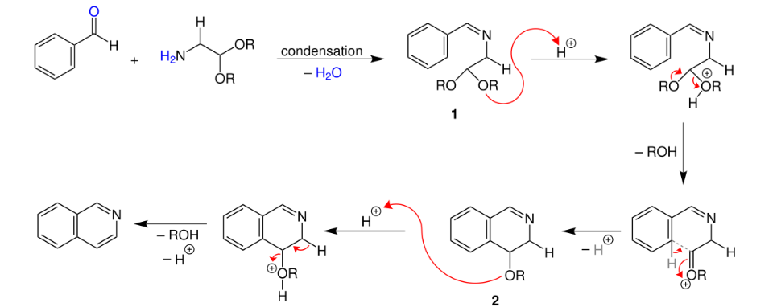
Synthesis of Isoquinoline
1. Synthesized from Aryl-aldehydes and Aminoacetal
Aromatic aldehydes react with aminoacetal (2,2-diethoxyethanamine) to form imines, which can be cyclized with acid to produce isoquinolines.
The Pomeranz - Fritsch Synthesis

Slide 27
Synthesis of Isoquinoline
2. Synthesized from 2-Aryl-Ethanamides or 2-Aryl-Ethamine-Imines
The amide or imine formed from the reaction of 2-aryl-ethanamines with an acid derivative or aldehyde can undergo cyclization to produce 3,4-dihydro- or 1,2,3,4-tetrahydroisoquinoline, respectively. Further dehydrogenation can lead to the formation of the aromatic heterocycle.
The Bischler - Napieralski Synthesis

Slide 28
Reactions
Electrophilic Substitution
The nitrogen in quinoline and isoquinoline has a deactivating effect on the ring toward electrophilic substitution, similar to pyridine. As a result, electrophilic aromatic substitution takes place on the benzene ring at positions 5 and 8.
Nitration
28

Slide 29
Reactions
Electrophilic Substitution
Sulfonation
29

Slide 30
Reactions
Electrophilic Substitution
Halogenation
30

Slide 31
Reactions
Nucleophilic Substitution
Nucleophilic substitution with ‘ Hydride ’ transfer
These reactions occur most rapidly at C-2 in quinoline and at C-1 in isoquinoline.
Alkylation and Arylation
Amination
31

Slide 32
Reactions
Nucleophilic Substitution
Nucleophilic substitution with displacement of good leaving groups
Reduction
It is possible to selectively reduce either the pyridine or benzene rings in quinoline and isoquinoline.
32

