Slide 1

Dr. Mohamed El-Newehy
Chemistry Department, College of Science, King Saud University http://fac.ksu.edu.sa/melnewehy/home
CHEM 244
PRINCIPLES OF ORGANIC CHEMISTRY I
FOR CHEMICAL ENGINEERING’ STUDENTS, COLLEGE OF ENGINEERING
PRE-REQUISITES COURSE; CHEM 101
CREDIT HOURS; 2 (2+0)

Slide 2
CHAPTER 5
ORGANIC HALOGEN COMPOUNDS

Slide 3
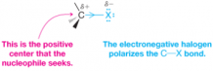
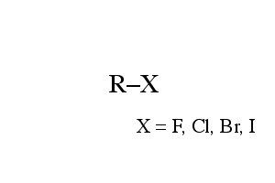
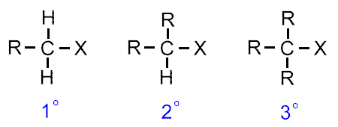
Classes and Nomenclature of Halogen Compounds
Alkyl halides, R-X.
Depending on the type of carbon to which the halogen is attached, Alkyl halides are subdivided into; primary (1°), secondary (2°), or tertiary (3°).

Slide 4



Classes and Nomenclature of Halogen Compounds
Vinylic halides; A halogen attached directly to a doubly bonded carbon.
Allylic halides; The halogen attached to a carbon next to a doubly bonded carbon.
Aryl halides, Ar-X; The halogen is directly attached to an aromatic ring.

Slide 5

Classes and Nomenclature of Halogen Compounds
Benzylic halides, Ar-C-X; The halogen one carbon away from an aromatic ring.

Slide 6



Physical Properties of Halogen Compounds
Solubility
All organic halides are insoluble in water and soluble in common organic solvents (benzene, ether).
Boiling points
Within a series of halides, the boiling points increase with increasing molecular weights.
Therefore, the boiling points increase in the order F < Cl <Br < I.
Within a homologous series, the boiling points also increase regularly with molecular weights.
Within a series of isomers, the straight-chain compound has the highest boiling point, and the most branched isomer the lowest boiling point.

Slide 7


Preparation of Halogen Compounds
1) Direct halogenation of hydrocarbons.
a) Halogenation of alkanes: Alkyl halides
b) Halogenation of alkenes: Allyl halides
c) Halogenation of alkyl benzenes: Benzyl halides
d) Halogenation of aromatic ring: Aryl halides

Slide 8




Preparation of Halogen Compounds
2) Addition of HX to unsaturated hydrocarbons
a) Addition of HX to alkenes: Alkyl halides
b) Addition of HX to alkynes: Vinyl halides
3) Conversion of alcohols: Alkyl halides

Slide 9
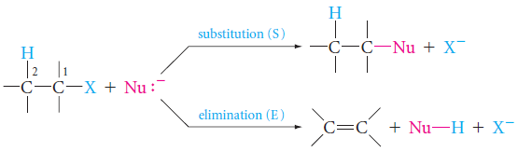
Reactions of alkyl Compounds
A) Nucleophiic substitution, or S_{N}, reactions.
Alkyl halides undergo nucleophilic substitution reactions, in which a nucleophile displaces the halide leaving group from the alkyl halide substrate.
B) Elimination, or E, reactions.
Those that involve the loss of HX from the halide.
C) Formation of organometallic compounds.
Those that involve reaction with certain metals.

Slide 10
a) Nucleophiic substitution (S_{N}) reactions
Reactions of alkyl Compounds
Reaction of Ethyl bromide (bromoethane) with hydroxide ion to give ethyl alcohol and bromide ion:
Hydroxide ion is the nucleophile.
It reacts with the substrate (ethyl bromide) and displaces bromide ion.
The bromide ion is called the leaving group.
In general

Slide 11
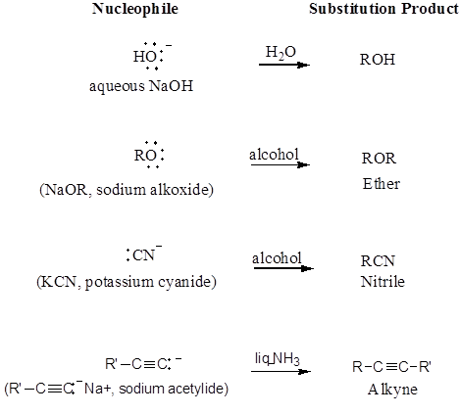
a) Nucleophiic substitution (S_{N}) reactions
Reactions of alkyl Compounds

Slide 12
a) Nucleophiic substitution (S_{N}) reactions
Reactions of alkyl Compounds

Slide 13
a) Nucleophiic substitution (S_{N}) reactions
Reactions of alkyl Compounds

Slide 14
a) Nucleophiic substitution (S_{N}) reactions
Reactions of alkyl Compounds

Slide 15
a) Nucleophiic substitution (S_{N}) reactions
Reactions of alkyl Compounds
Nucleophilic Substitution (S_{N}) Mechanisms
There are two main nucleophilic substitution mechanisms; S_{N}2 and S_{N}1.
The S_{N} part of each symbol stands for “substitution, nucleophilic”.
The meaning of the numbers 2 (bimolecular) and 1 (unimolecular).

Slide 16
The S_{N}2 Mechanism
Nucleophiic substitution (S_{N}) reactions
The S_{N}2 mechanism is a one-step process; the bond to the leaving group begins to break as the bond to the nucleophile begins to form.
The nucleophile attacks from the backside of the C - L bond (inversion of configuration).
At the transition state; the nucleophile and the leaving group are both partly bonded to the carbon at which substitution occurs.
The number 2 (bimolecular); The rate of the reaction depends on both the nucleophile and the substrate concentrations.

Slide 17
The S_{N}2 Mechanism
Nucleophiic substitution (S_{N}) reactions
Class of Alkyl Halide
The reaction is fastest when the alkyl group of the substrate is methyl or primary alkyl halides.
The reaction is slowest when it is tertiary alkyl halides.
Secondary alkyl halides react at an intermediate rate.
The rear side of the carbon, where displacement occurs, is more crowded if more alkyl groups are attached to it, thus slowing down the reaction rate.

Slide 18
The S_{N}2 Mechanism
Nucleophiic substitution (S_{N}) reactions
Summary,
The S_{N}2 mechanism is a one-step process favored for methyl and primary halides.
It occurs more slowly with secondary halides and usually not at all with tertiary halides.
An S_{N}2 reaction occurs with inversion of configuration, and its rate depends on the concentration of both the nucleophile and the substrate (the alkyl halide).

Slide 19
The S_{N}1 Mechanism
Nucleophiic substitution (S_{N}) reactions
The S_{N}1 mechanism is a two-step process;
In the first step, which is slow, the bond between the carbon and the leaving group breaks as the substrate dissociates (ionizes).
The electrons of the C - L bond go with the leaving group, and a carbocation is formed.
In the second step, which is fast, the carbocation combines with the nucleophile to give the product.

Slide 20
The S_{N}1 Mechanism
Nucleophiic substitution (S_{N}) reactions
The number 1 (unimolecular);
Rate determining, step involves only one of the two reactants: the substrate.
It does not involve the nucleophile at all.
That is, the first step is unimolecular.
Primary halides normally do not react by this mechanism.
The S_{N}1 process occurs with racemization, and its rate is independent of the nucleophile’s concentration.

Slide 21
Nucleophiic substitution (S_{N}) reactions
The S_{N}1 and S_{N}2 Mechanisms Compared
Class of Alkyl halide;
Primary halides almost always react by the S_{N}2 mechanism
Tertiary halides react by the S_{N}1 mechanism.
Only with secondary halides are we likely to encounter both possibilities.
Solvent polarity.
Polar protic solvents (Water and alcohols) (proton-donating).
The rate of S_{N}1 processes is enhanced by polar solvents.
The first step of the S_{N}1 mechanism involves the formation of ions and polar solvents can solvate ions.
S_{N}2 reactions, are usually retarded by polar protic solvents.
solvation of nucleophiles ties up their unshared electron pairs.
Polar but aprotic solvents (acetone, dimethyl sulfoxide, (CH₃)₂S=O, DMF)
These solvents accelerate S_{N}2 reactions because, by solvating the cation (say, K⁺ in K⁺⁻CN), they leave the anion more “naked” or unsolvated, thus improving its nucleophilicity.

Slide 22
The S_{N}1 and S_{N}2 Mechanisms Compared
Nucleophiic substitution (S_{N}) reactions
The S_{N}1 and S_{N}2 Mechanisms Compared

Slide 23
E2 mehcanism
Elimination (E) reactions
There are two main mechanisms for elimination reactions, designated E2 and E1.
The E2 mechanism is a process in which HX is eliminated and a C=C bond is formed in the same step.
Like the S_{N}2 mechanism, the E2 mechanism is a one-step process.
The nucleophile, acting as a base, removes the proton (hydrogen) on a carbon atom adjacent to the one that bears the leaving group.

Slide 24
E1 mehcanism
Elimination (E) reactions
Like the S_{N}1 mechanism, the E1 mechanism is a two-step process.
The first step as the S_{N}1 mechanism, the slow and rate-determining ionization of the substrate to give a carbocation
The second step; Two reactions are then possible for the carbocation.
It may combine with a nucleophile (the S_{N}1 process).
or it may lose a proton from a carbon atom adjacent to the positive carbon, to give an alkene (the E1 process).

Slide 25
Elimination versus Substitution
Reactions of alkyl Compounds
How substitution and elimination reactions compete with one another.
Let us consider the options for each class of alkyl halide.
Tertiary Halides
Substitution can only occur by the S_{N}1 mechanism.
Elimination can occur by either the E1 or the E2 mechanism.
With weak nucleophiles and polar solvents, the S_{N}1 and E1 mechanisms compete with each other.

Slide 26
Elimination versus Substitution
Reactions of alkyl Compounds
Tertiary Halides
If we use a strong nucleophile (which can act as a base) instead of a weak one, and if we use a less polar solvent, we favor elimination by the E2 mechanism.
Because the tertiary carbon is too hindered sterically for S_{N}2 attack, substitution does not compete with elimination.

Slide 27
Elimination versus Substitution
Reactions of alkyl Compounds
Primary Halides
Only the S_{N}2 and E2 mechanisms are possible, because ionization to a primary carbocation, the first step required for the S_{N}1 or E1 mechanisms, does not occur.
With most nucleophiles, primary halides give mainly substitution products (S_{N}2).
Only with very bulky, strongly basic nucleophiles, the E2 process is favored.

Slide 28
Elimination versus Substitution
Reactions of alkyl Compounds
Secondary Halides
All four mechanisms, S_{N}2 and E2 as well as S_{N}1 and E1, are possible.
The product composition is sensitive to the nucleophile (its strength as a nucleophile and as a base) and to the reaction conditions (solvent, temperature).
S_{N}2 is favored with stronger nucleophiles that are not strong bases.
S_{N}1 is favored with weaker nucleophiles in polar solvents.
E2 is favored by strong bases.

Slide 29

C) Formation of organometallic compounds
Reactions of alkyl Compounds
Most organic chlorides, bromides, and iodides react with certain metals to give organometallic compounds, molecules with carbon-metal bonds.
Grignard reagents are obtained by the reaction of alkyl or aryl halides with metallic magnesium in dry ether as the solvent.
General reaction
Specific example

Slide 30
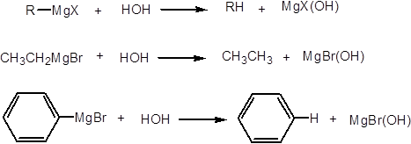
C) Formation of organometallic compounds
Reactions of alkyl Compounds
Grignard reagents react readily with any source of protons to give hydrocarbons.

