Slide 1

Dr. Mohamed El-Newehy
Chemistry Department, College of Science, King Saud University http://fac.ksu.edu.sa/melnewehy/home
CHEM 244
PRINCIPLES OF ORGANIC CHEMISTRY I
FOR CHEMICAL ENGINEERING’ STUDENTS, COLLEGE OF ENGINEERING
PRE-REQUISITES COURSE; CHEM 101
CREDIT HOURS; 2 (2+0)
Notes:
2/24/2018
1

Slide 2
CHAPTER 4
AROMATIC COMPOUNDS
Notes:
2/24/2018
2

Slide 3
The Structure of Benzene Ring
Benzene, C₆H₆, is the parent hydrocarbon of the especially stable compounds known as aromatic compounds.
The carbon-to-hydrogen ratio in benzene, C₆H₆, suggests a highly unsaturated structure.
It does not undergo the typical addition reactions of alkenes or alkynes.
Instead, benzene reacts mainly by substitution reactions.

Slide 4
The Kekulé Structure of Benzene
The Structure of Benzene Ring
He suggested that six carbon atoms are located at the corners of a regular hexagon, with one hydrogen atom attached to each carbon atom.
To give each carbon atom a valence of 4, he suggested that single and double bonds alternate around the ring (what we now call a conjugated system of double bonds).
All of thebcarbon–carbon bond lengths are identical: 1.39 Å, intermediate between typical single (1.54 Å) and double (1.34 Å) carbon–carbon bond lengths.

Slide 5
Orbital Model for Benzene
The Structure of Benzene Ring
Each carbon is therefore sp²-hybridized,
It also explains its hexagonal shape, with H – C - C and C – C - C angles of 120°.
An orbital representation of the bonding in benzene. Sigma (s) bonds are formed by the end-on overlap of sp² orbitals.
In addition, each carbon contributes one electron to the pi (p) system by lateral overlap of its p orbital with the p orbitals of its two neighbors.

Slide 6
Symbols for Benzene
Two symbols are used to represent benzene.
One is the Kekulé structure, and
The other is a hexagon with an inscribed circle, to represent the idea of a delocalized pi electron cloud.

Slide 7
Aromatic Character (Armaticity)
Aromatic character (Aromaticity) is associated with several structural requirements.
Cyclic structure.
Cyclic structure contains what looks like a continuous system of alternating double and single bonds.
Aromatic compounds must be planar.
Aromaticity is possible only if it obeys Hückel’s rule.
The number of π electrons in the compound = (4n + 2)
Where (n = 0,1, 2, 3, and so on).

Slide 8
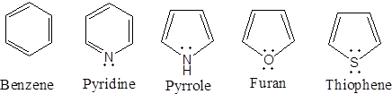
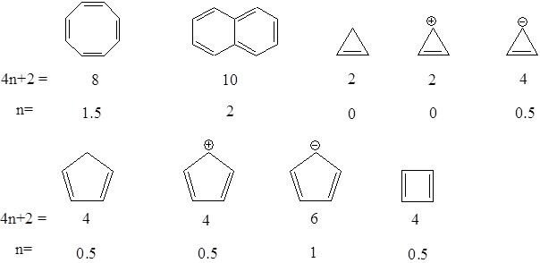
Aromatic Character (Armaticity)
Structure and name of aromatic compound | 4n + 2 | n
6 | 1
Examples
Not aromatic
Not aromatic
Not aromatic
Not aromatic
Not aromatic
Not aromatic

Slide 9
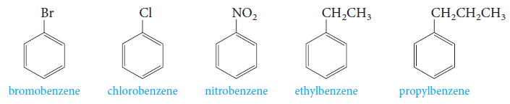
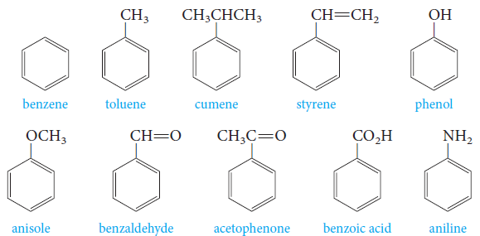
Nomenclature of Aromatic Compounds
Monosubstituted benzenes that do not have common names accepted by IUPAC are named as derivatives of benzene.
Monosubstituted benzenes that have common names are accepted by IUPAC (parent compounds).

Slide 10
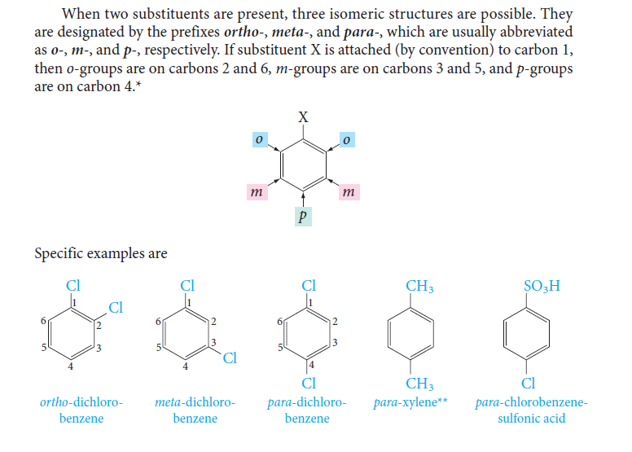
Nomenclature of Aromatic Compounds
When two substituents are present, three isomeric structures are possible.
They are designated by the prefixes; ortho- (o-), meta- (m-) and para- (p-).
If substituent X is attached to carbon 1; 0- groups are on carbons 2 and 6, m- groups are on carbons 3 and 5, and p- groups are on carbon 4.

Slide 11
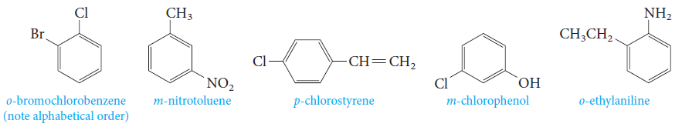
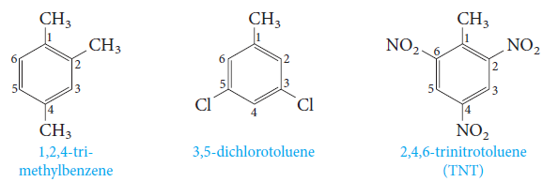
Nomenclature of Aromatic Compounds
Examples;
The prefixes; ortho- (o-), meta- (m-) and para- (p-) are used when the two substituents are not identical.
When more than two substituents are present, their positions are designated by numbering the ring.

Slide 12
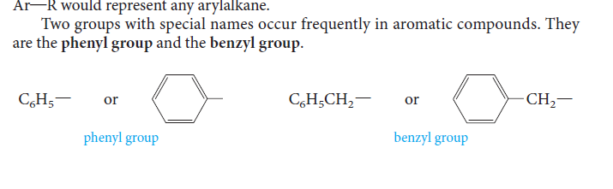
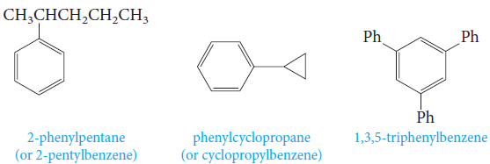
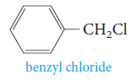
Nomenclature of Aromatic Compounds
Aromatic hydrocarbons, as a class, are called arenes.
The symbol Ar is used for an aryl group, (symbol R is used for an alkyl group).
Therefore, the formula Ar - R would represent any arylalkane.
Two groups with special names occur frequently in aromatic compounds; the phenyl group and the benzyl group.

Slide 13
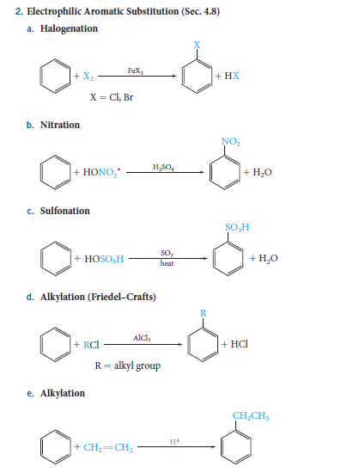
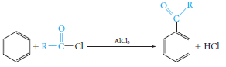
A) Electrophilic Aromatic Substitution
Reactions of Benzene
1) Halogenation
4) Alkylation (Friedel-Crafts)
2) Nitration
5) Acylation (Friedel-Crafts)
3) Sulfonation

Slide 14
A) Electrophilic Aromatic Substitution
Reactions of Benzene
The Mechanism of Electrophilic Aromatic Substitution
We can generalize this two-step mechanism for all the electrophilic aromatic substitutions.

Slide 15
A) Electrophilic Aromatic Substitution
Reactions of Benzene
The Mechanism of Electrophilic Aromatic Substitution
1) Halogenation

Slide 16
A) Electrophilic Aromatic Substitution
Reactions of Benzene
The Mechanism of Electrophilic Aromatic Substitution
2) Nitration
In aromatic nitration reactions, the sulfuric acid catalyst protonates the nitric acid, which then loses water to generate the nitronium ion (NO₂⁺), which contains a positively charged nitrogen atom.

Slide 17
A) Electrophilic Aromatic Substitution
Reactions of Benzene
The Mechanism of Electrophilic Aromatic Substitution
3) Sulfonation
We use either concentrated or fuming sulfuric acid, and the electrophile may be sulfur trioxide, SO₃, or protonated sulfur trioxide, ⁺SO₃H.
Sulfuric acid provides catalyst as following:

Slide 18
A) Electrophilic Aromatic Substitution
Reactions of Benzene
The Mechanism of Electrophilic Aromatic Substitution
4) Alkylation (Friedel-Crafts)
The electrophile is a carbocation, which can be formed either by removing a halide ion from an alkyl halide with a Lewis acid catalyst (for example, AlCl₃) .

Slide 19
A) Electrophilic Aromatic Substitution
Reactions of Benzene
The Mechanism of Electrophilic Aromatic Substitution
5) Acylation (Friedel-Crafts)
The electrophile is an acyl cation generated from an acid derivative, usually an acyl halide. The reaction provides a useful general route to aromatic ketones.

Slide 20
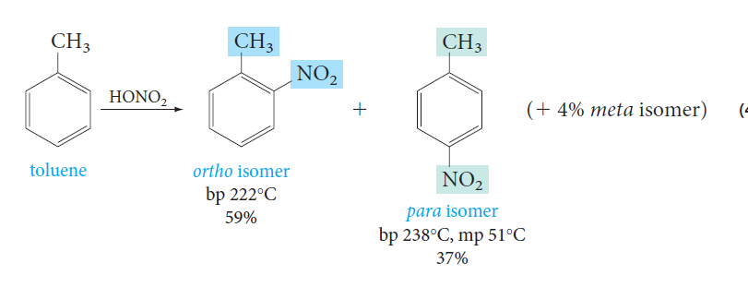
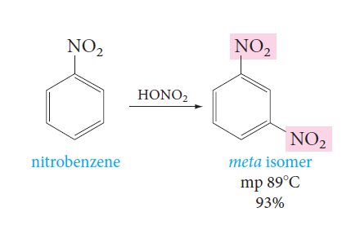
Disubstituted Benzenes: Orientation
Substituents present on an aromatic ring determine the position taken by a new substituent.
Nitration of toluene gives mainly a mixture of o- and p-nitrotoluene.
On the other hand, nitration of nitrobenzene under similar conditions gives mainly the meta isomer.

Slide 21
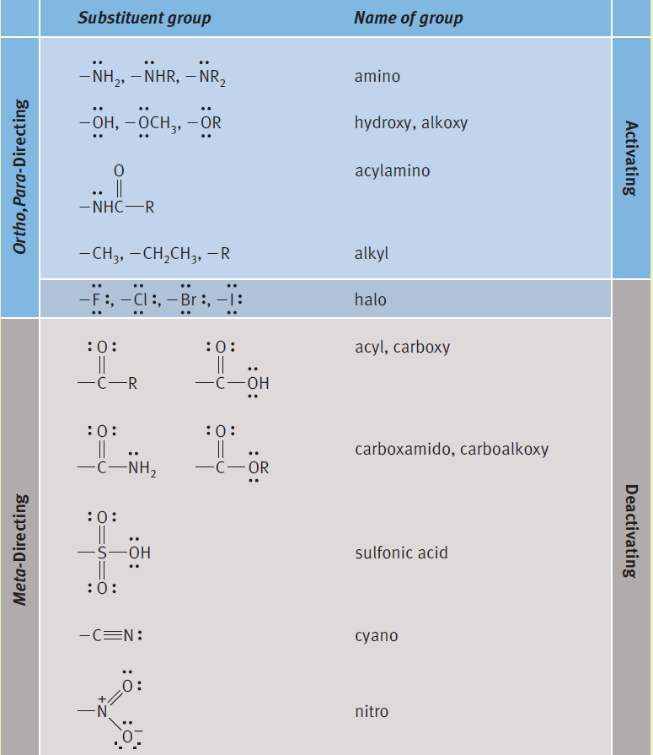
Disubstituted Benzenes: Orientation & Reactivity
Directing and Activating Effects of Common Functional Groups
Substituents that release electrons to the ring will activate the ring toward electrophilic substitution.
Substituents that withdraw electrons from the ring will deactivate the ring toward electrophilic substitution.

Slide 22
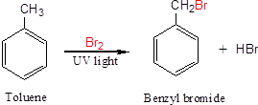
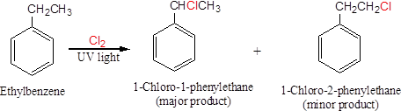
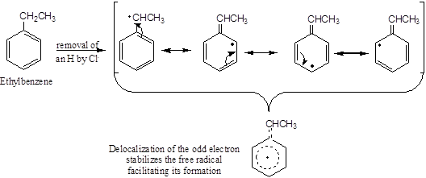
Side-Chain Reactions of Benzene-Derivatives
1. Halogenation of an Alkyl Side Chain

Slide 23
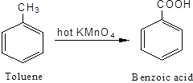
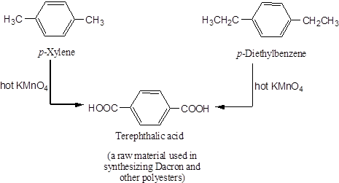
Side-Chain Reactions of Benzene-Derivatives
2. Oxidation of an Alkyl Side Chain
Conversion into a carboxyl group, -COOH, by treatment with hot potassium permanganate.
Regardless the length of the alkyl chain, the product is always the same.

