Slide 1
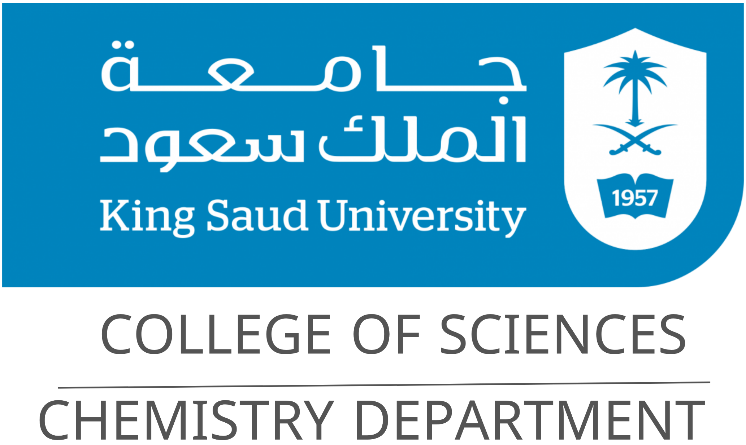
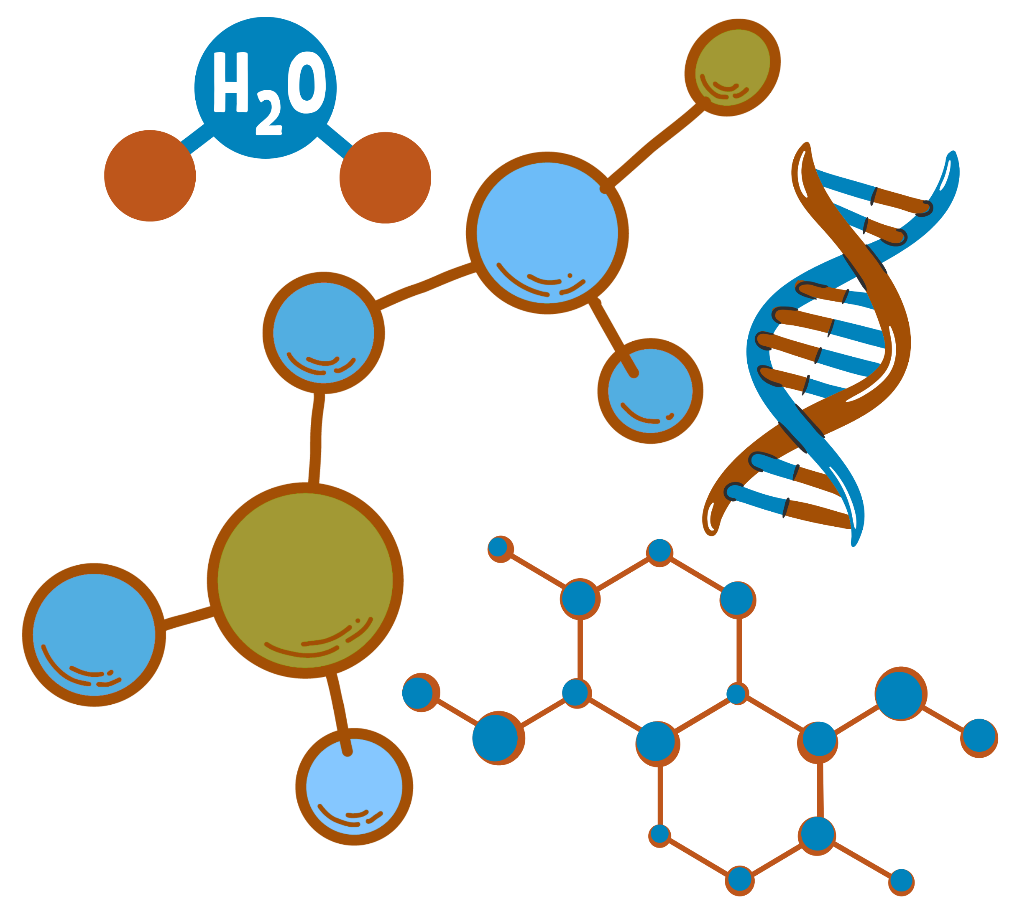
Principles of Organic Chemistry I
CHEM 244
Chapter 0:
Syllabus

Slide 2


Chapter 0: Syllabus
Course Title and General Information
Course Code | Course Title | Program
CHEM 244 | Principles of Organic Chemistry I | Chemical Engineering – College of Engineering
Credit Hours | Department | College
2 (2 Lectures + 0 Practical) | Chemistry Department | Science

Slide 3
Chapter 0: Syllabus
Course Content Overview and Reference
Chapter 1 | Introduction to Organic Chemistry
This chapter covers carbon compounds and their chemical bonds (ionic and covalent), along with atomic and molecular orbitals. It also includes hybridization, polarity, and the inductive effect.
Chapter 2 | Alkanes and Cycloalkanes
This chapter covers alkyl groups and their IUPAC nomenclature, along with physical properties and natural sources. It also includes methods of synthesis, reactions such as combustion, halogenation, and ring opening, as well as configuration and the conformational analysis of cyclohexanes.
Chapter 3 | Alkenes, Alkynes and Conjugated Dienes
This chapter introduces the IUPAC nomenclature, physical properties, and key methods of synthesis of alkenes and alkynes. It highlights major reactions, including acidity of terminal alkynes, addition and oxidation reactions, as well as resonance and stability in conjugated systems. Special focus is given to allylic species and the mechanisms of 1,4-addition and cycloaddition.

Slide 4
Chapter 0: Syllabus
Course Content Overview and Reference
Chapter 4 | Aromatic Compound
This chapter covers the aromatic character of compounds and Hückel’s rule, along with their nomenclature. It explores electrophilic substitution reactions such as alkylation, acylation, halogenation, sulphonation, and nitration, with emphasis on mechanisms. Additional topics include side-chain halogenation and oxidation, reactivity and orientation in substituted benzenes, and the chemistry of polynuclear aromatics.
Chapter 5 | Alkyl halides
This chapter covers the nomenclature, synthesis, and reactions of alkyl halides. It also introduces optical isomerism and discusses key reaction mechanisms, including S_{N}1, S_{N}2, E1, and E2 pathways.

Slide 5
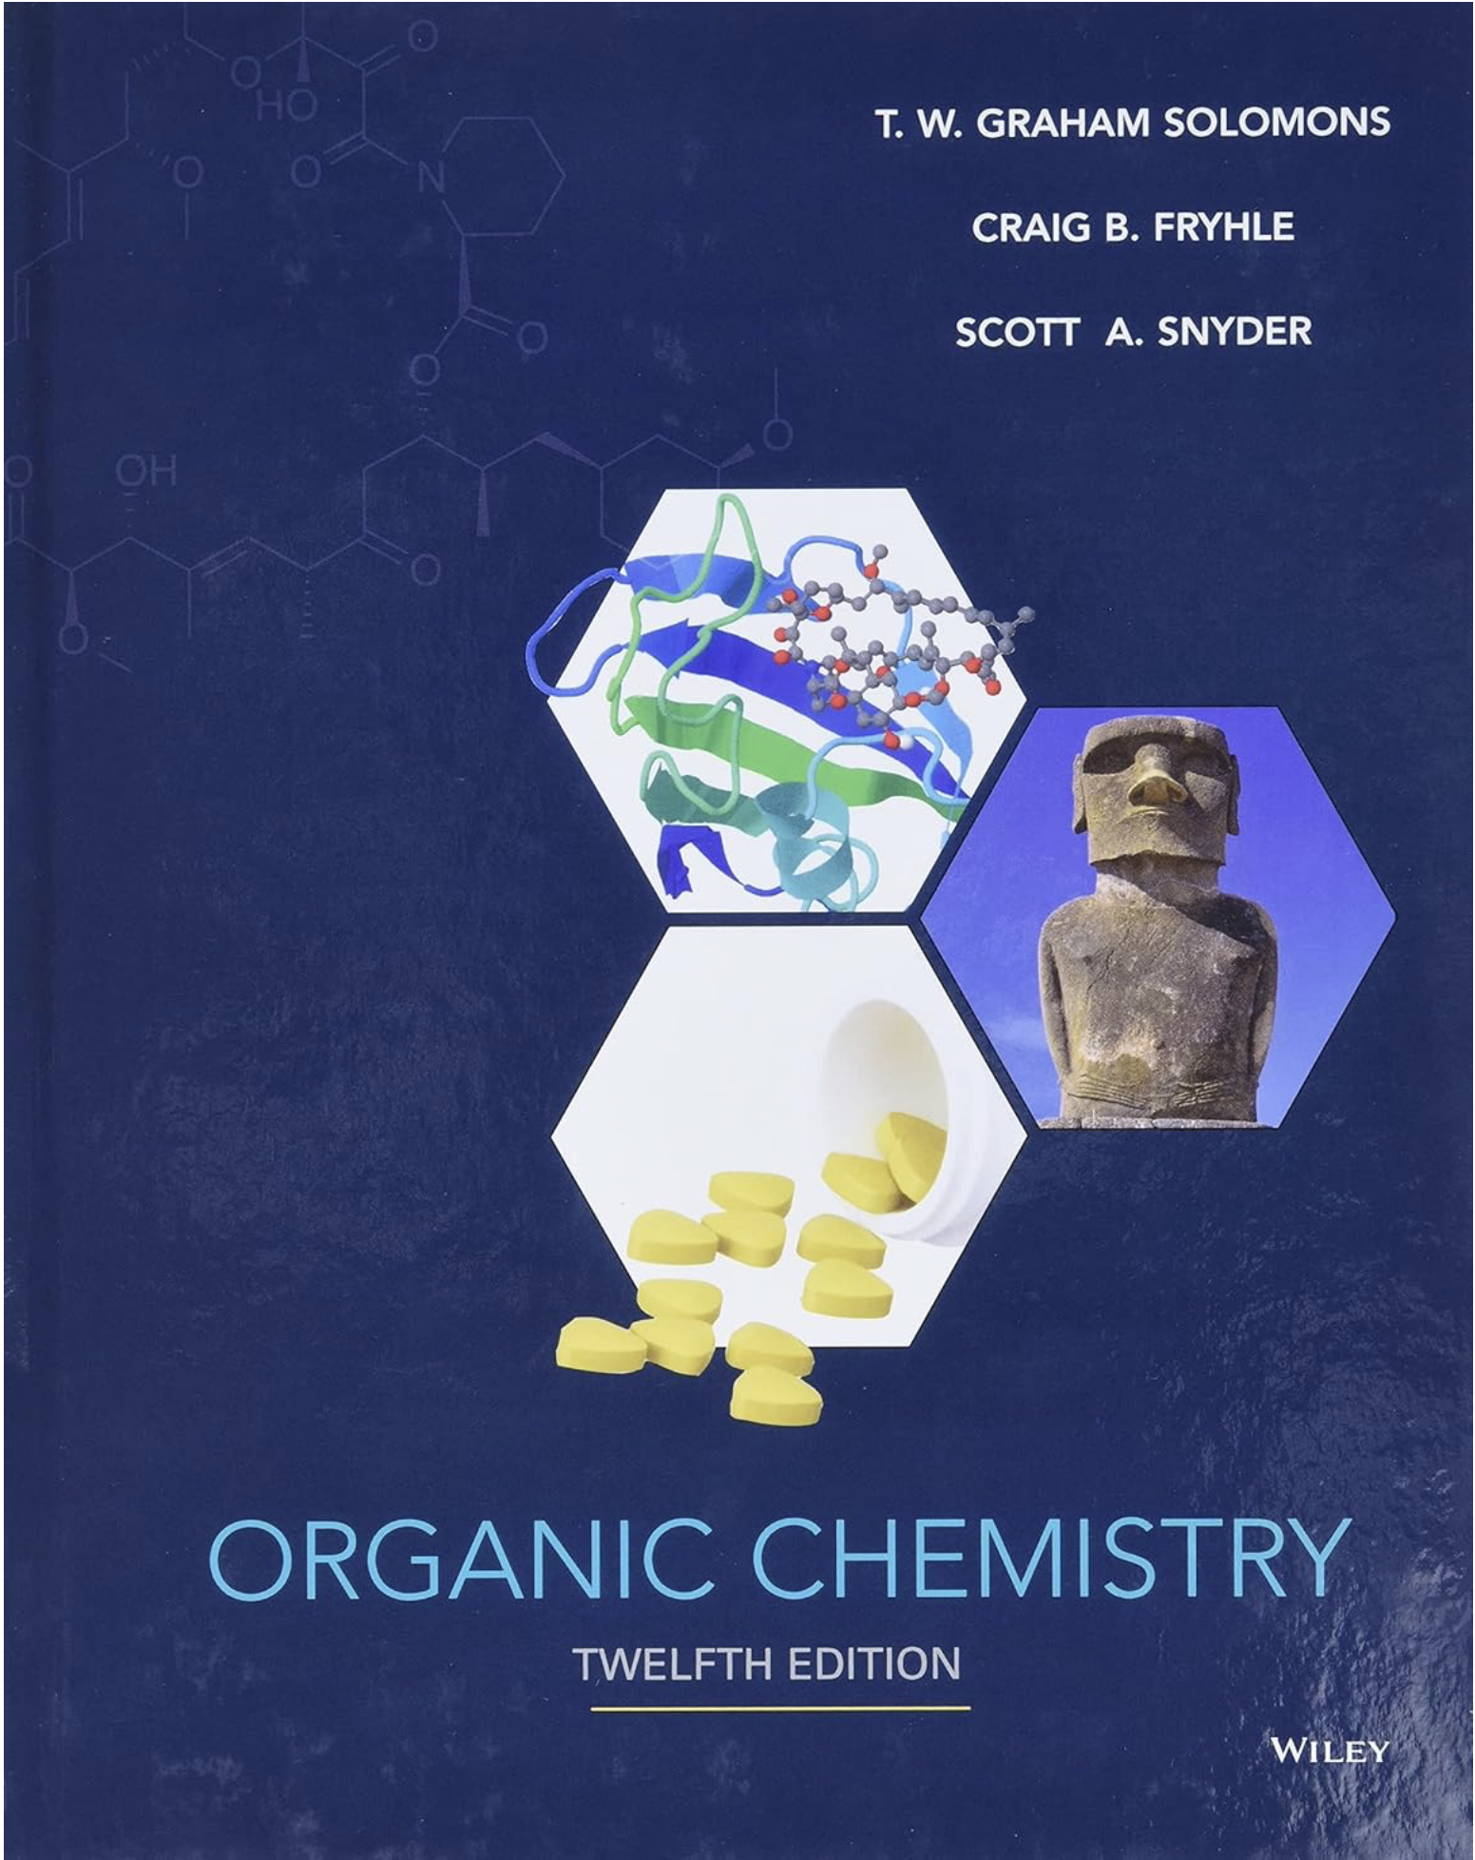
Chapter 0: Syllabus
Reference
Reference
Solomons, T. W. Graham, Fryhle, Craig B., & Snyder, Scott A. (2016). Organic Chemistry (12th ed.). Hoboken, NJ: John Wiley & Sons, Inc. ISBN 978-1-118-87576-6.

Slide 6
Chapter 0: Syllabus
Course Objectives
Name organic compounds using IUPAC naming system, their occurrence in nature, physical properties. | Identify, classify and understand physical and chemical properties of the major functional groups. | Understand the basic organic reaction for preparation of common functional groups.
Understand the reaction of functional groups and families of organic compounds. | The practical uses of organic compounds as drugs, food additives, pesticides, plastics, and other products, as well as their occurrence in nature.

Slide 7
Chapter 0: Syllabus
Course Learning Outcomes
Knowledge | Skills | Values
To recognize structures of organic compounds. To memorize naming, constitutional isomer, physical properties and reactions. | To differentiate between ionic and covalent bonds in chemical compounds. To recognize the IUPAC nomenclature of organic chemical compounds. To differentiate between aromatic and non-aromatic compounds according to Hukel’s rule. To predict the type of nucleophilic or electrophilic substitutions in organic reactions. | Work independently and as a part of a team during class session. Utilizing university electronic resources of learning.

Slide 8
Chapter 0: Syllabus
Assessment Methods and Weighting
No. | Assessment Task | Points
1 | 1st Midterm Exam | 15
2 | 2st Midterm Exam | 15
3 | 5 Quizzes | 15
4 | Presentation | 15
5 | Final Exam | 40
Total |  | 100

Slide 9
Chapter 0: Syllabus
Regulations for Attendance, Absence, and Alternative Examinations
Item | Limit/Rule
Semester Length | 15 weeks (30 lectures)
Allowed Absence | 25% = max 8 lectures
Lecture Duration | 1 lecture × 50 min per day (1 academic hour)
Max Absence in Hours | 8 academic hours (8 days)
Absence Excuses | Submit via e-mail to course instructor
Alternative Examination Regulations | Student must not have taken the Primary Examination. Student must not be denied in the course. Request must be submitted to course instructor within one week of the Primary Examination date. Excuse must be official and government-approved. No alternative for an alternative examination.

Slide 10
Chapter 0: Syllabus
Good
Luck

