Slide 1
PRINCIPLES OF ORGANIC CHEMISTRY I FOR CHEMICAL ENGINEERING’ STUDENTS, COLLEGE OF ENGINEERING
CHEM 244
Dr. Sultan Almadhhi
Assistant Professor of Organic Chemistry
King Saud University

Slide 2
Topics to be Covered
Introduction
(Carbon Compounds, Chemical Bonds (ionic and Covalent), Atomic and Molecular orbitals, Hybridization, Polarity and Inductive effect).
Alkanes and Cycloalkanes
(Alkyl groups, IUPAC nomenclature, Physical properties, Sources off, Synthesis. Reactions (Combustion, Halogenation, Ring opening). Configuration, cyclohexanes.
Alkenes, Alkynes and Conjugated Dienes
(IUPAC nomenclature, Physical properties, Synthesis (Dehydrohalogenation, from vicinal dihalides, Dehydration of alcohols). Reactions (Acidity of terminal alkynes, Addition reactions (Reduction, Halogenation, Addition of HX – Markovnikov rule, Carbonium ions and their stability, Reaction mechanism), Addition in the presence of peroxides, Hydration, Halohydrin formation), Oxidation of Alkenes (KMnO4, Peroxides and Ozonolysis). (Allyl radical and stability, Allyl cation, 1,3-Butadiene - electron delocalization, Resonance and the Stability of conjugated dienes, 1,4-Addition and 1,4-Cycloaddition reactions of diene).

Slide 3
Topics to be Covered
Aromatic Compound
(Aromaic character, Hukel rule, Nomenlature, Electrophilic substitution reactions (Alkylation, Acylation, Halogenatio, Sulphonation, Nitration; reaction mechanism), Side chain halogenation and oxidation, Reactivity and Orientation in substituted benzene, Polynuclear aromatics).
Alkyl halides
(nomenclature, synthesis and reactions, optical isomerism (SN1, SN2, E1 and E2 reactions)).

Slide 4
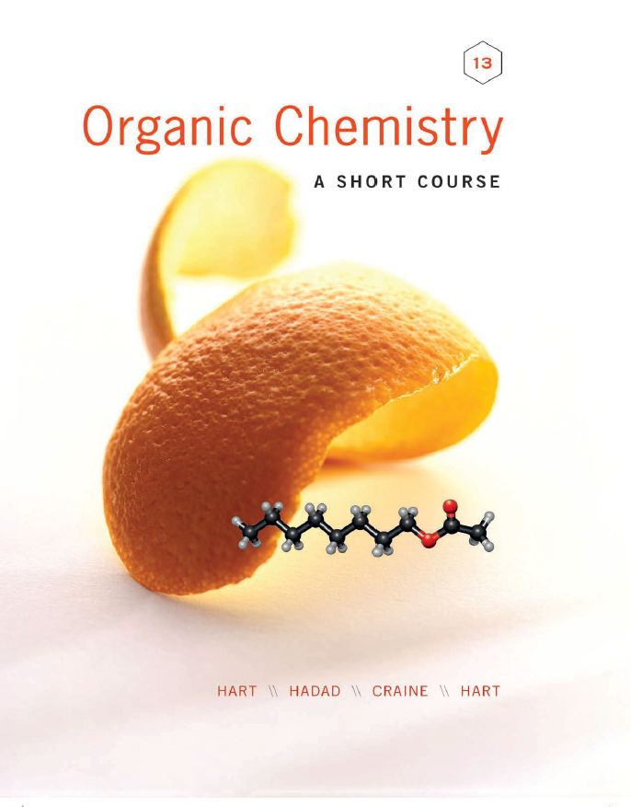
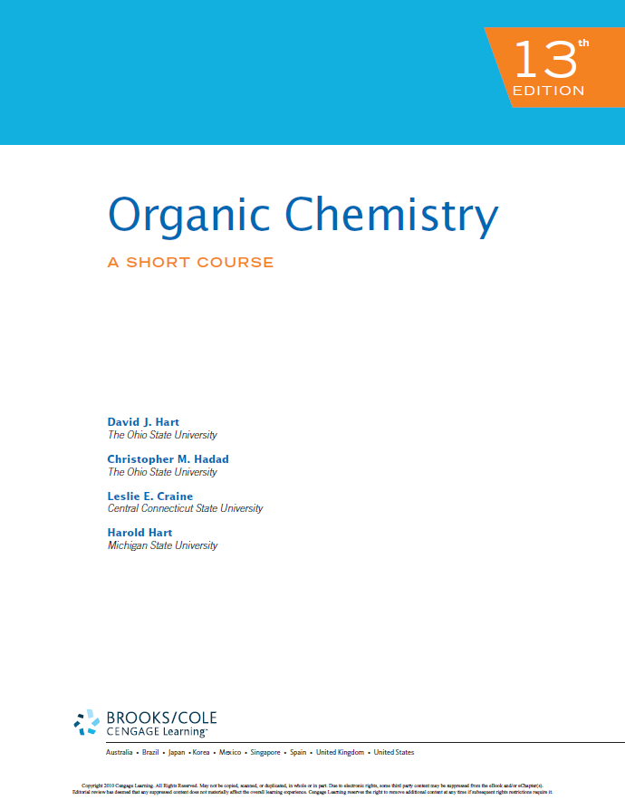
References
Organic chemistry: A short course by I Harold Hart, David J. Hart and Leslie E. Craine, Houghton Mifflin Company, USA.
Elements of Organic Chemistry (second edition) is written by Isaak Zimmerman and Henry Zimmerman and published by Macmillan Publishing Co., Inc. New York in 1983.
أسس الكيمياء العضوية - أ.د./ سالم بن سليم الذياب - الناشر: مؤسسة نافثة

Slide 5
Schedule of Assessment Tasks During the Semester
No. | Assessment Task | Points
1 | Frist Midterm Exam | 15
2 | Second Midterm Exam | 15
3 | 5 Quizes | 15
4 | Presentation | 15
5 | Final Exam | 40
Total |  | 100

Slide 6
Course Objectives
Name organic compounds using IUPAC naming system, their occurrence in nature, physical properties.
Identify, classify and understand physical and chemical properties of the major functional groups.
Understand the basic organic reaction for preparation of common functional groups.
Understand the reaction of functional groups and families of organic compounds.
The practical uses of organic compounds as drugs, food additives, pesticides, plastics, and other products, as well as their occurrence in nature.

Slide 7
Course Learning Outcomes
1 | Knowledge
1.1 | To recognize structures of organic compounds.
1.2 | To memorize naming, constitutional isomer, physical properties and reactions.
2 | Skills
2.1 | To differentiate between ionic and covalent bonds in chemical compounds.
2.2 | To recognize the IUPAC nomenclature of organic chemical compounds.
2.3 | To differentiate between aromatic and non-aromatic compounds according to Hukel’s rule.
2.4 | To predict the type of nucleophilic or electrophilic substitutions in organic reactions.

Slide 8
Course Learning Outcomes
3 | Values
3.1 | Work independently and as a part of a team during class session.
3.2 | Utilizing university electronic resources of learning.

