Slide 1
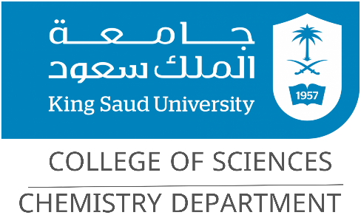
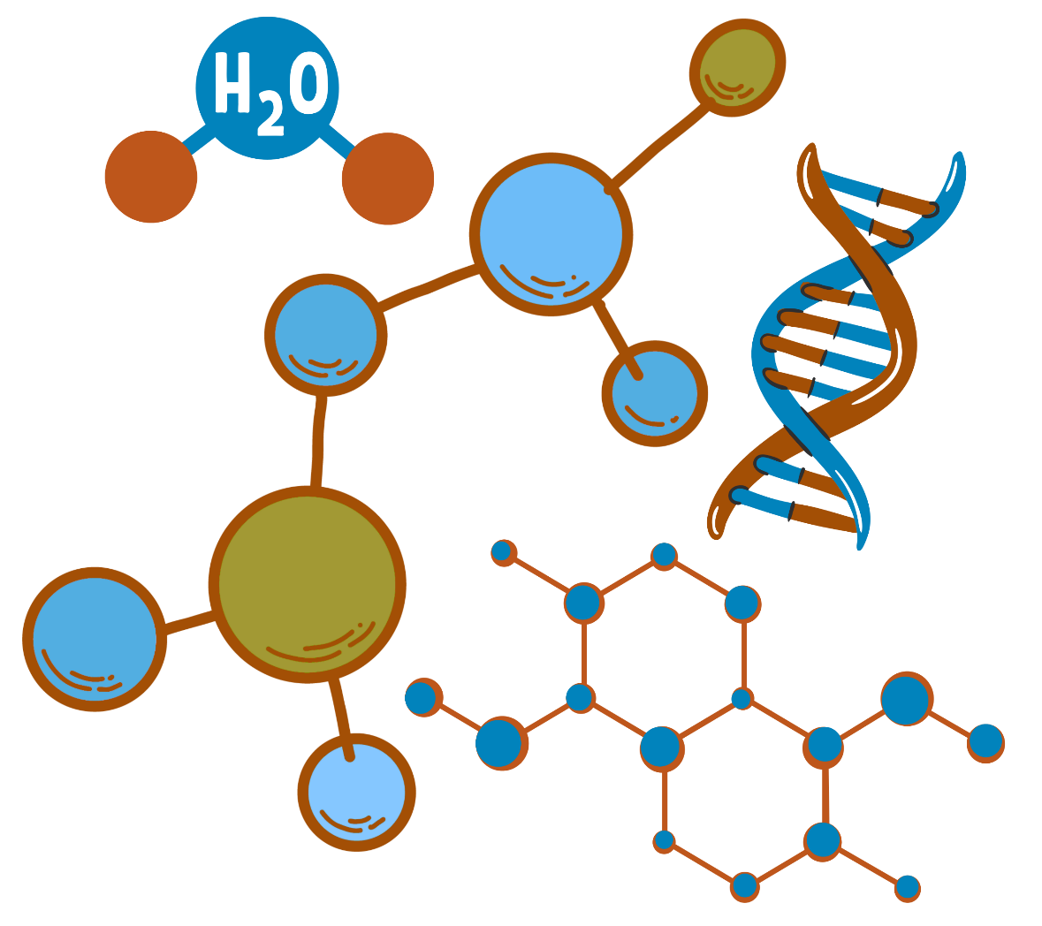
Organic Chemistry I
CHEM 240
Chapter 2: Structure and Classification of Organic Compounds

Slide 2

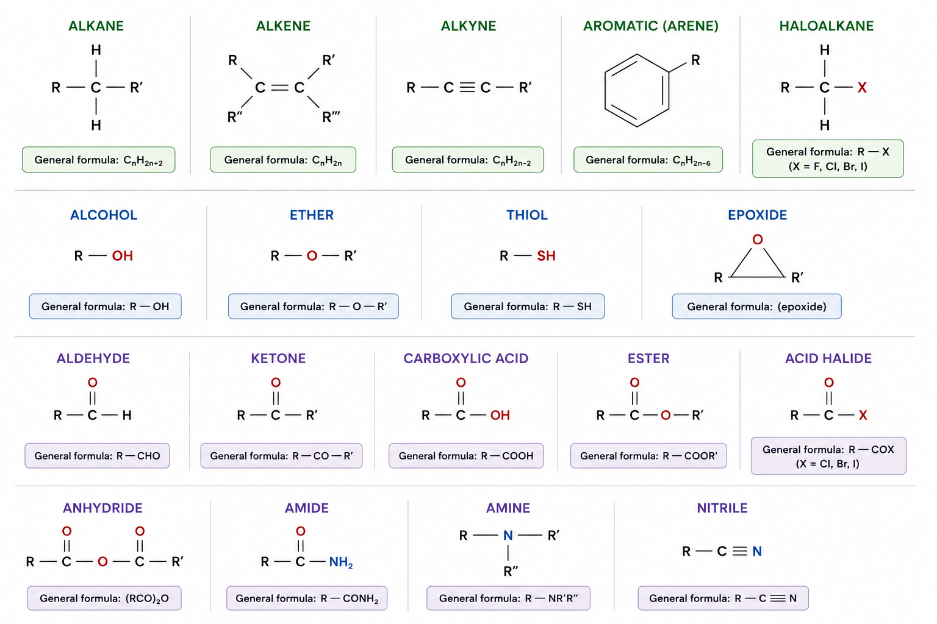
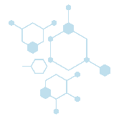
Chapter 2: Structure and Classification of Organic Compounds
1. Functional Groups:
1

Slide 3
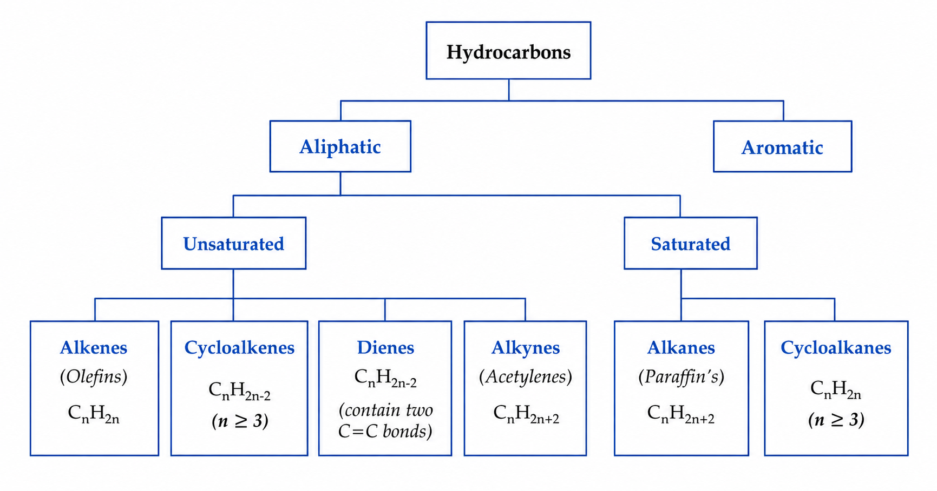
Chapter 2: Structure and Classification of Organic Compounds
2. Aliphatic Hydrocarbons:
Hydrocarbons are compounds that contain only carbon and hydrogen atoms.
Aliphatic hydrocarbons are subdivided into:
Saturated hydrocarbons
Alkanes; C_{n}H_{2n+2}
(contain carbon-carbon single bond)
Cycloalkanes: C_{n}H_{2n}
(contain carbon-carbon single bond in a single ring)
Unsaturated hydrocarbons
Alkenes; C_{n}H_{2n}
(contain carbon-carbon double bond)
Dienes; C_{n}H_{2n-2}
(contain two carbon–carbon double bonds)
Cycloalkenes; C_{n}H_{2n-2}
(contain a carbon–carbon double bond in a ring)
Alkynes; C_{n} H_{2n-2}
(contain carbon-carbon triple bond)
2

Slide 4
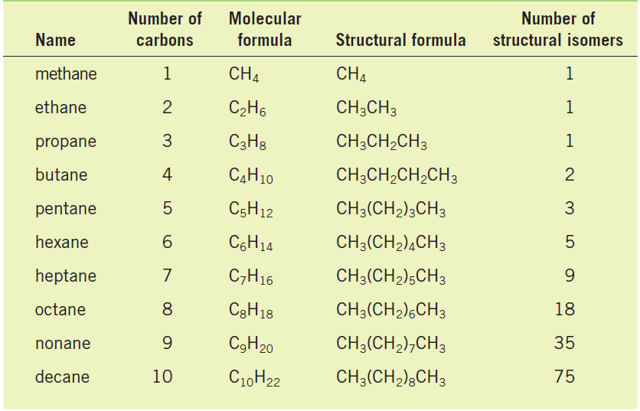
Chapter 2: Structure and Classification of Organic Compounds
2. Aliphatic Hydrocarbons
2.1. Alkanes and Cycloalkanes
Alkanes, whose molecules contain only single bonds, are referred to as saturated compounds because these compounds contain the maximum number of hydrogen atoms that the carbon compound can possess.
Alkanes have the general formula C_{n}H_{2n+2}
Cycloalkanes: are alkanes in which all or some of the carbon atoms are arranged in a ring. cycloalkanes containing a single ring have two fewer hydrogen atoms.
Cycloalkanes have the general formula C_{n}H_{2n}
3

Slide 5
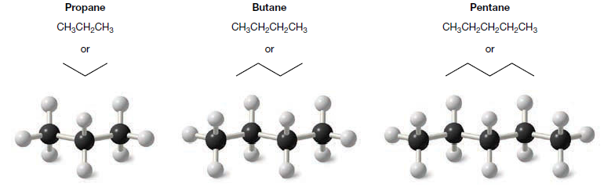
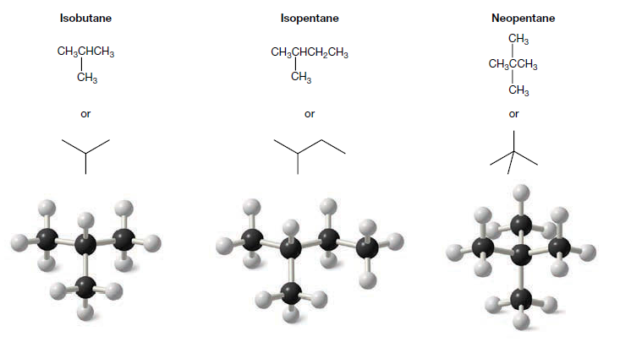
Chapter 2: Structure and Classification of Organic Compounds
2. Aliphatic Hydrocarbons
2.1. Alkanes and Cycloalkanes
2.1.1. Shapes of Alkanes
A general tetrahedral orientation of groups and thus sp³ hybridization is the rule for the carbon atoms of all alkanes and cycloalkanes.
Straight-chain:
Alkanes like butane, as an example, have a zigzag structure due to their tetrahedral carbon atoms. A more accurate term is "unbranched," meaning no carbon is bonded to more than two others.
Branched-chain alkanes:
Isobutane, isopentane, and neopentane are examples of branched-chain alkanes. In neopentane the central carbon atom is bonded to four carbon atoms.
4

Slide 6
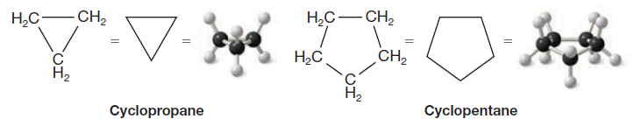
Chapter 2: Structure and Classification of Organic Compounds
2. Aliphatic Hydrocarbons
2.1. Alkanes and Cycloalkanes
2.1.2. Shapes of Cycloalkanes
Carbon atoms in cycloalkanes are sp³ hybridized, and their rings can adopt different shapes.
Planar rings:
Cyclopropane has a planar, triangular structure. Its three carbon atoms lie in the same plane.
Branched-chain alkanes:
Larger cycloalkanes generally adopt non-planar (puckered) structures. Cyclopentane, for example, adopts a puckered shape.
Cyclopentane
Cyclopropane
5

Slide 7
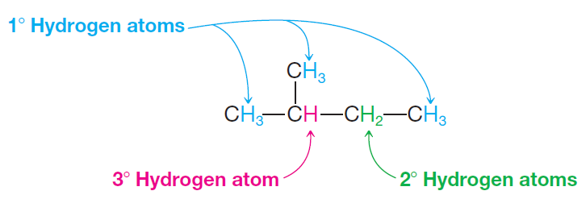
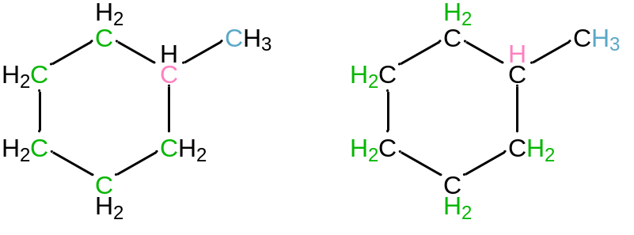
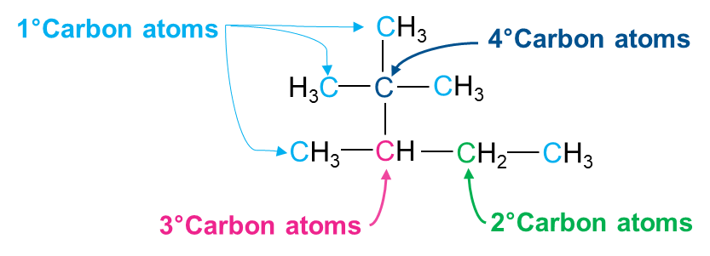
Chapter 2: Structure and Classification of Organic Compounds
2. Aliphatic Hydrocarbons
2.1. Alkanes and Cycloalkanes
2.1.3. How to classify carbon and hydrogen atoms
A primary (1°) carbon is one that is bonded to only one other carbon.
A secondary (2°) carbon is one that is bonded to two other carbons.
A tertiary (3°) carbon is one that is bonded to three other carbons.
The hydrogen atoms of an alkane are classified based on the carbon atom to which they are attached.
A hydrogen atom attached to a primary carbon atom is a primary (1°) hydrogen atom, and so forth.
In cycloalkanes, carbon and hydrogen atoms are classified in the same way based on the number of carbon atoms attached to the carbon atom.
Examples:
2-methylbutane and methylcyclohexane, have (1°), (2°), and (3°) carbon and hydrogen atoms. 2,2,3-trimethylpentane has (1°), (2°), (3°), and (4°) carbon atoms, but only (1°), (2°), and (3°) hydrogen atoms.
6

Slide 8
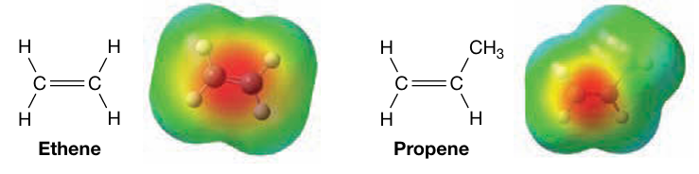



Chapter 2: Structure and Classification of Organic Compounds
2. Aliphatic Hydrocarbons
2.2. Alkenes, Dienes, and Cycloalkenes
Alkenes are hydrocarbons containing a carbon-carbon double bond, historically called olefins.
General formula is C_{n}H_{2n}
The simplest alkene, ethene (ethylene) (C₂H₄)
Dienes are hydrocarbons containing two carbon–carbon double bonds (C=C).
The general formula of acyclic dienes is C_{n}H_{2n-2}
2.2.1. How to Classify Dienes
Cumulated dienes: The double bonds share a common carbon atom.
Conjugated dienes: The double bonds are separated by one single bond.
Isolated dienes: The double bonds are separated by two or more single bonds.
7

Slide 9
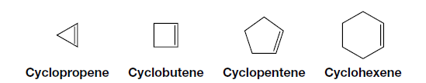
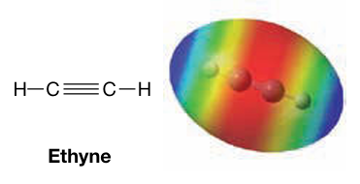
Chapter 2: Structure and Classification of Organic Compounds
2. Aliphatic Hydrocarbons
2.2. Alkenes, Dienes, and Cycloalkenes
Cycloalkenes are cyclic hydrocarbons containing a carbon–carbon double bond.
General formula is C_{n}H_{2n-2}
The simplest cycloalkenes, Cyclopropene (C₃H₄)
2.3. Alkynes
Hydrocarbons whose molecules contain the carbon–carbon triple bond and called acetylenes.
The simplest member, acetylene HC≡CH.
8

Slide 10
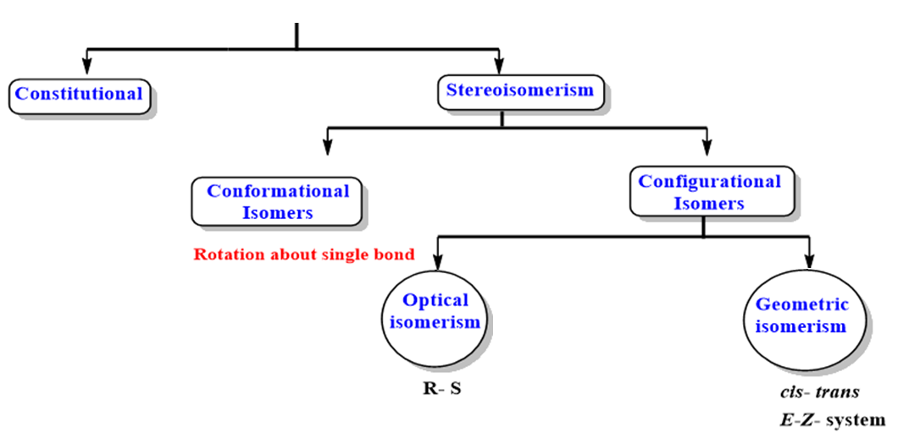
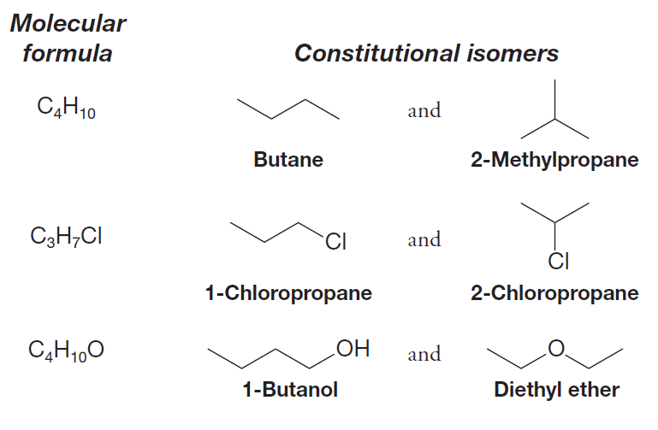
Chapter 2: Structure and Classification of Organic Compounds
2. Aliphatic Hydrocarbons
Types of Isomerism
2.4. Isomerism
Isomers are different compounds with identical molecular formulas.
2.4.1. Structural or constitutional isomers
Structural isomers have the same molecular formula but different in the sequence of atoms bonded to each other.
Examples:
9

Slide 11
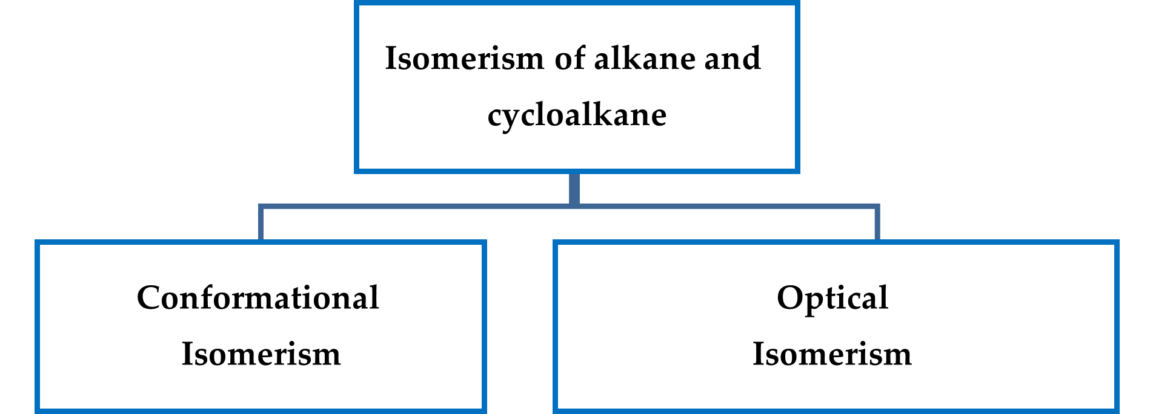
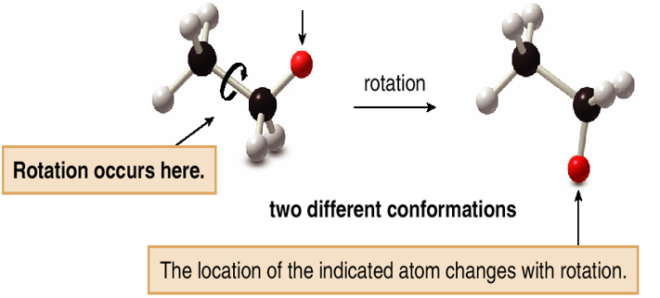
Chapter 2: Structure and Classification of Organic Compounds
2. Aliphatic Hydrocarbons
2.4. Isomerism
2.4.2. Conformational Isomerism: Conformations of Acyclic Alkanes
Stereoisomers: compounds with the same connectivity, different arrangement in space.
Two groups bonded by only a single bond can undergo rotation about that bond with respect to each other.
Conformations: are different arrangements of atoms that are interconverted by rotation about single bonds.
The temporary molecular shapes that result from such a rotation are called conformations of the molecule.
Each possible structure is called a conformer.
10

Slide 12
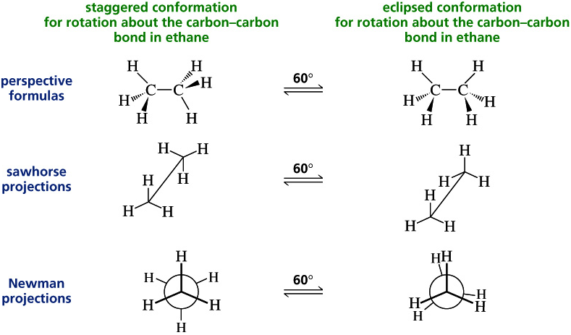
Chapter 2: Structure and Classification of Organic Compounds
2. Aliphatic Hydrocarbons
2.4. Isomerism
2.4.2. Conformational Isomerism: Conformations of Acyclic Alkanes(Rotation of C-C Single Bonds)
11

Slide 13
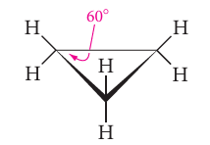
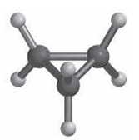
Chapter 2: Structure and Classification of Organic Compounds
2. Aliphatic Hydrocarbons
2.4. Isomerism
2.4.3. Conformational Isomerism: Conformational Analysis Cycloalkanes
Cyclopropane, with only three carbon atoms, is necessarily planar.
The C-C-C angle is only 60° (the carbons form an equilateral triangle), much less than the usual sp3 tetrahedral angle of 109.5°.
The hydrogens lie above and below the carbon plane, and hydrogens on adjacent carbons are eclipsed.
Angle strain exists in a cyclopropane ring because the sp3 orbitals of the carbon atoms cannot overlap as effectively as they do in alkanes.
12

Slide 14
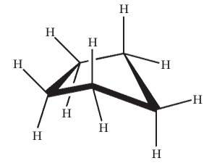
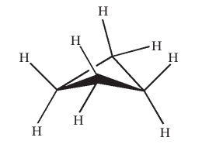
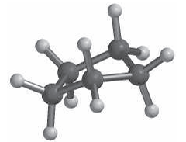
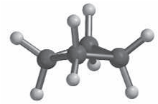
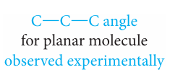


Chapter 2: Structure and Classification of Organic Compounds
2. Aliphatic Hydrocarbons
2.4. Isomerism
2.4.3. Conformational Isomerism: Conformational Analysis Cycloalkanes
Cycloalkanes with more than three carbon atoms are nonplanar and have “puckered” conformations.
In cyclobutane and cyclopentane, puckering allows the molecule to adopt the most stable conformation (with the least strain energy). Puckering introduces strain by making the C-C-C angles a little smaller than they would be if the molecules were planar; however, less eclipsing of the adjacent hydrogens.
Therefore, the molecule is flexible and shifts rapidly from one conformation to another. With little ring strain, cyclopentane is almost as stable as cyclohexane.
13

Slide 15
Chapter 2: Structure and Classification of Organic Compounds
2. Aliphatic Hydrocarbons
2.4. Isomerism
2.4.3. Conformational Isomerism: Conformational Analysis Cycloalkanes
Six-membered rings or Cyclohexane are rather special and have been studied in great detail because they are very common in nature.
Cyclohexane is more stable and it has several conformations that are important for us to consider :
  The most stable conformation of cyclohexane is the chair conformation.
  In a chair conformation all of the carbon–carbon bond angles are 109.5°, and are thereby free of ring strain.
  By partial rotations about the carbon–carbon single bonds of the ring, the chair conformation can assume another shape called the boat conformation.
14

Slide 16
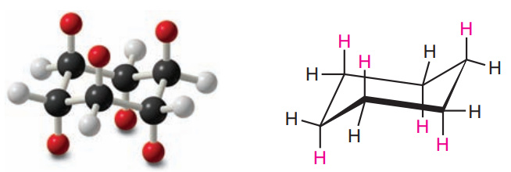

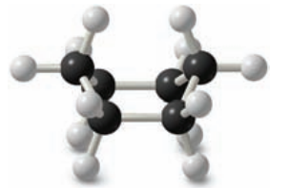
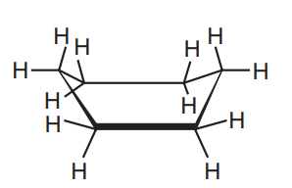
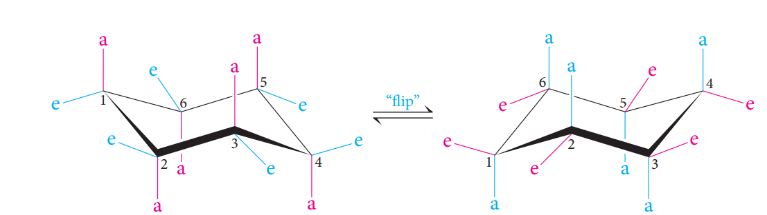
Chapter 2: Structure and Classification of Organic Compounds
2. Aliphatic Hydrocarbons
2.4. Isomerism
2.4.3. Conformational Isomerism: Conformational Analysis Cycloalkanes
Chair conformation (most stable)
Boat conformation
In the chair conformation, the hydrogens in cyclohexane fall into two sets, called axial (a) and equatorial (e).
15

Slide 17

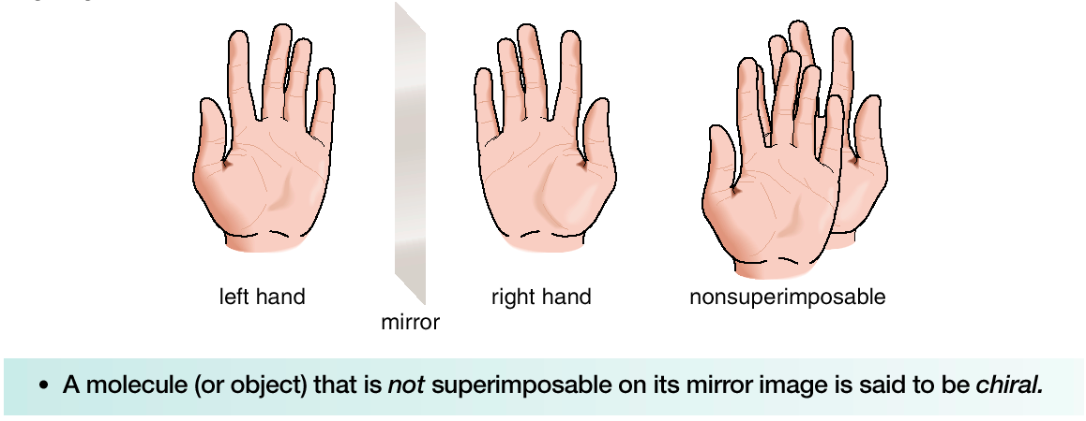
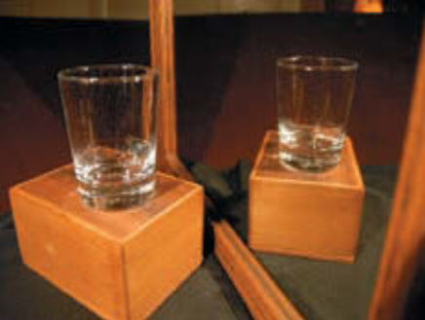
Chapter 2: Structure and Classification of Organic Compounds
2. Aliphatic Hydrocarbons
2.4. Isomerism
2.4.4. Configuration Isomers: Optical isomerism and Chirality
Chiral and Achiral Molecules
Although everything has a mirror image, mirror images may or may not be superimposable.
Some molecules are like hands. Left and right hands are mirror images, but they are not identical, or superimposable.
Other molecules are like glass. Two glasses are mirror images that are superimposable. A glass and its mirror image are identical.
A molecule or object that is superimposable on its mirror image is said to be achiral.
A molecule or object that is not superimposable on its mirror image is said to be chiral.
The glass and its mirror image are superposable.
16

Slide 18
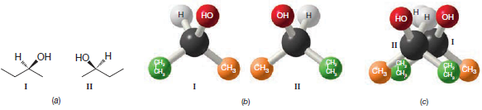
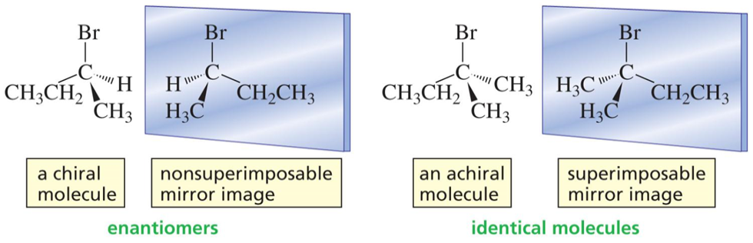
Chapter 2: Configuration Isomers: Optical isomerism and Chirality
2. Aliphatic Hydrocarbons
2.4. Isomerism
2.4.4. Configuration Isomers: Optical isomerism and Chirality
Chiral compound and its mirror image are called enantiomers.
Enantiomers: stereoisomers that are nonsuperimposible mirror images; only properties that differ are direction (+ or -) of optical rotation.
a) Three-dimensional drawings of the 2-butanol enantiomers I and II.
(b) Models of the 2-butanol enantiomers. (c) An unsuccessful attempt to superpose
models of I and II
17

Slide 19
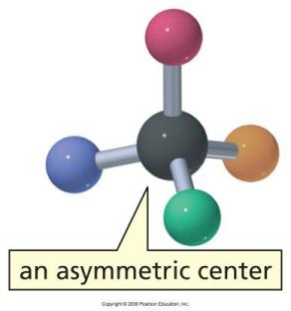
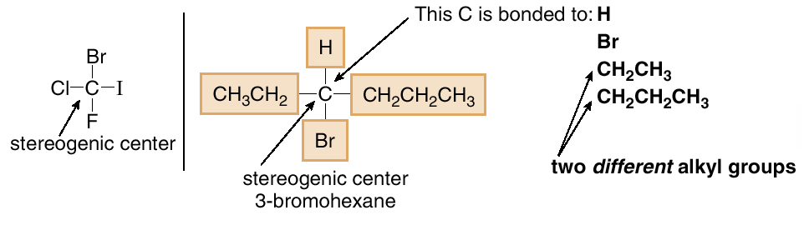
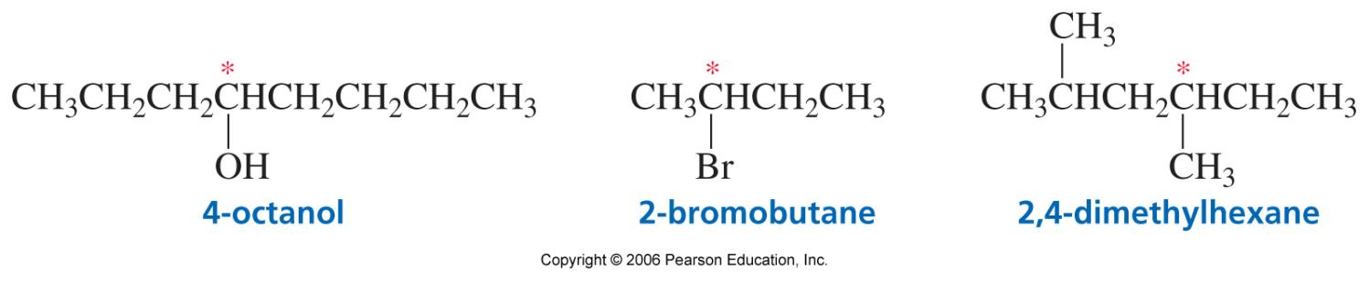
Chapter 2: Configuration Isomers: Optical isomerism and Chirality
2. Aliphatic Hydrocarbons
2.4. Isomerism
2.4.4. Configuration Isomers: Optical isomerism and Chirality
Asymmetric center (Stereogenic Centers): sp³ carbon with four different groups attached.
To locate a stereogenic center, examine each tetrahedral carbon atom in a molecule, and look at the four groups—not the four atoms bonded to it.
Always omit from consideration all C atoms that cannot be tetrahedral stereogenic centers. These include
  CH₂ and CH₃ groups
  Any sp or sp² hybridized C
18

Slide 20
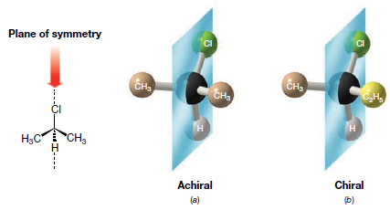
Chapter 2: Configuration Isomers: Optical isomerism and Chirality
2. Aliphatic Hydrocarbons
2.4. Isomerism
2.4.4. Configuration Isomers: Optical isomerism and Chirality
In general, a molecule with no stereogenic centers will not be chiral.
With one stereogenic center, a molecule will always be chiral.
With two or more stereogenic centers, a molecule may or may not be chiral.
Achiral molecules usually contain a plane of symmetry but chiral molecules do not.
A plane of symmetry is a mirror plane that cuts the molecule in half, so that one half of the molecule is a reflection of the other half.
a) 2-Chloropropane has a plane of symmetry and is achiral. (b) 2-Chlorobutane does not possess a plane of symmetry and is chiral.
19

Slide 21
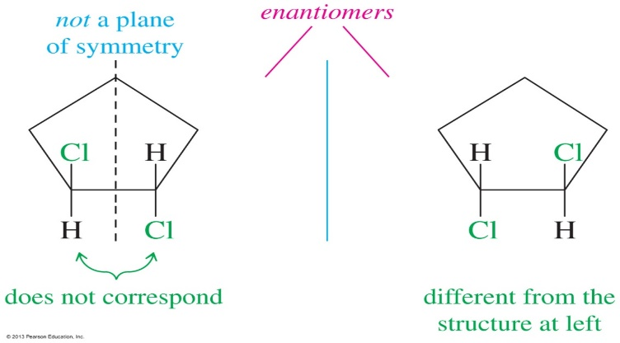
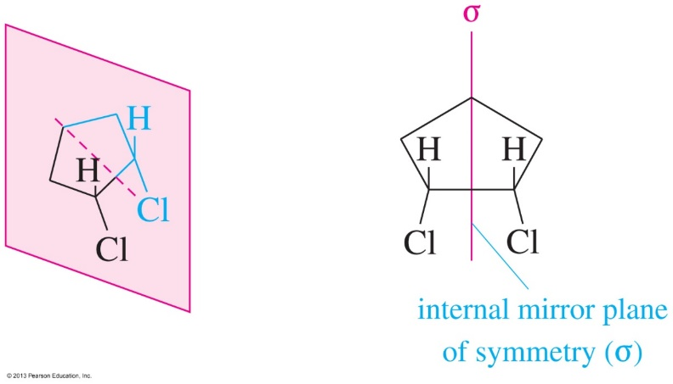
Chapter 2: Structure and Classification of Organic Compounds
2. Aliphatic Hydrocarbons
2.4. Isomerism
2.4.4. Configuration Isomers: Optical isomerism and Chirality
Internal Plane of Symmetry
Trans-1,2-dichlorocyclohexane does not have a plane of symmetry so the images are nonsuperimposable and the molecule will have two enantiomers.
  Cis-1,2-dichlorocyclohexane
  Contains an internal mirror plane of symmetry
  Both structures can be superimposed (they are identical to their mirror images).
  Any molecule that has an internal mirror plane of symmetry is achiral even if it contains asymmetric carbon atoms.
Cis-1,2-dichlorocyclopentane is a meso compound:
  - an achiral compound that contains chiral centers
  - often contains an internal mirror plane of symmetry
20

Slide 22
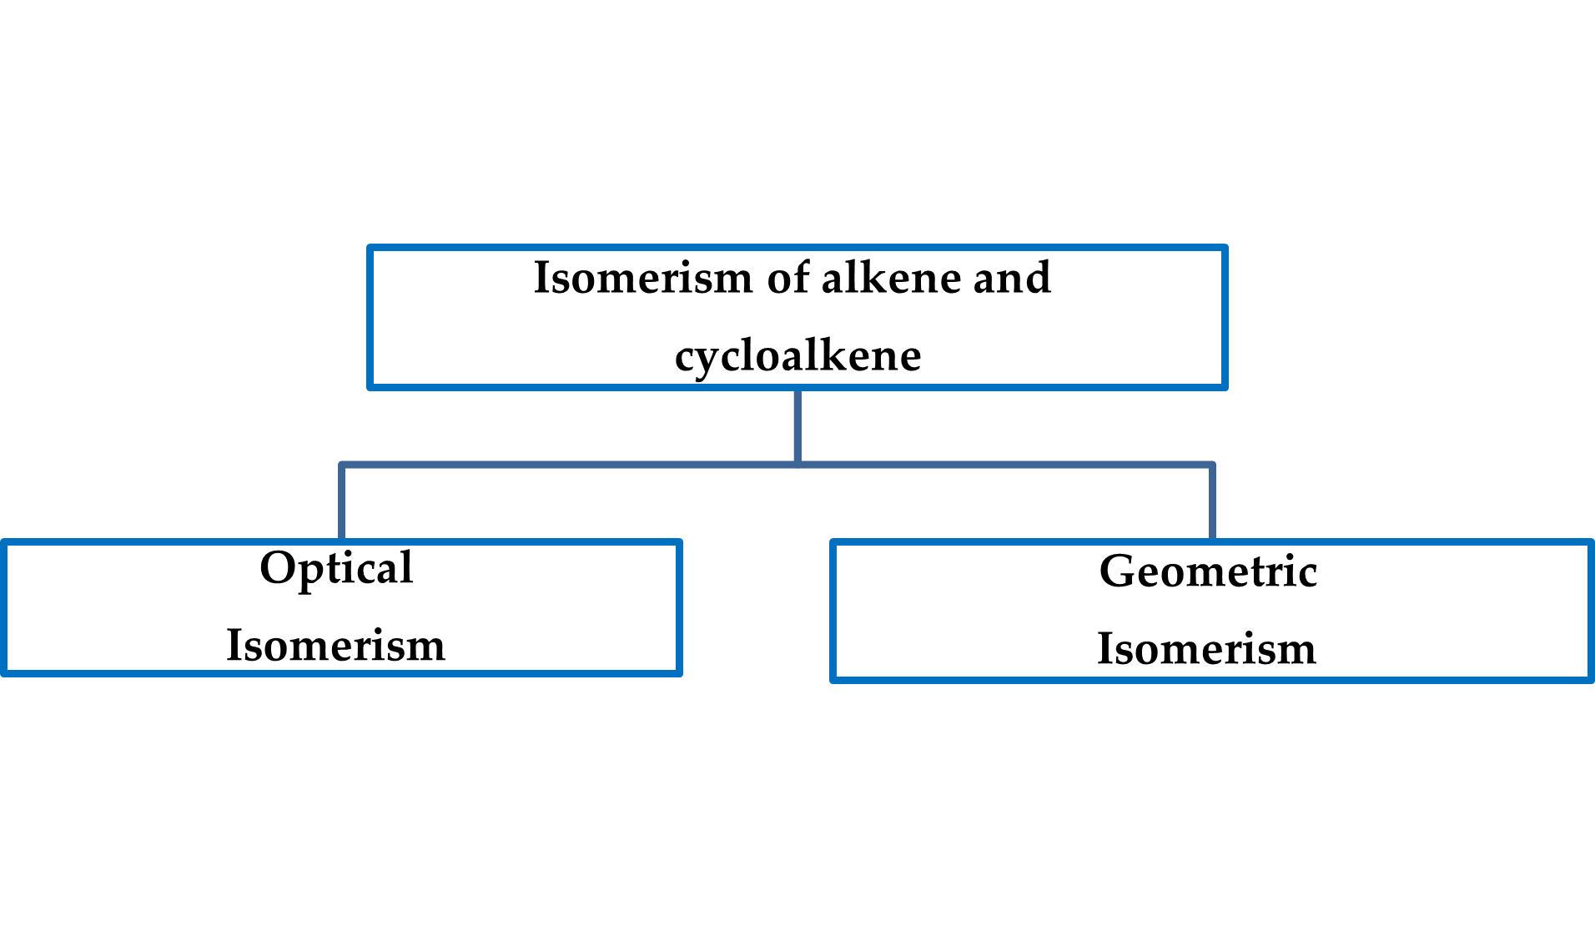

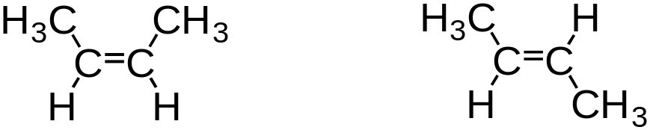

Chapter 2: Structure and Classification of Organic Compounds
2. Aliphatic Hydrocarbons
2.4. Isomerism
2.4.6. Configuration Isomers: Optical isomerism and Chirality
Diastereomers are stereoisomers that are not mirror images of each other they are stereoisomers that are not enantiomers.
Cis and trans 2-butene isomers are diastereomers
Cis and trans cycloalkane isomers are diastereomers
Chiral vs. Achiral
To determine if a compound is chiral:
  0 asymmetric carbons: Usually achiral
  1 asymmetric carbon: Always chiral
  2 asymmetric carbons: Chiral or achiral
    Does the compound have an internal plane of symmetry?
      Yes: achiral
      No:
        If mirror image is non-superimposable, then it’s chiral.
        If mirror image is superimposable, then it’s achiral.
The cis and trans isomers of 1,2-dichloroethene are both achiral because each isomer is superposable on its mirror image.
21

Slide 23
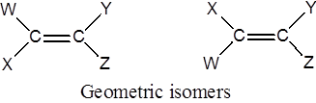
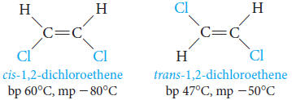
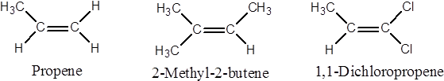
Chapter 2: Structure and Classification of Organic Compounds
2. Aliphatic Hydrocarbons
2.4. Isomerism
2.4.4. Configuration Isomers: Geometric Isomerism in Alkenes
The (cis )–(trans ) System for Alkene when W differs from X and Y from Z, Alkenes exist as geometric isomers
In alkenes, geometric isomerism is due to restricted rotation about the carbon - carbon double bond.
cis isomer; when two similar groups are on the same side or same side of the double bond.
trans isomer; when two similar groups are on the opposite direction or opposite sides of the double bond.
They have different physical properties and can be separated by fractional crystallization or distillation.
B) If (W = X or Y = Z), geometric isomerism is not possible.
22

Slide 24
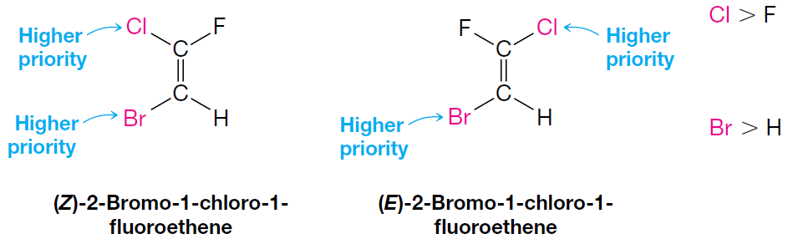
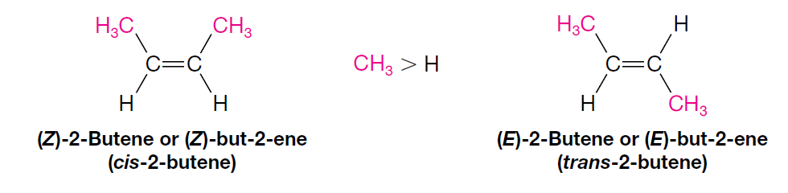
Chapter 2: Structure and Classification of Organic Compounds
2. Aliphatic Hydrocarbons
2.4. Isomerism
2.4.4. Configuration Isomers: Geometric Isomerism in Alkenes
C) The (E )–(Z ) System for Alkene
How To Use the (E )–(Z ) System
  Examine the two groups attached to one carbon atom of the double bond.
  Repeat that operation at the other carbon atom.
  Compare the group of higher priority on one carbon atom with the group of higher priority on the other carbon atom.
  (Z) from the German word zusammen, meaning together; if the two groups of higher priority are on the same side of the double bond.
  (E) from the German word entgegen, meaning opposite; If the two groups of higher priority are on opposite sides of the double bond.
23

Slide 25
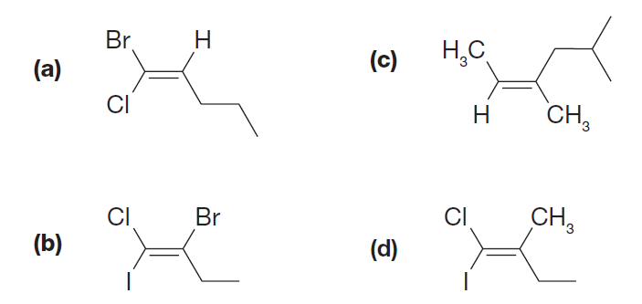
Chapter 2: Structure and Classification of Organic Compounds
2. Aliphatic Hydrocarbons
2.4. Isomerism
2.4.4. Configuration Isomers: Geometric Isomerism in Alkenes
C) The (E )–(Z ) System for Alkene
Practice Problem: Using the (E )–(Z ) designation for the following:
24

Slide 26
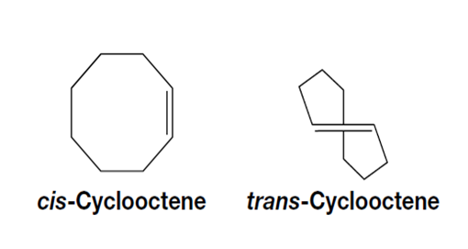


Chapter 2: Structure and Classification of Organic Compounds
2. Aliphatic Hydrocarbons
2.4. Isomerism
2.4.5. Configuration Isomers: Geometric Isomerism in Cycloalkenes
For very small rings (5 carbons or fewer), only the cis cycloalkene isomer is possible and a trans double bond cannot fit into these small rings.
While trans double bonds are too strained to exist in small cycloalkenes, they become possible in larger rings.
cis-trans Isomerism in Cycloalkanes
cis–trans isomerism (sometimes called geometric isomerism) is one kind of stereoisomerism.
25

Slide 27


Chapter 2: Structure and Classification of Organic Compounds
3. Aromatic Hydrocarbons
The term "aromatic" referred to pleasant-smelling compounds from plants, many of which contained a benzene ring.
Today, aromaticity is defined by electronic structure not odor.
Aromatic compounds, are classified based on special stability from a delocalized ring of π-electrons, even if they have no scent.
Aromatic compounds are a major class of unsaturated cyclic hydrocarbons, with benzene being the fundamental example.
3.1 Benzene: A Representative Aromatic Hydrocarbon
Its structure is a six-membered ring with delocalized electrons, often depicted by the Kekulé structure with alternating single and double bonds.
The molecule of benzene is Planar and that all of its carbon–carbon bonds are of equal length.
Each carbon is sp² hybridized and the bond angles is 120°.
The carbon–carbon bond lengths in benzene are 1.39 Å, a value in between that for a carbon–carbon single bond between sp² hybridized atoms (1.47 Å) and that for a carbon–carbon double bond (1.34 Å).
26

Slide 28


Chapter 2: Structure and Classification of Organic Compounds
3. Aromatic Hydrocarbons
3.2. Aromatic Character (Aromaticity)
To be classified as aromatic, a compound must have:
  Cyclic structure.
  Cyclic structure contains what looks like a continuous system of alternating double and single bonds.
  Aromatic compounds must be planar.
  Fulfill Huckel rule:
  The number of π electrons in the compound = (4n + 2) Where (n = 0,1, 2, 3, and so on).
4n+2= 6 6 6 6 6
n= 1 1 1 1 1
27

