Slide 1

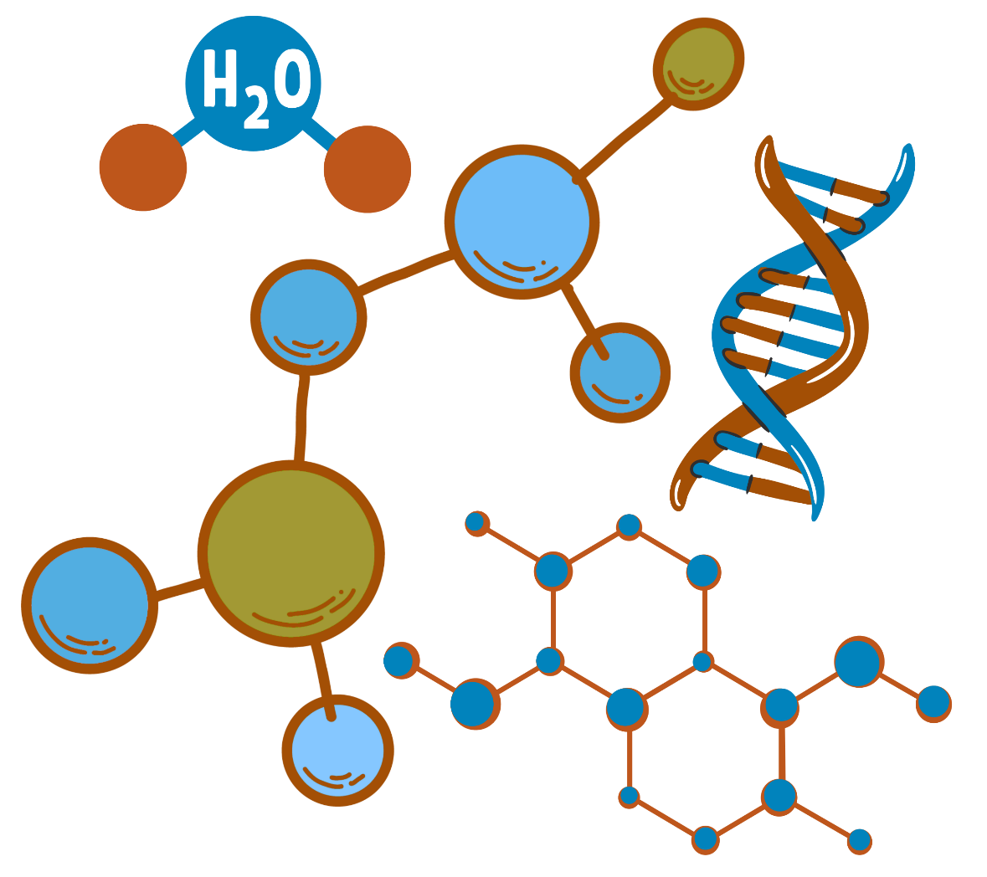
Organic Chemistry I
CHEM 240
Chapter 1: Introduction to Organic Chemistry

Slide 2

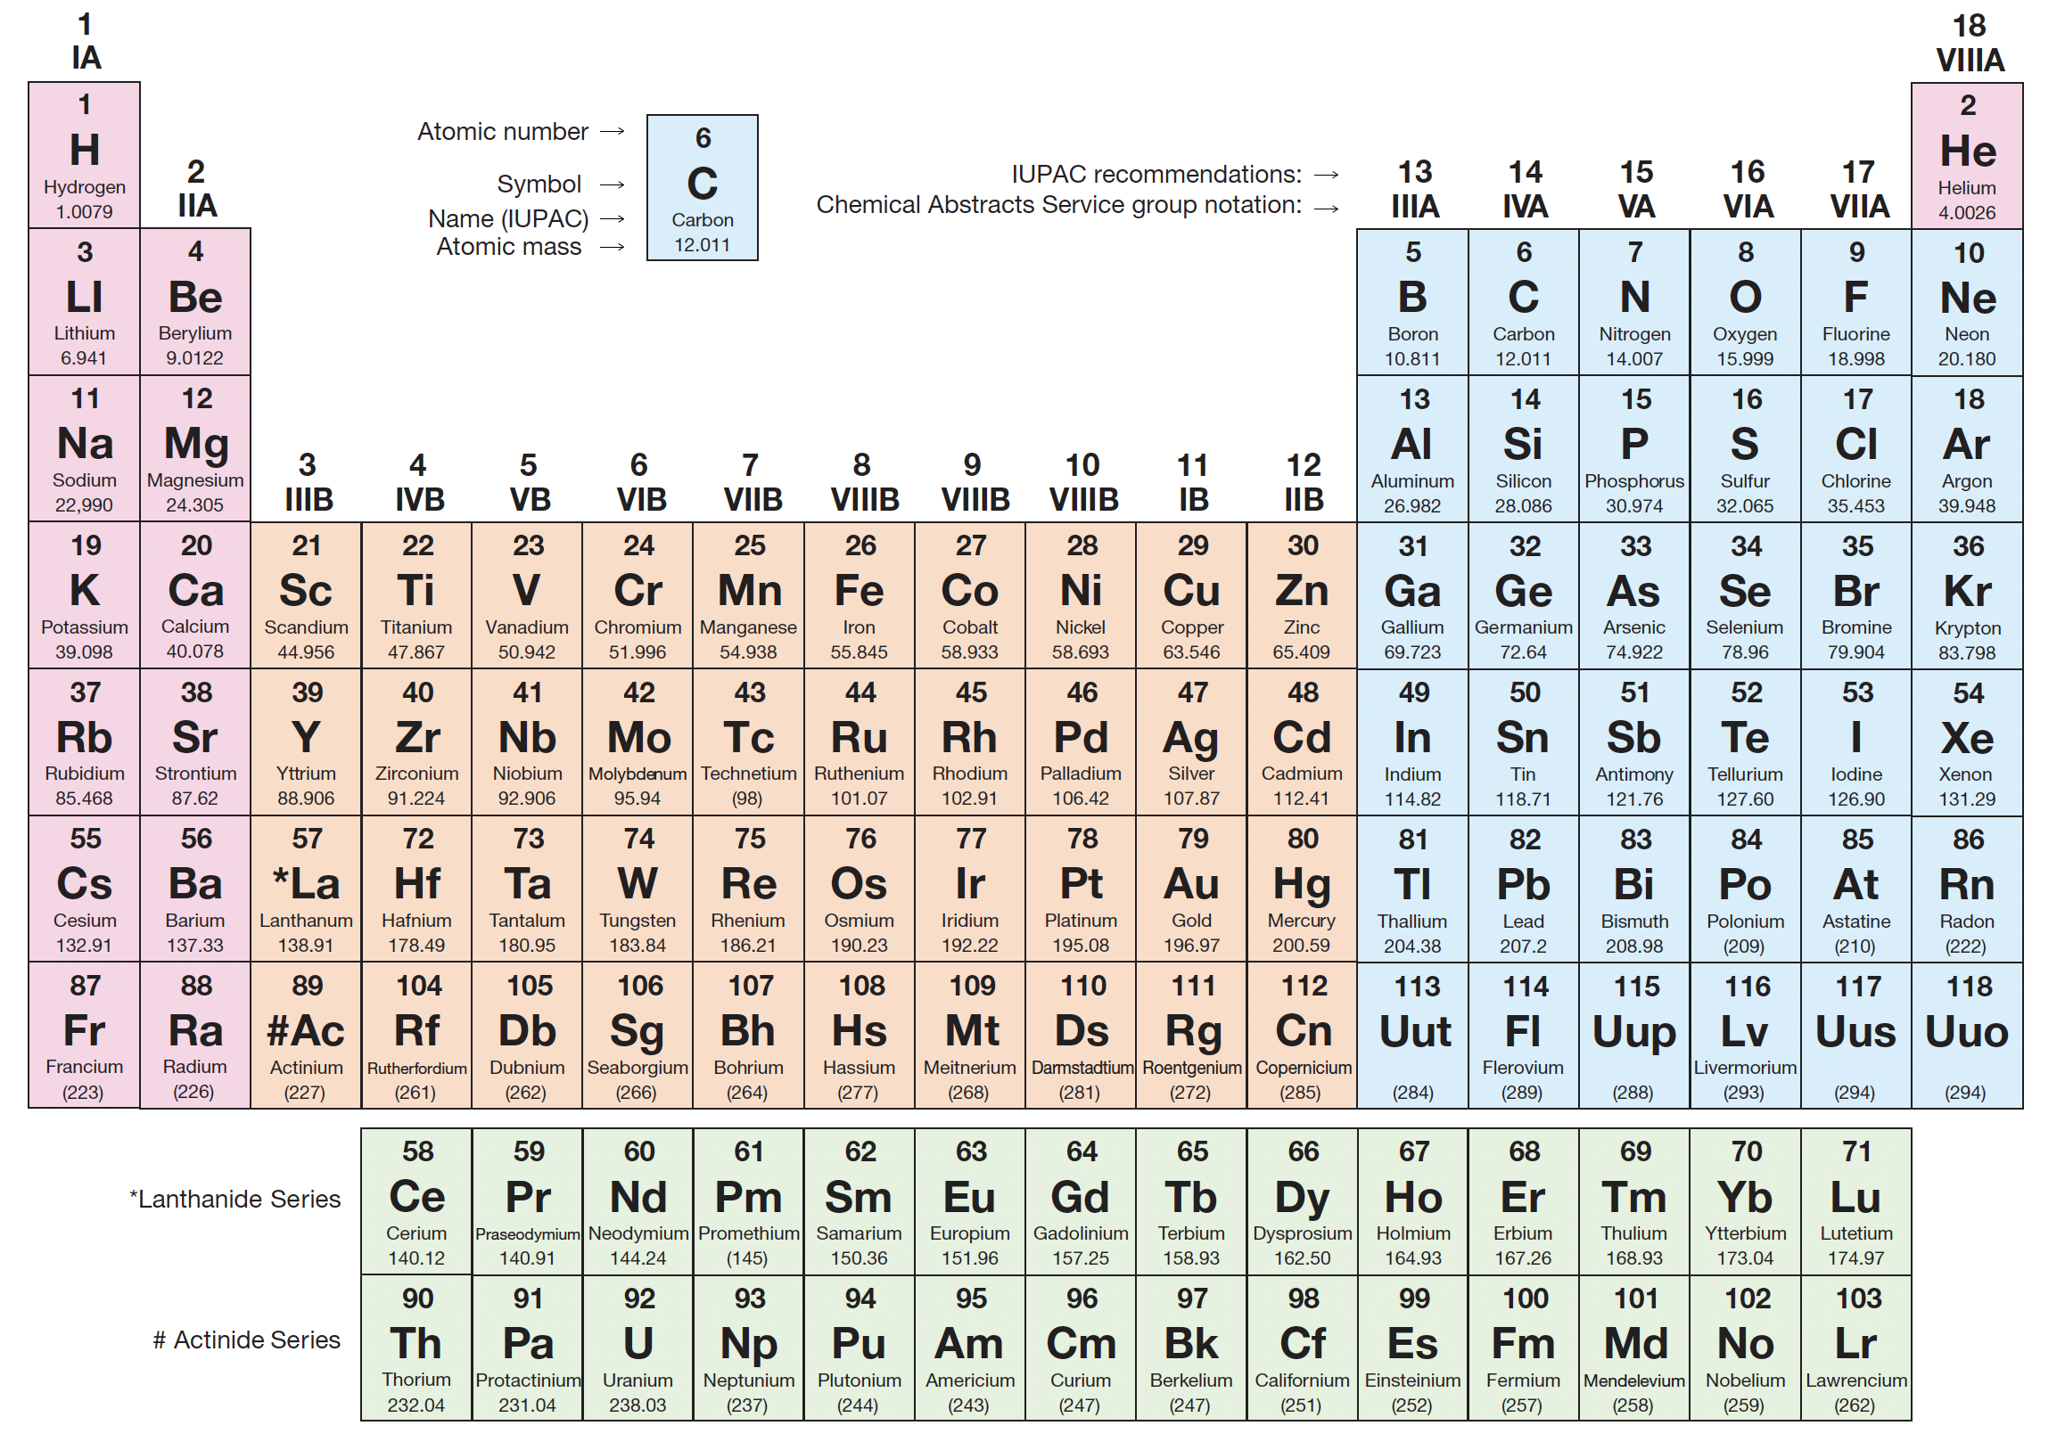
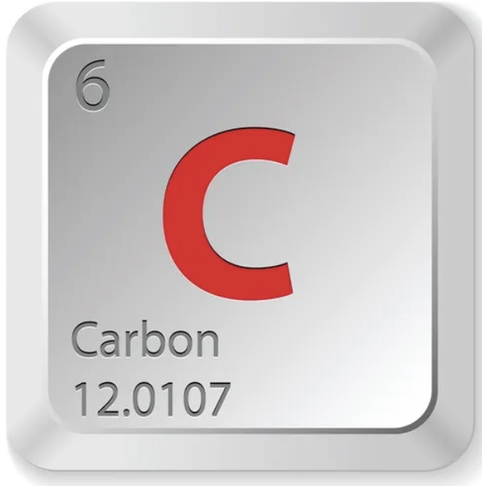
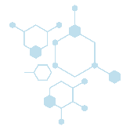
Chapter 1: Introduction to Organic Chemistry
1. Definition of Organic Chemistry
1.1. Chemistry of Carbon Compounds.
Why Carbon?
  Basis of organic chemistry (carbon compounds).
  Carbon forms strong and diverse bonds:
    With itself → form long chains and rings.
    With H, N, O, S → form wide variety of compounds.
    Central to life’s molecular structure compared with silicon-based life molecules (weaker bonds).
The modern definition of Organic Chemistry:
  It is the study of carbon/hydrogen-based compounds and their corresponding derivatives.
1

Slide 3
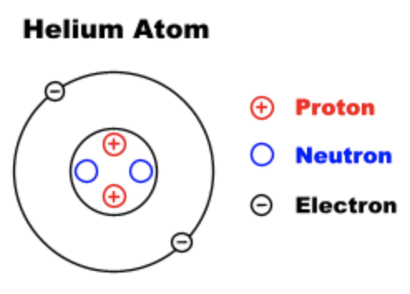
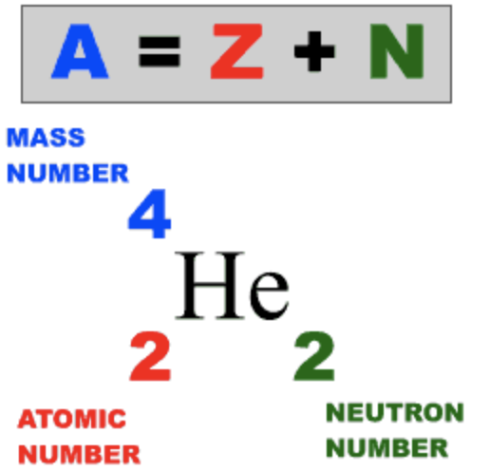
Chapter 1: Introduction to Organic Chemistry
2. Atomic structure, Electron Configuration, and Molecular Orbitals
2.1. Atomic Structure
Compounds are made of elements combined in different proportions.
An element is a pure chemical substance that cannot be broken down into simpler substances by ordinary chemical means.
Each element is made up of only one kind of atom, which is the smallest unit that retains the element’s properties.
Atoms consist of three main particles:
neutrons (neutral charge),
protons (positively charged), and
electrons (negatively charged).
  Neutrons and protons are found in the nucleus.
  Electrons are found outside the nucleus.
Atom is electrically neutral:
  Number of electrons = Number of protons
The atomic number (Z) of an element is the number of protons.
The atomic mass (A) is equal to the sum of the number of protons and the number of neutrons in the nucleus.
2

Slide 4
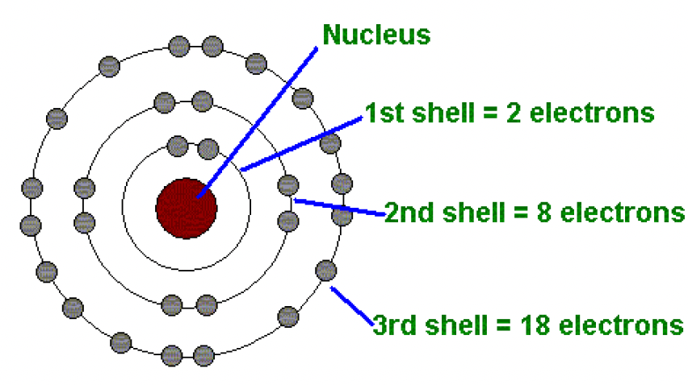
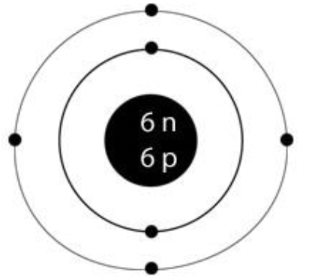
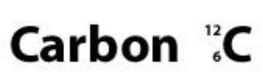
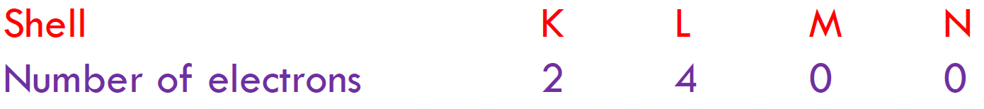
Chapter 1: Introduction to Organic Chemistry
2. Atomic structure, Electron Configuration, and Molecular Orbitals
2.1. Atomic Structure
Electrons are distributed around the nucleus in successive shells (energy levels) that are designated by capital letters (K, L, M, N, ..) or whole numbers (n).
  The maximum capacity of electrons in a shell= 2n² electrons.
Example:
  Carbon atom has an atomic number = 6 which means it has 6 electrons are distributed around its nucleus.
3

Slide 5
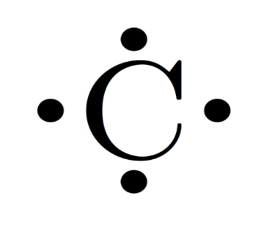
Chapter 1: Introduction to Organic Chemistry
2. Atomic structure, Electron Configuration, and Molecular Orbitals
2.1. Atomic Structure
Valence Electrons
  Valence electrons are involved in chemical bonding.
  The number of valence electrons can be determined by the main group number of the element in the periodic table.
  Examples:
    Carbon (₆C) – group #4 = 4 valence electrons
    Oxygen (₈O) – group #6 = 6 valence electrons
    Halogens (X) – group #7 = 7 valence electrons
Valences of Common Elements
 |  |  |  |  |  | Element
1 | 1 | 2 | 3 | 4 | 1 | Valence
4

Slide 6
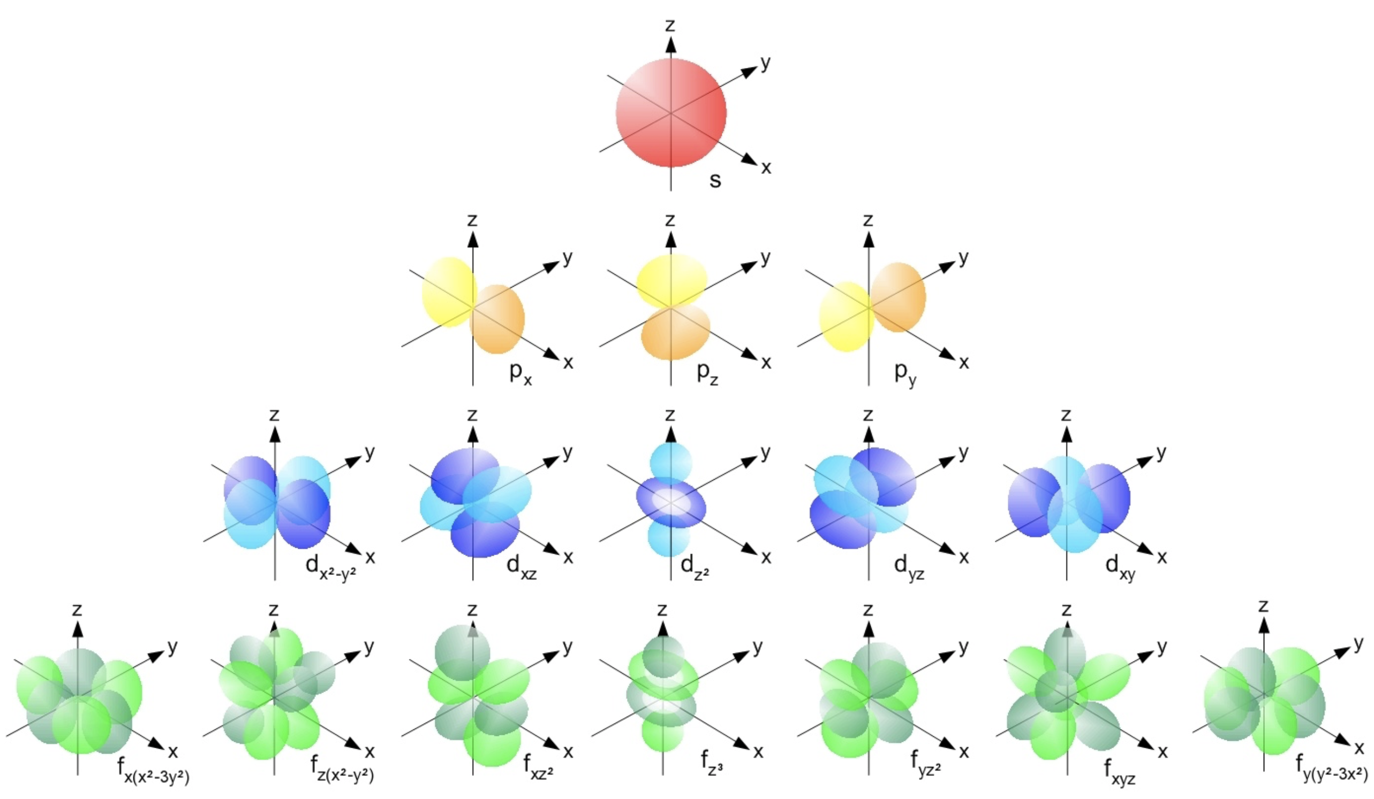
Chapter 1: Introduction to Organic Chemistry
2. Atomic structure, Electron Configuration, and Molecular Orbitals
2.2. Atomic orbitals and electron configuration
Atomic Orbitals
  Orbitals that represent a specific region in space of an atom in which an electron is mostly found.
  These orbitals are arranged in the order to be filled and increasing their energy.
  They are designated with letters (s, p, d, and f ), and they have different shapes and orientations in space.
    s-orbital: spherical shape.
    p-orbital: dumbbell-shaped in three orientations.
s-orbital
p-orbitals
5

Slide 7
Chapter 1: Introduction to Organic Chemistry
2. Atomic structure, Electron Configuration, and Molecular Orbitals
2.2. Atomic orbitals and electron configuration
Atomic Orbitals
  Each energy shell has specific numbers and types of the atomic orbitals.
  For example:
    K shell has only one (1s) orbital.
    L shell has one (2s) and three (2p) as (2p_{x}, 2p_{y}, and 2p_{z}).
Example;
Filling atomic orbitals of carbon atom (₆C ):
1s²2s²2p_{x}¹2p_{y}¹ or 1s²2s²2p²
6

Slide 8
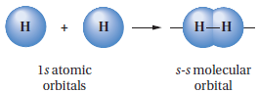


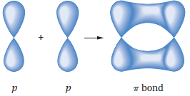
Chapter 1: Introduction to Organic Chemistry
2. Atomic structure, Electron Configuration, and Molecular Orbitals
2.3. Molecular Orbitals (MOs)
Molecular orbitals are formed as a result of overlapping two atomic orbitals, which gives a bonding system called ”covalent bond”.
There are two different covalent bonds based on the type of molecular atoms that are involved in the bond formation:
  Sigma bonds (𝞼 bonds) that can be formed via:
    The overlap of two (s) atomic orbitals.
    The end-on overlap of two (p) atomic orbitals.
    The overlap of (s) atomic orbital with (p) orbital.
  Pi bonds (𝜋 bonds) which can be formed from the side-side overlap between two (p) atomic orbitals.
8

Slide 9
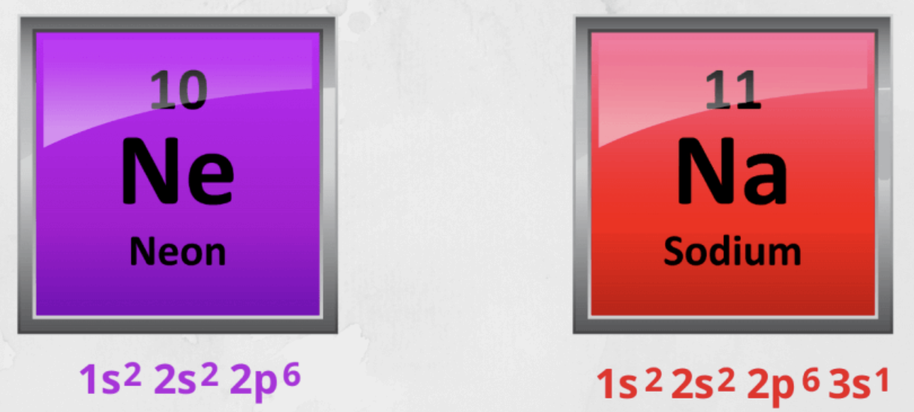
Chapter 1: Introduction to Organic Chemistry
3. Chemical Bonding
3.1. Chemical Bonds: The Octet Rule
G. N. Lewis and W. Kossel introduced the first explanation for the nature of chemical bonds in 1916.
They proposed that Nobel gases are stable elements and lack common chemical reactivity due to having their valence shells filled with electrons.
  2 electrons in case of helium (exception).
  8 electrons for the other gases.
The Octet Rule can be defined as the trendy for an atom to achieve a configuration, which its valence shell contains eight electrons alike to a Noble gas’s configuration.
8-electrons
8-electrons
9

Slide 10
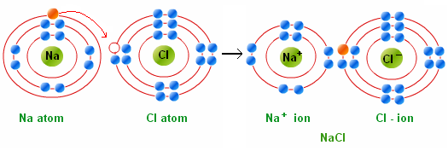

Chapter 1: Introduction to Organic Chemistry
3. Chemical Bonding
3.2. Ionic Bonds
Ionic Bonds (electrovalent bonds) are formed by transfer one or more electrons from one atom to another in order to create ions.
Elements in the left side of the periodic table tend to donate their valance electrons and become positively charged ions +ve called (cations).
Elements in the right side of the periodic table tend to gain the electrons and become negatively charged ions -ve called (anions).
Ionic Bond is the electrostatic force of attraction between oppositely charged ions.
The majority of ionic compounds are inorganic substances.
Example; NaCl
10

Slide 11


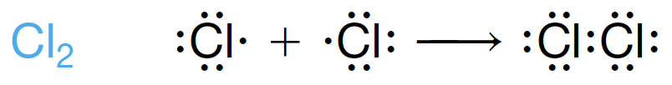

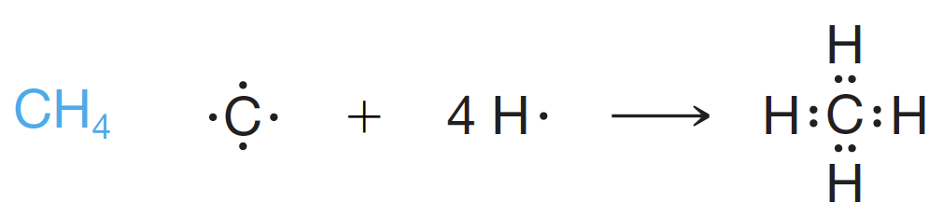
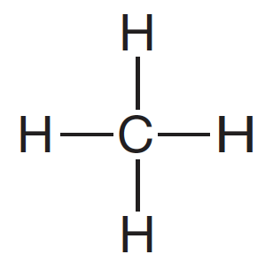
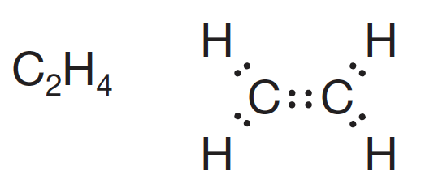
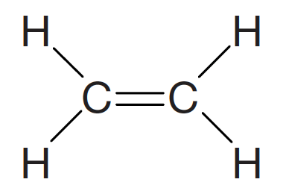


Chapter 1: Introduction to Organic Chemistry
3. Chemical Bonding
3.3. Covalent Bonds
Covalent Bonds are formed by sharing electrons between atoms that are similar or close in their electronegativities in order to achieve Nobel gases configurations.
A shared electron pair between two atoms can be represented by a dash (−).
When the atoms are identical or have equal electronegativities, the electron pairs are shared equally.
Drawn as
Drawn as
Drawn as
Drawn as
Drawn as
11

Slide 12
Chapter 1: Introduction to Organic Chemistry
3. Chemical Bonding
3.3. Covalent Bonds
Polar Covalent Bonds
  A type of covalent bonds in which the electron pair between two atoms is shared unequally due to the difference in their electronegativities.
  The more electronegative atom assumes a partial negative charge (δ-), and the less electronegative atom assumes a partial positive charge (δ+).
  Polar covalent bonds influence both physical properties and reactivity of molecules.
12

Slide 13
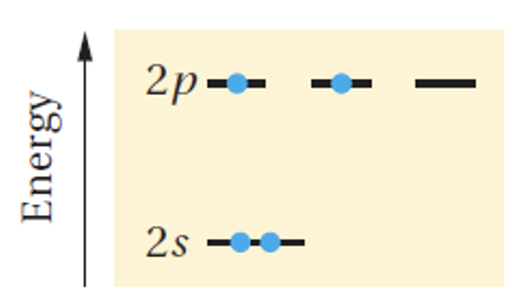
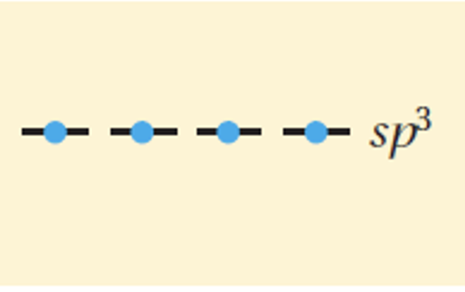
Chapter 1: Introduction to Organic Chemistry
4. Hybridization and Molecular Geometry
4.1. Orbitals Hybridization
Orbital hybridization describes how atomic orbitals mix to form new hybrid orbitals that are better suited for bonding in molecules having the same level of energy.
It helps to explain shapes of molecules and their bond angles.
In hydrocarbon organic molecules, there are three common types of hybridizations (sp³, sp², and sp).
1) sp³- Hybridization (in alkanes):
  The four atomic orbitals of the valence shell in the carbon atom are combined to form four identical hybrid orbitals, each has one valence electron having the same energy greater than the 2s orbital, but lower than the 2p orbitals.
  The four resulted hybrid orbitals are labeled (sp³) because each one has on part of s-character and three parts of p-character.
sp³- hybridization
Ground state of carbon
atom’s atomic orbitals
Four equivalent sp³
Hybrid orbitals
13

Slide 14
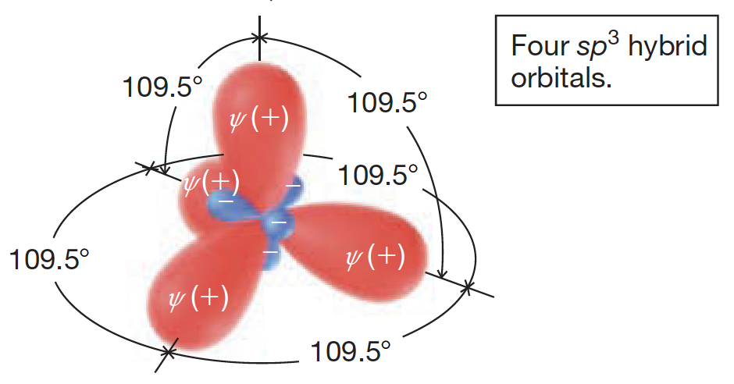
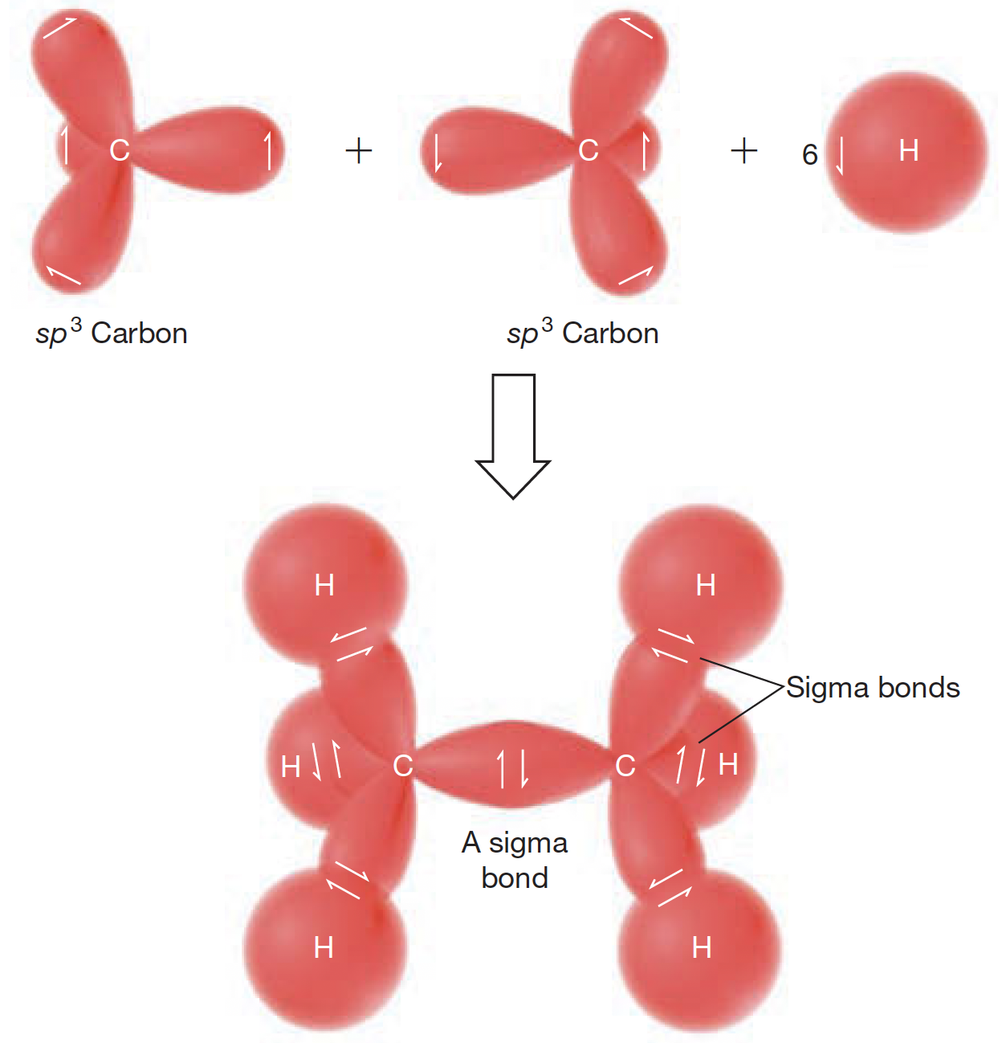
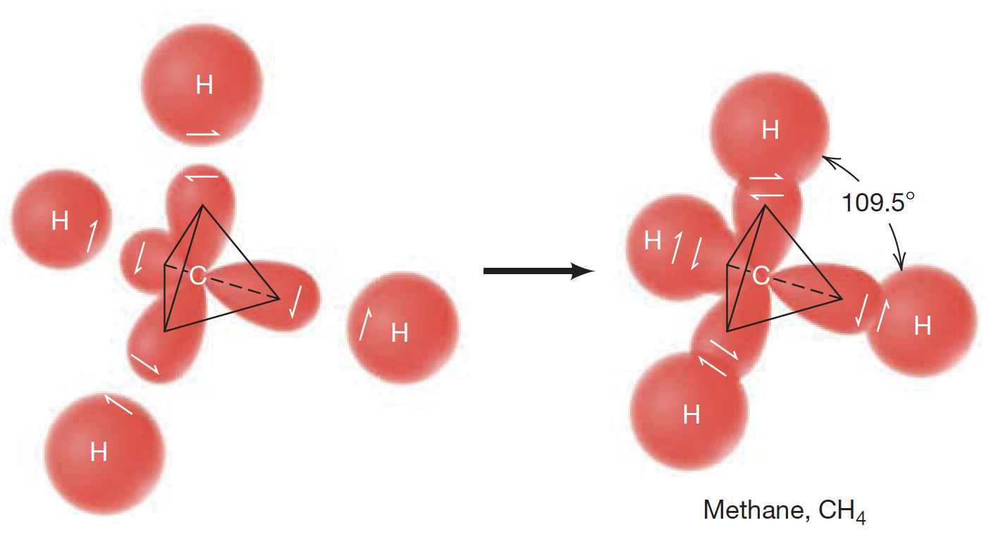
Chapter 1: Introduction to Organic Chemistry
4. Hybridization and Molecular Geometry
4.1. Orbitals Hybridization
1) sp³- Hybridization (in alkanes):
Molecular Geometry of Methane (CH₄): Tetrahedral
Forming single sigma (𝜎) bond in Ethane (C₂H₆)
14

Slide 15
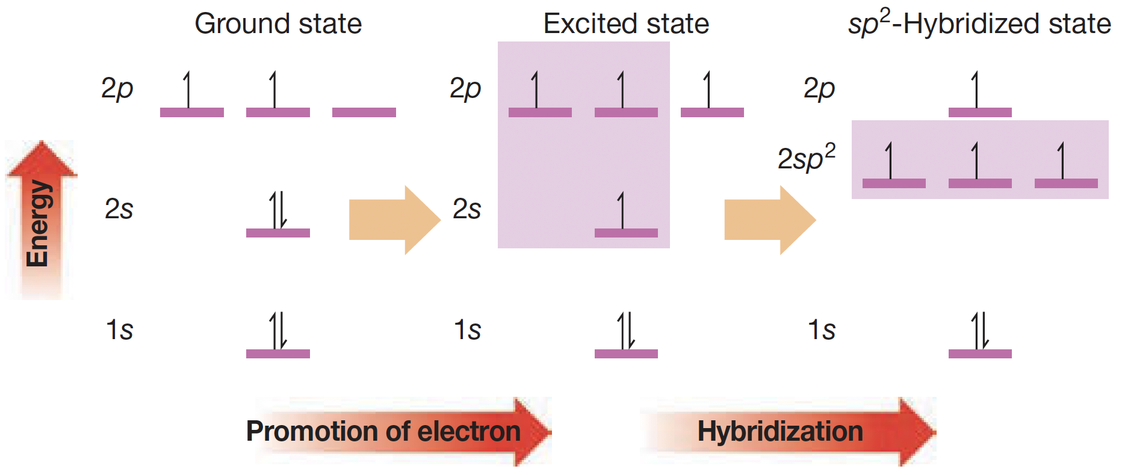
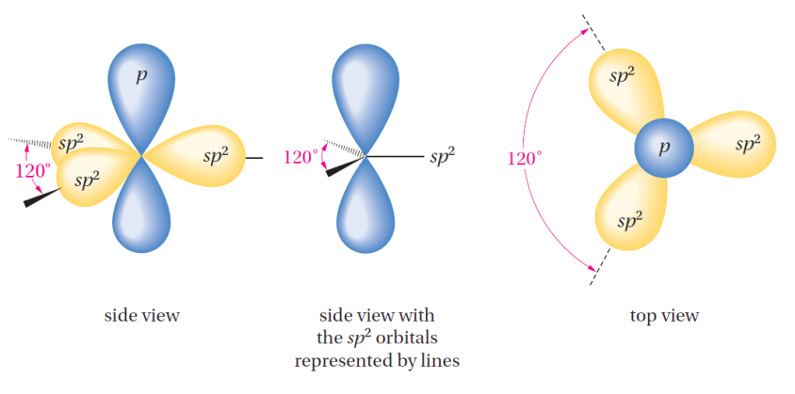
Chapter 1: Introduction to Organic Chemistry
4. Hybridization and Molecular Geometry
4.1. Orbitals Hybridization
2) sp²- Hybridization (in alkenes):
Three of the atomic orbitals are mixed to produce three equivalent sp²- hybridized orbitals.
Each sp² hybridized orbital possesses one part of s-character and two parts of p-character.
There are three valence electrons places in the three sp² hybridized orbitals.
The fourth valence electron is placed in the remaining 2p orbital, whose axis is perpendicular to the plane formed by the three sp² hybridized orbitals.
The molecular geometry resulted from sp²- hybridization in alkenes is trigonal planar with bond angles of 120°.
15

Slide 16
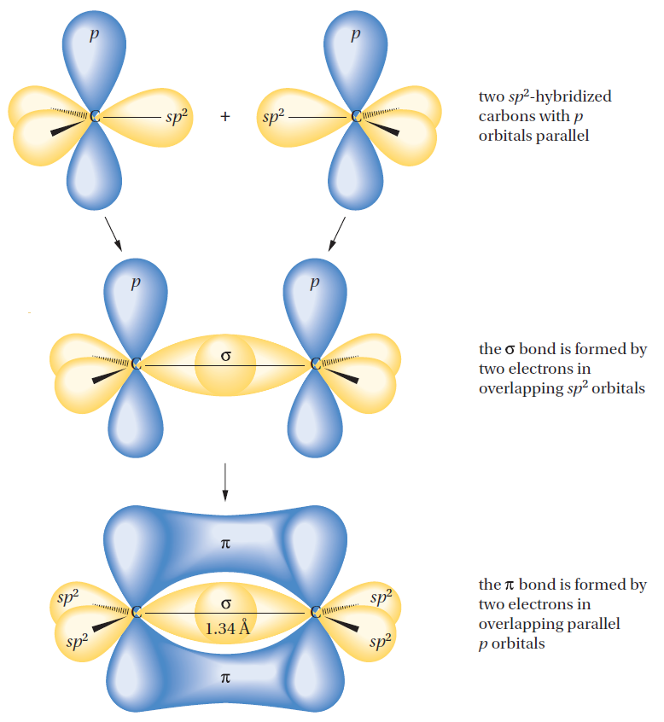
Chapter 1: Introduction to Organic Chemistry
4. Hybridization and Molecular Geometry
4.1. Orbitals Hybridization
2) sp²- Hybridization (in alkenes):
Two sp² carbons form a sigma (s) bond (end-on overlap of two sp² orbitals) and a pi (p) bond (lateral overlap of two properly aligned p orbitals).
The (π) bond’s length in unsaturated hydrocarbons (alkenes) is approximately equal to (1.34 °A).
15

Slide 17
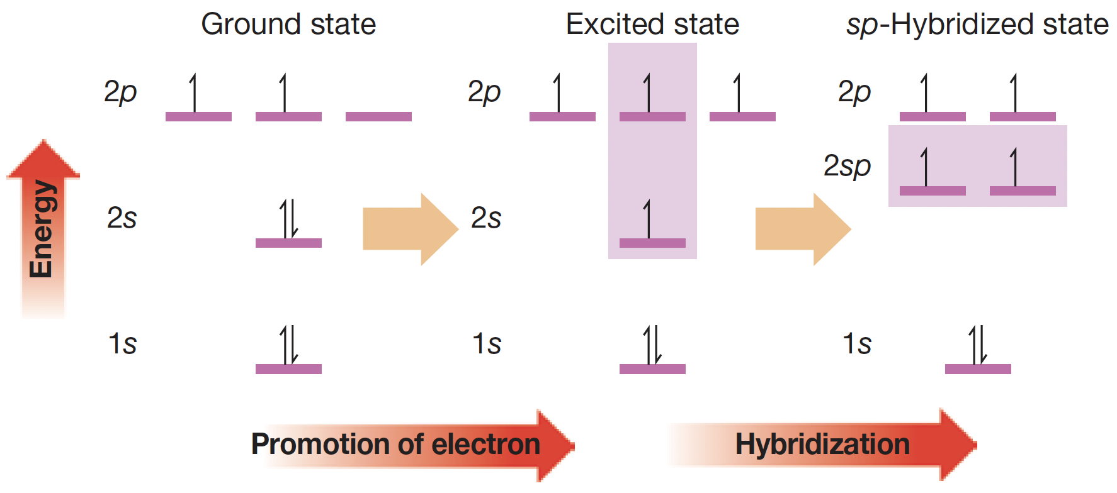
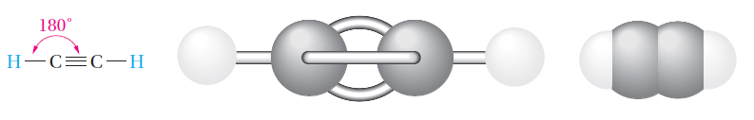
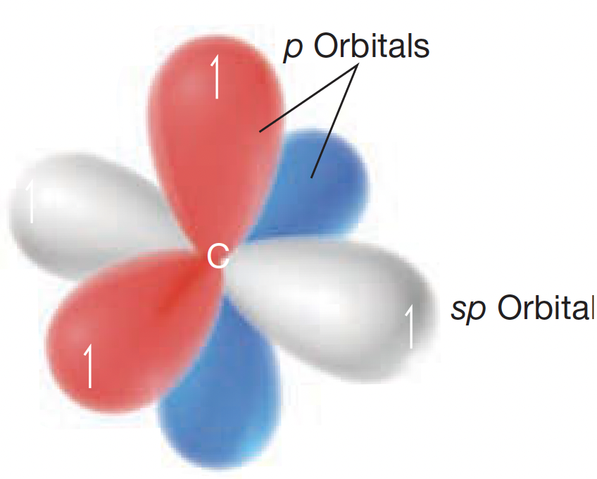
Chapter 1: Introduction to Organic Chemistry
4. Hybridization and Molecular Geometry
4.1. Orbitals Hybridization
3) sp- Hybridization (in alkynes):
In this process, only two of the atomic orbitals are mixed to produce two equivalent sp-hybridized orbitals.
Each sp hybridized orbital possesses one part of s-character and on part of p-character.
There are two valence electrons places in the two sp hybridized orbitals, and the other two valence electrons are placed in the two remaining 2p orbitals.
The molecular geometry resulted from sp- hybridization in alkynes is Linear with bond angles of 180°.
15

Slide 18
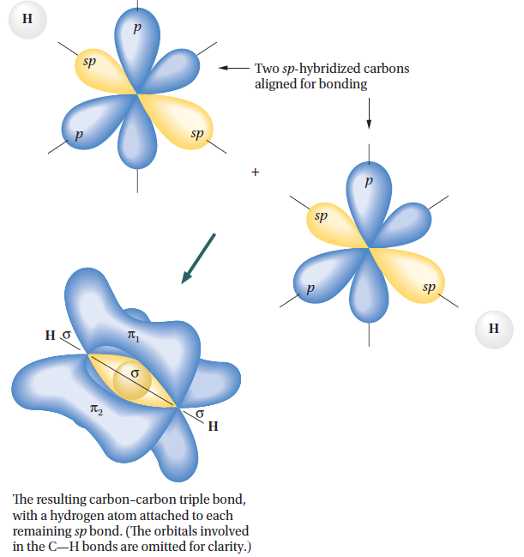
Chapter 1: Introduction to Organic Chemistry
4. Hybridization and Molecular Geometry
4.1. Orbitals Hybridization
3) sp- Hybridization (in alkynes):
A triple bond consists of the end-on overlap of two sp-hybrid orbitals to form a sigma (σ) bond and the lateral overlap of two sets of parallel-oriented p orbitals to form two mutually perpendicular (π) bonds.
The (π) bond’s length in unsaturated hydrocarbons (alkynes) is approximately equal to (1.20 °A).
15

Slide 19
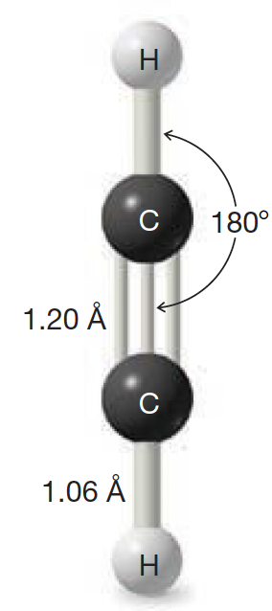
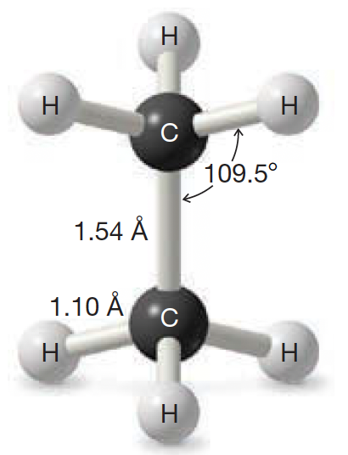
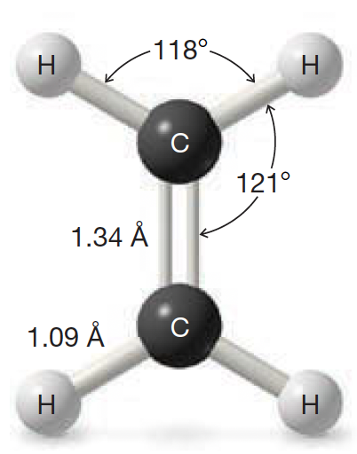
Chapter 1: Introduction to Organic Chemistry
4. Hybridization and Molecular Geometry
4.2. Summary Slide
Molecule name: Ethane (Alkane)
Molecular formula: C₂H₆
Hybridization type: sp³
Bond type: single sigma (𝜎) bond
Molecular geometry: Tetrahedral
Bond Angle: 109.5°
Bond Length: 1.54°A
Molecule name: Ethene (Alkene)
Molecular formula: C₂H₄
Hybridization type: sp²
Bond type: single sigma (𝜎) bond and one (𝜋) bond
Molecular geometry: trigonal planar Bond Angle: 120°
Bond Length: 1.34°A
Molecule name: Ethyne (Alkyne)
Molecular formula: C₂H₂
Hybridization type: sp
Bond type: single sigma (𝜎) bond and two (𝜋) bonds
Molecular geometry: Linear
Bond Angle: 180°
Bond Length: 1.20°A
19

