Slide 1
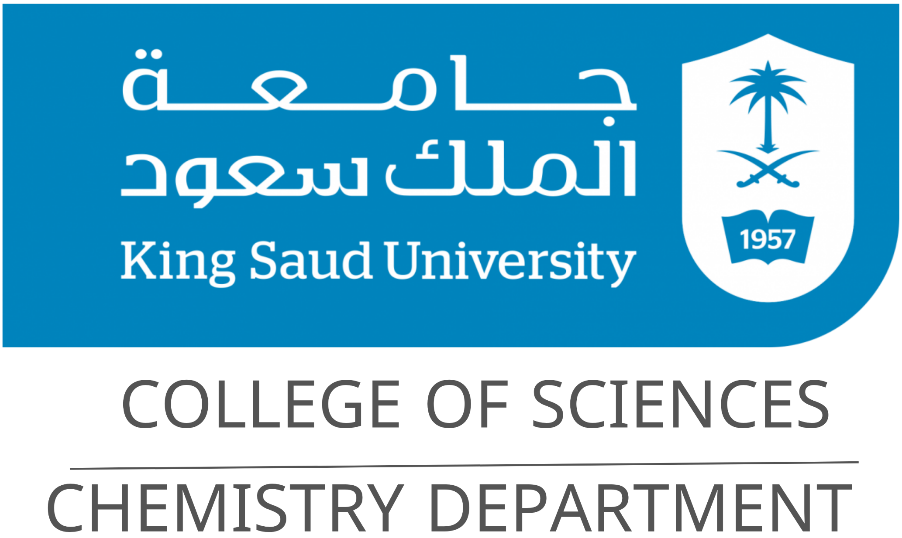
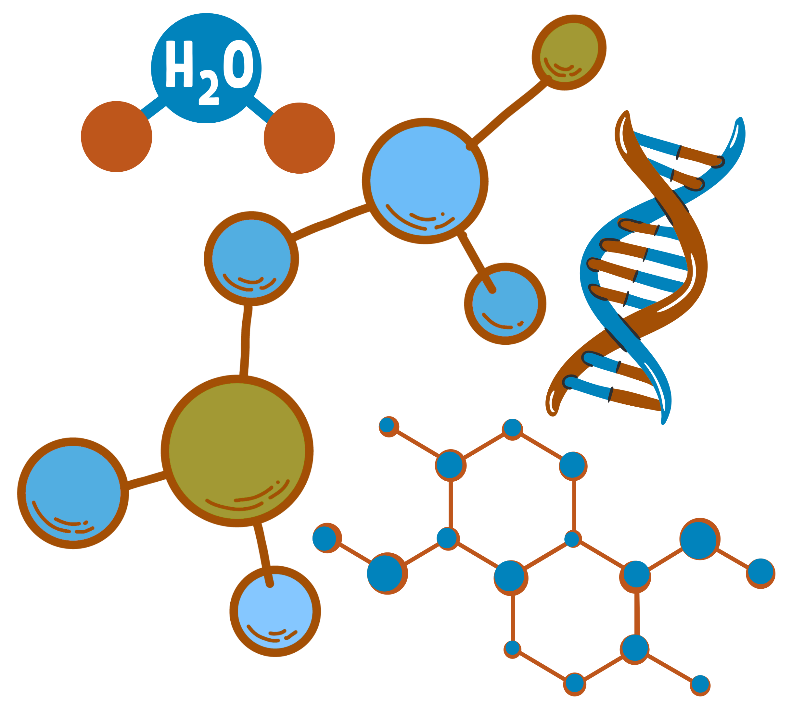
Organic Chemistry I
CHEM 240
Chapter 0:
Syllabus

Slide 2


Chapter 0: Syllabus
Course Title and General Information
Course Code | Course Title | Program
CHEM 240 | Organic Chemistry I | Chemistry – College of Sciences
Credit Hours | Department | College
2 (2 Lectures + 0 Practical) | Chemistry Department | Science
1

Slide 3
Chapter 0: Syllabus
Course Content Overview and Reference
Chapter 1 | Introduction to Organic Chemistry
Carbon compounds and their chemical bonds (ionic and covalent), atomic and molecular orbitals, and hybridization.
Chapter 2 | Structure and Classification of Organic Compounds
Structure and classification of hydrocarbons, including alkanes, cycloalkanes, alkenes, alkynes, conjugated dienes, and aromatic compounds. Alkyl groups, configuration and conformational analysis of cyclohexanes, resonance and stability of conjugated systems, allylic species, aromaticity and Hückel’s rule, polynuclear aromatic compounds, stereochemistry, and optical isomerism.
Chapter 3 | Nomenclature of Organic Compounds
IUPAC nomenclature of alkyl groups, alkanes, cycloalkanes, alkenes, alkynes, aromatic compounds, and stereocompounds.
2

Slide 4
Chapter 0: Syllabus
Course Content Overview and Reference
Chapter 4 | Properties and Intermolecular Forces
Physical properties of organic compounds and intermolecular forces, including van der Waals forces, London dispersion forces, dipole–dipole interactions, and hydrogen bonding. Physical properties of hydrocarbons, including boiling points and solubility. Resonance and stability of conjugated dienes and benzene. Polarity and inductive effect. Physical properties of enantiomers.
Chapter 5 | Organic Reactions
Elimination Reactions: Preparation of alkenes and alkynes by elimination reactions. E1 and E2 mechanisms. Electrophilic Addition Reactions: Addition reactions of alkenes and alkynes. Electrophilic addition to conjugated dienes, including 1,2- and 1,4-addition. Cycloaddition reactions of conjugated dienes. Free Radical Reactions: Free radical halogenation of alkanes and cycloalkanes. Allylic halogenation and related radical reactions. Electrophilic Aromatic Substitution Reactions: Electrophilic substitution reactions of aromatic compounds, including halogenation, nitration, sulphonation, alkylation, and acylation. Reactivity and orientation in substituted benzenes. Nucleophilic Reactions: Nucleophilic substitution reactions of alkyl halides, including SN1 and SN2 mechanisms. Preparation of alkyl halides through nucleophilic substitution reactions. Oxidation and Reduction Reactions: Combustion and oxidation reactions of hydrocarbons. Oxidation of alkenes, alkynes. Oxidation of alkylbenzene side chains and related oxidation and reduction reactions.
3

Slide 5
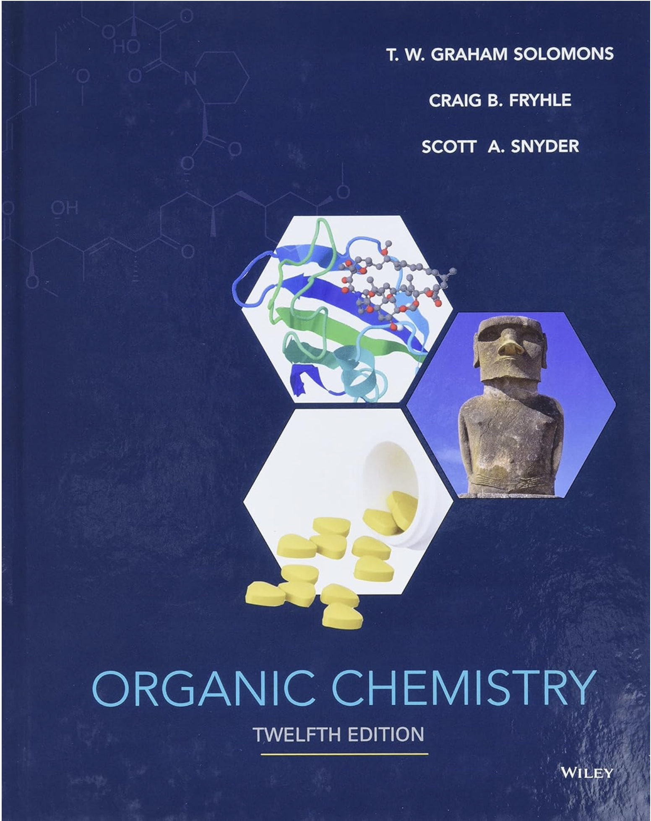
Chapter 0: Syllabus
Reference
Reference
Solomons, T. W. Graham, Fryhle, Craig B., & Snyder, Scott A. (2016). Organic Chemistry (12th ed.). Hoboken, NJ: John Wiley & Sons, Inc. ISBN 978-1-118-87576-6.
4

Slide 6
Chapter 0: Syllabus
Course Objectives
Explain fundamental concepts of organic chemistry, including carbon compounds, chemical bonding, atomic and molecular orbitals, and hybridization. | Identify and classify major organic compounds based on their structures, including alkanes, cycloalkanes, alkenes, alkynes, conjugated dienes, aromatic hydrocarbons, and stereocompounds, and describe their natural sources. | Apply IUPAC nomenclature rules systematically to name major classes of hydrocarbons.
5

Slide 7
Chapter 0: Syllabus
Course Objectives
Explain physical properties of organic compounds with intermolecular forces, resonance, polarity, and inductive effects, and apply. | Explain and predict fundamental organic reactions and their mechanisms, including elimination, electrophilic addition, free-radical reactions, electrophilic aromatic substitution, nucleophilic substitution, and oxidation–reduction reactions.
5

Slide 8
Chapter 0: Syllabus
Course Learning Outcomes
Knowledge | Skills | Values
To recognize the basic knowledge of IUPAC nomenclature, isomerism, physical properties and chemical reactions of organic compounds. To define and reproduce scientific information about organic compounds (aliphatic and aromatic). | To integrate and evaluate chemical information and data in order to gain a coherent understanding of organic chemistry. To analyze and interpret chemical data by applying chemical and physical concepts. | To apply team-working skills to address chemistry problems and coordinate effectively whether in a leadership role or as a member of group.
6

Slide 9
Chapter 0: Syllabus
Assessment Methods and Weighting
No. | Assessment Task | Points
1 | 1st Midterm Exam | 20
2 | 2st Midterm Exam | 20
3 | 5 Quizzes | 10
4 | Report and Presentation | 10
5 | Final Exam | 40
Total |  | 100
7

Slide 10
Chapter 0: Syllabus
Instructions for Computer-Based Exams (QQ)
1 | Only one device is allowed (using only smartphone or tablet) with the QQ application installed. Using any additional device or a different application is forbidden per the regulations and policies governing the computerized examinations.
2 | The device battery level must be above 50%, and power-saving mode must be disabled.
3 | Ensure a stable internet connection before starting the exam.
4 | Prior to entering the examination, students must verify their ability to access the application. In case of any technical issues prior to the exam, a support request must be submitted via: https://its.ksu.edu.sa
5 | The exam access code will be provided only once and will not be repeated again.
6 | After starting the exam, closing the screen or using the device for any other purpose is prohibited.
7 | Bring a pen; a paper draft sheet will be provided and must be turned in after exam completion and prior to leaving the exam’s room.
8 | Any technical issues/malfunctions during the exam must be reported immediately to the invigilator.
9 | Students are not permitted to leave before half of the allotted time has elapsed.
10 | Important Note: All exams of this course (Quizzes, midterms and final) are conducted exclusively via the QQ application. NO paper-based exam will be administered under any circumstances.
8

Slide 11
Chapter 0: Syllabus
Regulations for Attendance, Absence, and Alternative Examinations
Item | Limit/Rule
Semester Length | 14 weeks (28 lectures)
Allowed Absence | 25% = max 7 lectures
Lecture Duration | 1 lecture × 50 min per day (1 academic hour)
Max Absence in Hours | 7 academic hours (4 days)
Absence Excuses | Submit via e-mail to course instructor
Alternative Examination Regulations | Student must not have taken the Primary Examination. Student must not be denied in the course. Request must be submitted to course instructor within one week of the Primary Examination date. Excuse must be official and government-approved. No alternative for an alternative examination.
9

Slide 12
Chapter 0: Syllabus
Good
Luck

