Slide 1

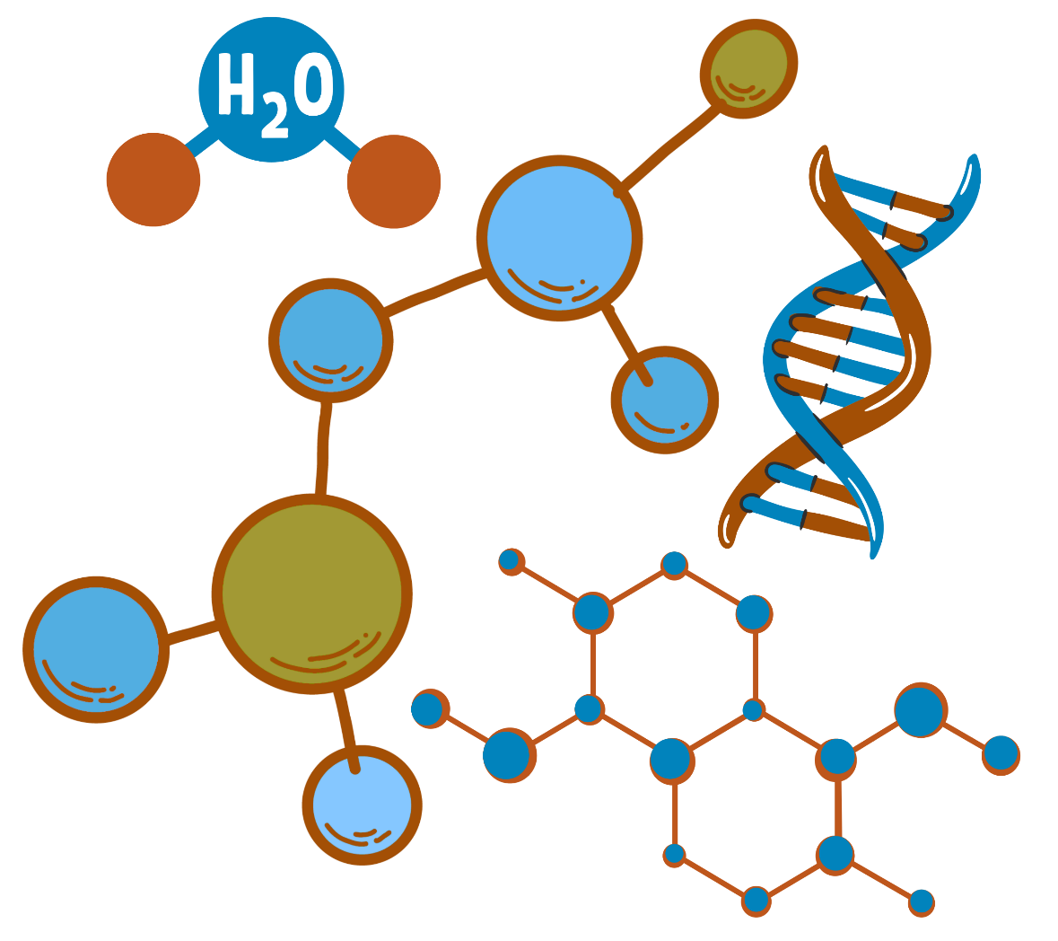
Organic Chemistry I
CHEM 240
Chapter 3: Nomenclature of Organic Compounds

Slide 2

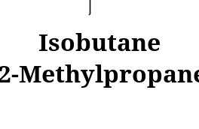
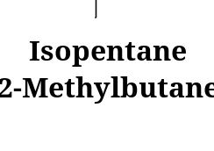
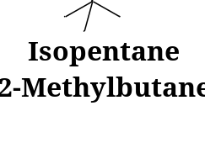
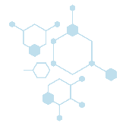
Chapter 3: Nomenclature of Organic Compounds
The older unsystematic names, (Common names).
Systematic nomenclature developed and updated by the International Union of Pure and Applied Chemistry (IUPAC).
Common name
IUPAC name
1. Nomenclature of Alkanes and Cycloalkanes
The names for some unbranched alkanes are listed in Table 3.1.
The ending for all of the names of alkanes is -ane.
The stems of the names of most of the alkanes (above C4) are of Greek and Latin origin. Thus, one, two, three, four, and five become meth-, eth-, prop-, but-, and pent-.
Table 3-1 The Unbranched alkanes
Name | Number of Carbon Atoms | Structure | Name | Number of Carbon Atoms | Structure
Methane Ethane Propane Butane Pentane | 1 2 3 4 5 | CH₄ CH₃CH₃ CH₃CH₂CH₃ CH₃(CH₂)₂CH₃ CH₃(CH₂)₃CH₃ | Hexane Heptane Octane Nonane Decane | 6 7 8 9 10 | CH₃(CH₂)₄CH₃ CH₃(CH₂)₅CH₃ CH₃(CH₂)₆CH₃ CH₃(CH₂)₇CH₃ CH₃(CH₂)₈CH₃
1

Slide 3
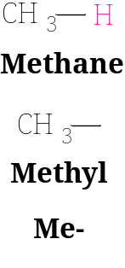
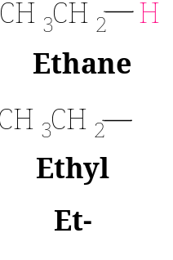


Chapter 3: Nomenclature of Organic Compounds
1. Nomenclature of Alkanes and Cycloalkanes
1.1. How to Name Alkyl Groups
If we remove one terminal hydrogen atom from an alkane, we obtain what is called an alkyl group.
These alkyl groups have names that end in -yl.
Alkane Alkyl
Example;
2

Slide 4
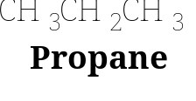
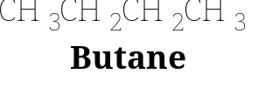
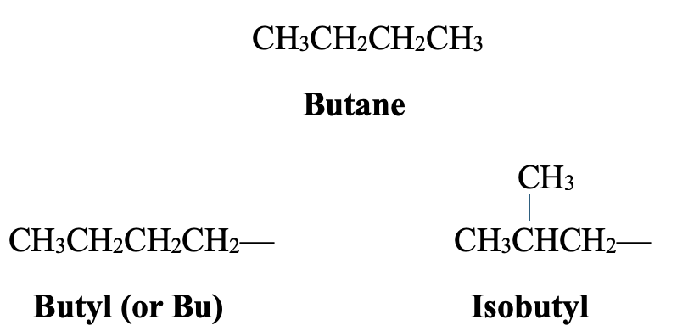
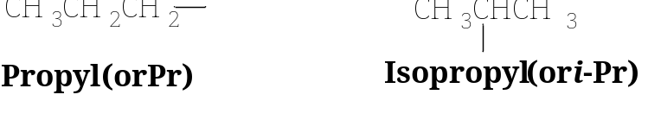
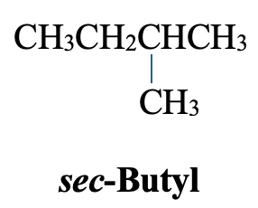
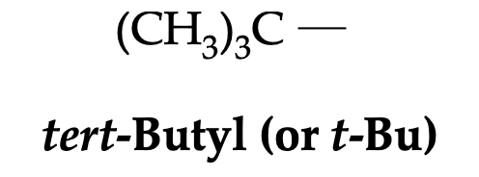






Chapter 3: Nomenclature of Organic Compounds
1. Nomenclature of Alkanes and Cycloalkanes
1.1. How to Name Alkyl Groups
For alkanes with more than two carbon atoms, more than one derived group is possible.
For example;
Two groups can be derived from propane,
  the propyl group is derived by removal of a terminal hydrogen, and
  the isopropyl (common name) is derived by removal of a hydrogen from the central carbon.
Three-Carbon Groups
Four-Carbon Groups
  The common names isopropyl, isobutyl, sec-butyl, and tert-butyl are approved by IUPAC for the unsubstituted groups, and they are still very frequently used.
3

Slide 5
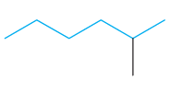
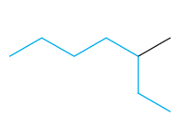
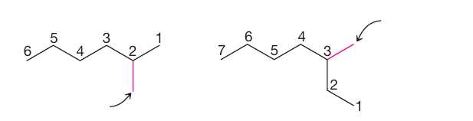
Chapter 3: Nomenclature of Organic Compounds
1. Nomenclature of Alkanes and Cycloalkanes
1.2. How to Name Alkanes
Branched-chain alkanes are named according to the following rules:
  1. Locate the longest continuous chain of carbon atoms; this chain determines the parent's name for the alkane.
  The longest continuous chain may not always be obvious from the way the formula is written.
CH₃CH₂CH₂CH₂CHCH₃
or
Longest chain
CH₃
Hexane
Because the longest continuous chain contains six carbon atoms
Heptane
Because the longest chain contains seven carbon atoms
  2. Number the longest chain beginning with the end of the chain nearer the substituent.
Substituent
Substituent
4

Slide 6

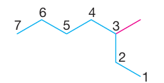

Chapter 3: Nomenclature of Organic Compounds
1. Nomenclature of Alkanes and Cycloalkanes
1.2. How to Name Alkanes
  3. Use the numbers obtained by application of rule 2 to designate the location of the substituent group.
The parent's name is placed last, and the substituent group, preceded by the number designating its location on the chain, is placed first. Numbers are separated from words by a hyphen (-).
Substituent
Longest chain
Locant
2-Methylhexane
3-Methylheptane
4. When two or more substituents are present, give each substituent a number corresponding to its location on the longest chain.
  The substituent groups should be listed alphabetically (i.e., ethyl before methyl).
  In deciding on alphabetical order, disregard multiplying prefixes such as “di” and “tri”.
4-Ethyl-2-methylhexane
5

Slide 7

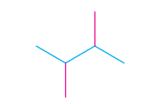
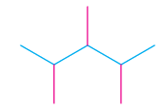

Chapter 3: Nomenclature of Organic Compounds
1. Nomenclature of Alkanes and Cycloalkanes
1.2. How to Name Alkanes
  5. When two substituents are present on the same carbon atom, use that number repeated twice.
3-Ethyl-3-methylhexane
6. When two or more substituents are identical, indicate this by the use of the prefixes di-, tri-, tetra-, and so on.
Then, make sure that each substituent is assigned a number. Commas (,) are used to separate numbers from each other.
2,3-Dimthylbutane
2,3,4-Trimthylpentane
2,2,4,4-Tetramthylpentane
6

Slide 8
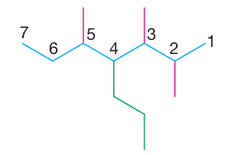
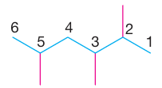
Chapter 3: Nomenclature of Organic Compounds
1. Nomenclature of Alkanes and Cycloalkanes
1.2. How to Name Alkanes
  7. When two chains of equal length compete for selection as the parent chain, choose the chain with the greater number of substituents.
2,3,5-Trimthyl-4-propylheptane
(four substituent)
8. When branching first occurs at an equal distance from either end of the longest chain, choose the name that gives the lower number at the first point of difference.
2,3,5-Trimthylhexane
(not 2,4,5-Trimthylhexane)
7

Slide 9




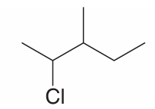
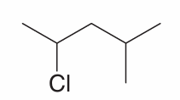
Chapter 3: Nomenclature of Organic Compounds
1. Nomenclature of Alkanes and Cycloalkanes
1.2. How to Name Alkanes
11. Halogen substituents are named by changing the -ine ending of the element to -o.
Common names for many simple haloalkanes are still widely used.
  In this common nomenclature system, haloalkane are named as alkyl halide.
IUPAC name:
common name:
Chloroethane
Ethyl chloride
1-Fluoropropane
Propyl fluoride
2-Bromopropane
Isopropyl bromide
IUPAC name:
2-Chloro-3-methylpentane
2-Chloro-4-methylpentane
9

Slide 10
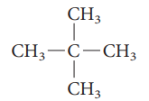
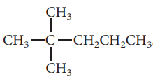





Chapter 3: Nomenclature of Organic Compounds
1. Nomenclature of Alkanes and Cycloalkanes
1.2. How to Name Alkanes
Examples:
IUPAC name:
common name:
2-Methylbutane
Isobutane
2,2-Dimethylpropane
Neopentane
2,2-Dimethylpentane
Neoheptane
Br
Br
IUPAC name:
common name:
1-Bromo-2,2-Dimethylpropane
Neopentyl bromide
2-Bromo-2-methylpropane
tert-Butyl bromide
IUPAC name:
3,5,7-Trimethylnonane
3,3,4-Trimethylhexane
10

Slide 11
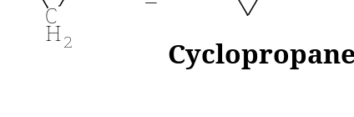
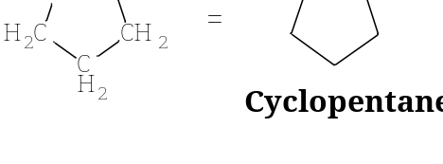
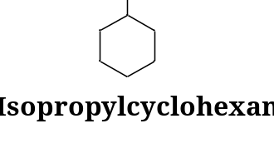
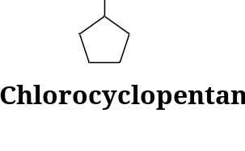
Chapter 3: Nomenclature of Organic Compounds
1. Nomenclature of Alkanes and Cycloalkanes
1.3. How to Name Monocyclic Cycloalkanes
Cycloalkanes are named by adding “cyclo” before the parent's name.
  Cycloalkanes with one ring and no substituents:
  Count the number of carbon atoms in the ring, then add “cyclo” to the beginning of the name of the alkane with that number of carbons.
  Example; cyclopropane has three carbons and cyclopentane has five carbons.
  Cycloalkanes with one ring and one substituent:
  Add the name of the substituent to the beginning of the parent's name.
  For compounds with only one substituent, it is not necessary to specify a number (locant) for the carbon bearing the substituent.
11

Slide 12
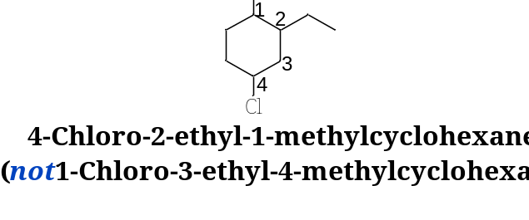
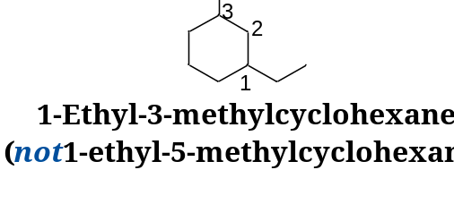
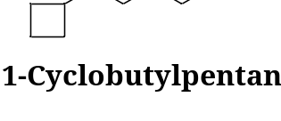
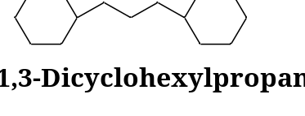
Chapter 3: Nomenclature of Organic Compounds
1. Nomenclature of Alkanes and Cycloalkanes
1.3. How to Name Monocyclic Cycloalkanes
Cycloalkanes with one ring and two or more substituents:
  For a ring with two substituents, begin by numbering the carbons in the ring, starting at the carbon with the substituent that is first in the alphabet and number in the direction that gives the next substituent the lower number possible.
  When there are three or more substituents, begin at the substituent that leads to the lowest set of numbers (locants).
  The substituents are listed in alphabetical order, not according to the number of their carbon atom.
  When a single ring system is attached to a single chain with a greater number of carbon atoms, or when more than one ring system is attached to a single chain, then it is appropriate to name the compounds as cycloalkylalkanes.
12

Slide 13
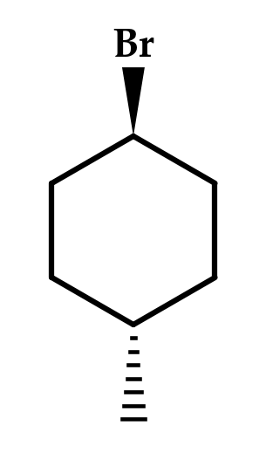
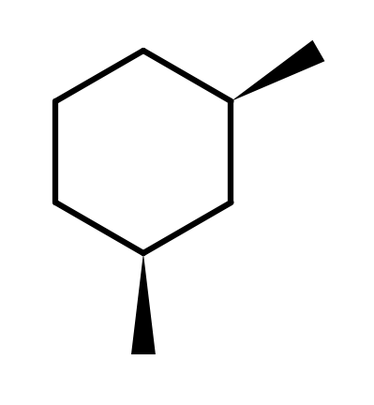
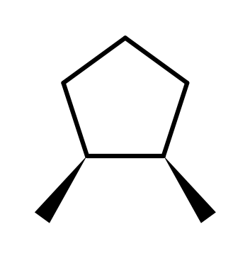
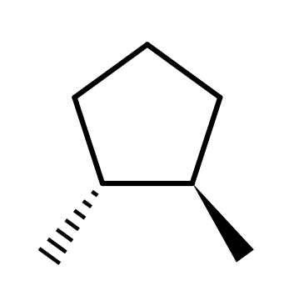
Chapter 3: Nomenclature of Organic Compounds
1. Nomenclature of Alkanes and Cycloalkanes
1.4. Cis–Trans Isomerism in Disubstituted Cycloalkanes
Rotation about the C–C bonds of a ring is restricted. Two substituents on different ring carbons can therefore lie on the same side or on opposite sides of the ring plane.
A wedged bond points toward the viewer (above the ring plane); a hashed bond points away from the viewer (below the plane).
cis- (Latin: “on this side”): both groups on the same side. trans- (Latin: “across”): the groups on opposite sides.
The prefix is written in italics before the name and joined by a hyphen. Cis and trans isomers are stereoisomers: same connectivity, different arrangement in space.
cis-1,2-Dimethylcyclopentane
trans-1,2-Dimethylcyclopentane
cis-1,3-Dimethylcyclohexane
trans-1-Bromo-4-methylcyclohexane
13

Slide 14

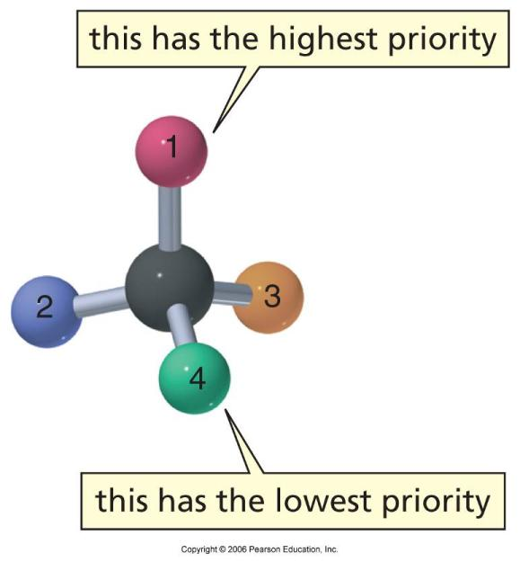
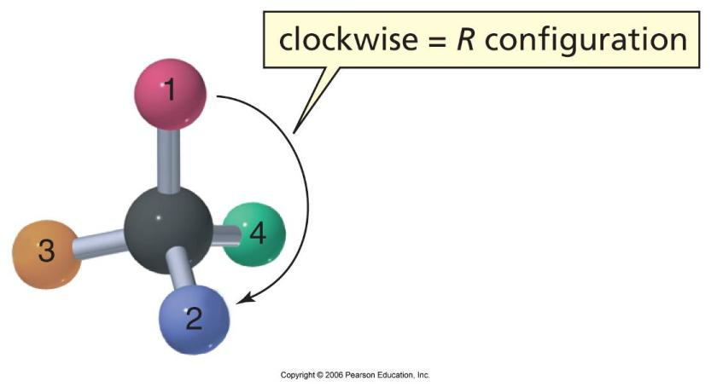
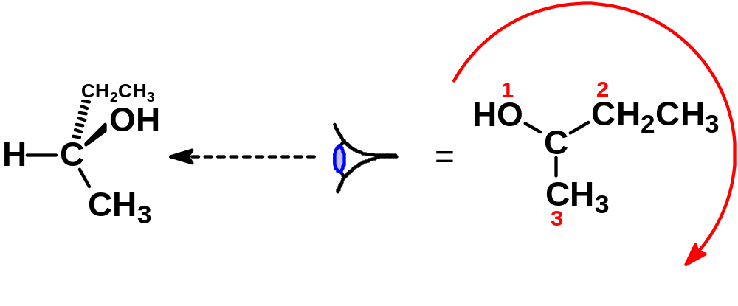
Chapter 3: Nomenclature of Organic Compounds
2. Naming Enantiomers: The R,S System
Cahn, Ingold, Prelog sequence rules:
R and S
  Assign priorities to the remaining groups based on atomic numbers.
  Clockwise (highest to lowest priority) ⇒ R
  Counterclockwise ⇒ S
(R)-2-butanol
14

Slide 15
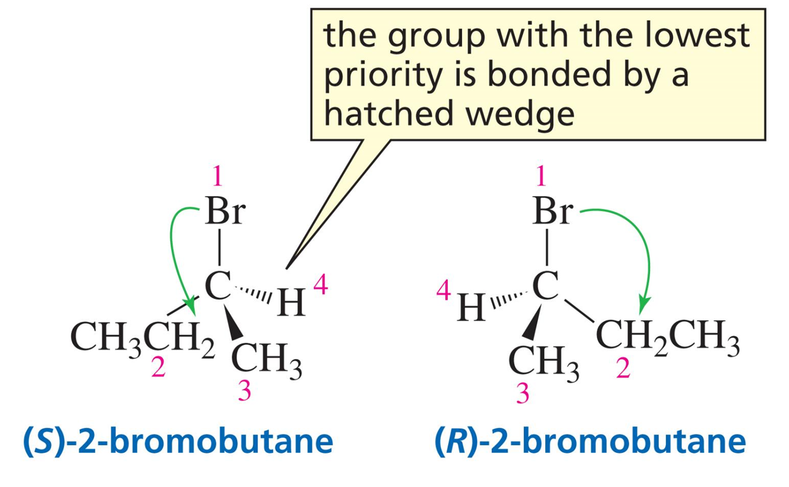
Chapter 3: Nomenclature of Organic Compounds
2. Naming Enantiomers: The R,S System
Cahn, Ingold, Prelog sequence rules:
Assign a numerical priority to each group bonded to the asymmetric carbon:
  group 1 = highest priority
  group 4 = lowest priority
Rules for assigning priorities:
  Compare the first atom in each group (i.e. the atom directly bonded to the asymmetric carbon)
  Atoms with higher atomic numbers have higher priority
15

Slide 16
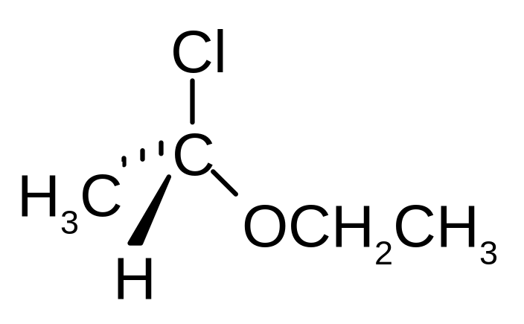
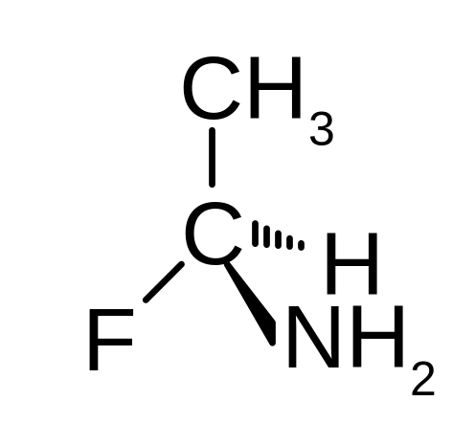
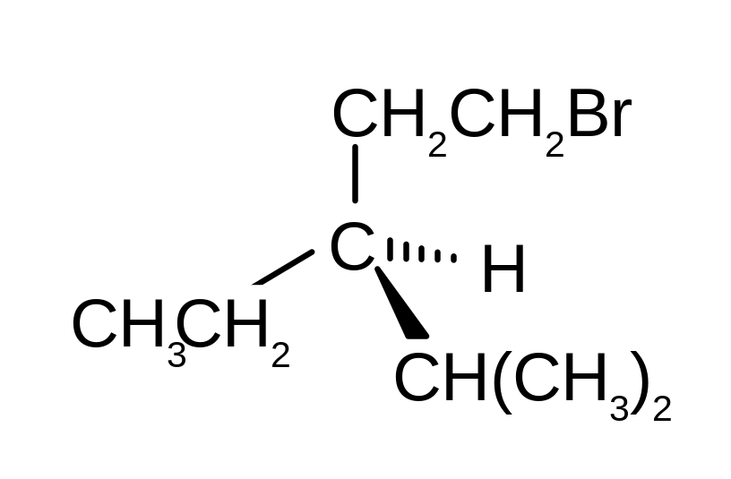
Chapter 3: Nomenclature of Organic Compounds
2. Naming Enantiomers: The R,S System
Cahn, Ingold, Prelog sequence rules:
1
3
  Example priorities:
  I > Br > Cl > S > F > O > N > C > H
3
4
2
1
2
4
In case of ties, use the next atoms along the chain as tiebreakers.
CH(CH₃)₂ > CH₂CH₂Br > CH₃CH₂
16

Slide 17
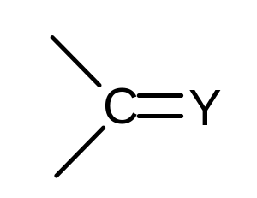
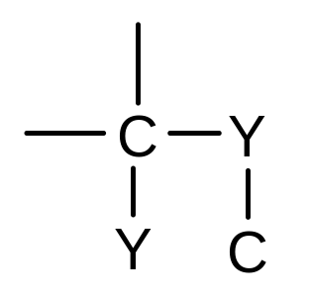
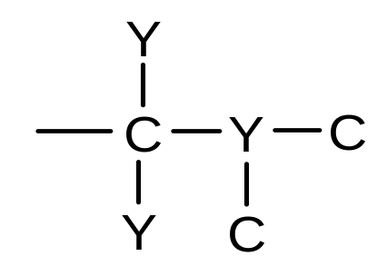

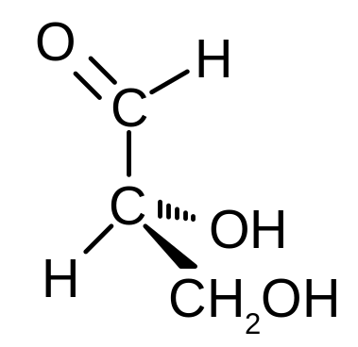
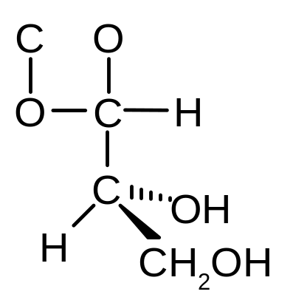
Chapter 3: Nomenclature of Organic Compounds
2. Naming Enantiomers: The R,S System
Cahn, Ingold, Prelog sequence rules:
Treat double and triple bonds as if both atoms in the bond were duplicated or triplicated:
2
2
1
1
4
3
4
3
17

Slide 18
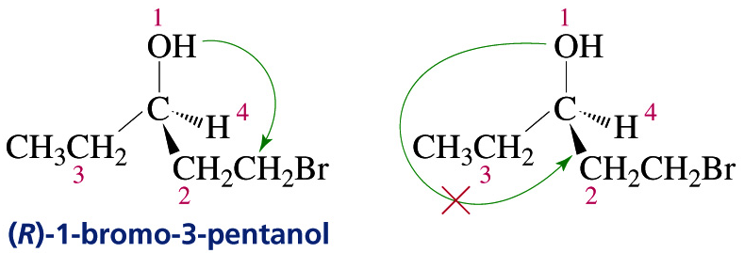

Chapter 3: Nomenclature of Organic Compounds
2. Naming Enantiomers: The R,S System
Cahn, Ingold, Prelog sequence rules:
In drawing the arrow from group (1) to group (2), you can draw past the group with the lowest priority (4) but never draw past the group with the next lower priority (3)
Orienting the lowest priority group in back
18

Slide 19



Chapter 3: Nomenclature of Organic Compounds
2. Naming Enantiomers: The R,S System
Cahn, Ingold, Prelog sequence rules:
Indicate whether the structure has R or S configuration:
2
3
switch CH₃ and CH₃CH₂
4
R
1
When naming compounds containing multiple chiral atoms, you must give the configuration around each chiral atom:
  position number and configuration of each chiral atom in numerical order, separated by commas, all in ( ) at the start of the compound name
(2S, 3S)-2-bromo-3-chlorobutane
19

Slide 20









Chapter 3: Nomenclature of Organic Compounds
3. Nomenclature of Alkenes and Cycloalkenes
3.1. How to Name Alkenes
The IUPAC rules for naming alkenes are similar in many respects to those for naming alkanes:
  Determine the parent's name by selecting the longest chain that contains the double bond and change the ending of the name of the alkane of identical length from -ane to -ene.
IUPAC name
Common name
  Number the chain from the end nearest the double bond, ensuring that both double-bonded carbon atoms are included in the parent chain.
  Designate the location of the double bond by using the number of the first atom of the double bond as a prefix. The locant for the alkene suffix may precede the parent's name or be placed immediately before the suffix.
  Indicate the locations of the substituent groups by the numbers of the carbon atoms to which they are attached.
2-Pentene
(not 3-Pentene)
20

Slide 21









Chapter 3: Nomenclature of Organic Compounds
3. Nomenclature of Alkenes and Cycloalkenes
3.1. How to Name Alkenes
Two frequently encountered alkenyl groups are the vinyl group and the allyl group.
The vinyl group
The allyl group
IUPAC name
Common name
3.2. How to Name Dienes
Number the chain from the end nearest the first double bond, giving the substituents the lowest possible numbers.
21

Slide 22







Chapter 3: Nomenclature of Organic Compounds
2. Nomenclature of Alkenes and Cycloalkenes
3.3. How to Name Cycloalkenes
Number substituted cycloalkenes in the way that gives the carbon atoms of the double bond the 1 and 2 positions and that also gives the substituent groups the lower numbers at the first point of difference.
With substituted cycloalkenes it is not necessary to specify the position of the double bond since it will always begin with C1 and C2.
22

Slide 23






Chapter 3: Nomenclature of Organic Compounds
3. Nomenclature of Alkenes and Cycloalkenes
3.4. Cis–Trans Isomerism in Alkenes
Rotation about a C=C double bond is restricted, so an alkene such as 2-butene exists as two different compounds (stereoisomers).
cis-: two identical (or similar) groups on the same side of the double bond; trans-: the groups on opposite sides.
Cis–trans isomerism is possible only when each carbon of the double bond carries two different groups. If either carbon bears two identical groups (e.g., =CH₂ or =C(CH₃)₂), no cis–trans isomers exist.
Cycloalkenes with fewer than eight ring carbons exist only in the cis form, so no prefix is needed (e.g., cyclohexene).
Cis–trans isomers exist
No cis–trans isomers
cis-2-Butene
trans-2-Butene
cis-1,2-Dichloroethene
trans-1,2-Dichloroethene
2-Methylpropene
1-Butene
23

Slide 24


Chapter 3: Nomenclature of Organic Compounds
3. Nomenclature of Alkenes and Cycloalkenes
3.5. The (E)–(Z) System for Naming Alkenes
When a double bond carries three or four different groups, cis and trans become ambiguous. IUPAC then uses the (E)–(Z) system, based on the Cahn–Ingold–Prelog (CIP) priority rules:
1. Look at each carbon of the double bond separately. The attached atom with the higher atomic number has the higher priority:
I > Br > Cl > S > F > O > N > C > H
2. If the first atoms are the same, compare the atoms attached to them and decide at the first point of difference: –CH₂CH₃ (C,H,H) > –CH₃ (H,H,H).
3. Multiple bonds are counted as duplicated atoms: –CH=CH₂ is treated as (C,C,H).
(Z) (zusammen = together): higher-priority groups on the same side.
(E) (entgegen = opposite): higher-priority groups on opposite sides.
The italic letter, in parentheses, is placed at the beginning of the name.
(Z)-isomer: same side
(E)-isomer: opposite sides
24

Slide 25




Chapter 3: Nomenclature of Organic Compounds
3. Nomenclature of Alkenes and Cycloalkenes
3.5. The (E)–(Z) System: Worked Examples
Step 1: at each carbon of the double bond, rank the two attached groups (the higher-priority group is shown in red).
Step 2: higher-priority groups on the same side → (Z); on opposite sides → (E).
a)
b)
c)
d)
(Z)-1-Bromo-1-chloroprop-1-ene
(E)-3-Methylpent-2-ene
(E)-1-Bromo-2-chloro-2-fluoro-1-iodoethene
(Z)-2-Chlorobut-2-ene
C1: Br > Cl; C2: CH₃ > H
C2: CH₃ > H; C3: CH₂CH₃ > CH₃
C1: I > Br; C2: Cl > F
C2: Cl > CH₃; C3: CH₃ > H
Note: cis/trans and (E)/(Z) do not always correspond. In (b) the two methyl groups are cis, yet the alkene is (E); in (d) they are trans, yet it is (Z).
25

Slide 26






Chapter 3: Nomenclature of Organic Compounds
4. Nomenclature of Alkyne
4.1. How to Name Alkyne
Alkynes are named in much the same way as alkenes.
Alkynes, are named by replacing the -ane of the name of the corresponding alkane with the ending -yne.
The chain is numbered to give the carbon atoms of the triple bond the lower possible numbers. The lower number of the two carbon atoms of the triple bond is used to designate the location of the triple bond.
The locations of substituent groups of branched alkynes and substituted alkynes are also indicated with numbers.
IUPAC name
Common name
26

Slide 27






Chapter 3: Nomenclature of Organic Compounds
4. Nomenclature of Alkyne
4.2. Terminal and Internal Alkynes, and Alkynyl Groups
A terminal alkyne has the triple bond at the end of the chain (–C≡C–H); an internal alkyne has it within the chain.
When a triple bond is part of a substituent, the group is an alkynyl group: the ending -yl replaces the final -e of the alkyne name (ethyne → ethynyl).
The ethynyl group is HC≡C–; the propargyl group (IUPAC: prop-2-yn-1-yl, or 2-propynyl) is HC≡C–CH₂–.
A ring attached to a C≡C unit may be named as an ethynyl-substituted ring or as a ring-substituted alkyne (see aryl groups, section 4.4).
1-Butyne
(terminal alkyne)
2-Butyne
(internal alkyne)
Ethynyl group
Propargyl group
(2-propynyl)
Ethynylcyclohexane
or cyclohexylethyne
Ethynylbenzene
(phenylacetylene)
27

Slide 28


Chapter 3: Nomenclature of Organic Compounds
4. Nomenclature of Alkyne
4.3 Priority of Multiple Bonds in IUPAC Nomenclature
When both double and triple bonds are present, number the parent chain to give the multiple bonds the lowest possible set of locants. In case of a tie, the double bond is given the lower locant.
Example 1 – Tie: The double bond is given the lower locant.
Example 2 – No Tie: The lowest set of locants determines the direction of numbering.
28
Notes:
New slide. Terminal vs internal alkynes; ethynyl and propargyl groups; naming rings attached to a triple bond (consistent with the aryl-group rule in 4.4).

Slide 29


Chapter 3: Nomenclature of Organic Compounds
5. Nomenclature of Aromatic Compounds
5.1. How to Name Monosubstituted Benzene
Benzene is the simplest aromatic compound, and the simple monosubstituted ring is named as derivative of benzene.
Common names are accepted by IUPAC as parent compounds.
29

Slide 30


Chapter 3: Nomenclature of Organic Compounds
5. Nomenclature of Aromatic Compounds
5.2. How to Name Disubstituted Benzene
When two substituents are present, their relative positions are indicated by the prefixes ortho-, meta-, and para- (abbreviated o-, m-, and p-) or using numbers.
If substituent X is attached to carbon 1;
o- groups are on carbons 2 and 6;
m- groups are on carbons 3 and 5, and
p- groups are on carbon 4.
30
Notes:
New slide. Carbon classification (1°–4°) and hydrogen classification. Links to sec-/tert- prefixes introduced on the previous slide. Quick check: ask students to classify the carbons of 2-methylbutane.

Slide 31


Chapter 3: Nomenclature of Organic Compounds
5. Nomenclature of Aromatic Compounds
5.2. How to Name Disubstituted Benzene
If a substituent have a special name, it could be used as the parent's name with the possible lowest number .
Some disubstituted benzene derivatives have a common names.
IUPAC name
Common name
31
Notes:
New slide. Rules 9 and 10 extend the alkane rules: naming complex substituents (numbered from the attachment carbon, in parentheses) and how to alphabetize them. Contrast systematic names with common names (tert-butyl, isopropyl).

Slide 32





Chapter 3: Nomenclature of Organic Compounds
5. Nomenclature of Aromatic Compounds
5.3. How to Name Polysubstituted Benzene
If more than two groups are present on the benzene ring, their positions must be indicated using numbers only.
The benzene ring is numbered so as to give the lowest possible numbers to the substituents.
When a substituent is one that together with the benzene ring gives a new base name, that substituent is assumed to be in position 1 and the new parent's name is used.
32
Notes:
New slide. Bicyclic alkanes: bicyclo[x.y.z]alkane. Emphasize that bridge sizes exclude bridgeheads and are written in decreasing order; walk through the numbering on bicyclo[3.2.1]octane (C8 is the one-carbon bridge).

Slide 33





Chapter 3: Nomenclature of Organic Compounds
5. Nomenclature of Aromatic Compounds
5.4. How to Name Aryl Groups
When the C₆H₅− group is named as a substituent, it is called a phenyl group (Ph−).
Benzyl group (C₆H₅CH₂-) is an alternative name for the phenylmethyl group.
Phenyl group
Benzyl group
A hydrocarbon composed of one saturated chain and one benzene ring is usually named as a derivative of the larger structural unit.
If the chain is unsaturated, the compound may be named as a derivative of that chain, regardless of ring size.
33
Notes:
New slide. Cis–trans isomerism in disubstituted cycloalkanes, with wedge/hash notation. This prepares students for cis/trans and E/Z in alkenes.

Slide 34





Chapter 3: Nomenclature of Organic Compounds
5. Nomenclature of Aromatic Compounds
5.5. How to Name Polycyclic Aromatic Hydrocarbons
Benzene rings that share two adjacent carbon atoms are fused rings; such compounds are polycyclic aromatic hydrocarbons (PAHs).
The common PAHs keep their retained names: naphthalene (two rings), anthracene (three rings in a line) and phenanthrene (three rings, angular).
Each parent has a fixed numbering; carbons shared by two rings are given the letter a (4a, 8a, …). Substituents receive the lowest possible locants.
In naphthalene, positions 1, 4, 5, 8 are α (alpha) and positions 2, 3, 6, 7 are β (beta) positions.
Naphthalene
Anthracene
Phenanthrene
1-Chloronaphthalene
(α-chloronaphthalene)
2-Methylnaphthalene
(β-methylnaphthalene)
34
Notes:
New slide. Cis–trans isomerism in alkenes and the condition that each double-bond carbon must carry two different groups.

Slide 35

Chapter 3: Nomenclature of Organic Compounds
6. Practice Problems
1) Give the IUPAC name of each of the following compounds
2) Write the structural formula for:
a) 2,2,4-trimethylpentane
b) 4-Isopropyl-3,5-dimethyl-2-octene
c) 5-Bromo-4-ethyl-6-methyl-2-nonyne
d) 1,3-Difluoro-4-methylbenzene
35
Notes:
New slide. Polycyclic aromatic hydrocarbons: naphthalene, anthracene, phenanthrene with their fixed numbering; alpha/beta positions of naphthalene.

Slide 36




Chapter 3: Nomenclature of Organic Compounds
6. Practice Problems (continued)
3) Give the IUPAC name of each compound (include cis/trans or (E)/(Z) where needed):
a)
b)
c)
d)
4) Write the structural formula for:
a) (Z)-3-Methylhex-3-ene
b) trans-1,2-Dibromocyclohexane
c) 2-Bromonaphthalene
d) 4-Isopropyl-2-methylheptane
e) 3-Cyclopentylprop-1-yne
36
Notes:
ANSWER KEY.
Q3: a) cis-1-Ethyl-3-methylcyclohexane; b) (E)-3-Chloropent-2-ene; c) 2-Methylbicyclo[2.2.1]heptane; d) 5-(2-Methylpropyl)nonane (5-isobutylnonane); e) 9-Methylanthracene.
Q4: a) CH3CH2C(CH3)=CHCH2CH3 with the two ethyl groups on the same side; b) cyclohexane with Br wedge on C1 and Br hash on C2; c) norbornane with two methyl groups on the one-carbon bridge (C7); d) naphthalene with Br at a beta position (C2); e) CH3CH(CH3)CH2CH(CH(CH3)2)CH2CH2CH3; f) HC≡C-CH2-cyclopentyl.
Q5: 3-ethyl-2,2-dimethylpentane (C9H20): 1° C = 5 (C1, C5, two 2-methyls, ethyl CH3); 2° C = 2 (C4, ethyl CH2); 3° C = 1 (C3); 4° C = 1 (C2). Hydrogens: 15 primary, 4 secondary, 1 tertiary.

Slide 37


Chapter 3: Nomenclature of Organic Compounds
5) Rank in order of decreasing priority:
a) -COOH -H -NH₂ -OH
b)
6) Which group in each pair has the highest priority?
a) -I or -Br
b) -CH₃Br or -CH₂CH₂Br
7) Label each compound as R or S
a)
b)
37

