Slide 1
Fundamentals of Organic Chemistry
CHEM 109
For Students of Health Colleges
Credit hrs.: (2+1)
King Saud University
College of Science, Chemistry Department
CHEM 109
Syllabus

Slide 2
Introduction
Types of chemical bonds: (Ionic and covalent bonds) - Atomic and molecular orbital: (sigma and pi bond) - Hybridization (sp³, sp², sp) - Inductive effect, polarization, and Stability of carbocations - Classification of organic compounds and functional groups.
Lectures (3)
Aliphatic Hydrocarbons
Classes of hydrocarbons: (saturated and unsaturated) – Nomenclature: (IUPAC and common names) – Isomerism: (Structural and Geometrical) - Physical properties of aliphatic hydrocarbons - Preparation of saturated hydrocarbons (Alkanes): (Hydrogenation of unsaturated hydrocarbons - Hydrolysis of alkyl Grignard reagent - Reaction of lithium dialkyl cuprates with alkyl halides) - Reactions of saturated hydrocarbons: (Halogenations) - Preparation of Unsaturated hydrocarbons: (Alkenes and Alkynes): (Elimination reactions (Dehydration, dehydrohalogenation and dehalogenation reactions) and Saytzeff rule) - Reactions of Unsaturated hydrocarbons: (Electrophilic addition reactions (Markovnikov's rule), hydrogenation, halogenation, hydrohalogenation, and hydration - Oxidation reactions - Acidity of alkynes) -Uses of alkanes, alkenes and alkynes
Lectures (6)
Aromatic compounds
Aromaticity: structure and bonding requirements and Hückel's rule - Nomenclature of aromatic compounds - Electrophilic aromatic substitution reactions: (Alkylation, acylation, halogenations, nitration and sulfonation) - Effects of substituents on electrophilic aromatic substitution reactions - Side-chain reactions: (Oxidation of alkylbenzenes) – Uses of aromatic compounds.
Lectures (2)
1st Midterm Exam

Slide 3
Alcohols, Phenols and Ethers
Structure, classifications and nomenclature - Physical properties - Preparation of alcohols and phenols: (Hydration of alkenes - Nucleophilic substitution reaction of alkyl halides - Reduction of aldehydes, ketones and acids - Addition of Grignard compounds to aldehydes and ketones) - Preparation of Phenols: (Benzene sulfonic acids) - Preparation of ethers (Williamson synthesis) - Reactions of Alcohols, Phenols and Ethers: (Salt formation of alcohols and phenols (Acidity of phenols and Reaction of Alcohols with Sodium metal) - Reactions of Alcohols and Ethers with Hydrogen halides - Conversion of Alcohols to alkyl halides - Oxidation of alcohols - Electrophilic substitution reactions of phenols) - Alcohols with More Than One Hydroxyl Group; glycols - Uses of aromatic alcohols, phenols and Ethers.
Lectures (3)
Aldehydes and Ketones
Structure and Nomenclature - Physical properties - Preparation of aldehydes and ketones: (Hydration of alkynes - Ozonolysis of alkynes - Friedel-Crafts acylation - Oxidation of alcohols) - Reactions of aldehydes and ketones: (Nucleophilic addition reaction (addition of hydrogen cyanide, Reduction, Grignard addition, addition of Alcohol (hemiacetal and acetal Formation), addition of ammonia and amine derivatives) - Uses of aldehydes and ketones.
Lectures (3)
Carboxylic acids and Their Derivatives
Structure and Nomenclature - Physical properties - Acidity of Carboxylic acids - Preparation: (Hydrolysis of nitrile - Carbonation of Grignard reagents) - Reactions of carboxylic acids: (Salt Formation - Ester, amide, anhydride, and acid chloride formation) - Uses of Carboxylic acids and Their Derivatives.
Lectures (3)
2nd Midterm Exam

Slide 4
Amines
Structure of amines - Nomenclature of amines - Physical properties of amines - Basicity of amines - Preparation of amines: (Reduction of nitro compounds, nitriles and amides - Alkylation of ammonia) - Reactions of amines: (Sulfa drugs - Diazonium salts (Formation and Replacement reactions) - Uses of Amines.
Lectures (2)
Carbohydrates
Definitions and Classification (monosaccharides, disaccharides and polysaccharides) – Monosaccharides: (Nomenclature - Structure (Optical isomerism, cyclic structure, Fischer Projection, Haworth Formulas)) - Reactions of Monosaccharides: (Reduction and oxidation of monosaccharides) – Disaccharides: (Maltose, Cellobiose, Sucrose and Lactose) – Polysaccharides: (Cellulose and Starch) - Uses of Carbohydrates.
Lectures (2)
Amino Acids, Peptides, and Proteins
Sources, classification and Structure - The acid–base Properties of Amino Acids - Reactions of amino acids: (The Ninhydrin Reaction, Peptides - Sanger reaction - Formation of an amide linkage (The peptide bond: Proteins)) - Structure of proteins – Importance of amino acids.
Lectures (2)
Nucleic Acids
Chemical Structure: (General structure (Nucleoside, Nucleotide and Nucleic acids) - DNA; structure - RNA; structure and types) - Importance of amino acids
Lectures (2)
Final Exam

Slide 5
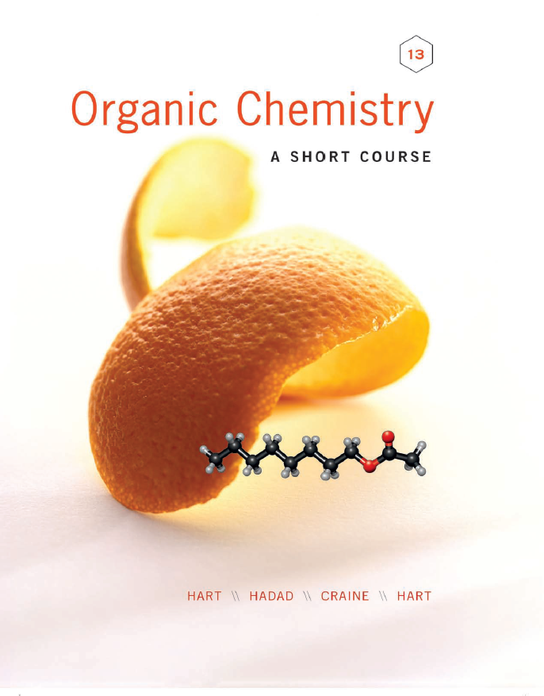
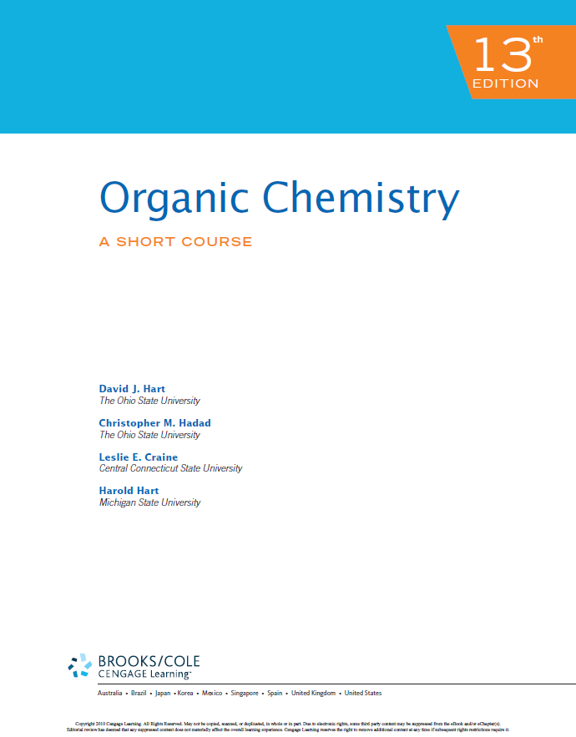
المراجع References
Organic chemistry: A short course by I Harold Hart, David J. Hart and Leslie E. Craine, Houghton Mifflin Company, USA.
Elements of Organic Chemistry (second edition) is written by Isaak Zimmerman and Henry Zimmerman and published by Macmillan Publishing Co., Inc. New York in 1983.
أسس الكيمياء العضوية - أ.د./ سالم بن سليم الذياب - الناشر: مؤسسة نافثة

Slide 6
أهداف دراسة المقرر Course Objectives
Upon successful completion of this course, the student will be able to:
To name organic compounds using IUPAC system and common names.
تسمية المركبات العضوية باستخدام الأسماء الشائعة ونظام IUPAC.
To recognize and apply functional groups regarding their physical properties, synthesis and transformation.
التعرف على المجموعات الوظيفية وتطبيقها فيما يتعلق بخصائصها الفيزيائية وتحولاتها.
To define the occurrence of organic compounds in nature.
التعرف على المركبات العضوية في المنتجات الطبيعة.
To understand the basic organic reactions for preparation and reactions of the related compounds.
الإلمام بأساسيات التفاعلات لتحضير وتفاعلات المركبات العضوية.
To learn about composition and properties of carbohydrates, amino acids, proteins and nucleic acids.
التعرف على تكوين وخواص الكربوهيدرات والأحماض الأمينية والبروتينات والأحماض النووية.
To appreciate of the role of organic chemistry in understanding the principles of biochemistry
تقدير أهمية دور الكيمياء العضوية في فهم مبادئ الكيمياء الحيوية.

Slide 7
مخرجات التعلم Course Learning Outcomes
1.0 | Knowledge المعرفة
1.1 | To recognize structures of organic compounds. التعرف على البنية الهيكلية للمركبات العضوية.
1.2 | To memorize naming, constitutional isomer, physical properties and reactions اتقان تسمية المركبات العضوية، التعرف على أنواع المتماكبات، الخصائص الفيزيائية و التفاعلات و التحولات الكيميائية.
1.3 | To learn about composition and properties of carbohydrates, amino acids, proteins and nucleic acids التعرف على تركيبة وخصائص الكربوهيدرات والأحماض الأمينية والبروتينات والأحماض النووية.

Slide 8
مخرجات التعلم Course Learning Outcomes
2.0 | Cognitive Skills المهارات المعرفية
2.1 | To differentiate between ionic and covalent bonds in chemical compounds. التمييز بين الروابط الأيونية والتساهمية في المركبات الكيميائية
2.2 | To recognize the IUPAC nomenclature of organic chemical compounds. التعرف على تسميات IUPAC للمركبات الكيميائية العضوية.
2.3 | To differentiate between aromatic and non-aromatic compounds according to Huekel’s rule. التمييز بين المركبات العطرية (الاروماتية) وغير العطرية وفقًا لقاعدة هوكل.
2.4 | To predict the type of nucleophilic or electrophilic substitutions in organic reactions. التمييز بين تفاعلات الاستبدال النيكليوفيلية والالكتروفيلية في التفاعلات العضوية.
2.5 | To know the importance of carbohydrates, amino acids, proteins and nucleic acids in our life. معرفة أهمية الكربوهيدرات والأحماض الأمينية والبروتينات والأحماض النووية في حياتنا.

Slide 9
مخرجات التعلم Course Learning Outcomes
3.0 | Interpersonal Skills & Responsibility المهارات الشخصية والالتزام
3.1 | To prepare and recognize organic compounds and Write laboratory reports التمييز وتحضير المركبات العضوية و كتابة تقارير المختبر.
3.2 | Work independently and as a part of a team during class session. العمل بشكل مستقل وكجزء من فريق خلال الحصة العملية
4.0 | Communication, Information Technology, Numerical مهارات الاتصال و التعامل مع تكنولوجيا المعلومات
4.1 | Utilizing university electronic resources of learning. الاستفادة من مصادر التعليم الإلكتروني بالجامعة.
4.2 | To interpret numerical, chemical and general scientific information. تفسير و استنتاج المعلومات العددية والكيميائية والعلمية العامة
5.0 | Psychomotor المهارات النفس حركية
5.1 | To demonstrate safe handling of laboratory chemicals and glassware during experiment. التعامل الآمن مع المواد الكيميائية والأدوات الزجاجية في المختبرات أثناء اجراء التجربة

Slide 10
ضوابط الاختبار البديل Alternative examination regulations

