Slide 1

Fundamentals of Organic Chemistry
CHEM 109
For Students of Health Colleges
Credit hrs.: (2+1)
King Saud University
College of Science, Chemistry Department
CHEM 109
CHAPTER 9. AMINO ACIDS, PEPTIDES AND PROTEINS

Slide 2
Learning Objectives
At the end of this chapter, students will able to:
Predict the different type of amino acids.
Recognize the basic properties (structure, physical and chemical properties) of amino acids.
Predict whether the acid and amine groups in amino acids will be protonated at different pH values
know how to prepare amino acids.
Describe the primary, secondary, tertiary and quaternary structure of proteins

Slide 3
Sources, Classification and Structure of Amino Acids
Proteins are naturally occurring polymers (polypeptides) composed of α-amino acids units joined one to another by amide (or peptide) bonds.
Example, animal hair and muscle, egg whites, and hemoglobin are all proteins.
Peptides are oligomers of amino acids that play important roles in many biological processes.
Example, the peptide hormone insulin controls our blood sugar levels.
Peptides are classified to dipeptides, tripeptides, tetrapeptides, etc.. According to the number of amino acids in the chain.
Proteins, peptides, and amino acids are essential to the structure, function, and reproduction of living matter.

Slide 4
The amino acids obtained from protein hydrolysis are α-amino acids.
The amino group is on the α -carbon atom, the one adjacent to the carboxyl group.
With the exception of glycine, where R = H, a-amino acids have a stereogenic center (chiral carbon) at the α -carbon.
All except glycine are therefore optically active.
All natural amino acids L-configuration relative to glyceraldehyde.
Note that the Fischer convention, used with carbohydrates, is also applied to amino acids.

Slide 5
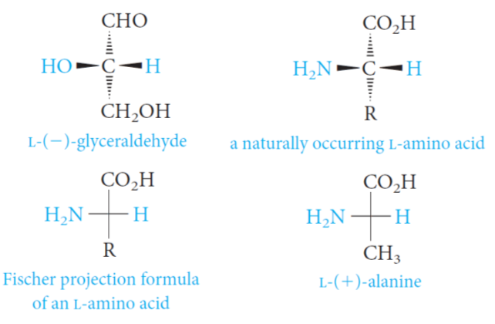
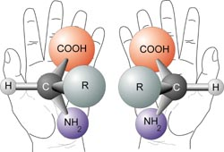

Slide 6
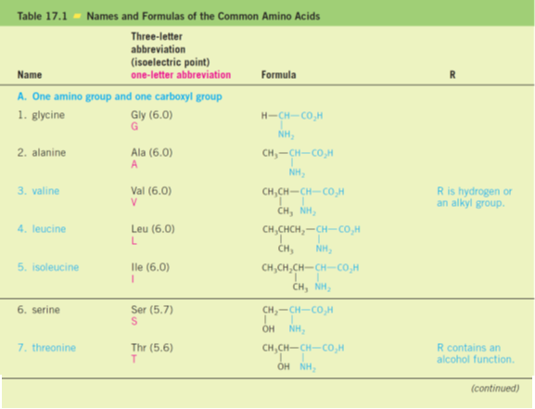
List of the 20 α-amino acids commonly found in proteins.
←
←
←

Slide 7
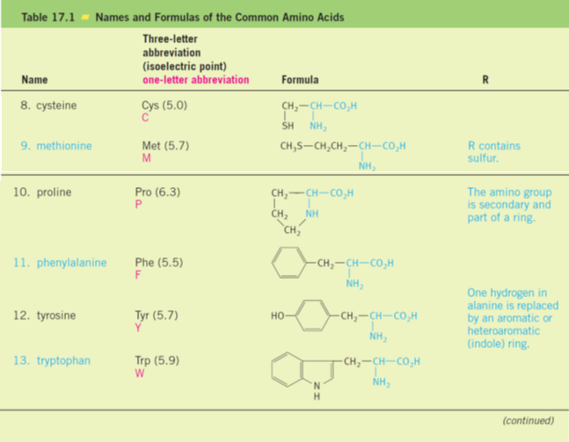
←
←
←

Slide 8
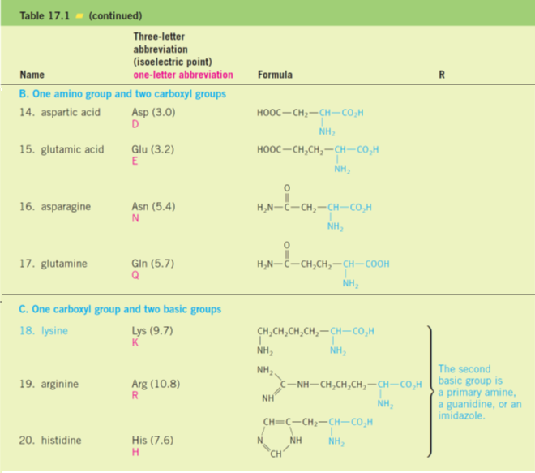
←
←

Slide 9
The amino acids are known by common names.
Each also has a three-letter abbreviation based on this name, which is used when writing the formulas of peptides, and a one-letter abbreviation used to describe the amino acid sequence in a protein.
For example; Glycine= Gly; Alanine = Ala; Valine = Val, etc..
The amino acids are classified into:
Essential amino acids
Eight amino cannot be synthesized by adult humans and therefore must be included in the diet in the form of proteins.
e.g. Valine, Leucine, Isoleucine, Threonine, Methionine, Phenylalanine, Tryptophan, and Lysine.
Non-essential amino acids
Twelve amino acids can be synthesized in the body from other foods.
e.g. Glycine, Alanine, Serine, Cysteine, Proline, Tyrosine, Aspartic acid, Glutamic acid, Asparagine, Glutamine, Arginine, and Histidine.

Slide 10
Classification - Amino acids are classified on the basis of the structure of R
  Aliphatic side chains non-polar amino acids: such as Alanine, Valine, Leucine, etc …..hydrophobic
  Polar side chains: are containing HO-, SH- and amide groups, such as Serine, Cystein ----hydrophilic
  Acidic: are containing more than one COOH group, such as Aspartic, Glutamic------hydrophilic
  Basic: are containing more than one N atom, Such as Lysine, Arginine------hydrophilic
  Heterocyclic/Aromatic – Such as Histidine----hydrophilic or hydrophobic

Slide 11
  Aliphatic side chains – hydrophobic
  Polar side chains – text classifies as HO-, S-, and amide containing – hydrophilic

Slide 12
  Acidic – hydrophilic
  Basic – hydrophilic
  Heterocyclic/Aromatic – hydrophilic or hydrophobic

Slide 13
The Acid–Base Properties of Amino Acids
Amino acids are classified according to the side chain into:
i) Neutral amino acids, such as Glycine, Alanine, Valine, etc..
ii) Basic amino acids, such as Arginine, Lysine (they have extra amino group)
iii) Acidic amino acid, such as Aspartic and Glutamice (they have extra carboxylic group)
Acid–Base Properties
  Since amino acids have both an acidic functionality and a basic functionality, we should expect the following equilibrium:
  In fact, the equilibrium lies to the right all amino acids are charged at any pH!
  Such species that are overall neutral molecules but contain charged ends are called zwitterions

Slide 14
The amino group is protonated and present as an ammonium ion, whereas the carboxyl group has lost its proton and is present as a carboxylate anion.
This dipolar structure is consistent with the salt-like properties of amino acids, which have rather high melting points and relatively low solubility in organic solvents.
Amino acids are amphoteric.
They can behave as acids and donate a proton to a strong base, or they can behave as bases and accept a proton from a strong acid.
The isoelectric point (pI), the amino acid will be dipolar and have a net charge of zero.

Slide 15
Synthesis of Amino Acids
Strecker Synthesis: Recall reductive amination and Cyanohydrin formation.

Slide 16
Reactions of Amino Acids
Formation of an amide linkage (The peptide bond: Proteins)
Amino acids are linked in peptides and proteins by an amide bond (peptide bond) between the carboxyl group of one amino acid and the α-amino group of another amino acid.
A molecule containing only two amino acids (the shorthand aa is used for amino acid) joined in this way is a dipeptide:
By convention, the peptide bond is written with the amino acid having a free ⁺NH₃ group at the left and the amino acid with a free CO₂⁻ group at the right.
These amino acids are called, respectively, the N-terminal amino acid and the C-terminal amino acid.

Slide 17
We often write the formulas for peptides in a kind of shorthand by simply linking the three-letter abbreviations for each amino acid, starting with the N-terminal one at the left.
For example; glycylalanine is Gly—Ala, and alanylglycine is Ala—Gly.
A tetrapeptide
glycylserylphenylalanylglycine = gly-ser-phe-gly

Slide 18
The peptide bond: Proteins
The Peptide (Amide) Bond
  The amide nitrogen is sp² hybridized and the lone pair is conjugated with the carbonyl group
  There is considerable C–N double-bond character
  Rotation about the C–N bond is difficult

Slide 19
Structure of Proteins
Proteins are biopolymers composed of many amino acids connected to one another through amide (peptide) bonds.
Some proteins are major components of structural tissue (muscle, skin, nails, and hair).
Others transport molecules from one part of a living system to another.
The main features of peptide and protein structure.
Primary structure;
How many amino acids are present and what their sequence is in the peptide or protein chain.
Secondary, tertiary, and quaternary structures;
Three-dimensional aspects of peptide and protein structure, usually referred to as their.

Slide 20
The Primary Structure of Proteins
The backbone of proteins is a repeating sequence of one nitrogen and two carbon atoms.
Peptides and proteins can be hydrolyzed to their amino acid components by heating with 6 M HCl.
An instrument called an amino acid analyzer is used to determine the amino acids mixture.

Slide 21
Uses of Amino Acids
Amino acids, often referred to as the building blocks of proteins, are compounds that play many critical roles in your body.
They're needed for vital processes like the building of proteins and synthesis of hormones and neurotransmitters.
Phenylalanine plays an integral role in the structure and function of proteins and enzymes and the production of other amino acids.
Valine helps stimulate muscle growth and regeneration and is involved in energy production.
Leucine helps to regulate blood sugar levels, stimulates wound healing and produces growth hormones.

