Slide 1

Fundamentals of Organic Chemistry
CHEM 109
For Students of Health Colleges
Credit hrs.: (2+1)
King Saud University
College of Science, Chemistry Department
CHAPTER 8: Carbohydrates
CHEM 109
Notes:
1

Slide 2
Learning Objectives
At the end of this chapter, students will able to:
Classify a monosaccharide as an aldose or a ketose, and indicate the number of carbon atoms.
Identify chiral and achiral carbon atoms in carbohydrates.
Use Fischer projections to draw the D or L stereoisomers for glucose, galactose, and fructose.
Draw the Haworth structures for monosaccharides.
Identify the products of oxidation or reduction of monosaccharides; determine whether a carbohydrate is a reducing sugar.
Describe the monosaccharide units and linkages in disaccharides.
Describe the structural features of amylose, amylopectin, glycogen, and cellulose.

Slide 3
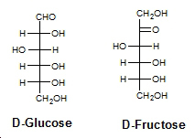
Carbohydrates
3
The word carbohydrate can be expressed as hydrates of carbon because molecular formulas of these compounds.
Example;
Glucose has the molecular formula C₆H₁₂O₆, which might be written as C₆(H₂O)₆.
polyhydroxyaldehydes
polyhydroxyketones
Carbohydrates are usually classified according to their structure as monosaccharides, oligosaccharides, or polysaccharides.
The term saccharide comes from Latin (saccharum, sugar) and refers to the sweet taste of some simple carbohydrates.

Slide 4

4
The three classes of carbohydrates are related to each other through hydrolysis.
Monosaccharides (or simple sugars) are carbohydrates that cannot be hydrolyzed to simpler compounds.
Oligosaccharides (from the Greek oligos, few) contain at least two and generally no more than a few linked monosaccharide units.
They may be called disaccharides, trisaccharides, and so on, depending on the number of units, which may be the same or different.
Example; Maltose is a disaccharide made of two glucose units.
Sucrose is made of two different monosaccharide units: glucose and fructose.
Polysaccharides contain many monosaccharide units - sometimes hundreds or even thousands.
Example;
Starch and cellulose, contain linked units of the same monosaccharide, glucose.

Slide 5
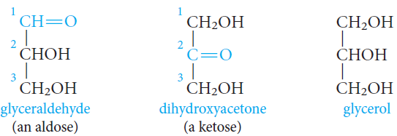
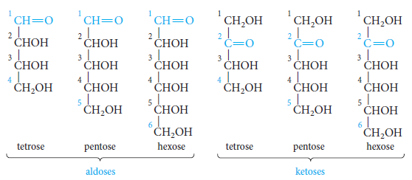
Monosaccharides
5
Glyceraldehyde is the simplest aldose, and dihydroxyacetone is the simplest ketose.
Each is related to glycerol in that each has a carbonyl group in place of one of the hydroxyl groups.
Monosaccharides are classified according to:
The number of carbon atoms present (triose, tetrose, pentose, hexose, and so on).

Slide 6
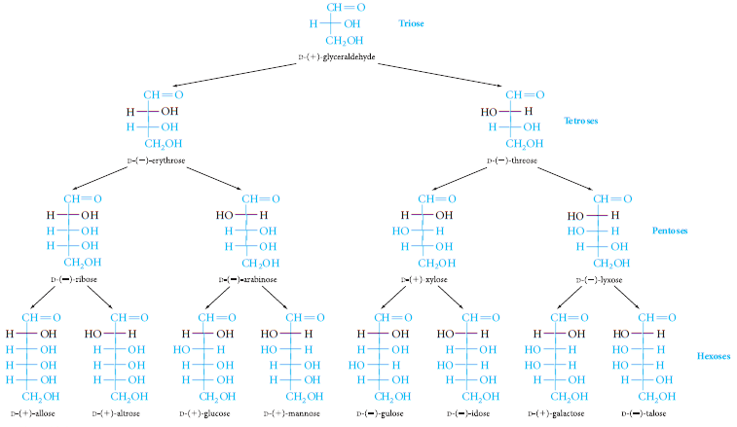
6

Slide 7
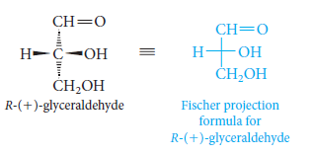
Chirality; Fischer Projection Formulas and D,L-Sugars
7
Fischer projection is a method of representing chiral molecules in two dimensions using vertical and horizontal lines.
The vertical lines represent bond pointing away from the viewer and are drawn behind the plan of the paper (shown as dashed line).
The horizontal lines represent bond coming towards the viewer and drawn project out of the plane of the paper (solid wedge)
For carbohydrates the convention is to put the carbonyl group at the top for aldoses and closest to the top for ketoses, then the carbon atoms are numbered from the top to the bottom.
The simplest aldose is glyceraldehyde (aldotriose).

Slide 8
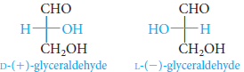
8
D-glyceraldehyde, with the hydroxyl group on the right.
L-glyceraldehyde, with the hydroxyl group on the left.
Thus to assign the configuration of a monosaccharide molecule that has more than one chiral centre as D or L you have to look at the chiral carbon farthest from the carbonyl group in Fischer projection and assign its configuration as D or L as described before.

Slide 9
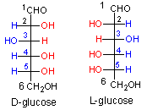
9
Enantiomers
Stereogenic centers are mostly carbon atoms (asymmetric carbon) that bind four different groups.
Stereoisomers = 2^{n} (n = number of stereogenic centers).

Slide 10
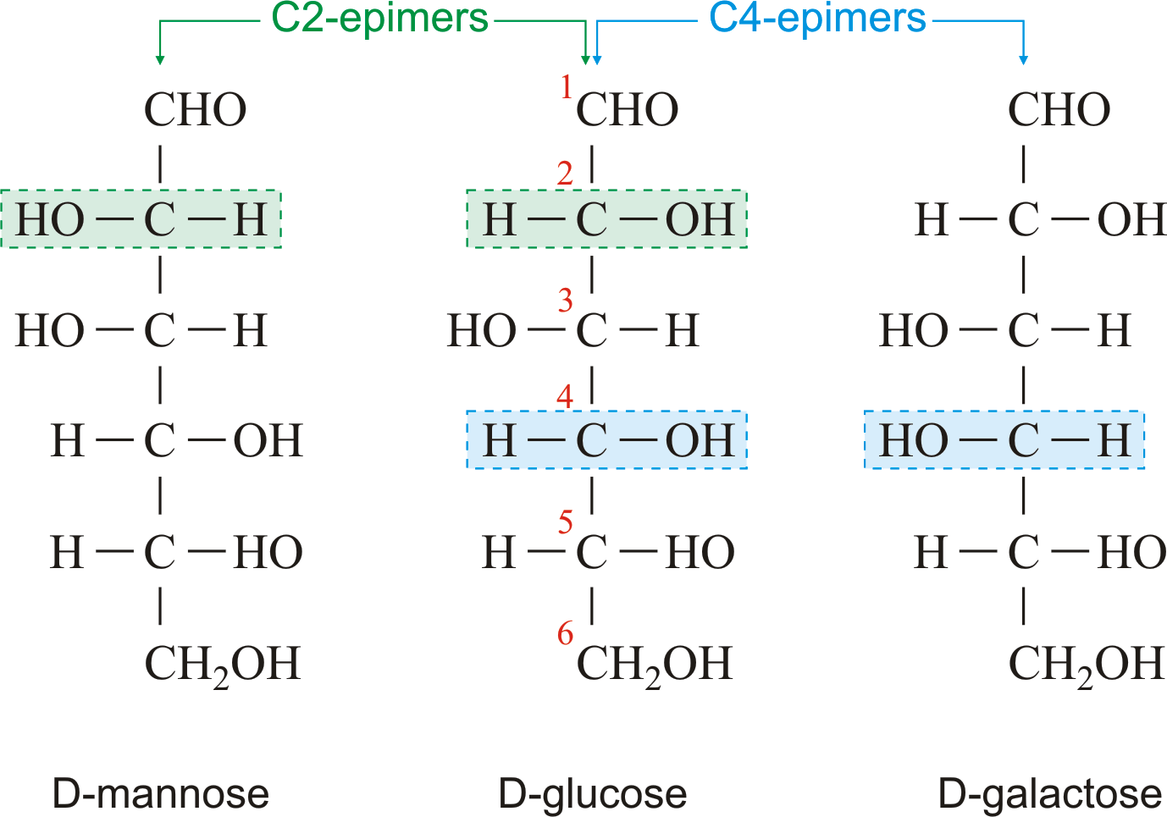
10
Epimers
A special name is given to diastereomers that differ in configuration at only one stereogenic center.
Examples;
D-glucose and D-mannose are epimers (at C-2).
D-glucose and D-galactose are epimers (at C-4).

Slide 11
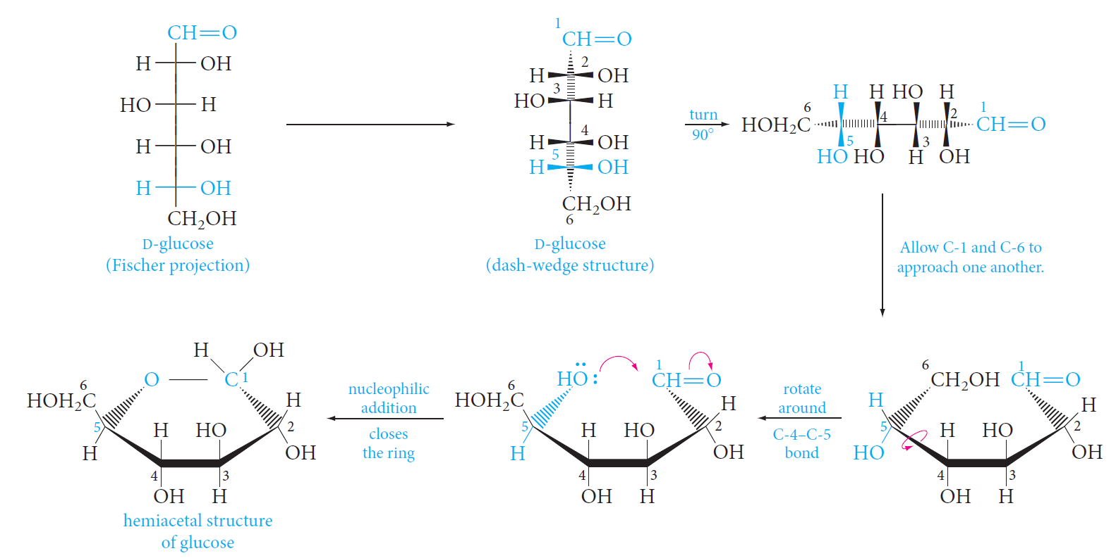
The Cyclic Hemiacetal
Structures of Monosaccharides
11
Monosaccharides exist mainly in cyclic, hemiacetal forms and not in the acyclic aldo- or keto-forms.

Slide 12
Haworth Projection
12
Substituents attached to the ring lie above or below the plane.
C-1 is the hemiacetal carbon (it carries a hydroxyl group, and it is also connected to C-5 by an ether linkage).
C-2, C-3, and C-4 are secondary alcohol carbons.
C-6 is a primary alcohol carbon.
For D-sugars, the terminal -CH₂OH group is up in the Haworth projection; for L-sugars, it is down.

Slide 13
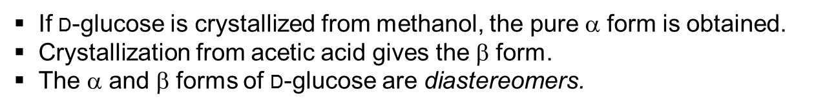
Anomeric Carbons; Mutarotation
13
Anomers
Anomeric carbon; The hemiacetal carbon, the carbon that forms the new stereogenic center.
Anomers; Two monosaccharides that differ only in configuration at the anomeric center are (a special kind of epimers).
Anomers are called α or β, depending on the position of the hydroxyl group.
For monosaccharides in the D-series, the hydroxyl group is “down” in the α anomer and “up” in the β anomer.

Slide 14
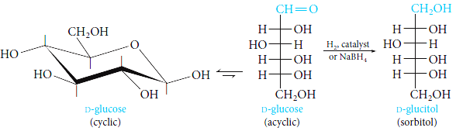
1) Reduction of Monosaccharides
Reactions of Monosaccharides
14
The carbonyl group of aldoses and ketoses can be reduced by various reagents to give polyols, called alditols.
Example;
Catalytic hydrogenation or reduction with sodium borohydride (NaBH₄) converts D-glucose to D-glucitol (sorbitol).
Sorbitol is used commercially as a sweetener and sugar substitute.

Slide 15
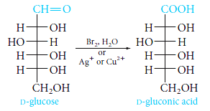

15
2) Oxidation of Monosaccharides
2.1. With Mild Oxidizing Agents
Mild oxidizing agents as
Tollens’ reagent (Ag⁺ in aqueous ammonia),
Fehling’s reagent (Cu²⁺ complexed with tartrate ion),
Benedict’s reagent (Cu²⁺ complexed with citrate ion).
These aldehyde groups can be easily oxidized to acids which are called aldonic acids.
A carbohydrate that reacts with Ag⁺ or Cu²⁺ is called a reducing sugar
Example; D-glucose is easily oxidized to D-gluconic acid.
With the copper reagents, the blue solution gives a red precipitate of cuprous oxide, Cu₂O.

Slide 16
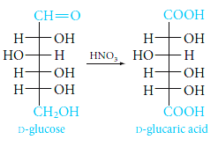
16
2.2. With Strong Oxidizing Agents
Stronger oxidizing agents, such as aqueous nitric acid.
The aldehyde group and the primary alcohol group can be oxidized, producing dicarboxylic acids called aldaric acids.
Example;
D-glucose gives D-glucaric acid.

Slide 17
Disaccharides
17
The most common oligosaccharides are disaccharides.
In a disaccharide,
two monosaccharides are linked by a glycosidic bond between the anomeric carbon of one monosaccharide unit and a hydroxyl group on the other unit.

Slide 18
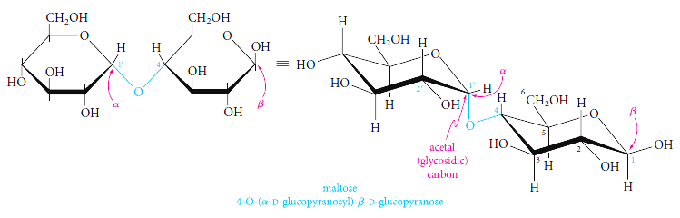
18
Maltose
Maltose is the disaccharide obtained by the partial hydrolysis of starch.
Further hydrolysis of maltose gives only D-glucose.
Maltose consist of two linked glucose units.
It turns out that the anomeric carbon of the left unit is linked to the C-4 hydroxyl group of the unit at the right as an acetal (glycoside).
The configuration at the anomeric carbon of the left unit is α.

Slide 19
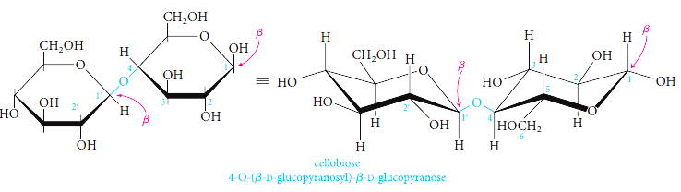
19
Cellobiose
Cellobiose is the disaccharide obtained by the partial hydrolysis of cellulose.
Further hydrolysis of cellobiose gives only D-glucose.
Cellobiose must therefore be an isomer of maltose.
In fact, cellobiose differs from maltose only in having the β configuration at C-1 of the left glucose unit.

Slide 20
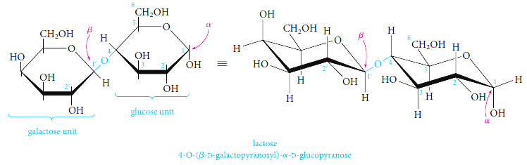
20
Lactose
Lactose is the major sugar in human and cow’s milk (4% to 8% lactose).
Hydrolysis of lactose gives equimolar amounts of D-galactose and D-glucose.

Slide 21
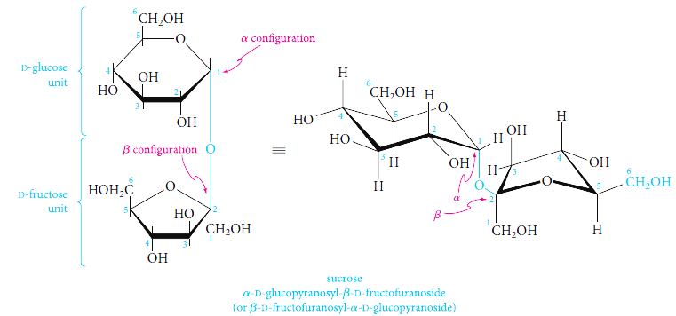
21
Sucrose
The most important commercial disaccharide is sucrose, ordinary table sugar.
Sucrose occurs in all photosynthetic plants, where it functions as an energy source.
It is obtained commercially from sugar cane and sugar beets, in which it constitutes 14% to 20% of the plant juices.
Sucrose is very water soluble (2 grams per milliliter at room temperature) because it is polar due to the presence of eight hydroxyl groups on its surface.
Hydrolysis of sucrose gives equimolar amounts of D-glucose and the ketose D-fructose.

Slide 22
Polysaccharides
22
Polysaccharides contain many linked monosaccharides and vary in chain length and molecular weight.
Most polysaccharides give a single monosaccharide on complete hydrolysis.
The monosaccharide units may be linked linearly, or the chains may be branched.

Slide 23
23
Starch
Starch is the energy-storing carbohydrate of plants.
It is a major component of cereals, potatoes, corn, and rice.
Starch is made up of glucose units joined mainly by 1,4-α-glycosidic bonds, although the chains may have a number of branches attached through 1,6- α -glycosidic bonds.
Partial hydrolysis of starch gives maltose, and complete hydrolysis gives only D-glucose.
Starch can be separated by various techniques into two fractions: amylose and amylopectin.
Amylose, which constitutes about 20% of starch, the glucose units (50 to 300) are in a continuous chain, with 1,4 linkages.
Amylopectin is highly branched. Although each molecule may contain 300 to 5000 glucose units, chains with consecutive 1,4 links average only 25 to 30 units in length. These chains are connected at branch points by 1,6 linkages.

Slide 24
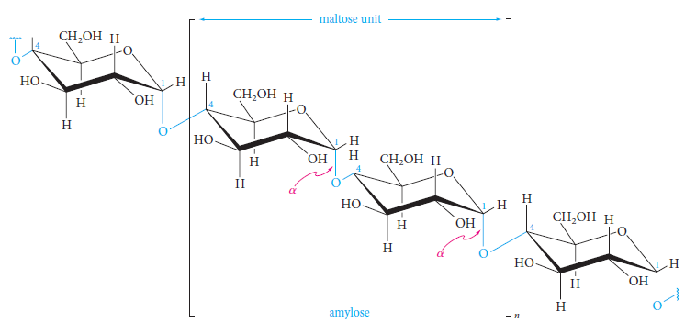
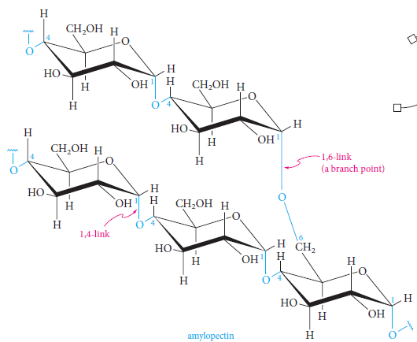
24

Slide 25
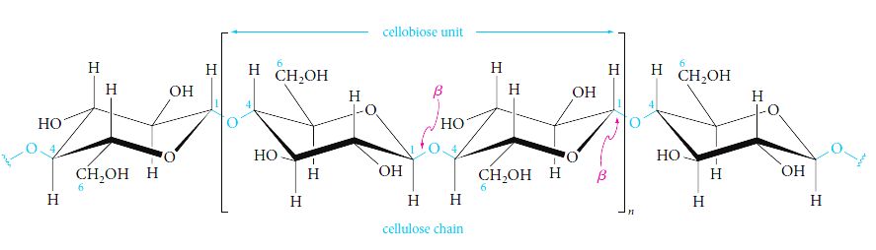
25
Cellulose
Cellulose is an unbranched polymer of glucose joined by 1,4-β-glycosidic bonds.
It consists of linear chains of cellobiose units.
These linear molecules, containing an average of 5000 glucose units, aggregate to give fibrils bound together by hydrogen bonds between hydroxyls on adjacent chains.
Cellulose fibers having considerable physical strength are built up from these fibrils, wound spirally in opposite directions around a central axis.
Wood, cotton, hemp, linen, straw, and corncobs are mainly cellulose.

Slide 26
Uses of Carbohydrates
Of course, your body doesn't run on gasoline - it runs on carbohydrates.
Carbohydrates, found in foods like grains, fruits, beans, milk products and vegetables, are by far your body's favorite source of energy, yet providing your body with pep is not the only role carbohydrates play.
Carbohydrates from the foods you consumed are broken down into smaller units of sugar. These small units get absorbed out of your digestive tract and into your bloodstream. This blood sugar, or blood glucose, is transported through your bloodstream to supply energy to your muscles and other tissues. This is an important process; in fact, we could say that of the different functions of carbohydrates, supplying energy to the body is the main role.
Most of your body cells use the simple carbohydrate glucose for energy, but your brain is particularly in need of glucose as an energy source.

