Slide 1

Fundamentals of Organic Chemistry
CHEM 109
For Students of Health Colleges
Credit hrs.: (2+1)
King Saud University
College of Science, Chemistry Department
CHAPTER 7: AMINES
CHEM 109

Slide 2
Learning Objectives
At the end of this chapter, students will able to:
Recognize and name amines.
Predict the reactivity of amines as bases and nucleophiles
Recognize the basic properties (structure, physical and chemical properties) of amines.
know the different methods for the preparation of amines.
Know the chemical reactions of amines.

Slide 3
Structure an Classification of Amines
Amines are compounds that derived from ammonia by replacement of one, two, or three hydrogens by alkyl or aryl groups.
Nitrogen atom with a lone pair of electrons, making amines both basic and nucleophilic
Ammonia
Amines occur naturally in plants and animals.

Slide 4
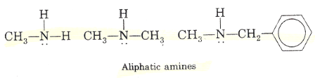
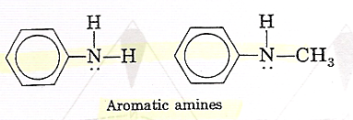
Aliphatic amines contain only alkyl groups bonded directly to the nitrogen atom.
Aromatic amines are those in which one or more aryl groups are bonded directly to nitrogen.

Slide 5
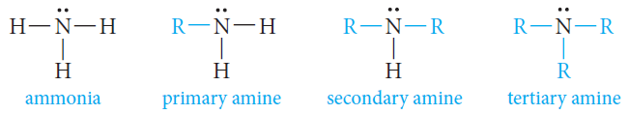
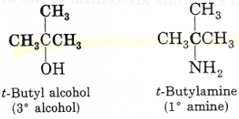
The relation between ammonia and amines is illustrated by the following structures:
Amines are classified as primary, secondary, or tertiary, depending on whether one, two, or three organic groups are attached to the nitrogen.
NOTE:
t-butyl alcohol is a tertiary alcohol (because three carbons are attached to the carbinol carbon).
t-butyl amine is a primary amine (because only one carbon is attached directly to the nitrogen atom).

Slide 6
Quaternary Ammonium Ions:
A nitrogen atom with four attached groups is positively charged Compounds are quaternary ammonium salts

Slide 7
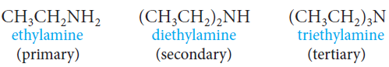
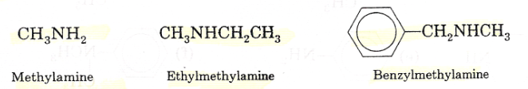
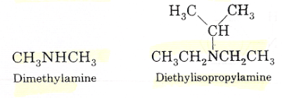
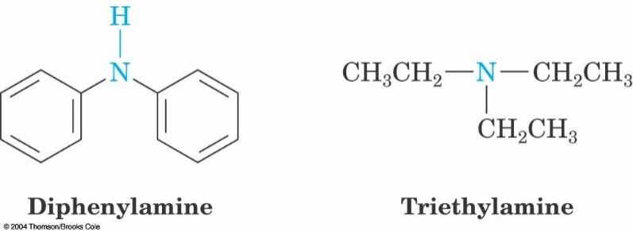
Nomenclature of Amines
Common Names
Amines are named by specifying the alkyl groups attached to the nitrogen and adding the suffix –amine (Alkylamine).

Slide 8
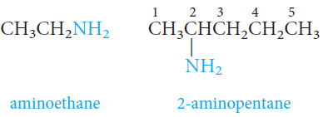
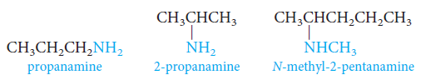
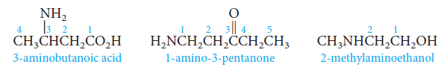
IUPAC Names
The amino group, -NH₂, is named as a substituent.
Amines can be named as alkanamines.
When other functional groups are present, the amino group, -NH₂, is named as a substituent.
N-methy-2-aminoethanol

Slide 9
When different alkyl groups are attached to the nitrogen; they are named in alphabetical order
3-Hexanamine
N-Methyl-3-hexanamine
N-Ethyl-N-methyl-3-hexanamine
N-Isopropyl-N-methyl-3-hexanamine
N-butyl-N-ethyl-3-hexanamine

Slide 10
Aromatic amines are named as derivatives of aniline.
Aniline is called benzenamine.

Slide 11
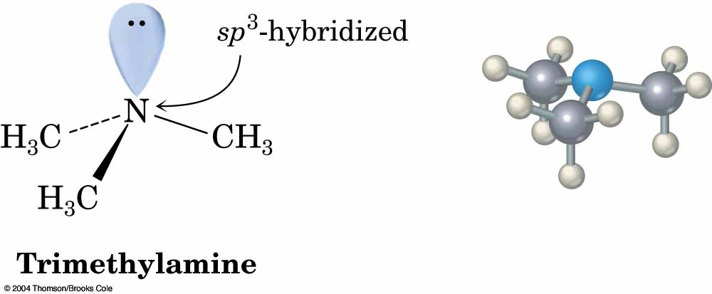
Structure and Bonding in Amines
Bonding to N is similar to that in ammonia: N is sp³-hybridized C–N–C bond angles are close to 109° tetrahedral value

Slide 12
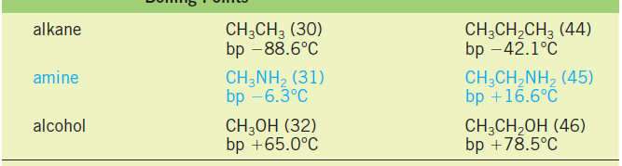
Physical Properties of Amines
Boiling Point
Methylamine and ethylamine are gases, but primary amines with three or more carbons are liquids.
Primary amines boil well above alkanes with comparable molecular weights, but below comparable alcohols.
Intermolecular N-H· · ·N hydrogen bonds are important and raise the boiling points of primary and secondary amines but are not as strong as the O-H · · · · O bonds of alcohols.
The reason for this is that nitrogen is not as electronegative as oxygen.
Tertiary amines are also polar compounds, but because hydrogen is not bonded to nitrogen, these amines are incapable of intermolecular hydrogen bonding.
Their boiling points are Lower than primary and secondary amines of identical molecular weights and Higher than those of alkanes of similar molecular weight.

Slide 13
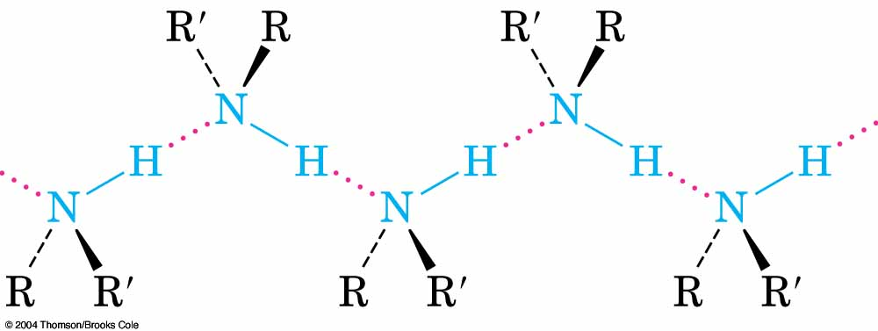
Solubility in Water
All three classes of amines can form hydrogen bonds with the -OH group of water (that is, O-H· · ·N).
Primary and secondary amines can also form hydrogen bonds with the oxygen atom in water: N-H· · ·O.
Amines with up to six carbons show appreciable solubility in water.

Slide 14
The Basicity of Amines
The unshared pair of electrons on the nitrogen atom dominates the chemistry of amines.
Because of this electron pair, amines are both basic and nucleophilic.
Aqueous solutions of amines are basic because of the following equilibrium:
The most convenient way to measure the basicity of an amine (RNH₂) is to look at the acidity of the corresponding ammonium ion (RNH₃⁺)
pK_{b} = - log K_{b}
Typical amines have K_{b} values = 10⁻³ to 10⁻⁴

Slide 15

 | K_{b}
Aliphatic amines | 10⁻³ – 10⁻⁴
Ammonia | 1.8 x 10⁻⁵
Aniline | 10⁻⁹ or less
Electron-donating groups increase the basicity of amines.
Electron-withdrawing groups decrease their basicity.
Amines are stronger bases than alcohols, ethers, or water

Slide 16
 | Structure | Basicity | Acidity of conjugate acid
compound |  | pK_{b} | pK_{a}
Ammonia | NH₃ | 4.7 | 9.3
Primary Amines
Methylamine | CH₃NH₂ | 3.4 | 10.6
Ethylamine | CH₃CH₂NH₂ | 3.2 | 10.8
Isopropylamine | (CH₃)₂CHNH₂ | 3.4 | 10.6
tert-Butylamine | (CH₃)₃CNH₂ | 3.6 | 10.4
Aniline | C₆H₅NH₂ | 9.4 | 4.6
Secondary amines
Dimethylamine | (CH3)2NH | 3.3 | 10.7
Diethylamine | (CH3CH2)2NH | 2.9 | 11.1
N-Methylaniline | C6H5NHCH3 | 9.2 | 4.8
Tertiary amines
Trimethylamine | (CH3)3N | 4.3 | 9.7
Triethylamine | (CH3CH2)3N | 3.2 | 10.8
N,N-Dimethylaniline | C6H5N(CH3)2 | 8.9 | 5.1

Slide 17
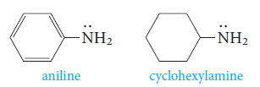
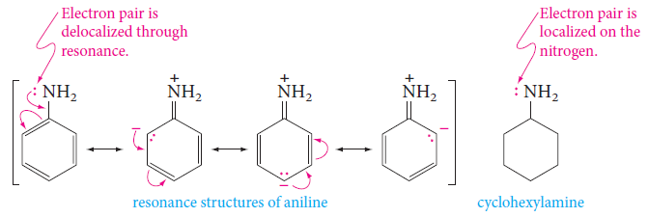
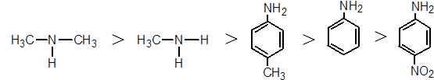
Aromatic amines are much weaker than aliphatic amines or ammonia.
Example: aniline is less basic than cyclohexylamine.
The reason is the resonance delocalization of the unshared electron pair that is possible in aniline, but not in cyclohexylamine:

Slide 18

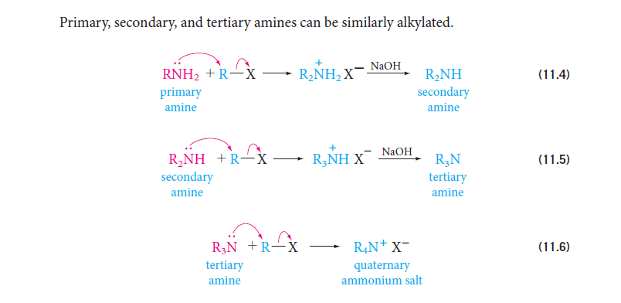
Preparation of Amines
1) Alkylation of Ammonia
Ammonia reacts with alkyl halides to give amines via a two-step process.
The first step is a nucleophilic substitution reaction.
The free amine can then be obtained from its salt by treatment with a strong base
Primary, secondary, and tertiary amines can be similarly alkylated.

Slide 19
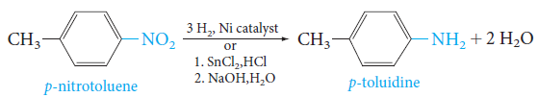
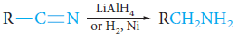
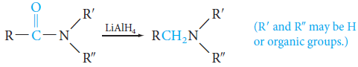
2) Reduction of Nitro Groups
The best route to aromatic primary amines is by reduction of the corresponding nitro compounds.
3) Reduction of Nitriles
Reduction of nitriles (cyanides) gives primary amines.
4) Reduction of Amides
Amides can be reduced to amines with lithium aluminum hydride.

Slide 20
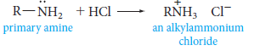
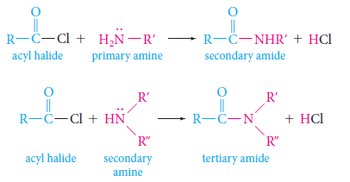
Reactions of Amines
1) Reactions with Acids: Salt Formation
Amines react with strong acids to form alkylammonium salts.
2) Acylation of Amines: Amides Formation
Primary and secondary amines react with acyl halides to form amides.

Slide 21
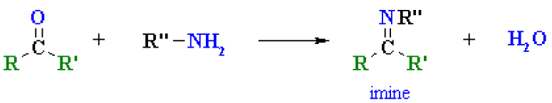
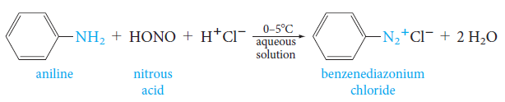
3) Imines Formation
Primary amines, R-NH₂ or ArNH₂, undergo nucleophilic addition with aldehydes or ketones in an acidic buffer to give substituted imines.
4) Aromatic Diazonium Salts
Primary aromatic amines react with nitrous acid at 0ºC to yield aryldiazonium ions.
The process is called diazotization.

Slide 22
They are useful in synthesis because the diazonium group (-N₂⁺) can be replaced by nucleophiles; the other product is nitrogen gas.

Slide 23
Uses of Amines
Amines are largely used in pharmaceutical industry.
Morphine and Demerol are used as analgesics that are pain killers.
Novocaine is used as anesthetic and Ephedra is a very common decongestant.
We use tetramethyl ammonium iodide for disinfecting drinking water.
They find large applications in man-made dyes.

