Slide 1

Fundamentals of Organic Chemistry
CHEM 109
For Students of Health Colleges
Credit hrs.: (2+1)
King Saud University
College of Science, Chemistry Department
CHEM 109
CHAPTER 6. CARBOXYLIC ACIDS AND THEIR DERIVATIVES

Slide 2
Learning Objectives
At the end of this chapter, students will able to:
Identify and name simple carboxylic acids.
Recognize the properties (structure, physical and chemical properties) of carboxylic acid .
Suggest preparation reactions from primary alcohols and from Grignard reagents and CO₂.
Predict the product of the reduction of a carboxylic acid and give the reagents required to perform this reaction.
Identify carboxylic acid derivatives as esters, amides, acid halides and acid anhydrides
Predict the products that will be formed when a carboxylic acid derivative is treated with an alcohol or amine.
Give the reagents required for the interconversion of carboxylic acid derivatives

Slide 3
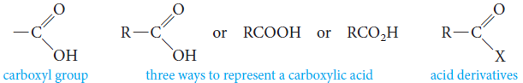




Structure of Carboxylic Acids
The functional group common to all carboxylic acids is the carboxyl group.
The name is a contraction of the parts: the carbonyl and hydroxyl groups.
The general formula for a carboxylic acid can be written in expanded or abbreviated forms.
Depending on whether an R or an Ar. residue is attached to the carboxyl group; Carboxylic acids are classified as;
Aliphatic Carboxylic Acids.
Aromatic Carboxylic Acids.
Fatty acids.
Long straight-chain carboxylic acids with even numbers of carbons, which were first isolated from fats and waxes.

Slide 4
Nomenclature of Carboxylic
Acids
Common Names
The common names of carboxylic acids all end in -ic acid.
These names usually come from some Latin or Greek word that indicates the original source of the acid.
Common name, substituents are located with Greek letters, beginning with the α–carbon atom.
IUPAC System
We replace the final e in the name of the corresponding alkane with the suffix -oic and add the word acid.
Alkane- e + oic acid = Alkanoic acid
IUPAC system, the chain is numbered beginning with the carboxyl carbon atom, and substituents are located in the usual way.

Slide 5
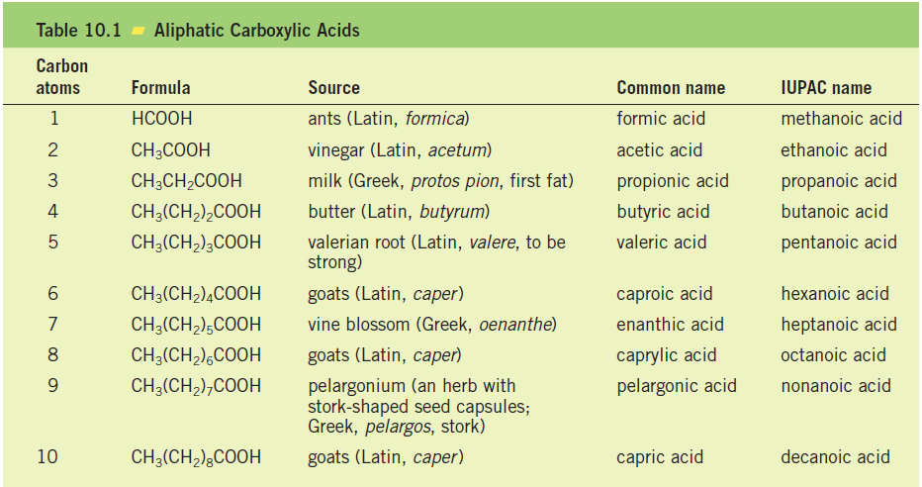

Slide 6
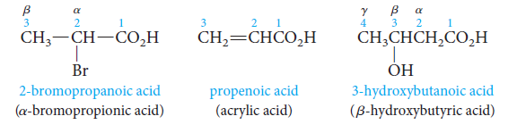
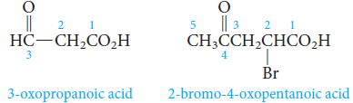

The carboxyl group has priority over alcohol, aldehyde, or ketone functionality in naming.
The prefix oxo- is used to locate the carbonyl group of the aldehyde or ketone.

Slide 7

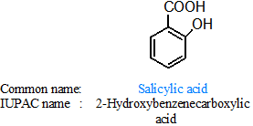
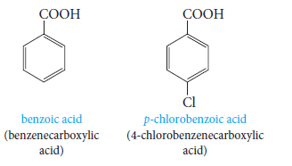
Cycloalkane carboxylic acid
When the carboxyl group is attached to a ring, the ending -carboxylic acid is added to the name of the parent cycloalkane. (i.e. Cycloalkanecarboxylic acid)
Aromatic acids are named by attaching the suffix -oic acid or -ic acid to an appropriate prefix derived from the aromatic hydrocarbon.

Slide 8
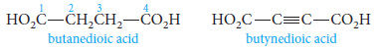
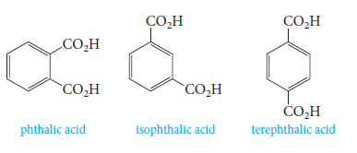
Dicarboxylic acids (acids that contain two carboxyl groups) are known almost exclusively by their common names.
Aliphatic dicarboxylic acids are given the suffix -dioic acid in the IUPAC system.
The three benzenedicarboxylic acids are generally known by their common names.
Common name:
IUPAC name:
Benzene-1,2-
dicarboxylic acid
Benzene-1,3-
dicarboxylic acid
Benzene-1,4-
dicarboxylic acid

Slide 9
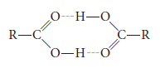
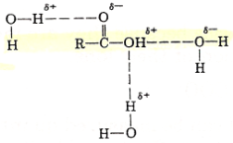
Physical Properties of Carboxylic
Acids
Carboxylic acids are polar and they form hydrogen bonds with themselves or with other molecules.
Carboxylic acids form dimer, with the individual units held together by two hydrogen bonds between electron-rich oxygens and electron-poor hydrogens.
Boiling Points
Therefore, they have high boiling points for their molecular weights-higher even those of comparable alcohols.
Solubility in water
Hydrogen bonding also explains the water solubility of the lower molecular weight carboxylic acids.
The first four aliphatic acids (formic through butyric) are completely miscible in water.
Aromatic acids are insoluble in water.

Slide 10
Solubility in H₂O at 25°C | b.p. °C | Mol. Wt. | Name | Structure
Very soluble Very soluble | 100 78 | 46 46 | Formic acid Ethyl alcohol | HCOOH CH₃CH₂OH
Very soluble Very soluble | 118 97 | 60 60 | Acetic acid n-Propyl alcohol | CH₃COOH CH₃CH₂CH₂OH
4.0 g/100 g H₂O 0.6 g/100 g H₂O | 187 156 | 102 102 | Valeric acid n-Hexyl alcohol | CH₃(CH₂)₃COOH CH₃(CH₂)₄CH2OH
Insoluble Insoluble | 250 250 | 122 122 | Benzoic acid 3-Phenylethanol | Ph-COOH Ph-CH₂CH₂OH

Slide 11
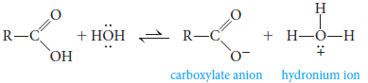
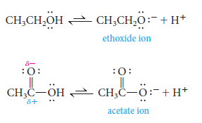
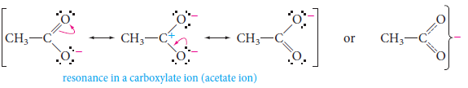
Acid Strength and Structure
Carboxylic acids (RCOOH) dissociate in water, yielding a carboxylate anion (RCOO⁻) and hydronium ion.
Why carboxylic acids are more acidic than alcohols?
In ethoxide ion, the negative charge is localized on a single oxygen atom.
In acetate ion, on the other hand, the negative charge can be delocalized through resonance.

Slide 12
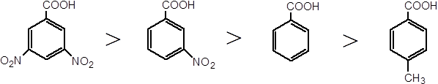
Effect of Structure on Acidity; the Inductive Effect
Acidities can vary depending on what other groups are attached to the molecule.
Recall that electron-withdrawing groups (-I) enhance acidity, and electron-releasing groups (+I) reduce acidity.
This effect relays charge through bonds, by displacing bonding electrons toward electronegative atoms, or away from electropositive atoms.

Slide 13

Effect of Structure on Acidity; the Inductive Effect
Formic acid is a substantially stronger acid than acetic acid.
This suggests that the methyl group is more electron-releasing (hence anion-destabilizing and acidity-reducing) than hydrogen.
Example: acetic acid with those of mono-, di-, and trichloroacetic acids.
Comparison of acid strengths of acetic Acid and chlorinated acetic acids

Slide 14
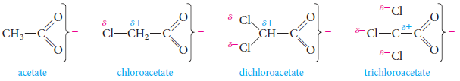
Effect of Structure on Acidity; the Inductive Effect
The more chlorines, the greater the effect and the greater the strength of the acid.

Slide 15
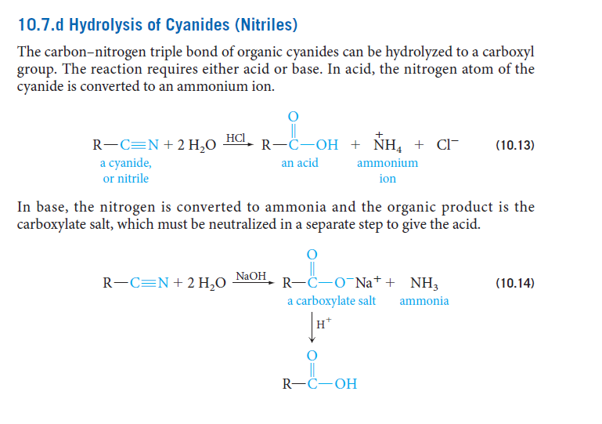

Preparation of Carboxylic Acids
1) Hydrolysis of Cyanides (Nitriles)
The reaction requires either acid or base.
In acid, the nitrogen atom of the cyanide is converted to an ammonium ion.
In base, the nitrogen atom is converted to ammonia and the organic product is the carboxylate salt, which must be neutralized in a separate step to give the acid.
Alkyl cyanides are generally made from the corresponding alkyl halide.

Slide 16
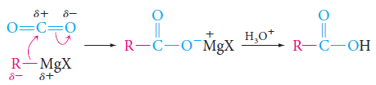
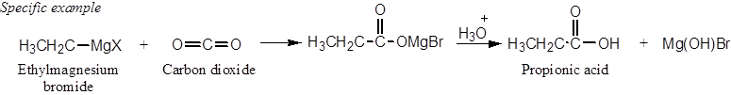
2) Reaction of Grignard Reagents with Carbon Dioxide (Carbonation of Grignard Reagent)
Grignard reagents add to the carbonyl group of carbon dioxide to give acids, after protonation of the intermediate carboxylate salt with a mineral acid like aqueous HCl.
The acid obtained has one more carbon atom (the reaction provides a way to increase the length of a carbon chain).
+ Mg(OH)₂X

Slide 17
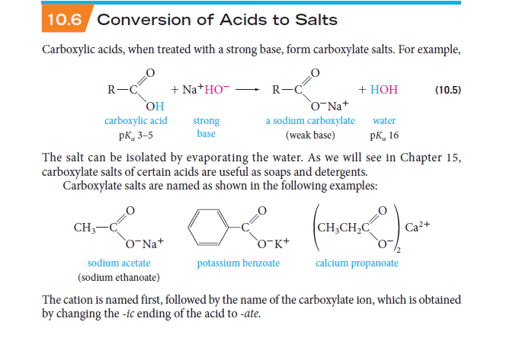

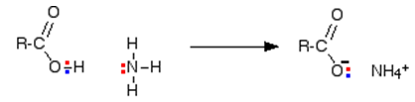
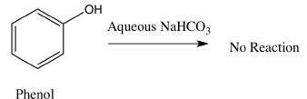

Reactions of Carboxylic Acids
1) Reactions with Bases: Salt Formation
Carboxylic acids, when treated with a strong base, form carboxylate salts.
Na⁺ ⁻OH
Examples.

Slide 18

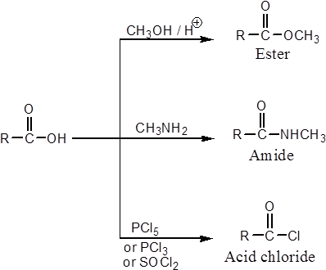
2) Nucleophilic Substitution Reactions

Slide 19

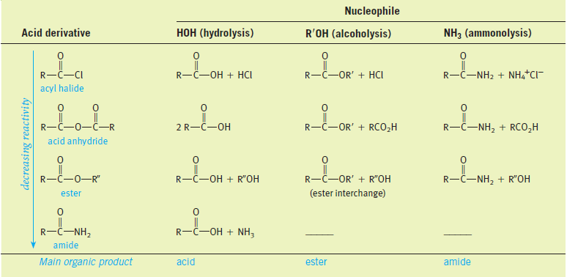
Carboxylic Acids Derivatives
Carboxylic acid derivatives are compounds in which the hydroxyl part of the carboxyl group is replaced by various other groups.
All acid derivatives can be hydrolyzed to the corresponding carboxylic acid.

Slide 20

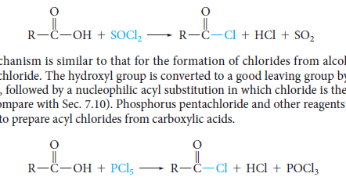
Acid Chloride
Acyl chlorides have the general formula RCOCl.
Acyl chlorides are more common and less expensive than bromides or iodides.
Nomenclature:
Acyl chlorides, or acid chlorides, are named by replacing the -ic acid ending of the parent acid by -yl chloride.
Preparation:
They can be prepared from acids by reaction with thionyl chloride or phosphorous pentachloride.

Slide 21
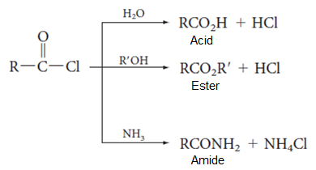


Reactions: They can react rapidly with most nucleophile.
Examples:

Slide 22
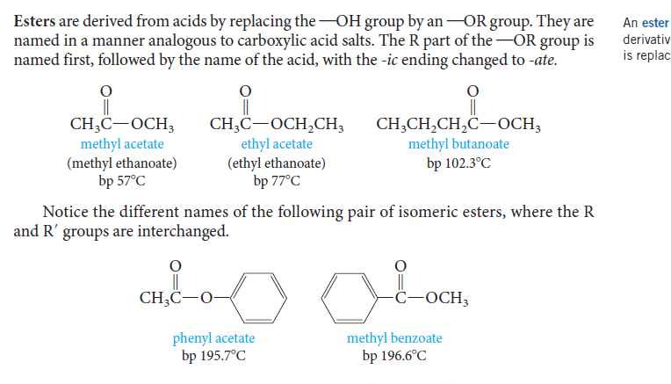
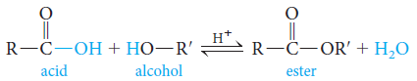
Esters
Esters are derived from acids by replacing the –OH group by an –OR group and have the general formula R/COOR.
Nomenclature:
They are named in a manner analogous to carboxylic acid salts.
The R part of the –OR group is name first, followed by the name of the acid, with the –ic acid ending changed to –ate.
Preparation:
When a carboxylic acid and an alcohol are heated in the presence of an acid catalyst (HCl or H₂SO₄), an equilibrium is established with the ester and water.

Slide 23
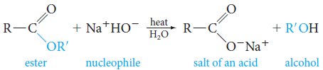
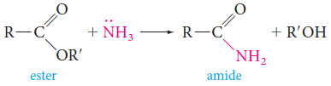
Reactions
Saponification; esters are commonly hydrolyzed with base.
Na⁺ ⁻OH
Ammonia converts esters to amides.

Slide 24
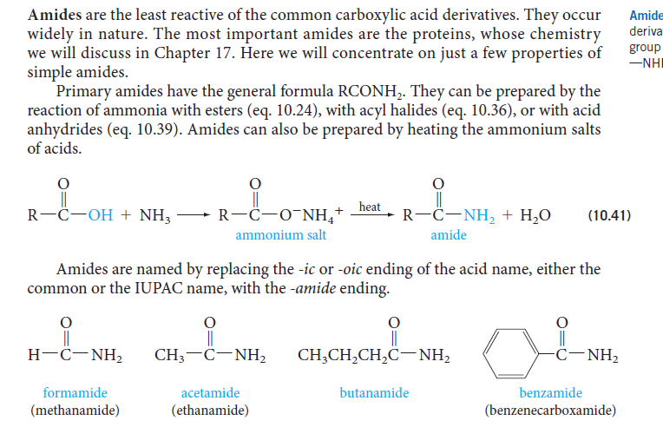

Amides
Amides are the least reactive of the common carboxylic acid derivatives.
Primary amides have general formula RCONH₂.
Nomenclature:
Amides are named by replacing the –oic acid ending of the acid name with the –amide ending, This will be either for the common or the IUPAC name.

Slide 25
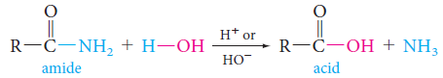
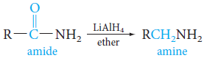
Preparation:
They can be prepared by the reaction of ammonia with esters, with acyl halides, or with acid anhydrides.
Amides can also prepared by heating the ammonium salts of acids as shown in the following scheme.
Reactions
Amides react with nucleophiles and they can be hydrolyzed by water.
Amides can be reduced by lithium aluminums hydride to give amines.

Slide 26
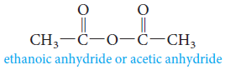
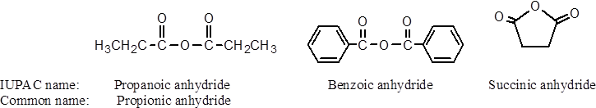
Acid Anhydrides
Acid anhydrides have general formula RCOOCOR.
Nomenclature:
The name of an anhydrides is obtained by naming the acid from which is derived and replacing the word acid with anhydride.

Slide 27
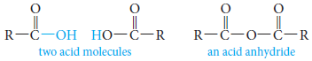

Preparation
Acid anhydrides are derived from acids by removing water from two carboxyl groups under heating and effect of suitable catalyst.
Anhydrides can also be prepared from acid chlorides and carboxylate salts.
This method is used for preparing anhydrides derived from two different carboxylic acids (mixed anhydrides).

Slide 28
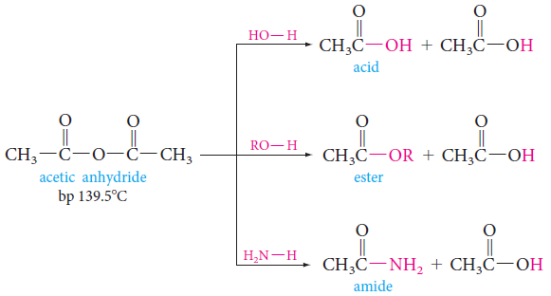
Reactions
Anhydrides undergo nucleophilic acyl substitution reactions (They are more reactive than esters, but less reactive than acyl halides).

Slide 29
Summary

Slide 30
Uses of Carboxylic Acids
Salicylic acid
It can be used to create acne medications.
Therefore, It is used frequently in cleansers, liquid foundations, moisturizers, anti-aging hydrating creams, eye gels, and sun screens.
Acetylsalicylic Acid in Aspirin
Acetic acid acts as the precursor for the formation of an ester of salicylic acid which is used for aspirin (Acetyl Salicylic acid) production.
Citric Acid
Citric acid has a sour taste and is often used to add flavor to sour candies (covered in a white powder).
Because citric acid is non-toxic and acidic, it is an ideal preservative. (it causes the pH to drop to a point where it is difficult for bacteria to survive).
Industrial uses
Manufacturing of soaps and detergents (oleic acid, Palmitic acid and stearic acid).

