Slide 1

Fundamentals of Organic Chemistry
CHEM 109
For Students of Health Colleges
Credit hrs.: (2+1)
King Saud University
College of Science, Chemistry Department
CHAPTER 10: Nucleic Acids
CHEM 109

Slide 2
Learning Objectives
At the end of this chapter, students will be able to:
Describe the structural building blocks of RNA and DNA
Differentiate between RNA and DNA structure.
Know the structure of nucleotides and nucleosides.
Recognize the important of both RNA and DNA

Slide 3
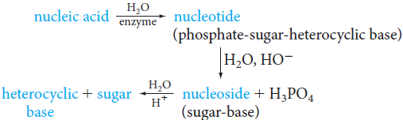
The General Structure of Nucleic
Acids
Nucleic acids are molecules that allow organisms to transfer genetic information from one generation to the next.
Nucleic acids, are linear polymers (chains) made out of units called nucleotides.
Hydrolysis of nucleic acids gives nucleotides, which are the building blocks of nucleic acids.

Slide 4
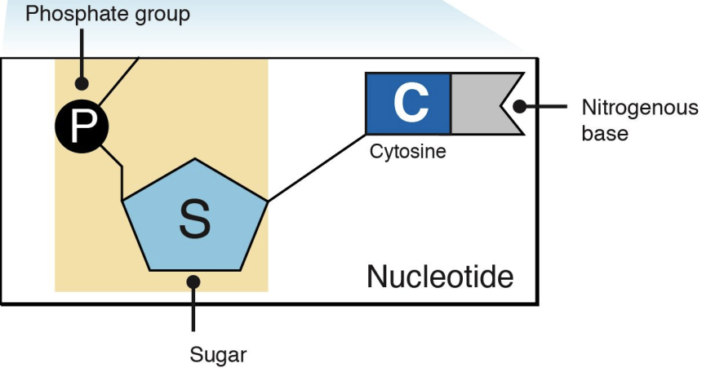
Nucleotides : contain three parts:
A Nitrogenous Base (Nucleobase)
A Five-Carbon Sugar (Pentose)
A Phosphate Group
Nucleosides : contain two parts:
A Nitrogenous Base (Nucleobase)
A Five-Carbon Sugar (Pentose)

Slide 5
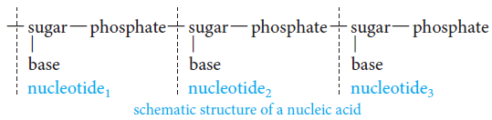
The overall structure of the nucleic acid is a macromolecule with a backbone of sugar molecules connected by phosphate links and with a base attached to each sugar unit.

Slide 6
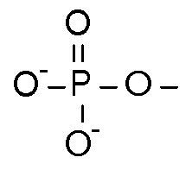
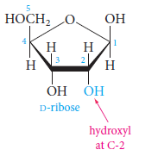
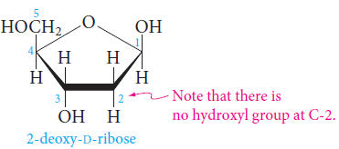
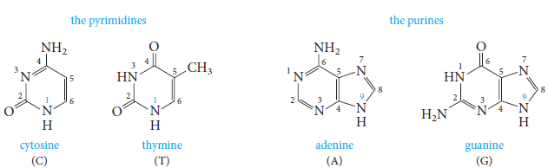
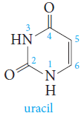
Phosphate group
Pentose Sugar
Ribonucleic acid (RNA) contains the pentose ribose.
Deoxyribonucleic acid (DNA) contains the pentose deoxyribose.
Heterocyclic Base
The sugars also contain a pyrimidine or purine base present on the 1-carbon replacing the hydroxyl group with a base.

Slide 7
Differences Between DNA and RNA Composition
 | DNA | RNA
Five-Carbon Sugar | Deoxyribose | Ribose
Nitrogenous Bases | Adenine, Guanine, Cytosine, and Thymine or methyluracil | Adenine, Guanine, Cytosine, and Uracil

Slide 8
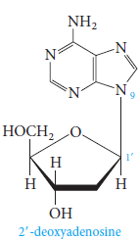
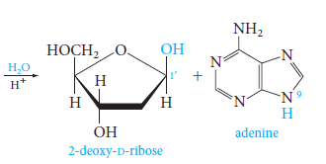
Nucleoside
The combination of the pentose sugar and a purine or pyrimidine base.
Base
Sugar

Slide 9
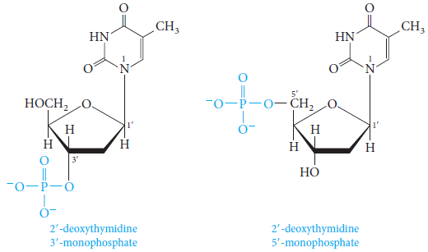
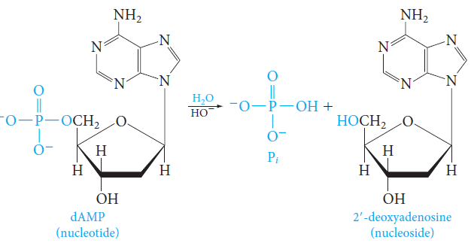
Nucleotides are phosphate esters of nucleosides.
A hydroxyl group in the sugar part of a nucleoside is esterified with phosphoric acid.
In DNA nucleotides, either the 3’ or the 5’ hydroxyl group of 2-deoxy-d-ribose is esterified.
Nucleotides can be hydrolyzed by aqueous base (or by enzymes) to nucleosides and phosphoric acid.

Slide 10
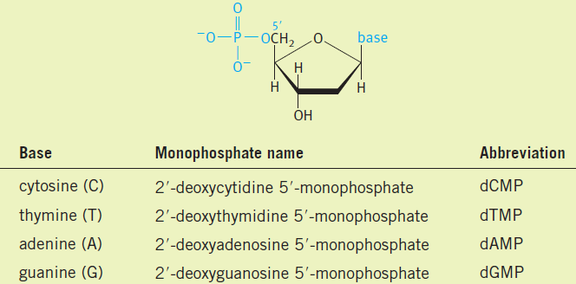
In these abbreviations, letter d stands for 2-deoxy-d-ribose, the next letter refers to the heterocyclic base, and MP stands for monophosphate.

Slide 11
Nucleic acids are polynucleotides attached by the phosphate moieties through the 3′ and 5′ sites on the pentose.
The name nucleic acid is derived from the fact that they are acidic, containing a phosphoric acid moiety, and are found in the nuclei of cells.
Pure nucleic acid was isolated by Levene in the early 1900s.
He showed that either D-ribose or D-deoxyribose was present in what are now known as ribonucleic acid (RNA) and deoxyribonucleic acid (DNA).
There are two major types of nucleic acids:
Deoxyribonucleic acid (DNA)
Ribonucleic acid (RNA).

Slide 12
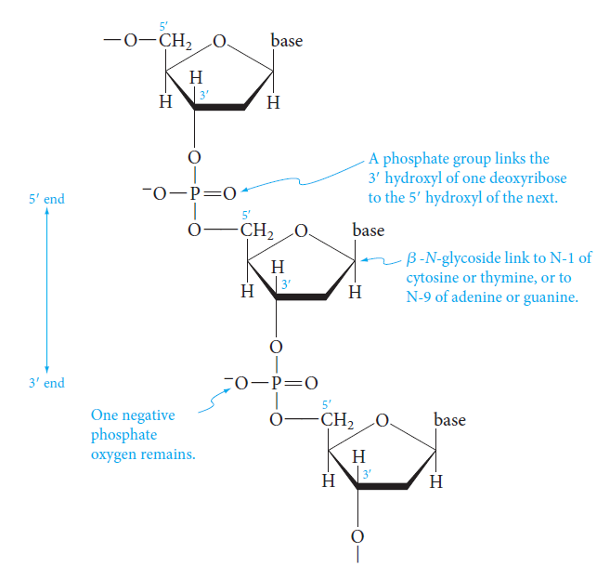
The Primary Structure of DNA
Deoxyribonucleic Acid
(DNA)
In DNA, 2-deoxy-d-ribose and phosphate units alternate in the backbone.
The 3’ hydroxyl of one ribose unit is linked to the 5’ hydroxyl of the next ribose unit by a phosphodiester bond.
The heterocyclic base is connected to the anomeric carbon of each deoxyribose unit by a β-N-glycosidic bond.
In DNA, there are no remaining hydroxyl groups on any deoxyribose unit.
Each phosphate, however, still has one acidic proton that is usually ionized at pH 7, leaving a negatively charged oxygen.
A segment of a DNA chain
A complete description of any particular DNA molecule, which may contain thousands or even millions of nucleotide units, would have to include the exact sequence of heterocyclic bases (A, C, G, and T) along the chain.

Slide 13
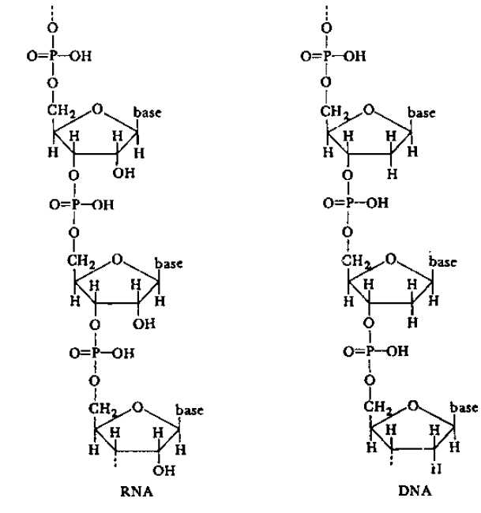
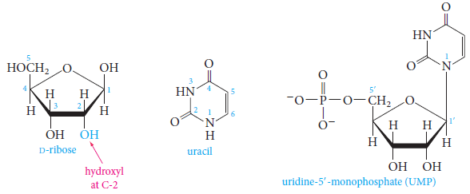
Ribonucleic Acid
(RNA)
RNA differs from DNA in three important ways:
The sugar is D-ribose;
Uracil replaces thymine as one of the four heterocyclic bases
Many RNAs are
Single-stranded segments,
Combinations of complementary two-stranded helices,
Complex structures.
X

Slide 14
Importance of DNA and
RNA
Heredity is encoded in DNA within the chromosomes.
RNA (ribonucleic acid) is the messenger of DNA within the cell.
Forms of RNA direct the cell to manufacture specific enzymes and other proteins.
DNA functions by carrying the template or "map" of chemical compounds, amino acids, that are used to build proteins.
DNA directs the production of proteins by providing the sequence of amino acids necessary to produce specific proteins.

