Slide 1
241 Chem
CH-7
Carboxylic Acids and their derivatives

Slide 2
Learning Objectives
By the end of this chapter the student will:
Structure of Carboxylic Acids and their derivatives
Nomenclature Carboxylic Acids and their derivatives
Physical Properties of Carboxylic Acids and their derivatives
Preparation of Carboxylic Acids and their derivatives
Reactions of Carboxylic Acids and their derivatives

Slide 3
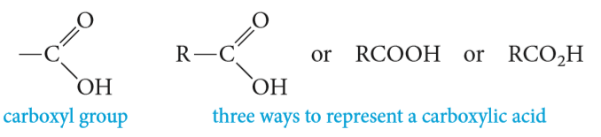
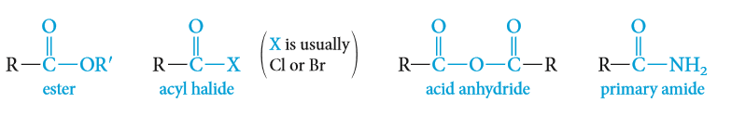
Structure of carboxylic Acids and their derivatives
The combination of a carbonyl group and a hydroxyl on the same carbon atom is called a carboxyl group
Carboxylic acids are strong organic acids which contain the carboxyl group.
Carboxylic acid derivatives, in which the hydroxyl group of an acid is replaced by other functional groups.
Carboxylic acids are classified as aliphatic or aromatic depending on whether R or an Ar is attached to the carboxylic group R-COOH or Ar-COOH

Slide 4
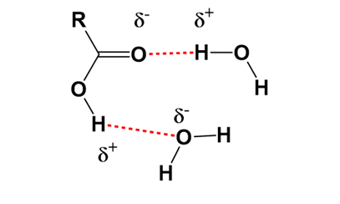
Physical Properties of Carboxylic acids
Solubility
Carboxylic acids interact with water molecules by hydrogen bonding through both the carbonyl and hydroxyl groups. Because of greater hydrogen bonding interactions, carboxylic acids are more soluble in water than are alcohols, ethers, aldehydes, and ketones of comparable molecular weight.
A carboxylic acid consists of two regions of distinctly different polarity: a polar hydrophilic carboxyl group and, a nonpolar hydrophobic hydrocarbon chain. The hydrophilic carboxyl group increases water solubility; the hydrophobic hydrocarbon chain decreases water solubility.
As the size of the hydrocarbon chain increases relative to the size of the hydrophilic group, water solubility decreases.

Slide 5
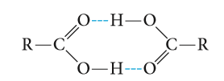
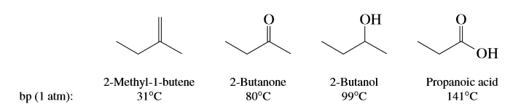
Physical Properties of Carboxylic acids
Boiling Point
Carboxylic acids have significantly higher boiling points than other types of organic compounds of comparable molecular weight, such as alcohols, aldehydes, and ketones.
The hydroxyl group of one carboxylic acid molecule acts as a proton donor toward the carbonyl oxygen of a second.
The hydroxyl proton of the second carboxyl function interacts with the carbonyl oxygen of the first. The result is that the two carboxylic acid molecules are held together by two hydrogen bonds. So efficient is this hydrogen bonding that some carboxylic acids exist as hydrogen-bonded dimers even in the gas phase. In the pure liquid a mixture of hydrogen-bonded dimers and higher aggregates is present.

Slide 6
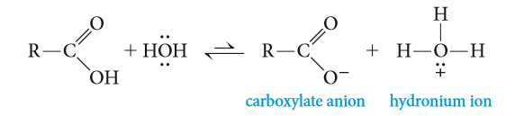
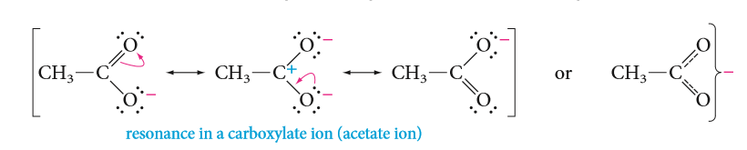
Physical Properties of Carboxylic acids
Acidity
Carboxylic acids are the most acidic class of compounds, they are much stronger acids than water and alcohols.
Dissociation of either an acid or an alcohol involves breaking an O-H bond, but dissociation of a carboxylic acid gives a carboxylate ion with the negative charge spread out equally over two oxygen atoms, compared with just one oxygen in an alkoxide ion .This charge delocalization makes the carboxylate ion more stable than the alkoxide ion; therefore, dissociation of a carboxylic acid to a carboxylate ion is less endothermic than dissociation of an alcohol to an alkoxide ion.

Slide 7
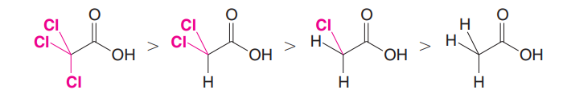
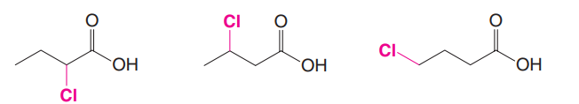

Physical Properties of Carboxylic acids
Effect of Structure on Acidity; the Inductive Effect Revisited
The most important factor operating here is the inductive effect of the groups close to the carboxyl group. This effect relays charge through bonds, by displacing bonding electrons toward electronegative atoms, or away from electropositive atoms. Recall that electron-withdrawing groups enhance acidity, and electron-releasing groups reduce acidity.

Slide 8
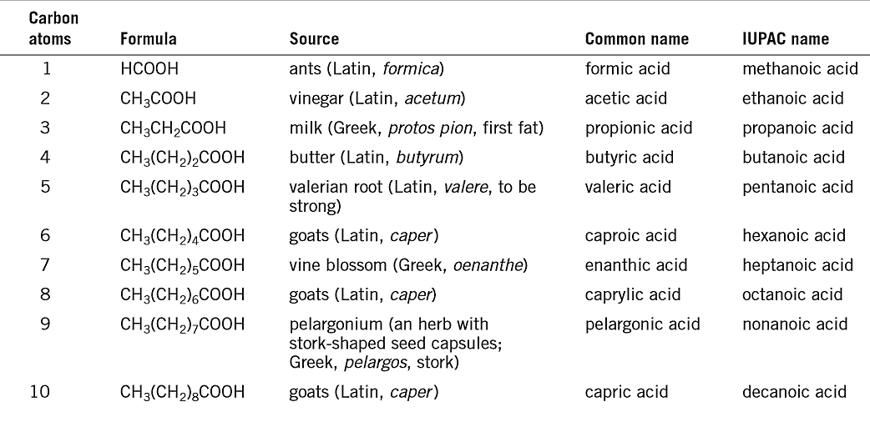
Nomenclature of carboxylic Acids
The IUPAC name:
The root name is based on the longest continuous chain of carbon atoms bearing the carboxyl group.
The -e is replaced by -oic acid.
The chain is numbered starting with the carboxyl carbon atom.
Cycloalkanes with carboxyl substituents are named as cycloalkanecarboxylic acids.
The Common name:
In common names, the positions of substituents are named using Greek letters ($α$, β, ɣ , δ…..) beginning with carbon next the carboxyl group.

Slide 9
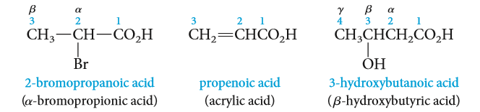
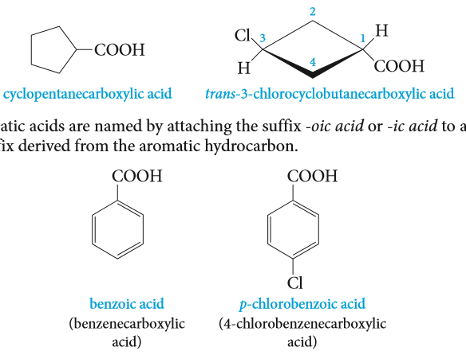
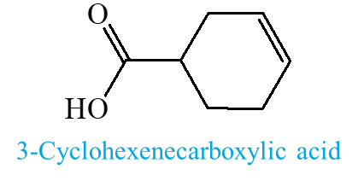
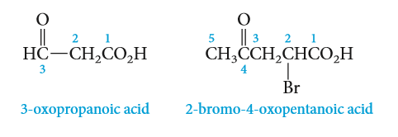

IUPAC name:
Common name:
trans-3-Phenylpropenoic acid
(Cinnamic acid)
Benzenecarboxylic acid
2-Aminobenzoic acid
4-chlorobenzoic acid
4-Formyl-3-methylhexanoic acid
4-Formyl-3-methyl-6-oxohexanoic acid

Slide 10

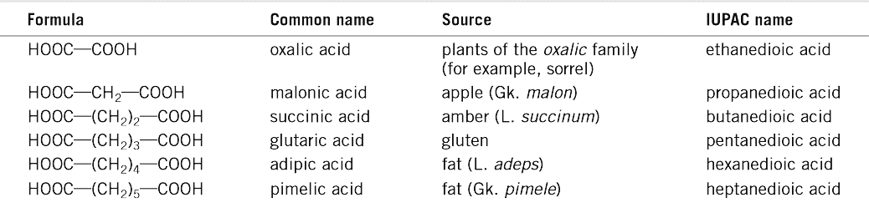
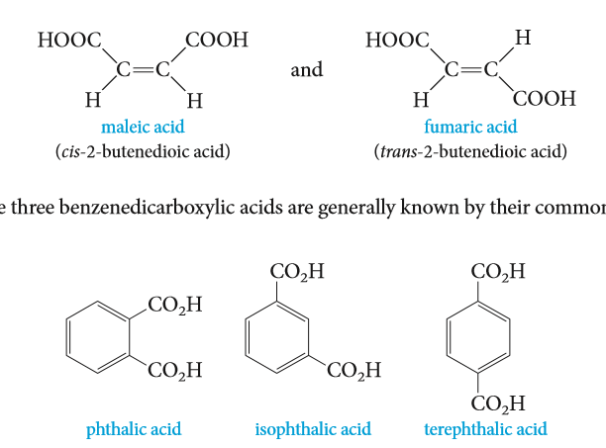
Dicarboxylic Acids:
Dicarboxylic acids are named as alkanedioic acids in the IUPAC system.
Many dicarboxylic acids occur in nature and go by their common names, which are based on their source.
IUPAC name:
Common name:
cis-2-butenedioic acid
maleic acid
trans-2-butenedioic acid
fumaric acid
1,2-Benzenedicarboxylic acid
phthalic acid
1,3-Benzenedicarboxylic acid
isophthalic acid
1,4-Benzenedicarboxylic acid
terephthalic acid

Slide 11
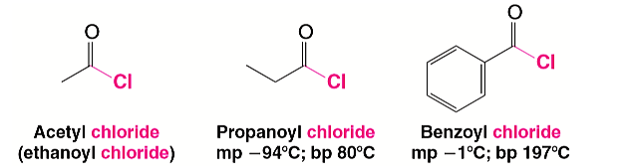
Nomenclature of Acyl Chlorides
Nomenclature of carboxylic Acid derivatives
Acyl chlorides are also called acid chlorides.
They are named by dropping -ic acid from the name of the acid and then adding -yl chloride.
Ethanoyl chloride
Acetyl chloride
Propanoyl chloride
3-Butenoyl chloride
3-Cyclohexenecarbonyl chloride
Benzoyl chloride
5-Bromo-2-methylbenzoyl chloride

Slide 12
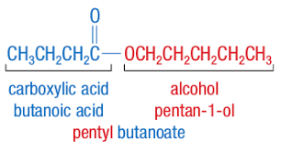
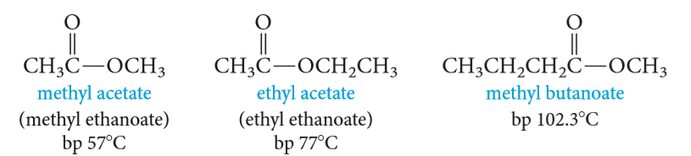
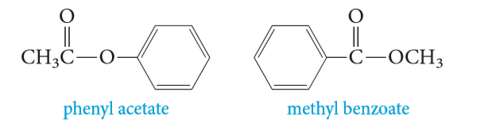
Nomenclature of carboxylic Acid derivatives
Nomenclature of Esters
The names of esters are derived from the names of the alcohol (with the ending -yl) and the acid (with replacing of the ending –ic acid by –ate).
Methyl ethanoate
methyl acetate
Ethyl ethanoate
ethyl acetate
isopropyl-4-hydroxy-5-methyl-5-hexenoate

Slide 13
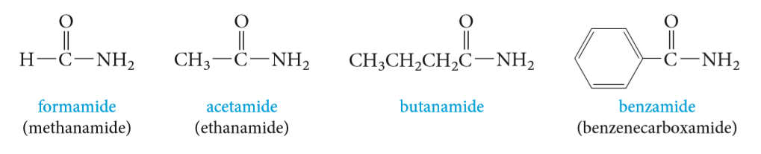
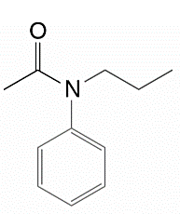
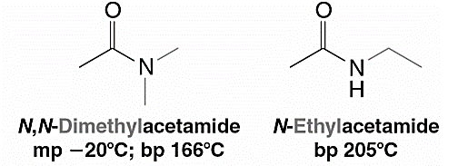
Nomenclature of carboxylic Acid derivatives
Nomenclature of Amides
Amides are named by replacing the -oic acid ending of the acid name, either the common or the IUPAC name, with the -amide ending.
Alkyl groups on the nitrogen atom of amides are named as substituents, and the named substituent is prefaced by N- or N,N-
Methanamide
formamide
Ethanamide
actamide
N,N-Dimethylethanamide
N-Ethylethanamide
N-Phenyl-N-propylethanamide

Slide 14
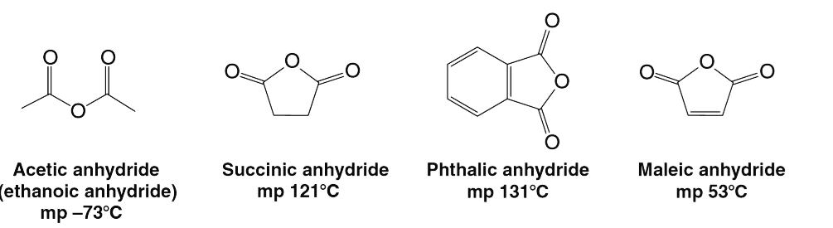
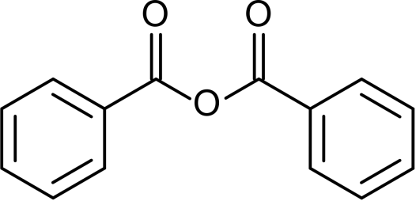
Nomenclature of carboxylic Acid derivatives
Nomenclature of Acid Anhydrides
Most anhydrides are named by dropping the word acid from the name of the carboxylic acid and then adding the word anhydride
Ethanoic anhydride
acetic anhydride
Butandioic anhydride
succinic anhydride
Benzoic anhydride
Phthalic anhydride
Cyclohexanecarboxylic anhydride
Benzoic ethanoic anhydride

Slide 15
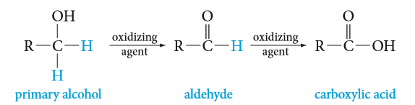
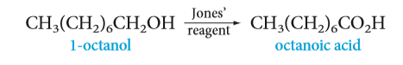
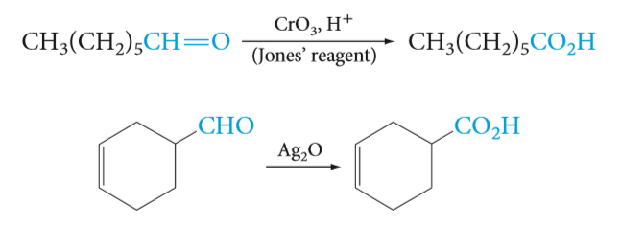
Preparation of Carboxylic Acids
1- Oxidation of aldehydes and primary alcohols:
Strong oxidizing agent
Weak oxidizing agent
Potassium permanganate KMnO₄ ,OH⁻/ H₃O⁺
Chromic oxide CrO₃ / H₂SO₄ (H₂CrO₄ Jones’ reagent )
silver oxide Ag₂O
Chromic oxide CrO₃ / pyridine
Pyridinium chlorochromate PCC / methylene chloride CH₂Cl₂

Slide 16
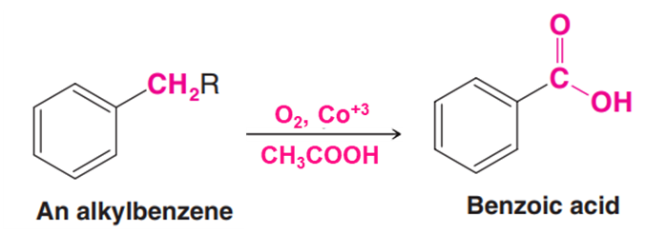
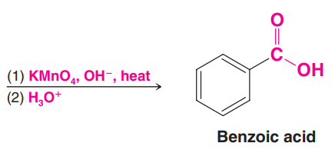
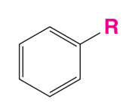
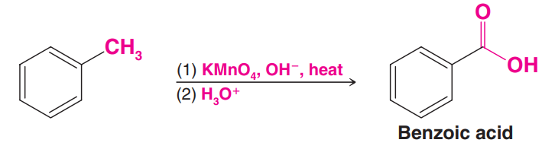
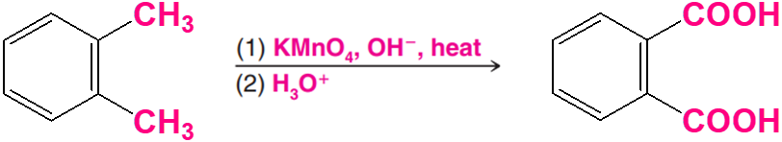
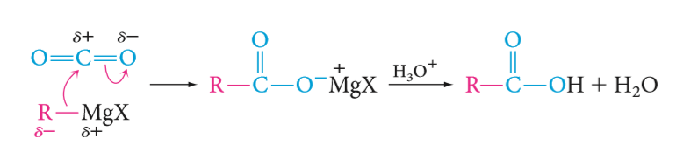
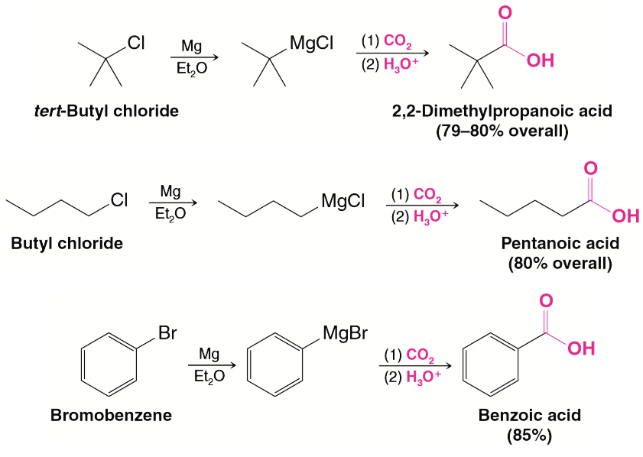
Preparation of Carboxylic Acids
2- Oxidation of Aromatic Side Chains:
3- Reaction of Grignard Reagents with Carbon Dioxide:

Slide 17
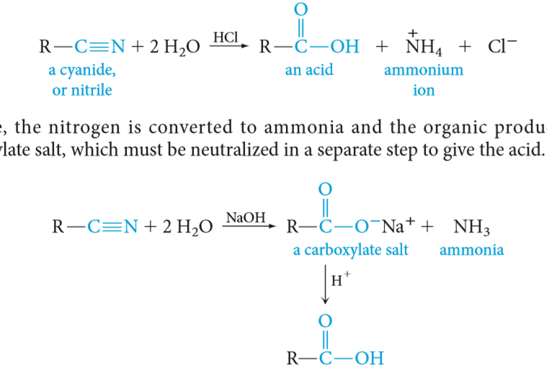
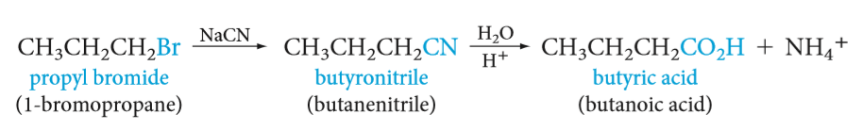
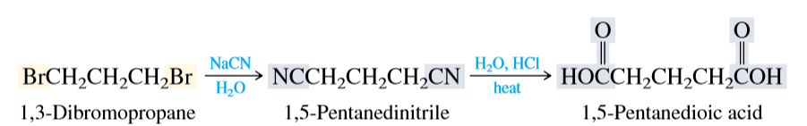
4- Hydrolysis of cyanohydrins and other nitriles:
Preparation of Carboxylic Acids
In Acid:
In Base:

Slide 18
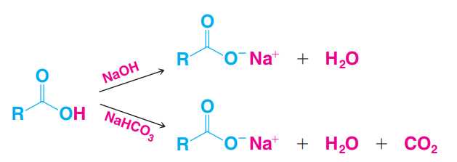
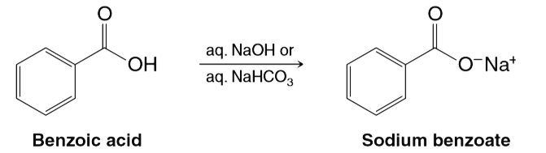
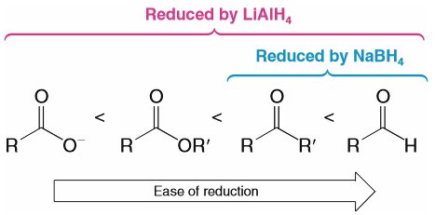
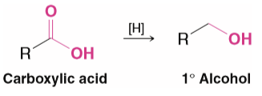
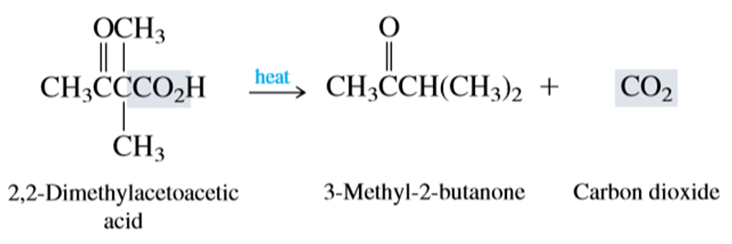
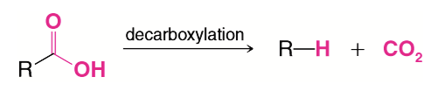
Reaction of Carboxylic Acids
1- Reaction with Bases: NaOH or NaHCO₃
2- Reduction of carbonyl group: Addition of metal hydrides (formation of alcohol)
3- Decarboxylation of Carboxylic Acids: Carboxylic acid loses CO₂

Slide 19
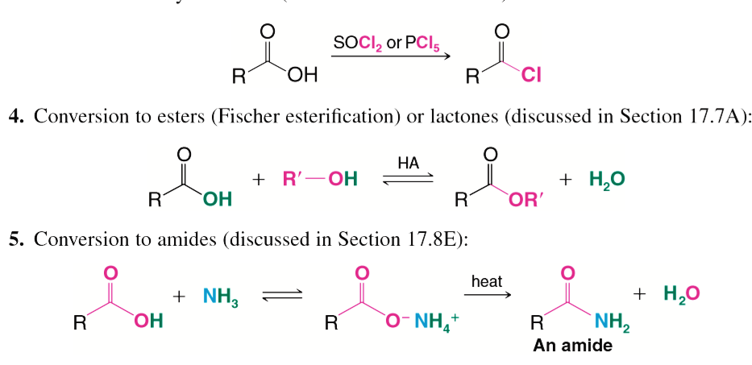
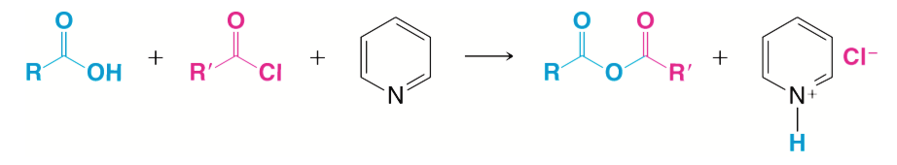
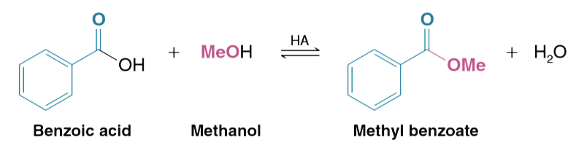
Reaction of Carboxylic Acids
4- Nucleophilic Substitution of Hydroxyl Group
a) Conversion to acyl chlorides:
c) Conversion to acid anhydrides:
Pyridine
b) Conversion to esters:
d) Conversion to amides:

Slide 20
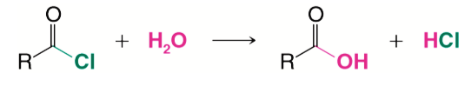
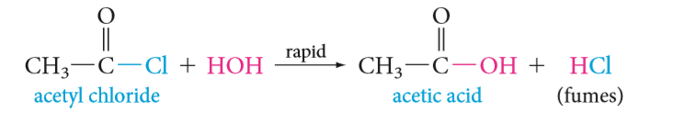
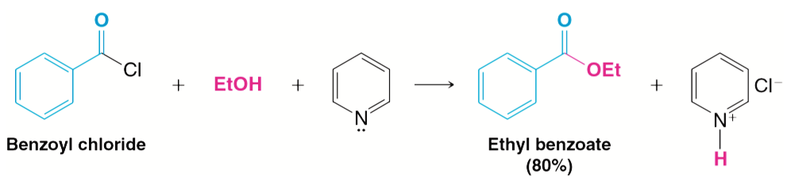

Preparation and Reaction of Acid derivatives
Preparation of Acyl Chlorides
Reaction of Acyl Chlorides
1- Conversion to Acids (hydrolysis):
2- Conversion to Esters:

Slide 21





Reaction of Acyl Chlorides
3- Conversion to Amides:
4- Conversion to Acid Anhydrides:
Pyridine
5- Conversion to Ketones (Friedel–Crafts acylation):

Slide 22





Preparation and Reaction of Acid derivatives
Preparation of Esters: Esteriﬁcation
1- Esters from Carboxylic Acid :
2- Esters from Acyl Chlorides:
3- Esters from Carboxylic Acid Anhydrides:

Slide 23





Preparation of Esters: Esteriﬁcation
4- Esters can synthesized by Transesteriﬁcation:
Cyclic Esters: Lactones
Carboxylic acids whose molecules have a hydroxyl group on a γ or δ carbon undergo an intramolecular esteriﬁcation to give cyclic esters known as γ - or δ -lactones.
Hint:

Slide 24





Preparation and Reaction of Acid derivatives
Reaction of Esters
1- Saponiﬁcation of Esters:
2- Ammonolysis of Esters:
3- Reduction of Esters:

Slide 25




Reaction of Esters
4- Reaction of Esters with Grignard Reagents:
5- The α -Hydrogen of Esters: The Claisen Condensation:
Being adjacent to a carbonyl group, the α-hydrogens of an ester are weakly acidic and can be removed by a strong base.

Slide 26







Preparation and Reaction of Acid derivatives
Preparation of Amides

Slide 27







Reaction of Amides
1- Conversion to acids (hydrolysis):
Acidic Hydrolysis:
Basic Hydrolysis:
2- Nitriles from the Dehydration of Amides:
Benzonitrile
3- Reduction of Amides:
Benzylamine
4- Hofmann degradation:
Aniline

Slide 28

Preparation and Reaction of Acid derivatives
Preparation of Acid Anhydride
Pyridine
Cyclic anhydrides can sometimes be prepared simply by heating the appropriate dicarboxylic acid.

Slide 29






Reaction of Acid Anhydride
1- Conversion to Acids (hydrolysis):
2- Conversion to Esters:
3- Conversion to Amides:
4- Conversion to Aryl ketones (Friedel–Crafts acylation):

