Slide 1
108 Chem
Chapter 6
Organic Halogen compounds

Slide 2
Organic Halides and their uses
Organic Halides are a large class of natural and synthetic chemicals that contain one or more halogens (fluorine, chlorine, bromine, or iodine) combined with carbon and other elements.
Halogen compounds are very important for a number of reasons:
  Simple alkyl and aryl halides (especially: Cl & Br) are versatile reagent in syntheses.
  Halogen can be converted to unsaturated compounds through dehydrogenation (Elimination reactions).
  Halogen can be replaced by many other functional groups (substitution reactions).

Slide 3
Classification Alkyl Halides
1.Alkyl Halides, R-X: compounds which have a halogen atom bonded to one sp³ hybrid C atom. Alkyl halides are also called haloalkanes.( primary (1°), secondary (2°) or tertiary (3°))
Compound | CH₃-Cl | CH₃-CH₂-Br | (CH₃)₂-CHF
Common name | Methyl Chloride | Ethyl bromide | Isopropyl fluoride
IUPAC name | Chloromethane | Bromoethane | 2-Fluoropropane
Class | 1° | 1° | 2°
Compound
Common name | Cyclohexyl Iodide | t.Butyl bromide | Methylcyclopentyl chloride
IUPAC name | Iodocyclohexane | 2-Bromo-2-methylpropane | 1-Chloro-1-methylcyclopentane
Class | 2° | 3° | 3°

Slide 4
2. Vinylic Halides, : has a halogen atom bonded to one sp² hybrid C atom.
C=C-X
CH₂=CHBr
Common name: Vinyl bromide
IUPAC name: Bromoethene
1-Chlorocyclobutene
3. Aryl Halides, Ar-X : has a halogen atom bonded directly to an aromatic ring.
Chlorobenzene
Common name: p-Bromotoluene
IUPAC name: 4-Bromotoluene
4. Allylic Halides, C=C-C- X : has a halogen atom bonded to one sp³ hybrid C atom.
CH₂=CHCH₂Cl
Common name: Allyl chloride
IUPAC name: 3-Chloro-1-propene
3-Chlorocyclopentene
5. Benzylic halides, Ar-C-X : has a halogen atom bonded to Carbone one away from aromatic ring.
Common name: Benzyl Chloride
IUPAC name: Chloromethylbenzene
Diphenyl methyl bromide
Bromodiphenylmethane

Slide 5
Nomenclature OF Alkyl halides
IUPAC names derived from the names of parent organic compound (alkane or alkene or alkyne or alcohol or aldehydes and so on) with a prefix indicating halogens and their positions.
Common names derived from the corresponding alkyl group followed by the name of halogen atom.

Slide 6
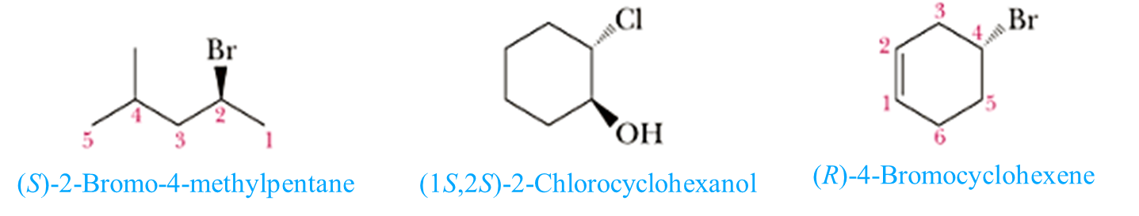
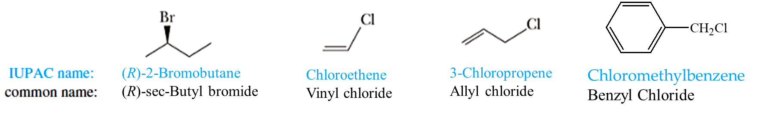
2-Chlorocyclohexanol
4-Bromocyclohexene
Chloromethylbenzene
Benzyl Chloride

Slide 7
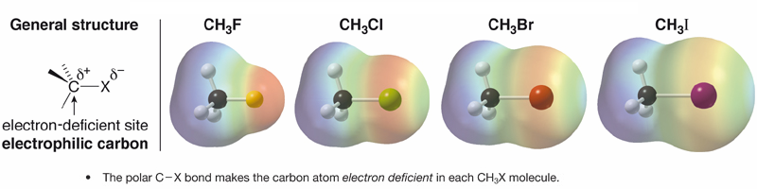
Physical Properties
Polarity
Fluorine, chlorine, bromine and iodine are all more electronegative than carbon ; as a result, C-X bonds with these atoms are polarized with a partial negative charge on halogen and a partial positive charge on carbon.

Slide 8
Physical Properties
Solubility
Alkyl halides have some polar character, but only alkyl fluorides have an atom that can form a hydrogen bond with water. The other alkyl halides are less soluble in water
In General, all organic halides are insoluble in water and soluble in common organic solvents.
The boiling point
The boiling points of alkyl halides increase with increasing molecular weight because of the increase in van der Waals forces.
Alkyl halides have higher boiling point than the corresponding alkanes, alkenes, and alkynes because:
    1. Polarity 2. Molecular weight
    Ethane (bp = -89°C) & Bromoethane (bp = 38°C)
    Butyl bromide (bp = 100°C ) & tert-Butyl bromide (bp = 72°C)
    CH₃CH₂CH₂F
    bp = 47⁰C
    CH₃CH₂CH₂Br
    bp = 71⁰C
    CH₃CH₂CH₂I
    bp = 102⁰C

Slide 9
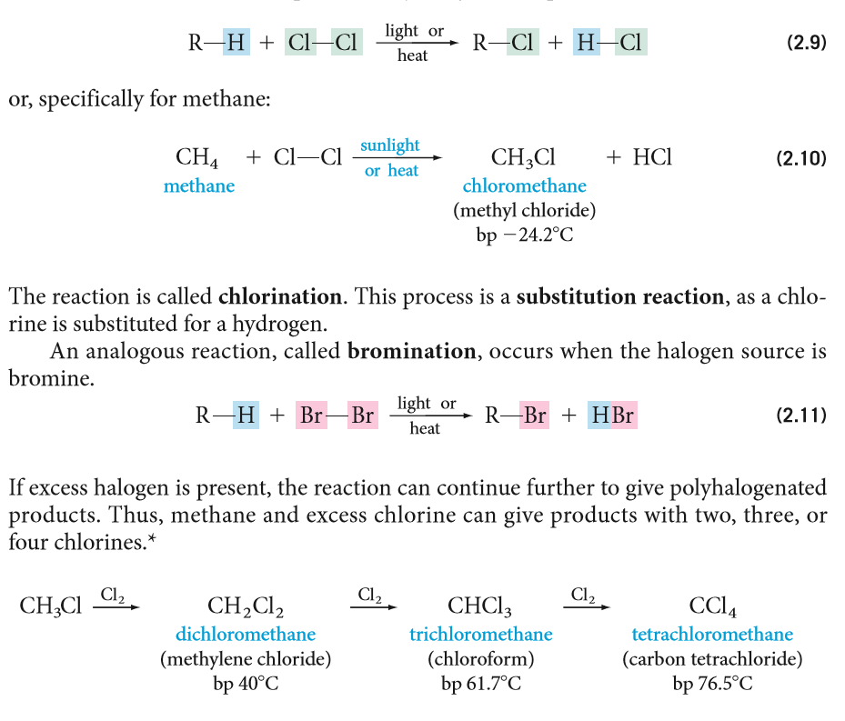
Preparation Of Organic Halides
1- Direct halogenation of hydrocarbons
Halogenation of alkanes: Substitution reaction called Free-Radical Reaction
Chlorination
Bromination
If excess halogen is present:

Slide 10
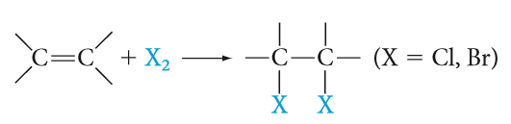
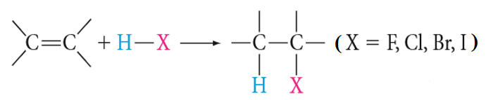
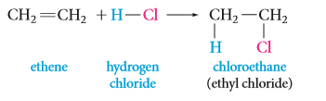
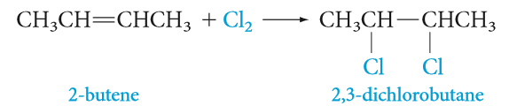
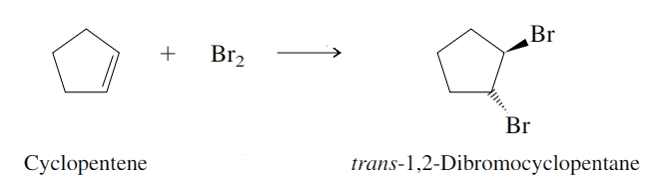
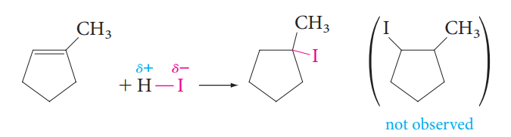
B. Halogenation of alkenes: Electophilic Addition
Preparation Of Organic Halides
CCl₄
Markovnikov’s Rule
CCl₄

Slide 11
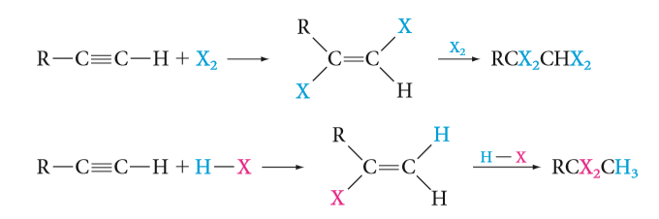
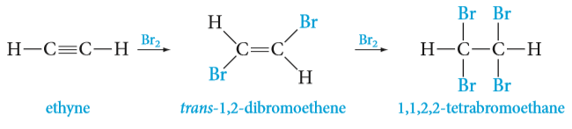
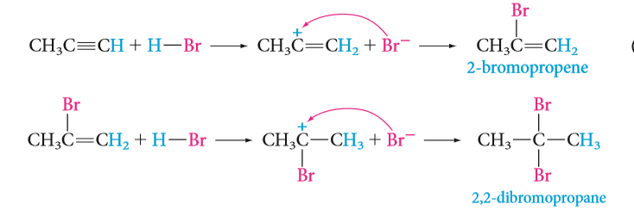
C. Halogenation of alkynes : Electophilic Addition
Preparation Of Organic Halides
Markovnikov’s Rule
propyne

Slide 12
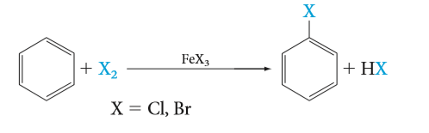
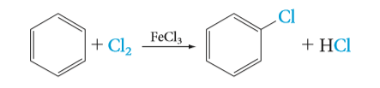
D. Halogenation of aromatic ring and alkyl benzene:
Preparation Of Organic Halides
Electrophilic Aromatic Substitution
Radical halogenation
Electrophilic Aromatic Substitution

Slide 13

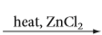

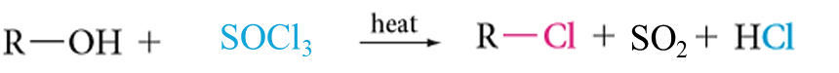
2-Conversion of alcohols into alkyl halides: Nucleophilic Substitution
Preparation Of Organic Halides

Slide 14


Reactions Of Organic Halides
1- Nucleophilic Substitution Reactions (S_{N})

Slide 15
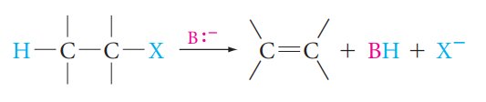
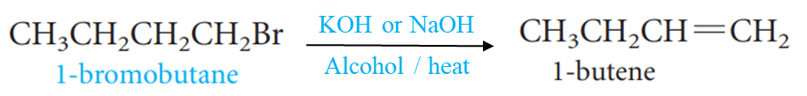
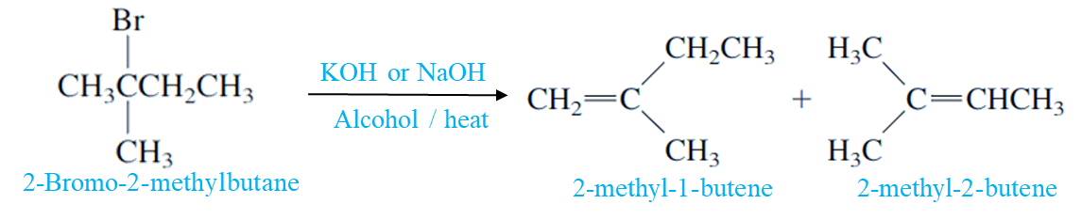
Reactions Of Organic Halides
2- Elimination Reactions (E)
Zaitsev’s Rule
major

Slide 16
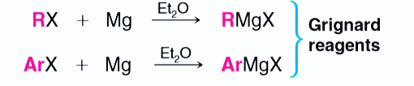
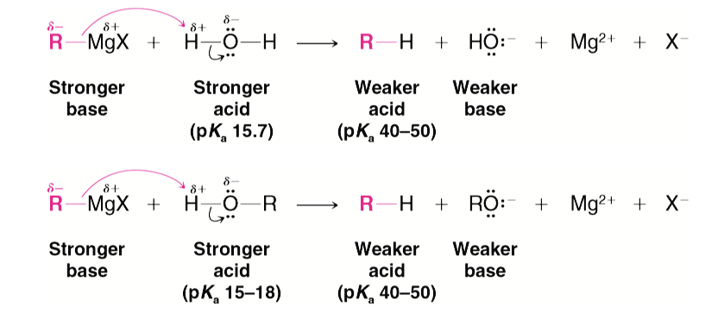
Reactions Of Organic Halides
3- Formation of Grignard reagent and its reactions:
Reactions of Grignard reagent

Slide 17
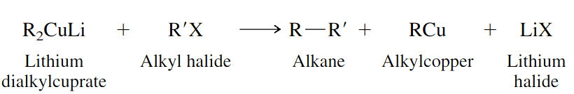
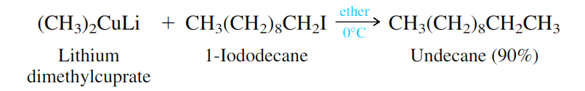
Reactions Of Organic Halides
4- Reduction of alkyl halides:
Reduction using lithium dialkylcuprate : Corey-House (Gilman reagent)

