Slide 1
Heterocyclic Chemistry
CH-6
Amino Acids, Peptides,
and Proteins

Slide 2
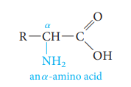
Introduction
There are about 26 amino acids, many others are also known from a variety of sources.
Amino acids are the building blocks used to make proteins and peptides.
The different amino acids have a variety of structural parts which result in different polarities and solubilities.
Each amino acid has at least one amine and one acid functional group.
The amino group may be at α or β or γ positions relative to the carboxyl group.

Slide 3
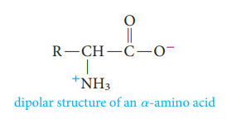
Introduction
Amino acids as zwitterions (dipolar ion structure)
Due to internal transfer of a proton from the -COOH group to the -NH₂ group the amino acid has both a negative charge at the carboxylate group and a positive charge at the ammonium group . This salt-like ion is called a zwitterion (dipolar ion structure).
In solutions the charge of the amino acid changes.

Slide 4
Introduction
The amino acids are known by common names.
For example: Glycine= Gly ; Alanine = Ala ; Valine = Val, etc..
Each also has a three-letter abbreviation based on this name, which is used when writing the formulas of peptides, and a one-letter abbreviation used to describe the amino acid sequence in a protein.
12 of the amino acids are non-essential, can be synthesized in the body from other foods.
Glycine, Alanine, Serine, Cysteine, Proline, Tyrosine, Aspartic acid, Glutamic acid, Asparagine, Glutamine, Arginine, and Histidine.
8 of amino acids are essential, cannot be synthesized by adult humans and therefore must be included in the diet in the form of proteins.
Valine, Leucine, Isoleucine, Threonine, Methionine, Phenylalanine, Tryptophan, and Lysine.

Slide 5
Classification of Amino Acids
There are basically four different classes of amino acids determined by differen
side chains:
Non polar /Neutral R = H, CH_{3,} alkyl groups, aromatic groups
Polar / Neutral R contain polar groups –CH₂OH, –CH₂SH, –CH₂CO–NH₂
Polar/Acidic R contain –COOH group
Polar/ Basic R contain –NH₂ group

Slide 6
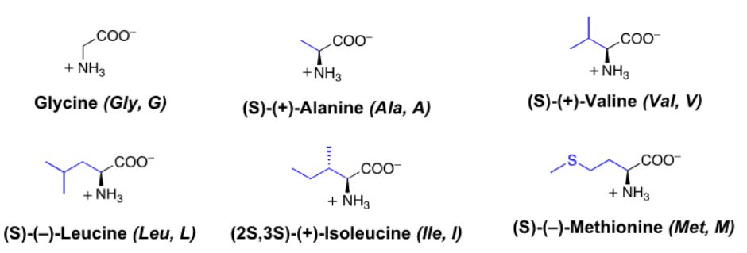
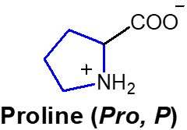
Classification of Amino Acids
1. Non polar / Neutral Amino Acids

Slide 7
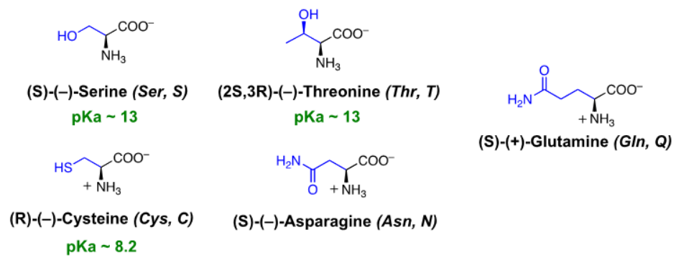
Classification of Amino Acids
2. Polar / Neutral Amino Acids

Slide 8
Classification of Amino Acids
3. Polar / Basic Amino Acids
4. Polar / Acidic Amino Acids

Slide 9
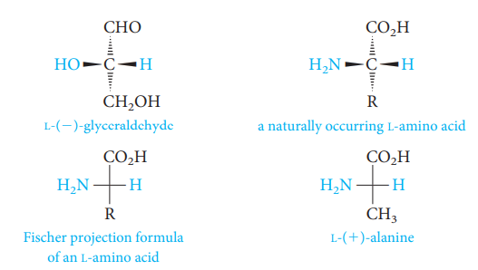
Configuration of Amino Acids
Most of the naturally occurring amino acids have L-configuration while naturally occurring carbohydrates have the D-configuration.

Slide 10
Synthesis of Amino acids
Strecker Synthesis
Treating an aldehyde with ammonia and hydrogen cyanide produces an α-aminonitrile.
Hydrolysis of the nitrile group of the α-aminonitrile converts the latter to an α-amino acid.

Slide 11
Reaction of Amino acids
1) The Ninhydrin Reaction
Ninhydrin is a useful reagent for detecting amino acids and determining the concentrations of their solutions.
It is the hydrate of a cyclic triketone, and when it reacts with an amino acid, a violet dye is produced.
The same violet dye is produced from all α-amino acids with a primary amino group. Only proline, which has a secondary amino group, reacts differently to give a yellow dye, but this, too, can be used for analysis.

Slide 12
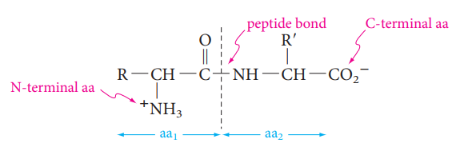
Reaction of Amino acids
2) Formation of an amide linkage ( The peptide bond: Proteins )
Amino acids are linked in peptides and proteins by an amide bond (peptide bond) between the carboxyl group of one amino acid and the α-amino group of another amino acid.
A molecule containing only two amino acids (the shorthand aa is used for amino acid) joined in this way is a dipeptide.
By convention, the peptide bond is written with the amino acid having a free ⁺NH₃ group at the left and the amino acid with a free CO₂⁻ group at the right.
These amino acids are called, respectively, the N-terminal amino acid and the C-terminal amino acid.

Slide 13
Reaction of Amino acids
we often write the formulas for peptides in a kind of shorthand by simply linking the three-letter abbreviations for each amino acid, starting with the N-terminal one at the left.
For example: glycylalanine is Gly—Ala, and alanylglycine is Ala—Gly.

Slide 14
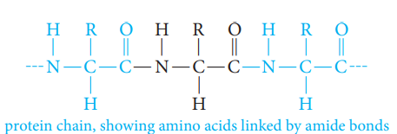
The peptide bond: Proteins
Proteins are biopolymers composed of many amino acids connected to one another through amide (peptide) bonds.
Some proteins are major components of structural tissue (muscle, skin, nails, and hair).
The Primary Structure of Proteins
The backbone of proteins is a repeating sequence of one nitrogen and two carbon atoms.
Peptides or proteins can be hydrolyzed to their amino acid components by heating the with 6 M HCl at 110°C for 24 hours.
An Instrument called an amino acid analyzer is used to determine the amino acids mixture.

Slide 15
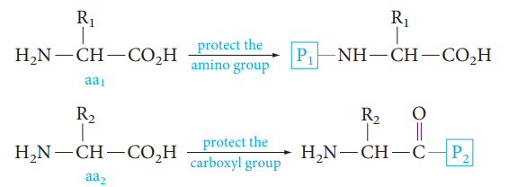
Peptide Synthesis
Many methods have been developed to link amino acids in a controlled manner.
To link the carboxyl group of one amino acid to the amino group of a second amino acid, we must first prepare each compound by protecting the amino group of the first and the carboxyl group of the second.
In this way, we can control the linking of the two amino acids so that the carboxyl
group of aa₁ combines with the amino group of aa₂.
After the peptide bond is formed, we must be able to remove the protecting groups under conditions that do not hydrolyze the peptide bond.

Slide 16
Amino acid residues

