Slide 1
241 Chem
CH-6
Aldehydes and ketones

Slide 2
Learning Objectives
By the end of this chapter the student will:
Know the structure of aldehyde and ketone.
Know the nomenclature of aldehyde and ketone.
Know the physical Properties of aldehyde and ketone.
Know the different methods of preparation of aldehyde and ketone.
Know the chemical reactions of aldehyde and ketone.

Slide 3
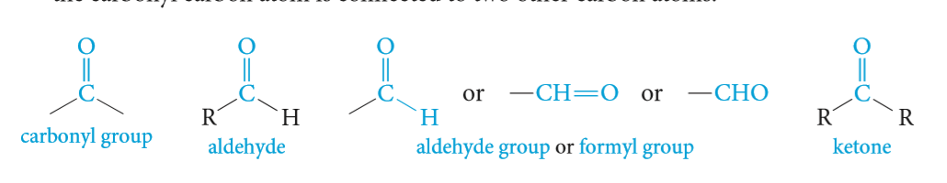
Structural Characteristic of Aldehydes and ketones
Aldehydes and ketones are characterized by the presence of the carbonyl group.
The functional group of an aldehyde is a carbonyl group bonded least one hydrogen atom attached and The remaining group may be another hydrogen atom or any aliphatic or aromatic organic group.
The functional group of a ketone is a carbonyl group bonded to two carbon atoms.

Slide 4
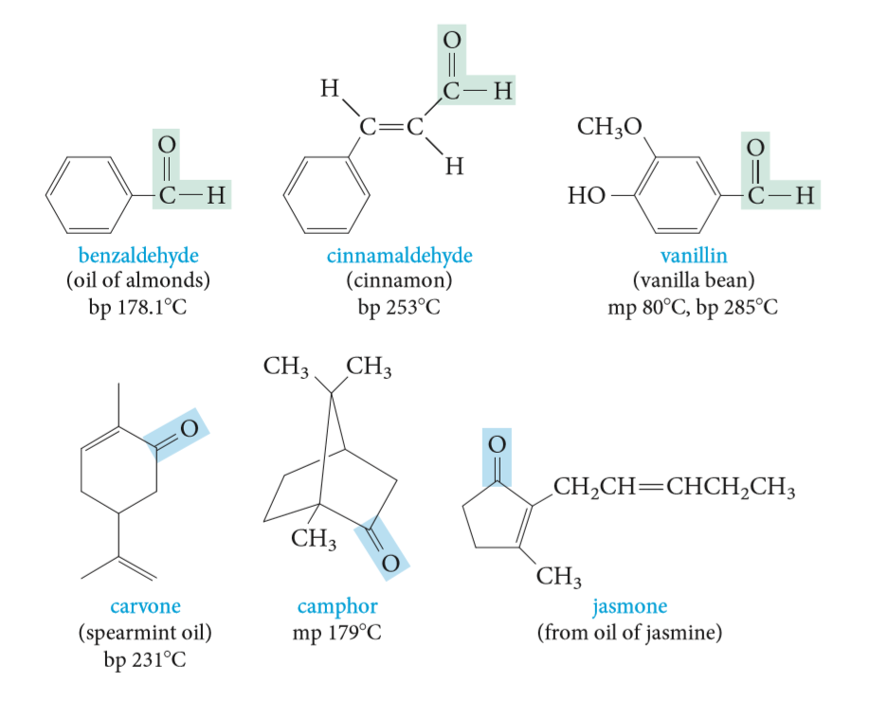
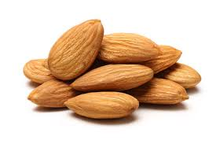

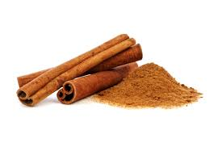

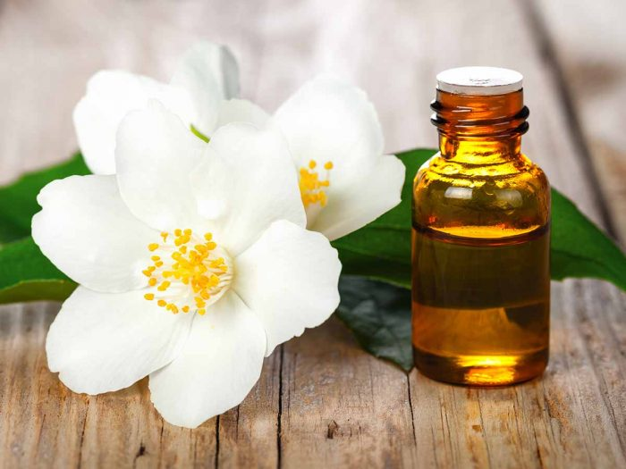
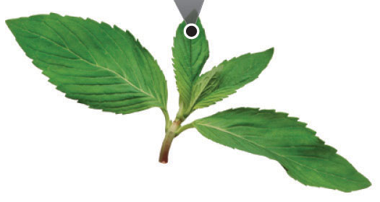
Aldehydes and ketones in Nature

Slide 5
Nomenclature of aldehydes
The IUPAC:
Select the longest chain of carbon atoms that contains the functional group.
Changing the suffix -e of the parent alkane to -al.
Number must start with carbonyl group of an aldehyde as carbon-1.
For unsaturated aldehydes, the presence of a carbon-carbon double or triple bond is indicated by the infix -en- or -yn-. As with other molecules with both an infix and a suffix, the location of the group corresponding to the suffix determines the numbering pattern.
For cyclic molecules in which -CHO is bonded directly to the ring, the molecule is named by adding the suffix
-carbaldehyde to the name of the ring. The atom of the ring to which the aldehyde group is bonded is numbered 1
If an aldehyde has a second functional group of higher naming priority, the aldehyde oxygen is indicated by the prefix ‘oxo- or formyl-’.
If carbon of CHO is included in the parent chain, then write oxo, if not included in parent chain write formyl.

Slide 6
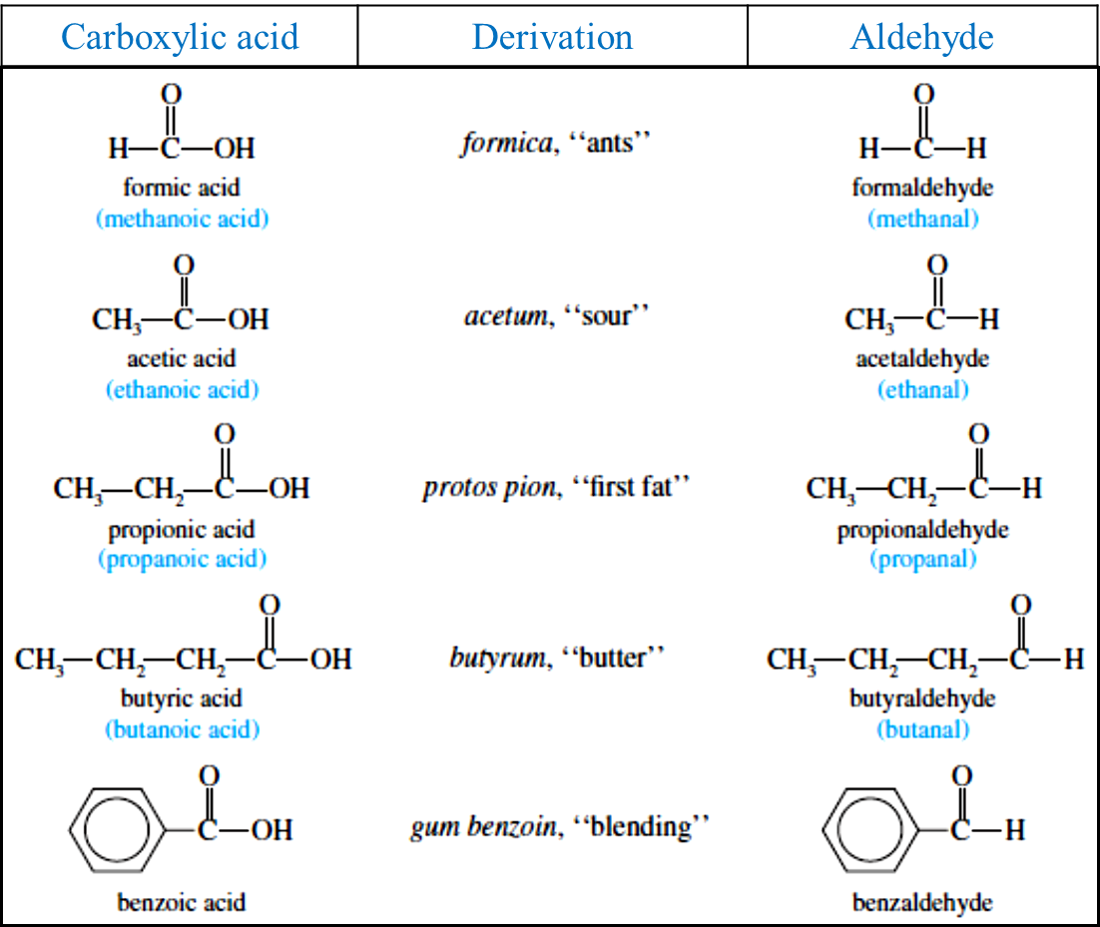
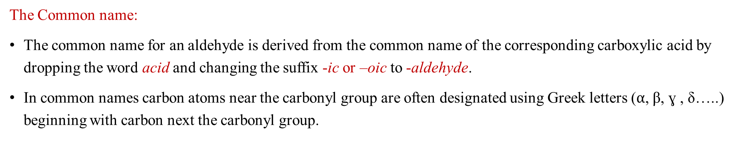
Nomenclature of aldehydes
The Common name:
The common name for an aldehyde is derived from the common name of the corresponding carboxylic acid by dropping the word acid and changing the suffix -ic or –oic to -aldehyde.
In common names carbon atoms near the carbonyl group are often designated using Greek letters ($α$, β, ɣ , δ…..) beginning with carbon next the carbonyl group.

Slide 7
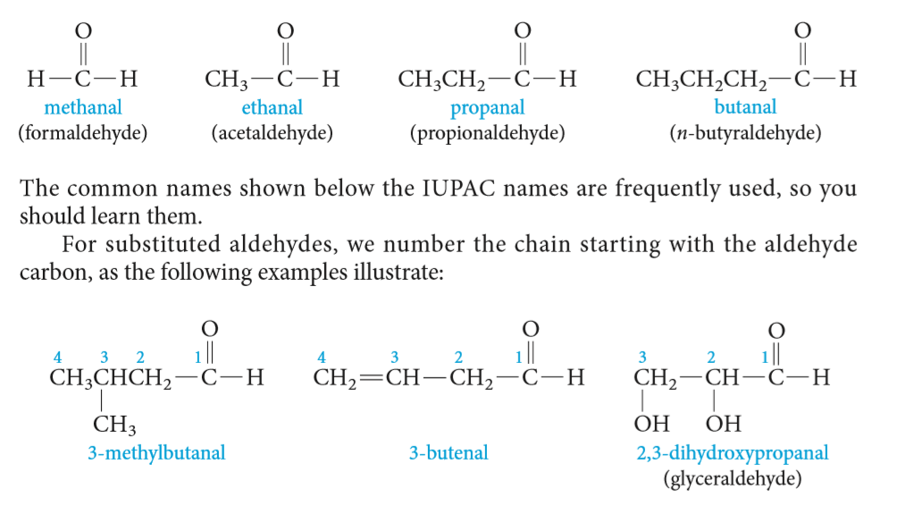
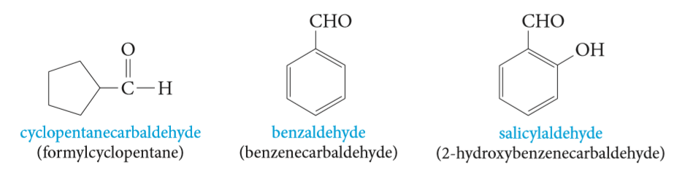



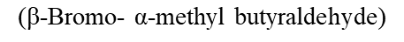
IUPAC name:
Common name:
4-Oxobutanoic acid
4-Formyl-3-methylhexanoic acid

Slide 8
Nomenclature of Ketones
The IUPAC:
Select the longest chain of carbon atoms that contains the functional group.
Changing the suffix -e of the parent alkane to -one
The parent chain is numbered from the direction that gives the carbonyl carbon the smaller number.
If a ketone has a second functional group of higher naming priority, the ketone oxygen is indicated by the prefix “oxo-.”
The Common names:
The common name for ketones are derived by naming the two alkyl or aryl groups bonded to the carbonyl group as separate words followed by the word ketone.

Slide 9
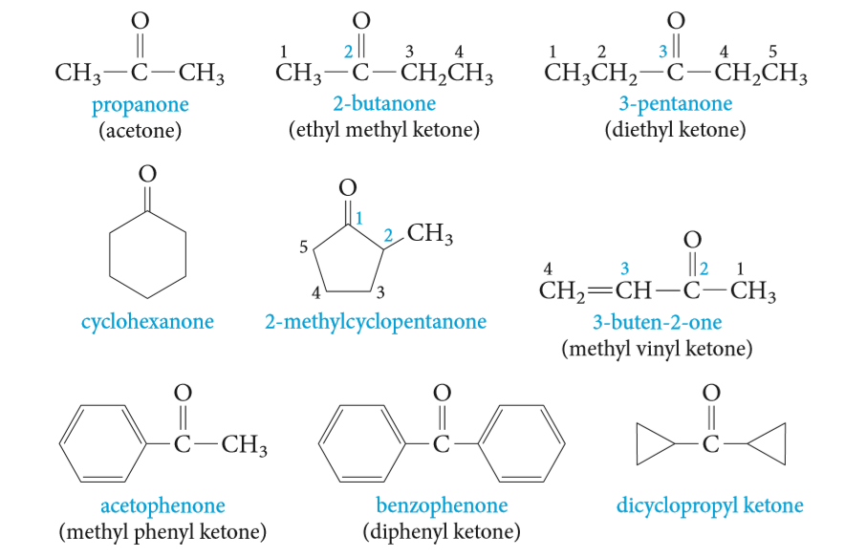
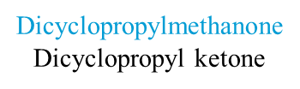




IUPAC name:
Common name:
3-Cyclobutyl-3-oxopropanal

Slide 10
Priority Order in Nomenclature System

Slide 11
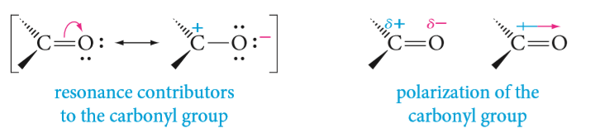
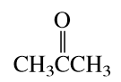
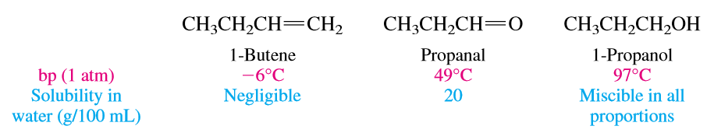
Physical Properties of aldehydes and ketones
Oxygen is much more electronegative than carbon. Therefore, the electrons in the C=O bond are attracted to the oxygen, producing a highly polarized bond.
Boiling points
In general, aldehydes and ketones have higher boiling points than alkenes because they are more polar and the dipole–dipole attractive forces between molecules are stronger. But they have lower boiling points than alcohols because, unlike alcohols, two carbonyl groups can’t form hydrogen bonds to each other.
Solubility:
Aldehydes and ketones can form hydrogen bonds with the protons of OH groups. This makes them more soluble in water than alkenes, but less soluble than alcohols.
Propanone
56.1ºC
ꝏ

Slide 12
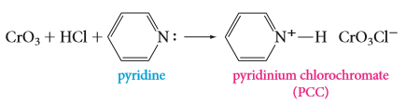
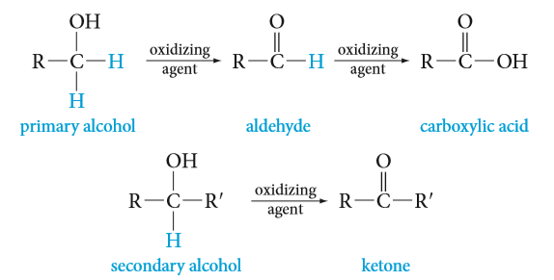
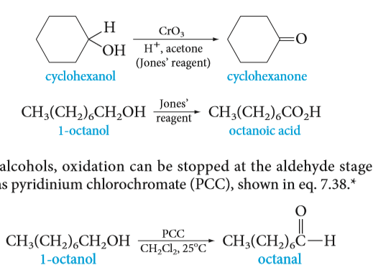
Preparation of Aldehyde and Ketone
1. Oxidation of Primary and Secondary Alcohols 2. Ozonolysis of Alkenes
3. Hydration of Alkynes 4. Friedel–Crafts Acylation
Oxidation of Primary and Secondary Alcohols
Strong oxidizing agent
Weak oxidizing agent
Potassium permanganate KMnO₄ ,OH⁻/ H₃O⁺
Chromic oxide CrO₃ / H₂SO₄ (H₂CrO₄ Jones’ reagent )
Chromic oxide CrO₃ / pyridine
Pyridinium chlorochromate PCC / methylene chloride CH₂Cl₂
Hint:

Slide 13
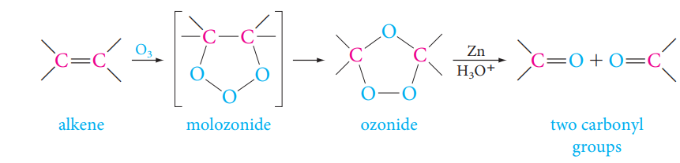
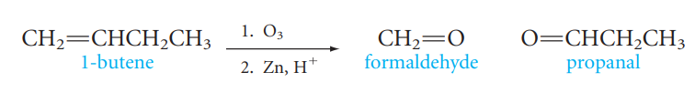

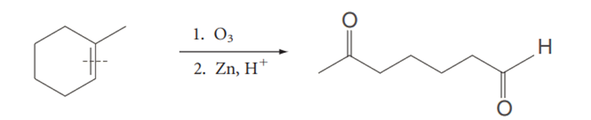
2- Ozonolysis of Alkenes
Preparation of Aldehyde and Ketone
Ozonolysis consists of bubbling ozone O₃ into a very cold (-78°C) solution of the alkene in CH₂Cl₂, followed by treatment of the solution with a reducing agent, commonly zinc and aqueous acid

Slide 14
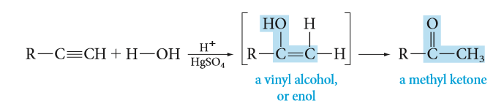
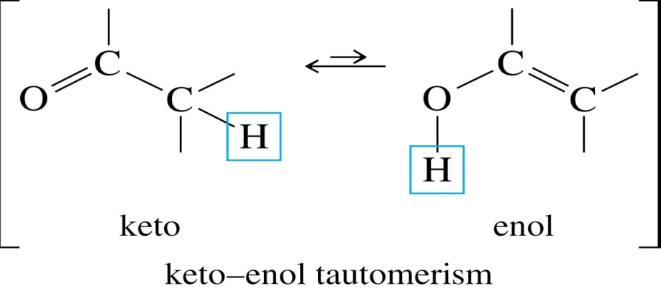
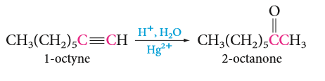
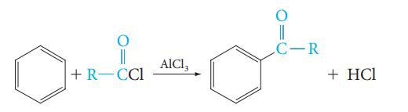
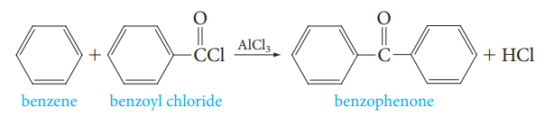
4- Friedel–Crafts Acylation: Preparation of Aromatic ketones
Preparation of Aldehyde and Ketone
3- Hydration of Alkynes
Addition of water to terminal alkynes requires not only an acid catalyst but mercuric ion as well.
Hint:

Slide 15
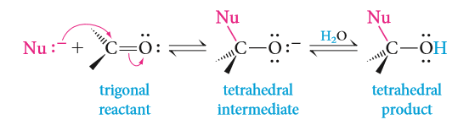
Reaction of Aldehyde and Ketone
Nucleophilic addition to carbonyl groups
    Addition of Grignard Reagents to aldehyde and ketone
    Reduction of carbonyl group
    The Addition of Alcohols: Hemiacetals and Acetals
    Addition of Hydrogen Cyanide: Formation of cynohydrins
    Addition of Ammonia and Ammonia Derivatives
Aldol condensation
Oxidation of Aldehydes

Slide 16
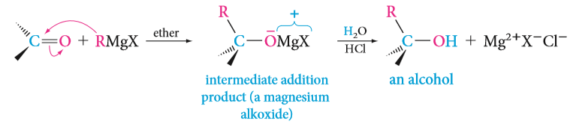
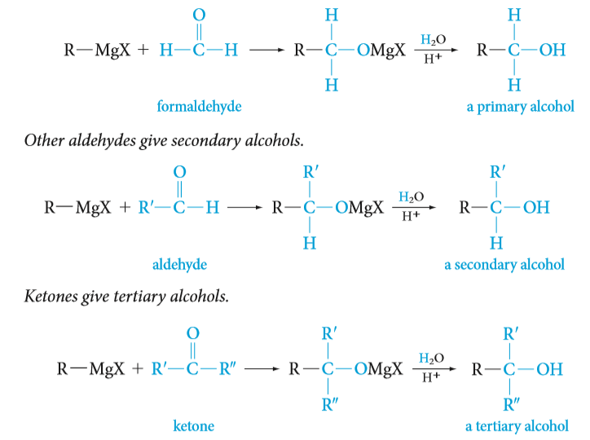
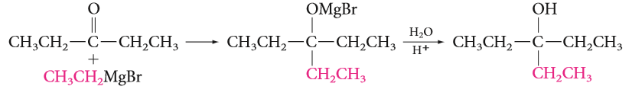
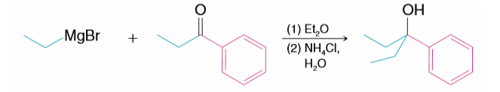
a) Addition of Grignard Reagents to aldehyde and ketone: formation of alcohol
Reaction of Aldehyde and Ketone
1- Nucleophilic addition to carbonyl groups:

Slide 17
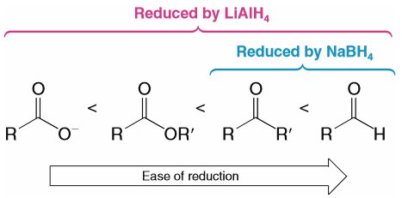
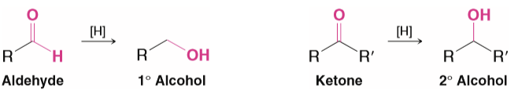
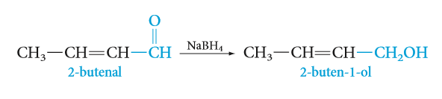
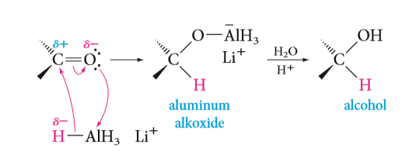
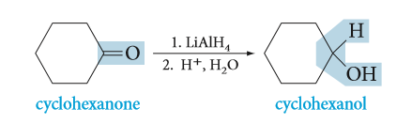
Reaction of Aldehyde and Ketone
b) Reduction of carbonyl group: Addition of metal hydrides (formation of alcohol)
H₂O

Slide 18
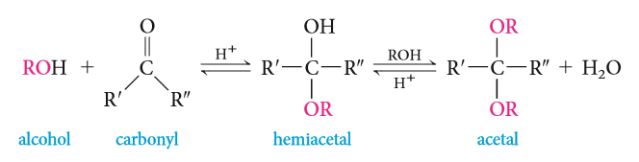

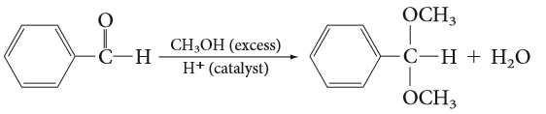
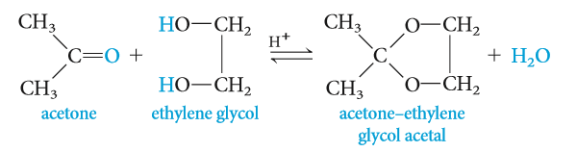
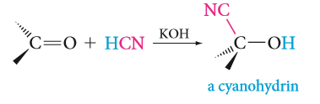
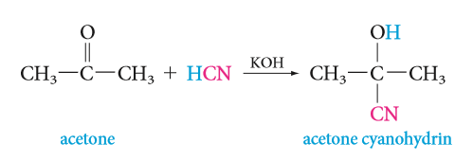
c) The Addition of Alcohols: Hemiacetals and Acetals
Reaction of Aldehyde and Ketone
d) Addition of Hydrogen Cyanide: Formation of cynohydrins

Slide 19
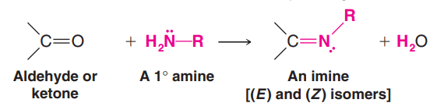
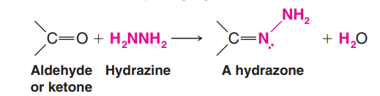
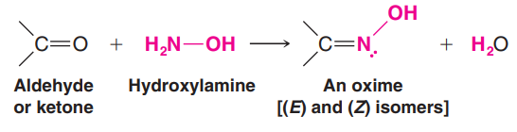
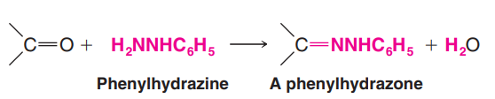
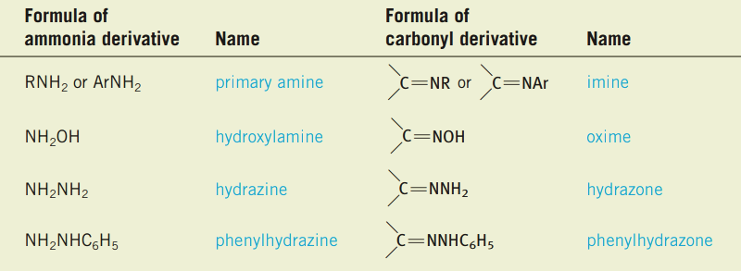
Reaction of Aldehyde and Ketone
e) Addition of Ammonia and Ammonia Derivatives

Slide 20
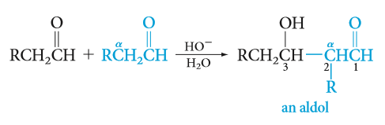
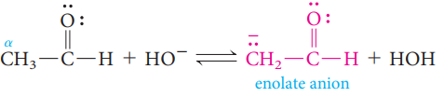
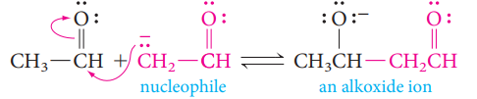





Reaction of Aldehyde and Ketone
3- Aldol condensation:
Enolate anions may act as carbon nucleophiles. They add reversibly to the carbonyl group of another aldehyde or ketone molecule, The product is called an aldol (so named because the product is both an aldehyde and an alcohol).
Three steps mechanism
The mixed aldol condensation
4- Oxidation of Aldehydes (slid 12)

