Slide 1
241 Chem
CH-5
Thiols and Sulfides

Slide 2
Learning Objectives
By the end of this chapter the student will Know:
General formula of Thiols & Sulfides
Nomenclature of Thiols & Sulfides
Physical Properties of Thiols & Sulfides
Preparations of Thiols & Sulfides
Reactions of Thiols & Sulfides

Slide 3
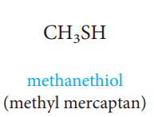

Structure of Thiols and sulfides
Thiols, general formula RSH, are the sulfur analogues of alcohols.
The functional group of a thiol is sulfhydryl group -SH bonded to an sp³ hybridized carbon.
Sulfides or Thioethers, general formula RSR, are the sulfur analogues of ethers .
Ethylthioethane
(Diethyl sulphide)

Slide 4
Nomenclature of Thiols and sulfides
In the IUPAC system, thiols are named by selecting as the parent alkane the longest chain of carbon atoms that contains the -SH group. To show that the compound is a thiol, retain the final -e in the name of the parent alkane and add the suffix -thiol.
The location of the -SH group takes precedence over alkyl groups and halogens in numbering the parent chain.
In the IUPAC system, -OH takes precedence over -SH in both numbering and naming. In compounds containing these two functional groups, an -SH group is indicated by the IUPAC prefix mercapto- or sulfanyl-
Common names for simple thiols are derived by naming the alkyl group bonded to -SH and adding the word mercaptan.
In the IUPAC system of sulfides, the shorter alkyl group and the sulfur are named as an alkylthio group attached to the longer alkane.
The common names of sulfides are derived in the same way as those of ethers but end in the word sulfide.

Slide 5
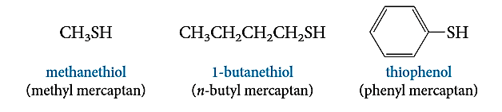
IUPAC name:
Common name:
1-butanethiol
n-Butyl mercaptan
2-Methyl-1-propanethiol
Isopentyl mercaptan
Butane-1,4-dithiol
Cyclohexanethiol
Cyclohexanyl mercaptan
IUPAC name:
Common name:
2-Mercaptoethanol
β-Mercaptoethanol
2-Butene-1-thiol
thiophenol
Phenyl mercaptan
3-Mercaptobenzoic acid
IUPAC name:
Common name:
Ethylthioethane
Ethylsulfanylethane
Diethyl sulfide
(Methylthio)cyclopentane
(Methylsulfanyl)cyclopentane
Cyclopentyl methyl sulfide
Methylthiobenzene
Methylsulfanylbenzene
Methyl Phenyl sulfid
3-Methylthiocyclohexene
3-Methylsulfanylcyclohexene

Slide 6
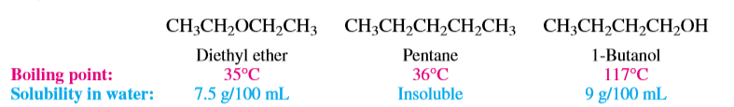
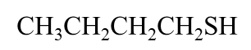


Acidity and basicity of Thiols
Physical Properties of Thiols
The S-H bond in thiols is less polar than O-H bond in alcohols, since Sulphur is less electronegative than the oxygen atom. Thus, thiols form much weaker hydrogen bonding than alcohols, and have lower boiling points than analogous alcohols.
Thiols are stronger acids (pKa 10) than alcohols (pKa 15).
Thiolate ions (e.g. CH₃CH₂S⁻) are stronger nucleophiles than corresponding alkoxides (CH₃CH₂O⁻). Conversely, thiols are stronger acids than corresponding alcohols.

Slide 7


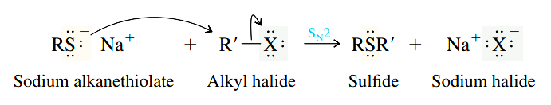
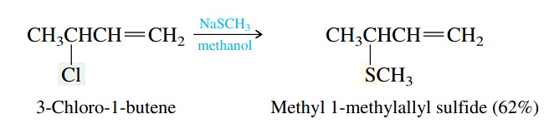
Preparation Of Thiols
Nucleophilic substitution reaction of alkyl halides by sodium hydrosulphide ( NaSH : excess of NaOH (KOH) and hydrogen sulfide H₂S).
Preparation Of Sulfide
2- Nucleophilic substitution reaction of primary or secondary alkyl halide with alkanethiolate.

Slide 8

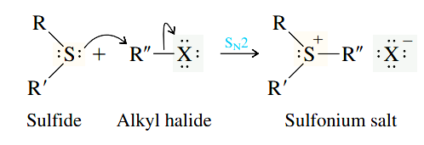
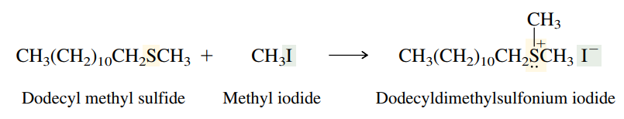
Reactions of Thiols and Sulfides
Oxidation of Thiol
The oxidation of thiols to disulfides by hydrogen peroxide or iodine.
Alkylation of Sulfides: Sulfonium Salts

