Slide 1
241 Chem
CH-3
Phenols

Slide 2
Learning Objectives
By the end of this chapter the student will Know:
The structure of phenols.
The difference in structure between alcohols and phenols.
The nomenclature of phenols.
The Physical properties of phenols.
The acidic properties of phenols vis acidic of alcohols.
The different methods of preparation of phenols.
The chemical reactions of phenols.

Slide 3
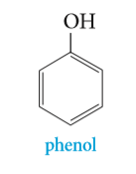
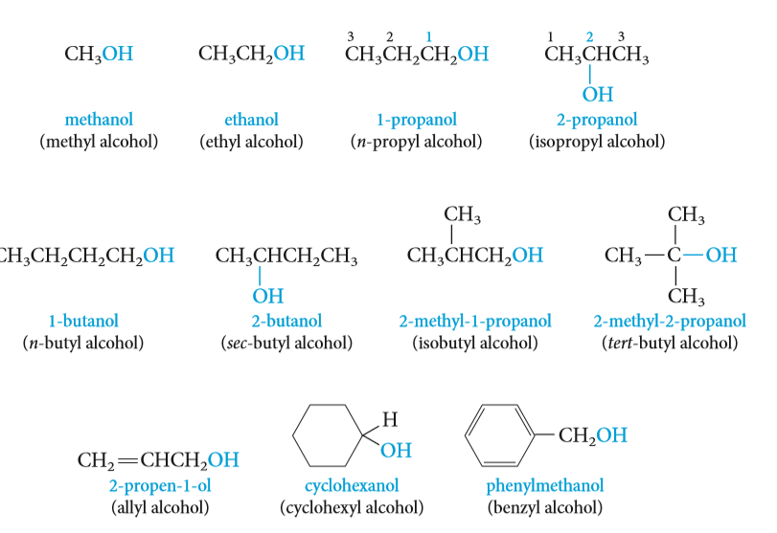
Structure of Phenols
Phenols are compounds of the general formula ArOH, where Ar is an groups.
Phenols differ from alcohols in having the OH group attached directly to an benzene ring.
Phenols is the specific name for hydroxybenzene, and it is the general name for the family of compounds derived from hydroxybenzene.

Slide 4
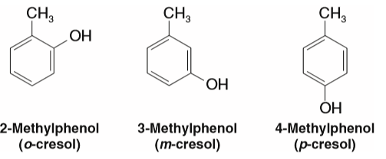
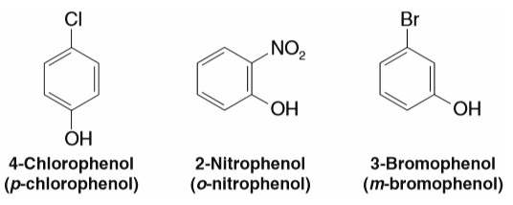
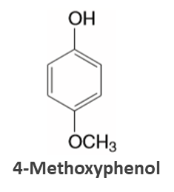
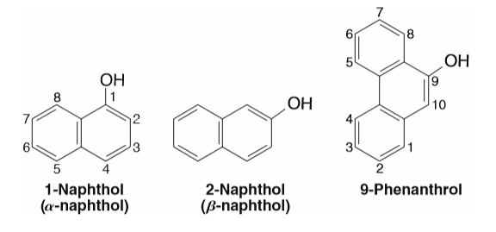
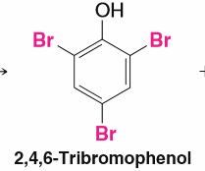
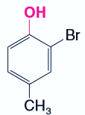
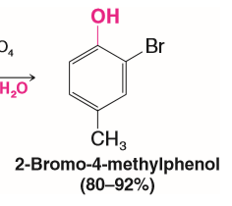
Nomenclature of phenols
The simplest member of this class of compounds is named phenol.
Phenols are usually named as derivatives of the parent compounds.
Numbering of the ring begins at the hydroxyl-substituted carbon and proceeds in the direction that gives the lower number to the next substituted carbon. Substituents are cited in alphabetical order.

Slide 5
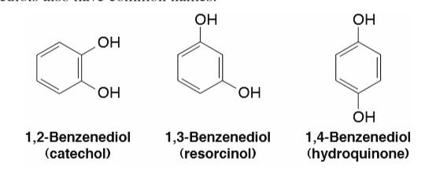
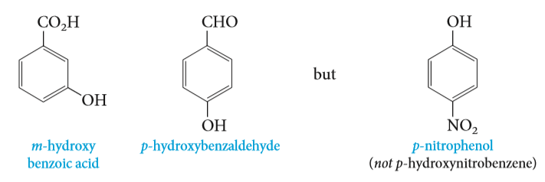
Nomenclature of phenols
Dihydroxypenols
Polyhydroxypenols
1,2,3-Benzenetriol
Pyrogallol
1,2,4-Benzenetriol
Hydroxy quinol
1,3,5-Benzenetriol
(Phloroglucinol)
The hydroxyl group is named as a substituent when it occurs in the same molecule with carboxylic acid, aldehyde, or ketone functionalities, which have priority in naming.

Slide 6
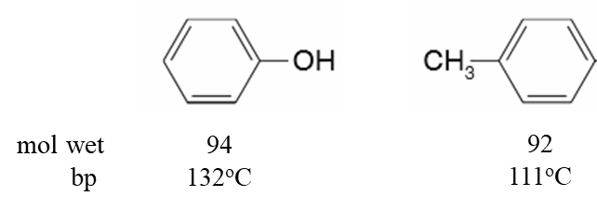
Physical properties of phenols
Phenol is a colourless, crystalline
The presence of hydroxyl groups in phenols means that phenols are like alcohols. For example, they are able to form strong intermolecular hydrogen bonds, and therefore have higher boiling points than hydrocarbons of the same molecular weight.
Phenols are also modestly soluble in water because of their ability to form strong hydrogen bonds with water molecules.

Slide 7
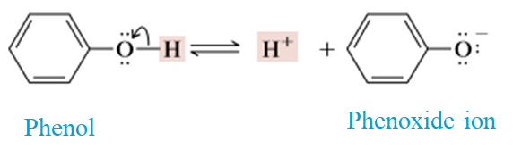
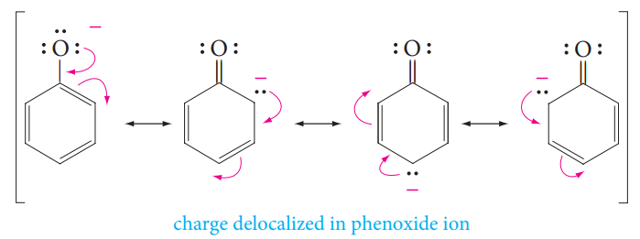
Physical properties of phenols
Acidity of phenols
Like water, alcohols and phenols are weak acids. The hydroxyl group can act as a proton donor, and dissociation occurs in a manner similar to that for water
Phenols are more acidic than alcohols, and weaker acids than carboxylic acids.
Phenols are stronger acids than alcohols mainly because the corresponding phenoxide ions are stabilized by resonance.
The negative charge of an alkoxide ion is concentrated on the oxygen atom, but the negative charge on a phenoxide ion can be delocalized to the ortho and para ring positions through resonance.

Slide 8
Substituents effects on the Acidity of Phenols
Electron-withdrawing groups increase acidity by stabilizing the conjugate base.
Electron-donating groups decrease acidity because they destabilize the conjugate base.

Slide 9
Preparation of Phenols
Hydrolysis of Diazonium salts
Alkali fusion of Benzenesulfonic acid or Sodium benzene-sulfonates
.Hydrolysis of Chlorobenzene (The Dow process)
From Cumene Hydroperoxide

Slide 10
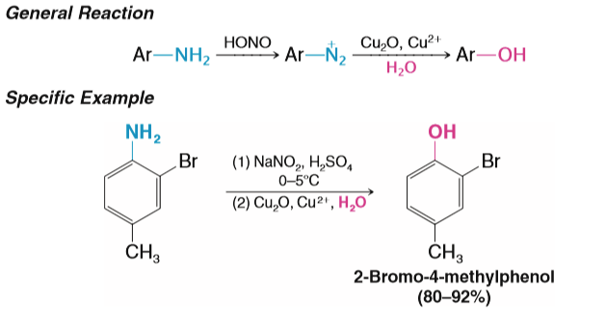
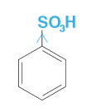
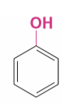

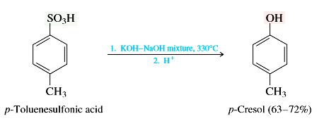
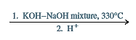
Preparation of Phenols
1. Hydrolysis of Diazonium salts
Diazonium salts react with water in the presence of mineral acids to yield phenols.
2. Alkali fusion of Benzenesulfonic acid or Sodium benzene-sulfonates
Addition-elimination of nucleophilic aromatic substitution

Slide 11
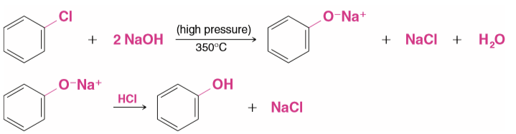
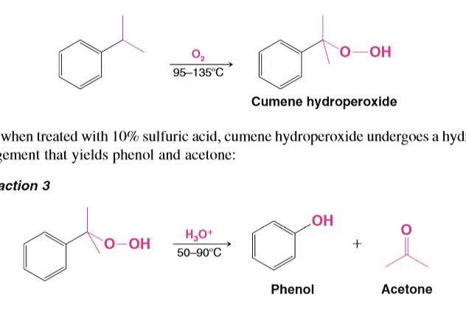
Preparation of Phenols
3. Hydrolysis of Chlorobenzene (The Dow process)
4. From Cumene Hydroperoxide ( Industrial Syntheses )
Cumene
(isopropylbenzene(

Slide 12
Reactions of phenols
Salt formation via strong base or active metal
Ester formation
Reaction of aromatic nucleus of phenol:
  Nitration
  Friedel-Crafts acylation
  Sulphonation
  Halogenation
Kolbe–Schmitt reaction: Synthesis of salicylic acid
Oxidation of Phenols

Slide 13
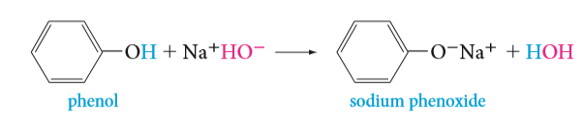
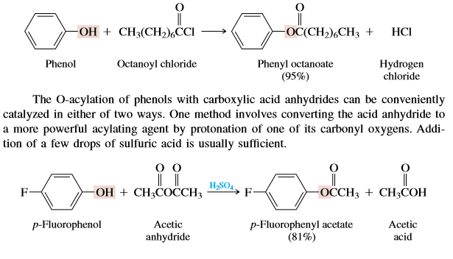
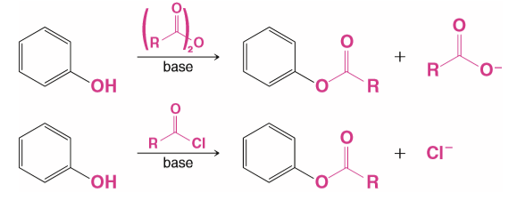
Salt formation via strong base or active metal
Reactions of phenols
With active metals
With bases
Formation of Esters From Phenols react with carboxylic acid anhydrides and acid chloride
O-Acylation

Slide 14
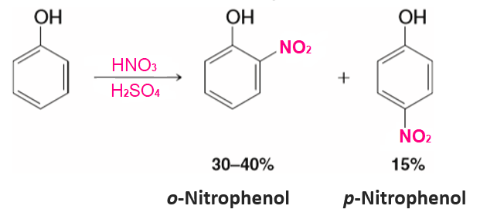
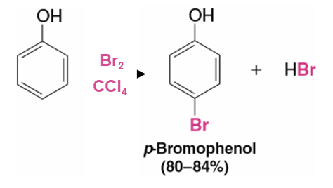
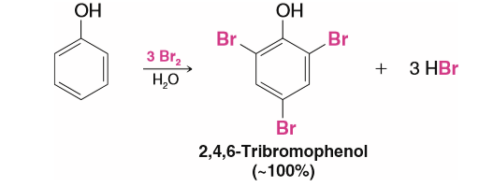
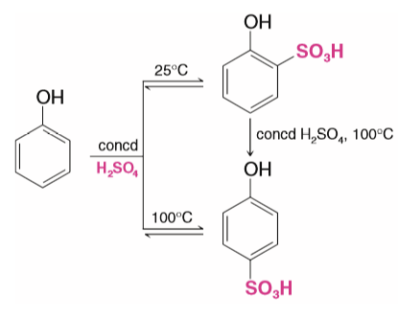
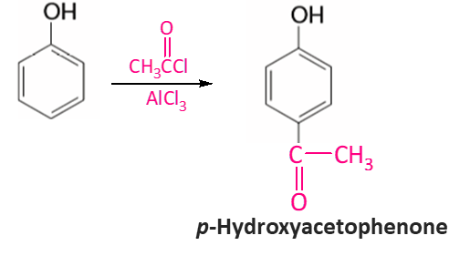
Reactions of phenols
Reaction of aromatic nucleus of phenol
The hydroxyl group is a powerful activating group and an ortho - para director in Electrophilic Aromatic Substitutions
a. Nitration
c. Halogenation
b. Sulfonation
d. Acylation
Friedel-Crafts Acylation ( C-Acylation )
2-Hydroxysulfonic acid
4-Hydroxysulfonic acid

Slide 15
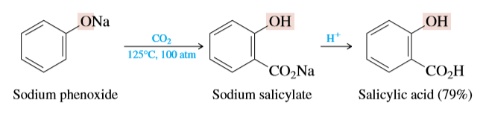
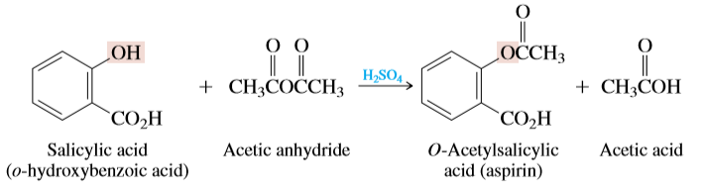
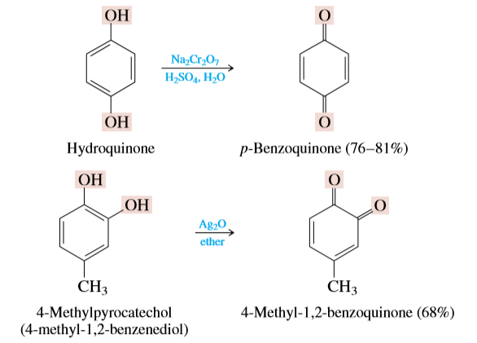
Kolbe–Schmitt reaction: Synthesis of salicylic acid
Reactions of phenols
Oxidation of Phenols: Quinones
Oxidation of derivatives of 1,2-benzenediol (pyrocatechol) 1,4-benzenediol (hydroquinone) by oxidizing agents (Silver oxide or Chromic acid )

