Slide 1
108 Chem
Chapter 3
Benzene
&
Aromatic Compounds

Slide 2
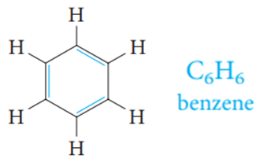
The expressing aromatic compounds came to mean benzene and derivatives.
Structure of Benzene: Resonance Description
It contains a six-membered ring and three additional degrees of unsaturation.
It is planar.
All C—C bond lengths are equal.

Slide 3
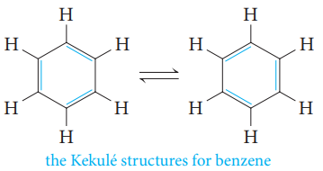
The Kekule Structure for Benzene:
In 1865, Kekulé proposed a reasonable structure for benzene. He suggested that six carbon atoms are located at the corners of a regular hexagon, with one hydrogen atom attached to each carbon atom.
To give each carbon atom a valence of 4, he suggested that single and double bonds alternate around the ring (what we now call a conjugated system of double bonds).
Kekulé suggested that the single and double bonds exchange positions around the ring so rapidly that the typical reactions of alkenes cannot take place.

Slide 4
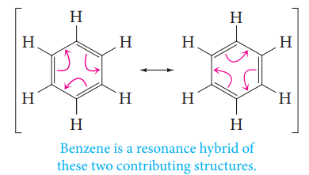
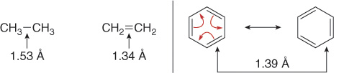
Kekulé’s formulas represent two identical contributing structures to a single resonance hybrid structure of benzene.
Modern physical measurements support this model for the benzene structure. Benzene is planar, and each carbon atom is at the corner of a regular hexagon. All of the carbon–carbon bond lengths are identical: 1.39 Å, intermediate between typical single (1.54 Å) and double (1.34 Å) carbon–carbon bond lengths.

Slide 5
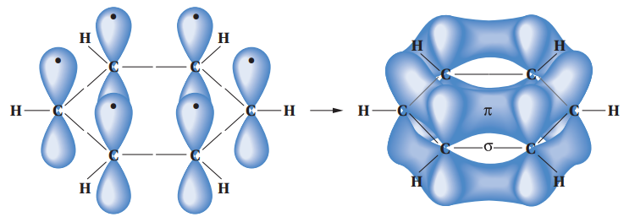
Orbital Model for Benzene:
Each carbon atom in benzene is connected to only three other atoms (two carbons and a hydrogen).
Each carbon is therefore sp² -hybridized, as in ethylene.
It also explains its hexagonal shape, with H-C-C and C-C-C angles of 120°.
An orbital representation of the bonding in benzene. Sigma (s) bonds are formed by the end-on overlap of sp2 orbitals. In addition, each carbon contributes one electron to the pi (p) system by lateral overlap of its p orbital with the p orbitals of its two neighbors.

Slide 6
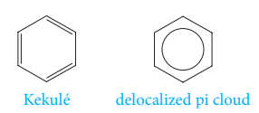
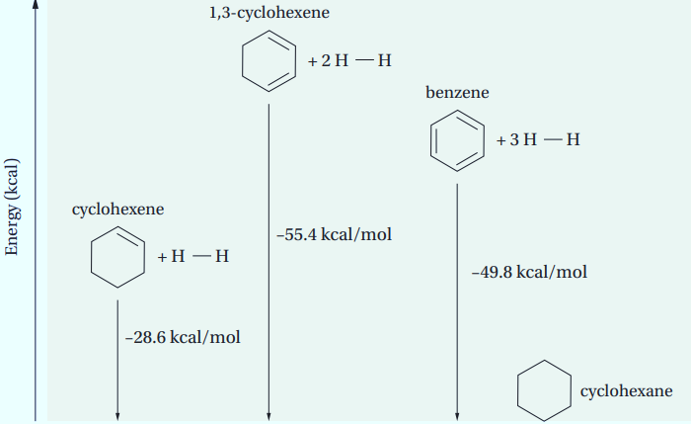
Symbols for Benzene:
Two symbols are used to represent benzene. One is the Kekulé structure, and the other is a hexagon with an inscribed circle, to represent the idea of a delocalized pi electron cloud.
The Resonance Energy of Benzene
The real benzene molecules are more stable than the contributing resonance structures (the hypothetical molecule 1,3,5-cyclohexatriene) by about 36 kcal/mol (86 - 50 = 36).

Slide 7
The Resonance Energy of Benzene
We define the stabilization energy, or resonance energy, of a substance as the difference between the actual energy of the real molecule (the resonance hybrid) and the calculated energy of the most stable contributing structure. For benzene, this value is about 36 kcal/mol. This is a substantial amount of energy. Consequently, as we will see, Benzene and other aromatic compounds usually react in such a way as to preserve their aromatic structure and therefore retain their resonance energy.

Slide 8
Aromatic Character: The (4n + 2 ) π Rule
A molecule must be cyclic.
A molecule must be planar.
A molecule must be completely conjugated.
A molecule must satisfy Hückel’s rule, and contain a particular number of π electrons.
      4n+2 π electrons ( n= 0, 1, 2, 3, ….= 2, 6, 10, 14, ….)

Slide 9
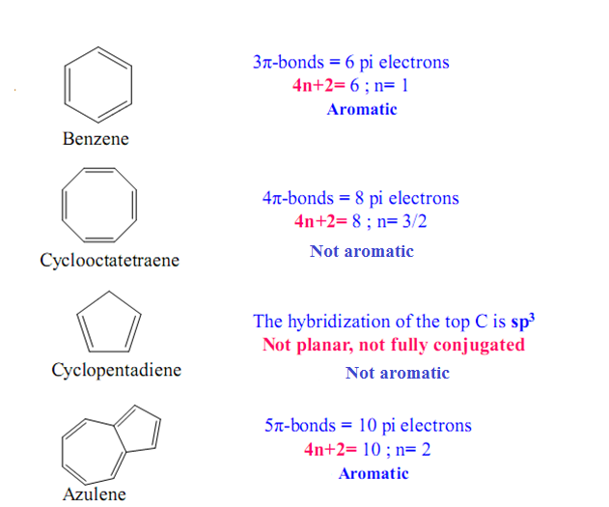

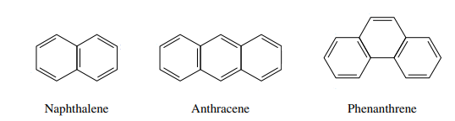
Examples:
Benzene
Aromatic
Cyclobutadiene
Not aromatic
Cyclopentadiene
Not aromatic
Cyclooctatetraene
Not aromatic
Naphthalene
Aromatic
Anthracene
Aromatic

Slide 10
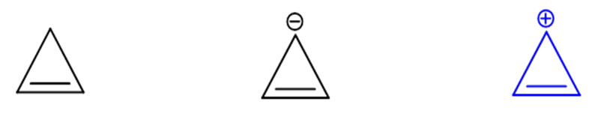
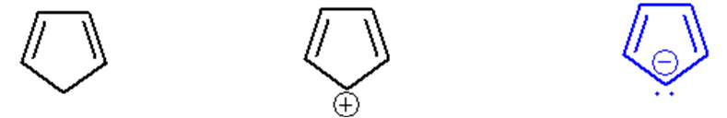
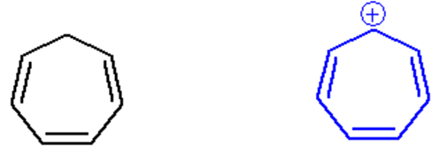
Examples:
Not aromatic
Not aromatic
Aromatic
Not aromatic
Not aromatic
Aromatic
Not aromatic
Aromatic
Not aromatic

Slide 11
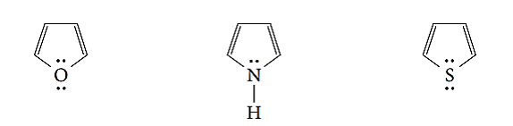
Examples:
Furan
Aromatic
Thiophene
Aromatic
Pyrrole
Aromatic
Pyridine
Aromatic
1H-Indole
Aromatic
Quinoline
Aromatic

Slide 12
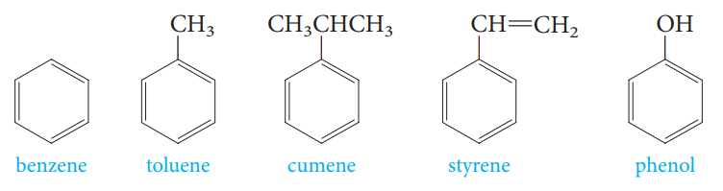
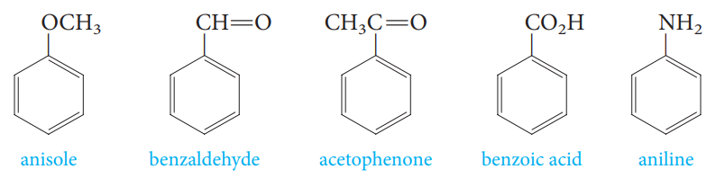
Nomenclature of Aromatic compounds
Common names have acquired historic respectability and are accepted by IUPAC. Examples include:

Slide 13
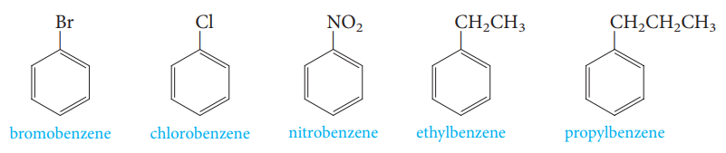
Monosubstituted benzenes that do not have common names accepted by IUPAC are named as derivatives of benzene.
ethoxybenzene
vinylbenzene
allylbenzene
ethynylbenzene

Slide 14
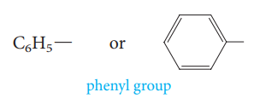
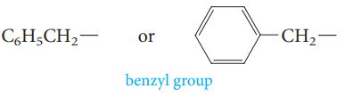
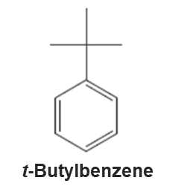
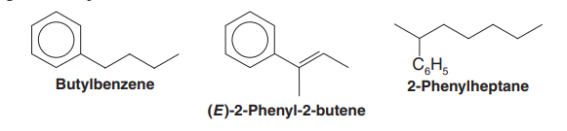
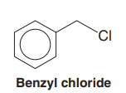
When the C₆H₅- group is named as a substituent, it is called a phenyl group. The phenyl group is often abbreviated as C₆H₅- , Ph- or ϕ−.
Benzyl group, C₆H₅CH₂- is an alternative name for the phenylmethyl group. It is sometimes abbreviated Bn.
Examples:

Slide 15
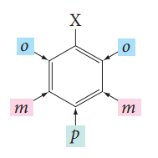
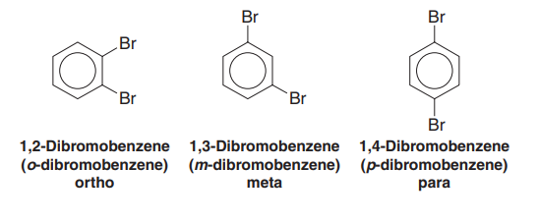
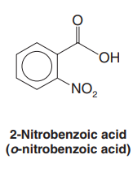
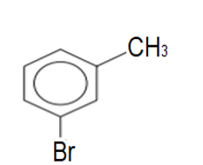
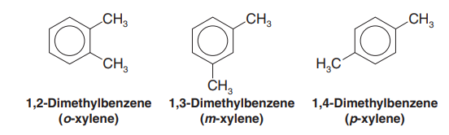
When two substituents are present, three isomeric structures are possible. They are designated by the prefixes ortho-, meta-, and para- (abbreviated as o-, m-, and p-) or by the use of numbers.
Examples:
3-Bromotoluene
m-bromotoluene

Slide 16
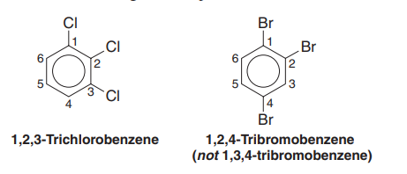
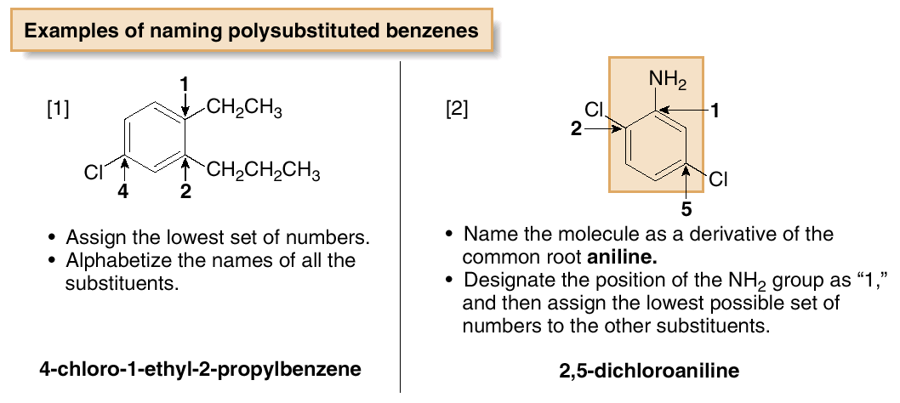
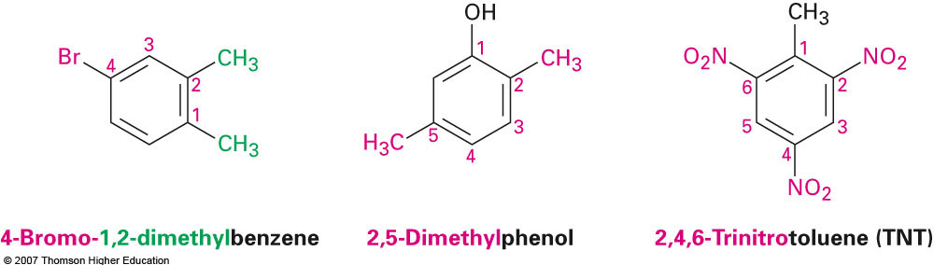
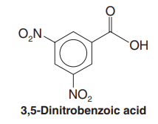
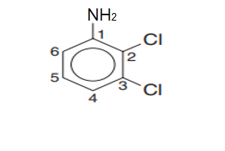
When more than two groups are present on the benzene ring, their positions must be indicated by the use of numbers.
Examples:
2,3-dicloroaniline

Slide 17
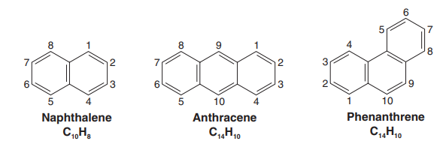
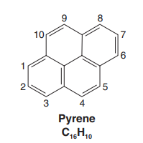
Polycyclic Aromatic Hydrocarbons:
Biphenyl
C₁₂H₆

Slide 18
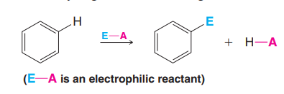
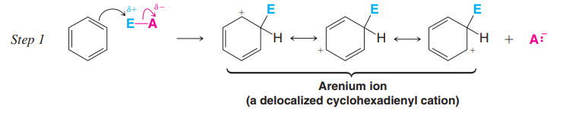
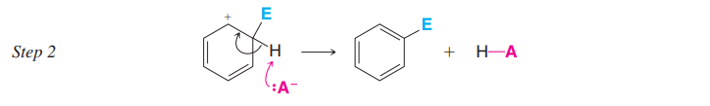
Reaction of Benzene
A- Electrophilic Aromatic Substitution
Some of the most important reactions of aromatic compounds are those in which an electrophile replaces one of the hydrogen atoms of the ring.
These reactions, called electrophilic aromatic substitutions (EAS).
The Mechanism of Electrophilic Aromatic Substitution

Slide 19
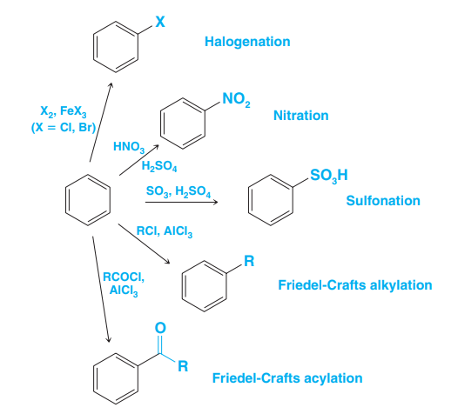
Electrophilic Aromatic Substitution

Slide 20
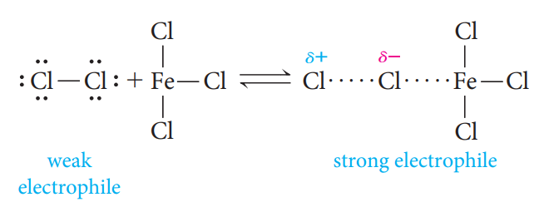
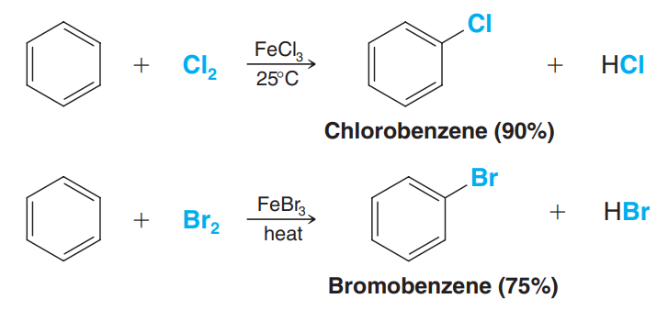
Halogenation of Benzene
Benzene reacts with bromine and chlorine in the presence of Lewis acids ( iron chloride (FeCl₃) for chlorination, and iron bromide (FeBr₃) for bromination).

Slide 21
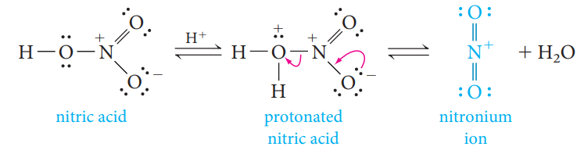
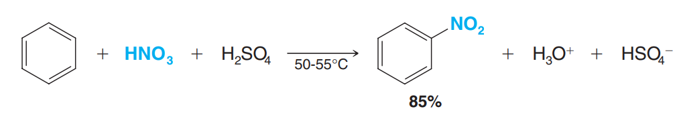
Nitration of Benzene
Benzene undergoes nitration on reaction with a mixture of concentrated nitric acid and concentrated sulfuric acid.

Slide 22

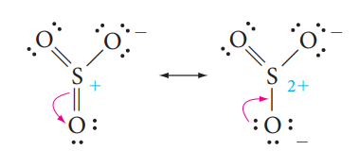
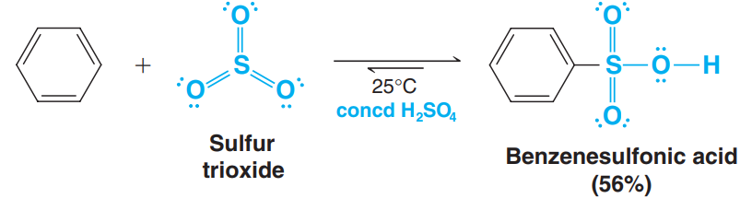
Sulfonation of Benzene
Benzene reacts with concentrated or fuming sulfuric acid, and the electrophile may be sulfur trioxide (SO₃), or protonated sulfur trioxide (⁺SO₃H).

Slide 23
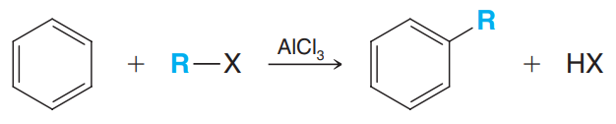
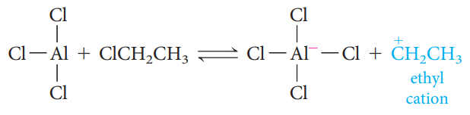
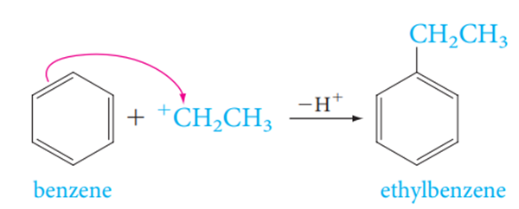
Friedel-Crafts Alkylation
The Electrophile is a carbocation, which can be formed either by removing
a halide ion from an alkyl halide with a Lewis acid catalyst (for example, AlCl₃).

Slide 24
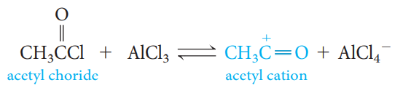
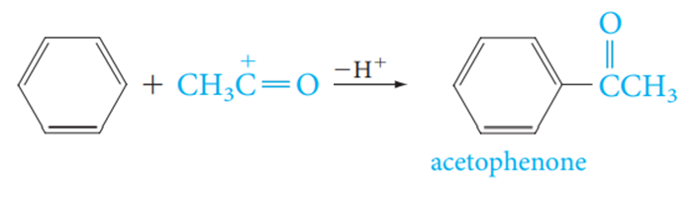
Friedel-Crafts Acylation
The Electrophile is an acyl cation generated from an acyl halide, the reaction requires the addition of at least one equivalent of a Lewis acid (such as AlCl₃). The product of the reaction is an aryl ketone.

Slide 25
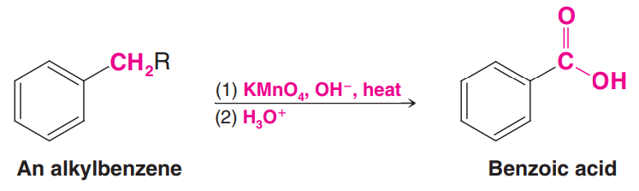
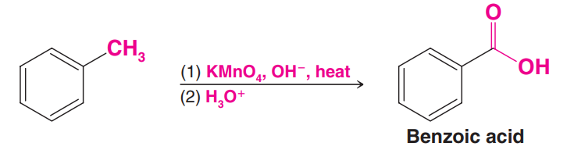

Reaction of Benzene
B- Reactions of the Side Chain of Alkylbenzene
1- Oxidation of the Side Chain
Alkylbenzenes with alkyl groups longer than methyl are ultimately degraded to benzoic acids.

Slide 26



2- Halogenation of the Side Chain
Chlorine and bromine can be made to replace hydrogen atoms that are on a benzylic carbon, such as the methyl group of toluene.
Benzylic halogenation is carried out in the absence of Lewis acids and under conditions that favor the formation of radicals.

Slide 27



Substituents Can Affect Both the Reactivity of the Ring and the Orientation of the Incoming Group
A substituent group already present on a benzene ring can affect both the reactivity of the ring toward electrophilic substitution and the orientation that the incoming group takes on the ring.

Slide 28

Directing and Activating Effects of Common Functional Groups
(Groups are Listed in Decreasing Order of Activation)

Slide 29


Examples:
m-Dinitrobenzene

