Slide 1
240 Chem
Chapter 3
Unsaturated Hydrocarbons:
Alkenes, Cycloalkenes
and Dienes

Slide 2
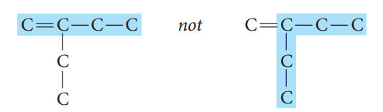
Alkenes and Cycloalkenes
Alkene: C_{n}H_{2n} Crabon-Carbon double bond
Cycloalkene: C_{n}H_{2n-2} Single ring with one or more double bond
Nomenclature of Alkenes
The IUPAC rules for naming alkenes are similar to those for alkanes, but a few rules must be added for naming and locating the multiple bonds.
  The ending -ene is used to designate a carbon–carbon double bond. When more than one double bond is present, the ending is -diene, -triene, and so on.
  Select the longest chain that includes both carbons of the double.

Slide 3

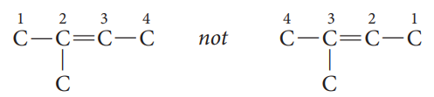


Number the chain from the end nearest the double bond so that the carbon atoms in that bond have the lowest possible numbers.
If the double bond is equidistant from both ends of the chain, number the chain from the end nearest the first branch point.
Indicate the position of the double bond using the lower numbered carbon atom of that bond.
If more than one double bond is present, number the chain from the end nearest the first double bond.

Slide 4




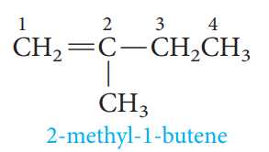
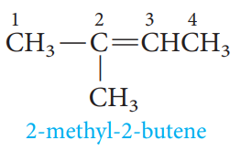
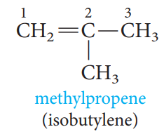
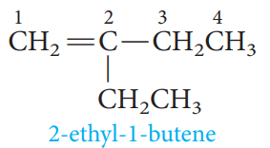
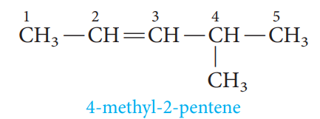
Examples

Slide 5
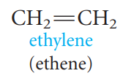
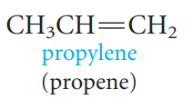
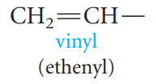
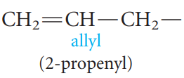
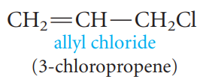
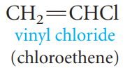
Common names
The simplest members of the alkene series are frequently referred to by their older common names, ethylene and propylene.
Two important groups also have common names. They are the vinyl and allyl groups, these groups are used in common names.

Slide 6
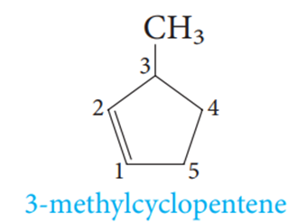
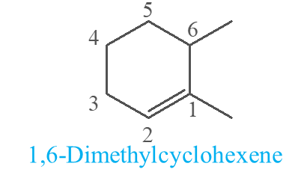
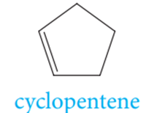
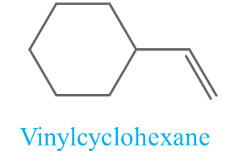
Nomenclature of Cycloalkenes
In cycloalkenes, the double is always found between carbon 1 and carbon 2. It is therefore not necessary to specify the position of the double bond with a number. If substituents are present, the ring must numbered, starting from the double bond, in the direction that gives the substituents the lowest number(s).

Slide 7
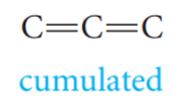
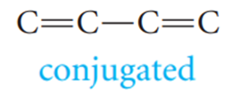
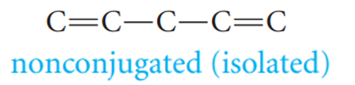
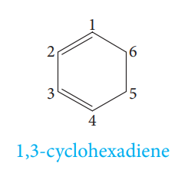
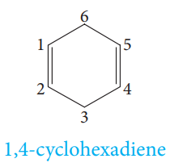
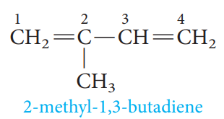
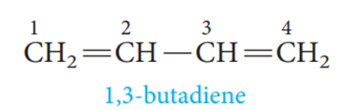
Alkadienes or Dienes
Compounds with more than one double exist. If two double bonds are present, the compounds are called alkadienes or, more commonly, dienes. There are also trienes, tetraenes, and even polyenes .
Depending on the relative positions of the multiple bonds, double bonds are said to be:
Nomenclature of Dienes

Slide 8
Physical properties of alkenes
Physical States and Solubilities
C₁-C₄
gases
C₅-C₁₈
liquids
More than C₁₈
solids
Alkenes are nonpolar compounds. Thus alkenes are soluble in the nonpolar solvents such as carbon tetrachloride (CCl₄) and benzene (C₆H₆), but they are insoluble in polar solvents such as water.

Slide 9
Geometric Isomerism in Alkene
Because rotation at carbon–carbon double bonds is restricted, geometric isomerism is possible in appropriately substituted alkenes.
The cis-trans system
cis (two similar groups are on the same side)
trans (two similar groups are on the opposite sides)

Slide 10
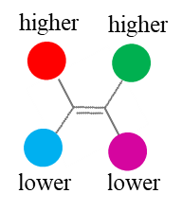
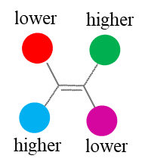
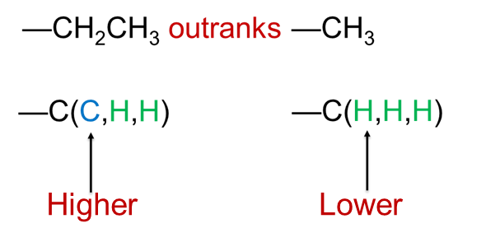
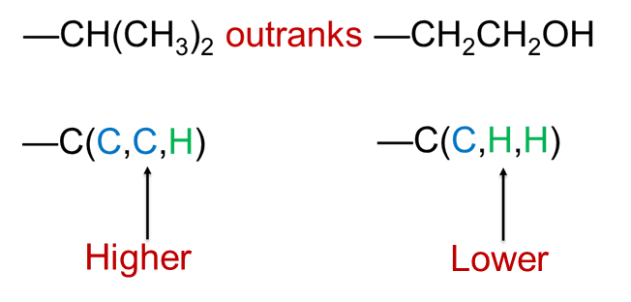
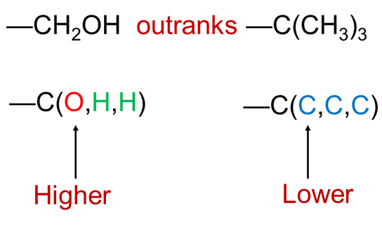
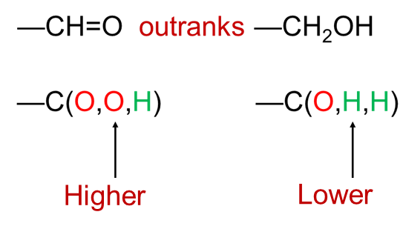
The E-Z System
Z : Zusammen
(two groups of higher priority are on the same side)
E : Entgegen
(two groups of higher priority are on the opposite sides)
Higher atomic number gets higher priority.
I > Br > Cl > S > P > F > O > N > C > H

Slide 11
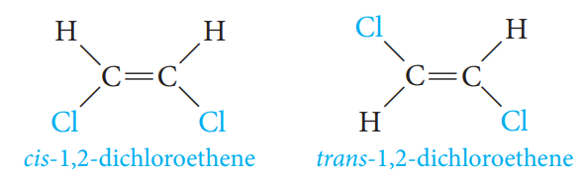
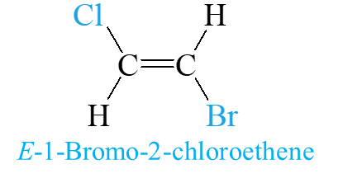
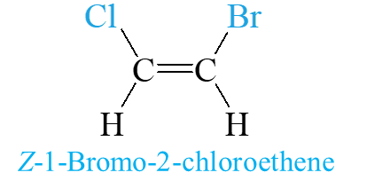
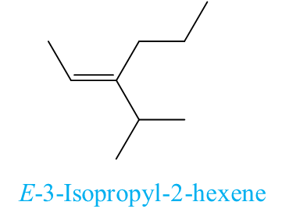
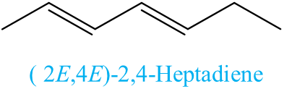
Examples

Slide 12
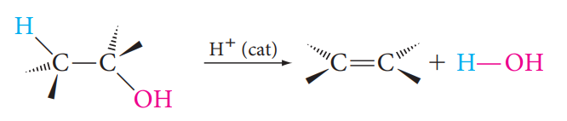

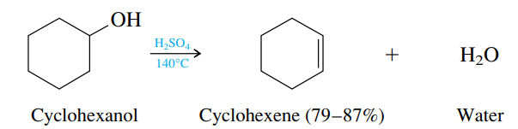
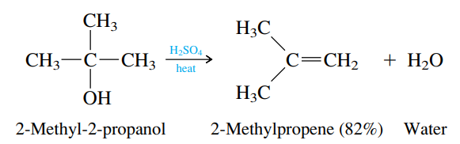
Preparation of alkenes
Alkenes are prepared from alcohols and alkyl halides by Elimination Reactions.
1- Dehydration of Alcohols
It is an elimination reaction and can occur by either an E1 or an E2 mechanism, depending on the class of the alcohol.
Examples:
Primary Alcohol
Secondary Alcohol
Tertiary Alcohol

Slide 13
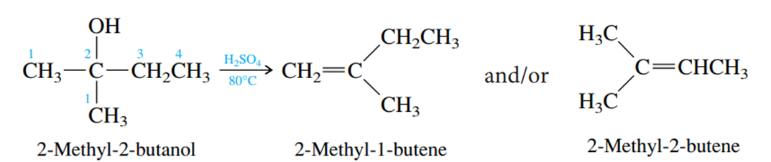
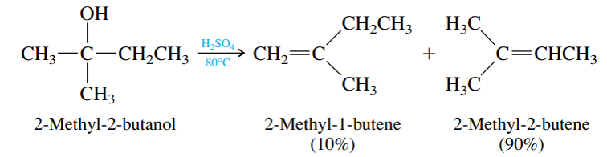
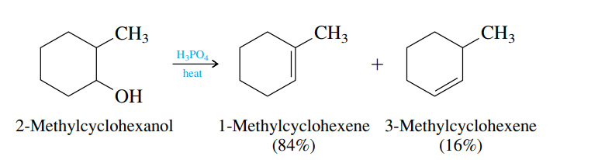
Regioselectivity in Dehydration of Alcohols: Zaitsev’s Rule
Zaitsev’s Rule:
Hydrogen is preferably removed from the carbon with least no. of hydrogen since the alkene formed is more highly branched and is energetically more stable.
R₂C=CR₂ > R₂C=CHR > R₂C=CH₂, RCH=CHR > RCH=CH₂ > CH₂=CH₂
Examples:
major
major

Slide 14
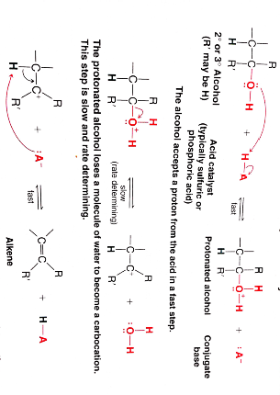
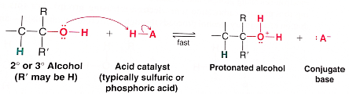
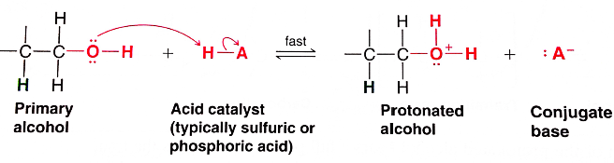
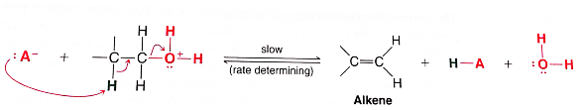
Dehydration of a Secondary or Tertiary Alcohol: An E1 Mechanism
Step 1
Step 2
Step 3
Dehydration of a Primary Alcohol: An E2 Mechanism
Step 1
Step 2

Slide 15
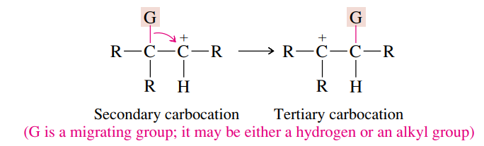
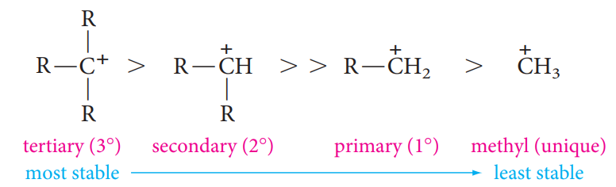
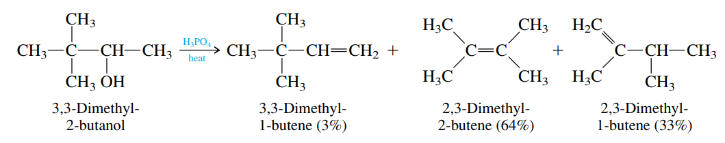
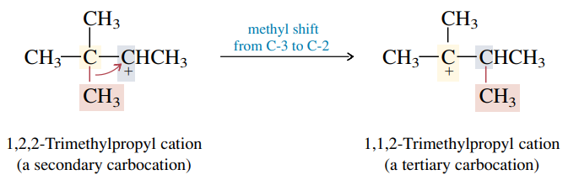
Rearrangement during Dehydration of Alcohols

Slide 16
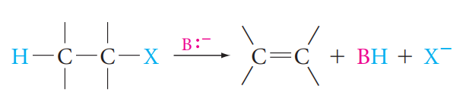



2- Dehydrohaloganation of Alkyl halides
E2: Bimolecular Elimination:
Examples:
Zaitsev’s Rule
major

Slide 17




Reaction of alkenes
Electrophilic Addition reactions on the carbon-carbon double bond.
1- Addition of Hydrogen: Catalytic Hydrogenation

Slide 18




2- Addition of Halogens: Halogenation
The Mechanism:

Slide 19




3- Addition of Acids:
Acids that add in this way are the hydrogen halides (H-F, H-Cl, H-Br, H-I) and sulfuric acid (H-OSO₃H).

Slide 20




Addition of Unsymmetric Reagents to Unsymmetric Alkenes; Markovnikov’s Rule
When an unsymmetric reagent adds to an unsymmetric alkene, the electropositive part of the reagent adds to the carbon of the double bond that has the greater number of hydrogen substituents .

Slide 21




4- Addition of Water : Hydration
Markovnikov’s Rule

Slide 22





5- Addition of HOX : Halohydrin Formation
The Mechanism:

Slide 23





6- Hydroboration:
Hydroboration-oxidation reactions are regioselective; the net result of hydroboration-oxidation is anti-Markovnikov addition of water to an alkene.

Slide 24




Reaction of alkenes
Oxidation of alkenes to Diols or Carbonyl-Containing Compounds.
1- Oxidation of alkenes with Permanganate
syn hydroxylation
OH⁻
H₂O, cold

Slide 25



2- Oxidation of alkenes with peroxy acid
anti hydroxylation

Slide 26




3- Ozonolysis:
Oxidation of alkenes by ozone O₃

Slide 27




Reactions of Dienes
1- Electrophilic Additions to Conjugated Dienes:
The Mechanism:

Slide 28



2- The Diels-Alder reaction
The Diels–Alder reaction is the cycloaddition reaction of a conjugated diene and a dienophile (alkene) to give a cyclic product in which three π bonds are converted to two σ bonds and a new π bond.

