Slide 1
241 Chem
CH-2
Alcohols

Slide 2
Learning Objectives
By the end of this chapter the student will:
Know the structure of alcohols
Know the different classes of alcohols.
Know the nomenclature of Alcohols
Know the physical Properties.
Know the acidity of Alcohols.
Know the different methods of preparation of Alcohols .
Know the chemical reactions of Alcohols

Slide 3
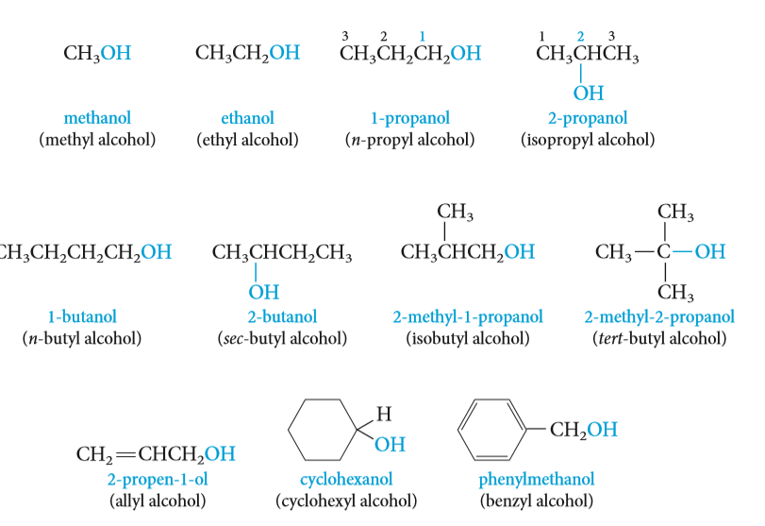

Structural Characteristic of Alcohols
Alcohols, a class of compounds containing the hydroxyl group ( OH )
Alcohols have a hydroxyl ( OH ) group bonded to a saturated carbon atom.
The alcohol carbon atom may be part of a simple alkyl group, an alkenyl or the carbon atom may be a saturated carbon atom that is attached to a benzene ring:

Slide 4
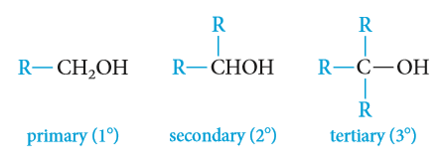
Classification of Alcohols
Alcohols are classified as primary ( 1º ), secondary ( 2º ), or tertiary ( 3º ), depending on whether one, two,
or three organic groups are connected to the hydroxyl-bearing carbon atom.
The carbon atom which connected to the hydroxyl group called carbinol carbon.
Methyl alcohol, which is not strictly covered by this classification, is usually grouped with the primary alcohols.
Example:
1º
1º
2º
3º
2º
3º

Slide 5
Type of Alcohols
Monohydroxyls: containing one hydroxyl group.
Dihydroxyls (glycols) : containing two hydroxyl groups.
Polyhydroxyls : containing more than two hydroxyl groups.

Slide 6
Nomenclature of Alcohols
Common names derived by naming the alkyl group followed by the word alcohol.
The IUPAC system: select the longest carbon chain that contains the -OH group as the parent alkane and numbered from the end closer to OH. change the suffix -e of the parent alkane to -ol
use a number to show the location of the OH group.
If there is a functional group suffix and a substituent, the functional group suffix gets the lowest possible number.
For cyclic alcohols, numbering begins with the carbon bearing the OH group. The OH group is known to be on carbon 1 of the ring.
In complex alcohols, the number for the hydroxyl group is often placed between the infix and the suffix.
So the compound containing two hydroxyl groups is named as a diol , one containing three hydroxyl groups as a triol , and so on.
Compounds containing OH and C=C groups are often referred to as unsaturated alcohols. choose the chain that include them both even if this is not the longest chain.
The IUPAC system: the double bond is shown by changing the infix of the parent alkane from -an- to -en- and the hydroxyl group is shown by changing the suffix of the parent alkene from -e to -ol.
Numbers must be used to show the location of both the carbon-carbon double bond and the hydroxyl group.

Slide 7
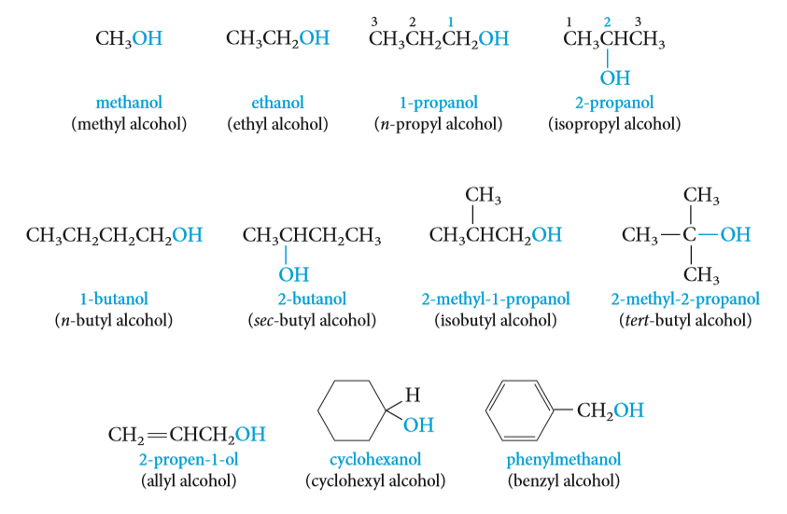
Nomenclature of Alcohols
(Ethylene glycol)
(Trimethylene glycol)
(Glycerol)

Slide 8
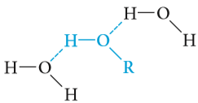
Physical Properties of Alcohols
Most of the common alcohols, up to about 11 or 12 carbon atoms, are liquids at room temperature.
Methanol and ethanol are free-flowing volatile liquids with characteristic fruity odors.
The higher alcohols are viscous, and some of the highly branched isomers are solids at room temperature.
The higher alcohols have heavier but still fruity odors.
Solubility
Water and alcohols have similar properties because they all contain hydroxyl groups that can form hydrogen bonds.
Several of the lower-molecular-weight alcohols as CH₃OH to C₃H₇OH are miscible (soluble in any proportions) with water.
The solubility decreases as the alkyl group becomes larger.
The number of hydroxyl groups increases so the solubility increases.

Slide 9

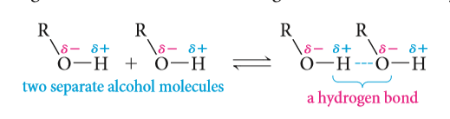
Physical Properties of Alcohols
Boiling Points
The boiling points of alcohols are much higher than those of ethers or hydrocarbons with similar molecular weights.
Alcohol molecules can associate with each other through hydrogen bonding, whereas those of ethers and hydrocarbons cannot.
The boiling points increase with the increase of the number of OH groups .
The boiling point decreases with increase in branching in the alkyl group.
Boiling points of 1º alcohol > 2º alcohol > 3º alcohol.

Slide 10
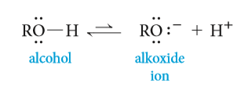
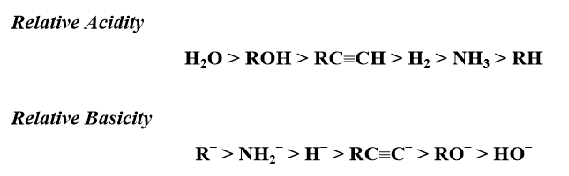
Physical Properties of Alcohols
Acidity of Alcohols
Alcohols can function as both weak acids (proton donors) and weak bases (proton acceptors).A strong base can remove the hydroxyl proton to give an alkoxide ion (for example, methoxide ion from methanol, ethoxide ion from ethanol, and so on).
Electron-withdrawing groups increase acidity by stabilizing the conjugate base.
Electron-donating groups decrease acidity because they destabilize the conjugate base.
The order of acidity of various liquid alcohols generally : water > 1º>2º>3º

Slide 11
Preparation Of Alcohols
Preparation of alcohols via alkenes
    Oxidation reaction
    Addition reaction
Preparation of alcohols via alkyl halides (Nucleophilic Substitution)
Preparation of alcohols via Grignard reagents with:
    Aldehydes, Ketones, Esters and Epoxides
Preparation of alcohols via Reduction reaction of:
Aldehydes, Ketones, Acids and Esters

Slide 12
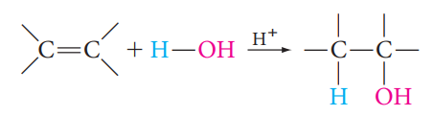
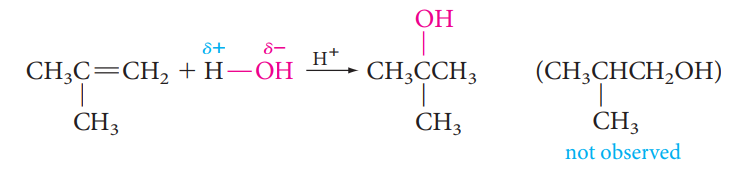
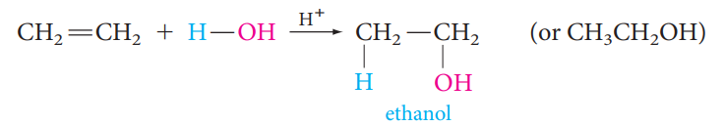

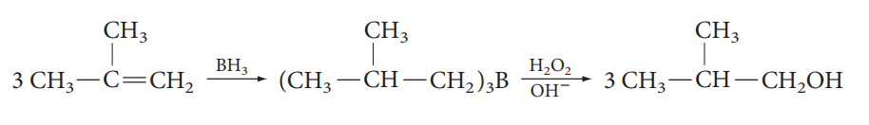
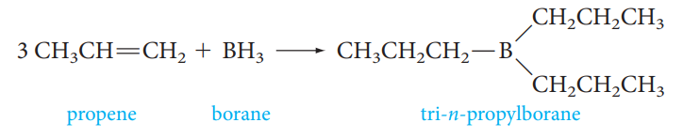
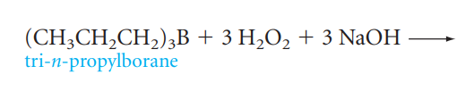
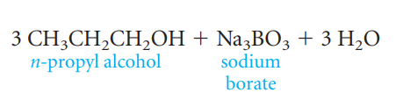
Preparation Of Alcohols
1- Preparation of alcohols via alkenes
a) Acid-Catalyzed Hydration of Alkenes: Addition of water to alkenes
Markovnikov Hydration
Anti-Markovnikov Hydration : Hydroboration–Oxidation:

Slide 13
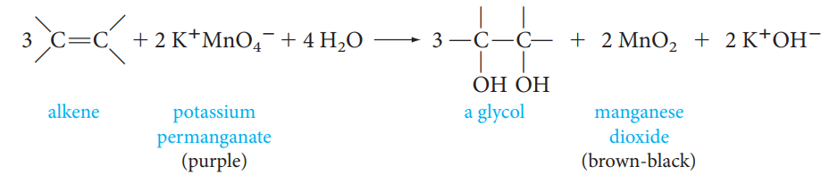
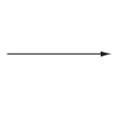
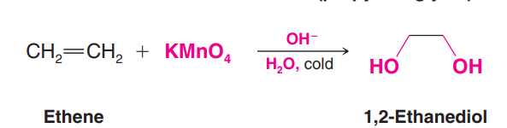
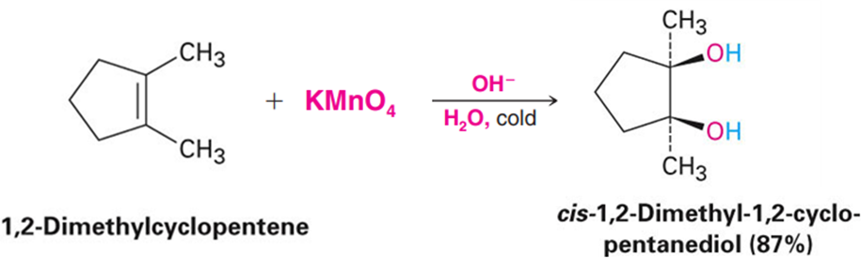
Preparation Of Alcohols
b) Oxidation of alkenes: Synthesis of 1,2-diols
Oxidation of alkenes with Permanganate : syn hydroxylation
OH⁻
H₂O, cold

Slide 14
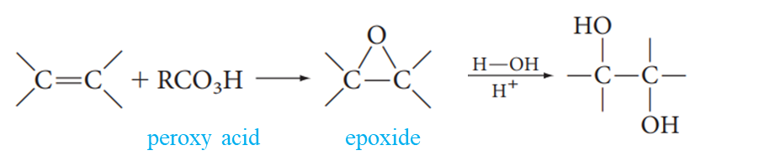
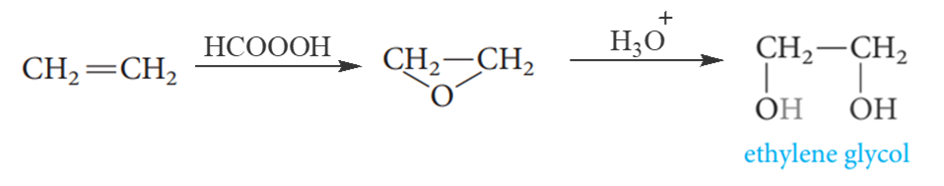
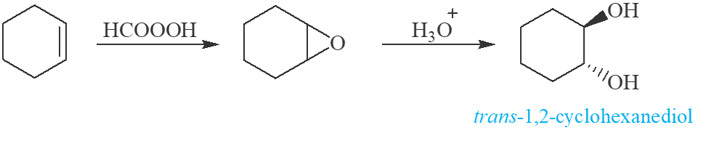
Preparation Of Alcohols
b) Oxidation of alkenes: Synthesis of 1,2-diols
Oxidation of alkenes with peroxy acid : anti hydroxylation

Slide 15

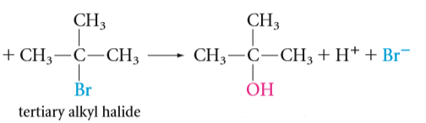
Preparation Of Alcohols
2- Preparation of alcohols via alkyl halides: Hydrolysis of alkyl halides
Nucleophilic Substitution Reactions (S_{N}1 and S_{N}2 )

Slide 16
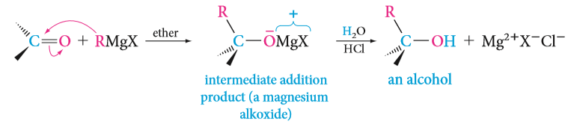
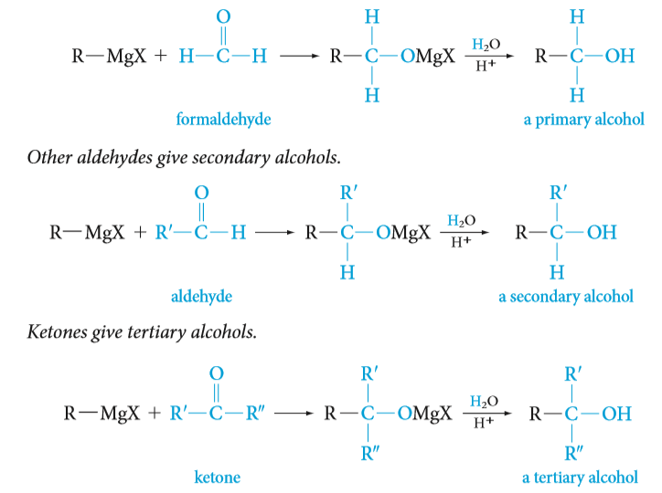
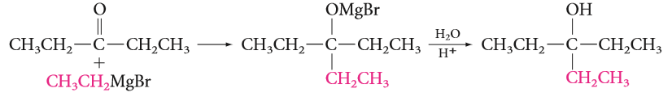
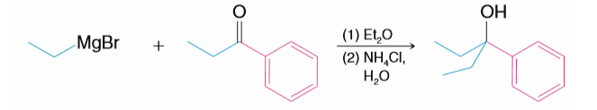
Preparation Of Alcohols
3- Preparation of alcohols via Grignard reagents with Aldehydes, ketones, Ester and Epoxide.
A) Grignard reagent with aldehydes and ketones

Slide 17
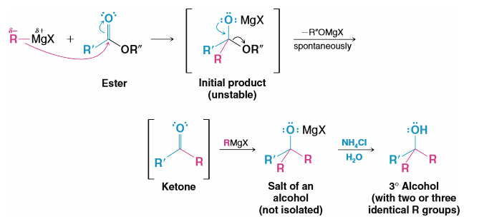
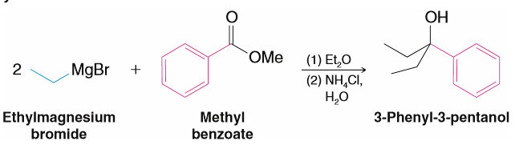
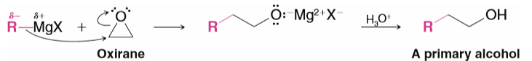
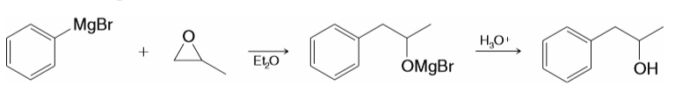
Preparation Of Alcohols
B) Grignard reagents with Ester
C) Grignard reagents with Epoxide (Oxiranes)

Slide 18
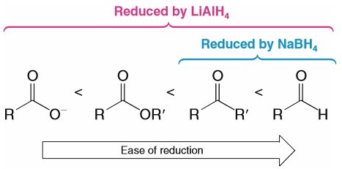
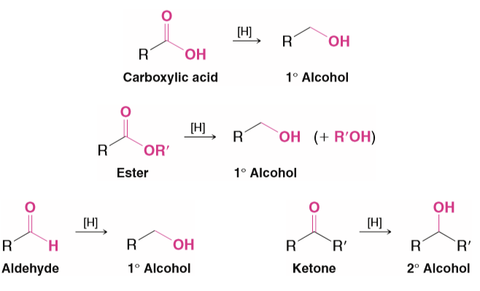
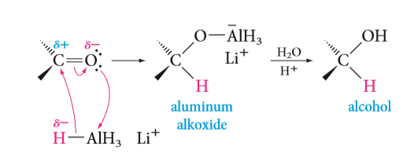
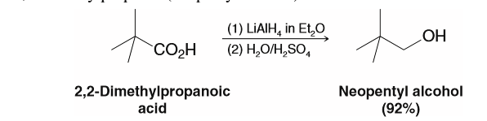
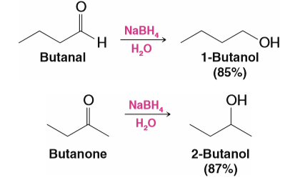
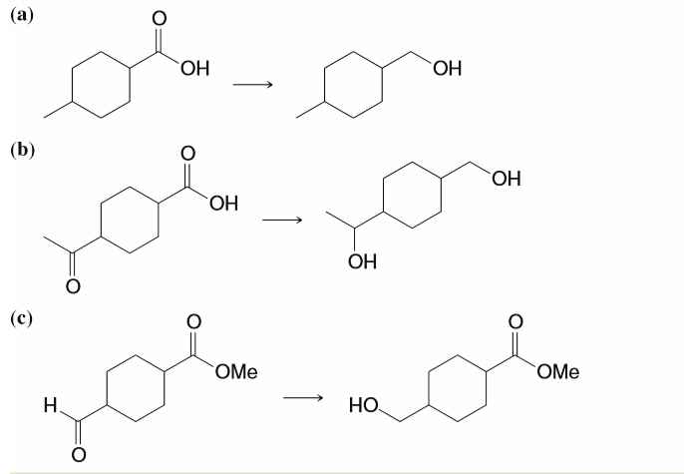
Preparation Of Alcohols
4- preparation of alcohols via Reduction reaction
By hydrogenation of the carbon–oxygen double bond.
sodium borohydride (NaBH₄) reduce carbonyl groups (aldehydes, ketones).
lithium aluminum hydride (LiAlH₄) reduce all kind of carbonyl groups.

Slide 19
Reactions Of Alcohols
The reactions of alcohols have mainly to do with the following:
  The hydrogen atom of the hydroxyl group is weakly acidic.
                Preparation of alkoxides
                Preparation of Esters (Fisher esterification)
  The oxygen atom of the hydroxyl group is nucleophilic and weakly basic.
                Oxidation Reactions
  The hydroxyl group can be converted to a leaving group so as to allow substitution or elimination reactions.
                Conversion of Alcohols into Alkyl Halides
                Preparation of alkenes
                Preparation of Ethers

Slide 20
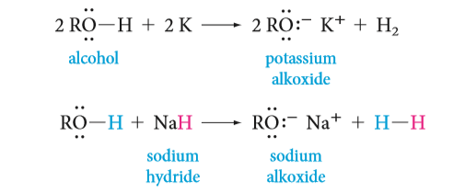

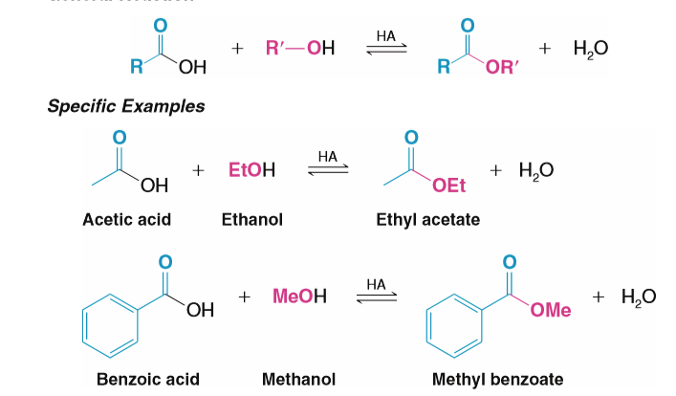
Reactions Of Alcohols
Preparation of alkoxides
They can be prepared by the reaction of an alcohol with sodium or potassium metal or with a metal hydride.
Hint:
2- Preparation of Esters: Acid-catalyzed esterification (Fisher esterification)

Slide 21

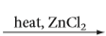
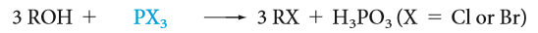

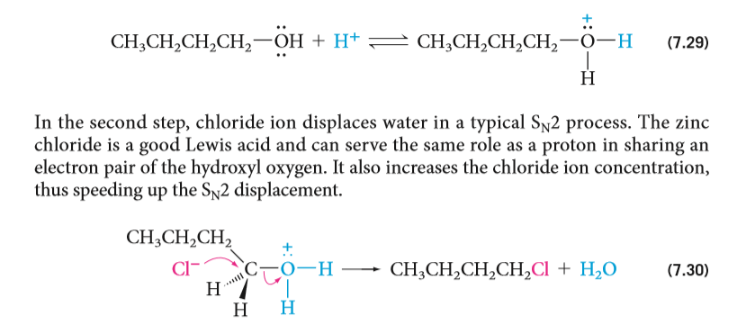
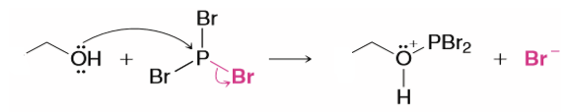
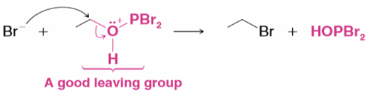
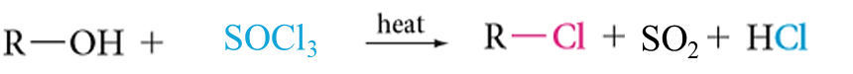
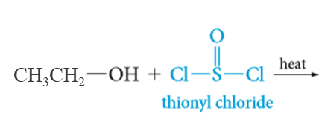
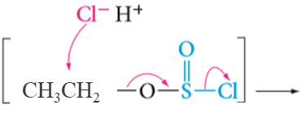
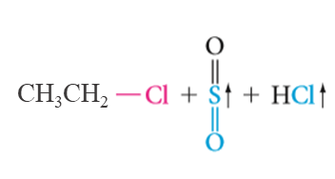
Reactions Of Alcohols
    3- Conversion of Alcohols into Alkyl Halides: S_{N}1 or S_{N}2
The most commonly used reagents for conversion of alcohols to alkyl halides are the following:
  Hydrogen halides (HCl, HBr, Hl)
  Phosphorus tribromide (PBr₃)
  Thionyl chloride (SOCl₂)

Slide 22
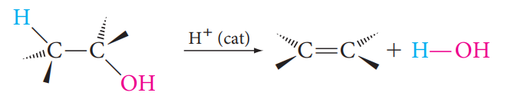
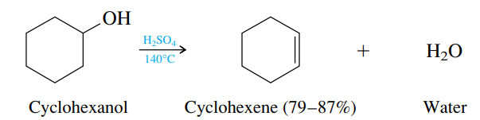

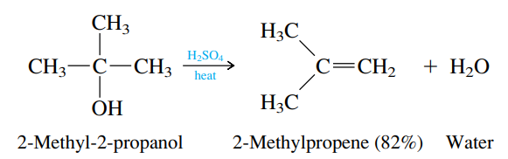






Reactions Of Alcohols
4- Elimination Reaction: Preparation of alkenes ( E1 or E2)
heat
Primary Alcohol
Secondary Alcohol
Tertiary Alcohol
Hint: Rearrangement
5- Preparation of Ethers

Slide 23




Reactions Of Alcohols
6. Oxidation of Alcohols
Strong oxidizing agent
Weak oxidizing agent
Potassium permanganate KMnO₄ ,OH⁻/ H₃O⁺
Chromic oxide CrO₃ / H₂SO₄ (H₂CrO₄ Jones’ reagent )
Chromic oxide CrO₃ / pyridine
Pyridinium chlorochromate PCC / methylene chloride CH₂Cl₂
Hint:
No reaction
Tertiary alcohol

