Slide 1
CEN448 Security and Internet Protocols
Dr. Yaser M. Ibrahim
Computer Engineering Department
College of Computer and Information Sciences
King Saud University
ymibrahim@ksu.edu.sa
* Some slides are based on slides by Dr. Lawrie Brown, Australian Defense Force Academy

Slide 2
Instructor
Dr. Yaser Ibrahim
Email: ymibrahim@ksu.edu.sa
Office: CCIS (Bldg. 31) - Room 2188
Tel. : 01-4695208
Office Hours:
Sun. 8 to 9 AM
Mon. 8 to10 AM
Wed. 8 to 10 AM
TA: ??

Slide 3
Course Catalog Description
Overview, Security Concepts, Attacks, Services; Block Ciphers; Block Cipher Operation; Public-Key Cryptography and RSA; Cryptographic Hash Functions; User Authentication Protocols; Transport-Level Security; Wireless Network Security; IP Security; Intruders; Malicious Software; Firewalls
Prerequisites : CEN 445 - Computer Networks

Slide 4
Textbook and References
Textbook
“Cryptography and Network Security”
William Stallings, 5th Ed., Prentice Hall
References
“Security Engineering: A Guide to Building Dependable Distributed Systems”
Ross Anderson, 2nd Ed., Wiley (1st edition and a few chapters of 2nd edition are available online at: http://www.cl.cam.ac.uk/~rja14/book.html)
“Handbook of Applied Cryptography”
Alfred Menezes, Paul van Oorschot and Scott Vanstone, CRC Press (available online at: http://www.cacr.math.uwaterloo.ca/hac/)
Handouts and the Web
Links to many resources will be provided

Slide 5
Grading
Final Exam: 40%
Mid-term Exam #1: 20%
On 22/11/1433 (Oct. 8, 2012)
Mid-term Exam #2: 20%
On 12/1/1434 (Nov. 26, 2012)
Assignments & Quizzes: 20%
Assignments are mini-projects
Quizzes: every couple of weeks
Practice problems from the book will be assigned but won’t have any credit

Slide 6
General Rules and Comments
Questions and participation during class are highly encouraged.
Cooperation and discussions between students are encouraged
However, copying someone else’s work is not acceptable.
Email will be used to communicate important information to students.
Please make sure to update your email address on the KSU system.
Students are responsible for observing the university calendar
Class drop and withdrawal dates and any other important dates.

Slide 7
More Rules and Comments
Attendance is mandatory
Exceeding 25% absence rate will mean denial from final exam
Excuses for absences are accepted only within 1 week of the absence
Please be aware that plagiarism and cheating will not be tolerated
Will lead to failing the course
There will not be make-up for missed assignments and quizzes
Don’t ask me to help you regarding your grade, please! I will not do that.

Slide 8
Course Outline
Network Security Concepts: Attacks, Mechanisms, Services
Symmetric (Secret-Key) Cryptography
Classical Encryption Techniques
Modern Block Ciphers: DES, AES
Asymmetric (Public-Key) Cryptography
Message Authentication: Hash, MAC, Signatures
User Authentication
Network Attacks and Defenses
Transport-level, IP, and wireless security
Malware, Intruders, and Firewalls

Slide 9
Chapter 1 Introduction
Reading Assignment
Read Ch. 1 from Stallings textbook

Slide 10
Computer Security
Definition according to NIST
“The protection afforded to an automated information system in order to attain the applicable objectives of preserving the integrity, availability and confidentiality of information system resources (includes hardware, software, firmware, information/data, and telecommunications)”
Notes:
The NIST Computer Security Handbook [NIST95] defines the term computer security as shown on this slide. This definition introduces three key objectives that are at the heart of computer security as we see on the next slide.

Slide 11
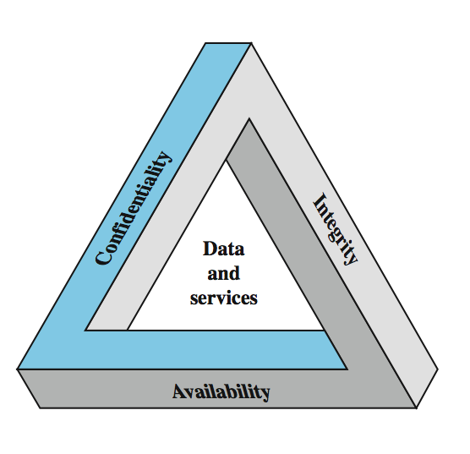
Key Security Concepts
Notes:
These three concepts form what is often referred to as the CIA triad (Figure 1.1). The three concepts embody the fundamental security objectives for both data and for information and computing services. FIPS PUB 199 provides a useful characterization of these three objectives in terms of requirements and the definition of a loss of security in each category:
• Confidentiality (covers both data confidentiality and privacy): preserving authorized restrictions on information access and disclosure, including means for protecting personal privacy and proprietary information. A loss of confidentiality is the unauthorized disclosure of information.
• Integrity (covers both data and system integrity): Guarding against improper information modification or destruction, and includes ensuring information non-repudiation and authenticity. A loss of integrity is the unauthorized modification or destruction of information.
• Availability: Ensuring timely and reliable access to and use of information. A loss of availability is the disruption of access to or use of information or an information system.
Although the use of the CIA triad to define security objectives is well established, some in the security field feel that additional concepts are needed to present a complete picture. Two of the most commonly mentioned are:
• Authenticity: The property of being genuine and being able to be verified and trusted; confidence in the validity of a transmission, a message, or message originator.
• Accountability: The security goal that generates the requirement for actions of an entity to be traced uniquely to that entity.

Slide 12
Computer Security Challenges
not simple
must consider potential attacks
procedures used counter-intuitive
involve algorithms and secret info
must decide where to deploy mechanisms
battle of wits between attacker / admin
not perceived on benefit until fails
requires regular monitoring
too often an after-thought
regarded as impediment to using system
Notes:
Computer security is both fascinating and complex. Some of the reasons follow:
1. Computer security is not as simple as it might first appear to the novice. The requirements seem to be straightforward, but the mechanisms used to meet those requirements can be quite complex and subtle.
2. In developing a particular security mechanism or algorithm, one must always consider potential attacks (often unexpected) on those security features.
3. Hence procedures used to provide particular services are often counterintuitive.
4. Having designed various security mechanisms, it is necessary to decide where to use them.
5. Security mechanisms typically involve more than a particular algorithm or protocol, but also require participants to have secret information, leading to issues of creation, distribution, and protection of that secret information.
6. Computer security is essentially a battle of wits between a perpetrator who tries to find holes and the designer or administrator who tries to close them.
7. There is a natural tendency on the part of users and system managers to perceive little benefit from security investment until a security failure occurs.
8. Security requires regular monitoring, difficult in today's short-term environment.
9. Security is still too often an afterthought - incorporated after the design is complete.
10. Many users / security administrators view strong security as an impediment to efficient and user-friendly operation of an information system or use of information.

Slide 13
Aspects of Security
Security attack
Any action that compromises the security of information owned by an organization
Attack vs. threat
Security mechanism
A process (or a device) that is designed to detect, prevent, or recover from a security attack
E. g. encryption
Security service
A service that enhances the security of the data processing/transfer systems
Uses security mechanisms
E. g. digital signature
Notes:
The OSI security architecture focuses on security attacks, mechanisms, and services. These can be defined briefly as follows:
• Security attack: Any action that compromises the security of information owned by an organization.
• Security mechanism: A process (or a device incorporating such a process) that is designed to detect, prevent, or recover from a security attack.
• Security service: A processing or communication service that enhances the security of the data processing systems and the information transfers of an organization. The services are intended to counter security attacks, and they make use of one or more security mechanisms to provide the service.
In the literature, the terms threat and attack are commonly used to mean more or less the same thing. Table 1.1 provides definitions taken from RFC 2828, Internet Security Glossary.
Threat - A potential for violation of security, which exists when there is a circumstance, capability, action, or event that could breach security and cause harm. That is, a threat is a possible danger that might exploit a vulnerability.
Attack - An assault on system security that derives from an intelligent threat; that is, an intelligent act that is a deliberate attempt (especially in the sense of a method or technique) to evade security services and violate the security policy of a system.

Slide 14
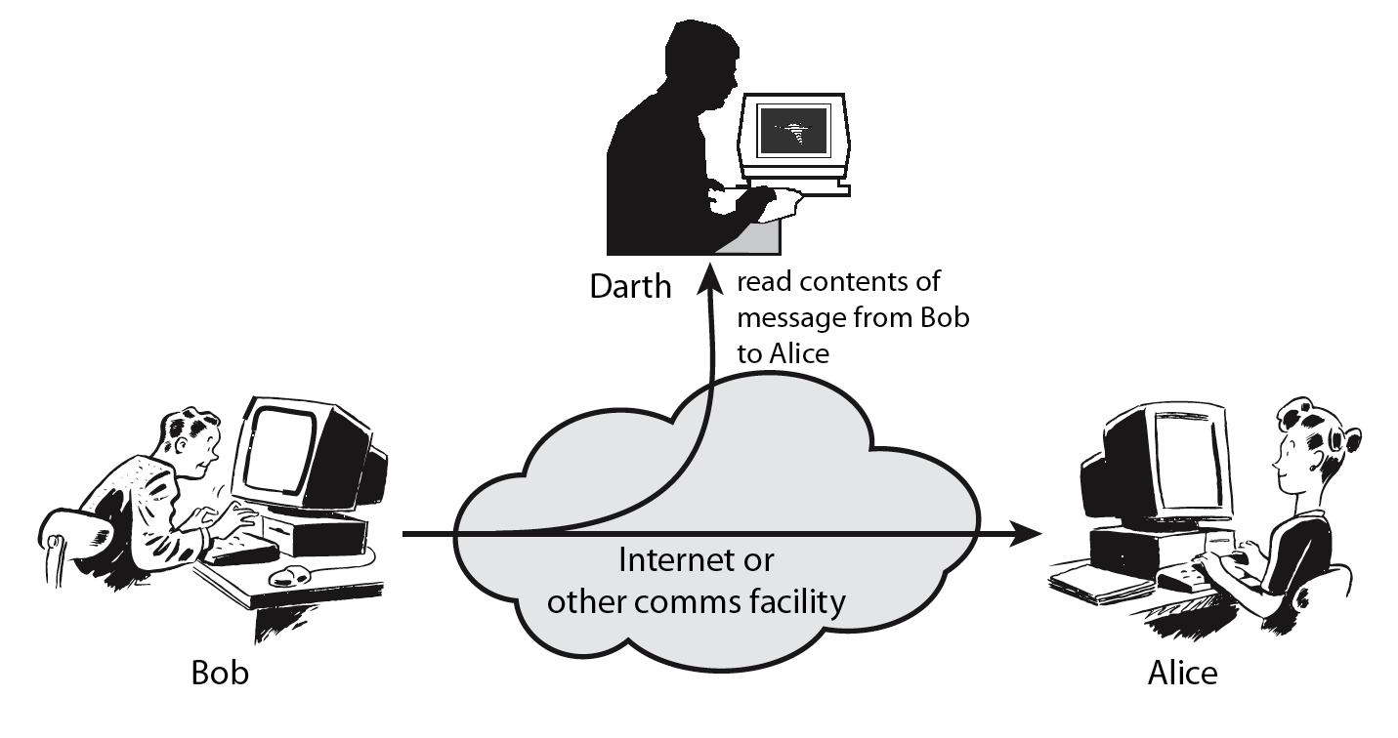
Passive Attacks
Notes:
A useful means of classifying security attacks, used both in X.800 and RFC 2828, is in terms of passive attacks and active attacks. A passive attack attempts to learn or make use of information from the system but does not affect system resources.
Passive attacks are in the nature of eavesdropping on, or monitoring of, transmissions. The goal of the opponent is to obtain information that is being transmitted. Two types of passive attacks are:
+ release of message contents - as shown above in Stallings Figure 1.2a here
+ traffic analysis - monitor traffic flow to determine location and identity of communicating hosts and could observe the frequency and length of messages being exchanged
These attacks are difficult to detect because they do not involve any alteration of the data.

Slide 15
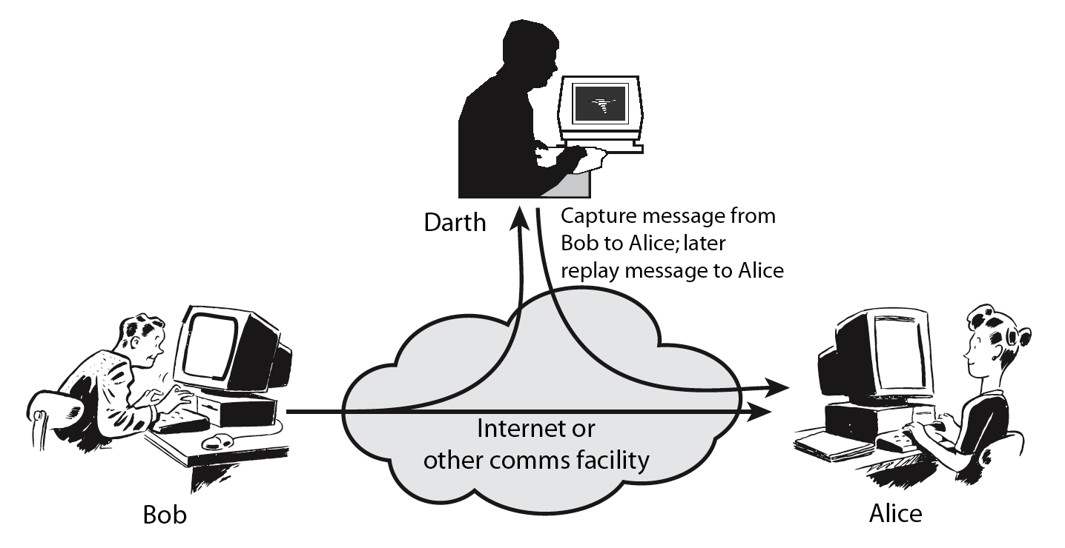
Active Attacks
Notes:
Active attacks involve some modification of the data stream or the creation of a false stream and can be subdivided into four categories: masquerade, replay, modification of messages, and denial of service:
masquerade of one entity as some other
replay previous messages (as shown above in Stallings Figure 1.3b)
modify/alter (part of) messages in transit to produce an unauthorized effect
denial of service - prevents or inhibits the normal use or management of communications facilities
Active attacks present the opposite characteristics of passive attacks. Whereas passive attacks are difficult to detect, measures are available to prevent their success. On the other hand, it is quite difficult to prevent active attacks absolutely, because of the wide variety of potential physical, software, and network vulnerabilities. Instead, the goal is to detect active attacks and to recover from any disruption or delays caused by them.

Slide 16
Security Services Categories
Authentication - assurance that communicating entity is the one claimed
Access Control - prevention of the unauthorized use of a resource
Data Confidentiality –protection of data from unauthorized disclosure
Data Integrity - assurance that data received is as sent by an authorized entity
Non-Repudiation - protection against denial by one of the parties in a communication
Availability – resource accessible/usable
Notes:
This list is taken from Stallings Table 1.2 which provides details of the 5 Security Service categories and the 14 specific services given in X.800.
This list includes the various "classic" security services which are traditionally discussed. Note there is a degree of ambiguity as to the meaning of these terms, and overlap in their use. The broad service categories are:
authentication is concerned with assuring that a communication is authentic. Two specific authentication services are defined in X.800: Peer entity authentication: provides corroboration of the identity of a peer entity in an association; and Data origin authentication: provides corroboration of the source of a data unit.
access control is the ability to limit and control the access to host systems and applications via communications links.
confidentiality is the protection of transmitted data from passive attacks, and the protection of traffic flow from analysis.
integrity assures that messages are received as sent, with no duplication, insertion, modification, reordering, replay, or loss.
availability is the property of a system / resource being accessible and usable upon demand by an authorized system entity, according to performance specifications for the system.

Slide 17
Security Mechanism
feature designed to detect, prevent, or recover from a security attack
no single mechanism that will support all services required
however one particular element underlies many of the security mechanisms in use:
cryptographic techniques
hence our focus on this topic
Notes:
Now introduce “Security Mechanism” which are the specific means of implementing one or more security services. Note these mechanisms span a wide range of technical components, but one aspect seen in many is the use of cryptographic techniques.

Slide 18
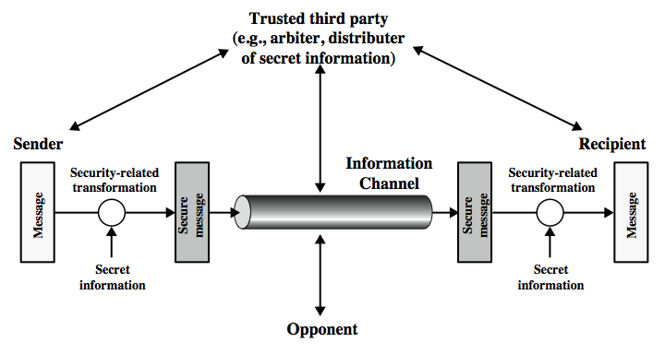
Model for Network Security
Notes:
In considering the place of encryption, its useful to use the following two models from Stallings section 1.6.
The first, illustrated in Figure 1.4, models information being transferred from one party to another over an insecure communications channel, in the presence of possible opponents. The two parties, who are the principals in this transaction, must cooperate for the exchange to take place. They can use an appropriate security transform (encryption algorithm), with suitable keys, possibly negotiated using the presence of a trusted third party. Parts One through Four of this book concentrates on the types of security mechanisms and services that fit into the model shown here.

