Slide 1
Complete Blood Count (CBC)

Slide 2
Objectives:
To estimate the number of RBC in blood sample
To estimate the number of total WBC in blood sample
To perform a differential count for a blood sample

Slide 3
Introduction
Complete blood count (CBC) is a test that gives information about the cells in a patient's blood.(red blood cells, white blood cells, and platelets).

Slide 4
CBC test usually includes:
WBC count (White Blood Cell count).
WBC differential count.
RBC count (Red Blood Cell count).
HCT (Hematocrit)
Hb (Hemoglobin)
Mean corpuscular volume (MCV).
Mean corpuscular hemoglobin (MCH).
Mean corpuscular hemoglobin concentration (MCHC).
Reticulocyte Count (slightly immature red blood cells.).
Platelet count.
Mean platelet volume (MPV).

Slide 5
CBC can be applied by two way:
Automated blood count (automated hematology analyzers)
Manual blood count
Note: flow-cytometry.

Slide 6
Automated hematology analyzers

Slide 7
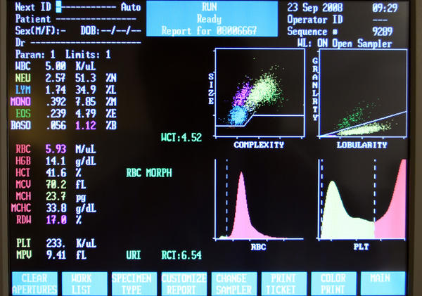

Slide 8
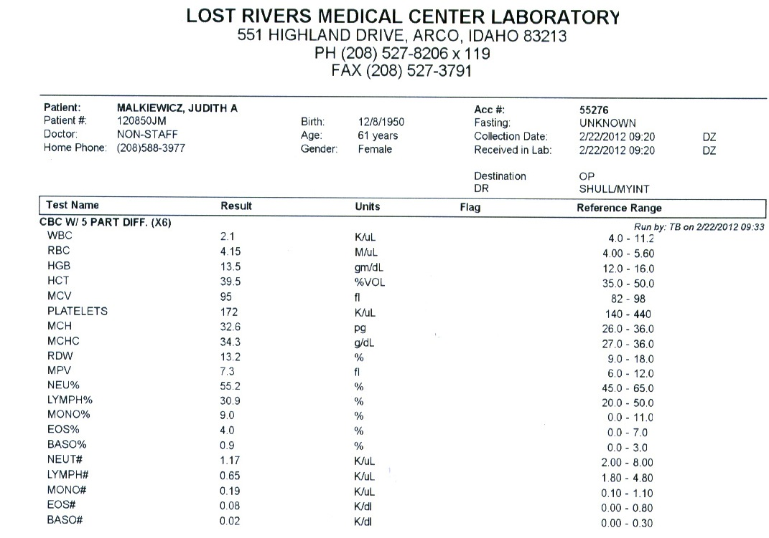

Slide 9
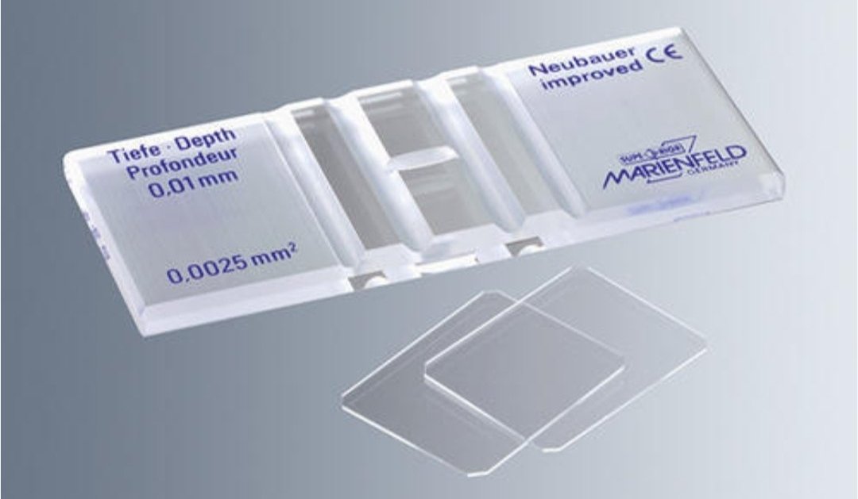
2. Manual blood count
This measurement is made with a microscope and a specially ruled chamber (hemocytometer) using diluted blood.

Slide 10
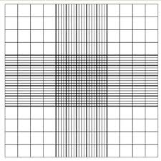
Hemocytometer

Slide 11
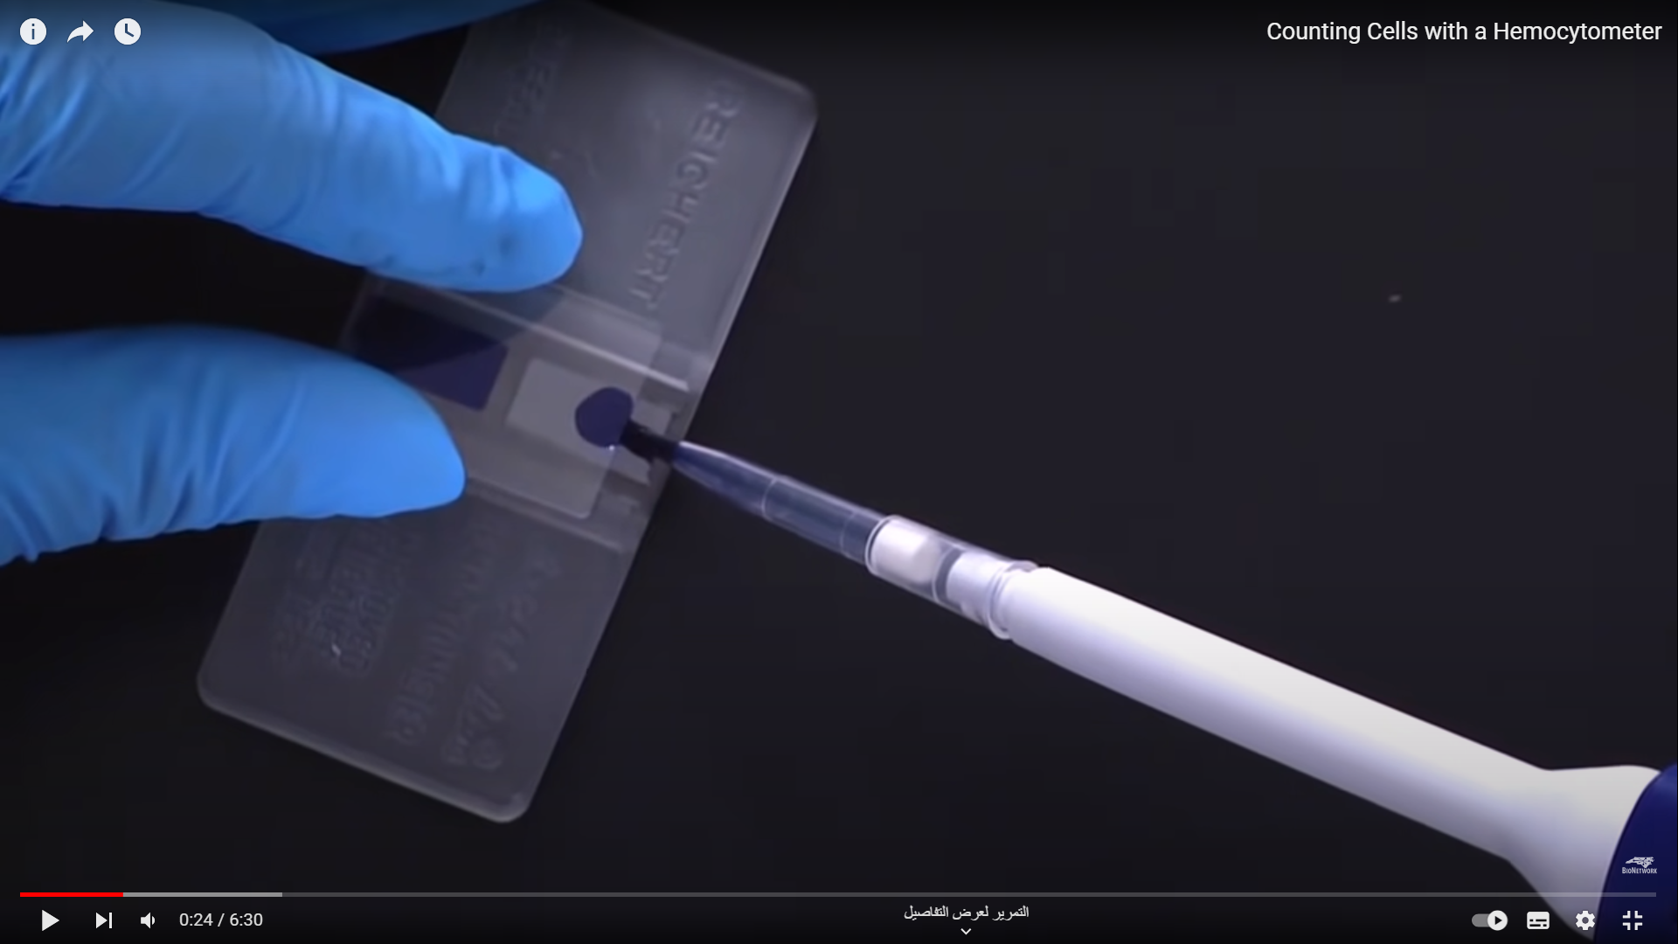
Picture taken from: https://www.youtube.com/watch?app=desktop&v=pP0xERLUhyc

Slide 12
Red blood count:
It is test done to determination the number of RBC in a sample of blood , also it evaluate the size and shape of RBC
It is range from 4.2 – 5.5 million RBC per cubic millimeter (mm³)
It is considered a very important indicator of a patent’s health.
Low RBC count
Anemia
Acute or chronic blood loss
Malnutrition
Chronic inflammation
High RBC count
Polycythemia
Congenital heart disease, causing low blood oxygen levels. Leading to high RBC count.
Renal Cell Carcinoma.

Slide 13
Normally high (RBC count)
People who live at high altitudes
Smokers
Oxygen is low→ RBC synthesis increases

Slide 14
WBC count :
Total leukocytes count shows the number of WBC in a sample of blood .
A normal WBC count is between 4,500 and 11,000 cells per cubic millimeter .
The number of WBC is sometimes used to identify an infection or to monitor the body’s response to treatment.
Low WBC count → Leukopenia
A Condition in which the number of leukocytes is abnormally low and which is most commonly due HIV and radiation poisoning.
High WBC count → Leukocytosis
Infection, or cancer (Leukemia).
It can occur normally after eating fat-rich meals .

Slide 15
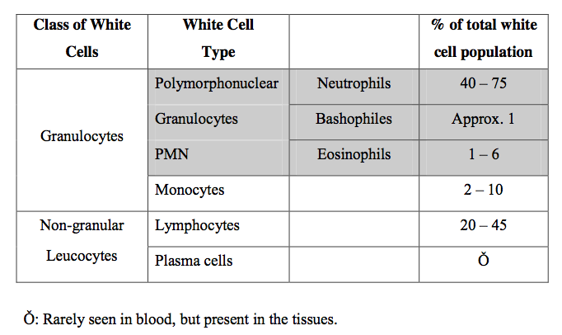
(C) Differential Count
It determines the number of each type of WBC present in the blood

Slide 16
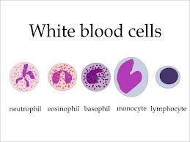

Slide 17
Platelets Count
These play a role in clotting. This test measures the number of platelets in your blood. The normal range is 150,000 to 450,000 platelets/mcL.
Platelet count
Mean platelet volume (MPV)

Slide 18
How to count blood cells

Slide 19
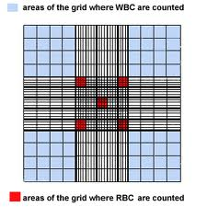
It is necessary to obtain RBC free preparation of WBC from blood .

Slide 20
Calculations: RBC blood cell count ( 5 squares): Find the sum of RBCs in 5 large squares. divide it with 80 (5 X 16) small squares to find the average in one square. Multiply it by 200 This factor accounts for the dilution for microscopic examination. Multiply by 4000 to obtain the number per cubic milliliter.(to convert the concentration of RBCs per small square to the number of RBCs per cubic milliliter (volume).)

Slide 21
Example:
The sum of RBCs in 5 large squares = 84+71+63+93+83= 394 cells.
The average of RBCs in one square= 394/80 = 4.9 cells.
And 4. RBC count= 4.9 x 200 x 4000 = 4 million/mm³.
Normal range= 4.2 - 5 million/mm³

Slide 22
WBC blood cell count ( 4 squares) Find the sum of WBCs in 4 large squares, and divide it with 64 (4 X 16) small squares to find the average in one square, multiply it by 20 to allow for the dilution and then multiply by 160 to obtain the number per cubic milliliter. Example: The sum of WBCs in 4 large squares = 16+21+17+15= 69 cells. The average of WBCs in one square= 69/64 = 1.07 cells. WBC count= 1 x 20 x 160 = 3200 Cells/mm³. Normal range= 4500-11000 cells /mm³

Slide 23
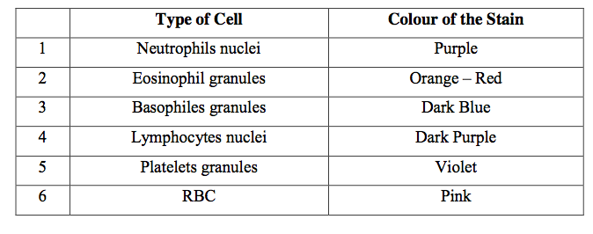
What is Leishman’s stain ?
It is stain, based on a mixture of methylene blue and eosin.
It differentiates between WBC as indicated in the following table:

