Slide 1
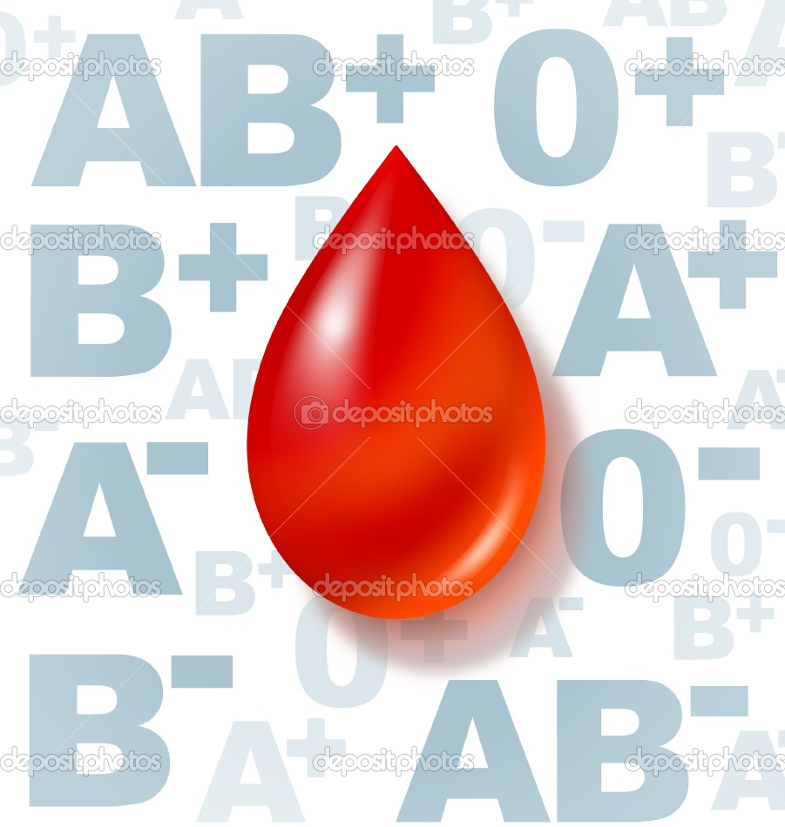
Blood Group
&
human traits

Slide 2
The most well-known and medically important blood types are in the ABO group.
All humans and many other primates can be typed for the ABO blood group.
There are four principal types: A, B, AB, and O.
There are two antigens and two antibodies that are mostly responsible for the ABO types.

Slide 3
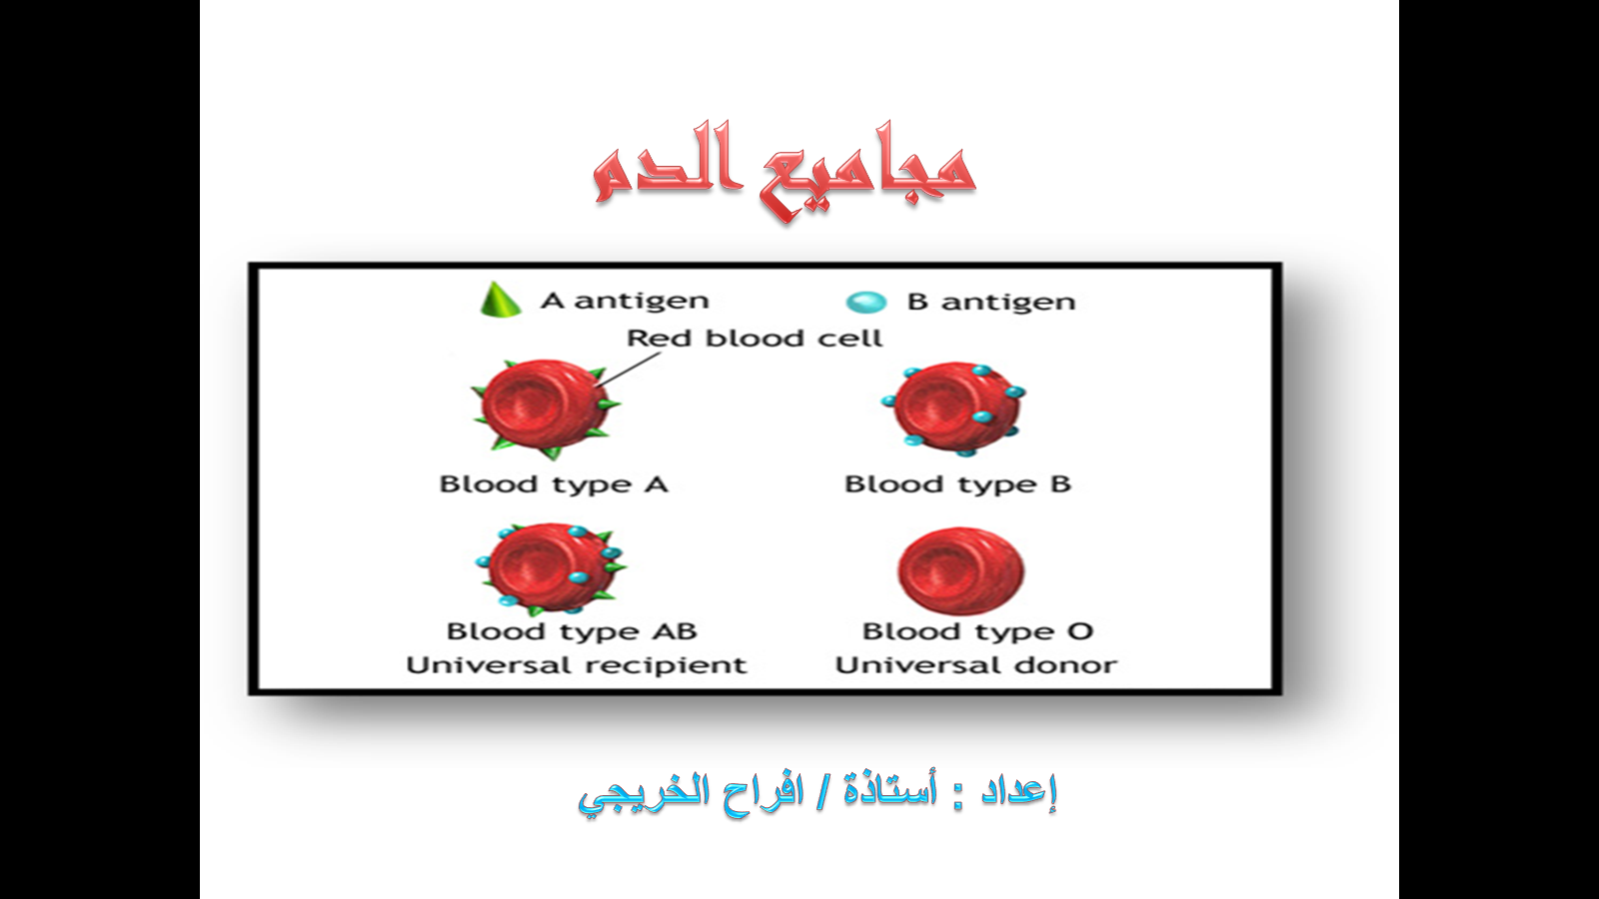

Slide 4
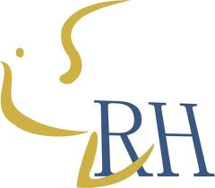
Rh blood group system :
The Rh system is the second most significant blood-group system in human-blood transfusion with currently 50 antigens.
The most significant Rh antigen is the D antigen, because it is the most likely to provoke an immune system response of the five main Rh antigens .

Slide 5

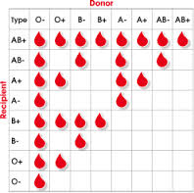
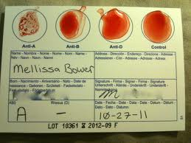
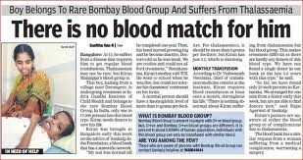
We can say :
The presence or absence of D Ag determines if the person is Rh+ or Rh-

Slide 6
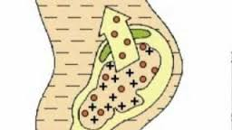
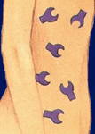
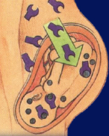
Rh antibodies
Result from the exposure to Rh antigens
Bind at 37°C
Anti-Rh⁺ antibodies
Possible subsequent pregnancies
Mother makes anti-Rh⁺ antibodies.

Slide 7
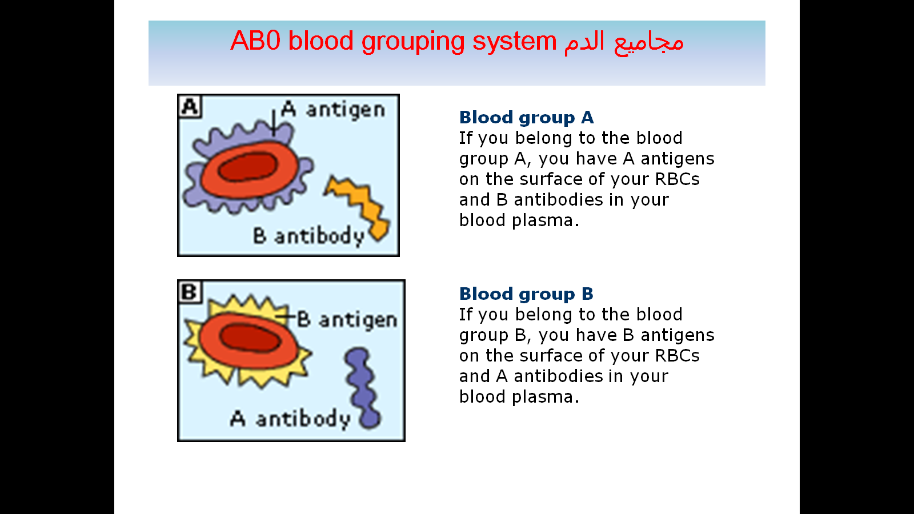
ABO blood group system

Slide 8
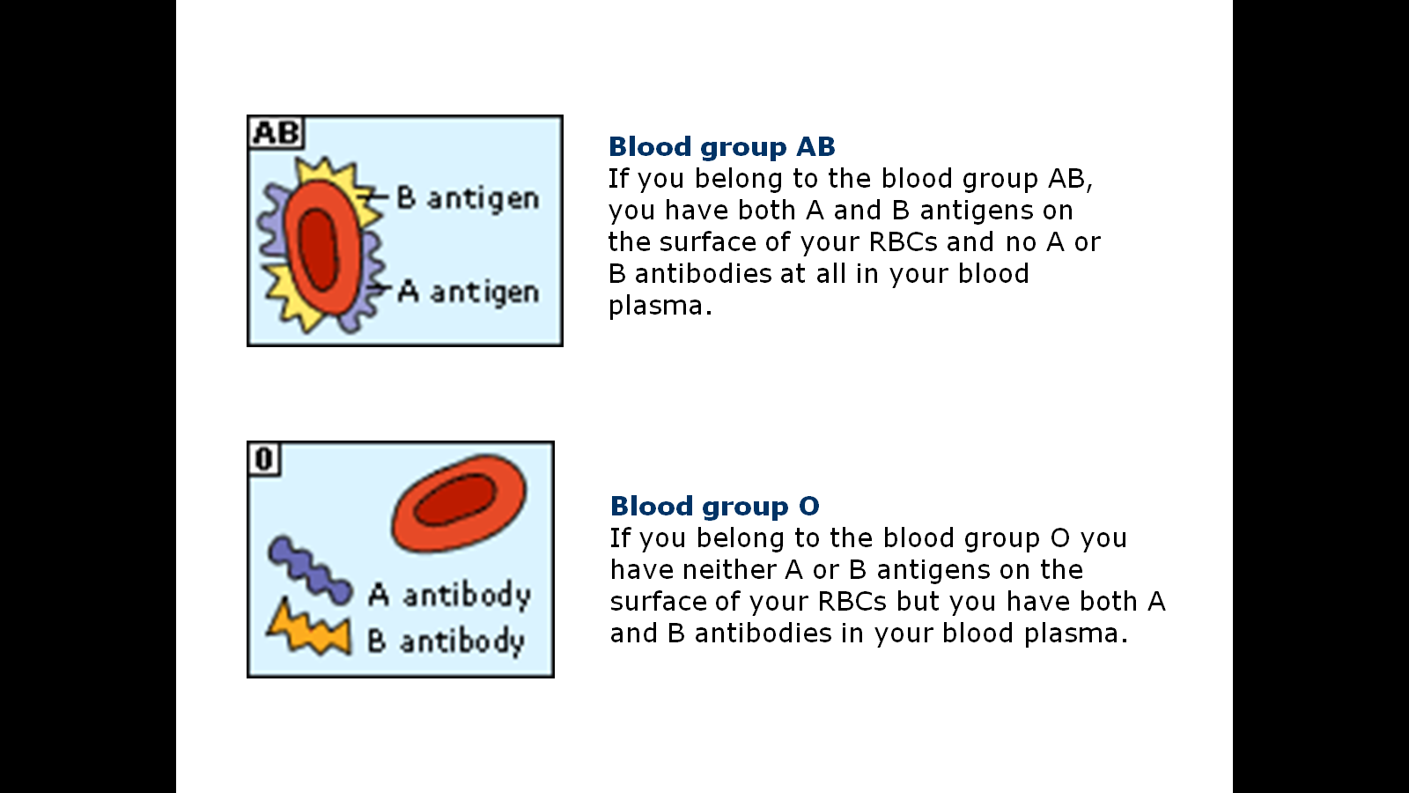
ABO blood group system

Slide 9
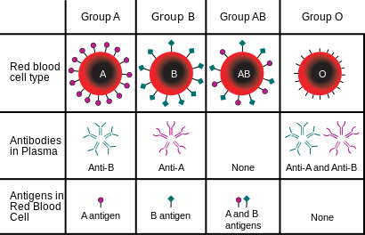
The Antigens

Slide 10
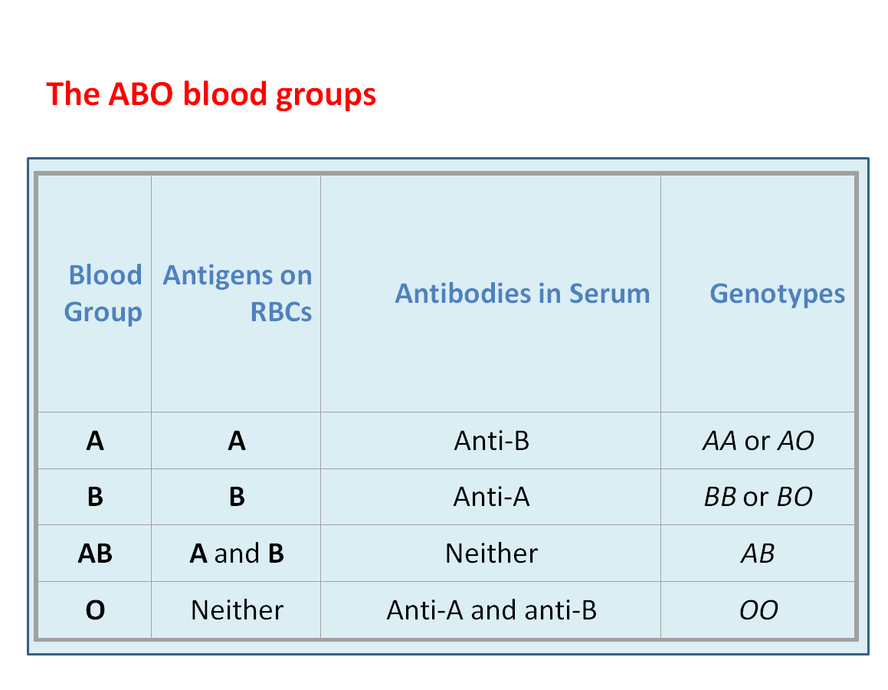

Slide 11
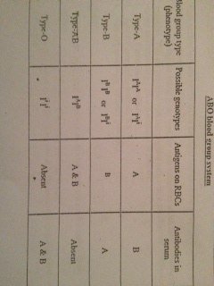
ABO blood group system

Slide 12
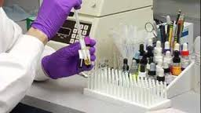
BLOOD GROUP TEST

Slide 13
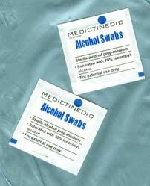
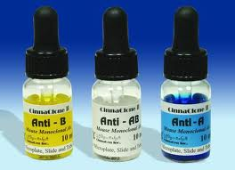


BLOOD GROUP TEST
YOU NEED:
3
1
2
4

Slide 14
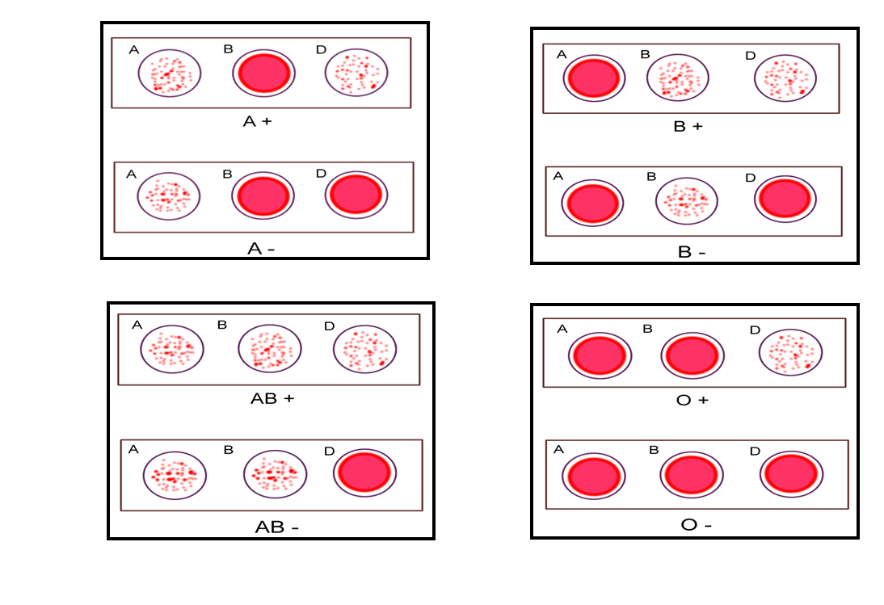
The Result WITH D(+,-)

Slide 15




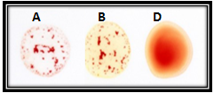
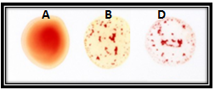


Exercise

Slide 16
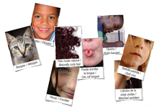
Human Traits

Slide 17
Phenotype & Genotype
The phenotype is the name of the characteristics or traits, such as its morphology, development, biochemical or physiological properties and behavior .
The genotype is the genetic makeup and can be predicted using the phenotype.

Slide 18
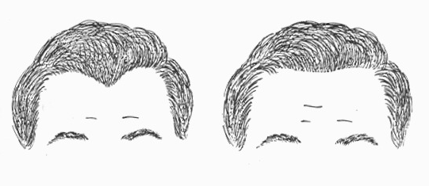
Phenotype:
Widows peak
Genotype:
WW or Ww
Phenotype:
Strait hair line
Genotype:
ww

Slide 19
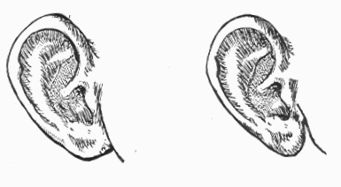
Phenotype:
Free earlobe
Genotype:
FF or Ff
Phenotype:
attached earlobe
Genotype:
ff

Slide 20
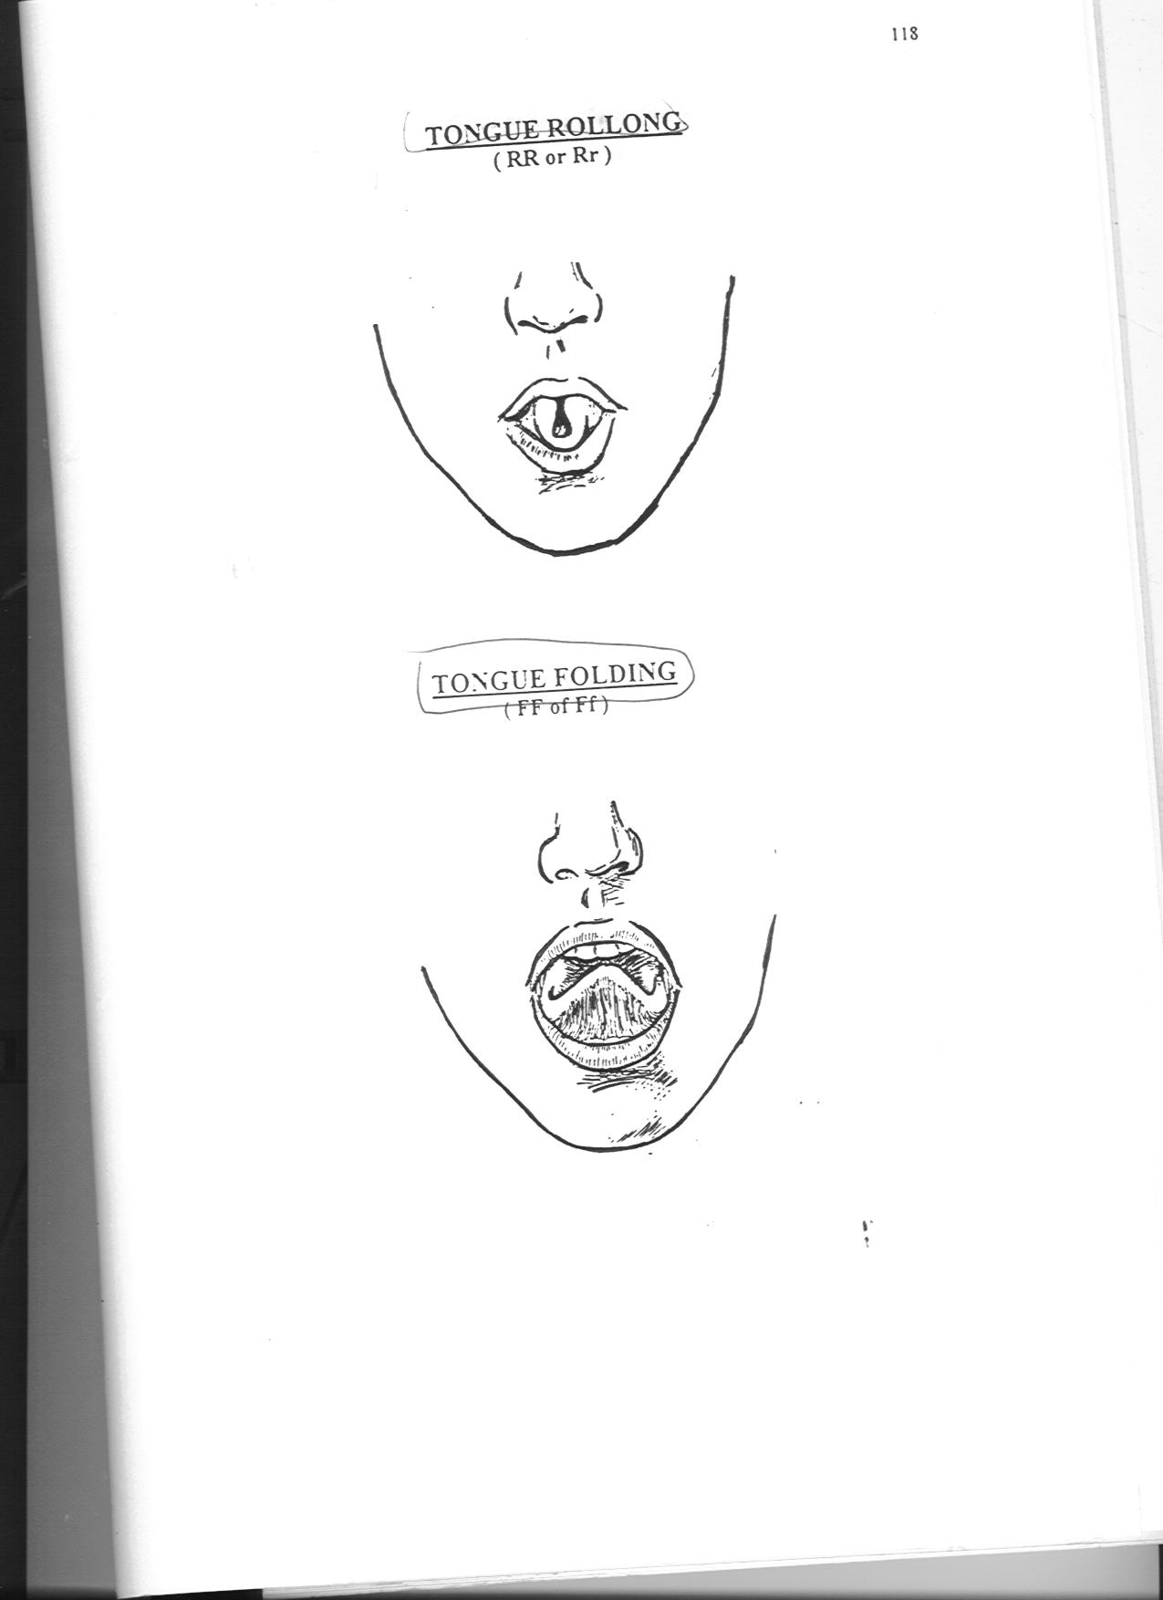
Phenotype:
Tongue rolling
Genotype:
RR or Rr
Phenotype:
Tongue folding
Genotype:
TT or Tt

Slide 21
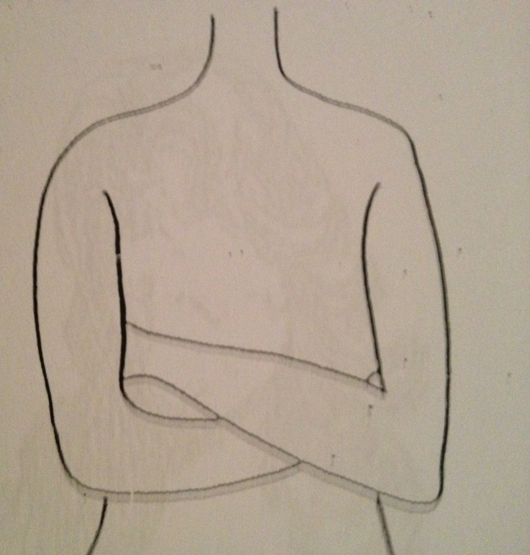
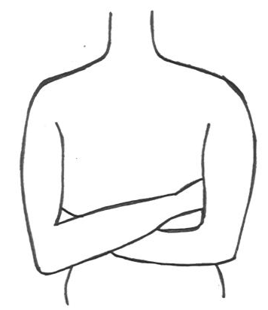
Phenotype:
Right handedness
Genotype:
RR or Rr
Phenotype:
left handedness
Genotype:
rr

Slide 22
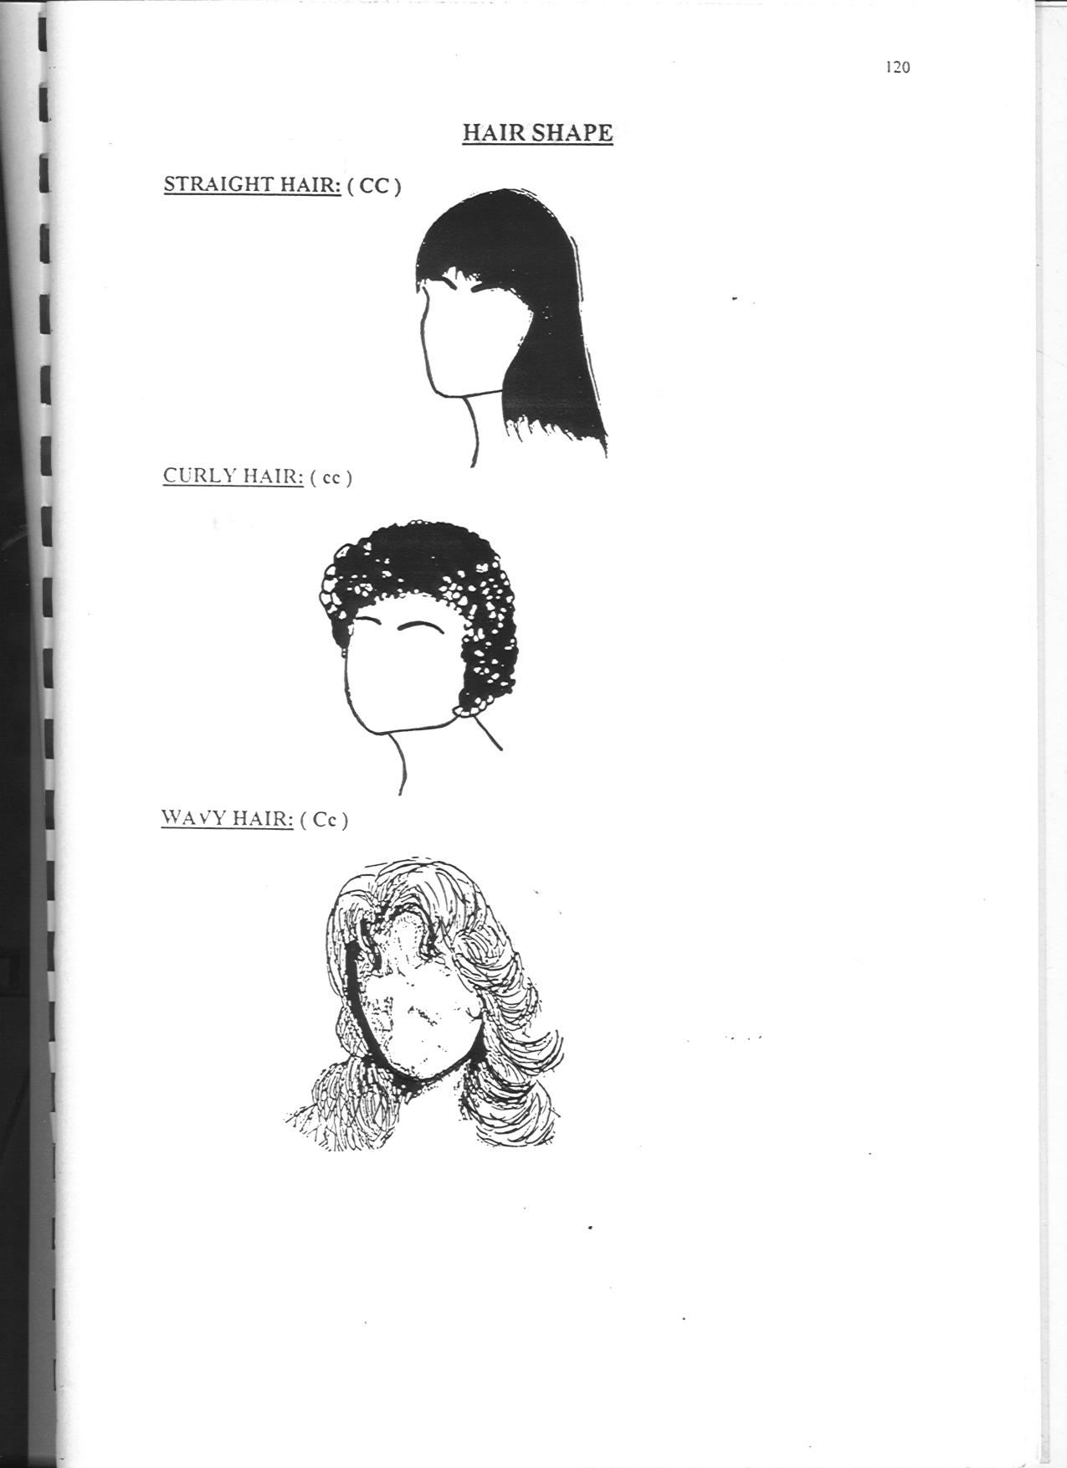
Phenotype:
Straight hair
Genotype:
cc
Phenotype:Wavy hair
Genotype:
Cc
Phenotype:
Curly hair
Genotype:
CC

Slide 23


