Slide 1
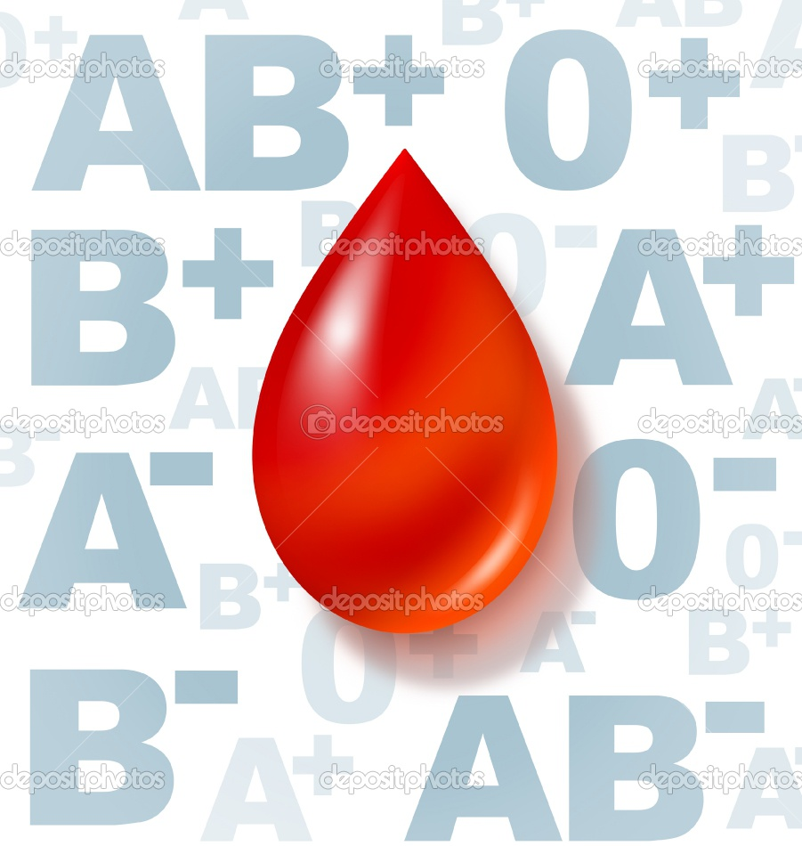
Blood Group
&
human traits

Slide 2
The most well-known and medically important blood types are in the ABO group.
All humans and many other primates can be typed for the ABO blood group.
There are four principal types: A, B, AB, and O.
There are two antigens and two antibodies that are mostly responsible for the ABO types.

Slide 4
Rh blood group system :
The Rh system is the second most significant blood-group system in human-blood transfusion with currently 50 antigens.
The most significant Rh antigen is the D antigen, because it is the most likely to provoke an immune system response of the five main Rh antigens .

Slide 5
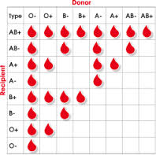
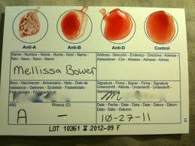
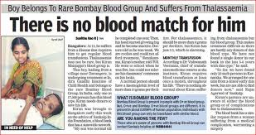
We can say :
The presence or absence of D Ag determines if the person is Rh+ or Rh-

Slide 6
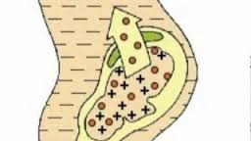
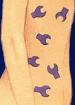
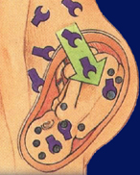
Rh antibodies
Result from the exposure to Rh antigens
Bind at 37°C
Anti-Rh⁺ antibodies
Possible subsequent pregnancies
Mother makes anti-Rh⁺ antibodies.

Slide 7
ABO blood group system

Slide 8
ABO blood group system

Slide 9
The Antigens

Slide 11
ABO blood group system

Slide 12
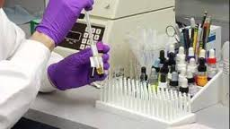
BLOOD GROUP TEST

Slide 13
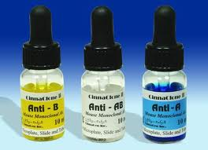
BLOOD GROUP TEST YOU NEED:
3
1
2
4

Slide 14
The Result WITH D(+,-)

Slide 15
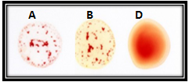
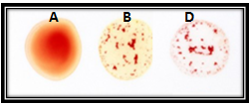
Exercise

Slide 16
Phenotype | Genotype
A+ | AA,Aa / DD,Dd
A- | AA,Aa/ dd
B+ | BB, Bb / DD,Dd
B- | BB,Bb/dd
AB+ | AB / DD,Dd
AB- | AB / dd
O+ | oo/DD,Dd
O- | oo/dd

Slide 17
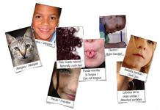
Human Traits

Slide 18
Phenotype & Genotype
The phenotype is the name of the characteristics or traits, such as its morphology, development, biochemical or physiological properties and behavior .
The genotype is the genetic makeup and can be predicted using the phenotype.

Slide 19
Phenotype: Widows peak Genotype: WW or Ww
Phenotype:
Strait hair line
Genotype:
ww

Slide 20
Phenotype:
Free earlobe
Genotype:
FF or Ff
Phenotype:
attached earlobe
Genotype:
ff

Slide 21
Phenotype:
Tongue rolling
Genotype:
RR or Rr
Phenotype:
Tongue folding
Genotype:
TT or Tt

Slide 22
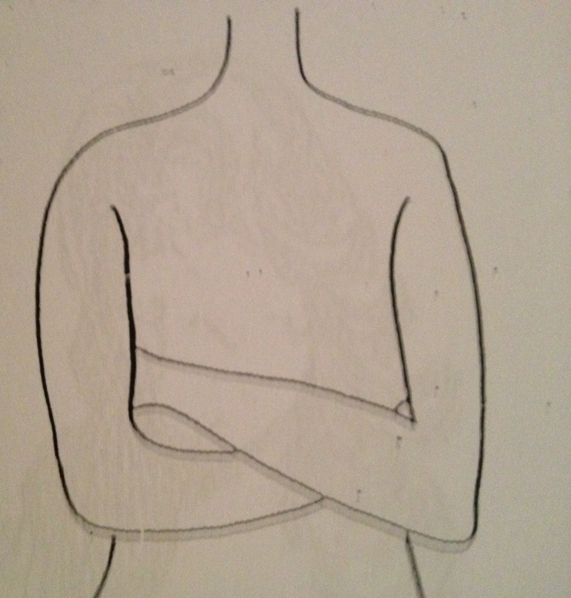
Phenotype:
Right handedness
Genotype:
RR or Rr
Phenotype:
left handedness
Genotype:
rr

Slide 23
Phenotype:
Straight hair
Genotype:
cc
Phenotype:Wavy hair
Genotype:
Cc
Phenotype:
Curly hair
Genotype:
CC

