Slide 1
KINGDOOM OF SAUDI ARABIA
King Saud University
College of Sciences - Department of Botany and Microbiology
Plant Physiology
BOT 312
Dr. Abdulrahman Al-hashimi

Slide 2
Lecture 11
Growth and Development
Double Fertilization
Embryogenesis
Leaf and Root Development
Cell Differentiation
Programmed Cell Death

Slide 3
Introduction
Plant growth is defined as “a permanent increase in the size of a plant or an organ or its part or even of an individual cell.”
Plant development includes all the changes that a plant goes throughout its life cycle, including growth and differentiation.
Plant growth is concentrated in regions of cell division called Meristems (Meristematic tissues).
During the process of development, a complex body organization is formed that produces roots, leaves, branches, flowers, fruits, and seeds, and finally they die.

Slide 4
Double Fertilization
In plants, as in all other eukaryotes, the union of one sperm with the egg forms a single diploid cell called the zygote (2n).
this process is called fertilization.
In angiosperms, this event is accompanied by a second fertilization event, another sperm fuses with two polar nuclei to form a triploid endosperm nucleus (3n), that develops into endosperm tissue (that supplies food for growing embryo).
The fertilized ovule forms the seed, whereas the tissues of the ovary become the fruit, usually enveloping the seed.

Slide 5
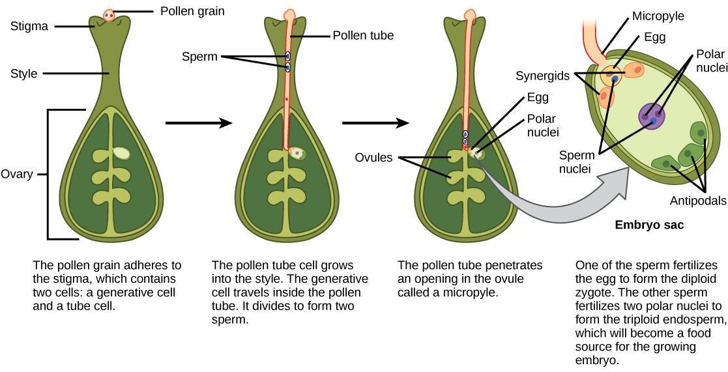
Double Fertilization

Slide 6
Embryogenesis
All cells of a plant develops from a zygote, which produces a number of cells that organize into tissues and organs.
Vegetative phase of development begins with embryogenesis.
The embryogenesis is a process occurs after the fertilization to transforms the zygote into a multicellular plant embryo.
The embryogenesis and endosperm development typically occur in parallel with seed development.
When these processes completed, the seed and the embryo within it become dormant and able to survive long periods.

Slide 7
Leaf and Root Development
The root and shoot apical meristems are primary meristems formed during embryogenesis.
The shoot apical meristem repetitively forms units known as phytomeres, each consisting of one or more leaves, the node, the internode, and one or more axillary buds.
Leaves form in a characteristic pattern, with three stages:
(1) organogenesis,
(2) development of suborgan domains,
(3) cell and tissue differentiation.

Slide 8
Leaf and Root Development

Slide 9
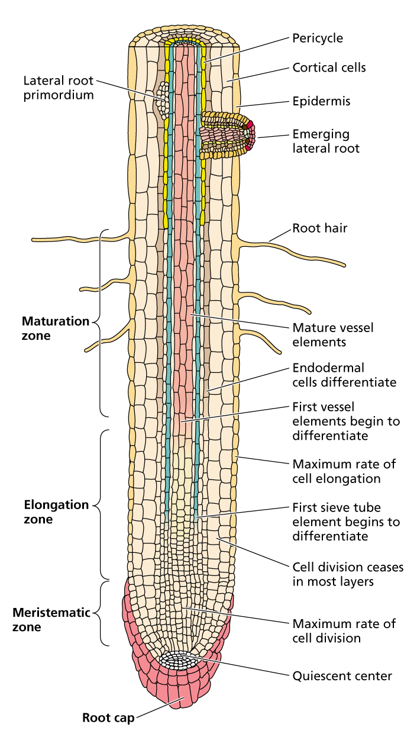
Leaf and Root Development
Root apical meristem is subterminal and covered by a root cap.
The cell divisions in the root apex generate a number of cells that subsequently elongate and differentiate to specialized function.
Four developmental zones are recognized in the root:
Root cap, Meristematic zone, Elongation zone and Maturation zone.

Slide 10
Cell Differentiation
Differentiation is the process by which cells acquire metabolic, structural, and functional properties distinct from those of their progenitors.
In the differentiation process, a less specialized cell becomes a more specialized cell type, to perform specific functions.
For example: some cells lose their protoplasm during the formation of tracheary elements.

Slide 11
Cell Differentiation
In plants, unlike animals, cell differentiation is frequently reversible, particularly when differentiated cells are removed from the plant and placed in tissue culture.
Under these conditions, cells dedifferentiate (lose their differentiated characteristics), reinitiate the cell division, and in some cases, when provided with the appropriate nutrients and hormones, can regenerate the whole plants.
Several genes play critical roles in regulating the growth and cell differentiation in plants.

Slide 12
Programmed Cell Death
The plant senescence is an active developmental process, which can occur at the level of the whole plant (as in monocarpic senescence); at the organ level (as in leaf senescence; and at the cellular level (as in tracheary element differentiation).
Programmed cell death is a specialized type of plant senescence.
Programmed cell death is a genetically programmed process.
The programmed cell death (PCD) can be initiated by specific signals, such as errors in DNA replication during the cell division.
The programmed cell death can protect the plant against pathogenic organisms (hypersensitive response).

Slide 13
Any
QUESTIONS ?

