Slide 1
Blood Biochemistry
BCH 577
By
Dr. Mohamed Saad Daoud

Slide 2
Leukocytes
Introduction:
Our bodies continuously are exposed to Infectious agents (bacteria, viruses, fungi, and parasites).
Infectious agents are capable of causing serious abnormal physiologic function or even death if they invade the deeper tissues.
Highly infectious bacteria and viruses can cause acute lethal diseases such as pneumonia, streptococcal infection, and typhoid fever.

Slide 3
Our bodies have a special system for fighting the different infectious and toxic agents leukocytes (white blood cells) and tissue cells derived from leukocytes.
Leukocytes and tissue cells derived from leukocytes work together in two ways to prevent disease:
(1) by actually destroying invading bacteria or viruses by phagocytosis.
(2) by forming antibodies which destroy or inactivate the invader.

Slide 4
Leukocytes (White Blood Cells):
The leukocytes are the mobile units of the body’s protective system.
They are formed partially in:
  the bone marrow (granulocytes, monocytes and a few lymphocytes) and partially in
  the lymph tissue (lymphocytes and plasma cells).
  After formation, they are transported in the blood to different parts of the body where they are needed.

Slide 5
Most of the white blood cells are transported to areas of infection and inflammation to provide rapid and potent defense against infectious agents.

Slide 6
Types of Leukocytes
There are five types of white blood cells normally present in the blood:
Polymorphonuclear neutrophils
Polymorphonuclear eosinophils
Polymorphonuclear basophils
Monocytes
Lymphocytes
And occasionally Plasma cells

Slide 8
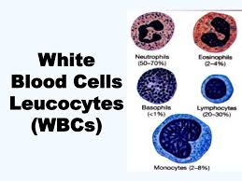

Slide 9
The first three types of cells (polymorphonuclear cells), have a granular appearance (granulocytes), the clinical terminology, “polys,” because of the multiple nuclei.
The granulocytes and monocytes protect the body against invading organisms mainly by ingesting them (phagocytosis).
The lymphocytes and plasma cells function mainly in connection with the immune system.

Slide 10
Concentrations of the Different White Blood Cells in the Blood
The adult human being has about 7000 white blood cells per microliter of blood (µL).
Of the total white blood cells, the normal percentages of the different types are approximately the following:
Polymorphonuclear neutrophils 50-70 %
Polymorphonuclear eosinophils 2-4 %
Polymorphonuclear basophils 0-1 %
Monocytes 2-8 %
Lymphocytes 20-30 %

Slide 11
Genesis of Blood Cells
Pluripotential Hematopoietic Stem Cells, Growth Inducers, and Differentiation Inducers:
The blood cells begin their lives in the bone marrow from a single type of cell called the pluripotential hematopoietic stem cell, from which all the cells of the circulating blood are eventually derived.
The following figure shows the successive divisions of the pluripotential cells to form the different circulating blood cells.
Notes:
Fpllowing fi

Slide 12
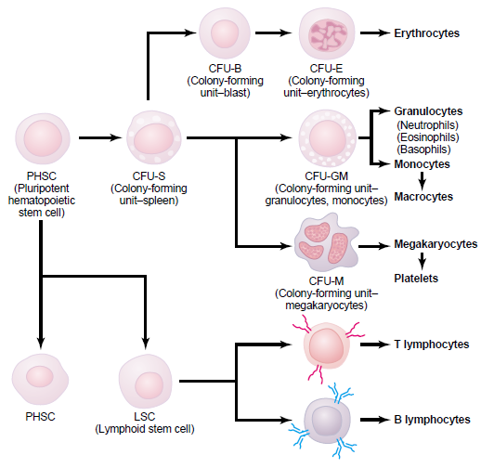
Formation of the multiple different blood cells from the original pluripotent hematopoietic stem cell (PHSC) in the bone marrow.

Slide 13
Small portion of cell reproduces and remains exactly like the original pluripotential cells and is retained in the bone marrow to maintain a supply of these, although their numbers diminish with age.
Most of the reproduced cells, differentiate to form the other cell types.
The intermediate stage cells are very much like the pluripotential stem cells, even though they have already become committed to a particular line of cells and are called committed stem cells.

Slide 14
The committed stem cells
The different committed stem cells, when grown in culture, will produce colonies of specific types of blood cells.
A committed stem cell that produces granulocytes and monocytes is called a colony-forming unit granulocytes and monocytes (CFU-GM).
Growth and reproduction of the different stem cells are controlled by multiple proteins called growth inducer. After that other inducer called differentiation inducer completes the process.

Slide 15
Growth inducers promote growth but not differentiation of the cells.
Four major growth inducers:
  Interleukin-3 – promotes growth and reproduction of virtually all the different types of committed stem cells
  Interleukin 5, 6 & 7 – induce growth of only specific types of cells

Slide 17
Differentiation inducers causes one type of committed stem cell to differentiate one or more steps toward a final adult blood cell.
Formation of the growth inducers and differentiation inducers is itself controlled by factors outside the bone marrow.
Infectious diseases cause growth, differentiation, and eventual formation of specific types of white blood cells that are needed to battle each infection.

Slide 18
Lineages of white blood cells (sources and precursor)
1- The myelocytic lineage, beginning with the myeloblast
2- The lymphocytic lineage, beginning with the lymphoblast.
3- The granulocytes and monocytes are formed only in the bone marrow.
4- Lymphocytes and plasma cells are produced mainly in lymph glands, spleen, thymus, tonsils, and various pockets of lymphoid tissue.

Slide 19
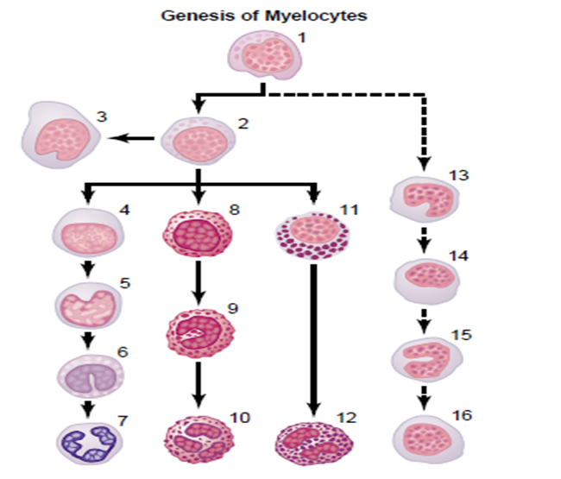
The Different cells of the myelocyte series are;
Myeloblast
Promyelocyte
Megakaryocyte
Neutrophil myelocyte
Young neutrophil metamyelocyte
“Band” neutrophil metamyelocyte
Polymorphonuclear neutrophil
Eosinophil myelocyte
Eosinophil metamyelocyte
Polymorphonuclear eosinophil
Basophil myelocyte
Polymorphonuclear basophil
(13–16) stages of monocyte formation.

Slide 20
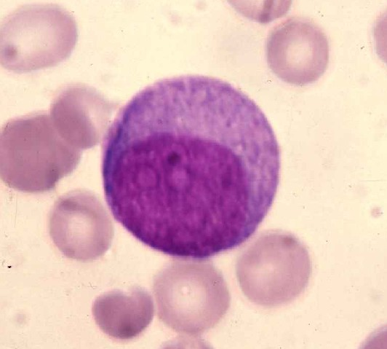
Granulocyte Lineage:
Myeloblast → promyelocyte → myelocyte → metamyelocyte → band form → mature neutrophil
Myeloblast:
It is a large cell (18 µm) with pale
basophilic cytoplasm without any
granules. It has a large round nucleus
and prominent nucleoli which
appear as lightly staining spheres
within the nucleus.

Slide 21
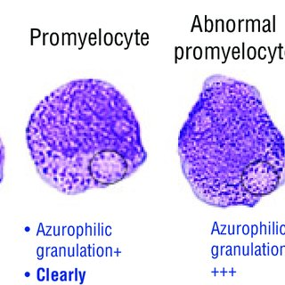
Normal myeloblasts have no granules but abnormal myeloblasts may have a few granules.
Myeloblasts undergo one cell division and mature into promyelocytes.
Pro-myelocytes:
The most characteristic features of the
promyelocyte are :
its large overall cell size
its large rounded nucleus with
prominent nucleoli
the presence of purple-staining
nonspecific azurophilic granules.

Slide 22
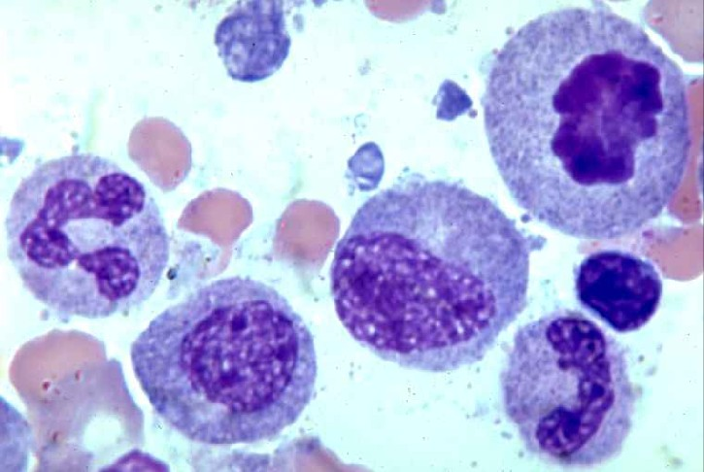
Myelocyte:
The most characteristic features of the
myelocyte stage are:
the range in cell size - early myelocytes are
as large as promyelocytes, whereas late
myelocytes are closer in size to metamyelocytes .
the shape and size of the nucleus - more condensed than that of a promyelocyte and frequently indented (dislocated)
the presence of both the purplish-staining azurophilic and lilac-staining linear-specific granules.
The number of linear-specific granules per cell increases and the number of azurophilic granules per cell decreases.

Slide 23
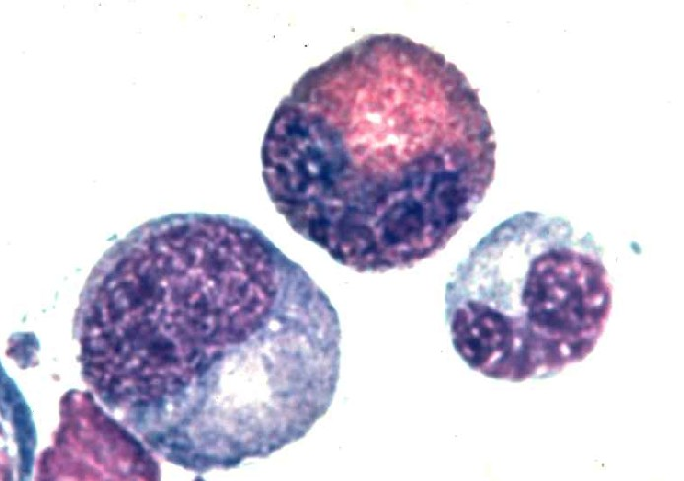
Metamyelocyte:
When the nucleus becomes flattened and the chromatin further condensed (bean or kidney shaped) and the cytoplasm is similar to that myelocyte but with less granules. the cell is called a metamyelocyte.

Slide 24
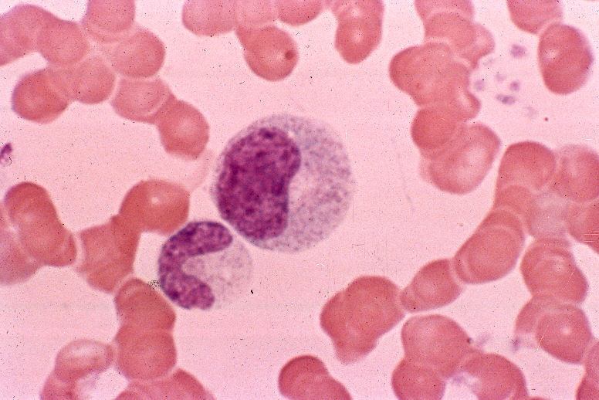
Band (Stab or juvenile):
When the nucleus becomes horseshoe-shaped,
it is called a band cell.
The shape can also be described as C or
S shaped.
A band cell can also be referred to as a stab cell.
There are smaller numbers of cells of neutrophil lineage with non-segmented nuclei. They are referred to as neutrophil band cells or band forms. They are less mature than segmented neutrophils.

Slide 25
Cytoplasm | Nucleus | Size | Cell
Blue usually without granules. Some azurophilic granules may be present | Round, fine chromatin, nucleoli | 12-20μ | Myeloblast
Blue cytoplasm with numerous azurophilic granules | Slightly indented nucleus often eccentrically placed. Chromatin coarser than a myeloblast. Nucleoli seen | 15-25μ | Promyelocyte
Most immature forms have less basophilia than the promyeloblast. Basophilia disappears as cell matures. Secondary granules appear. | Round to oval, indented, chromatin more coarse than promyelocyte, no nucleoli | 10-20μ | Myelocyte
Pink with secondary granules. | Indented, coarse clumped chromatin | 12-18μ | Metamyelocyte
Pink with secondary granules | Band shaped. Borders are parallel for most of the length. May be folded | 10-12μ | Band Form

Slide 26
Neutrophils (polymorphonuclear leucocyte):
The normal number of neutrophilic granulocytes in the peripheral blood is about 2500–7500/μL (50-70% from WBC).
Neutrophilic granulocytes have a dense nucleus split into three to five lobes and a pale cytoplasm.
The cytoplasm contains numerous pink blue or gray-blue granules.
Two types of granules can be distinguished: primary or azurophilic granules, which appear at the promyelocyte stage and secondary granules, which appear later.

Slide 27
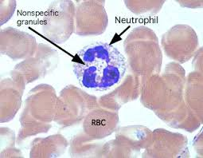
The primary granules contain myeloperoxidase, acid phosphatase, and acid hydrolases,
The secondary granules have lysozyme, lactoferrin, and collagenase.
All granules are of lysosomal origin.

Slide 28
Eosinophils:
Eosinophils, which make up 1–4% of the peripheral blood leukocytes, are similar to neutrophils but with somewhat more intensely stained reddish granules and bi-lobed nucleus.
In absolute terms, eosinophils number up to 400/μL.
Eosinophilic cells can first be recognized at the myelocyte stage.
Eosinophils have a role in allergic reactions, in the response to parasites, and in the defense against certain tumors.

Slide 29
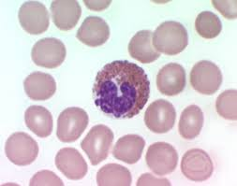
Eosinophil

Slide 30
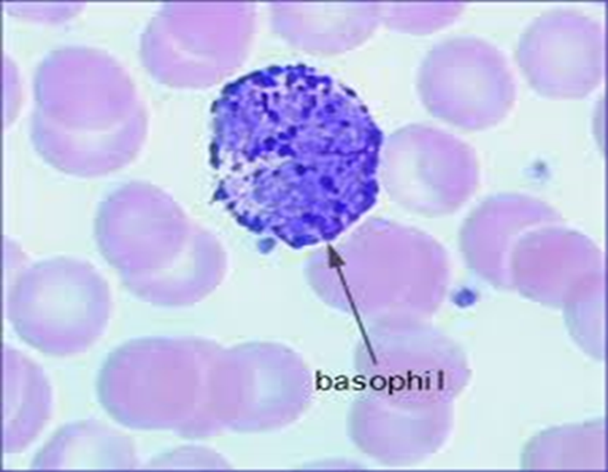
Basophils:
Basophils are seen less frequently than eosinophils; under normal conditions, fewer than 100 cells/μL are found in the peripheral blood.
Basophils have receptors for immunoglobulin (Ig)E and, in the cytoplasm, characteristic dark granules overlie the nucleus.
Degranulation of basophils results from the binding of IgE and allergic or anaphylactic reactions are associated with the release of histamine and heparin.

Slide 31
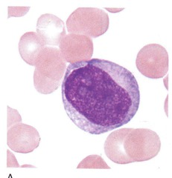
Monocyte Lineage
There are only 3 maturational stages (cells) in the monocytic series.
1- the monoblast,
2- the pro-monocyte,
3- the mature monocyte.

Slide 32
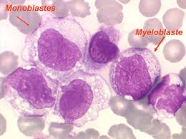
Monoblast:
Morphologically, the monoblast is undistiguishable from the myeloblast.
That is, it is a very large cell of up to 20 μ in size.
The nucleus occupy more than 85% of the cell with very smooth chromatin, and 1 to 3 nucleoli could be seen.
The very limited cytoplasm present is usually light to slightly dark blue in color, with no granules or vacuoles of any type.
CD markers (cluster of differentiation or
cluster of designation) and advanced molecular
techniques can differentiate between
monoblast and myeloblast

Slide 33
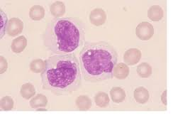
Promonocyte:
This is similar to the promyelocyte in everything, except they don’t have the typical primary (reddish pink) granules of the promyelocytes.
That is, their shape, size, chromatin quality, they might not have nucleoli.
The cytoplasm are very
much similar to that of promyelocytes.

Slide 34
Monocyte:
The monocyte ranges in size from 15 to 20 μ but appears large on stained blood films.
The nucleus is very variable in shape where it could be round, horse-shoe, or lobulated indented with clumped chromatin.
The cytoplasm is irregular in shape with pale grayish-blue color and very fine granules.
The cytoplasm could have some projections (pseudopods) and may contain vacuoles.
Monocytes constitute 2-6% of differential count (in absolute numbers 200–800/μL).

Slide 35
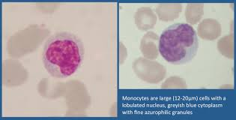
Monocytes differentiates into macrophages under the influence of certain growth factors.
Monocytes and macrophages can phagocytose pathogens and secrete many cytokines.

Slide 36
Lymphocyte Lineage
Lymphocytes are the cornerstone of the adaptive immune system. They are derived from common lymphoid progenitors.
The Lymphocytes is primarily composed of T-cells, B-cells and natural killer cells (NK)
Lymphoblast → prolymphocyte → lymphocyte.

Slide 37
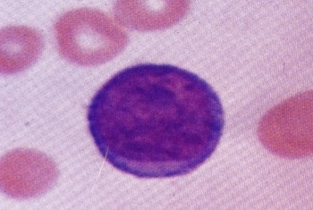
Lymphoblast:
All- in contrast to the myeloblast, the lymphoblast is a small blast with scant cytoplasm, dense chromatin, indistinct nucleoli

Slide 38

Pro-lymphocytes:
It is a medium-sized cell with a variable amount of non – granular basophilic cytoplasm, round-oval or irregular nucleus. Coarse chromatin and single prominent nucleoli.

Slide 39
Lymphocyte:
Lymphocytes are produced in the primary lymphoid organs (thymus and adult bone marrow) at a high rate 10⁹ per day.
There are two main types of lymphocytes known as T and B cells. These two types of lymphoid cells are developed and differentiated in the primary lymphoid organs.
Some of these cells migrate to the blood circulation via the secondary lymphoid tissues (spleen, lymph nodes, tonsils, and etc.).

Slide 40
T cells are developed in the thymus, where as the B lymphocytes are differentiated in the adult bone marrow and fetal liver.
Lymphocytes show several variations in the size (6-10 μm) and morphology.
These variations are seen in the:
  A. Nuclear to cytoplasmic ratio (N: C ratio).
  B. The nuclear shape.
  C. The presence or absence of azurophilic granules.

Slide 41
Lymphocytes in the blood smear stained with Giemsa stain, show two distinct morphological types:
The first are relatively small, typically a granular lymphocytes with higher N: C ratio.
The second type is larger with lower N: C ratio, and contains intra-cytoplasmic azurophilic granules same as those found in the granulocytes or to that of the monocytes and macrophage, so it should not be confused with them. These lymphocytes are known as the large granular lymphocyte

Slide 42
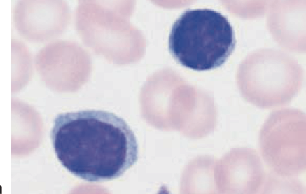
Small lymphocytes being 6-9 µm and large lymphocytes 10-14 µm in diameter.
The nucleus stains dark and is round or slightly indented with the cytoplasm appearing as a rim (small amount) around the nucleus.
Lymphocytes are involved in the specific immune response including antigen-antibody reactions.

Slide 43
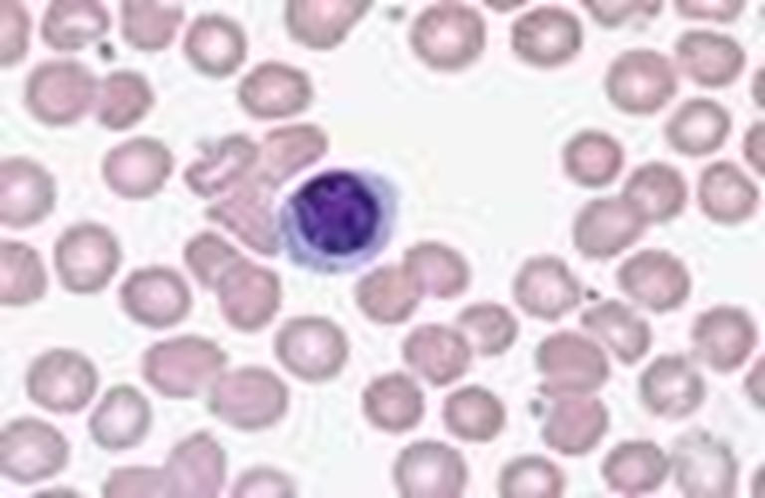
Lymphocytes help to protect the body against tumors. However, lymphocytes can also cause the rejection of tissues during organ transplants because they interpret these tissues as foreign invaders.

Slide 44
Life Span of the White Blood Cells
The life of the granulocytes after being released from the bone marrow is normally 4 to 8 hours circulating in the blood and another 4 to 5 days in tissues where they are needed.
In times of serious tissue infection, this total life span is often shortened to only a few hours because the granulocytes proceed even more rapidly to the infected area, perform their functions, and, in the process, are themselves destroyed.

Slide 45
The monocytes have a short transit time, 10 to 20 hours in the blood, before wandering through the capillary membranes into the tissues.
Once in the tissues, they swell too much larger sizes to become tissue macrophages, and, in this form, can live for months unless destroyed while performing phagocytic functions.
These tissue macrophages are the basis of the tissue macrophage system, which provides continuing defense against infection.

Slide 46
Lymphocytes enter the circulatory system continually, along with drainage of lymph from the lymph nodes and other lymphoid tissue.
After a few hours, they pass out of the blood back into the tissues by diapedesis. Then, still later, they re-enter the lymph and return to the blood again and again.
Thus, there is continual circulation of lymphocytes through the body.
The lymphocytes have life spans of weeks or months; this life span depends on the body’s need for these cells.

