Slide 1
Bone Disease Markers
BCH473: Biomarkers

Slide 2
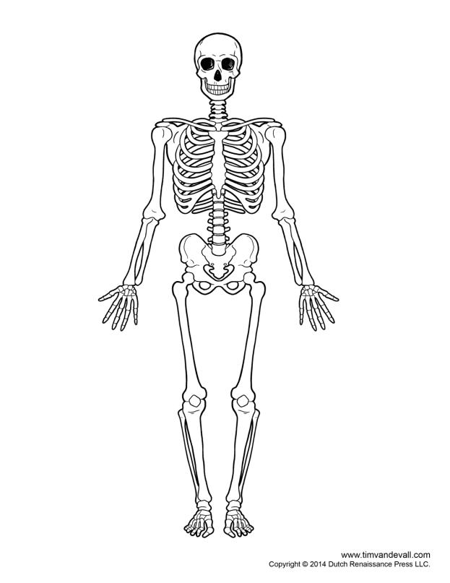
Skeleton
Provides structural integrity + strength to body
Protect vital organs
Blood cell formation
Storage of essential minerals: particularly calcium, phosphate, magnesium and sodium
1-2 kg of calcium; 1 kg phosphates
Approximately 98% of the 1–2 kg of calcium and 85% of the 1 kg of phosphorus in the human adult are found in bone, the principal reservoir for these minerals.

Slide 3
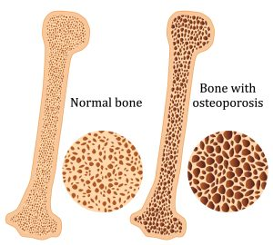
Bone Disorders
Abnormalities in the metabolism of calcium and phosphate leading to abnormal bone formation.
Osteoporosis, rickets, osteomalacia and renal bone diseases are most common

Slide 4
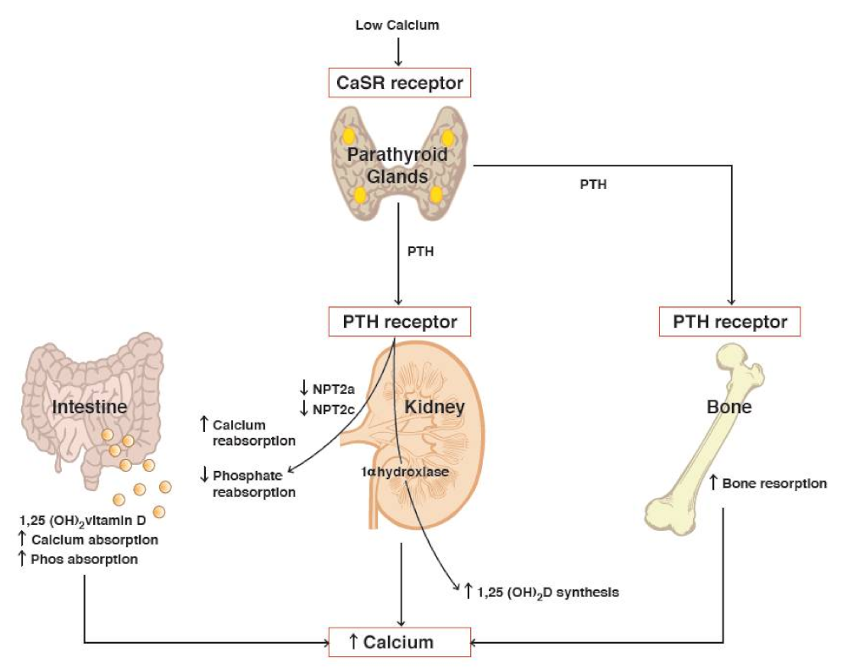
Key Players in Bone Metabolism
Calcium and phosphates
Parathyroid hormone (PTH)
Cholecalciferol and Calcitriol (Vitamin D3)
Estrogen and other sex hormones
Target organs
Kidney
Bone
GI tract

Slide 5
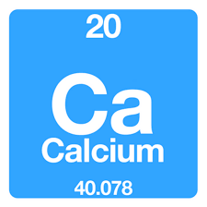
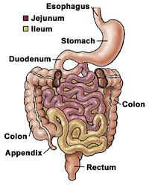
Calcium
> 99% in bone
Muscle and nerve function
Blood clotting mechanisms
Active transport absorption in the duodenum and passive diffusion in the jejunum
98% reabsorption in the kidney

Slide 6
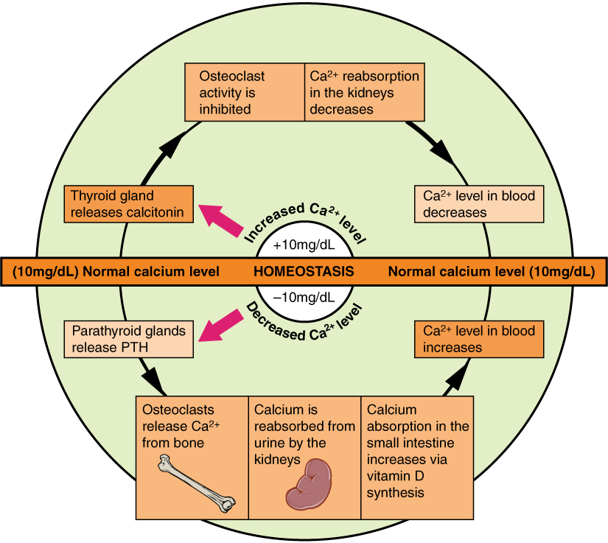
Calcium Homeostasis
Calcium homeostasis is maintained by actions of hormones that regulate calcium transport in the gut, kidneys, and bone. The 3 primary hormones are parathyroid hormone (PTH) 1,25-dihydroxyvitamin D-3 (Vitamin D3), and calcitonin

Slide 8
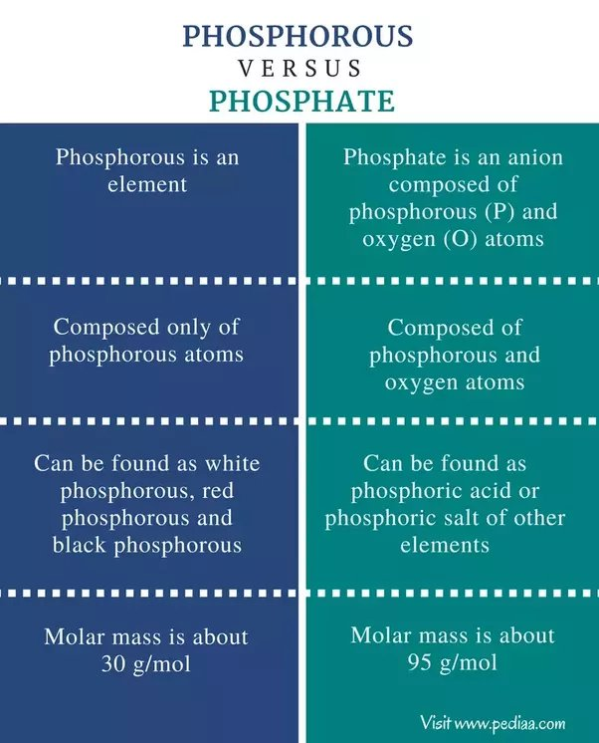
Phosphate
Key component of bone mineral
Role in enzyme systems and molecular interactions
85% in bone
Plasma Phosphate is mostly unbound
1000-1500 mg/day requirement

Slide 10
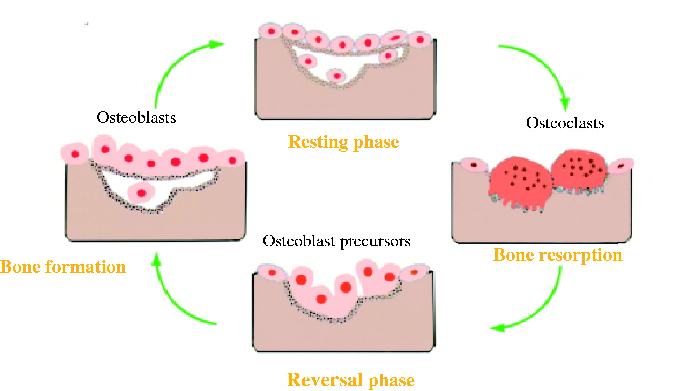
Uses of bone turnover markers
Biomarkers of bone formation and resorption reflect the overall osteoblastic and osteoclastic activity in the skeleton.
Biomarkers of bone turnover can be used to document the effects of therapeutic agents in some patients with osteoporosis and possibly reduce the need for frequent bone density testing.
In cancer patients with bone metastases, biomarkers of bone resorption provide evidence of the efficacy of anti-resorptive therapy.

Slide 11
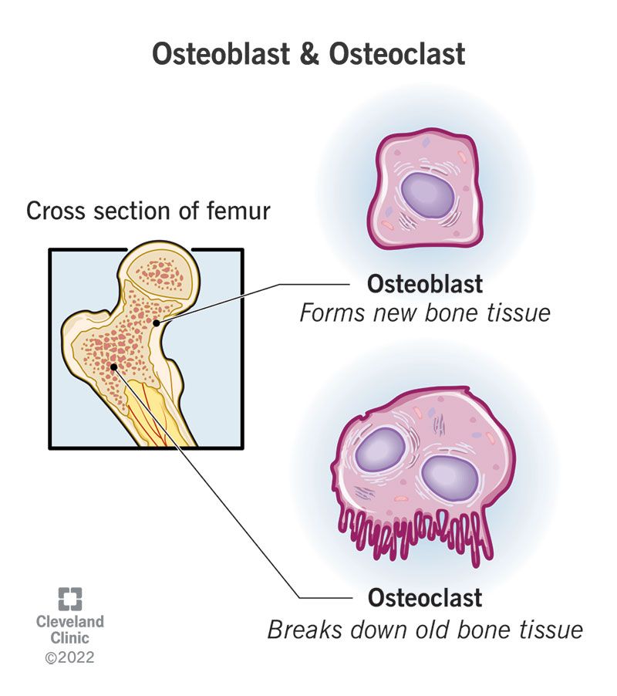
Markers of Bone Turnover
Markers of bone formation are measured in serum. Some are enzymes or other proteins secreted by osteoblasts, others are byproducts of type I collagen deposition.
Osteoblasts (formation) are mononuclear cells that attach to bone surfaces and form new bone, most commonly at sites that recently underwent resorption. They produce type I collagen and other matrix components of osteoid, and they also mineralize the osteoid with hydroxyapatite.
Osteoclasts (resorption) are multinucleated cells that resorb bone. They initiate bone remodeling and help shape growing bone and so are more numerous in children. They also liberate skeletal calcium to maintain a normal serum calcium concentration. Postmenopausal women who are estrogen-deficient tend to produce more osteoclasts, which accounts for the bone loss that can occur after menopause.

Slide 12
Markers of Bone Formation
Total alkaline phosphatase
Alkaline phosphatase, introduced into clinical use in 1929, was the first biochemical marker of bone turnover and is still the one most widely used in clinical practice. This enzyme is found in the plasma membrane of osteoblasts and in cells of the liver, kidney, intestine, spleen, and placenta. Its function is still not precisely known, but it is thought to play a role in osteoid formation and mineralization.
Bone alkaline phosphatase
In normal adults, about half the alkaline phosphatase in the serum comes from bone..

Slide 13
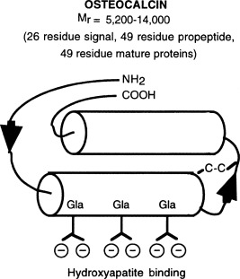
Markers of Bone Formation
Osteocalcin
Osteocalcin is a large peptide that is synthesized by osteoblasts. It binds to hydroxyapatite, and much of it is deposited in the bone matrix.
Because osteocalcin fragments are released from the bone matrix during resorption, assays for circulating osteocalcin and its fragments reflect both bone formation and resorption.
(Osteocalcin may affect the action of insulin)

Slide 14
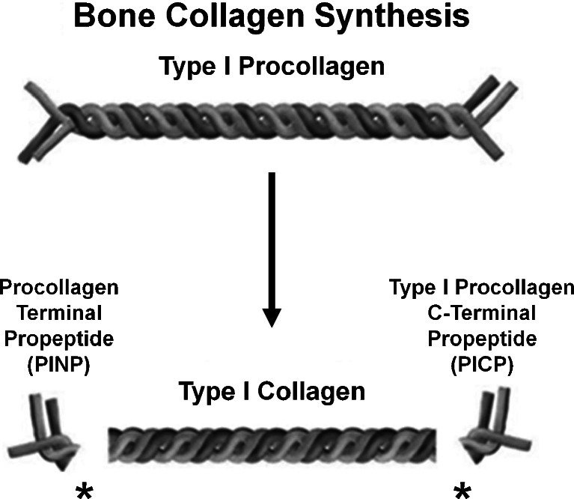
Markers of Bone Formation
Procollagen type I propeptides
Procollagen type I propeptides are cleaved from the ends of the procollagen molecule and can be detected in the circulation. Those from the amino-terminal end are called PINPs; those from the carboxy-terminal end are called PICPs.
Serum procollagen type I N-propeptide (PINP) is designated the reference marker of bone formation in osteoporosis; the reference marker for resorption is C-terminal telopeptide of type I collagen (CTX).
Procollagen I carboxyterminal propeptide (PICP) as a bone formation marker and carboxyterminal telopeptide of type I collagen (ICTP) as a bone degradation marker in children with chronic renal failure under conservative therapy.
Although these propeptides are also synthesized in the skin, tendons, ligaments, cornea, blood vessels, fibrocartilage, and many other tissues, their main source is bone. The level of each of the propeptides in blood is thought to reflect the amount of newly synthesized collagen.

Slide 15
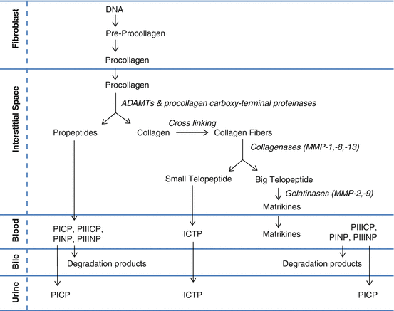

Slide 16
Markers of Bone Resorption
Markers of bone resorption are excellent indices of disease activity in patients with osteoporosis due to menopause, immobilization, or autoimmune processes, as well as Paget disease of bone or bone metastases.
Osteoclasts are multinucleated cells that dissolve bone. They initiate bone remodeling and help shape growing bone and so are more numerous in children. They also liberate skeletal calcium to maintain a normal serum calcium concentration. Postmenopausal women who are estrogen-deficient tend to produce more osteoclasts, which accounts for the bone loss that can occur after menopause.
Markers of bone resorption are measured in serum or urine. The most direct indicators are fragments of bone collagen produced by osteoclast activity.

Slide 17
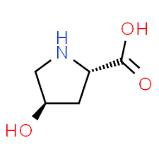
Hydroxyproline
Hydroxyproline is an amino acid common to and characteristic of all forms of collagen, and urinary hydroxyproline excretion is the oldest test of bone resorption.
However, this test lacks specificity for bone resorption because excreted hydroxyproline also comes from other tissues, particularly from skin collagen (which can turn over rapidly in certain disorders), from newly synthesized collagen that is not incorporated into tissue, and from dietary collagen and gelatin.
Because it is less specific than newer tests, it is no longer widely used.

Slide 18
Pyridinoline
Urinary pyridinoline and deoxypyridinoline are more specific markers of bone resorption.
Pyridinolines are cross-linking amino acids that strengthen collagen fibrils in the extra-cellular matrix. They are found in the main fibril-forming collagens (types I, II, and III) of many tissues.
Pyridinoline is the major chemical form, but deoxypyridinoline is also unusually abundant in bone collagen and hence is a relatively selective bone marker.

Slide 19
Role of Vitamin D and Calcium in Bone diseases

Slide 22
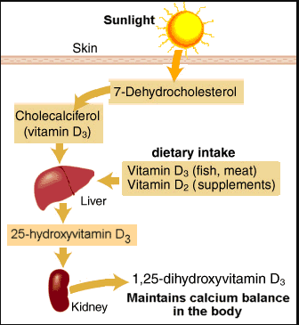
Vitamin D Metabolism

Slide 26
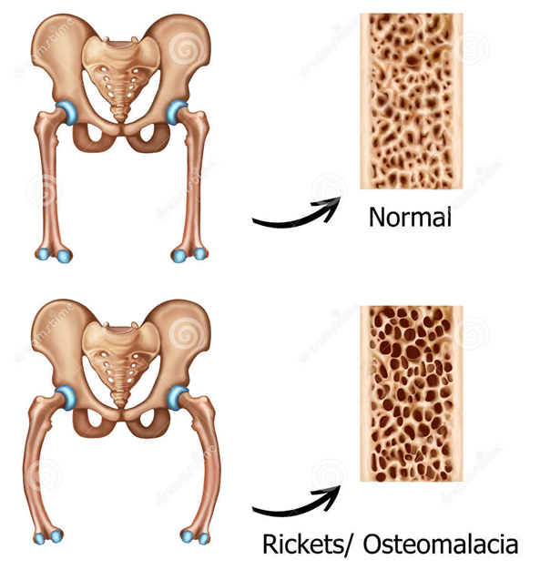
Rickets
Rickets is a condition that results from a delay in depositing calcium phosphate mineral in growing bones, thus leading to skeletal deformities, especially bowed legs.

Slide 27
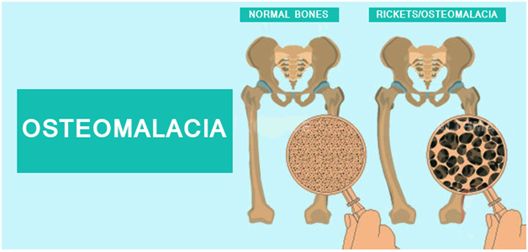
Osteomalacia
In adults, the rickets equivalent disease is called osteomalacia.
Since longitudinal growth has stopped in adults, deficient bone mineralization does not cause skeletal deformity but can lead to fractures, particularly of weight-bearing bones such as the pelvis, hip, and feet.
Even when there is no fracture, many patients with rickets and osteomalacia suffer from bone pain and can experience severe muscle weakness.

Slide 28
Causes of Rickets and Osteomalacia
Since vitamin D is formed in the skin by sunlight, the most common cause is reduced sun exposure.
This is particularly important in northern latitudes where the winter sun does not have the power to form vitamin D in the skin.
Thus the disease is often seen in individuals living at northern latitudes or who habitually cover themselves.
This problem can also occur in children who are confined indoors and in individuals who are house-bound (e.g., due to chronic ill health or frailty).
Patients with diseases of the gastrointestinal tract, such as gastrectomy, malabsorption syndromes, and small bowel resection, are also at higher risk, since these conditions reduce vitamin D absorption from the diet.

