Slide 1
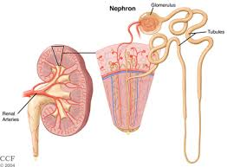
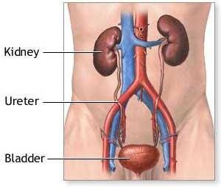
Biomarkers of renal diseases
BCH473: Biomarkers
Lecture 3

Slide 2
Renal Functions
Excretion of metabolic wastes: urea, creatinine
Kidneys excrete a variety of waste products produced by metabolism. These include the nitrogenous wastes urea from protein catabolism, as well as uric acid, from nucleic acid metabolism.
Regulation of extracellular fluid volume, electrolyte composition, and acid-base balance (pH=7.4 ± 0.5).
Synthesis and release of hormones (renin and erythropoietin)
Metabolism of vitamin D₃ to the active 1,25-dihydroxy vitamin D₃
Notes:
Many of the kidney's functions are accomplished by relatively simple mechanisms of filtration, reabsorption, and secretion, which take place in thenephron. Filtration, which takes place at the renal corpuscle, is the process by which cells and large proteins are filtered from the blood to make an ultrafiltrate that eventually becomes urine. The kidney generates 180 liters of filtrate a day, while reabsorbing a large percentage, allowing for the generation of only approximately 2 liters of urine. Reabsorption is the transport of molecules from this ultrafiltrate and into the blood. Secretion is the reverse process, in which molecules are transported in the opposite direction, from the blood into the urine.
Excretion of wastes
The kidneys excrete a variety of waste products produced by metabolism. These include the nitrogenous wastes called "urea", from protein catabolism, as well as uric acid, from nucleic acidmetabolism. Formation of urine is also the function of the kidney.
Acid-base homeostasis
Two organ systems, the kidneys and lungs, maintain acid-base homeostasis, which is the maintenance of pH around a relatively stable value. The lungs contribute to acid-base homeostasis by regulating bicarbonate (HCO₃⁻) concentration. The kidneys have two very important roles in maintaining the acid-base balance: to reabsorb bicarbonate from urine, and to excrete hydrogen ions into urine

Slide 3
Features of a useful renal biomarker
Origin is known and defined
High sensitivity
Easy accessible sample
Change in advance of clinical signs

Slide 4
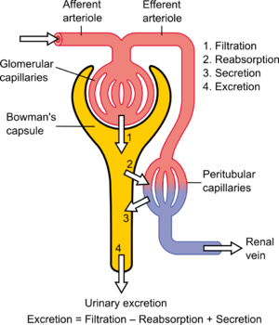
Basic physiologic mechanisms of the kidney

Slide 5
Filtration, reabsoption, and excretion rates of substances
Filtered Reabsorbed Excreted Reabsorbed
(meq/24h) (meq/24h) (meq/24h) (%)
Glucose (g/day) 180 180 0 100
Bicarbonate (meq/day) 4,320 4,318 2 > 99.9
Sodium (meq/day) 25,560 25,410 150 99.4
Chloride (meq/day) 19,440 19,260 180 99.1
Water (l/day) 169 167.5 1.5 99.1
Urea (g/day) 48 24 24 50
Creatinine (g/day) 1.8 0 1.8 0

Slide 6
Pathophysiologic Response of the Kidney
Acute renal failure
Adaptation following toxic insult
Chronic renal failure

Slide 7
Susceptibility of the kidney to toxic injury
• Reasons for the susceptibility of the kidney to toxicity
- Kidney receive about 20-25% of the resting cardiac output. Any drug or chemical in the systemic circulation will be delivered to these organs in relatively high amounts.
- The processes involved in forming a concentrated urine also serve to concentrate potential toxicants in the tubular fluid.
A nontoxic concentration of a chemical in the plasma may reach to toxic concentrations in the kidney.
Intraluminal precipitation of relatively insoluble compounds, causing acute renal failure (ARF) secondary to tubular obstruction
- Renal transport, accumulation, and metabolism of xenobiotics contribute significantly to the susceptibility of the kidney to toxic injury.

Slide 8
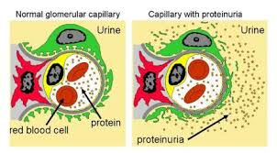
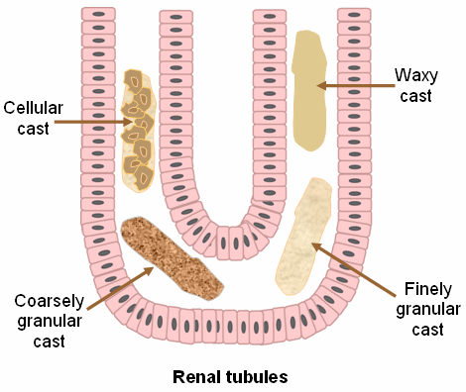
Markers of Kidney Damage
Proteinuria
Microalbuminuria
Hematuria
Casts (especially with cellular elements)

Slide 9
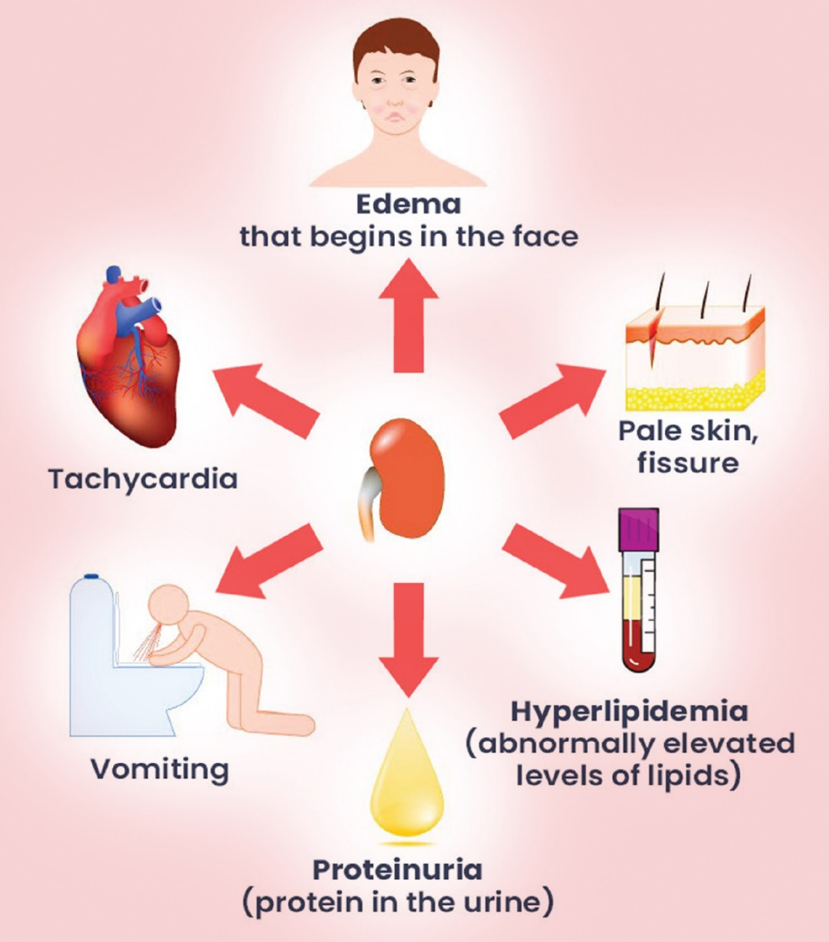
Proteinuria
Proteinuria (from protein and urine) means the presence of an excess of serum proteins in the urine.
There are three main mechanisms that cause proteinuria:
Due to disease in glomerulus
Because of increased quantity of proteins in serum (overflow proteinuria)
Due to low reabsorption at proximal tubule
Notes:
Plasma proteins are essential components of any living being. The kidneys play a major role in the retention of plasma proteins, and this is accomplished by the renal tubules through their reabsorption of such proteins as they pass through the glomerular filtration barrier. Normal urine protein excretion is up to 150 mg/d. Therefore, the detection of abnormal quantities or types of protein in the urine is considered an early sign of significant renal or systemic disease.
The detection of various types of proteins excreted in the urine has been extensively used in the assessment of renal diseases. The detection of low levels of albumin excretion (termed microalbuminuria) has been linked to the identification of the early stages of diabetic kidney disease.
Normally, the concentration of albumin in the urine is less than 5 mg/L. When expressed as an excretion rate (ie, urine albumin excretion rate [UAER]), this concentration averages 2.6-12.6 µg/min in males and 1.1-21.9 µg/min in females. Microalbuminuria is referred to as excretion of 30-300 mg/d or 20-200 µg/min of albumin, which, by routine dipstick screening methods, is too small to be detected.

Slide 10
Proteinuria diagnosed by dipstick test
Protein dipstick grading
Designation | Approx. amount
 | Concentration | Daily
Trace | 5–20 mg/dL
1+ | 30 mg/dL | Less than 0.5 g/day
2+ | 100 mg/dL | 0.5–1 g/day
3+ | 300 mg/dL | 1–2 g/day
4+ | More than 2000 mg/dL | More than 2 g/day

Slide 13
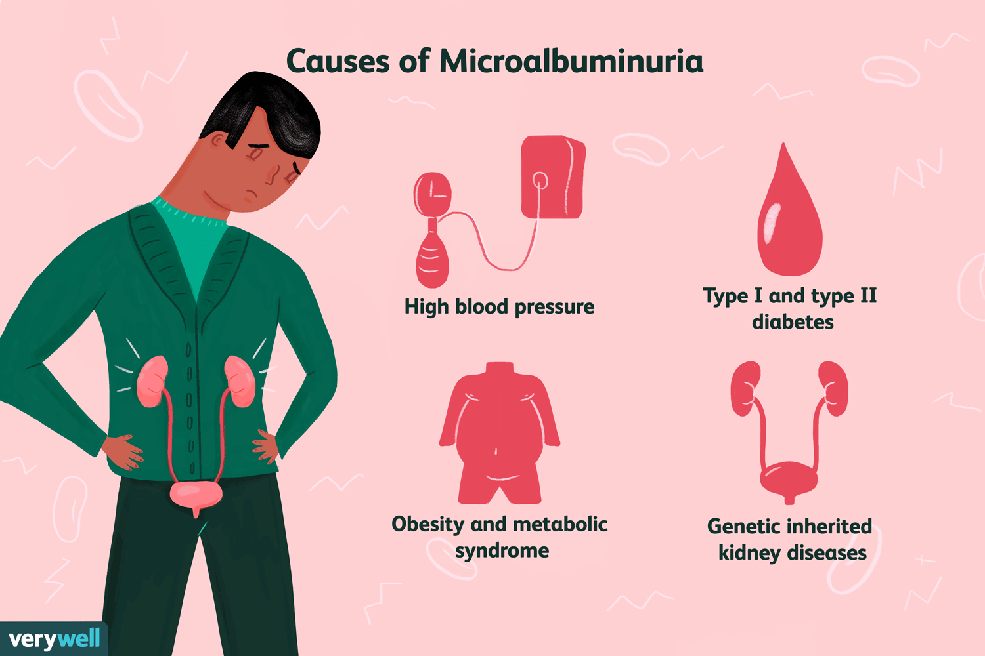
Microalbuminuria
Microalbuminuria refers to a persistent increase in the albumin excretion rate to values between 20 and 200 ug/min (30 and 300 mg/day).
A persistent increase is documented when these values are transgressed in at least two of three consecutive sterile timed urine specimens performed within 6-12 weeks.
The presence of microalbuminuria permits the diagnosis of early nephropathy , since microalbuminuria is not a marker but the first sign of diabetic nephropathy.

Slide 15
Nephrotoxicants
• Heavy Metals Toxicity --- mercury, cadmium, lead, chromium, uranium, ...
• Halogenated Hydrocarbons --- Chloroform, bromobenzene
• Mycotoxins (fungal toxins)
- Ochratoxin A and Citrinin from cereal grains
• (Drug medicine) Therapeutic drugs ---
Acetaminophen
Non-steroidal anti-inflammatory Drugs (NSAIDS)
Aminoglycosides
Amphotericin B
Cyclosporine
Cisplatin

Slide 16
Assessment of Renal Function due to Nephrotoxicity
Nephrotoxicity can be determined by measurement of:
urine volume and osmolality
pH ( normal pH = 6.5 - 7.0)
urinary composition (e.g., electrolytes, glucose, protein)
- Glucouria
→ indicates defects in proximal tubular reabsorption of sugars
- Urinary excretion of high-molecular-weight proteins such as albumin
→ indicates glomerular damage
- Excretion of low-molecular-weight proteins such as microglobulin
→ indicates proximal tubular injury

Slide 17
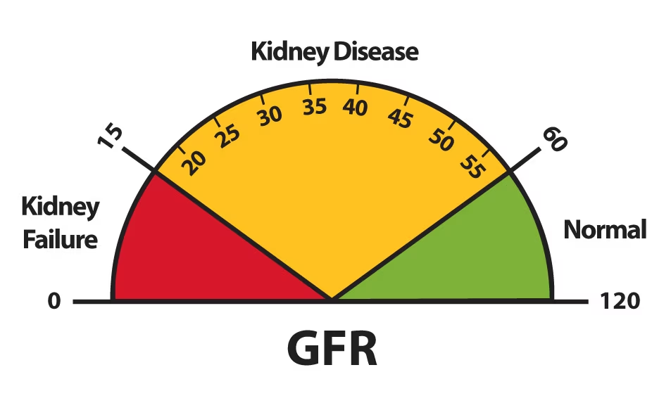
General Renal Markers
GFR (Glomerular Filtration Rate)
GFR describes the flow rate of filtered fluid through the kidney.
GFR is the best test to measure your level of kidney function and determine the stage of kidney disease.
GFR can be calculated from the results of blood creatinine test, age, gender and other factors.

Slide 18
GFR Measurement
• GFR can be measured directly by determining creatinine or inulin clearance.
Creatinine or inulin clearance (mL/min) =
Inulin conc. in urine (mg/L) x urine volume (ml/min)
Inulin conc. in serum (mg/L)
Creatinine is released from skeletal muscle at a constant rate. It is completely filtered.
Inulin is an exogenous compound that is completely filtered with no reabsorption or secretion.

Slide 19
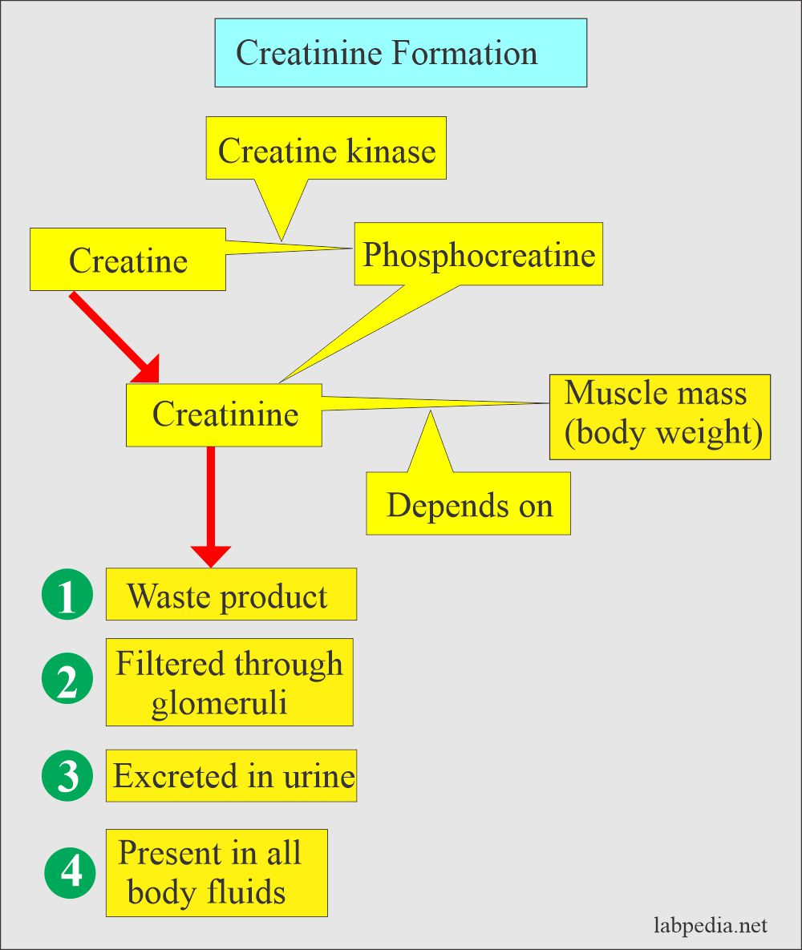
Serum Creatinine
Creatinine is a waste product in your blood that comes from muscle activity.
It is normally removed completely from your blood by kidneys.
When kidney function slows down, the creatinine level rises.
Serum creatinine test results are used to calculate your GFR.

Slide 20
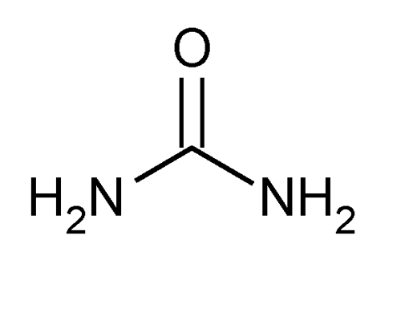
BUN (Blood Urea Nitrogen)
Urea nitrogen is a normal waste product in blood that comes from the breakdown of protein from the foods we eat and from the body metabolism.
It is normally removed from blood by kidneys, but when kidney function slows down, the BUN level rises.
BUN can also rise if you eat more protein, and it can fall if you eat less protein.
Blood urea nitrogen (BUN) normal ranges 1.8-7.1 mmol/L.

Slide 21
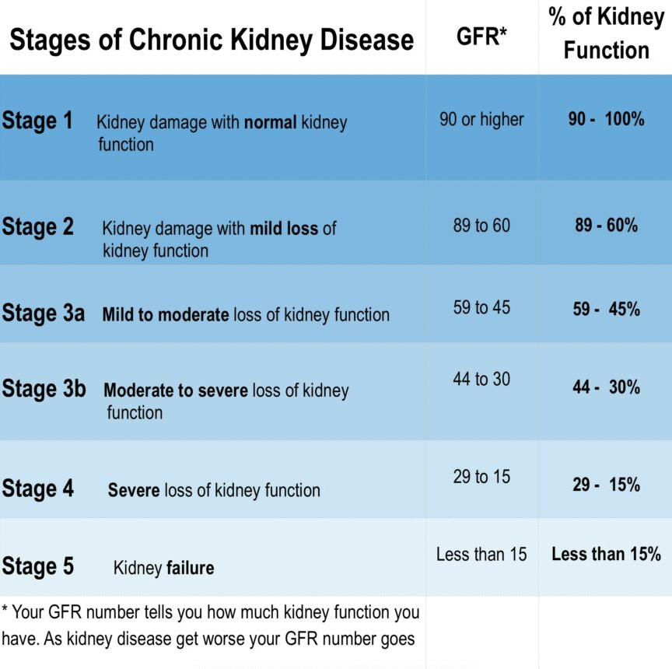
Chronic Kidney Diseases
Chronic kidney disease includes conditions that damage your kidneys and decrease their ability to keep you healthy.
If kidney disease gets worse, wastes can build to high levels in your blood and make you feel sick.
You may develop complications like high blood pressure, anemia (low blood count), weak bones, poor nutritional health and nerve damage.
Also, kidney disease increases your risk of having heart and blood vessel disease.
These problems may happen slowly over a long period of time.
Early detection and treatment can often keep chronic kidney disease from getting worse.
When kidney disease progresses, it may eventually lead to kidney failure, which requires dialysis or a kidney transplant to maintain life.
Notes:
The two main causes of chronic kidney disease are diabetes and high blood pressure, which are responsible for up to two-thirds of the cases.
Diabetes happens when your blood sugar is too high, causing damage to many organs in your body, including the kidneys and heart, as well as blood vessels, nerves and eyes.
High blood pressure, or hypertension, occurs when the pressure of your blood against the walls of your blood vessels increases. If uncontrolled, or poorly controlled, high blood pressure can be a leading cause of heart attacks, strokes and chronic kidney disease.
Also, chronic kidney disease can cause high blood pressure.

Slide 22
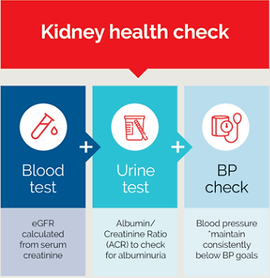

Slide 23
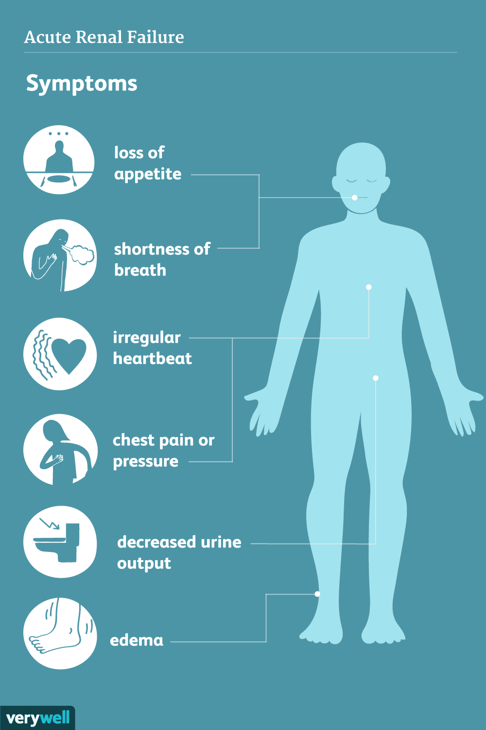
Acute Renal Failure
Sudden decrease in GFR (over hours to days)
Increase in BUN
What does a BUN blood test tell you?
A common blood test, the blood urea nitrogen (BUN) test reveals important information about how well your kidneys are working. A BUN test measures the amount of urea nitrogen that's in your blood
Increase in serum creatinine
Oliguria (is the low output of urine)

