Slide 1
Biochemical and Genetic Markers
BCH473: Biomarkers
Lecture 2

Slide 2
Biochemical Markers
These type of markers serve as indices for health- and physiology-related assessments
Disease risk
Psychiatric disorders
Environmental exposure and its effects
Disease diagnosis
Metabolic processes
Substance abuse
Pregnancy
Epidemiologic studies

Slide 3
Measurable and Quantifiable Biological Parameters
Specific enzyme concentration (transaminases)
Measurement of serum alanine aminotransferase (ALT) is a common, readily available, and inexpensive laboratory assay in clinical practice. ALT activity is not only measured to detect liver disease, but also to monitor overall health
Specific hormone concentration (insulin)
Specific cytokines (IL-6)
L ‐6, an upstream inflammatory marker, was independently associated with the risk of major adverse cardiovascular events, cardiovascular and all‐cause mortality, myocardial infarction, heart failure, and cancer mortality in patients with stable coronary heart disease
Presence of biological substances (cholesterol)

Slide 4
Why Protein biomarker analysis is important?
Proteins are the physiological/pathological active key players inside and outside cells.

Slide 5
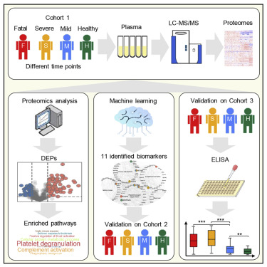
High throughput biomarker analysis - Proteomics
What is proteomics ?
is the study of the interactions, function, composition, and structures of proteins and their cellular activities.
Proteomic biomarkers are often referred to those biomarkers discovered using technologies capable of analyzing many proteins simultaneously, such as protein microarray and mass spectrometry (MS).

Slide 6
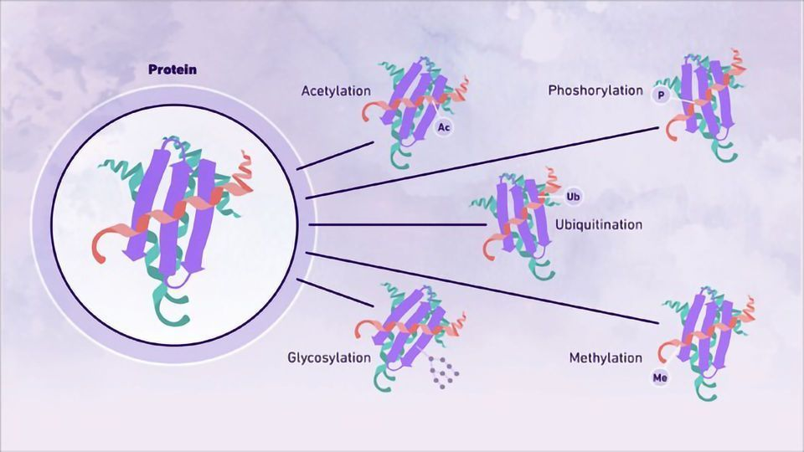
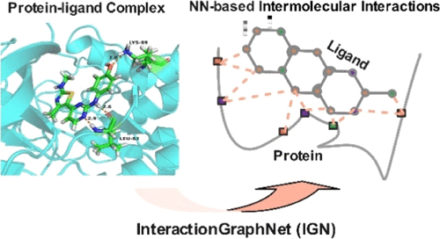
Post-Translational Modifications
Is the covalent and generally enzymatic modification of proteins following protein biosynthesis. This process occurs in the endoplasmic reticulum and the Golgi apparatus.[1] Proteins are synthesized by ribosomes translating mRNA into polypeptide chains, which may then undergo PTM to form the mature protein product. PTMs are important components in cell signaling, as for example when prohormones are converted to hormones.
Protein-protein, protein-ligand interactions
Necessary prerequisite for signal transduction, immunoreaction, and gene regulation. Several biophysical methods for the assessment of protein–ligand interactions exist, including surface plasmon resonance (SPR), capillary electrophoresis, isothermal titration calorimetry (ITC), and mass spectrometry (MS).
Sequence-structure-function relationships
The sequence-structure-function paradigm plays a central role in structural biology: the primary structure (i.e. amino acid sequence) of a protein dictates the three-dimensional structure (fold), which in turn influences the function

Slide 7
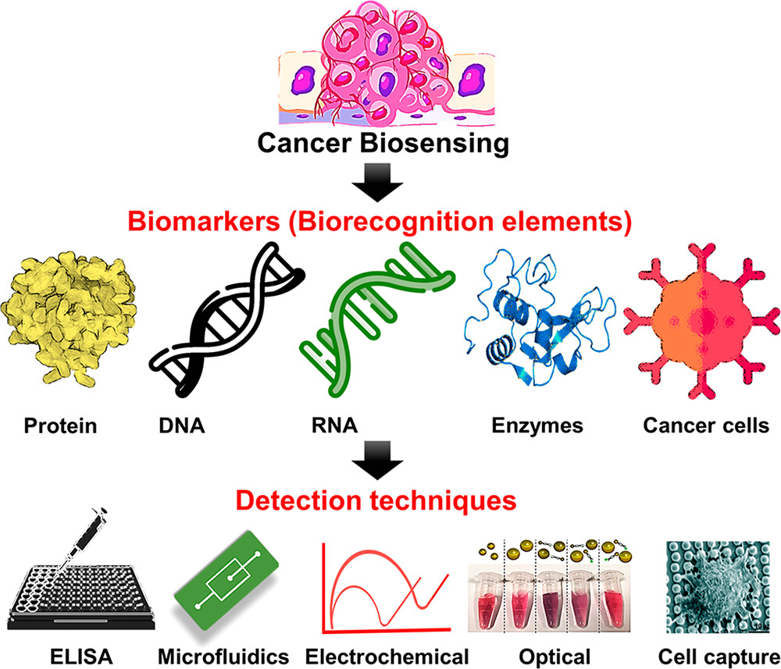
What is a biochemical marker in cancer?
In tumors, it is a measurable substance or substances that are produced and released from the tumor cells that indicate tumor cell activity.

Slide 8
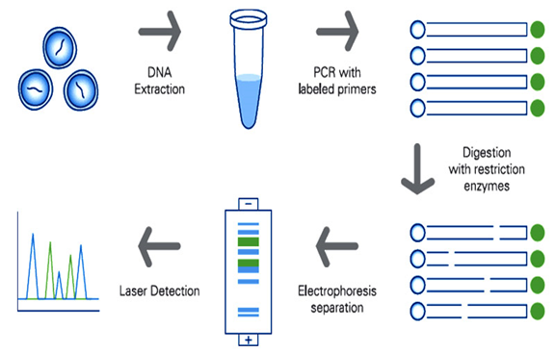
What are genetic markers of disease
A genetic marker is a gene or DNA sequence with a known location on a chromosome that can be used to identify cells, individuals or species.
It can be described as a variation (which may arise due to mutation or alteration in the genomic loci) that can be observed.

Slide 9
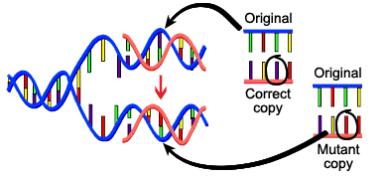
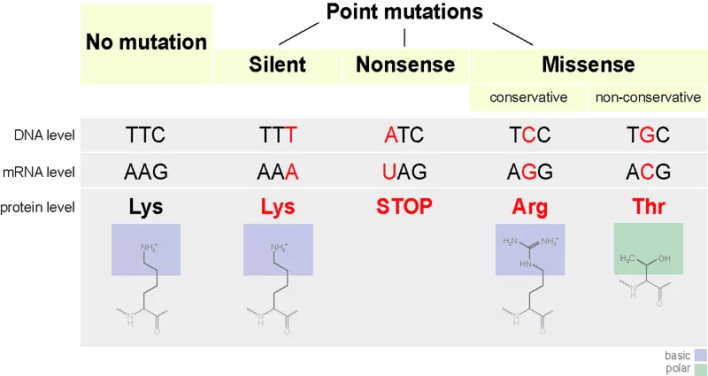
Cancer Specific Mutations
What are mutations?

Slide 10
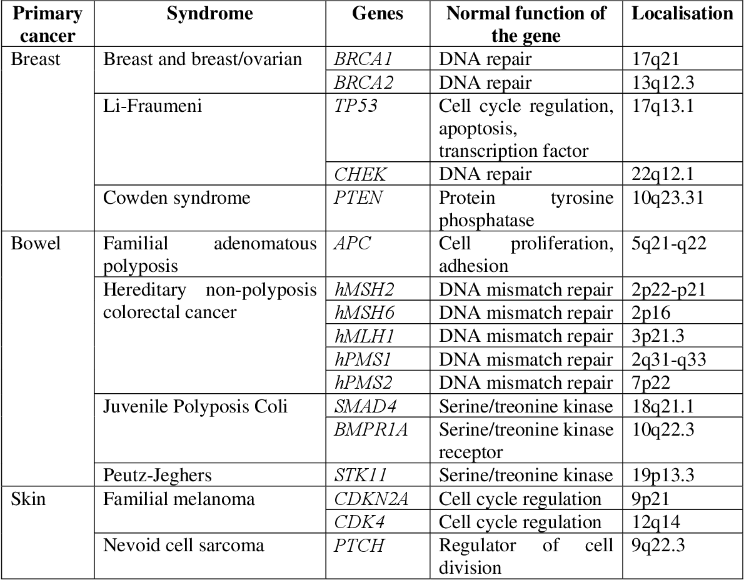
Some common types of Genetic Markers

Slide 11
Single Nucleotide Polymorphism in human DNA
Millions of sites in human DNA are different between individuals
Single Nucleotide Polymorphisms (SNPs) in genes or in non-coding DNA may or may not affect phenotype
SNPs can cause Restriction Fragment Length Polymorphisms (RFLPs) if in a restriction enzyme site

Slide 12
Microsatellite repeats
Characterized by a short repeat unit of 2-8 base pairs that is repeated up to 100 times. They are also known as short tandem repeats (STRs)
Microsatellites can be amplified for identification by the polymerase chain reaction (PCR) process, using the unique sequences of flanking regions as primers.
A number of DNA samples are amplified using polymerase chain reaction with primers targeting a variable simple sequence repeat.

Slide 13
Genetic disorders
Genetic tests
Genetic tests are performed on a sample of blood, hair, skin, amniotic fluid (the fluid that surrounds a fetus during pregnancy).
More than 1,200 clinically applicable genetic tests available
The results of a genetic test can confirm or rule out a suspected genetic condition or help determine a person's chance of developing or passing on a genetic disorder.
Several hundred genetic tests are currently in use, and more are being developed.
A genetic disorder is an illness caused by one or more abnormalities in the genome, especially a condition that is present from birth (congenital).
Most genetic disorders are quite rare and affect one person in every several thousands or millions.

Slide 14
Cystic fibrosis
Autosomal-recessive genetic disorder that can affect the respiratory, gastrointestinal, and reproductive systems
Most common fatal genetic disorder among Caucasians
Characterized by defective chloride transport across epithelial cell membranes.
CFTR gene is mutated which results in loss of chloride transport function.
The defective gene is CFTR on chromosome 7
More than 1,500 mutations and deoxyribonucleic acid (DNA) sequence variations have been found in the CFTR gene
Genetic testing for cystic fibrosis should be offered to adults with a family history of cystic fibrosis, partners of individuals with cystic fibrosis, couples currently planning a pregnancy, and couples seeking prenatal testing.

Slide 15
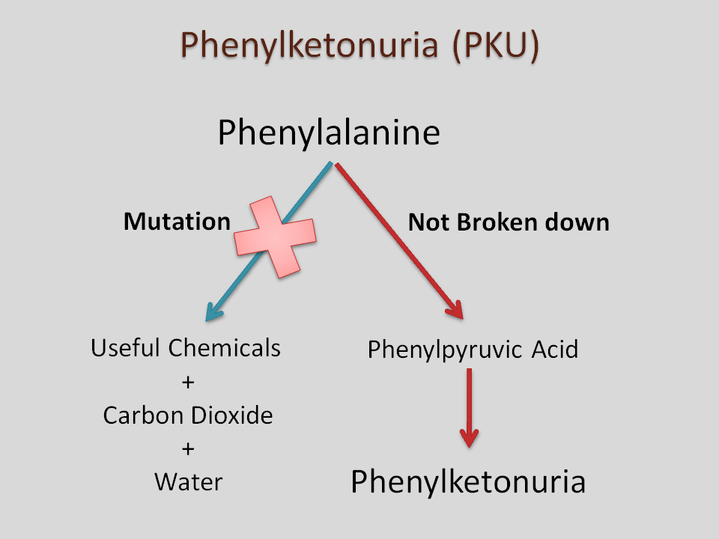
Phenylketonuria (PKU)
Caused by mutations in the gene encoding for phenylalanine hydroxylase (PAH), which normally converts phenylalanine to tyrosine
Over 400 known mutations exist
Mutation frequency varies among ethnic groups
Genotype and phenotype are generally related
Autosomal recessive inheritance; about one person in 60 is a PKU gene carrier

Slide 16
Whole genome sequencing
Whole genome sequencing, or entire genome sequencing is a laboratory process that determines the complete DNA sequence of an organism's genome at a single time.
Whole genome sequencing of individuals may replace all the existing genetic tests of hereditary disorders due to its lower cost and complete information.

