Slide 1
Biomarkers of Neurological Disorders
BCH473: Biomarkers

Slide 2
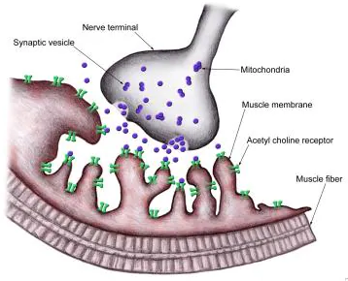
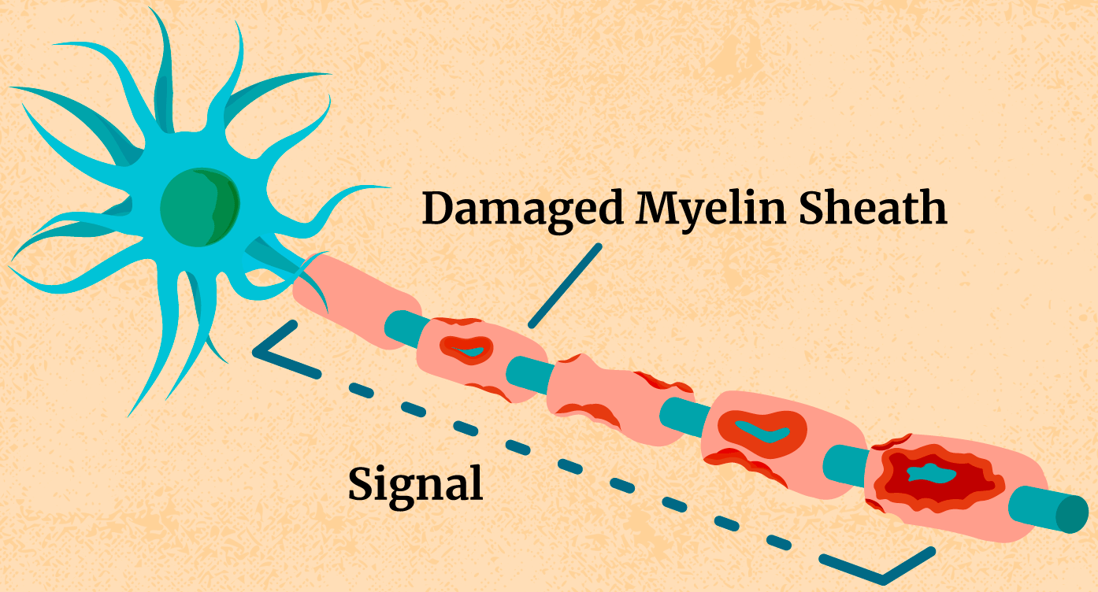
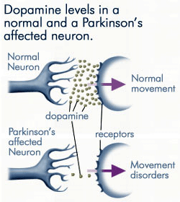
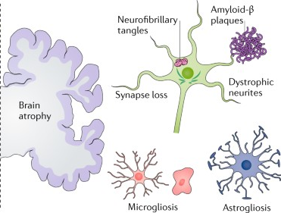
Myasthenia Gravis
Multiple Sclerosis
Parkinson’s Disease
Alzheimer’s Disease

Slide 3
Neurological Basis
The causes are not understood for any of these diseases
we know what happens but not why it happens
only the symptoms are treated not the disease itself

Slide 4
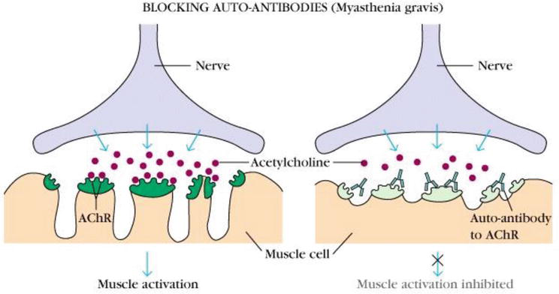
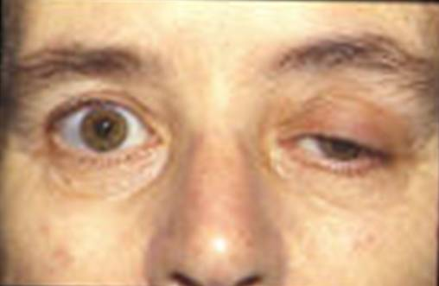
Myasthenia Gravis
Myasthenia gravis is an either autoimmune or congenital neuromuscular disease that leads to fluctuating muscle weakness and fatigue. In the most common cases, muscle weakness is caused by circulating antibodies that block acetylcholine receptors at the postsynaptic neuromuscular junction, inhibiting the excitatory effects of the neurotransmitter acetylcholine on nicotinic receptors at neuromuscular junctions.

Slide 5
Myasthenia Gravis
A disease where the immune system attacks and destroys acetylcholine receptors at the neuromuscular junction, resulting in muscular weakness
ocular myasthenia gravis: restricted primarily to ocular-motor system
generalized myasthenia gravis: widespread destruction of the neuromuscular junction including the ocular-motor system
The cause is unknown, but it appears to be an autoimmune disorder involving the thymus

Slide 6
Myasthenia Gravis: Symptoms
Ptosis
Diplopia
Muscle fatigue after exercise
Other indicators
antibodies for the acetylcholine receptor are present in the serum
50% incidence for the ocular form of the disease
90% incidence for the generalized form of the disease

Slide 7
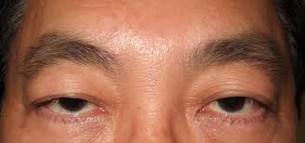
Myasthenia Gravis: Symptoms
Ptosis
Ptosis is an abnormal drooping of the upper eyelid when your eyes are looking straight ahead. It happens when one or both of the muscles that lift the upper lid aren't working properly or have become loosened from their positions above the lid.
You can be born with ptosis (congenital ptosis) or you may develop the condition (acquired ptosis). In both cases it can run in families.

Slide 8
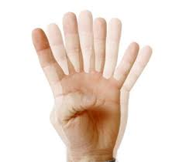
Myasthenia Gravis: Symptoms
Diplopia
Diplopia, commonly known as double vision, is the simultaneousperception of two images of a single object that may be displaced horizontally, vertically, or diagonally (i.e. both vertically and horizontally) in relation to each other.
It is usually the result of impaired function of the extra-ocular muscles, where both eyes are still being used, just not in focus

Slide 9
Myasthenia Gravis: Diagnosis
Neurological examination
presenting symptoms
Diagnosis is confirmed by using a short-acting (<5 minutes) cholinesterase inhibitor (edrophonium) to reverse the presenting symptoms – patients should show an immediate, short-lived improvement

Slide 10
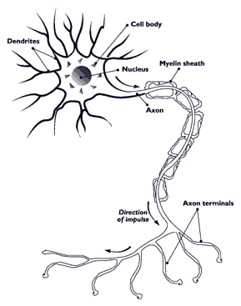
Multiple Sclerosis
Multiple sclerosis (MS), also known as disseminated sclerosis or encephalomyelitis disseminata, is an inflammatory disease in which the insulating covers of nerve cells in the brain and spinal cord are damaged. This damage disrupts the ability of parts of the nervous system to communicate, resulting in a wide range of signs and symptoms, including physical, mental, and sometimes psychiatric problems. MS takes several forms, with new symptoms either occurring in isolated attacks (relapsing forms) or building up over time (progressive forms)

Slide 11
Multiple Sclerosis
A slowly progressive neurological disease characterized by patches of demyelination in brain and spinal cord
affects only oligodendrocytes not Schwann cells
significant neural recovery often occurs during periods of spontaneous remission
The cause is unknown and the course is highly variable

Slide 12
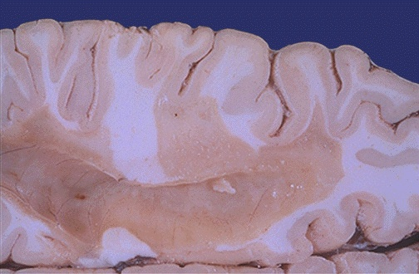
MS: Postmortem Analysis
brain photograph courtesy of the University of Utah Medical School

Slide 13
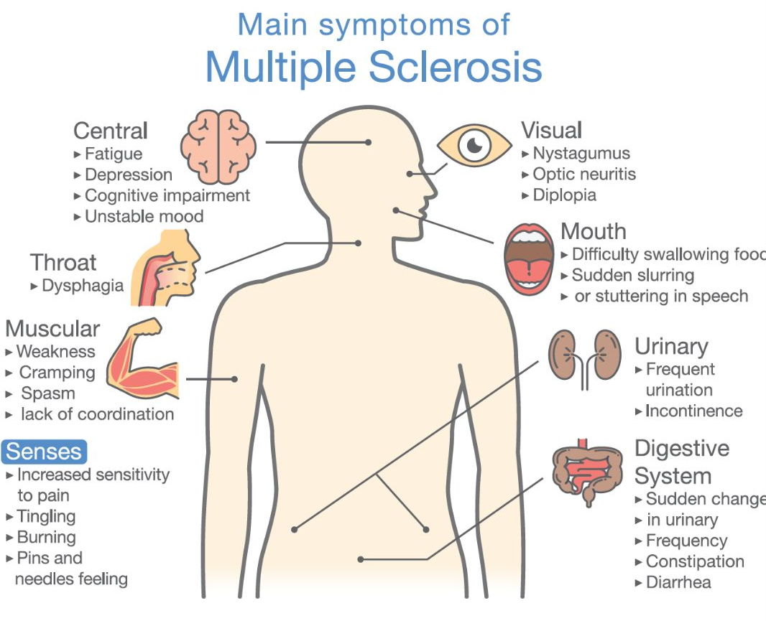

Slide 14
Advanced symptoms can include:
pronounced difficulty moving
severe visual impairment or even blindness
severe neuropathic pain
pronounced cognitive and emotional disturbances

Slide 15
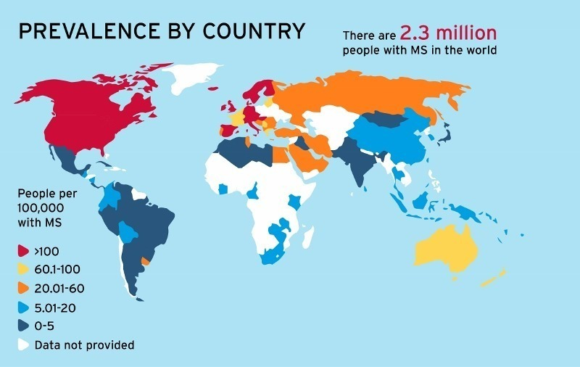
Geographic Distribution

Slide 16
MS - Biomarkers
Work to develop biomarkers that help with diagnosis and prediction of disease progression is ongoing.
New diagnostic methods that are being investigated include work with anti-myelin antibodies, and studies with serum and cerebrospinal fluid, but none of them has yielded reliably positive results.
At the current time, there are no laboratory tests that can predict prognosis. Several promising approaches have been proposed including: interleukin-6, nitric oxide and nitric oxide synthase, osteopontin, and fetuin-A.

Slide 17
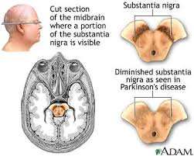
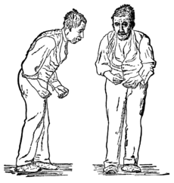
Parkinson’s Disease
Parkinson's disease is a degenerative disorder of the central nervous system.
The motor symptoms of Parkinson's disease result from the death of dopamine-generating cells in the substantia nigra, a region of the midbrain; the cause of this cell death is unknown.
Early in the course of the disease, the most obvious symptoms are movement-related; these include shaking, rigidity, slowness of movement and difficulty with walking and gait.

Slide 18
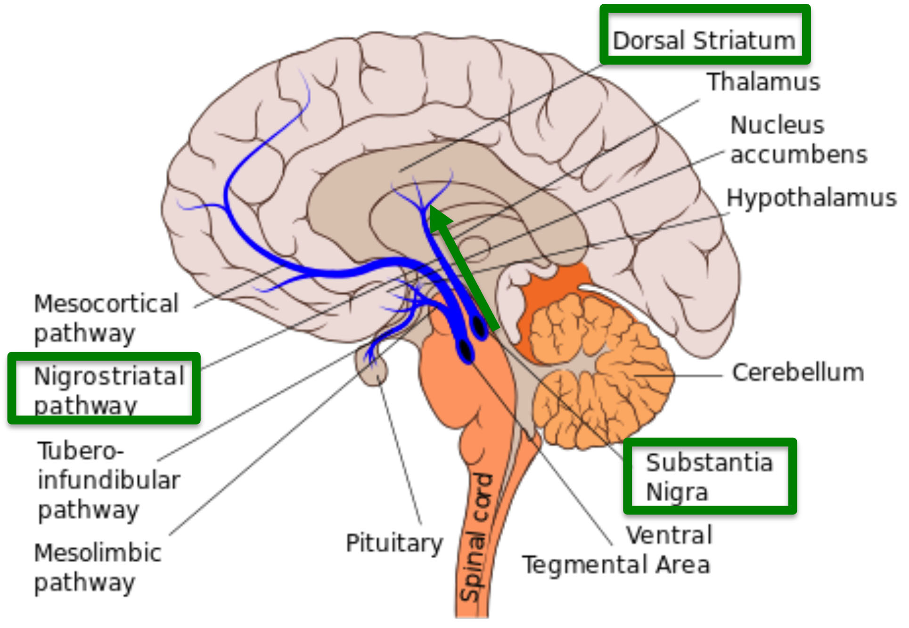
Parkinson’s Disease
A slowly progressive neurological disorder caused by the loss of dopamine-containing cells in the Nigrostriatal pathway
Prominent symptoms involve motor function
psychiatric complications may also occur

Slide 19
PD: Incidence
Onset usually appears after age of 40 years
mean age of onset 57 years
but can begin at any time including childhood when it is termed juvenile parkinsonism
affects 1% aged 50 years and over
10% aged 60 years and over may have undiagnosed, early stages of the disease
about 1½ times more common in women than in men

Slide 20
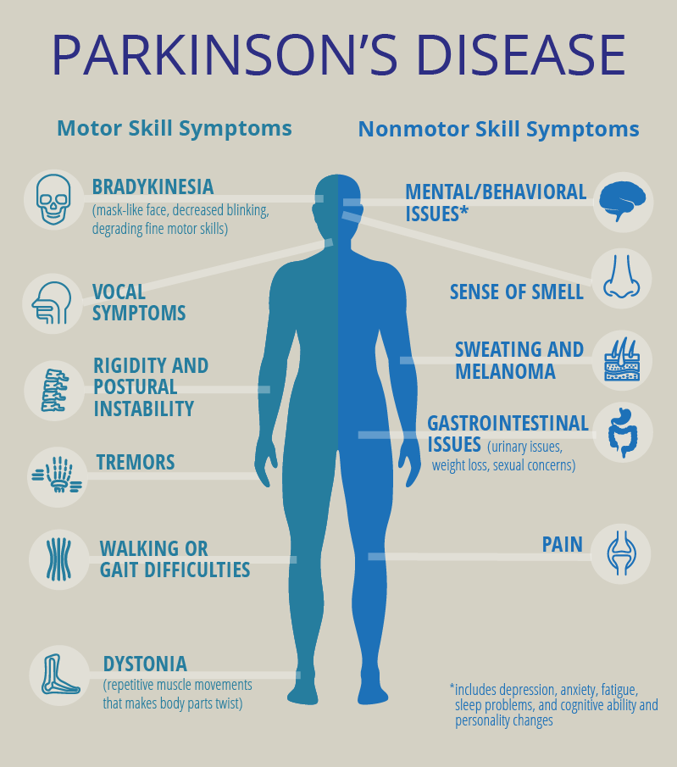
PD: Diagnosis
Neurological examination
presenting symptoms
exclusion of other disorders
Response to levodopa therapy

Slide 21
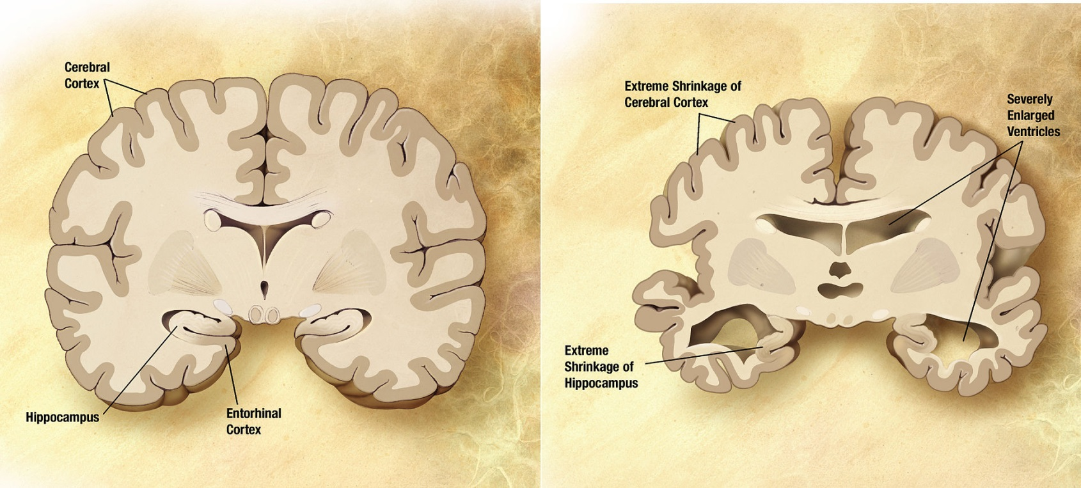
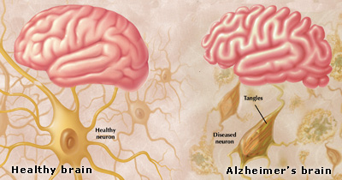
Alzheimer’s Disease

Slide 22
Alzheimer’s Disease: Incidence
Diagnosed cases
10% of the population aged 65 years and over
50% of the population aged 85 years and over

Slide 23
Alzheimer’s Disease
A progressively degenerative neurological disorder leading to dementia with increasing mental confusion, emotional instability, and premature death.
The cause is unknown but amyloid plaques are present in the CNS, initially in the hippocampus and later in the cerebral cortex and related structures.
Widespread CNS atrophy is present in advanced cases.

Slide 24
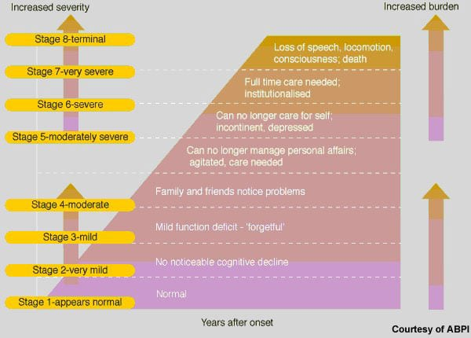
Stages of Alzheimer’s Disease

Slide 25
Alzheimer’s Disease: Postmortem Analysis
b-amyloid (protein fragment)
-Amyloid-beta (Aβ or Abeta) denotes peptides of 36–43 amino acids that are crucially involved in Alzheimer's disease as the main component of the amyloid plaques found in the brains of Alzheimer patients. The peptides result from the amyloid precursor protein (APP), which is being cut by certain enzymes to yield Aβ.
twisted microfilaments with abnormal Tau
Unclear whether b-amyloid or twisted microfilaments cause Alzheimer’s or are products of the disease
Advanced stage shows widespread CNS atrophy

