Slide 1
Cardiac Disease Biomarkers
BCH473: Biomarkers

Slide 2
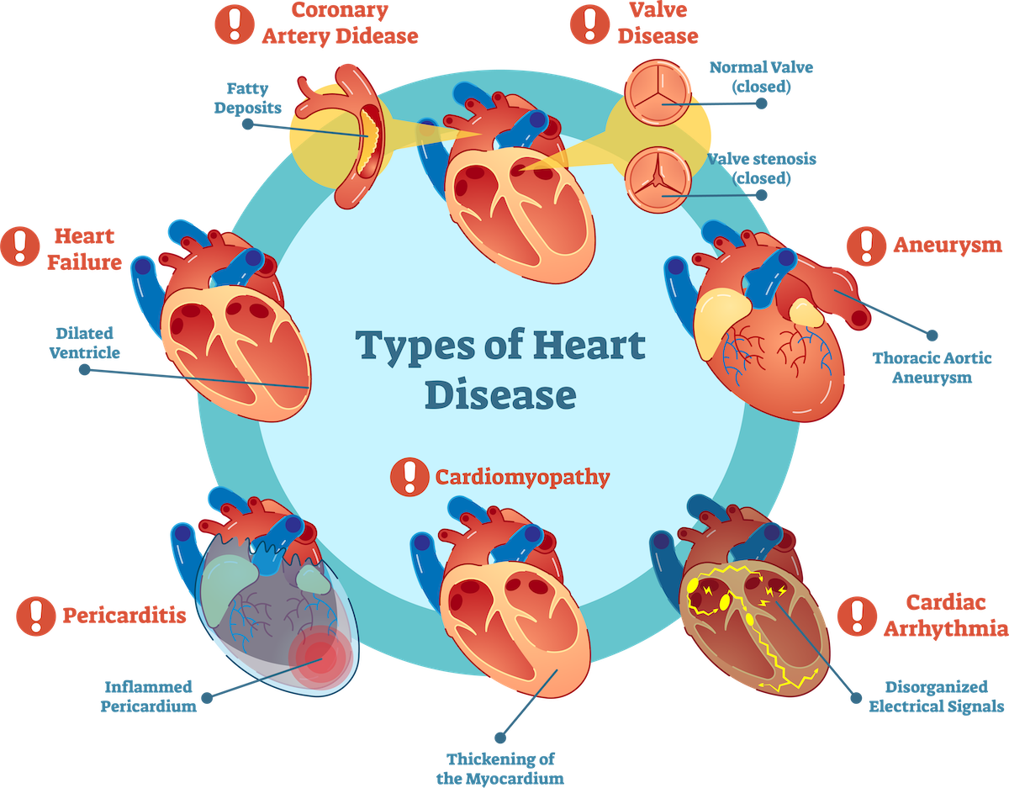
Heart disease describes a range of conditions that affect heart
Diseases under the heart disease umbrella include:
Blood vessel diseases, such as coronary artery disease.
Heart rhythm problems (arrhythmias).
Heart defects you're born with (congenital heart defects), among others.

Slide 3
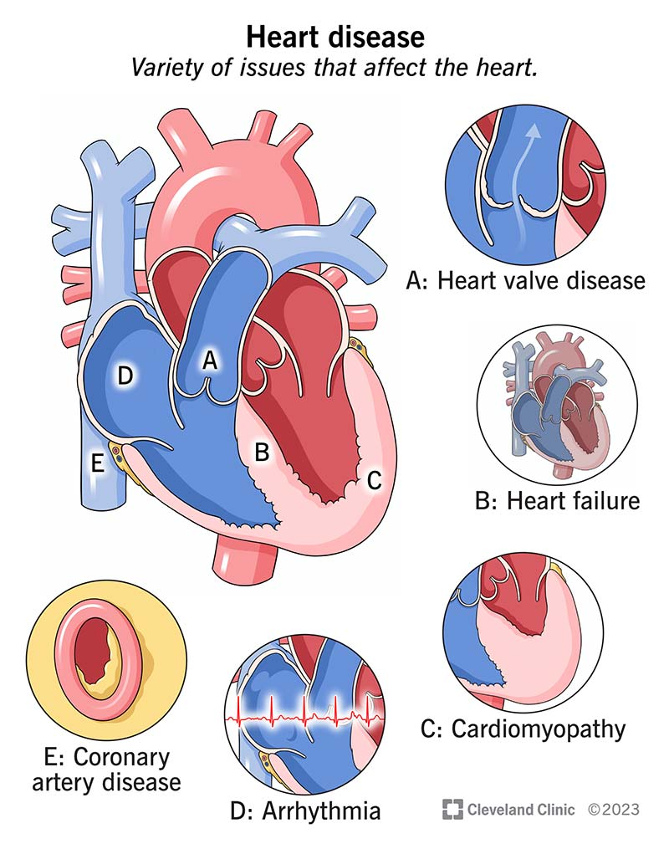
The term "heart disease" is often used interchangeably with the term "cardiovascular disease."
Cardiovascular disease generally refers to conditions that involve narrowed or blocked blood vessels that can lead to a heart attack, chest pain (angina) or stroke.
Other heart conditions, such as those that affect your heart's muscle, valves or rhythm, also are considered forms of heart disease.

Slide 4
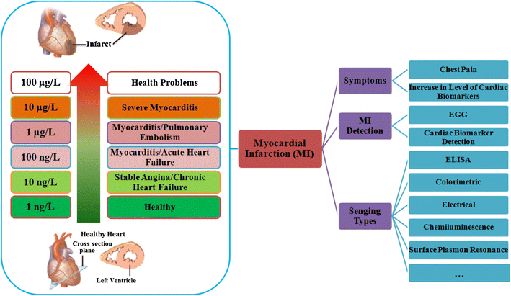
“A biomarker is a substance used as an indicator of a biologic state. It is a characteristic that is objectively measured and evaluated as an indicator of normal biologic processes, pathogenic processes, or pharmacologic responses to a therapeutic intervention.”
“Cardiac markers are substances released from heart muscle when it is damaged as a result of myocardial infarction.”
Troponin levels

Slide 5
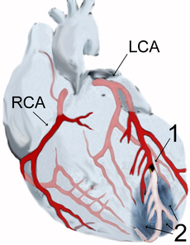
Acute Myocardial Infarction
Diagram of a myocardial infarction (2) of the tip of the anterior wall of the heart (an apical infarct) after occlusion (1) of a branch of the left coronary artery (LCA). In the diagram, RCA is the right coronary artery.
Myocardial infarction or acute myocardial infarction (AMI), commonly known as a heart attack, occurs when blood stops flowing properly to a part of the heart, and the heart muscle is injured because it is not receiving enough oxygen.
Usually, this is because one of the coronary arteries that supplies blood to the heart develops a blockage due to an unstable buildup of white blood cells, cholesterol and fat. The event is called "acute" if it is sudden and serious.

Slide 6
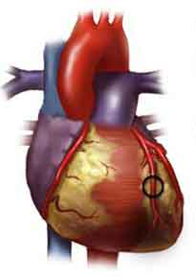
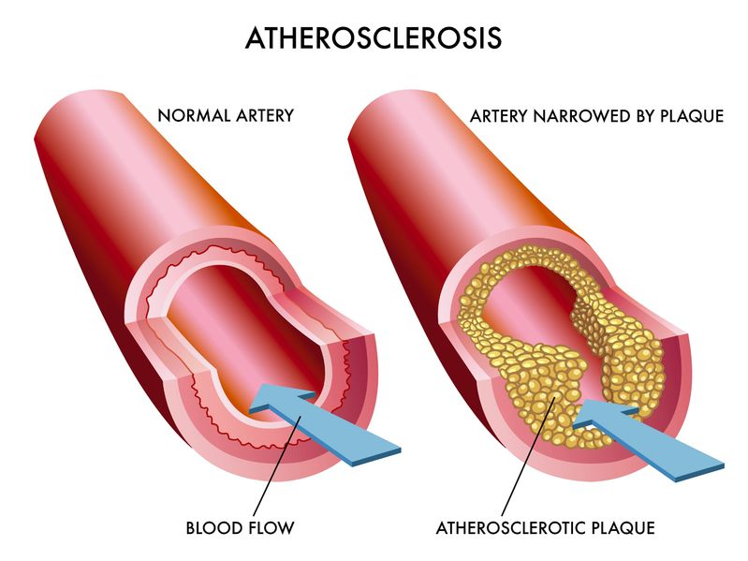
Atherosclerotic disease
Cardiovascular disease is caused by narrowed, blocked or stiffened blood vessels that prevent your heart, brain or other parts of your body from receiving enough blood.

Slide 7
Diagnosis of Myocardial Infarction
A patient is diagnosed with MI if two (probable) or three (definite) of the following criteria are satisfied:
Clinical history of ischemic type chest pain lasting for more than 20 minutes
Changes in serial ECG tracings
Rise and fall of serum cardiac biomarkers

Slide 8
Which Biomarkers?
Creatine Kinase CK (CPK)
CK-MB (Heart type isoform)
Troponin-I/T
Others
Lactate Dehydrogenase (LDH)
Myoglobin
Alanine Transaminase (ALT)
Aspartate Transaminase (AST)

Slide 9
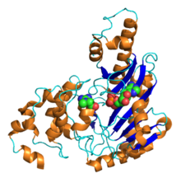
Creatine kinase (CK/CPK) is an enzyme expressed in a number of tissues.
Function: it catalyses the conversion of creatine to phosphocreatine degrading ATP to ADP
(In cardiac as well as other tissues, phosphocreatine serves as an energy reservoir for the rapid regeneration of ATP)

Slide 10
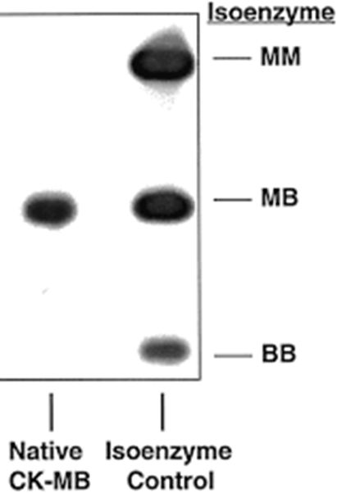
Creatine Kinase
The CK enzyme consists of two subunits, B (brain type) or M (muscle type), Making three different isoenzymes:
CK-MM, CK-BB and CK-MB
CK-BB occurs mainly in tissues, rarely of any significance in the bloodstream
Skeletal muscle expresses CK-MM (98%) and low levels of CK-MB (1%)
Sensitive lab tests can pick up these low levels of CK-MB from skeletal muscle
The myocardium has CK-MM at 70% and CK-MB at ~30%
CK therefore, lacks specificity for cardiac damage and needs to be augmented with the MB fraction and Relative Index (RI) to indicate true cardiac damage

Slide 11
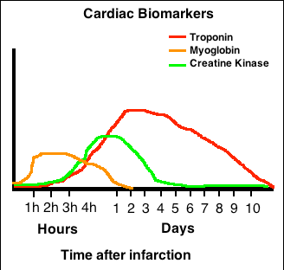
Creatine Kinase
Needs >two-fold increase with simultaneous increase in CK-MB to be diagnostic for MI
Increases 4-6 hours after onset of MI
Peak activity is at 18 to 24 hours
Usually has returned to baseline levels by 36 hours
False positive (for MI) CK elevation can be seen in:
Significant skeletal muscle injury
Significant CNS damage (Stroke/Trauma)
Occasionally from GI, renal, urologic disease

Slide 12
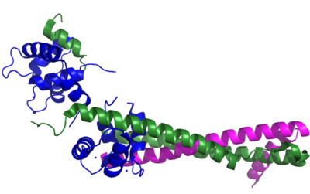
Troponin
Ribbon representation of the human cardiac troponin core complex.
troponin C
troponin I
troponin T
Troponin is a complex of three regulatory proteins that is integral to contraction in skeletal as well as cardiac muscle
Troponin has three subunits, TnC, TnT, and TnI
Thus far, studies have failed to find a source of Troponin-I outside the heart; Because of its increased specificity Troponin-I is useful

Slide 13
Other Cardiac Markers
LD (LDH)
Used in the past along with aminotransferases to diagnose AMI. LD is non-specific for cardiac tissue, which contains LD-1. However, pancreas, kidney, stomach tissue and red cells also contain LD-1. In the setting of AMI, LD rises at about 10 hours, peaks at 24-48 hours, and remains elevated for up to 8 days.
Myoglobin
Ubiquitous small-size heme protein released from all damaged tissues. Increases often occur more rapidly than TI and CK. Not utilized often for AMI/cardiac damage assessment because of its very rapid metabolism (short plasma half-life) causing short burst increases that are difficult to assess clinically, as well as its lack of specificity for cardiac tissue.
ALT/AST
Used as surrogate markers of cellular damage in the past. Very non-specific so not used for assessment of myocardial damage any longer
H-FABP
Heart-type fatty acid binding protein
Kinetically similar to myoglobin but more specific to cardiac tissue which contains a greater percentage of this protein than skeletal muscle
Current studies ongoing to further evaluate its utility

Slide 14
Timing Summary
The MB type is specific to myocardial cells while MM and BB are specific to skeletal muscle and brain tissue respectively.
The CK level will increase approximately 3-4 hours after a myocardial infarction and stays elevated for 3-4 days.
TEST | ONSET | PEAK | DURATION
CK/CK-MB | 3-12 hours | 18-24 hours | 36-48 hours
Troponins | 3-12 hours | 18-24 hours | Up to 10 days
Myoglobin | 1-4 hours | 6-7 hours | 24 hours
LDH | 6-12 hours | 24-48 hours | 6-8 days

Slide 15
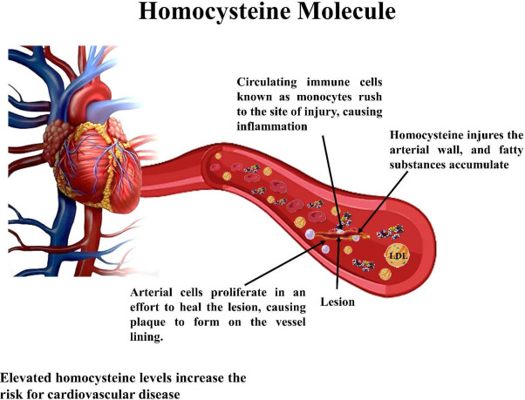
Homocysteine
Moderate hyperhomocysteinemia occurs in 5-7% of the population
Recognized as an independent risk factor for the development of atherosclerotic vascular disease and venous thrombosis
Can result from genetic defects, drugs, vitamin deficiencies, or smoking

Slide 16
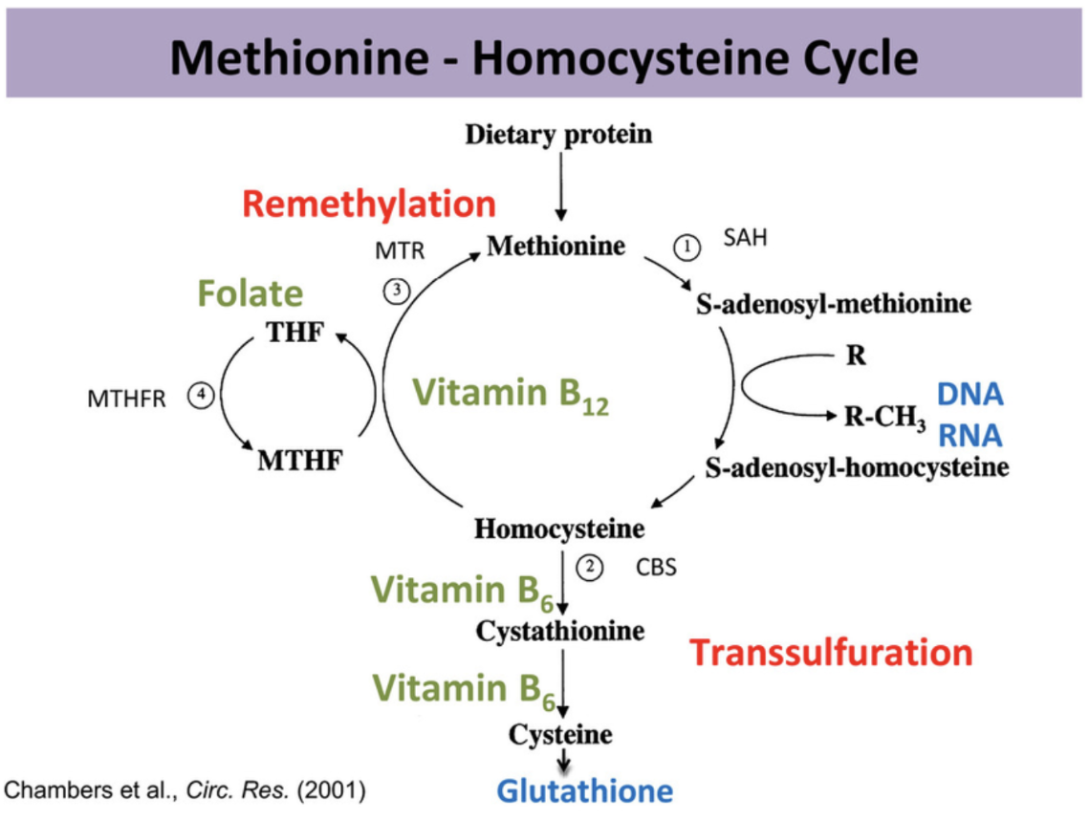

Slide 17
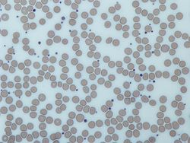
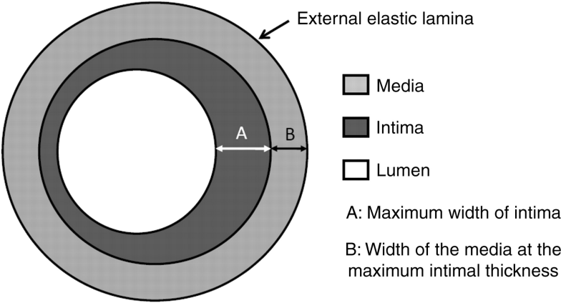
Homocysteine
Homocysteine implicated directly in vascular injury including:
Intimal thickening
Smooth muscle hypertrophy
Platelet aggregation
RBCs and platelets (blue dots in the image).
Elevated levels appear to be an independent risk factor.
Screening recommended in patients with premature CV disease and absence of other risk factors.
Treatment includes supplementation with folate, B6 and B12
Intimal medial thickness, is a measurement of the thickness of tunica intima and tunica media, the innermost two layers of the wall of an artery.

Slide 18
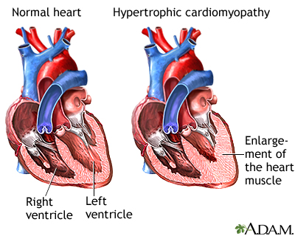
Cardiac hypertrophy is a thickening of the heart muscle (myocardium) which results in a decrease in size of the chamber of the heart, including the left and right ventricles.

Slide 19
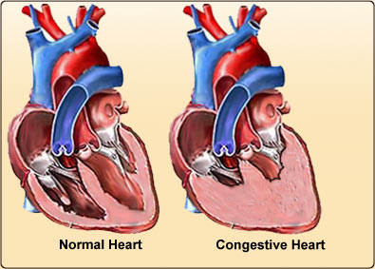
Congestive Heart Failure
Leading cause of hospitalization in people >65.
Congestive heart failure can be caused by:
Diseases in which the heart muscle weakens
Diseases in which the heart muscles stiffens
Conditions where oxygen demand by the body tissue is beyond the capacity of the heart

Slide 20
Many forms of heart disease can be prevented or treated with healthy lifestyle choices.

