Slide 1
Biomarkers of Gastrointestinal Diseases
BCH473: Biomarkers

Slide 2
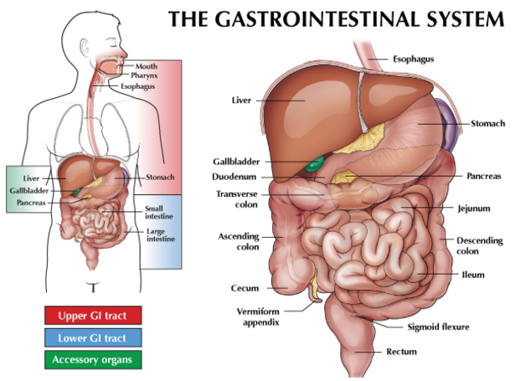

Slide 3
The Comprehensive GI (gastrointestinal) Function Markers
Beneficial Short Chain Fatty Acids (SCFA) - Beneficial SCFA come from dietary carbohydrates that have escaped digestion or absorption in the small intestine. They are also produced by bacteria in the large intestine via the fermentation of fiber. The production of SCFA in the intestine plays an important role in maintaining the intestinal lining. They affect the bacteria of the colon as well as the health of the colon and the entire body.
Lactoferrin - Lactoferrin is released in inflammatory condition such as Crohn’s disease and ulcerative colitis. It can help to differentiate between IBS and these conditions, and to monitor improvement in inflammatory bowel diseases.
WBC (White Blood Cells) - White blood cells indicate inflammation in the digestive tract.
Mucus - Excess mucus indicates infection, inflammation, or injury of the lining of the digestive tract.

Slide 4
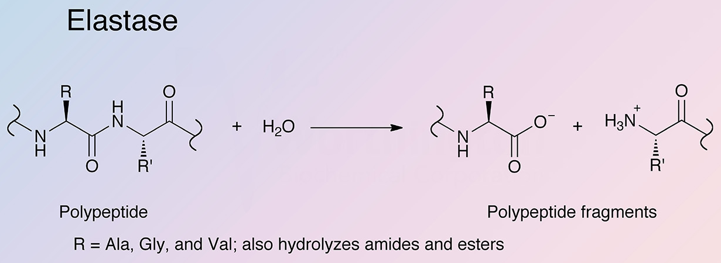
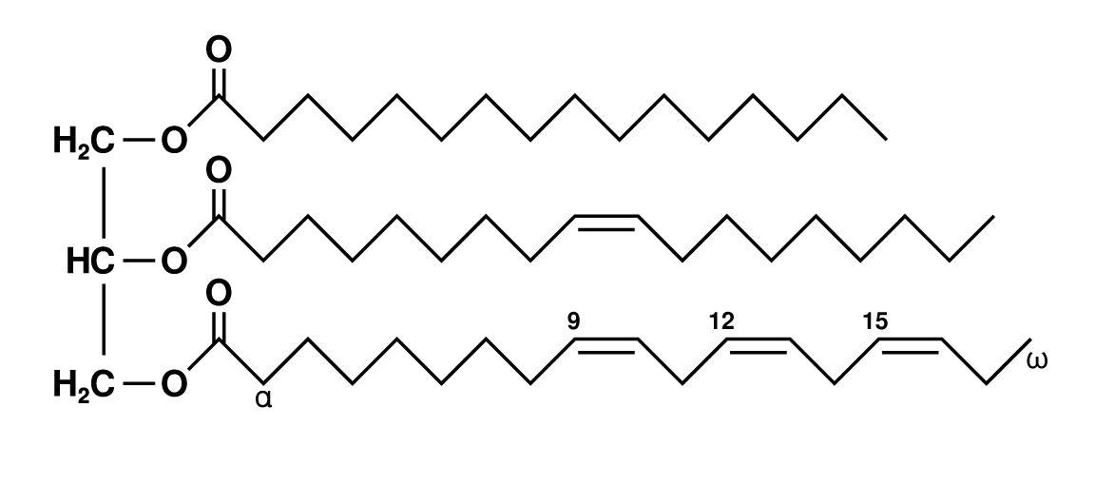
Digestive Markers
Elastase 1 - is a pancreatic enzyme that survives passage through the digestive tract. It is used to measure pancreatic insufficiency.
Triglycerides - Small amounts of triglycerides, are normal. Higher levels indicate incomplete fat digestion and possible insufficient pancreatic enzymes, insufficient bile, or hypochlorhydria.
Vegetable Fibers - Fibrous residue of undigested vegetable matter suggests possible maldigestion.
Unsaturated fat triglyceride

Slide 5
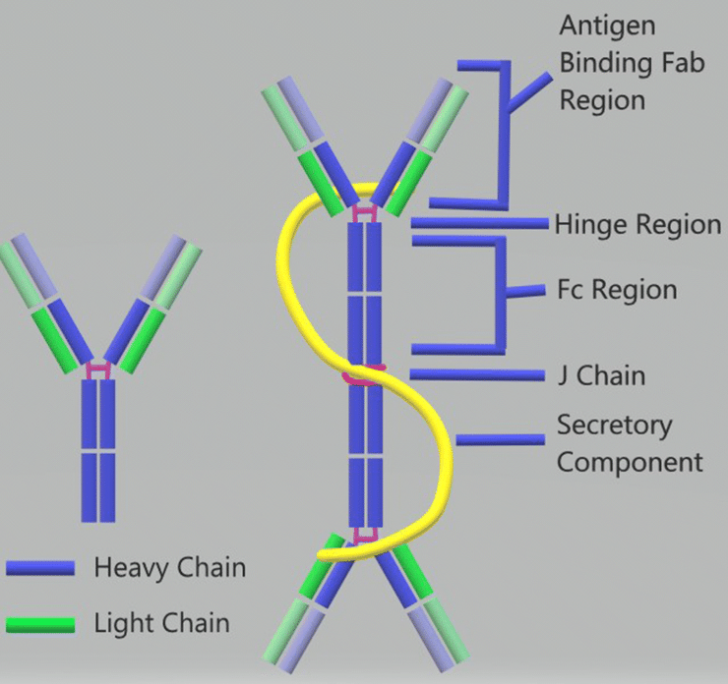
Immune Markers
Fecal sIgA - Secretory IgA (sIgA) reflects the activity of the immune system in the digestive tract.
Anti-gliadin sIgA - Gliadin is a protein found in wheat and related grains. An immune reaction to gliadin may indicate a gluten intolerance.
Secretory Immunoglobulin A

Slide 6
Stool Markers
pH - the acidity of stool environment. An abnormal pH may indicate fat malabsorption or an enzyme deficiency. A stool pH of <6 may indicate carbohydrate malabsorption.
Occult blood - occult blood in the stool can be a sign of many different conditions, including polyps, cancer, peptic ulcer, inflammatory bowel disease, diverticulosis, and pancreatitis.
RBC (Red Blood Cells) - The presence of red blood cells may be due to hemorrhoids (or piles), injury or even severe constipation.
Color - The normal stool color is light brown to brown. Clay, white or tan colored stool can indicate the absence of bile or a pancreatic insufficiency.

Slide 7
Markers of Absorption
Long Chain Fatty Acids (LCFA) - These fatty acids are usually absorbed by a healthy digestive tract. If malabsorption is present, they are elevated in the stool.
Total Fat - Total fecal fats include triglycerides, cholesterol, and long chain fatty acids. Poor digestion and absorption of fats leads to increased fat in the stool.
Cholesterol - Fecal cholesterol come from dietary sources and bile. Fecal cholesterol levels remain relatively constant regardless of diet. An elevated level may indicate malabsorption.

Slide 8
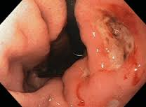
Peptic Ulcer
Loss of tissue from the lining of the digestive tract. May be acute or chronic.
Classified as gastric or duodenal.
CAUSES: drugs, stress, heavy alcohol and tobacco use, infection (H. pylori bacteria); Conditions that cause high gastric acid concentration.

Slide 9
Peptic Ulcers - comparison
Gastric Ulcers
burning pain 1-2 hrs. after meals, upper left abd/back,relieved by food
weight loss
gastric secretions deceased
Older men; under stress
Duodenal Ulcers
burning/ cramping pain 2-4hrs. P meal, beneath xiphoid and back, relieved by antacids/food
increased gastric acid
Young men; chronic illnesses

Slide 10
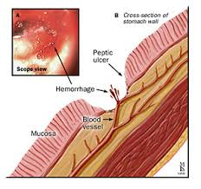
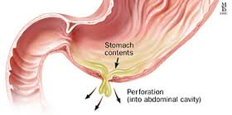
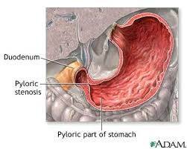
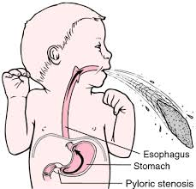
Peptic Ulcer Complications
Perforation
Hemorrhage
Pyloric obstruction

Slide 11
Malabsorption Syndromes
A variety of well-known GI disorders are associated with malabsorption syndromes that can cause selected nutritional, biochemical, and vitamin deficiencies.
Various biochemical deficiencies, including vitamin E and vitamin B₁₂ deficiency, can occur as a result of GI disorders

Slide 12
Malabsorption syndromes
Defective intra-luminal digestion:
Pancreatic insufficiency
Defective bile secretion
Mucosal abnormalities:
Disaccharase deficiency (lactose intolerance)
Reduced surface area
Celiac disease
Surgical resection
Infections: Tropical infection

Slide 13
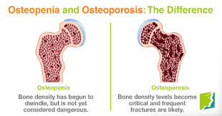
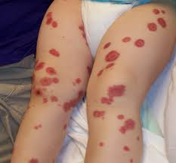
Clinical features of Malabsorption Syndrome
Hematopietic system:
Anemia: iron, folate and B12 deficiency
Bleeding: vitamin K deficiency
Musculoskeletal system:
Osteopenia: calcium and vitamin D deficiency
Skin:
Purpura: vitamin K deficiency
Dermatitis: vitamin A deficiency
Purpura

Slide 14
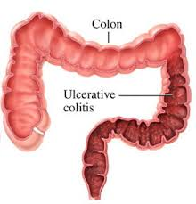
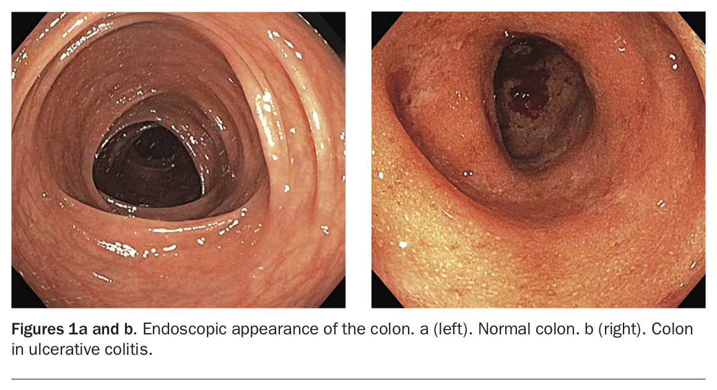
Inflammatory bowel disease
Inflammatory bowel disease, including Crohn's disease and ulcerative colitis, primarily affect young adults.
Ulcerative colitis is a chronic relapsing inflammatory disease involving the mucosa of the colon and rectum in a continuous manner.

Slide 15
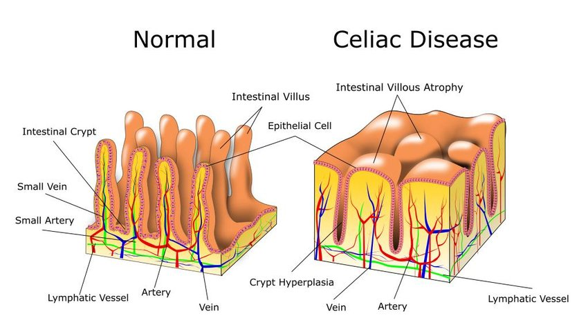
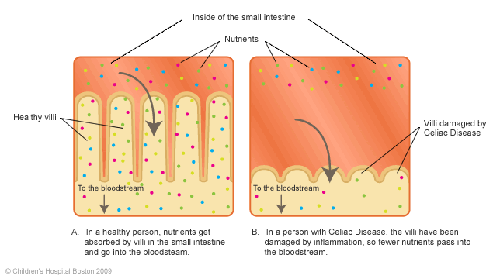
Celiac Disease

Slide 16
Celiac disease
Inappropriate immune response to the dietary protein gluten, which is found in rye, wheat, and barley.
Autoimmune disorder with a prevalence of approximately 0.5 to 1 percent in the United States. (1 in every 100-200 persons)
After absorption in the small intestine these proteins interact with the antigen-presenting cells in the lamina propria causing an inflammatory reaction that targets the mucosa of the small intestine.
Manifestations range from no symptoms to overt malabsorption with involvement of multiple organ systems and an increased risk of some malignancies.
Most patients with celiac disease express human leukocyte antigen (HLA)-DQ2 or HLA-DQ8, which facilitate the immune response against gluten proteins
Treatment is avoidance of food products that contain gluten.
Notes:
Not completely understood how gluten sensitivity begins or whether early exposure to gluten proteins increases the risk of sensitivity

Slide 17
Comorbidities of Celiac disease
Osteoporosis
Deficiencies in folic acid, vitamin B12, fat-soluble vitamins, and iron
Increased mortality due to increased risk of malignancy
Notes:
Osteoporosis is a common finding in patients with celiac disease. The mechanism for bone loss is multifactorial and is thought to be related to secondary hyperparathyroidism from vitamin D deficiency and calcium malabsorption.1 With treatment of celiac disease, bone density values often return to normal in children, but may not do so in adults.17 Consideration should be given to testing bone mineral density in adults at the time of diagnosis, particularly in those who have been symptomatic.

Slide 18
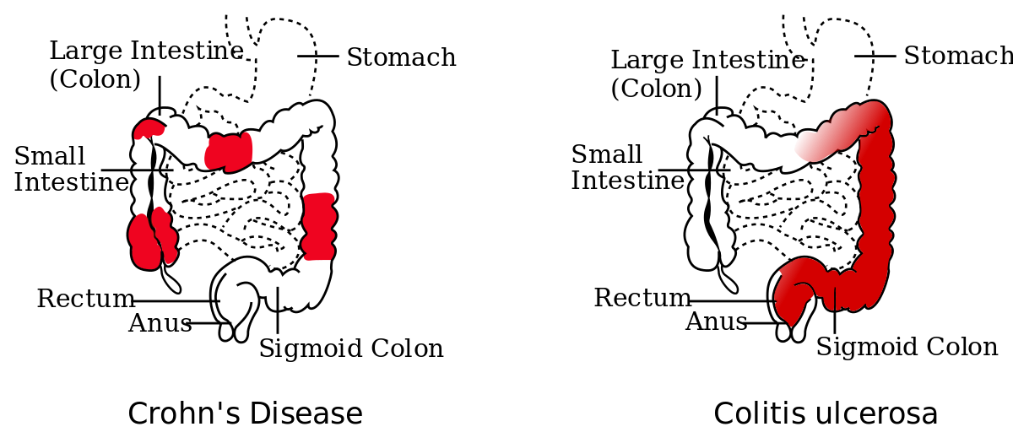
Crohn’s Disease
Crohn’s disease (CD) is a chronic relapsing inflammatory condition usually with flare-ups alternating with periods of remission, and an increasing disease severity and incidence of complications as time goes on.
It can affect any part of the gastrointestinal tract from the mouth to the anus. For typical sites & proportion of patients affected see below:

Slide 19
Epidemiology-Crohn’s Disease
World wide distribution but more common in the West.
Incidence: 7/100 000 pop/yr
The incidence is lower in
non-white races.
Females are affected more than males 1.2:1
Epidemiology
Jews are more affected
than non-Jews
Bimodal age distribution:
20-40 yrs/60-80 yrs
The incidence is rising
Prevalence: 100/100 000 pop/yr

Slide 20
Etiology & Pathogenesis
The aetiology of Crohn’s disease is unknown. There are many proposed pathogenic mechanisms, some of which are represented in this diagram.
As there is no one cause, it is likely that Crohn’s disease is an outcome of interactions between genetic predisposition, environmental factors and the subsequent reaction of the host immune system.
Genetic susceptibility
Environmental factors
Host
Immune
Response
Crohn’s Disease

Slide 21
Gastrointestinal Tumors - Introduction
Tumor markers:
Measurable molecules that are associated with a malignancy.
Tumor-derived - produced by tumor cells
May be in circulation or tissue bound.
Although there are a multitude of tumor markers, very few of them have found their way into clinical practice because of their lack of specificity.

Slide 22
Features of tumor markers
Some tumor markers are associated with many types of cancer; others, with as few as one.
Not specific
Some tumor markers are always elevated in specific cancers; most are less predictable.
Most are found in low levels in healthy persons,
Can be associated with non-neoplastic diseases as well.
No tumor marker test is free of false negatives or false positives.
Quantitative assays can be useful for staging
Higher levels can indicate more advanced cancer and a worse prognosis in some cases
Staging is necessary in choosing treatment modalities

Slide 23
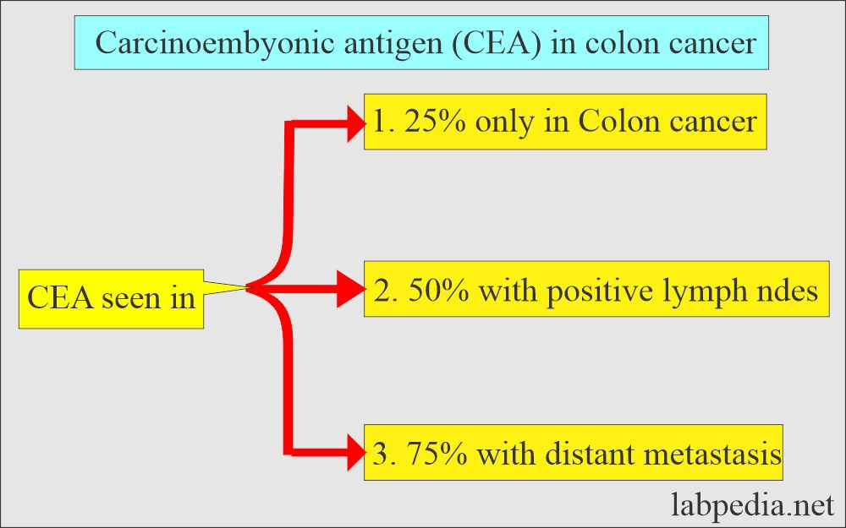
Colorectal Cancer Diagnosis and Screening
Carcinoembryonic Antigen (CEA)
CEA – A glycoprotein which is the most useful and widely investigated marker for colorectal cancer.
Both the proportion of patients with elevated levels and the extent of elevation are primarily dependent on disease stage.

Slide 24
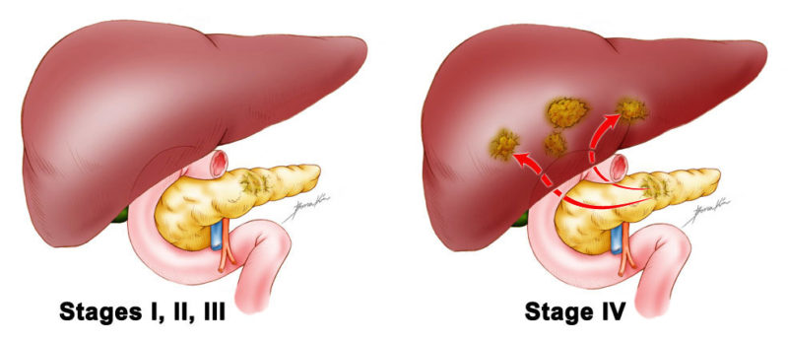
Pancreatic cancer - Diagnosis
CA 19-9
Most widely used tumor marker for pancreatic cancer
Mean specificity – 90%, sensitivity – 81%, using a cut-off point of 37 IU/ml

Slide 25
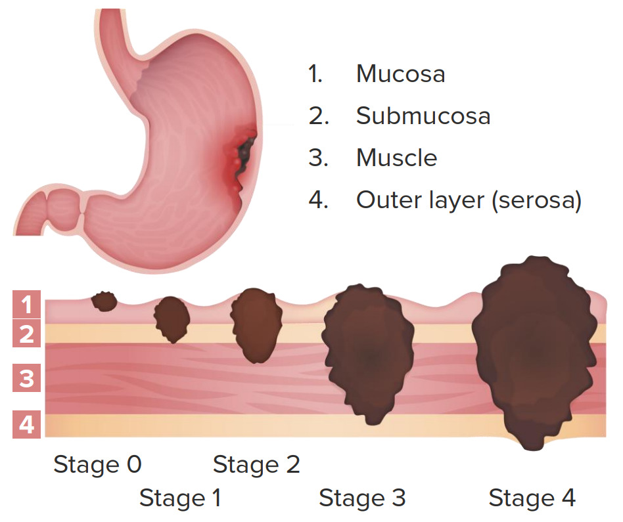
Gastric cancer
The most widely described markers for gastric cancer are CA19-9 and CA72-4.
CA72-4 appears to be the most sensitive and specific, followed by CA19-9.
Their role in the follow-up of patients with diagnosed disease remains to be evaluated.

Slide 26
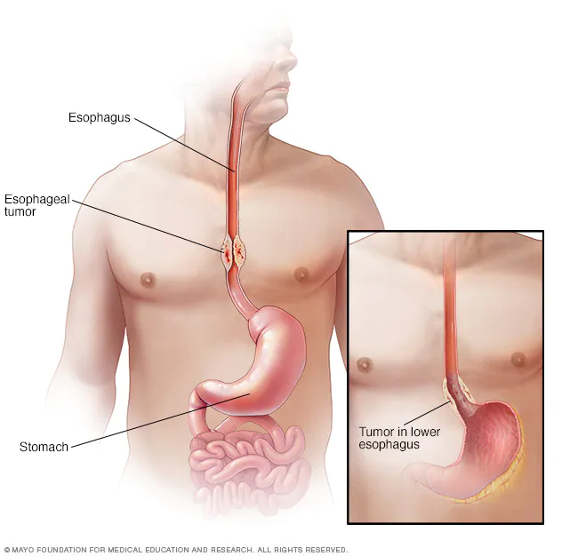
Esophageal cancer
Biochemical markers have been little investigated in esophageal cancer.
Preliminary data - best available markers for the squamous cell ca. are SCC and cytokeratins [ e.g ., CYFRA 21-1, TPA, TPS] ; CA19-9 - adenocarcinoma.
Presently, these markers are of little value in either the diagnosis or management of oesophageal cancer.

