Slide 1


Advanced Topics in
Biochemical Research
(BCH 604)
Professor Nasser M. Al-Daghri

Slide 2
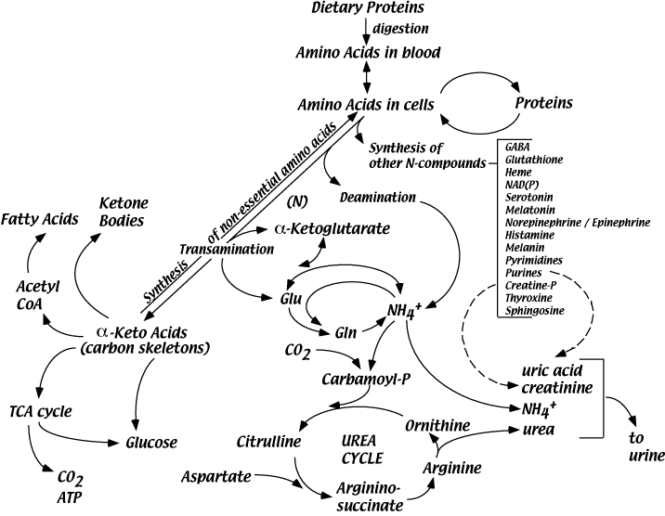
Nitrogen Metabolism
As one of the fundamental requirements for cell growth and proliferation, nitrogen acquisition and utilization must be tightly regulated.
Nitrogen can be generated from amino acids (AAs) and utilized for biosynthetic processes through transamination and deamination reactions.
Importantly, limitations of nitrogen availability in cells can disrupt the synthesis of proteins, nucleic acids, and other important nitrogen-containing compounds.
Kurmi and Haigis 2020; Trends in Cell Biology

Slide 3
Protein Degradation
• Endogenous proteins degrade continuously
- Damaged
- Mis-folded
- Un-needed
• Dietary protein intake - mostly degraded
Nitrogen Balance - expresses the patient’s current status - are they gaining or losing net Nitrogen?

Slide 4
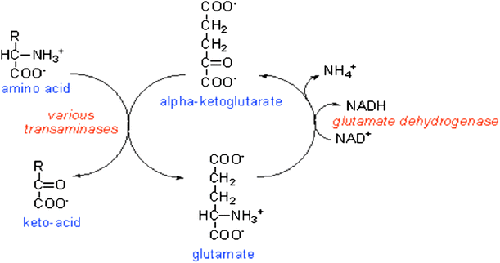
In peripheral tissues, transaminases tend to form Glutamate when they catabolize amino acids
In other words, alpha-ketoglutarate is the preferred acceptor, and Glutamate is the resulting amino acid:
Some amino acid + α-ketoglutarate → some alpha keto acid + Glutamate

Slide 5
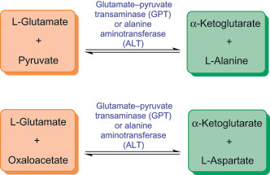
Glutamate can donate its amines to form other amino acids as needed.
A specific example - production of Aspartate in liver
Glutamate + oxaloacetate → α-ketoglutarate + aspartate

Slide 6
Nitrogen removal from amino acids
Step 1: Remove amino group
Step 2: Take amino group to liver for nitrogen excretion
Step 3: Entry into mitochondria
Step 4: Prepare nitrogen to enter urea cycle
Step 5: Urea cycle

Slide 7
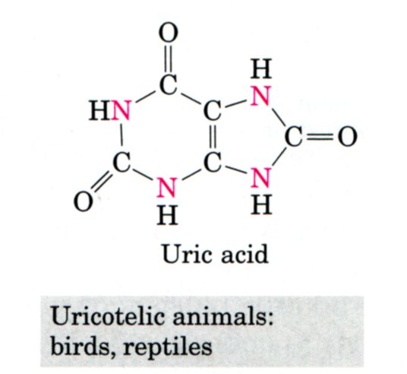
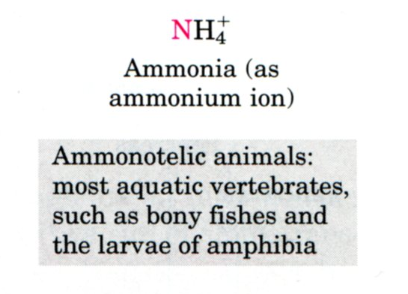
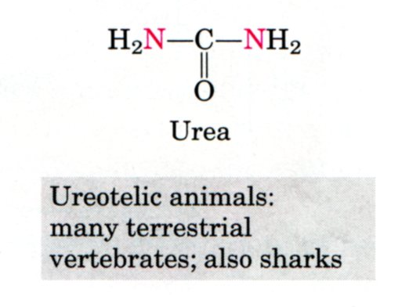
Excretory forms of nitrogen
Excess NH₄⁺ is excreted as ammonia (microbes, aquatic vertebrates or larvae of amphibia),
Urea (many terrestrial vertebrates)
or uric acid (birds and terrestrial reptiles)

Slide 8
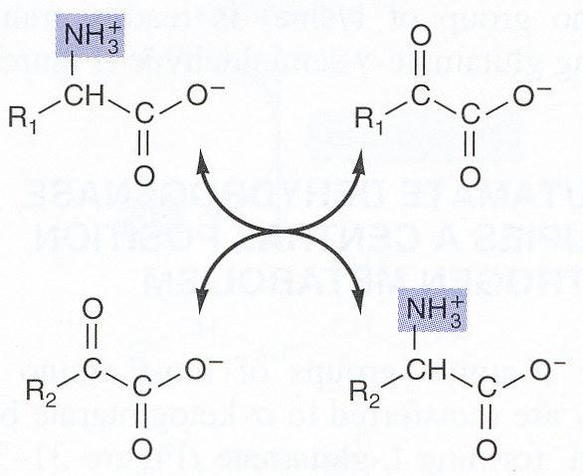
Step 1. Remove amino group
Transfer of the amino group of an amino acid to an α-keto acid ⇒ the original AA is converted to the corresponding α-keto acid and vice versa:

Slide 9
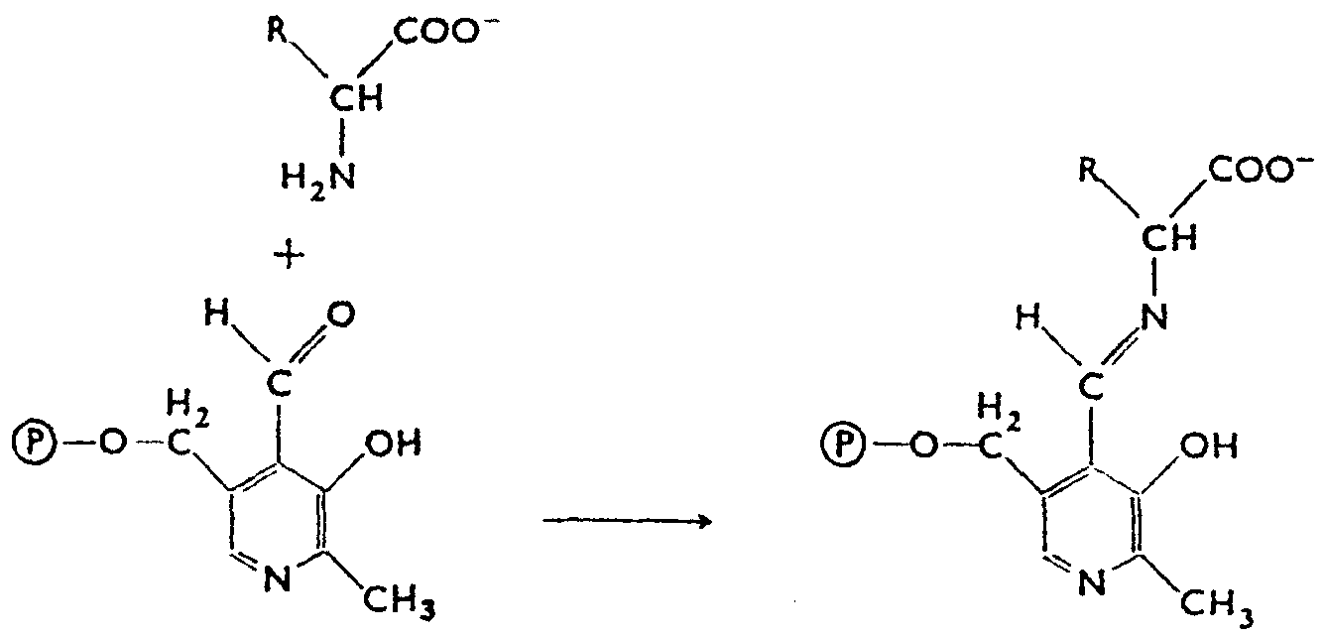
Transamination is catalyzed by transaminases (aminotransferases) that require participation of pyridoxalphosphate:
amino acid
pyridoxalphosphate
Schiff base

Slide 10
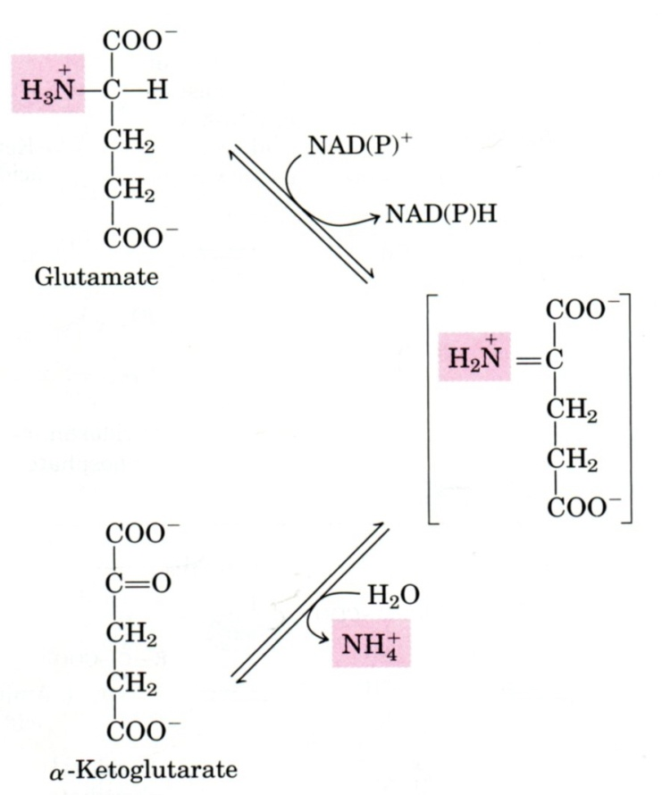
Step 2: Take amino group to liver for nitrogen excretion
Glutamate releases its amino group as ammonia in the liver.
The amino groups from many of the a-amino acids are collected in the liver in the form of the amino group of L-glutamate molecules.
Glutamate dehydrogenase
The glutamate dehydrogenase of mammalian liver has the unusual capacity to use either NAD⁺ or NADP⁺ as cofactor

Slide 11
Nitrogen carriers
1. Glutamate
transfers one amino group WITHIN cells:
Aminotransferase → makes glutamate from a-ketogluta-rate
Glutamate dehydrogenase → opposite
2. Glutamine
transfers two amino group BETWEEN cells → releases its amino group in the liver
3. Alanine
transfers amino group from tissue (muscle) into the liver

Slide 12
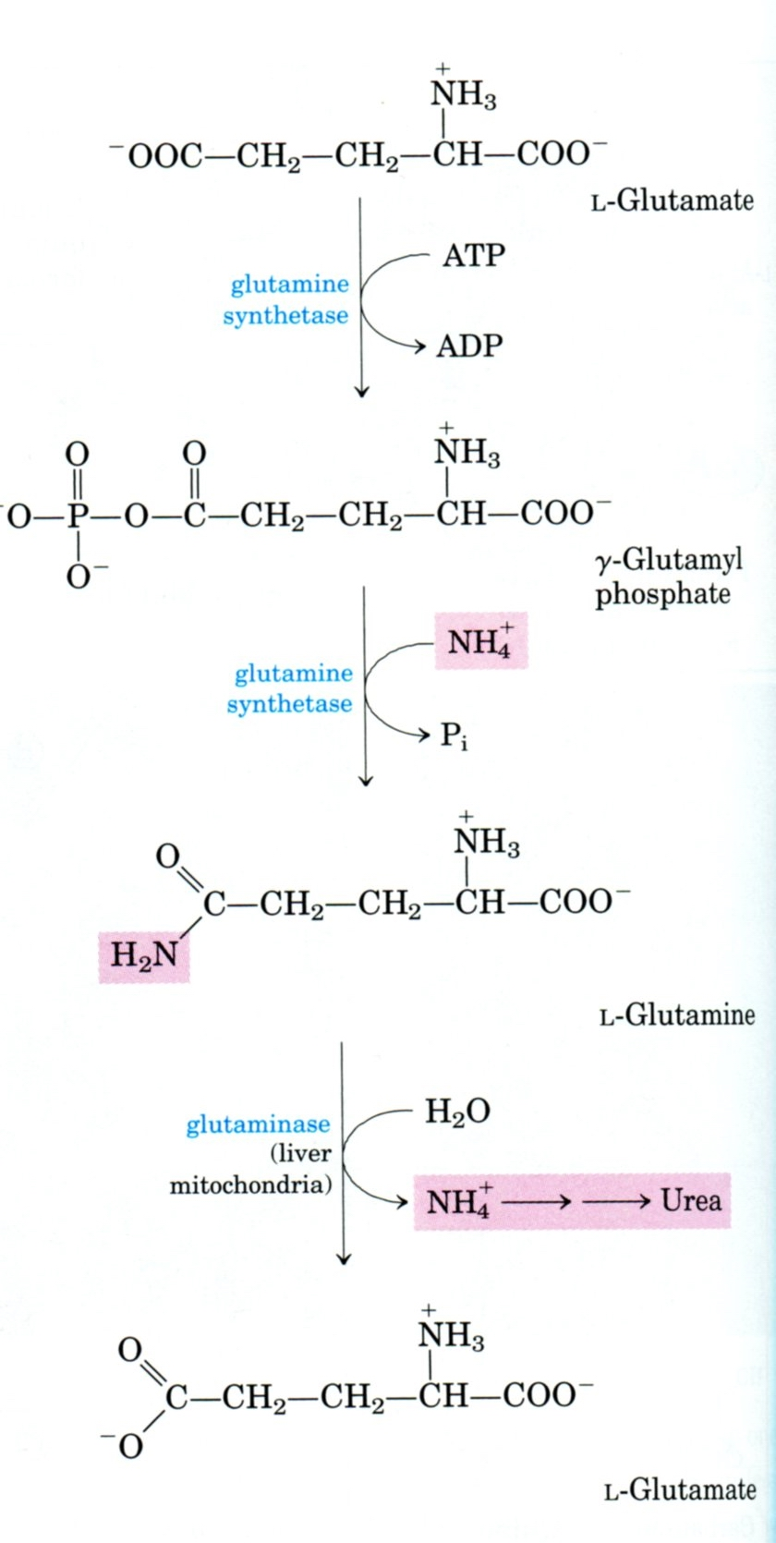
Move within cells
SynthAtase = ATP
Move between cells
In liver

Slide 13
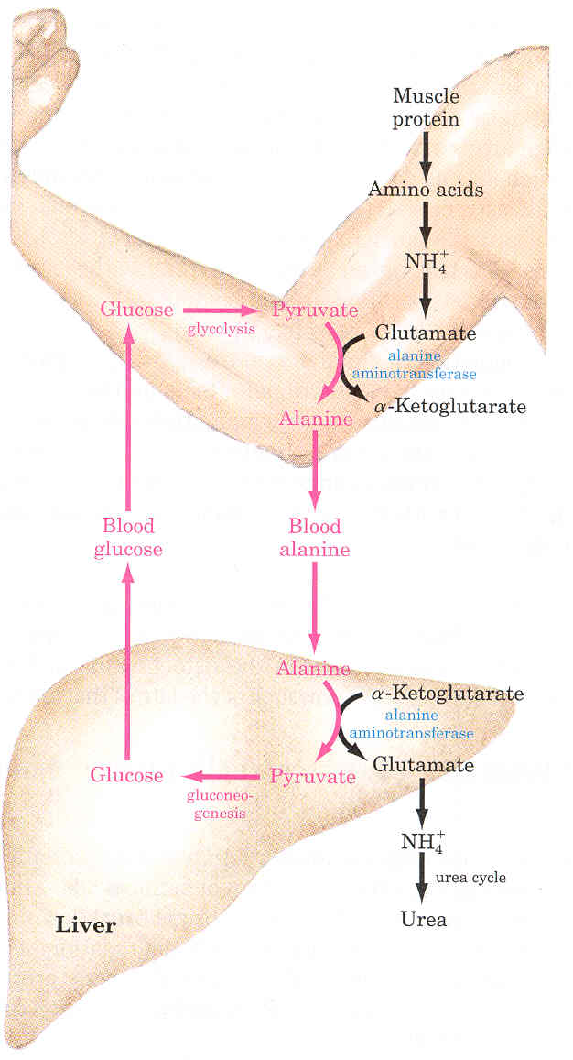
Glucose-alanine cycle
Alanine plays a special role in transporting amino groups to liver.
Ala is the carrier of ammonia and of the carbon skeleton of pyruvate from muscle to liver.
The ammonia is excreted and the pyruvate is used to produce glucose, which is returned to the muscle.
According to D. L. Nelson, M. M. Cox :LEHNINGER. PRINCIPLES OF BIOCHEMISTRY Fifth edition

Slide 14
Sources of ammonia for the urea cycle:
Oxidative deamination of Glu, accumulated in the liver by the action of transaminases and glutaminase
Glutaminase reaction releases NH₃ that enters the urea cycle in the liver (in the kidney, it is excreted into the urine)
Catabolism of Ser, Thr, and His (nonoxidative deamination) also releases ammonia:
Serine - threonine dehydratase
Serine →→ pyruvate + NH₄⁺
Threonine →→ a-ketobutyrate + NH₄⁺
Bacteria in the gut also produce ammonia.

Slide 15
Review
Nitrogen carriers  glutamate, glutamine, alanine
2 enzymes outside liver, 2 enzymes inside liver:
  Aminotransferase (PLP) → a-ketoglutarate → glutamate
  Glutamate dehydrogenase (no PLP) → glutamate → a-ketoglutarate (in liver)
  Glutamine synthase → glutamate → glutamine
  Glutaminase → glutamine → glutamate (in liver)

Slide 16
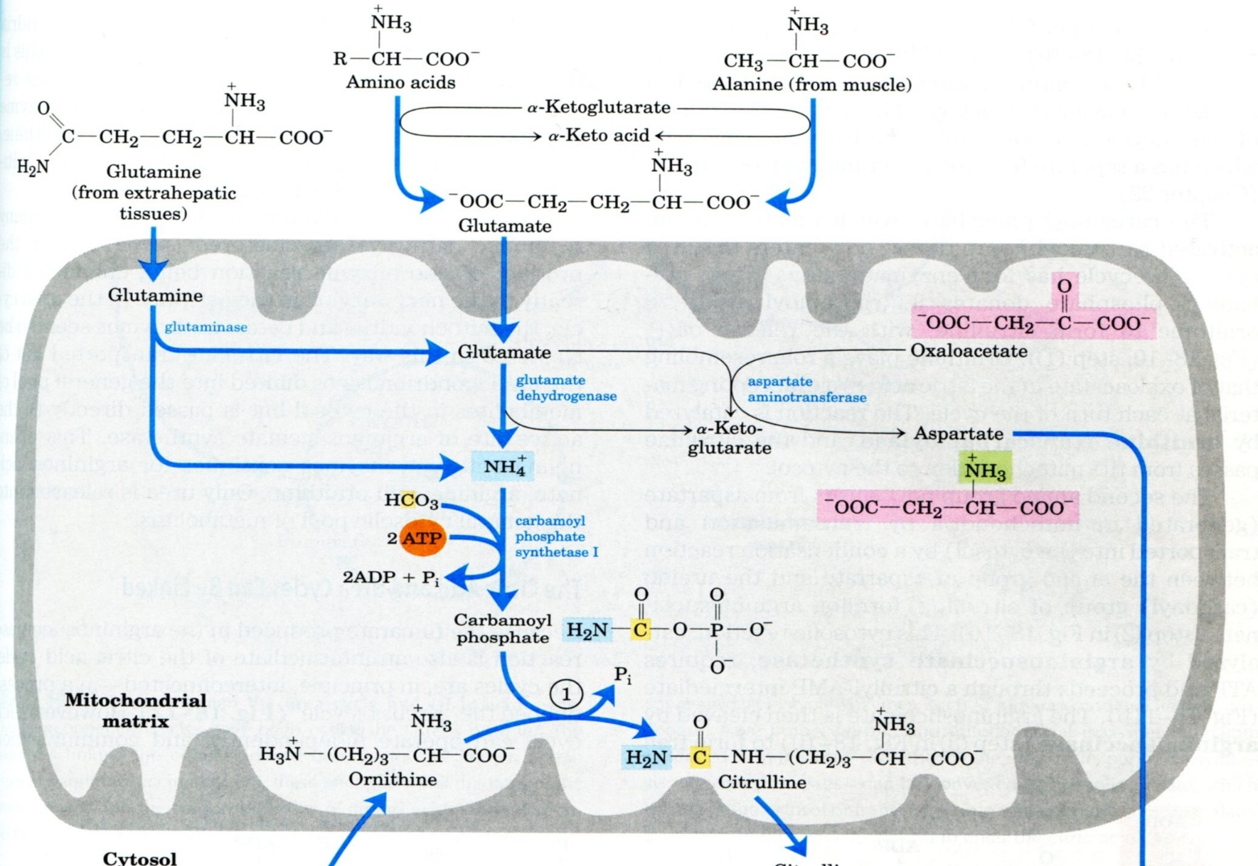
Step 3: Entry of nitrogen to mitochondria

Slide 17

Step 4: prepare nitrogen to enter urea cycle
Regulation

Slide 18
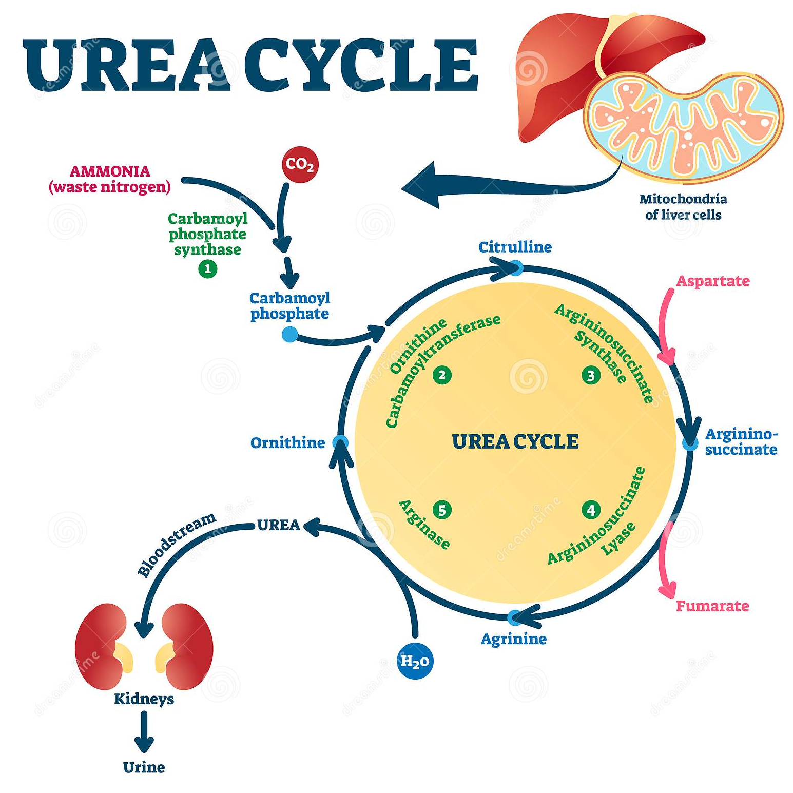
Step 5
Ammonia is formed by the breakdown of amino acids/gut bacteria.
The mitochondrial stage:
Carbamoyl phosphate is formed from ammonia and bicarbonate, by carbamoyl phosphate synthetase (CPS).
Ornithine transcarbamoylase (OTC) condenses carbamoyl phosphate and ornithine to form citrulline.
Citrulline is then transported to the cytosol by SLC25A15.
The cytosolic stage:
Argininosuccinate synthetase (AS) condenses citrulline and aspartate to form argininosuccinate.
Argininosuccinate is broken down into arginine and fumarate by argininosuccinate lyase (AL).
Arginine is broken down into urea and ornithine by arginase.
Ornithine translocase transports ornithine into the mitochondria.

