Slide 1


Advanced Topics in
Biochemical Research
(BCH 604)
Professor Nasser M. Al-Daghri

Slide 2
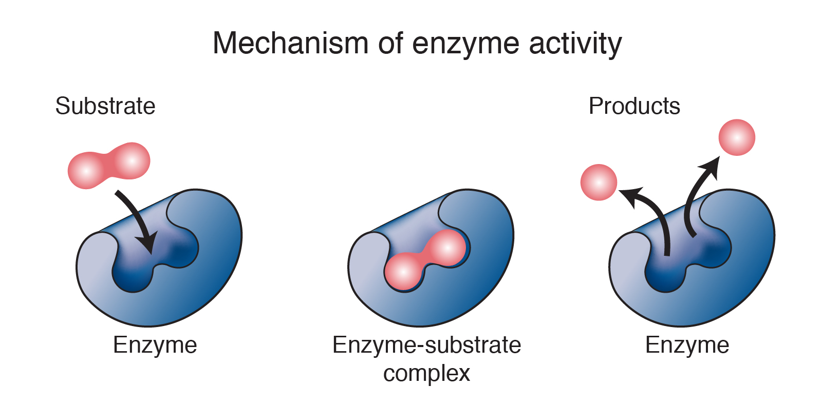
Enzyme Function
Enzymes are catalysts for chemical reactions in living things
They help speed up chemical reactions in the human body.
They bind to molecules and alter them in specific ways.
They are essential for respiration, digesting food, muscle and nerve function, among thousands of other roles.

Slide 3
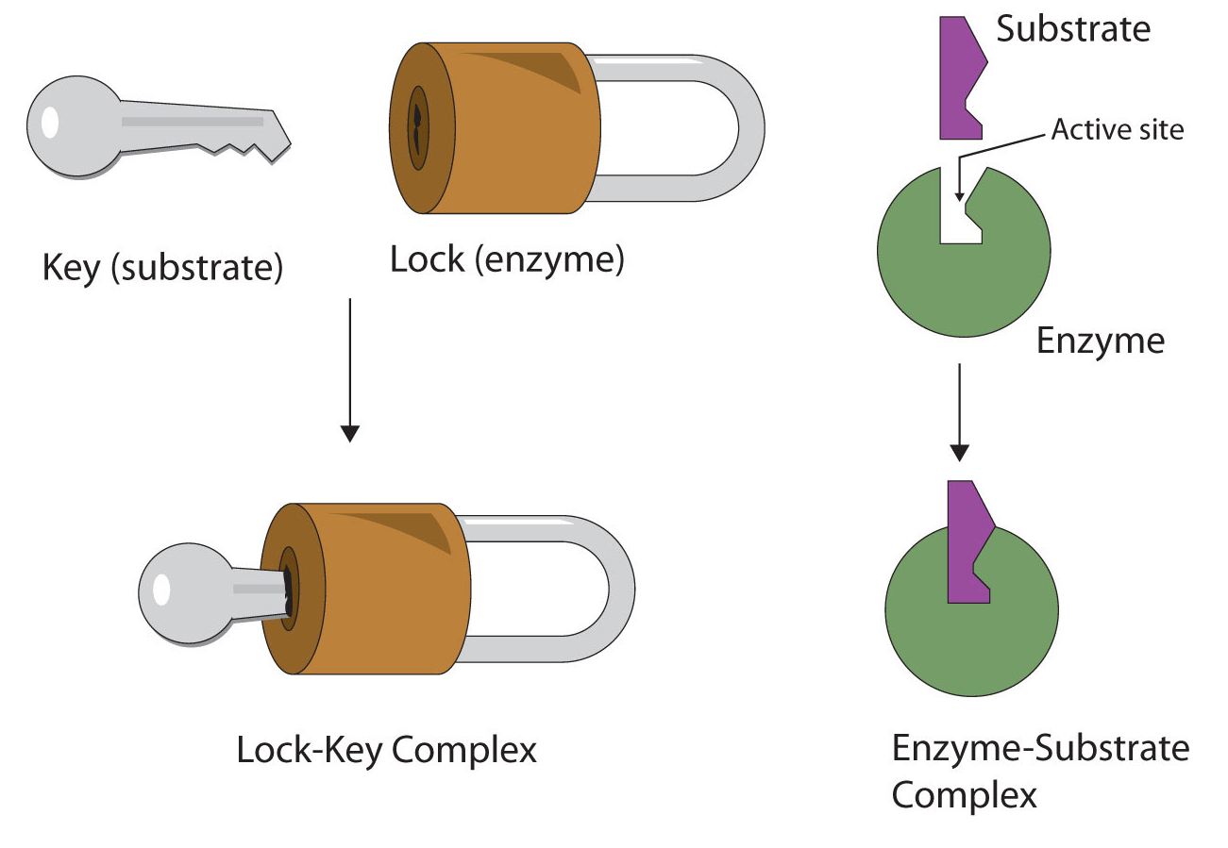
Enzyme working model : Lock and Key

Slide 4
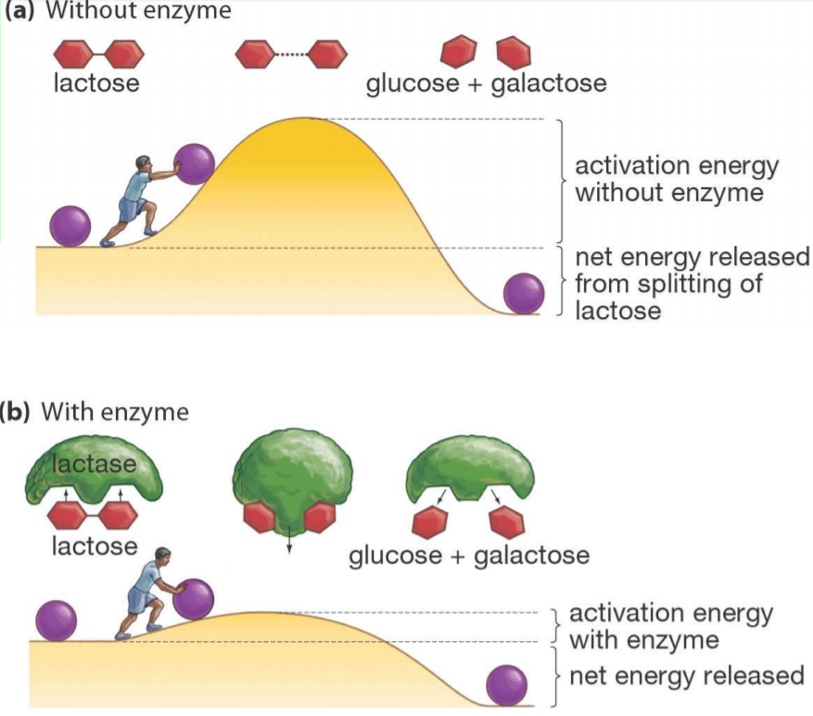
Enzyme : Reduced activation Energy (Lactose Example)

Slide 5

Holoenzyme:
Catalytically active enzyme–cofactor complex is called a holoenzyme.
Apoenzyme:
The enzymatically inactive protein resulting from the removal of a holoenzyme’s cofactor is referred to as an apoenzyme.
Flavin (Co-enzyme) + Inactivated Succinate dehydrogenase
(Apoenzyme)
Other examples are DNA Polymerase and RNA polymerase.
Activated Succinate dehydrogenase
(Holoenzyme)

Slide 6
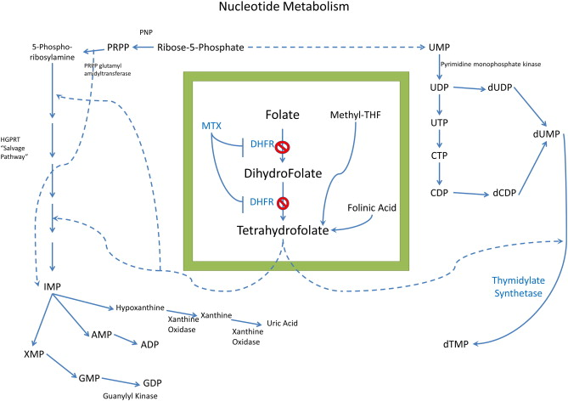
Inhibitor:
Many substances alter the activity of an enzyme by combining with it in a way that influences the binding of substrate and/or its turnover number. Substances that reduce an enzyme’s activity in this way are known as inhibitors.
Example:
Methotrexate (also called amethopterin) chemically resembles dihydrofolate. Methotrexate binds tightly to the enzyme dihydrofolate reductase, thereby preventing it from carrying out its normal function, the reduction of dihydrofolate to tetrahydrofolate, an essential cofactor in the biosynthesis of the DNA precursor dTMP.

Slide 7
Specificity of Enzyme
The noncovalent forces through which substrates and other molecules bind to enzymes are similar in character to the forces that dictate the conformations of the proteins themselves
Both involve van der Waals, electrostatic, hydrogen bonding, and hydrophobic interactions.
In general, a substrate- binding site consists of an indentation or cleft on the surface of an enzyme molecule that is complementary in shape to the substrate (geometric complementarity).
Moreover, the amino acid residues that form the binding site are arranged to interact specifically with the substrate in an attractive manner (electronic complementarity).

Slide 8
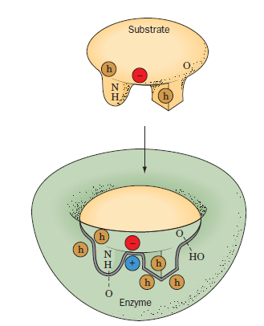
An enzyme–substrate complex illustrating both the geometric and the physical complementarity between enzymes and substrates. Hydrophobic groups are represented by an h in a brown circle, and dashed lines represent hydrogen bonds

Slide 9
Factors Affecting Enzymatic Activity
Factors Affecting Enzymatic Activity
Temperature & pH
Radiation & Light
Activators
End products concentration
Inhibitors
Enzyme & Substate concentration

Slide 10
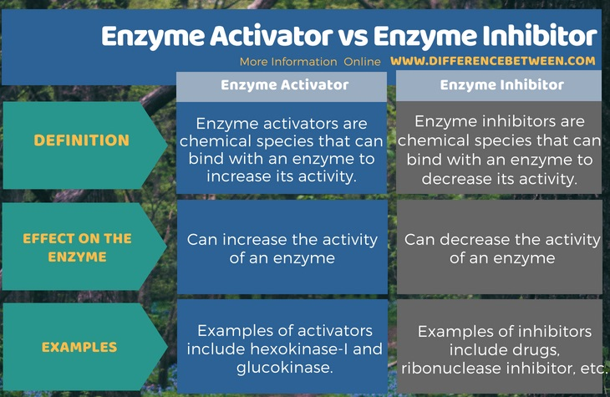

Slide 11
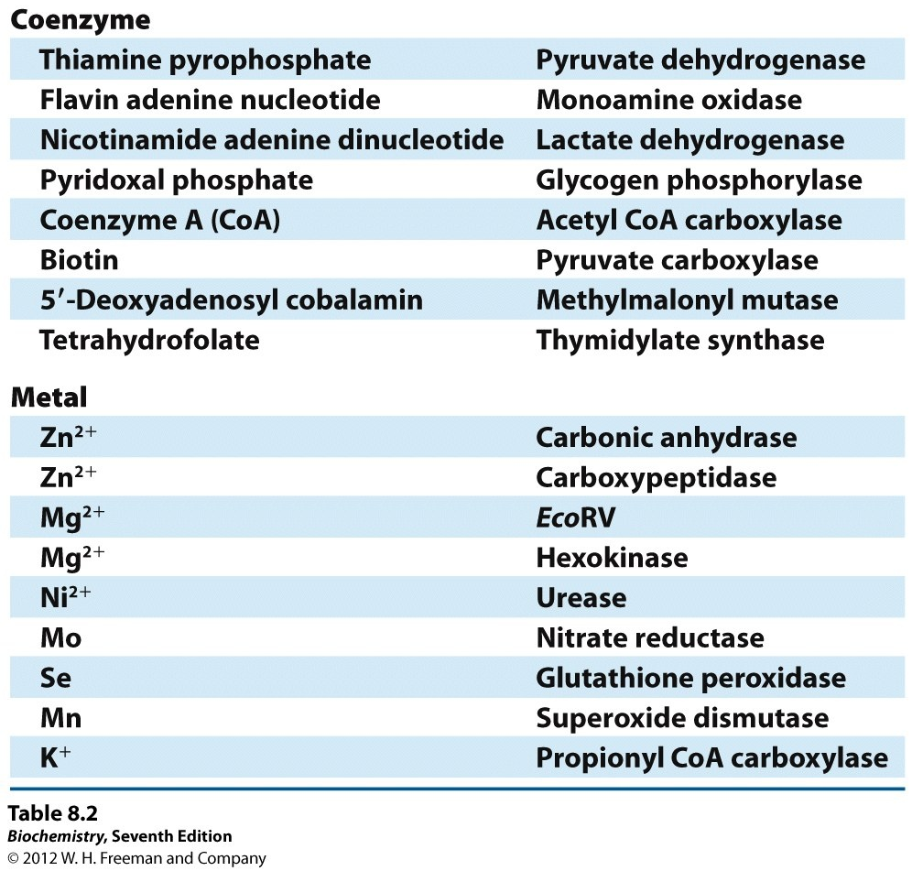
Enzyme co-factors

Slide 12
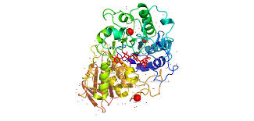

Slide 13
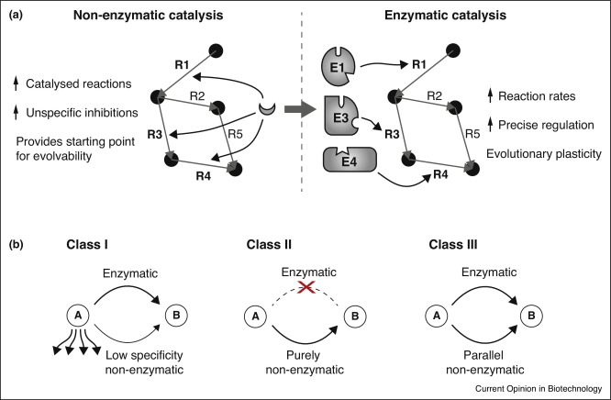
Non-enzymatic reactions in cellular metabolism.
(a) Evolution. Non-enzymatic reactions (R1, R3, R4, left panel) provide a template for the evolutionary selection of enzymes (E1, E3, E4). Enzymes can achieve higher substrate specificity and reaction rate, can be regulated and decrease the dependency on rare catalysts.
(b) Three classes of non-enzymatic reactions dominate in modern metabolism. The presence of enzymes does not prevent or replace non-enzymatic metabolic reactions, which divide into three classes: Class I reactions are non-specific and act on a broad range of substrates, Class II reactions are specific and occur exclusively non-enzymatic as part of the metabolic network, while Class III reactions occur simultaneously in an enzymatic and non-enzymatic manner.

Slide 14
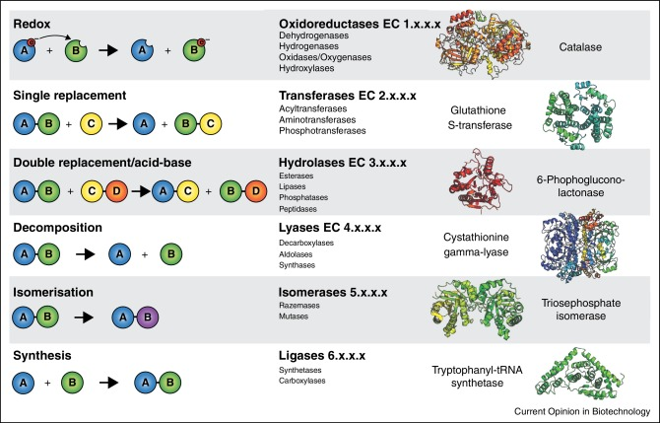
Class III non-enzymatic reactions occur in parallel to the six main classes of enzymes.
Non-enzymatic counterparts of six enzymes representatives to the six general chemical reaction types/main classes of enzymatic reactions (top hierarchical level of enzyme commission number).

Slide 15
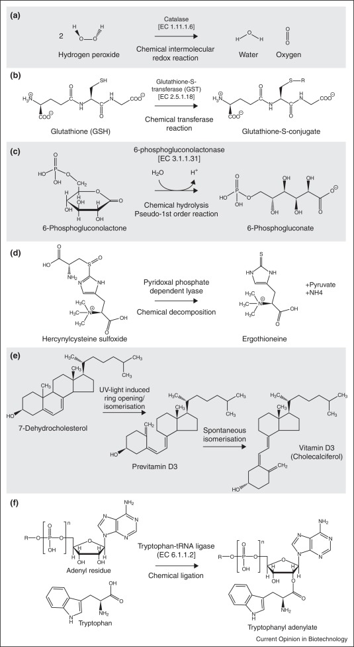
Examples for biologically important non-enzymatic chemical reactions.
(a) The intermolecular redox reaction of two hydrogen peroxide molecules into water and oxygen is catalyzed non-enzymatically or by catalase (EC 1.11.1.6).
(b) The thiol group of GSH is an acceptor of electrophiles allowing the formation of glutathione-S-conjugates, either non-enzymatically or through GSTs (EC 2.5.1.18).
(c) 6-phosphogluconolactone is hydrolyzed to 6-phosphogluconate in the PPP spontaneously, or through 6-phosphogluconolactonase (EC 3.1.1.31), whose main function is to prevent unwanted side-reactions.
(d) The final step in ergothioneine biosynthesis is the decomposition of hercynylcysteine sulfoxide either by a pyridoxal phosphate-dependent lyase, or non-enzymatically by pyridoxal phosphate alone.
(e) The two final steps in cholecalciferol (vitamin D₃) biosynthesis are non-enzymatic isomerizations, one UV-light dependent and one spontaneous. For both reactions no enzymatic counterpart is known (Class II reactions).
(f) Tryptophan-tRNA ligase or a non-enzymatic reaction conjugate tryptophan to its tRNA.

Slide 16
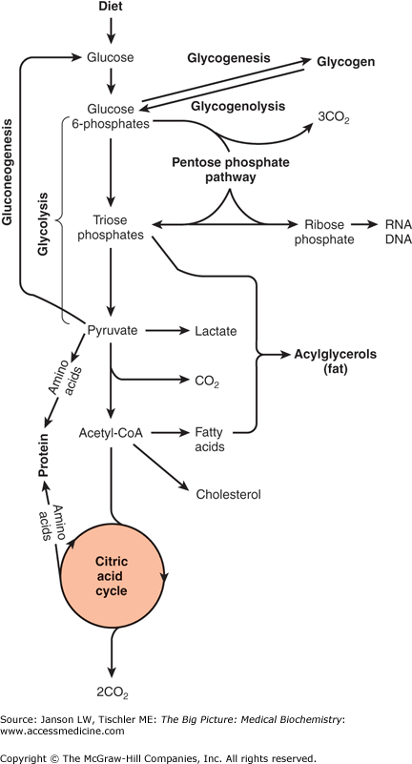
Carbohydrate Metabolism

Slide 17
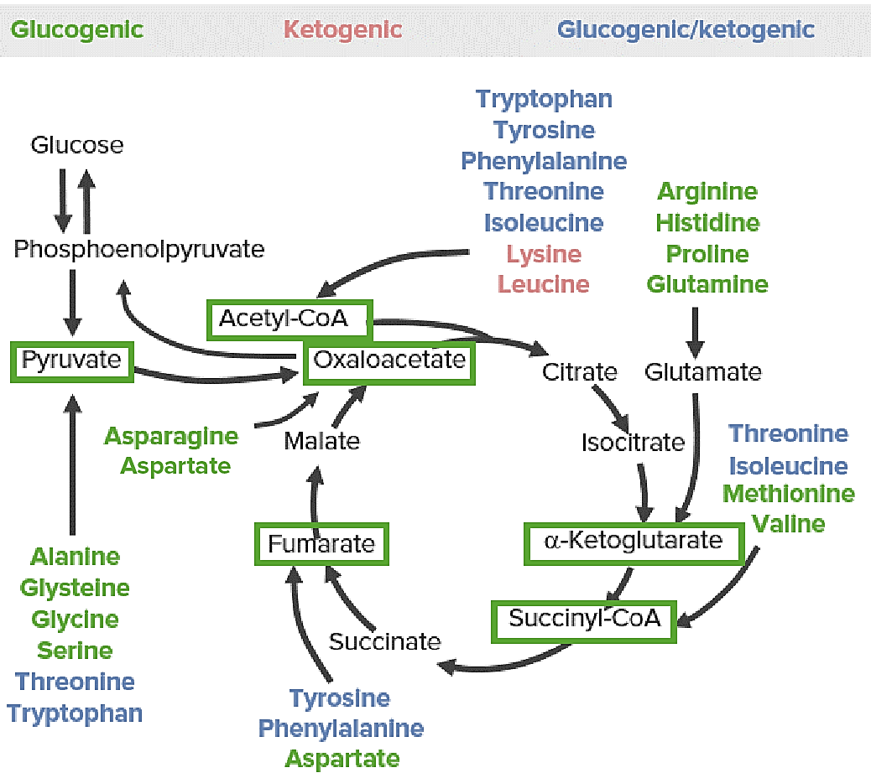
Protein Metabolism

Slide 18
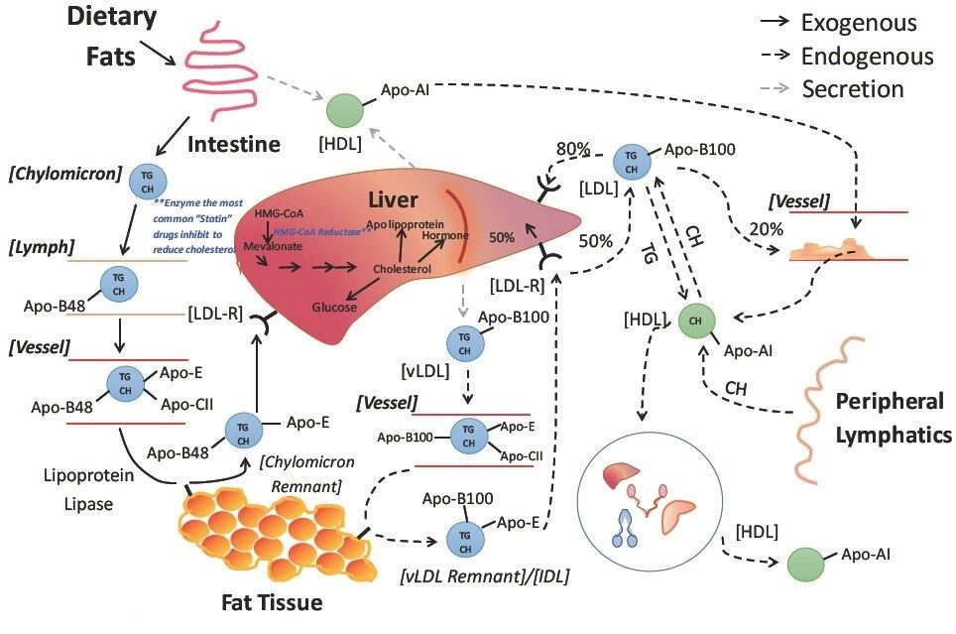
Lipid Metabolism

Slide 19
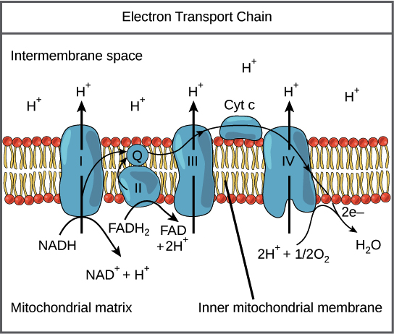
Oxidative Phosphorylation

Slide 20
Photosynthesis and Carbon Fixation

Slide 21
Nitrogen Metabolism

Slide 22
Integration of Metabolism

Slide 23
Nucleic Acids

Slide 24
Replication

Slide 25
Transcription

Slide 26
Cancer Biochemistry

