Slide 1
An Introduction to Enzymes

Slide 2
WHAT ARE ENZYMES?
Enzymes are biological catalysts. They increase the rate of chemical reactions taking place within living cells without themselves suffering any overall change. The reactants of enzyme-catalyzed reactions are termed substrates. Each enzyme is quite specific in character, acting on a particular substrate or substrates to produce a particular product or products.

Slide 3
Like all catalysts, enzymes do not change the position of equilibrium. That is, enzymes cannot make a reaction take place that would not occur without them. Instead, they increase the reaction rate: They cause reactions to take place faster by lowering the activation energy. As catalysts, enzymes are remarkable in two respects:
They are extremely effective, increasing reaction rates by anywhere from10⁹ to10²⁰ times.
Most of them are extremely specific

Slide 4
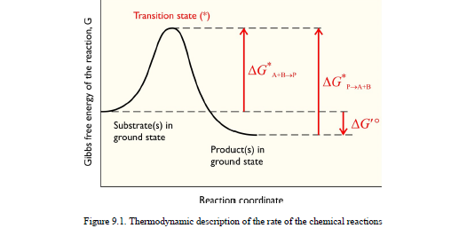

Slide 5
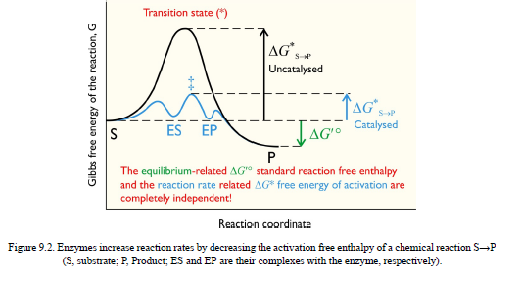

Slide 6
All enzymes are proteins. However, without the presence of a non-protein component called a cofactor, many enzyme proteins lack catalytic activity. When this is the case, the inactive protein component of an enzyme is termed the apoenzyme, and the active enzyme, including cofactor, the holoenzyme. The cofactor may be an organic molecule, when it is known as a coenzyme, or it may be a metal ion.
Some enzymes bind cofactors more tightly than others. When a cofactor is bound so tightly that it is difficult to remove without damaging the enzyme, it is sometimes called a prosthetic group.

Slide 7
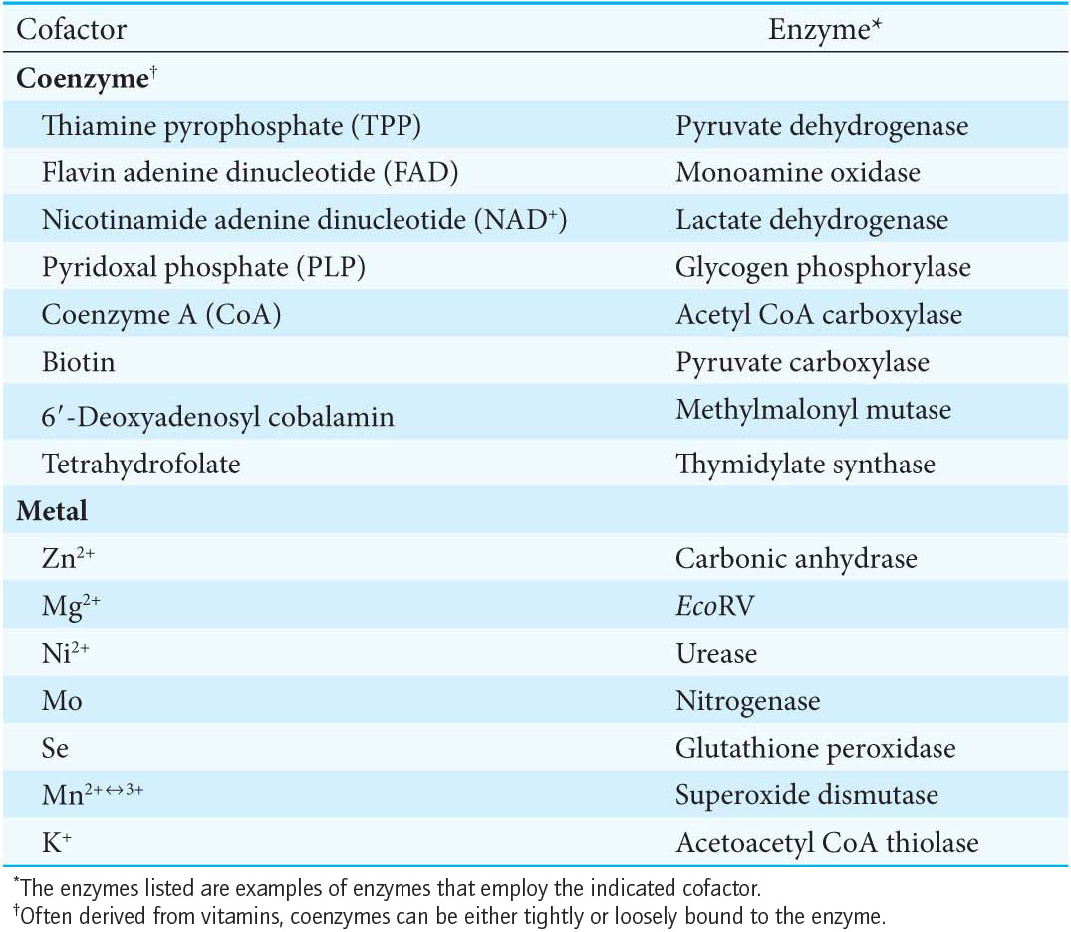

Slide 8
Cofactor The nonprotein part of an enzyme necessary for its catalytic function
Coenzyme A nonprotein organic molecule, frequently a B vitamin, that acts as a cofactor
Active site A three-dimensional cavity of the enzyme with specific chemical properties that enable it to accommodate the substrate
Inhibitor A compound that binds to an enzyme and lowers its activity

Slide 9
The compound on which the enzyme works, and whose reaction it speeds up, is called the substrate. The substrate usually binds to the enzyme surface
while it undergoes the reaction. The substrate binds to a specific portion of the enzyme during the reaction, called the active site. If the enzyme has coenzymes, they are located at the active site.
Therefore, the substrate is simultaneously surrounded by parts of the apoenzyme, coenzyme, and metal ion cofactor (if any).

Slide 10
Activation is any process that initiates or increases the action of an enzyme. It can be the simple addition of a cofactor to an apoenzyme or the cleavage of a polypeptide chain of a proenzyme .
Inhibition is the opposite-any process that makes an active enzyme less active or inactive.Inhibitors
are compounds that accomplish this task, and there are many types of enzyme inhibition.

Slide 11
Proenzyme (zymogen) A protein that becomes an active enzyme after undergoing a chemical change. Some enzymes are manufactured by the body in an inactive form. To make them active, a small part of their polypeptide chain must be removed. These inactive forms of enzymes are called proenzymes or zymogens. After the excess polypeptide chain is removed, the enzyme becomes active.

Slide 12
For example, trypsin is manufactured in the pancreas as the inactive molecule trypsinogen
(a zymogen). When a fragment containing six amino acid residues is removed from the N-terminal end, the molecule becomes a fully active trypsin molecule. Removal of the fragment not only shortens the chain, but also changes the three-dimensional structure
(the tertiary structure), thereby allowing the molecule to achieve its active form.

Slide 13
Why does the body go through so much trouble? Why not just make the fully active trypsin to begin with? The reason is very simple. Trypsin is a protease-it catalyzes the hydrolysis of peptide bonds -and is, therefore, an important catalyst for the digestion of the proteins we eat. But it would not be good if it cleaved the proteins of which our own bodies are made! Therefore, the pancreas makes trypsin in an inactive form; only after trypsin enters the digestive tract does it become active.

Slide 14
The Enzyme Commission's system of classification

Slide 15
The Enzyme Commission's system of classification
The Enzyme Commission divided enzymes into six main classes, on the basis of the total reaction catalyzed. Each enzyme was assigned a code number, consisting of four elements, separated by dots. The first digit shows to which of the main classes the enzyme belongs, as follows:

Slide 16
Enzymes can be classified into six major groups according to the type of reaction they catalyze :
1. Oxidoreductases catalyze oxidations and reductions.
2. Transferases catalyze the transfer of a group of atoms, such as from one molecule to another.
3. Hydrolases catalyze hydrolysis reactions.
4. Lyases catalyze the addition of two groups to a double bond or the removal of two groups from adjacent atoms to create a double bond.
5. Isomerases catalyze isomerization reactions.
6. Ligases, or synthetases, catalyze the joining of two molecules.

Slide 17
Oxidoreductase catalyze oxidation-reduction reactions.
Transferases move functional groups between molecules.
Hydrolyases cleave bonds with the addition of water.
Lyases remove atoms to form double bonds or add atoms to double bonds.
Isomerases move functional groups within a molecule.
Ligases join two molecules at the expense of ATP.

Slide 18
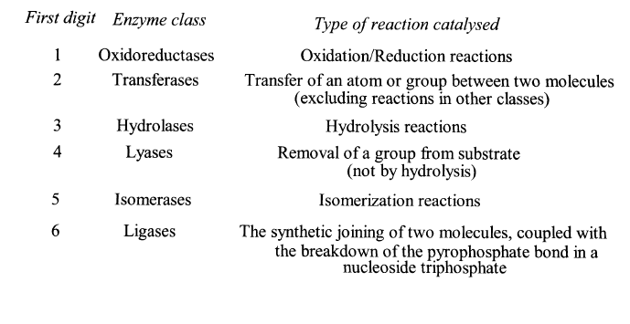

Slide 19
The six main classes of enzymes
Main Class 1: Oxidoreductases
These enzymes catalyze the transfer of H atoms, 0 atoms or electrons from one substrate to another. The second digit in the code number of oxidoreductases
indicates the donor of the reducing equivalents (hydrogen or electrons) involved in the reaction. For example:

Slide 20
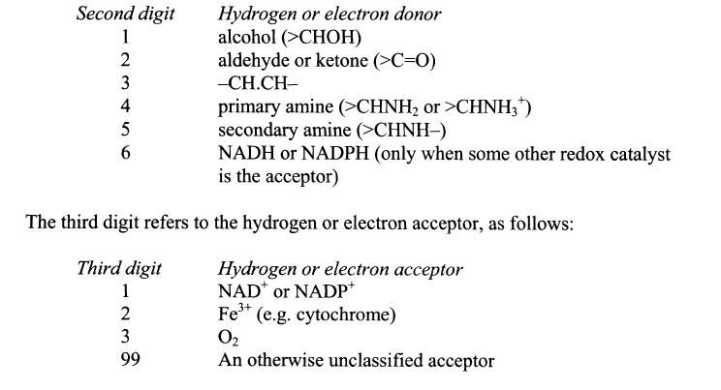

Slide 21
Main Class 2: Transferases
These catalyze reactions of the type:
AX+ B ↔ BX + A
but specifically exclude oxidoreductase and hydrolase reactions. In general, the Enzyme Commission recommends that the names of transferases should end 'Xtransferase', where X is the group transferred, although a name ending 'trans-X-ase‘ is an acceptable alternative. The second digit in the classification describes the type of group transferred. For example:

Slide 22
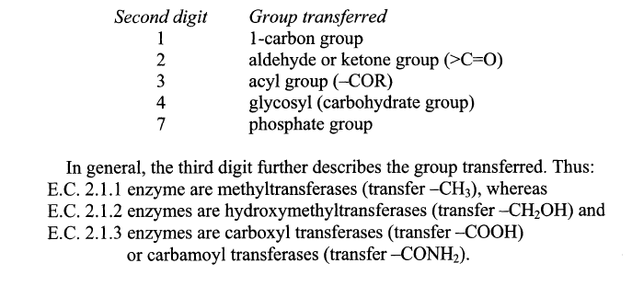

Slide 23
Similarly,
E.C. 2.4.1 enzymes are hexosyltransferases (transfer hexose units), and
E.C. 2.4.2 enzymes are pentosyltransferases (transfer pentose units).
The exception to this general rule for transferases is where there is transfer of phosphate groups: these cannot be described further, so there is opportunity to indicate the acceptor.
E.C. 2.7.l enzymes are phosphotransferases with an alcohol group as acceptor,
E.C. 2.7.2 enzymes are phosphotransferases with a carboxyl group as acceptor,
E.C. 2.7.3 enzymes are phosphotransferases with a nitrogenous group as acceptor.
Phosphotransferases usually have a trivial name ending in '-kinase'.

Slide 24
Main Class 3: Hydrolases
These enzymes catalyse hydrolytic reactions of the form:
A-X + H₂0 ↔ X-OH + HA
They are classified according to the type of bond hydrolyzed. For example:
Second digit Bond hydrolysed
ester
glycosidic (linking carbohydrate units)
4 peptide (-CONH-)
5 C-N bonds other than peptides

Slide 25
The third digit further describes the type of bond hydrolysed. Thus:
E.C. 3.1.1 enzymes are carboxylic ester (-COO-) hydrolases,
E.C. 3.1.2 enzymes are thiol ester (-COS-) hydrolases,
E.C. 3.1.3 enzymes are phosphoric monoester ( -O – PO₃) hydrolases,
E.C. 3.1.4 enzymes are phosphoric diester ( -O-PO₂ -O-) hydrolases.

Slide 26
Main Class 4: Lyases
These enzymes catalyze the non-hydrolytic removal of groups from substrates, often leaving double bonds.
The second digit in the classification indicates the bond broken, for example:
Second digit Bond broken
1 C-C
2 C-O
3 C-N
4 C-S

Slide 27
The third digit refers to the type of group removed. Thus, for the C-C lyases:
Third digit Group removed
1 carboxyl group (i.e. CO₂)
2 aldehyde group (-CH=O)
3 ketoacid group ( -CO.CO₂)

Slide 28
Main Class 5: Isomerases
Enzymes catalyzing isomerization processes are classified according to the type of
reaction involved. For example:
Second digit Type of reaction
Racemization or epimerization (inversion
at an asymmetric carbon atom)
2 cis-trans isomerization
3 intramolecular oxidoreductases
4 intramolecular transfer reaction

Slide 29
The third digit describes the type of molecule undergoing isomerization. Thus,
for racemases and epimerases:
Third digit Substrate
1 amino acids
2 hydroxy acids
3 carbohydrates
An example is alanine racemase (E.C. 5.1.1.1) which catalyses:
L-alanine ↔ D-alanine

Slide 30
Main Class 6: Ligases
These enzymes catalyze the synthesis of new bonds, coupled to the breakdown of ATP or other nucleotide triphosphates. The reactions are of the form:
X + Y + ATP ↔ X-Y + ADP + P_{i}
or X + Y + ATP ↔ X-Y + AMP + (PP)_{i}
The second digit in the code indicates the type of bond synthesized. For example:
Second digit Bond synthesized
1 C-O
2 C-S
3 C-N
4 C-C

Slide 31
The third digit further describes the bond being formed. Thus
E.C. 6.3.l enzymes are acid-ammonia ligases (amide, -CONH₂ , synthases) and E.C. 6.3.2 enzymes are acid-amino acid ligases
(peptide, -CONH-, synthases).
Prior to 1984, such enzymes could also be known as synthetases.

Slide 32
Enzymes bring substrates together to form an enzyme-substrate complex on a particular region of the enzyme called the active site.
The interaction of the enzyme and substrates at the active site promotes the formation of the transition state.

Slide 33
The active site is a three-dimensional cleft or crevice created by amino acids from different parts of the primary structure.
The active site constitutes a small portion of the enzyme volume.
Active sites create unique microenvironments.
The interaction of the enzyme and substrate at the active site involves multiple weak interactions.
Enzyme specificity depends on the molecular architecture at the active site.

Slide 34
Enzymes do not interact with their substrates like a lock and key.
Rather, the enzyme changes shape upon substrate binding, a phenomenon called induced fit.

Slide 35
THE FISCHER 'LOCK-AND-KEY' HYPOTHESIS

Slide 36
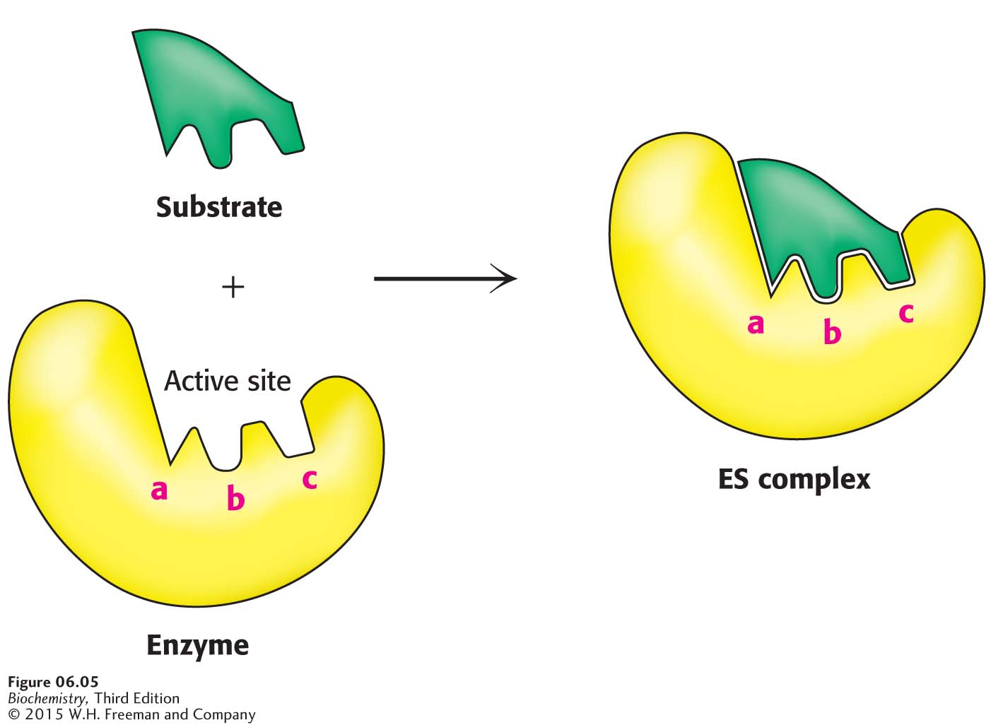
Notes:
Figure 6.5 Lock-and-key model of enzyme–substrate binding. In this model, the active site of the unbound enzyme is complementary in shape to the substrate.

Slide 37
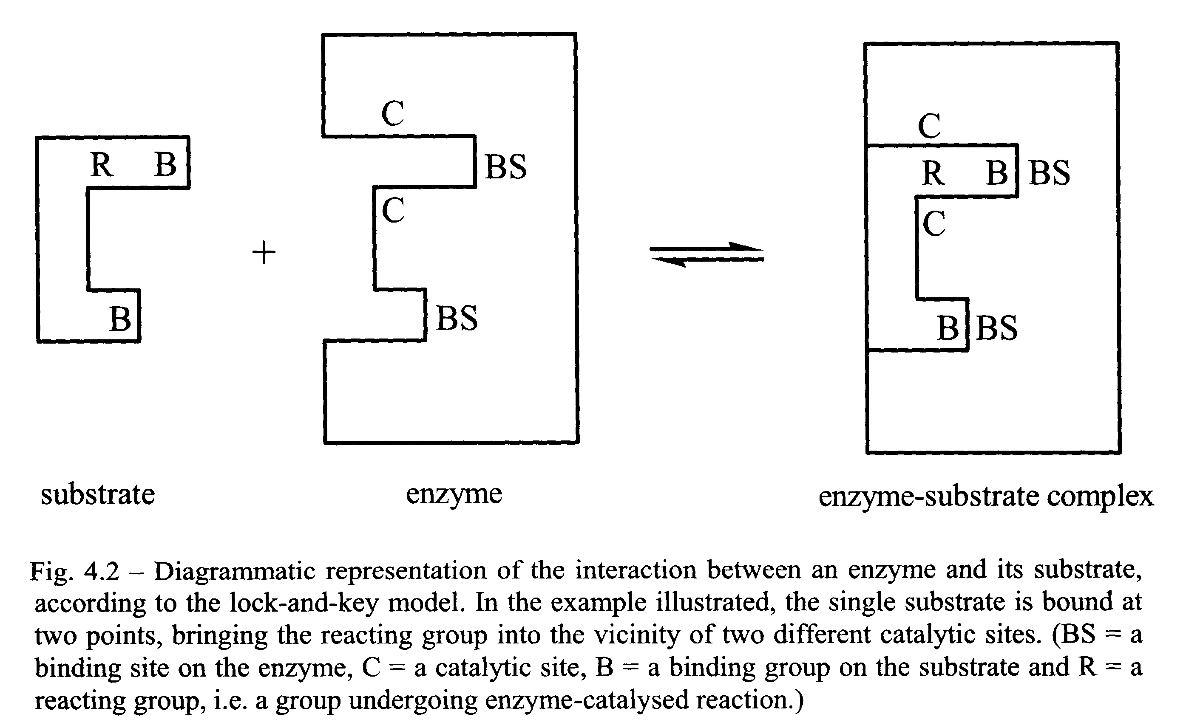

Slide 38
THE KOSHLAND 'INDUCED-FIT' HYPOTHESIS

Slide 39
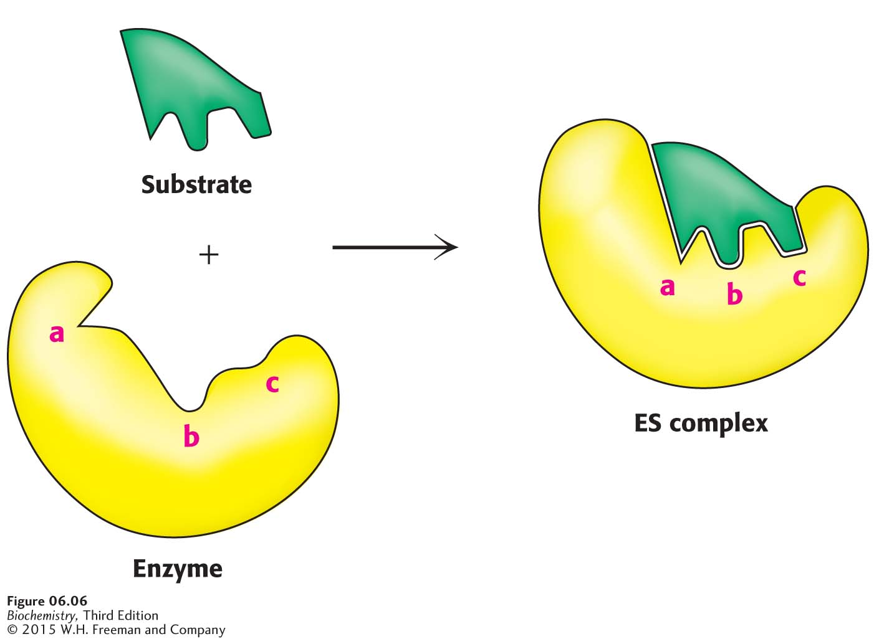
Notes:
Figure 6.6 Induced-fit model of enzyme–substrate binding. In this model, the enzyme changes shape on substrate binding. The active site forms a shape complementary to the substrate only after the substrate has been bound.

Slide 40
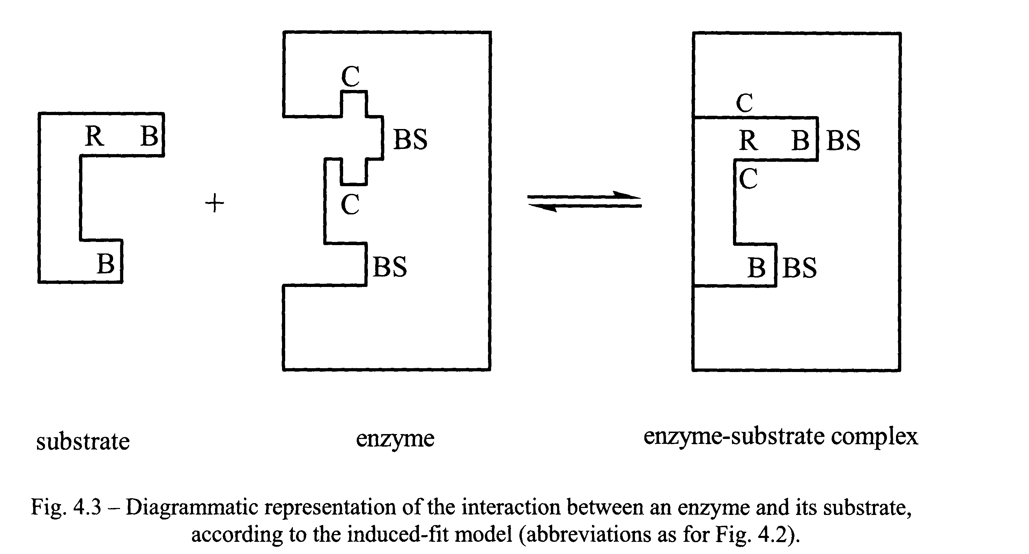

Slide 41
Binding energy is the free energy released upon interaction of the enzyme and substrate.
Binding energy is greatest when the enzyme interacts with the transition state, thus facilitating the formation of the transition state.

