Slide 1
BARIUM MEAL
Manal ALOsaimi

Slide 2
Introduction
Is a radiologic examination of the Upper GI tract. It consists of a series of X-ray images of the esophagus, stomach and duodenum.

Slide 3
These problems can be detected with a BARIUM MEAL:
An upper GI series can be used to help determine the cause of:
abdominal pain
nausea
vomiting
gastroesophageal reflux: a condition in which food and digestive juices rise from the stomach into the esophagus
unexplained weight loss

Slide 4
To Prepare:
No eating or drinking is allowed for 8 hours before the procedure.
If you are pregnant, or think you might be, tell the staff before the x-ray is taken.
Patients should tell their doctor about all health conditions they have especially allergies to medications or foods.

Slide 5
Technique
Double Contrast
Demonstrate Mucosal Pattern
Single Contrast
Children
very ill. patient

Slide 6
Patient positions
RAO (recumbent)
PA(recumbent) PRONE
AP(recumbent)
SUPINE
LPO (recumbent)
RT LAT
(recumbent)

Slide 7
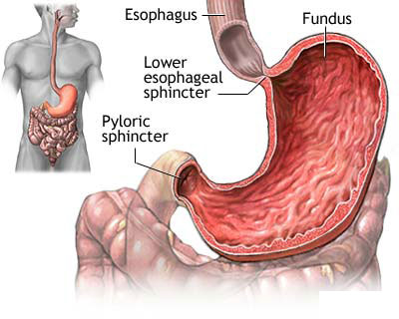
Anatomy:

Slide 8
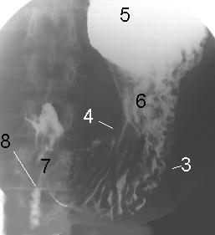
Anatomy:
Greater curvature (3)
Lesser curvature (4)
Fundus (5)
Body (6)
Pyloric region (7)
Duodenum (8)

Slide 9
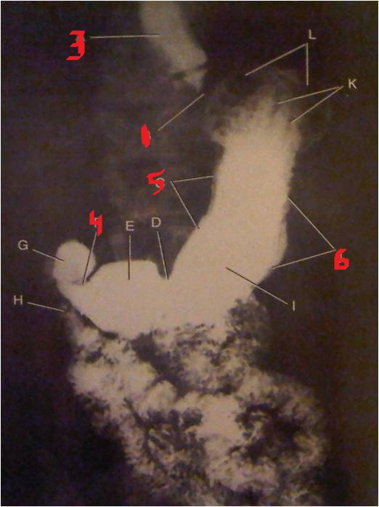
Anatomy:
1- cardiac orifice (esophagogastric junction): opening between the esophagus and the stomach.
3-distal esophagus.
4-pyloric valve or sphincter: distal opening of the stomach.
5- lesser curvature: medial border of the stomach, extends between the cardiac and pyloric openings.
6-greater curvature: lateral border of the stomach, four or five times longer than the lesser curvature.

Slide 10
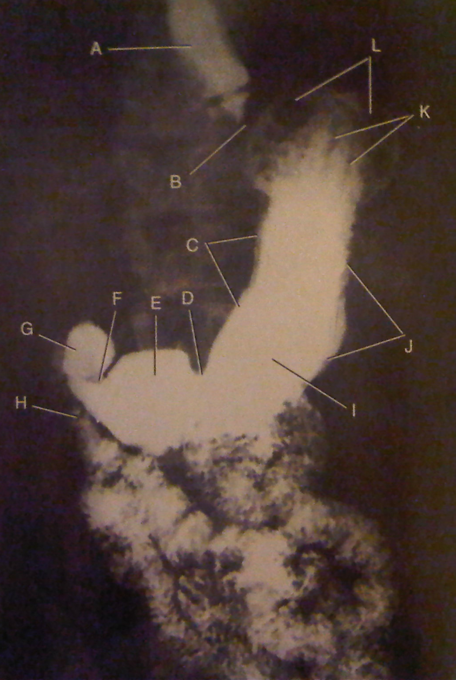
Anatomy:
Distal esophagus
Esophagogastric junction (cardia orifice)
Lesser curvature
Angular notch
Pylorus of stomach
Pyloric valve
Duodenal bulb of the duodenum
Descending portion of the duodenum
Body of stomach
Greater curvature of stomach
Gastric folds
Fundus of stomach

Slide 11
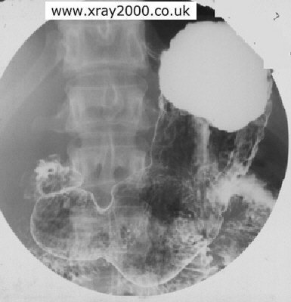
Barium Meal, Double Contrast
(Supine Position)
Supine Position:
Note Barium Distribution in the Fundus due to gravity
Angular Notch
Incisura Angularis
Pylorus of stomach
Body

Slide 12
Air-Barium Distribution in the Stomach
Gas
Ba
Gas
Ba

Slide 13
Fundus
When the pt is
(AP recumbent)
Supine position
Most posterior part
(PA recumbent)
Prone position
Highest part
Erect (upright) position
Filled with Ba
Filled with air
Highest part
Filled with air
Pylorus filled with Ba
The air-fluid level is a straight line

Slide 14
Ba in Fundus
SUPINE
(AP recumbent)
LPO recumbent

Slide 15
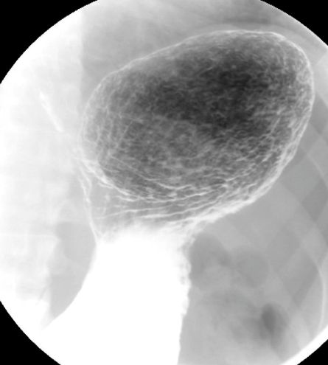
Air in Fundus
Erect
Air-fluid level straight
RAO
recumbent

Slide 16
Air in Fundus
Prone
PA recumbent

Slide 17
Thank you

