Slide 1
Antipsychotic Drugs
PHL. 322
Final lab
Presented by
Mohammed Alyami
Teaching assistant
Department of pharmacology & Toxicology
College of pharmacy
KSU

Slide 2
Antipsychotic drugs
Used to
treat schizophrenia
Antischizophrenia drugs
Neuroleptic drugs
Major tranquilizers

Slide 3
Schizophrenia
Split
Mind
Describe the fragmented thinking of people with the disorder
Is a serious brain illness which are characterized by severe problems with a person’s
thoughts,
feelings,
behavior,
and use of words and language.
Notes:
His term was not meant to convey the idea of split or multiple personality, a common misunderstanding by the public at large

Slide 4
Neuroleptic drugs
Typical
(classic drug)
Phenothiazines class
Thioxanthenes
class
Atypical
(newer agent)
Heterocyclic structure
Butyrophenones
class
Chlorpromazine
Thioridazine
Fluphenazine
Thiothixene
Haloperidol
Clozapine
Olanzapine
Quetiapine
Risperidone
Ziprasidone

Slide 5
What do all antipsychotic in have common?
They reduce dopaminergic neurotransmission

Slide 6
Dopaminergic pathway in CNS
We will discuss only two pathways
Mesolimbic pathway
Mesocortical pathway

Slide 7
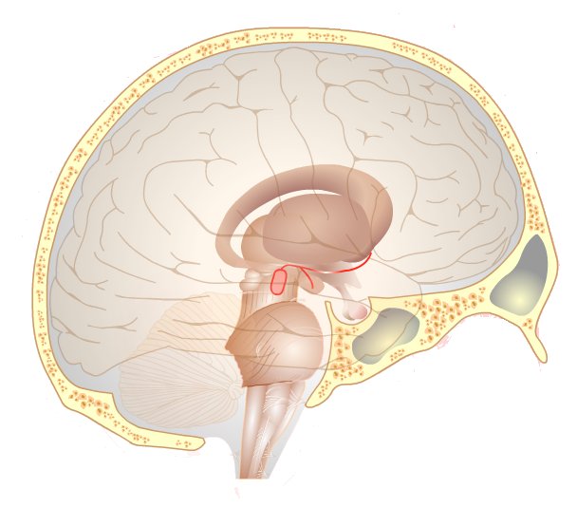
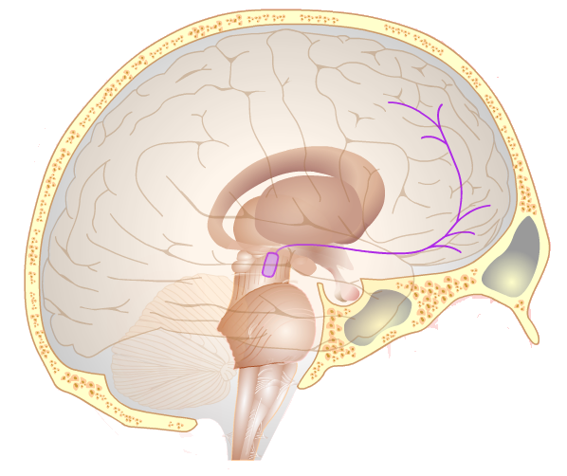
Mesolimbic pathway
Mesocortical pathway
Diminished activity implicated in :
Negative symptoms of schizophrenia e.g.
Restrictions in
emotion,
thought,
speech,
pleasure and attention.
Excess activity implicated in:
Positive symptom schizophrenia
e.g.
- hallucinations
- delusions

Slide 8
What do all antipsychotic in have common?
They reduce dopaminergic neurotransmission

Slide 9
Typical is D2 antagonist
Atypical is serotonin-dopamine antagonist
high affinity to D2
Low affinity to D2
high affinity to 5-HT2A
Typical
Atypical
Atypical
D2 receptor
-
D2 receptor
-
-
5-HT2A receptor
Binding to D2 receptor
(tight)
Binding to D2 receptor
(loose)
Atypical dissociate rapidly from D2 receptor

Slide 10
Atypical dissociate rapidly from D2 receptor
Dopamine
Atypical
-
D2 receptor
Loose binding

Slide 11
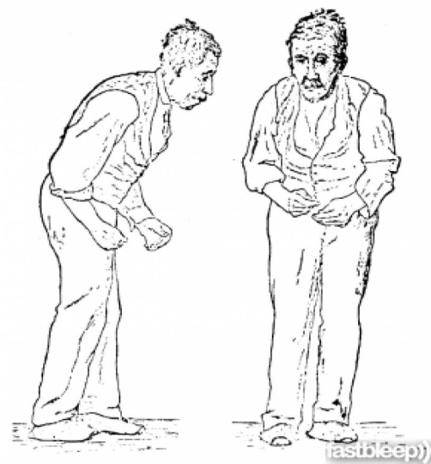
High occupancy for D2
High EPS risk
Antipsychotic efficacy
78%
D2 occupancy
60%
75%
EPS
Which has more EPS risk typical or atypical neuroleptic? And Why?

Slide 12
Summary
Atypical neuroleptic | Typical neuroleptic
5-HT2A antagonist D2 antagonist Rapid D2 Dissociate | D2 antagonist | MOA
Antagonism of H1, M1, 5-HT2c, alpha 1 receptor , among other | Antagonism of H1, M1, alpha-1 receptor , among other | Other effect

Slide 13
The Swimming Test (Behavioral despair test )
Shows promising potential as a screening for novel Antidepressants
May be to understand pathophysiology of depression
Characterized by
Depression
A lack of motivation
Increase despair
decrease mobility
Increase immobility

Slide 14
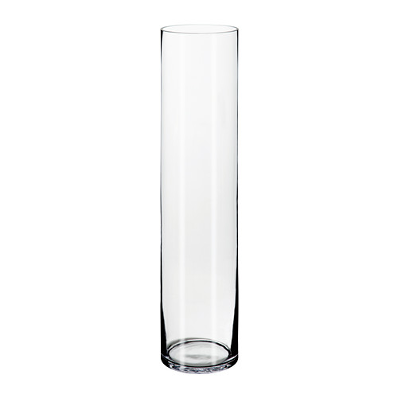
The Swimming Test
Procedure
1- mouse is placed in acrylic glass cylinders
filled with water (23–25 °C)
to a depth of 17 cm (can reach to 20 cm ).
2- The water level in the glasses must be
- high enough to prevent the mouse from touching the bottom of the cylinder with his paws or tail,
- low enough to avoid an escape through the top opening of the cylinder.
17cm

Slide 15
The Swimming Test
Three groups of mice
Depression mouse
(model )
Mouse with Antipsychotic
Control mouse
Rapid despair
Resistant despair
low Active swimming time (increased immobility)
Long Active swimming time (increased mobility )
Notes:
After injection of CPZ we can observe signs as:
Ataxic gait: loss of muscle coordination .
Catalepsy : rigid body

Slide 16
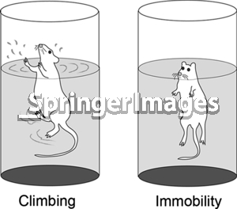
3 - A 6-minute session was employed (control mouse) , and mobility time was scored only during the final 4 minutes, to eliminate the period of escape activity.
Active

Slide 17
Duration of the experiment = 6 minutes
Zero time
2 minutes
The last 4 minutes is counted
Neglected
We Record the time(each minute) which is the mouse is active and
Stop the time when it is non-active (immobility= passive floating, or making only movements necessary to remain afloat)

Slide 18
240 sec
180 sec
Active time
120 sec
60 sec
Control
depression
AP
Conclusion : -

