Slide 1
MARIE: An Introduction to a Simple Computer

Slide 2
Lecture Overview
A simple program
A discussion on assemblers
Extending our ISA

Slide 3
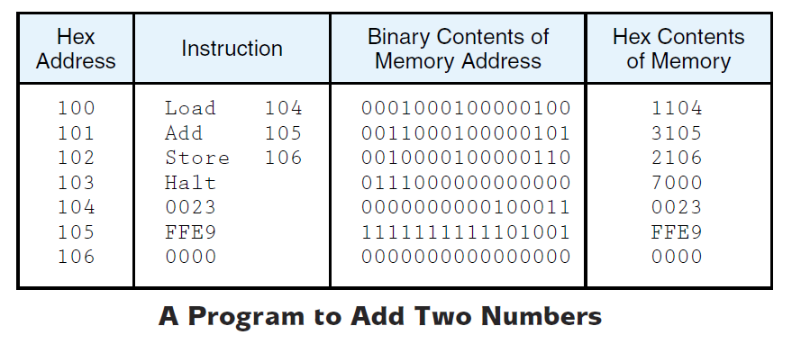
A simple program
A Simple program
The figure below shows a program written in assembly language for MARIE
What does this program do?

Slide 4
A simple program
A Simple program
This program simply adds to numbers and stores the result in the main memory.
It loads the value stored at the location address 104₁₆ into AC (the value is 0023₁₆ = 35₁₀), ), (2*16¹+3*16⁰) or 0000 0000 0010 0011 =35)
It adds this value to the value stored at the location address 105₁₆ (the value is FFE9₁₆ = (-23)₁₀), (1111 1111 1110 1001)=0000 0000 0001 0110+1 =-23)
Stores the sum into the location address 106₁₆.
So what will be stored in the location address 106₁₆?
Now let us discover what happens during each “Fetch, decode, execute” cycle.

Slide 5
Lecture Overview
A simple program
A discussion on assemblers
Extending our ISA

Slide 6
What do Assemblers do
A discussion on Assemblers
Assembly language can be understood by the programmer but not the computer!
Assembly language must be converted into Machine Codes (binary codes) before being executed or even stored in the main memory.
An Assembler is used to translate assembly language into machine code
It reads a source file (assembly program) and convert it to an object file (Machine code)
Assembler VS Compiler
An assembler translates each mnemonic instruction (written in assembly) to exactly one machine code.
With compilers, this is not usually the case

Slide 7
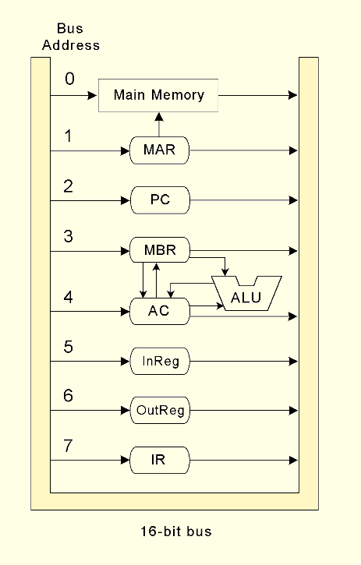
Remember - Registers and Buses
MARIE
The Data path in MARIE is shown in this figure
Note that a data word (that is an instruction) in the main memory travels a relatively long path before achieving the IR!

Slide 8
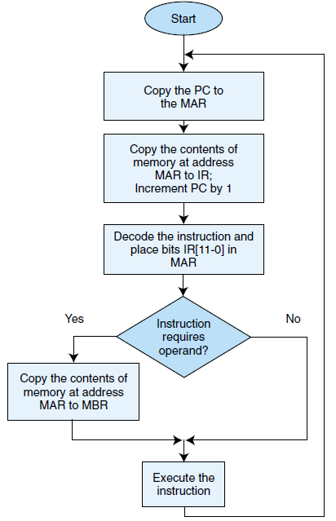
Remember - The Fetch-Decode-Execute cycle
Instruction processing
MARIE, like any other computer architecture, follow the basic machine cycle:
the fetch, decode, and execute cycle
Fetch
Decode
Execute

Slide 9
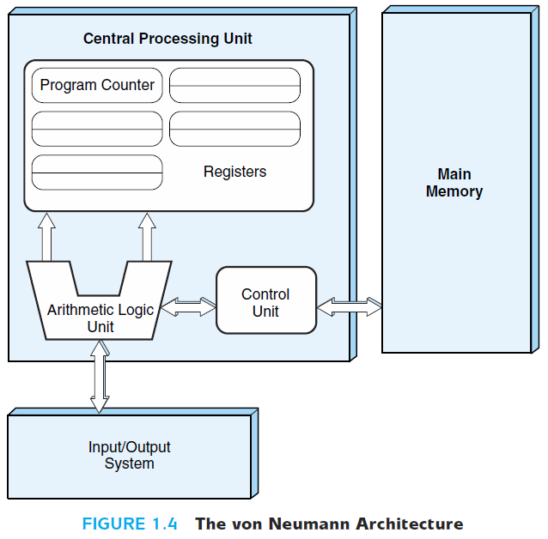
Remember - The Von Neumann model
Chapter 1: Introduction
Fetch
PC indicates the iteration number
CU fill the instruction register
Instruction 1
Instruction 2
Instruction 3
Instruction 3
Data 1
Data 2
Instruction 4
…
2. Decode
what ALU should do (add, multiply, …)?
Fill registers with needed data
…
…
Instruction N

Slide 10
Remember - The Von Neumann model
3. Execute
Execute the instruction
Place the results in registers or memory
Instruction 1
Instruction 2
Instruction 3
Instruction 3
Data 1
Data 2
Instruction 4
Result
…
…
…
Instruction N

Slide 11
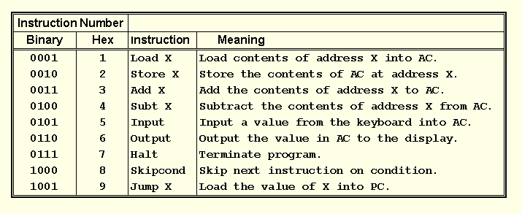
The Instruction Set Architecture
MARIE
The fundamental MARIE instructions are:

Slide 12
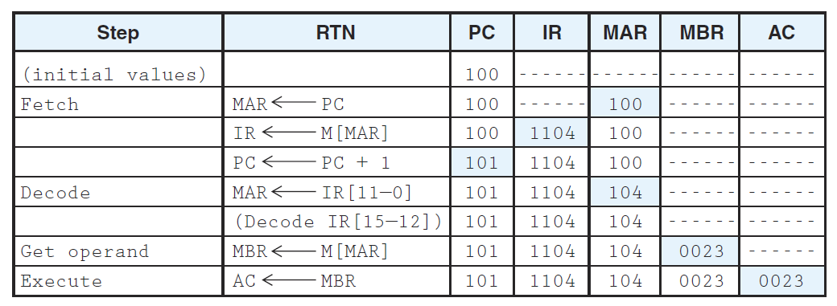
What do Assemblers do
A discussion on Assemblers
Going back to our simple program, what really happens inside the CPU during each fetch, decode, execute cycle?
Load 104:

Slide 13
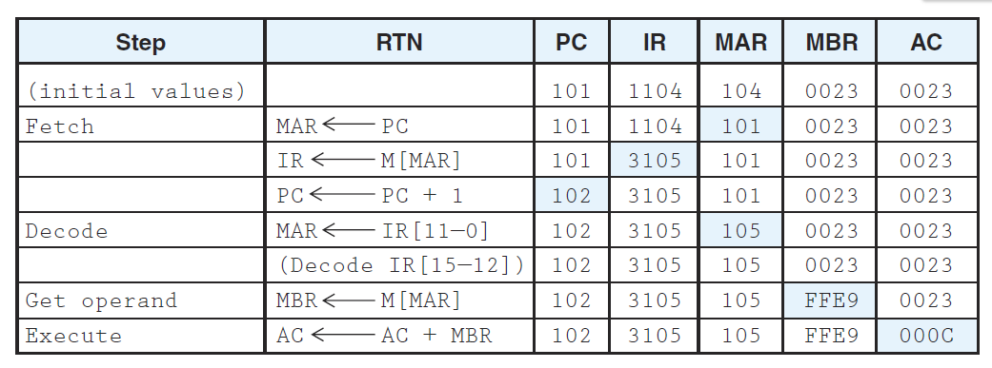
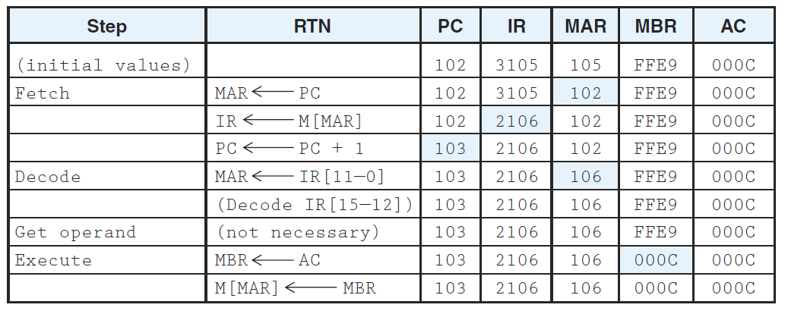
What do Assemblers do
A discussion on Assemblers
Add 105:
Store 106:

Slide 14
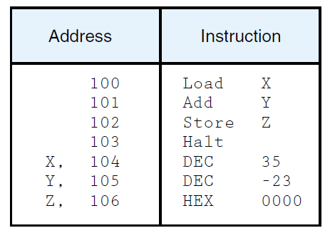
What do Assemblers do
A discussion on Assemblers
An assembler directive is an instruction that is not supposed to be translated into machine code
In assembly language we can also use labels in order to clarify the program
Example: base 16 is the default base when writing assembly program for MARIE, to specify the used base we can use “constant directives” such as DEC (decimal) or HEX (Hexadecimal)

