Slide 1

Research Methods for Business Students
8th edition
Chapter 14
Writing and presenting your project report

Slide 2
Learning Objectives
By the end of this chapter you should be able to:
14.1 understand the issues about which you need to be concerned when undertaking writing for your project report;
14.2 evaluate different ways to structure your project report;
14.3 differentiate between a project report and a consultancy report;
14.4 adopt an appropriate and accessible writing style for your report;
14.5 write a project report focused on meeting the necessary assessment criteria;
14.6 write a reflective account of your research project;
14.7 plan a presentation of your project report using either slides or a poster.

Slide 3
Hints to assist with writing (1 of 2)
Creating time for your writing.
Write when your mind is fresh.
Find a regular writing place.
Create a structure for your writing.
Set goals and achieve them.

Slide 4
Hints to assist with writing (2 of 2)
Finish a writing session on a high point and provide a link to a new session.
Commence a new writing session by reviewing your previous session.
Ensure you keep earlier versions and back-up copies of your work.
Get friends to read your work.

Slide 5
Ways to structure your project report
Linear-analytic approach.
Comparative approach.
Chronological approach.
Theory-building approach.
Suspense approach.

Slide 6
Traditional project report structure
Abstract
Introduction
Literature Review
Method
Findings/Results
Discussion
Conclusions
References
Appendices

Slide 7
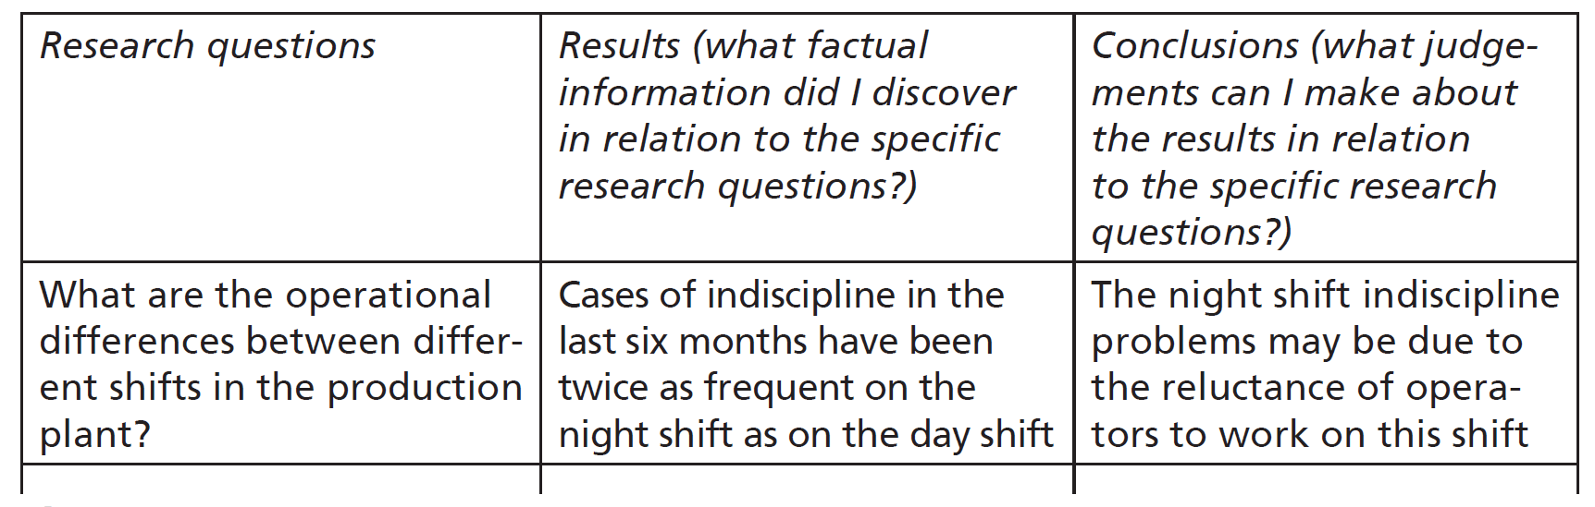
Figure 14.1
Using a matrix in the planning of the content for the results and conclusions chapters

Slide 8
Categories of ethnographic writing
Realist
Confessional
Critical
Formal
Structural
Post-structural
Advocacy
Source: Developed from Van Maanen (2011b) with additional comments by the authors

Slide 9
Traditional consultancy report structure
Executive summary;
Introduction;
Background and method;
Results/Findings;
Recommendations;
References:
Appendices.

Slide 10
Developing an appropriate writing style. Ensure:
Write simple sentences;
Avoid jargon;
Beware of using large numbers of quotations from the literature;
Check your spelling and grammar;
Avoid using common grammatical errors.

Slide 11
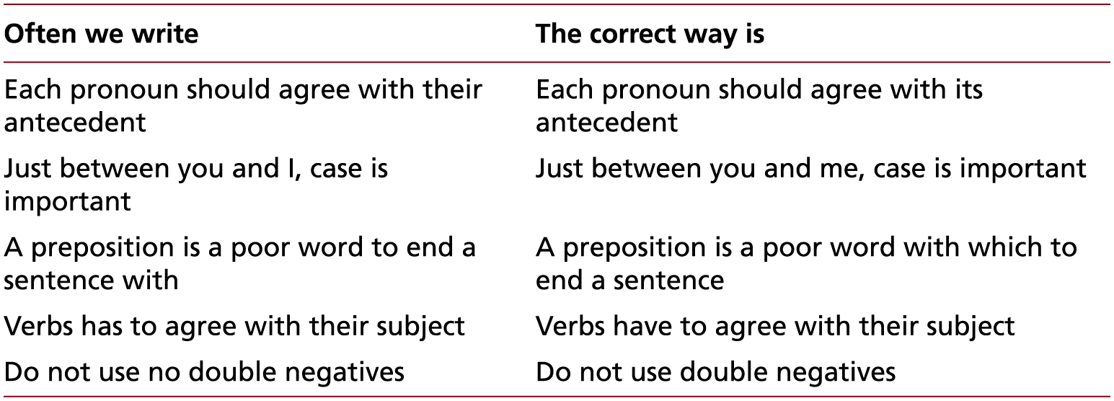
Table 14.2 (1 of 2)
Ten common grammatical errors
Source: Developed from Day (1998: 160)

Slide 12
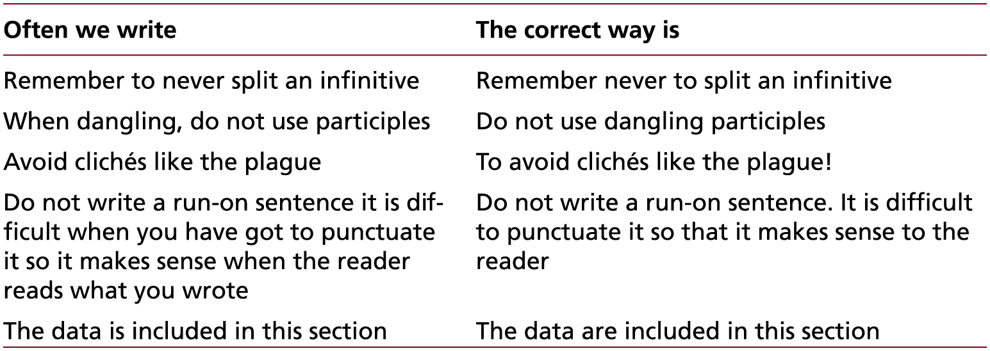
Table 14.2 (2 of 2)
Ten common grammatical errors
Source: Developed from Day (1998: 160)

Slide 13
Giving the presentation
Think about whether you would prefer to sit or stand at the presentation.
Consider how you will deal with difficult questions.
Avoid jargon.
Check the room before the presentation to ensure you have everything you need, you are happy and familiar with the layout, and all the equipment is working.

Slide 14
Planning and preparing your poster
Title;
Summary;
Short introduction including key literature;
Aim and objectives/research question;
Methodology;
Findings/Results;
Discussion and/or Conclusions.

Slide 15
Figure 14.2
Poster outlining a research project
© Chaiyatorn Limapornvanich 2018, reproduced with permission

