Slide 1
Research Methods for Business Students
8th edition
Chapter 13
Analysing data qualitatively

Slide 2
Learning Objectives
By the end of this chapter you should be able to:
13.1 understand the diversity of qualitative data and the interactive nature of qualitative analysis;
13.2 identify the key aspects to consider when choosing a qualitative analysis technique and the main issues when preparing your qualitative data for analysis including using computer-aided qualitative data analysis software (CAQDAS);
13.3 transcribe a recorded interview or notes of an interview or observation and create a data file for analysis by computer;
13.4 choose from different analytical aids to help you to analyse your qualitative data, including keeping a reflective or reflexive journal;
13.5 select an appropriate analytical technique or combination of techniques for your research project to undertake qualitative data analysis;
13.6 identify the common functions of CAQDAS and describe the issues associated with its use.

Slide 3
Key aspects to consider when choosing a qualitative analysis technique
the methodological and philosophical basis of the research;
the approach to theory development used in the research;
the analytical approach used in the technique.

Slide 4
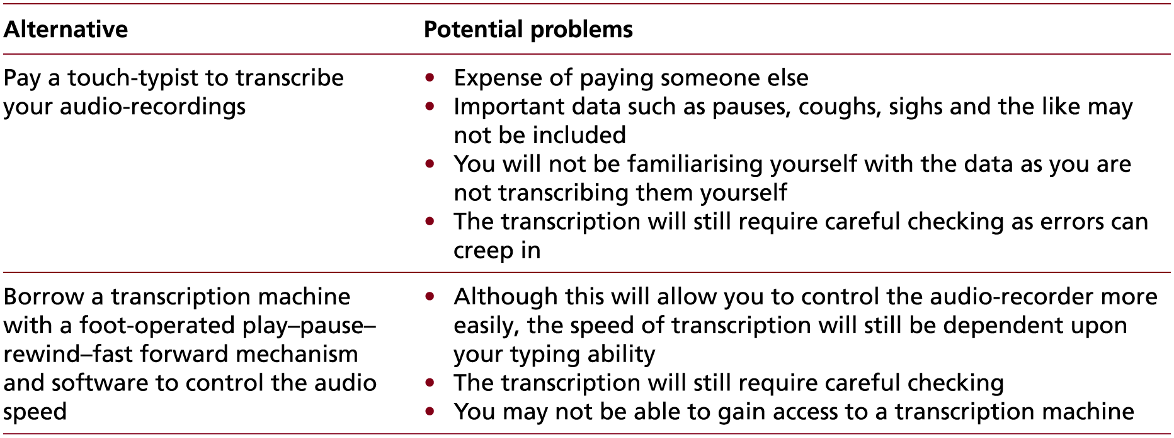
Table 13.1 (1 of 2) Alternative ways of reducing the time needed to transcribe audio-recordings

Slide 5
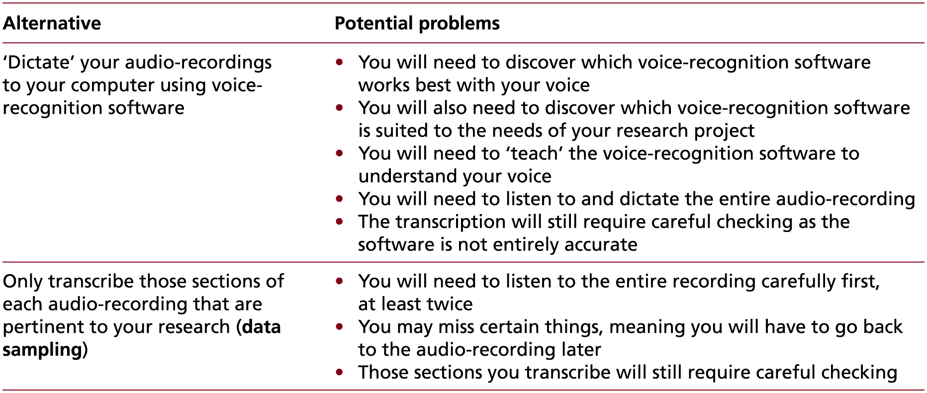
Table 13.1 (2 of 2) Alternative ways of reducing the time needed to transcribe audio-recordings

Slide 6
Aids to help your analysis
Interim or progress summaries;
transcript summaries;
document summaries;
self-memos;
a research notebook;
a reflective diary or journal.

Slide 7
Uses of thematic analysis
comprehend often large and disparate amounts of qualitative data;
integrate related data drawn from different transcripts and notes;
Identify key themes or patterns from a data set for further exploration;
produce a thematic description of these data; and/or
develop and test explanations and theories based on apparent thematic patterns or relationships;
draw and verify conclusions.

Slide 8
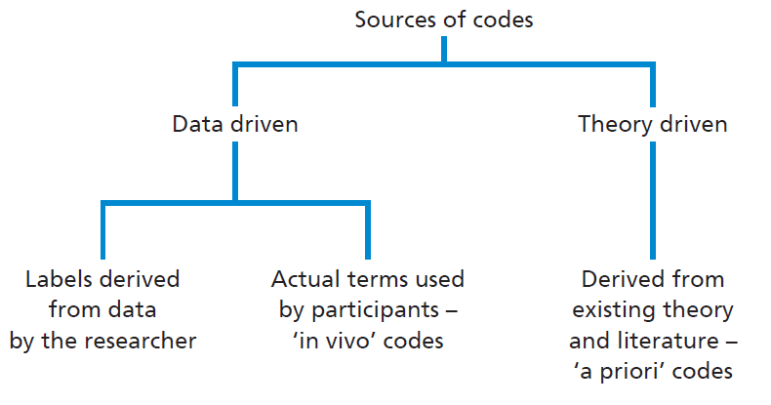
Figure 13.1 Sources and types of code

Slide 9
Thematic analysis: when searching for themes ask… (1 of 2)
What are the key concepts in these codes?
What, if anything, seems to be recurring in these codes?
What seems to be important, whether it recurs often or not?
What patterns and/or trends are evident in the coded data?
Which codes appear to be related?
How do a particular set of codes appear to be related?

Slide 10
Thematic analysis: when searching for themes ask… (2 of 2)
What is the essence of each apparent theme?
How might themes be related to each other?
Which themes appear to be main themes and which appear to be sub-themes (related to a main theme)? There may also be third level themes evident in your analysis.
How may the relationship between themes be represented (as a hierarchy or a network) to produce a thematic map?
Is there an overarching theme (or more than one) that unites your analysis?

Slide 11
Template analysis: ways of reorganising a template
Insertion of a new code or theme into the hierarchy as the result of a relevant issue being identified through data collection for which there is no existing code or theme.
Deletion of a code or theme from the hierarchy if it is not needed.
Merging codes or themes that were originally considered distinctive.
Altering the classification of codes or themes, so that some are promoted to a higher level in the coding template, while others may be demoted.
Changing the scope of a code or theme. Inserted, deleted, merged and altered codes or themes may have implications for others in the coding template. This may result in the need to move a code or theme within the coding template, change its purpose or split it into two or more new codes or themes.

Slide 12
Deductive explanation building procedure
Devise a theoretically based proposition, which you will then seek to test.
Undertake data collection through an initial, purposive case study in order to be able to compare the findings from this in relation to your theoretically based proposition.
Where necessary, amend the theoretically based proposition in the light of the findings from the initial case study.
Select a further, purposive case study to undertake a further round of data collection in order to compare the findings from this in relation to the revised proposition.
Where necessary, further amend the revised proposition in the light of the findings from the second case study.
Undertake further iterations of this process until a satisfactory explanation is derived.

Slide 13
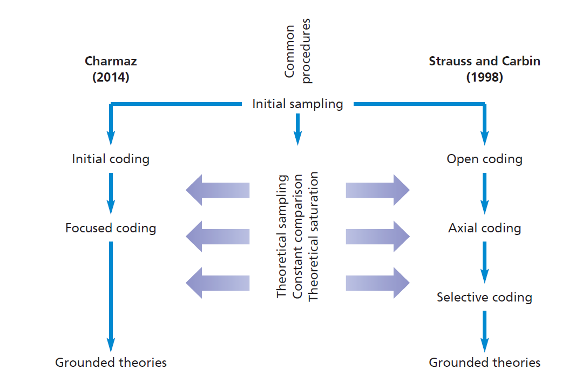
Figure 13.2 Alternative approaches to Grounded Theory Method
Source: © Mark Saunders, Philip Lewis and Adrian Thornhill 2018

Slide 14
Elements of structured narrative analysis
an abstract (which states the point of the story);
an orientation (which describes the situation including when and where it took place and who was involved);
a complicating action (which describes the sequence of events including a critical point);
an evaluation (where the narrator explains the meaning of the narrative);
a resolution (how the issue is solved – the outcome); and
a coda (which ends the narrative and relates it to the present).

Slide 15
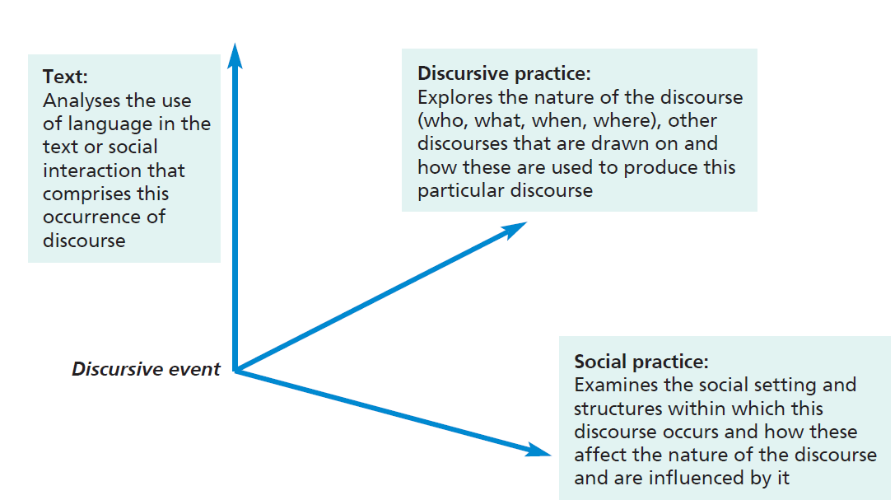
Figure 13.3 A three-dimensional analytical framework for Critical Discourse Analysis
Source: Developed from Fairclough (1992)

Slide 16
Visual Analysis: you need to understand
who took or created the image or images that you wish to analyse;
how these images were taken or created;
the purpose for which these images were taken or created;
how these images have been used previously;
any intended audience for these images, and;
the intended effect(s) of the image maker and those who commissioned these images.

Slide 17
Figure 13.4 UK road signs for tourist attractions

Slide 18
Box 13.17 Images from the English Riviera

Slide 19
Functions of CAQDAS
Managing the research project
Writing analytic memos, comments, notes, etc.
Exploring the data
Searching the data initially
Developing coding
Coding
Retrieving coded data
Revising codes and coding
Organising data
Hyperlinking
Searching and interrogating
Mapping
Producing outputs

