Slide 1
Research Methods for Business Students
8th edition
Chapter 12
Analysing data quantitatively

Slide 2
Learning Objectives
By the end of this chapter you should be able to:
12.1 identify the main issues that you need to consider when preparing data for quantitative analysis and when analysing these data;
12.2 recognise different types of data and understand the implications of data type for subsequent analyses;
12.3 code data and create a data matrix using statistical analysis software;
12.4 select the most appropriate tables and graphs to explore and illustrate different aspects of your data;
12.5 select the most appropriate statistics to describe individual variables and to examine relationships between variables and trends in your data;
12.6 interpret the tables, graphs and statistics that you use correctly.

Slide 3
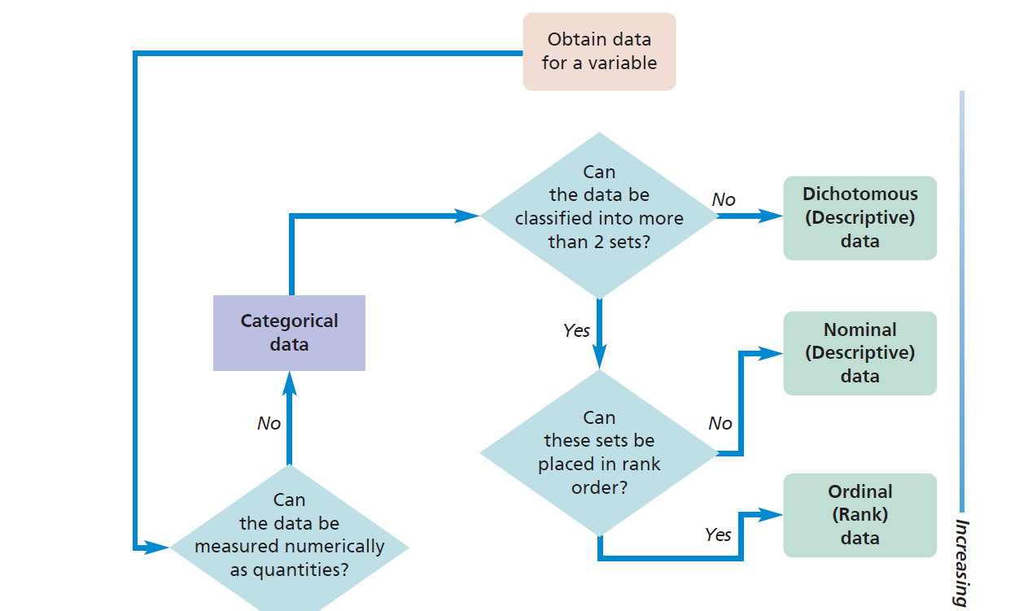
Figure 12.1 (1 of 2) Defining the data type

Slide 4
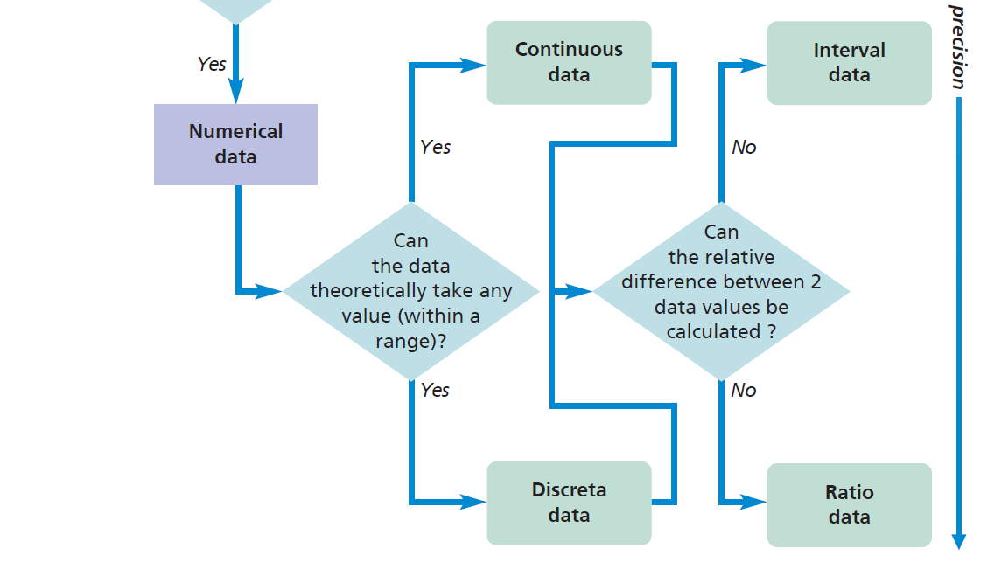
Figure 12.1 (2 of 2) Defining the data type

Slide 5
Creating a codebook for a variable
Examine the data and establish broad categories.
Subdivide the broad categories into increasingly specific subcategories dependent on your intended analyses.
Allocate codes to all categories at the most precise level of detail required.
Note the actual responses that are allocated to each category and produce a codebook.
Ensure that those categories that may need to be aggregated are given adjacent codes to facilitate re-coding.

Slide 6
Reasons for missing data
the data were not required from the respondent, perhaps because of a skip generated by a filter question in a questionnaire;
the respondent refused to answer the question (a non-response);
the respondent did not know the answer or did not have an opinion. Sometimes this is treated as implying an answer; on other occasions it is treated as missing data;
the respondent may have missed a question by mistake, or the respondent’s answer may be unclear;
leaving part of a question in a survey blank implies an answer; in such cases the data are not classified as missing.

Slide 7
Table 12.1 A simple data matrix

Slide 8
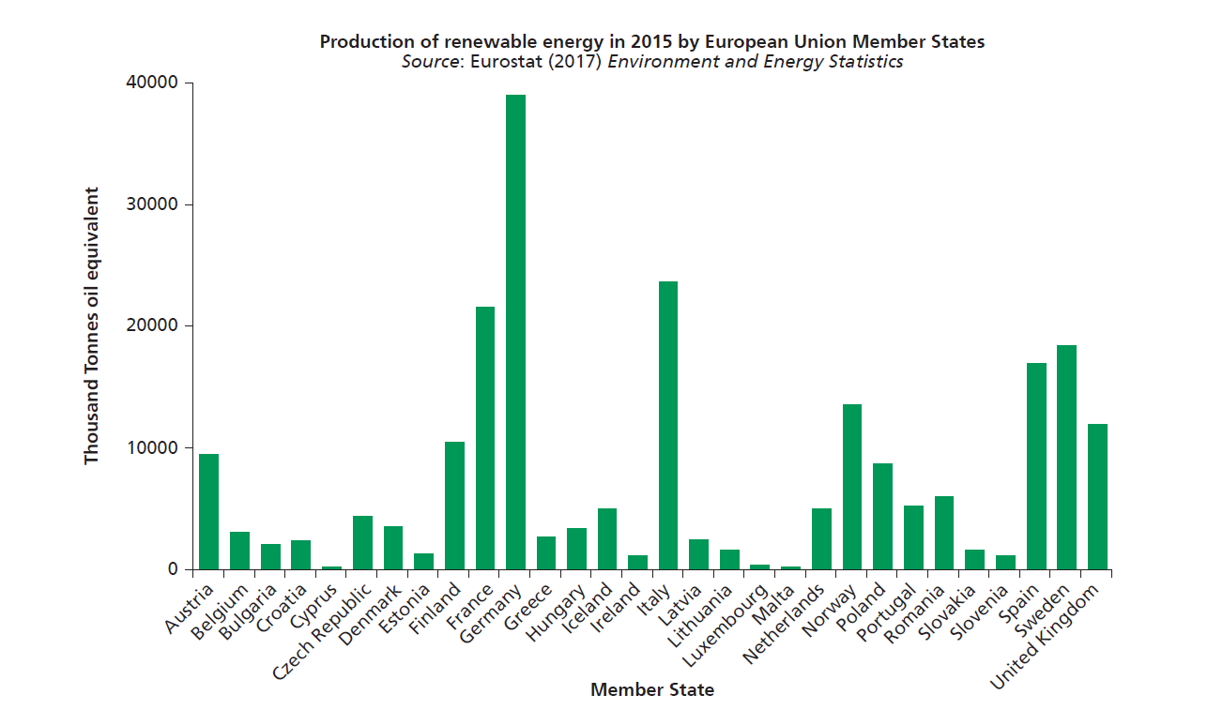
Figure 12.2 Bar graph
Source: Adapted from Eurostat (2017) © European Communities 2017. Reproduced with permission

Slide 9
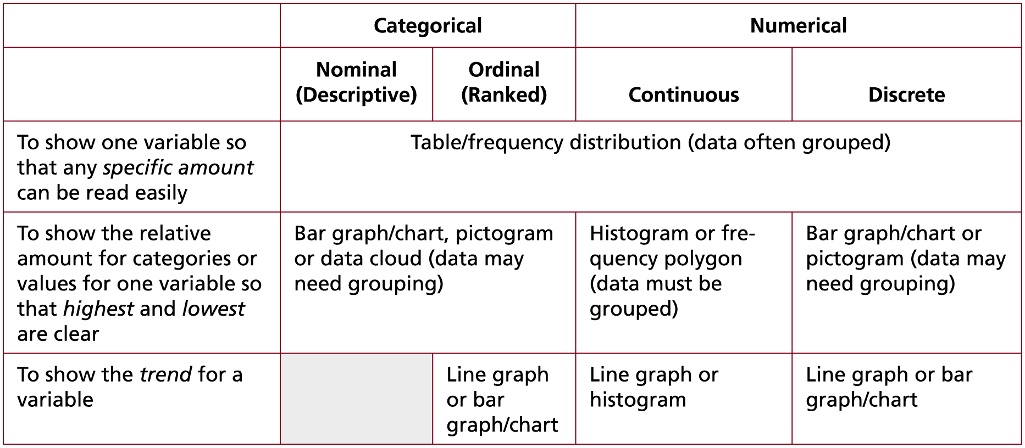
Table 12.2 (1 of 4) Data presentation by data type: A summary
Source: © Mark Saunders, Philip Lewis and Adrian Thornhill 2018

Slide 10
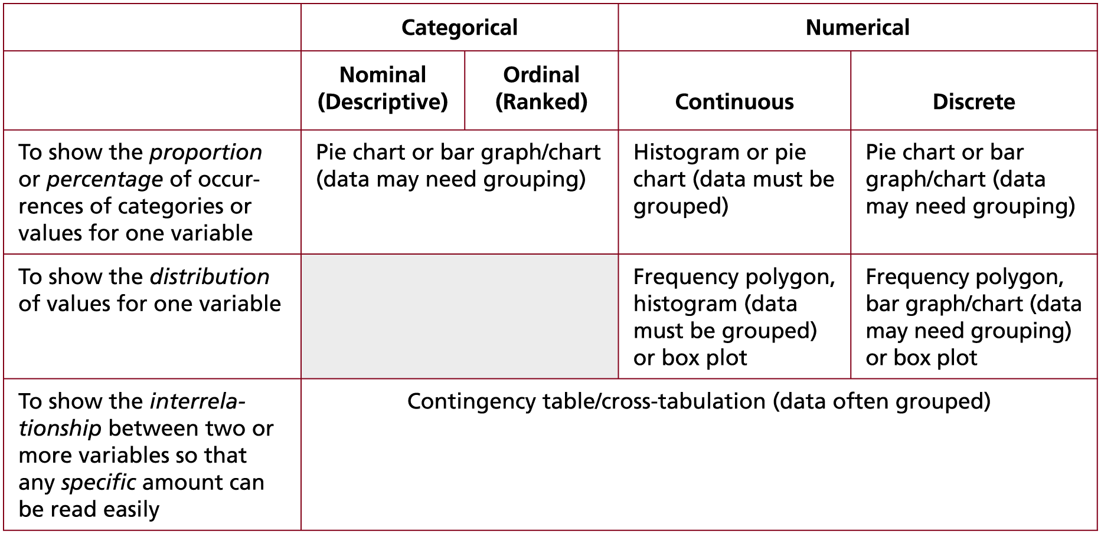
Table 12.2 (2 of 4) Data presentation by data type: A summary
Source: © Mark Saunders, Philip Lewis and Adrian Thornhill 2018

Slide 11
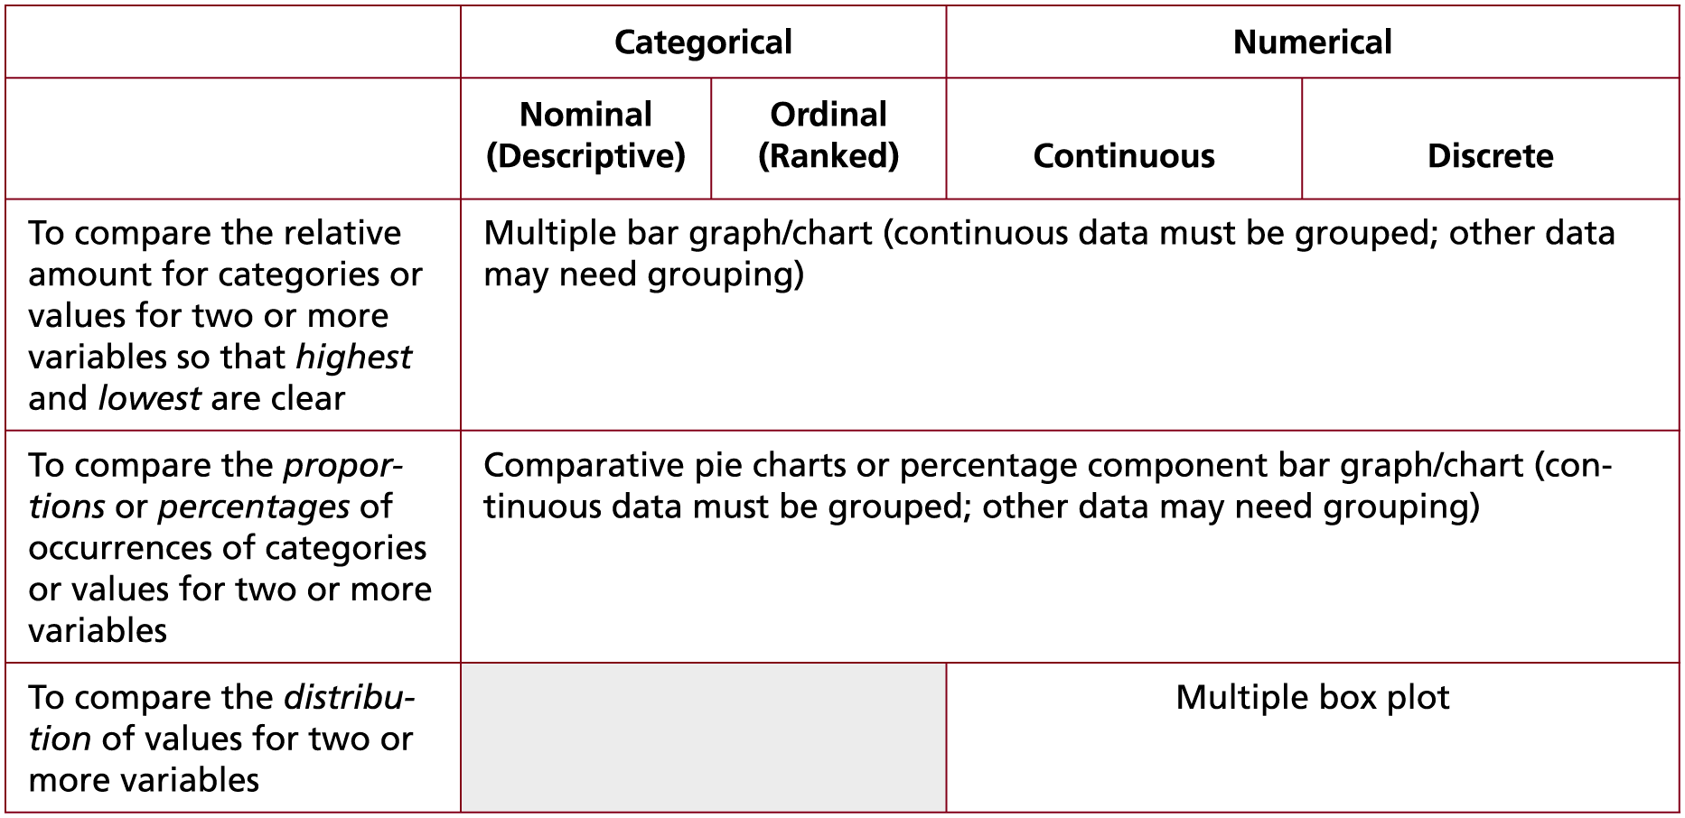
Table 12.2 (3 of 4) Data presentation by data type: A summary
Source: © Mark Saunders, Philip Lewis and Adrian Thornhill 2018

Slide 12
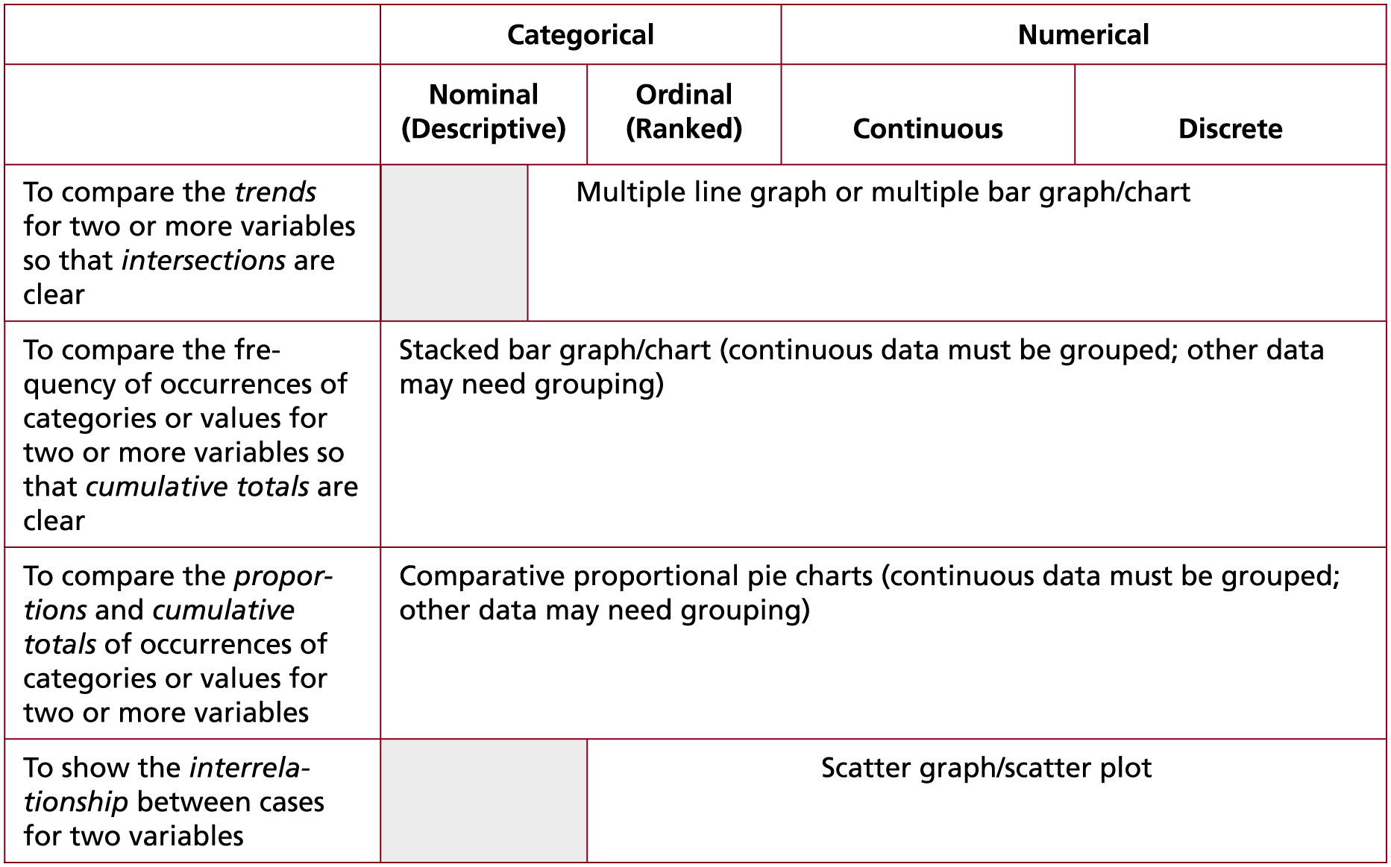
Table 12.2 (4 of 4) Data presentation by data type: A summary
Source: © Mark Saunders, Philip Lewis and Adrian Thornhill 2018

Slide 13
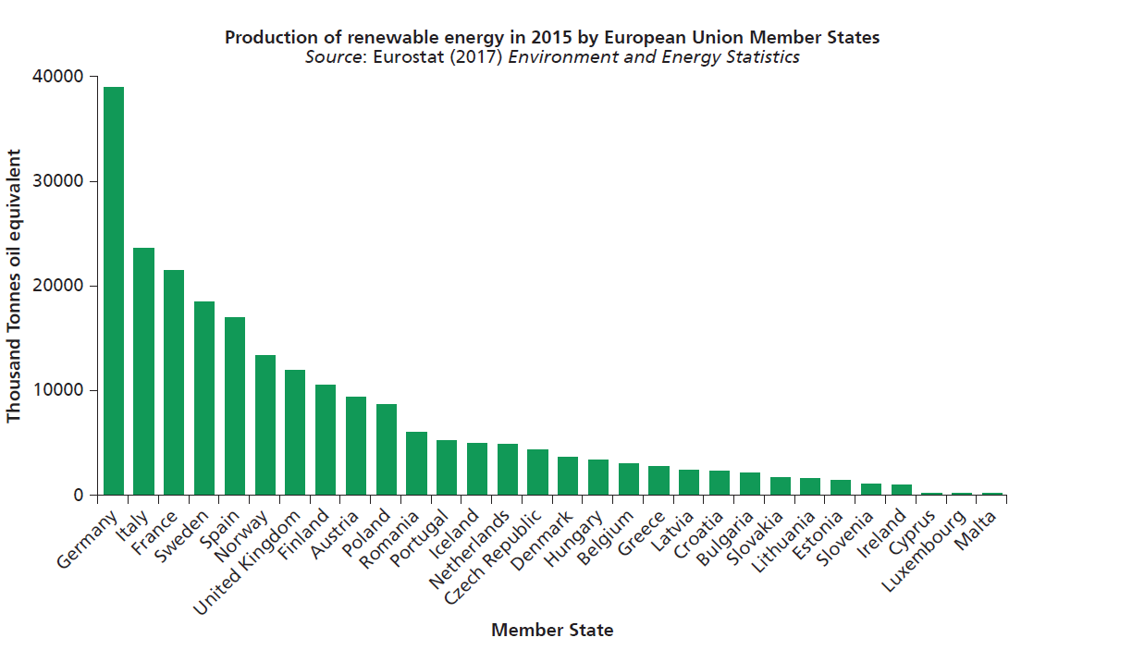
Figure 12.3 Bar graph (data reordered)
Source: Adapted from Eurostat (2017) © European Communities 2017, reproduced with permission

Slide 14
Word cloud

Slide 15
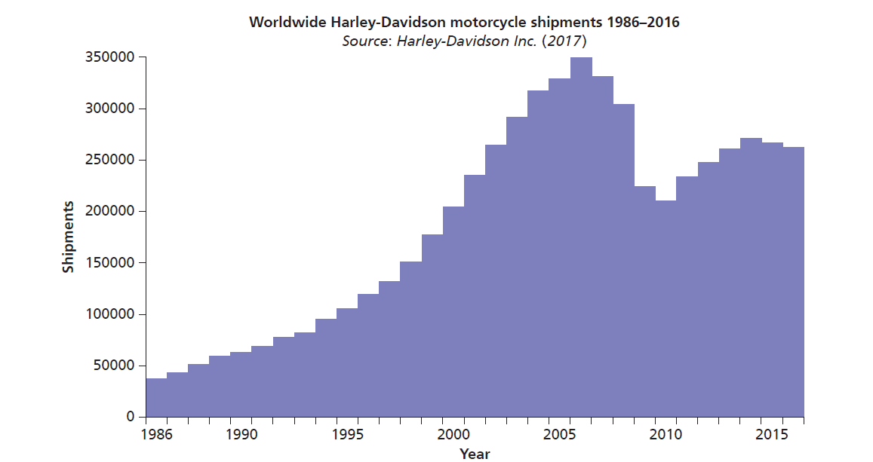
Figure 12.4 Histogram
Source: Adapted from Harley-Davidson Inc. (2017)

Slide 16
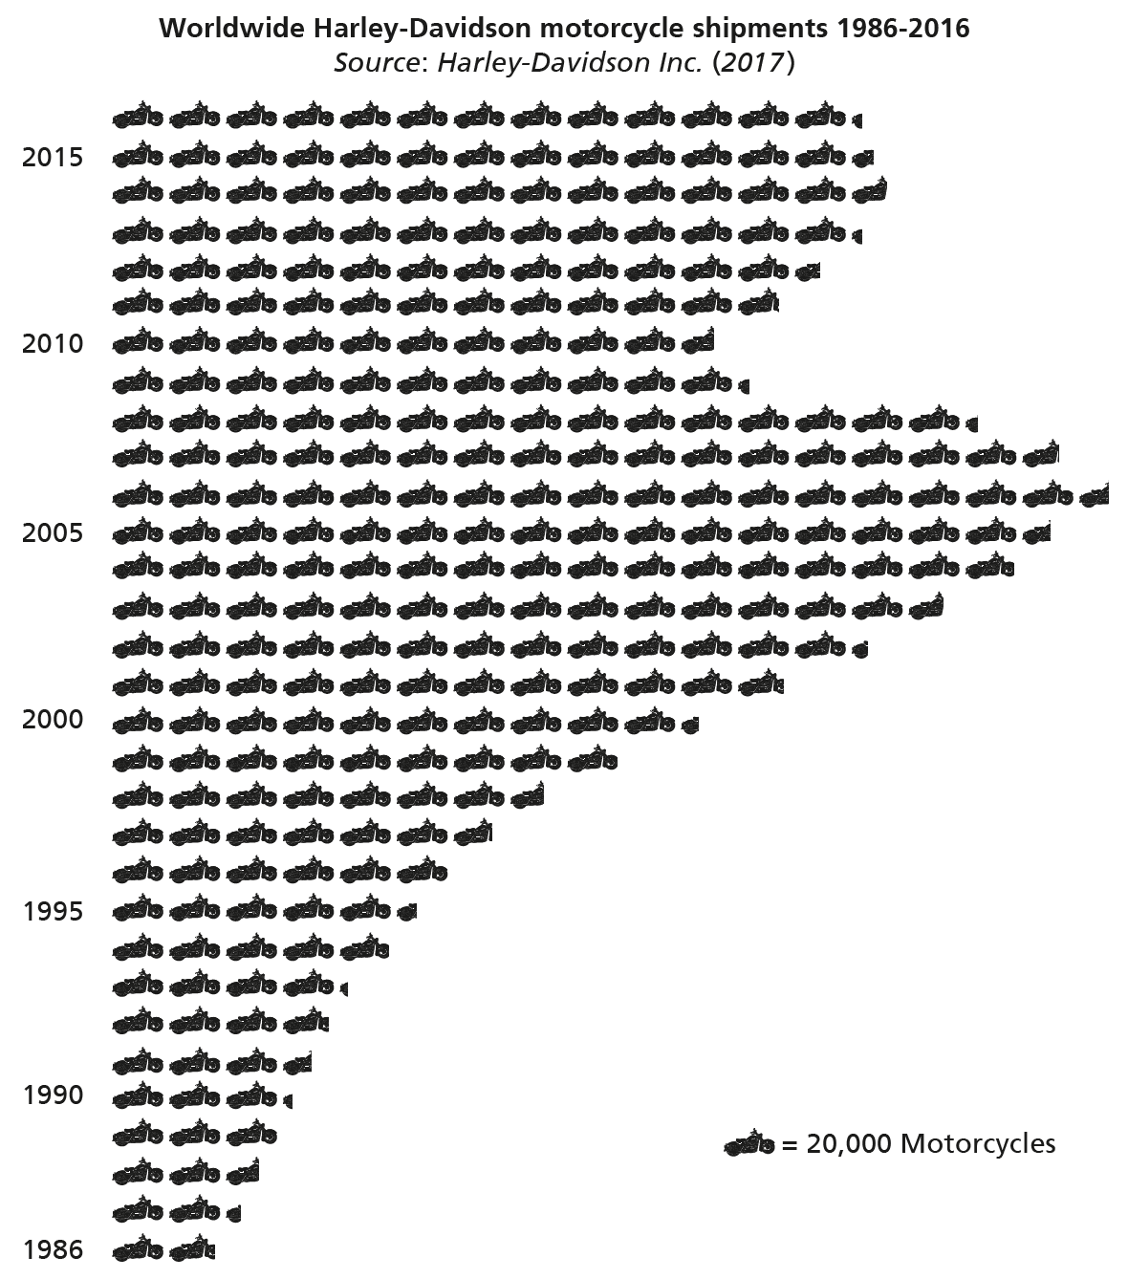
Figure 12.5 Pictogram
Source: Adapted from Harley-Davidson Inc. (2017)

Slide 17
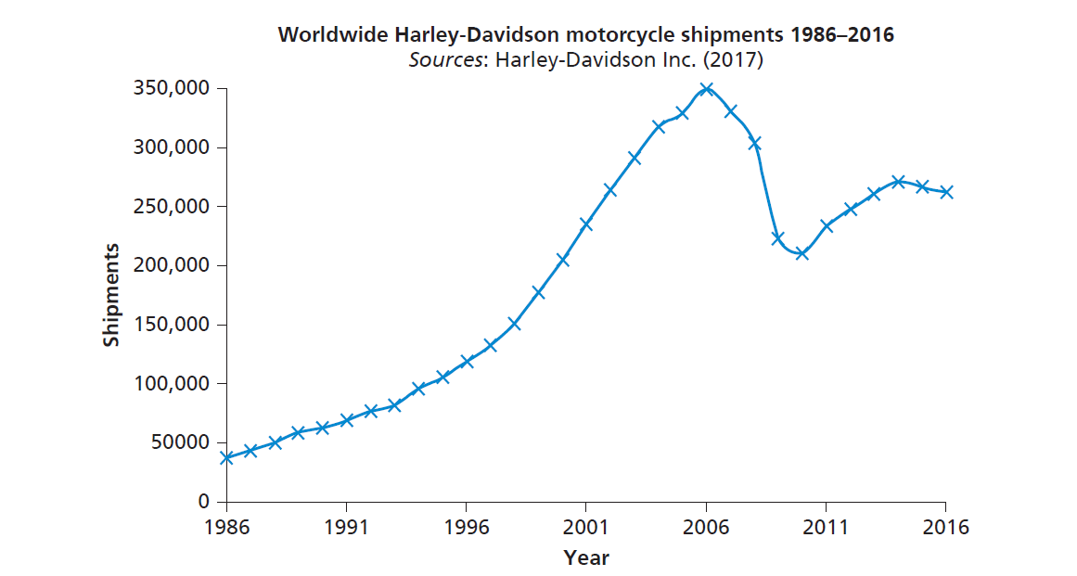
Figure 12.6 Line graph
Source: Adapted from Harley-Davidson Inc. (2017)

Slide 18
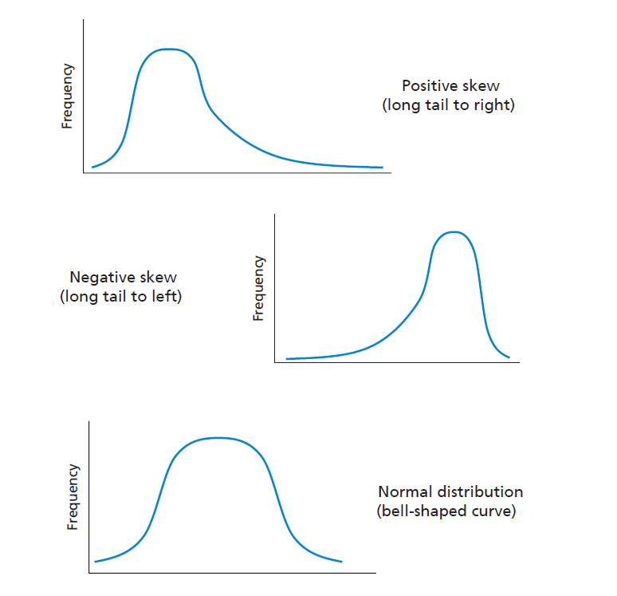
Figure 12.7 Frequency polygons showing distributions of values

Slide 19
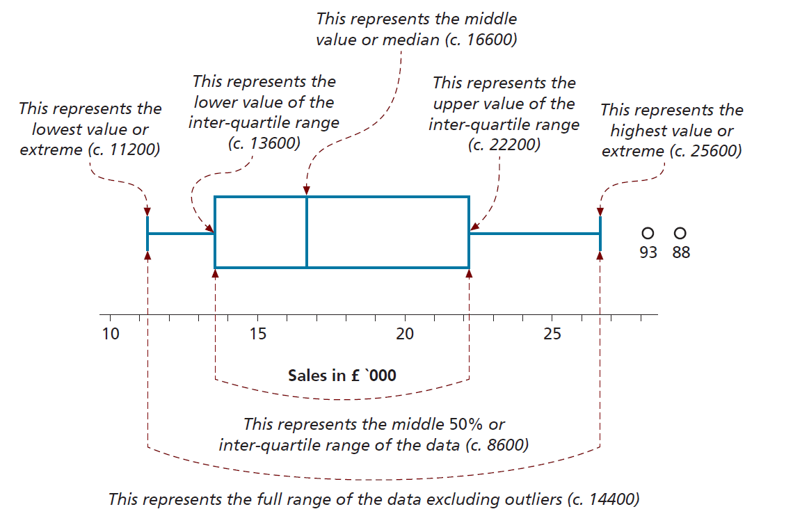
Figure 12.8 Annotated box plot

Slide 20
Table 12.3 Contingency table: Number of insurance claims by gender, 2018
Source: PJ Insurance Services

Slide 21
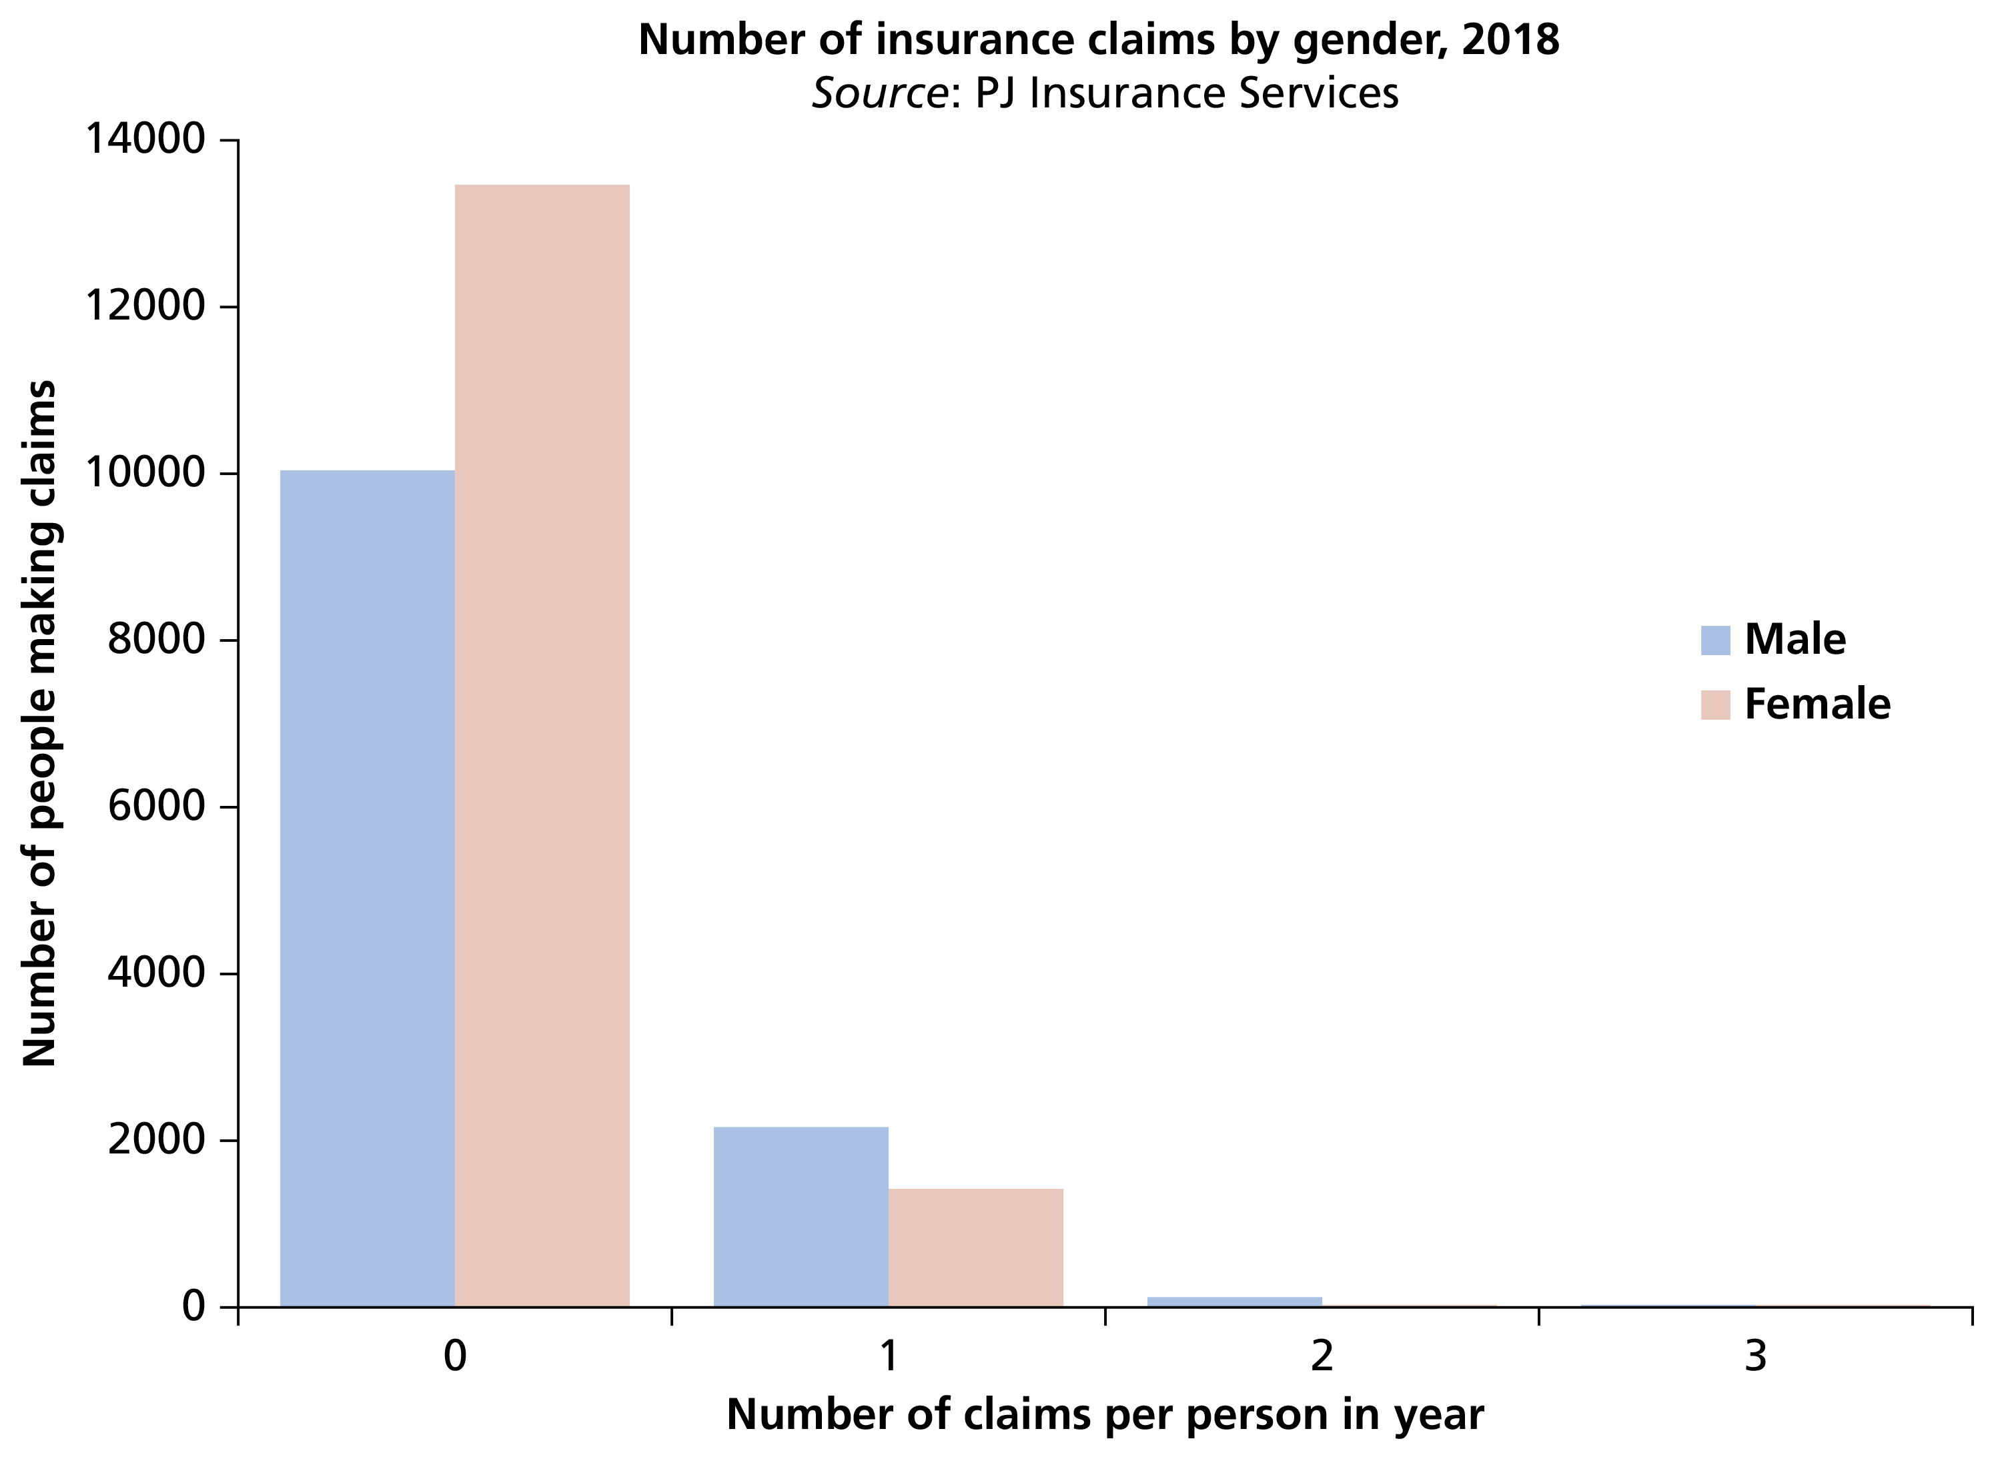
Figure 12.9 Multiple bar graph

Slide 22
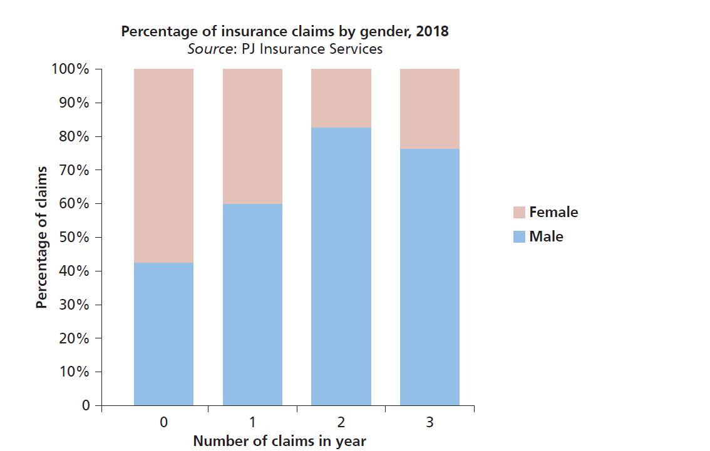
Figure 12.10 Percentage component bar graph

Slide 23
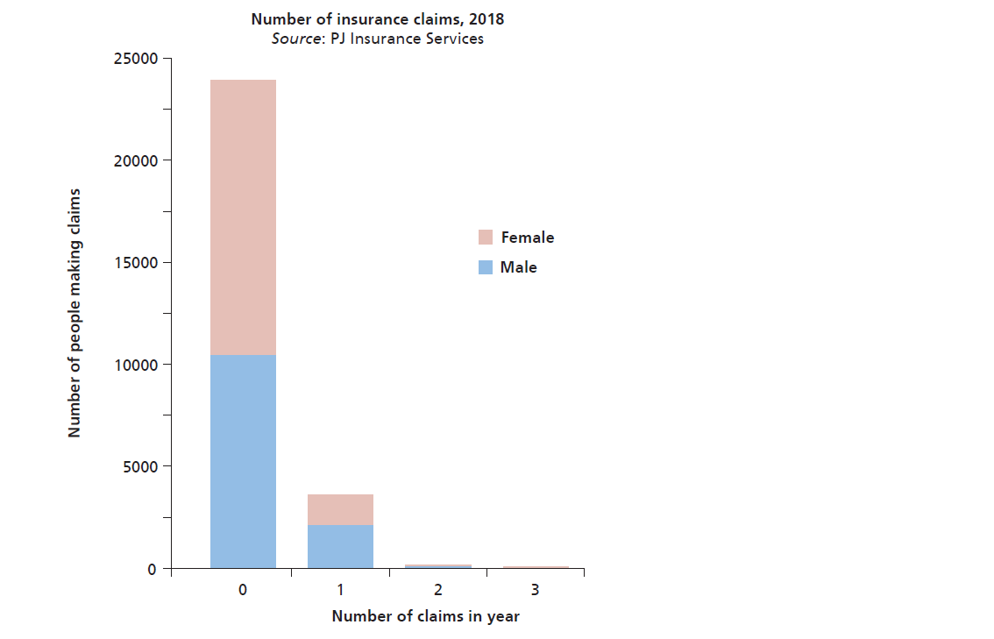
Figure 12.11 Stacked bar graph

Slide 24
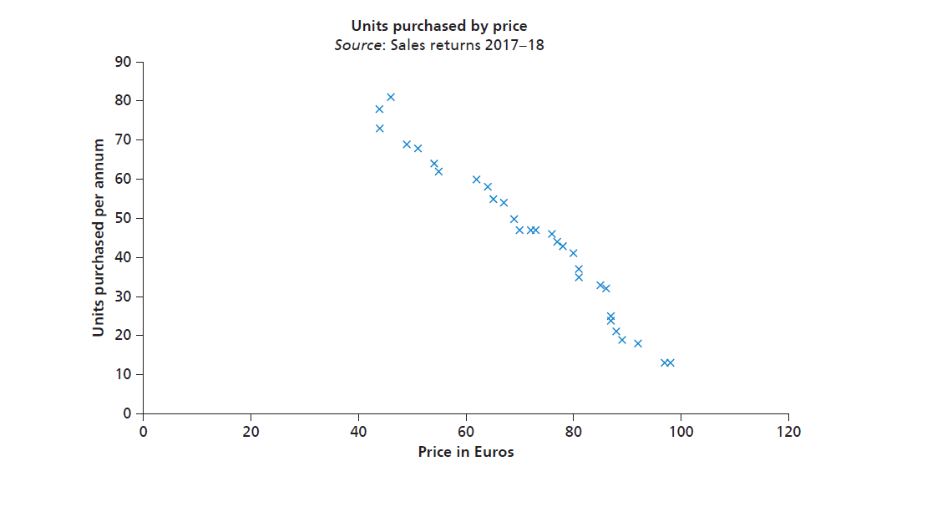
Figure 12.12 Scatter graph

Slide 25
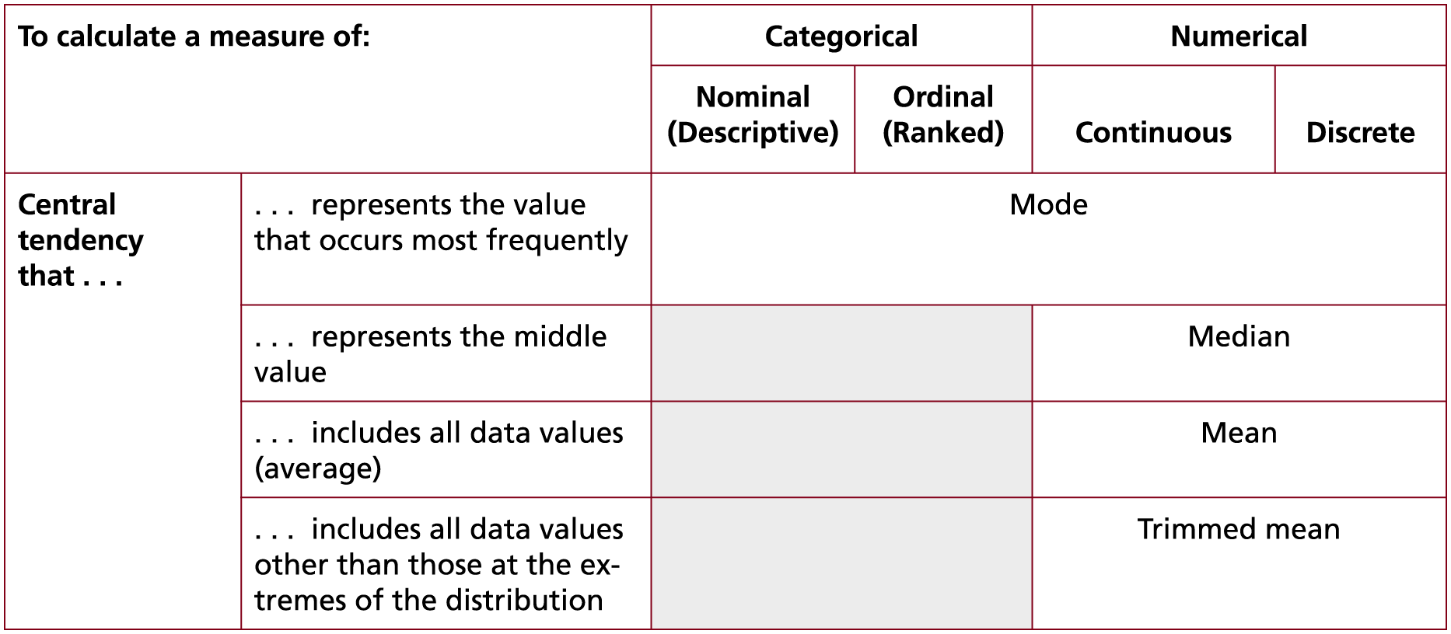
Table 12.4 (1 of 3) Descriptive statistics by data type: a summary
Source: © Mark Saunders, Philip Lewis and Adrian Thornhill 2018

Slide 26
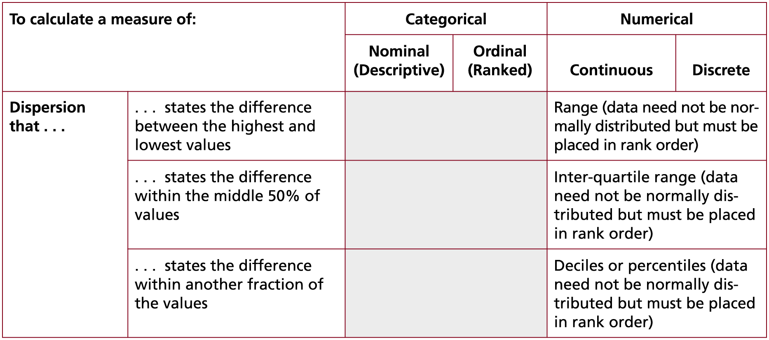
Table 12.4 (2 of 3) Descriptive statistics by data type: a summary
Source: © Mark Saunders, Philip Lewis and Adrian Thornhill 2018

Slide 27
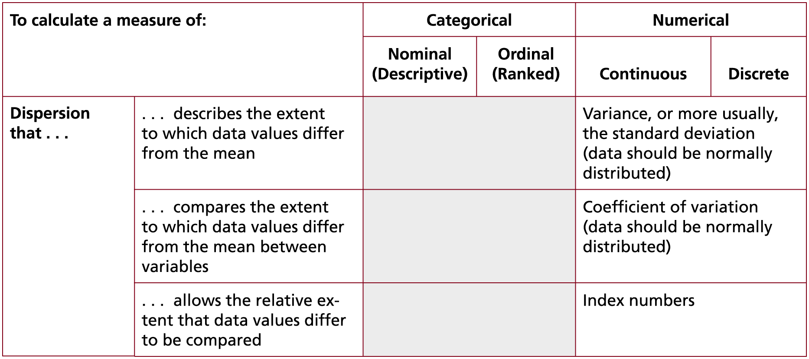
Table 12.4 (3 of 3) Descriptive statistics by data type: a summary
Source: © Mark Saunders, Philip Lewis and Adrian Thornhill 2018

Slide 28
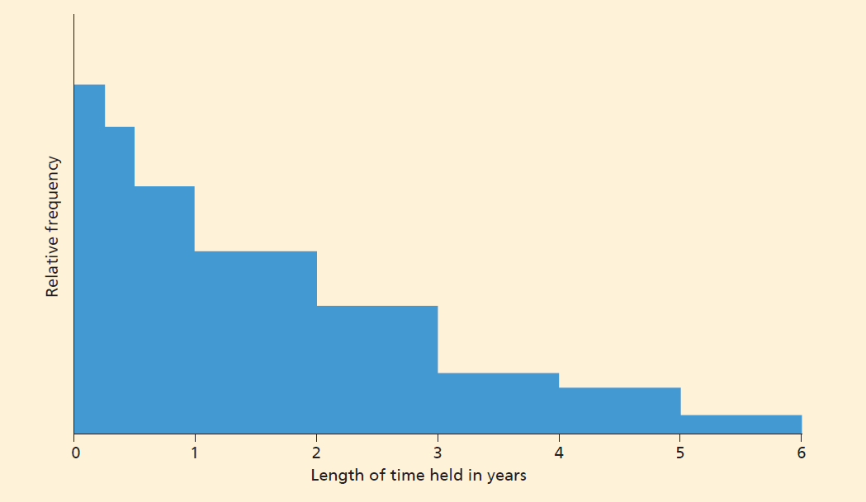
Histogram

Slide 29
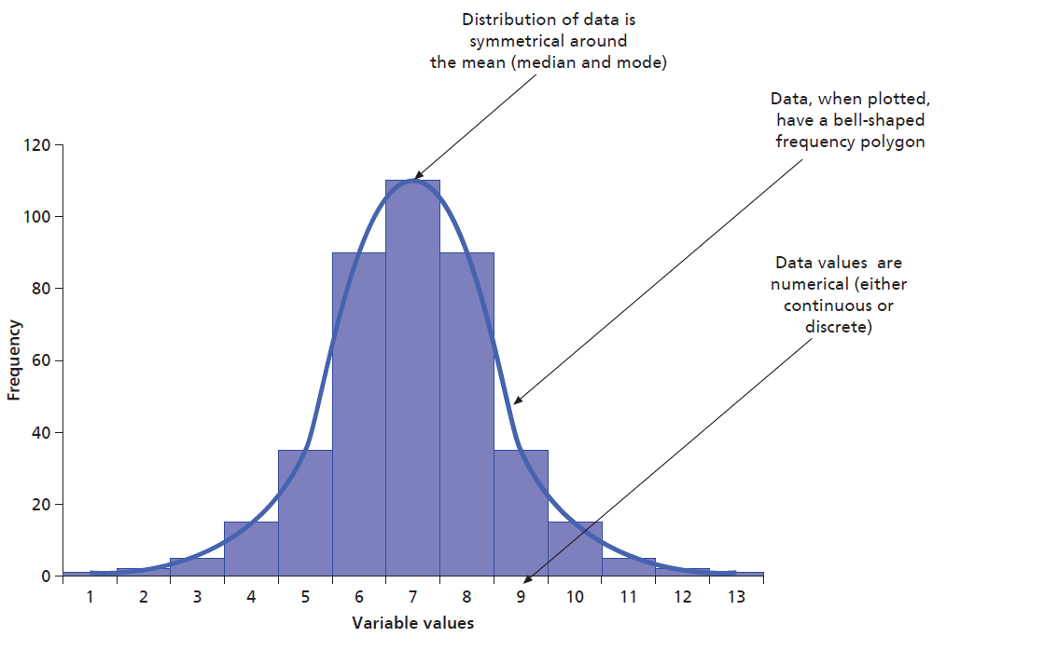
Figure 12.13 Annotated frequency polygon showing a normal distribution

Slide 30
Table 12.5 (1 of 5) Statistics to examine relationships, differences and trends by data type: A summary
 | Categorical |  | Numerical
 | Nominal (Descriptive) | Ordinal (Ranked) | Continuous | Discrete
To test normality of distribution |  |  | Kolmogorov-Smirnov test, Shapiro-Wilk test
To test whether two variables are independent | Chi square (data may need grouping) |  | Chi square if variable grouped into discrete classes
To test whether two variables are associated | Cramer’s V and Phi (both variables must be dichotomous)
Source: © Mark Saunders, Philip Lewis and Adrian Thornhill 2018

Slide 31
Table 12.5 (2 of 5) Statistics to examine relationships, differences and trends by data type: A summary
 | Categorical |  | Numerical
 | Nominal (Descriptive) | Ordinal (Ranked) | Continuous | Discrete
To test whether two groups (categories) are different |  | Kolmogorov-Smirnov (data may need grouping) or Man-Whitney U test | Independent t-test or paired t-test (often used to test for changes over time) or Mann-Whitney U test (where data skewed or a small sample)
To test whether three or more groups (categories) are different |  |  | Analysis of variance (ANOVA)
Source: © Mark Saunders, Philip Lewis and Adrian Thornhill 2018

Slide 32
Table 12.5 (3 of 5) Statistics to examine relationships, differences and trends by data type: A summary
 | Categorical |  | Numerical
 | Nominal (Descriptive) | Ordinal (Ranked) | Continuous | Discrete
To assess the strength of relationship between two variables |  | Spearman’s rank correlation coefficient or Kendall’s rank order correlation coefficient | Pearson’s product moment correlation coefficient (PMCC)
To assess the strength of a relationship between one dependent and one independent variable |  |  | Coefficient of determination
Source: © Mark Saunders, Philip Lewis and Adrian Thornhill 2018

Slide 33
Table 12.5 (4 of 5) Statistics to examine relationships, differences and trends by data type: A summary
 | Categorical |  | Numerical
 | Nominal (Descriptive) | Ordinal (Ranked) | Continuous | Discrete
To assess the strength of a relationship between one dependent and two or more independent variables |  |  | Coefficient of multiple determination
To predict the value of a dependent variable from one or more independent variables |  |  | Regression equation
To explore relative change over time |  |  | Index numbers
Source: © Mark Saunders, Philip Lewis and Adrian Thornhill 2018

Slide 34
Table 12.5 (5 of 5) Statistics to examine relationships, differences and trends by data type: A summary
 | Categorical |  | Numerical
 | Nominal (Descriptive) | Ordinal (Ranked) | Continuous | Discrete
To compare relative changes over time |  |  | Index numbers
To determine the trend over time of a series of data |  |  | Time series, moving averages or regression equation (regression analysis)
Source: © Mark Saunders, Philip Lewis and Adrian Thornhill 2018

Slide 35
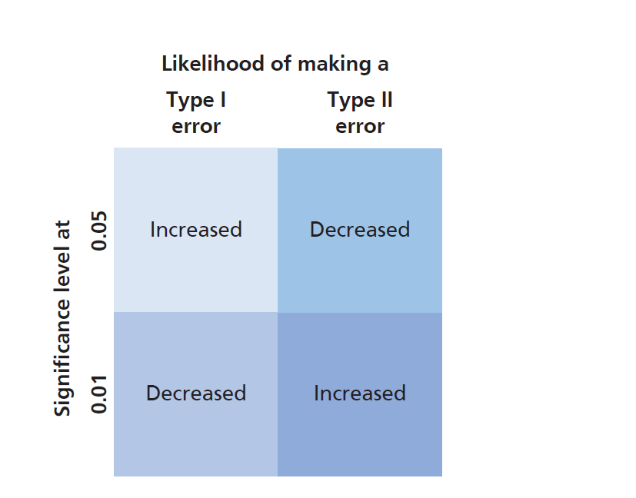
Figure 12.14 Type I and Type II errors

Slide 36
Figure 12.15 Interpreting the correlation coefficient
Source: Developed from earlier editions, Hair et al., (2014)

